Slide 1
LLNL Efforts on FPY Evaluations
N. Schunck and R. Vogt
LLNL-PRES-795717

Slide 2
LLNL work will ensure cross-validation and verification
Complementary approaches to FPY and their observable consequences:
Density functional theory (DFTNESS & FELIX)
Complete event Monte Carlo (FREYA)
Two main activities:
Estimate the evolution of initial yields as a function of incident neutron energy
Calculate the initial conditions of the fission fragments prior to de-excitation
Microscopic calculations will provide insights into trends that can be encoded
empirically and tested in FREYA
FREYA will be augmented by FIER data to be able to study both independent and
cumulative FPYs for major and minor actinides
FREYA can also test empirical formulations of the fragment excitation energy
calculated in the DFT approaches
LLNL-PRES-746697
LLNL-PRES-780697
LLNL-PRES-789532
LLNL-PRES-795717

Slide 3
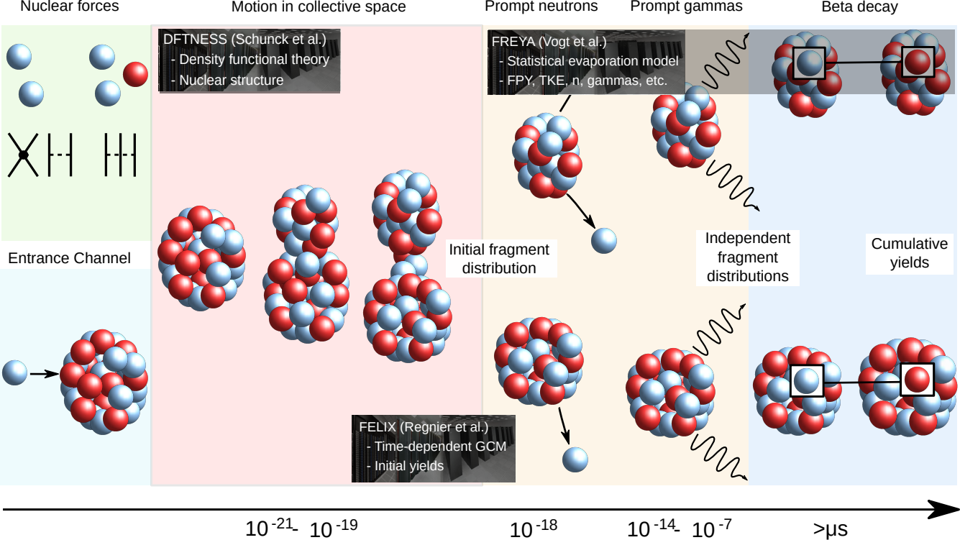
The Physics Problem
Fission product yields are the end product of a complex process involving multiple phases described by different models
LLNL-PRES-795717
Notes:
Fission involves many different physics phases (the colored boxes) and the related models: nuclear forces (everything, in principle), nuclear reactions (entrance channel), nuclear structure (=deformation), evaporation, beta-decay
Models are all connected: outputs of one are inputs to the other
Uncertainties in final cumulative yields thus depend on the uncertainties associated with each class of models, and their propagation from one to the other
Our LLNL approach:
Nuclear structure described by density functional theory (DFT): shares many features with mic-mac, only the potential energy surfaces are computed from nuclear forces rather than parametrized average potential
Primary yields computed with FELIX solver based on DFT potential energy surfaces
Fission events are generated with FREYA, gives independent and cumulative yields
Overall pipeline different enough from LANL to provides cross-validation and verification

Slide 4
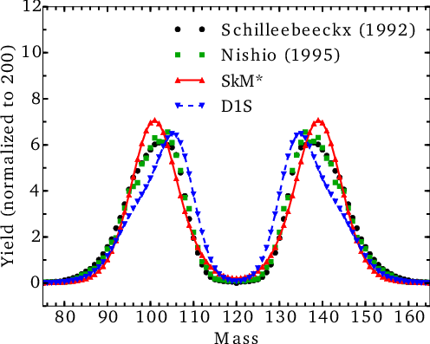
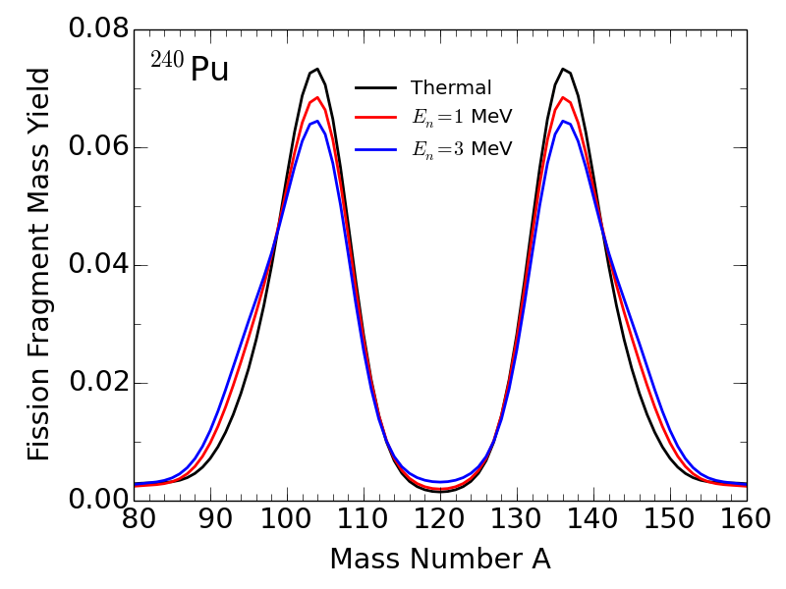
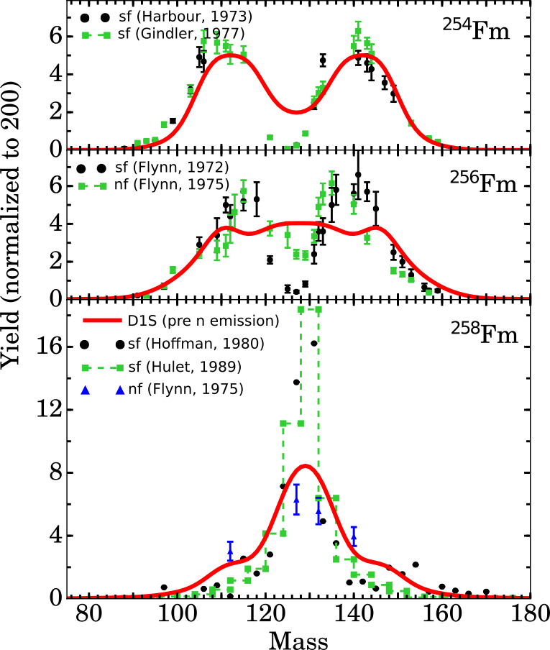
Fission Mass Distributions
Microscopic models have predictive power and can provide baseline or trends as a function of Z, N and neutron incident energy
D. Regnier, et al., Comp. Phys. Comm. 200, 350 (2016); D. Regnier, et al, Comp. Phys. Comm. 225, 180 (2018); D. Regnier, et al., Phys. Rev. C 93, 054611 (2016), D. Regnier, et al., Phys. Rev. C 99, 024611 (2019)
Use density functional theory to compute primary fission yields as a function of neutron incident energy
Calibrate predictions on experimental data when available
Extract empirical formulas for evolution as a function of incident energy
Apply formalism to odd-mass systems
LLNL-PRES-746697
LLNL-PRES-780697
LLNL-PRES-789532
LLNL-PRES-795717
Notes:
Like the mic-mac approach, potential energy surfaces determine scission configurations, hence what the fragments are (but not the probability of observing a given fragment)
FELIX solves a collective time-dependent Schroedinger equation which determines the probability of observing any of the fragmentations encoded in the PES
Easy to extend to increasing neutron energies
Good predictive power, but poor precision (when it comes to an evaluation)
Goal: use it as a baseline to
Estimate the yields where there is less data (minor actinies)
Estimate trend of yields as a function of neutron incident energy across the major (and minor) actinides

Slide 5
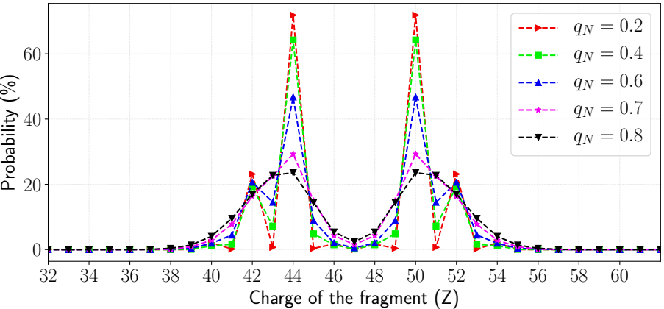
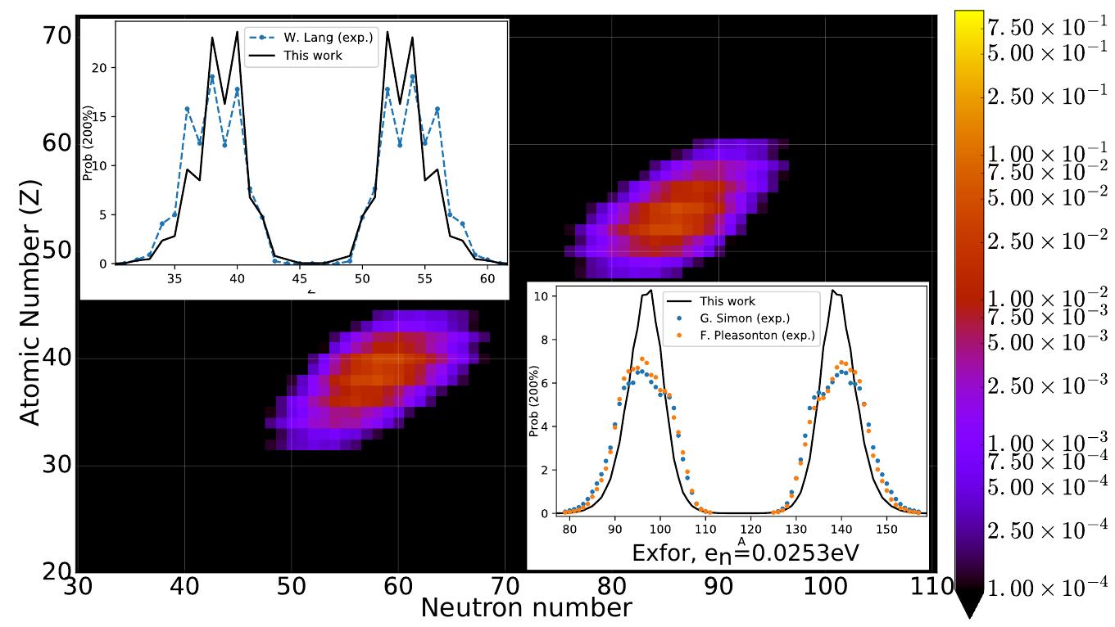
Number of Particles in Fission Fragments
Particle number projection could be key to reproducing odd-even staggering effect of charge distributions
Traditional models of fission do not give precise estimate of charge or mass
Particle number projection techniques predict dispersion in particle number at scission
²⁴⁰Pu
Advantages
  Generates odd-even staggering effect
  Polarizability of fragment distributions
Adapt work of M. Verriere under FIRE collaboration to FELIX solver
Preliminary
²³⁶U
C. Simenel, Phys. Rev. Lett. 105, 192701 (2010);
G. Scamps, et al., Phys. Rev. C 87, 014605 (2013);
M. Verriere, et al., Phys. Rev. C 100, 024612 (2019)
LLNL-PRES-746697
LLNL-PRES-780697
LLNL-PRES-795717
Notes:
Until now, standard models of fission did not yield integer number of protons or neutrons in the fragments because said fragments are estimated by “cutting” the volume in 2 at the position of the neck, and the number of particle is obtained simply by integration of the density (which can yield non-integer numbers)
Enters particle number projection, very standard in nuclear structure, applied for the first time for fission fragments very recently
For each scission configuration (=1 single shape of the fissioning nucleus), gives a dispersion of the number of particles (upper figure)
When folding this information with the probability of populating said shape (obtained by random walk, Langevin, FELIX), can give odd-even staggering of charge distribution
Tested with mic-mac+random walk, we will implement it into our FELIX solver
Odd-even staggering (bottom plot) is LANL work

Slide 6
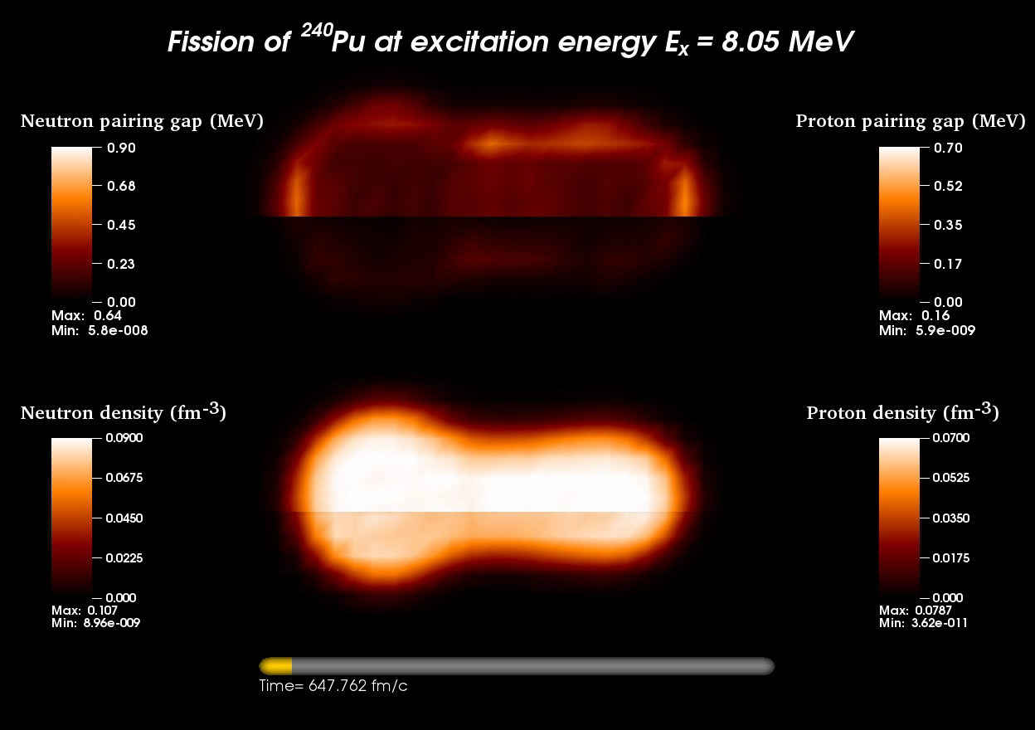
Time-Dependent Density Functional Theory
Real-time evolution of fissioning nucleus gives wealth of information on scission mechanism – including excited fragments
A. Bulgac, P. Magierksi, K. Roche, I. Stetcu, PRL 116 122504 (2016)
LLNL-PRES-737743
LLNL-PRES-795717
Notes:
On-going collaboration between University of Washington (Bulgac), LANL (Stetcu) and PNNL (Roche)
DFT can be extended to deal with time-dependent phenomena: simulate the evolution of the fissioning nucleus if it is put at some excitation energy near the saddle point
Shape evolution “automatically” determined by nuclear forces as encoded in energy functional: no a priori shapes

Slide 7
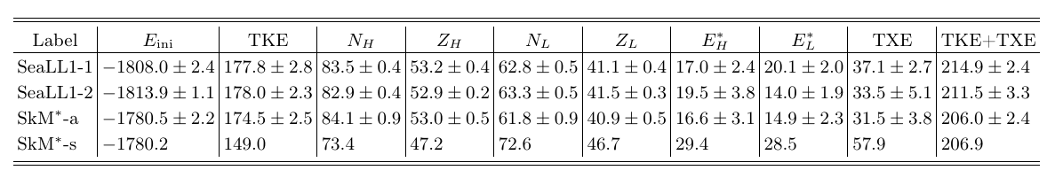
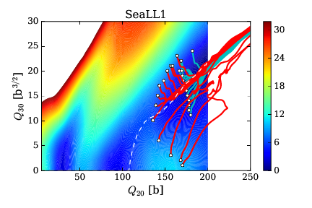
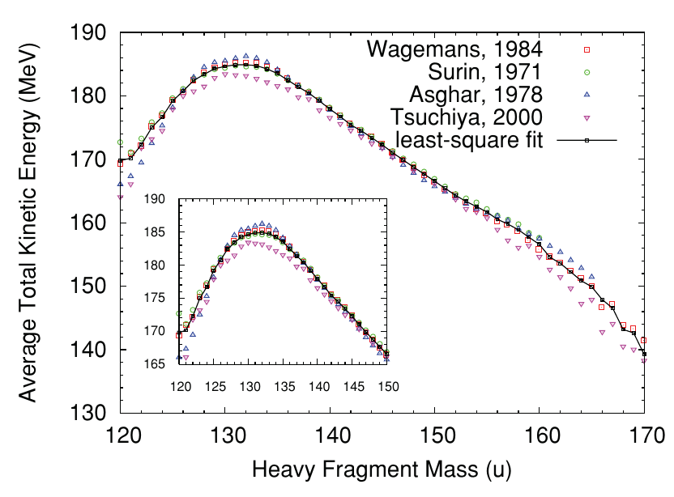
Excitation Energy Sharing
We will compute the excitation energy of fission fragments and extract empirical laws that can be easily implemented in FREYA/CGMF
Results for ²⁴⁰Pu with different density functionals; excitation energy accessed directly at split
²⁴⁰Pu
LLNL-PRES-737743
LLNL-PRES-795717
Notes:
Advantage of TDDFT: when the system splits, the 2 fragments are excited, and this energy can be computed
No need to invent some excitation energy sharing mechanism, we have direct access to it
TKE also very straightforward to compute
Already done: Proof of principle on 240Pu and 236U for most likely fission (=the peaks of the distribution, see table for different functionals)
We will extend this to other scission configurations to infer a universal law giving the excitation energy of the initial fragments

Slide 8
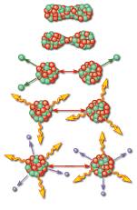
Event-by-event modeling in FREYA is efficient framework for studying fission
Goal(s): Fast generation of (large) samples of complete fission events
Complete fission event: Full kinematic information on all
final particles
Two product nuclei: Z_{H} , A_{H} , P_{H} and Z_{L} , A_{L} , P_{L}
ν neutrons: { p_{n} }, n = 1,…,ν
N_{γ} photons: { p_{m} }, m = 1,…,N_{γ}
Advantage of having samples of complete events:
Straightforward to extract any observable,
including fluctuations and correlations,
and to take account of cuts & acceptances
Advantage of fast event generation:
Can be incorporated into transport codes
Can easily be adapted to new model inputs &
provide a fast and efficient testing ground for models
of fission yields and excitation energies
LLNL-PRES-795717

Slide 9
²⁵²Cm(sf), ²⁵⁸Pu(sf) test cases:
FPYs for r-process nucleosynthesis
GEF fragment yields used as input to FREYA, tested effects of different de-excitation processes in the two codes on stellar abundances
FREYA reproduces initial GEF yields precisely, some differences in FPYs due to handling of emission in two codes
Differences are reflected in ν(A), as also shown
LLNL-PRES-795717

Slide 10
β-delayed emission needs to be included in FREYA for FPY evaluations
So far, FREYA includes only prompt emission, allowing us to calculate
independent fission product yields only
To be fully effective for the study of cumulative yields, delayed emission
must be added
Studies of delayed emission kinematics would then also be possible
LLNL-PRES-795717

Slide 11
LBNL FIER package contains known delayed data
Can be incorporated in FREYA for cumulative yields
Main data included in FIER:
  half lives and branching ratios for most of the nuclear chart (black);
  β-decay endpoints and intensities (red) available for subset of known nuclei;
The overlap of the two includes most fission fragments (green)
Modeling required to fill the gaps where β-decay data are missing
²³³U(n,f)
²⁵²Cf(sf)
FIER: E. Matthews et al., NIMA 891, 111 (2018)
LLNL-PRES-795717

Slide 12
Highlighting areas of β data and fission yield overlap
²³³U(n,f)
²⁵²Cf(sf)
LLNL-PRES-795717

Slide 13
Timeline (I)
FY20
  Primary fission fragments for ²³⁹Pu and ²³⁵U as a function of E_{n} (DFTNESS+FELIX)
  • Fragment excitation energy E* from TDDFT runs for most likely fission in ²³⁹Pu & ²³⁵U
  • Effect of particle number projection in FELIX
  • Integrate FIER (β-decay and delayed photons) data into FREYA (prompt neutrons and photons)
FY21
  • Finite-temperature calculations near scission for ²³⁹Pu and ²³⁵U (DFTNESS)
  • Evolution of fragment E* as a function of E_{n} for ²³⁹Pu and ²³⁵U on TDDFT runs
  • Empirical law for fragment E* as a function of E_{n} from TDDFT runs for ²³⁹Pu and ²³⁵U
  • Uncertainties of independent and cumulative yields from DFT inputs for ²³⁹Pu and ²³⁵U as a function of E_{n} (FREYA)
LLNL-PRES-795717

Slide 14
Timeline (II)
FY22
  Potential energy surfaces for odd-mass actinides ²³⁸U and ²³²Th (DFTNESS)
  • Initial fission yields for ²³⁸U for thermal neutrons (FELIX)
  • Initial and independent yields for minor actinides (DFTNESS+FELIX, FREYA)
  • Independent and cumulative yields for ²³⁹Pu and ²³⁵U based on E* "law" extracted from TDDFT runs (FREYA)
FY23
  • Initial yields for select minor actinides (DFTNESS+FELIX)
  Independent and cumulative yields for minor actinides (FREYA)
  • FREYA under version control and code refactoring
LLNL-PRES-795717

