Slide 1
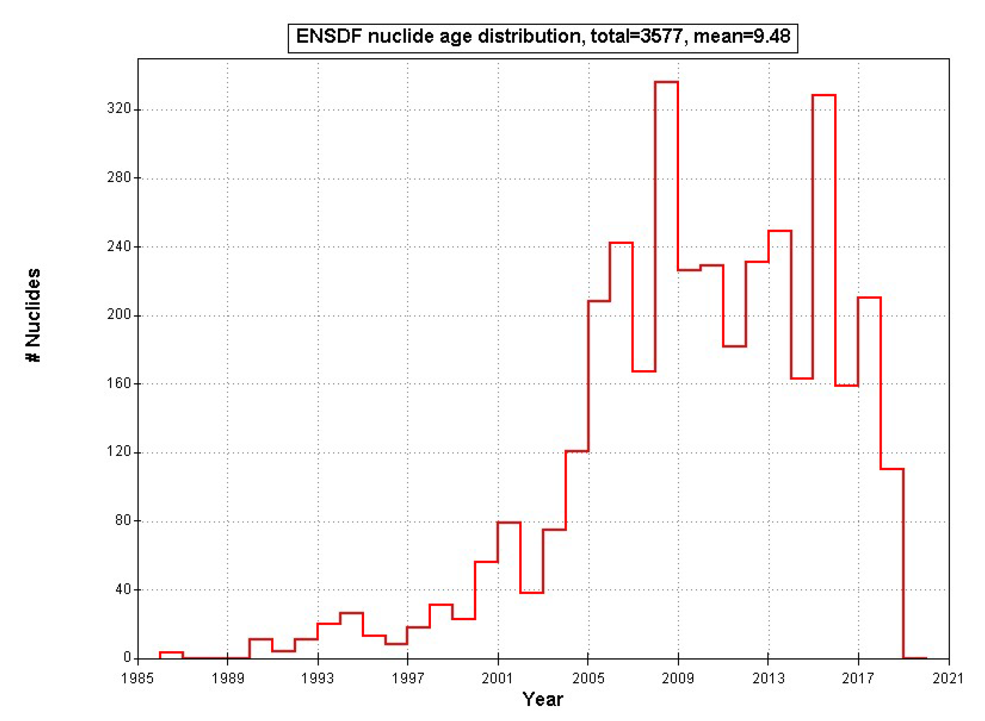
February 2019
Mean=9.48 y

Slide 2
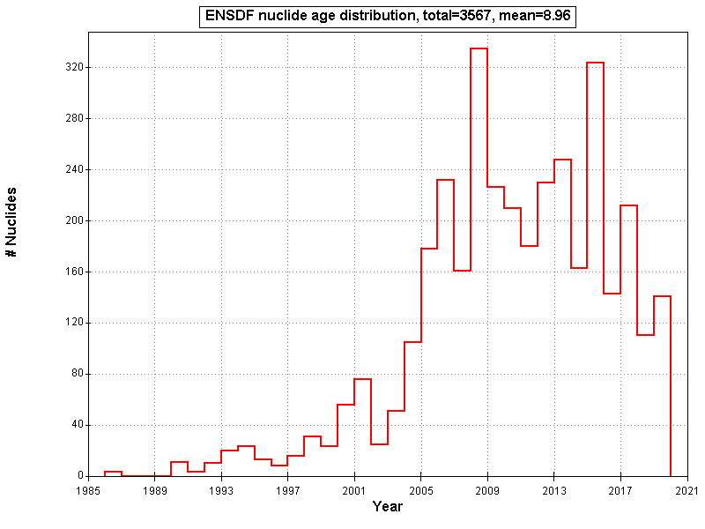
October 2019
Mean=8.96 Y

