Slide 1
US Nuclear data week, USNDP
4-8 November, 2019
Decay Data Issues in
Activation Measurements
Roberto Capote
Nuclear Data Section, IAEA

Slide 2
Decay data issues in activation experiments:
Different DD values to deal with - DDEP vs ENSDF = f(t)
T_{1/2}=14.997 (12) h –R. Firestone et al, Nucl. Data Sheets 108 (2007) 2317
T_{1/2}=14.958 (2) h – V.P. Chechev, N.K. Kuzminov, 06/2014, IAEA IRDFF evaluation adopted for DDEP.
From users: A long standing issue, we need time stamp and archive !
_____________________________________________________
A. Trkov et al, IRDFF-II: A new neutron metrology library
Nuclear Data Sheets 163, 1-111 (2020); arXiv 1909.03336 (2019)

Slide 3
US Nuclear data week, USNDP
4-8 November, 2019
The Medical Isotope Browser
An app for prediction of radioisotope production yields
Roberto Capote for
Arjan Koning and Marco Verpelli
Nuclear Data Section, IAEA

Slide 4
Contents
The medical isotope browser
Physics and nuclear data input
Current status of visual software
Future extensions

Slide 5
The medical isotope browser
A web application for medical isotope production on the basis of user input:
  User provides characteristics of the incident particle source:
    Energy range
    Specification of the target material
    Power of the accelerator
    Irradiation time and cooling time
  Software returns, virtually instantaneously:
    Yield of desired isotope
    Contaminations (unwanted side-products)
    …in a visually attractive and descriptive way

Slide 6
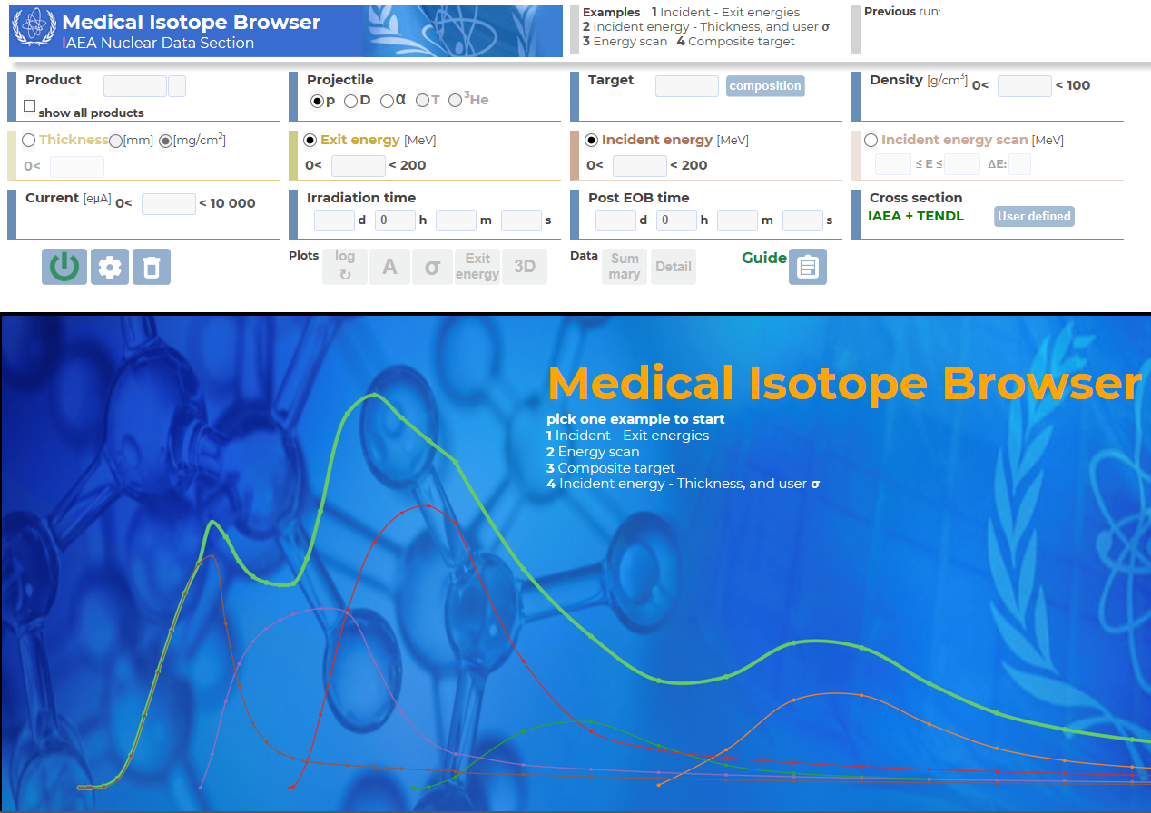
https://www-nds.iaea.org/mib

Slide 7
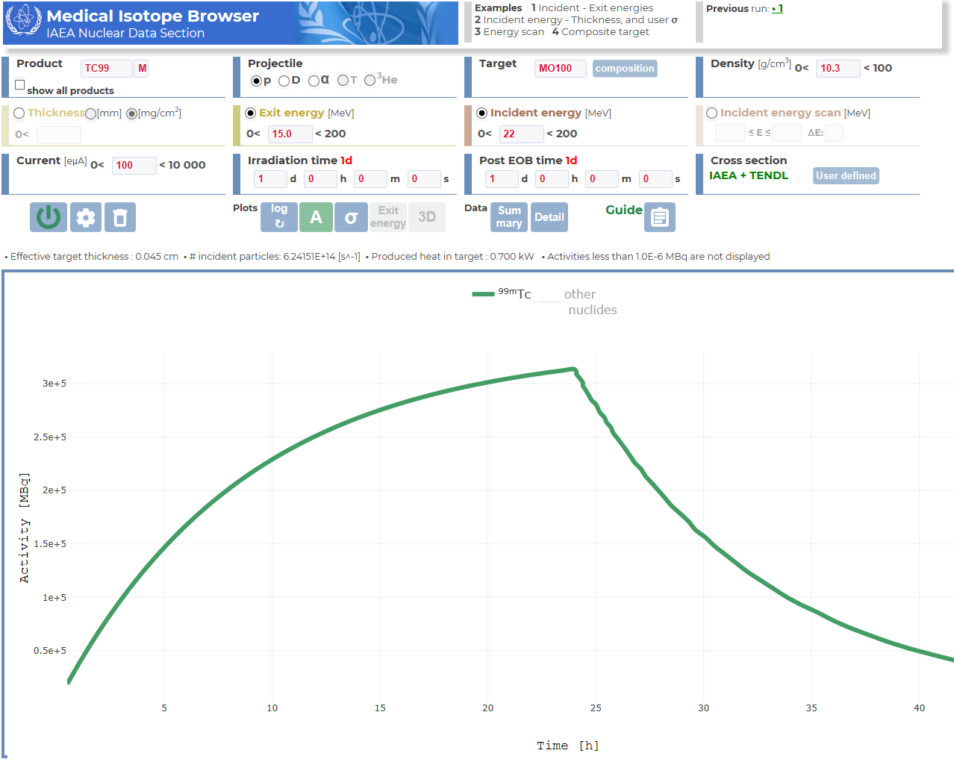

Slide 8
ISOTOPIA: Predicts radioisotope yield
(Projectile,
Target,
Beam power,
Etc.)
I
INPUT
Radioactive Decay Data
Production and
depletion equations
Stopping power
Cross section data
ISOTOPIA
PROGRAM
(Reaction rates,
Yields (GBq),
Etc.)
OUTPUT
Calculation time: < 0.2 sec.

Slide 9
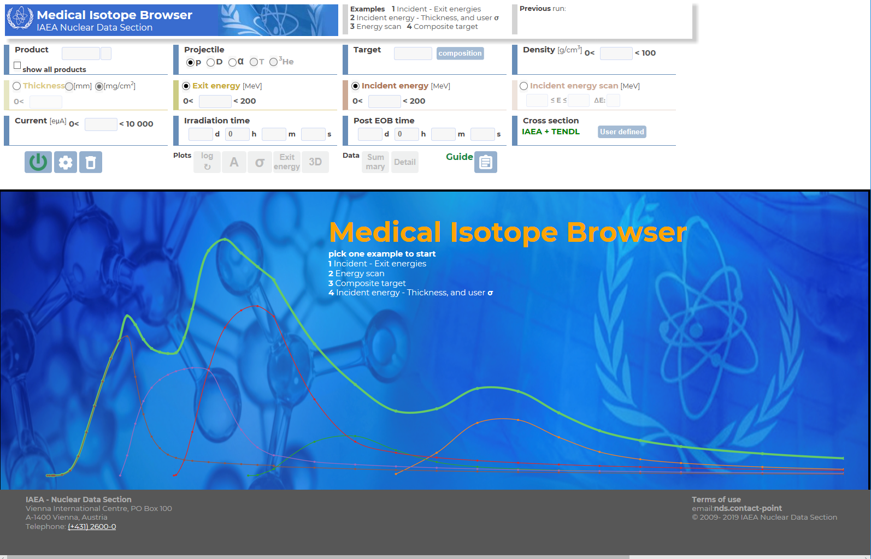
Medical Isotope Browser: GUI around ISOTOPIA
(Projectile,
Target,
Beam power,
Etc.)
I
INPUT
Radioactive Decay Data
Production and
depletion equations
Stopping power
Cross section data
ISOTOPIA
PROGRAM
(Reaction rates,
Yields (GBq),
Etc.)
OUTPUT
Calculation time: < 0.2 sec.

Slide 10
Essential 1: High-quality cross section data
E. Betak, A.D. Caldeira, R. Capote, B.V. Carlson, H.D. Choi, F.B. Guimaraes, A.V. Ignatyuk, S.K. Kim, B. Kiraly, S.F. Kovalev, E. Menapace, A.L. Nichols, M. Nortier, P. Pompeia, S.M. Qaim, B. Scholten, Yu. N. Shubin, J-Ch. Sublet, F. Tarkany et al, Nuclear data for the production of therapeutic radionuclides. In: S.M. Qaim, F. Tarkanyi, R. Capote (Technical editors) , IAEA Technical Reports Series no. 473, IAEA, scientific and technical report STI/DOC/010/473, IAEA Vienna, Austria (2011)
F. T. Tarkanyi, A. V. Ignatyuk, A. Hermanne, R. Capote, B. V. Carlson, J. W. Engle, M. A. Kellett, T. Kibedi, G. N. Kim, F. G. Kondev, M. Hussain, O. Lebeda, A. Luca, Y. Nagai, H. Naik, A. L. Nichols, F. M. Nortier, S. V. Suryanarayana, S. Takacs, and M. Verpelli: Recommended nuclear data for medical radioisotope . production: diagnostic positron emitters, J. Rad.Nucl.Chem. 319 (2019) 487-531.
A. Hermanne, A. V. Ignatyuk, R. Capote, B. V. Carlson, J. W. Engle, M. A. Kellett, T. Kibedi, G. N. Kim, F. G. Kondev, M. Hussain, O. Lebeda, A. Luca, Y. Nagai, H. Naik, A. L. Nichols, F. M. Nortier, S. V. Suryanarayana, S. Takacs, F. T. Tarkanyi, and M. Verpelli: Reference cross sections for charged-particle monitor reactions, Nucl. Data Sheets 148 (2018) 338-382.
F. T. Tarkanyi, A. V. Ignatyuk, A. Hermanne, R. Capote,B. V. Carlson, J. W. Engle, M. A. Kellett, T. Kibedi, G. N. Kim, F. G. Kondev, M. Hussain, O. Lebeda, A. Luca, Y. Nagai, H. Naik, A. L. Nichols, F. M. Nortier, S. V. Suryanarayana, S. Takacs, and M. Verpelli: Recommended nuclear data for medical radioisotope production: diagnostic gamma emitters, J. Rad. Nucl. Chem. 319 (2019) 533-666;
J. W. Engle, A. V. Ignatyuk, R. Capote, B. V. Carlson, A. Hermanne, M. A. Kellett, T. Kibedi, G. N. Kim, F. G. Kondev, M. Hussain, O. Lebeda, A. Luca, Y. Nagai, H. Naik, A. L. Nichols, F. M. Nortier, S. V. Suryanarayana,S. Takacs, F. T. Tarkanyi, and M. Verpelli: Recommended Nuclear Data for the Production of Selected Therapeutic Radionuclides, Nucl. Data Sheets 155 (2019) 56-74.
e.g., https://www-nds.iaea.org/monitor_reactions.html
20 years of IAEA CRP’s and other meetings led to ~150 high-quality nuclear reaction channels

Slide 11
Essential 2: Complete and good/reasonable quality cross section data
TENDL: TALYS Evaluated Nuclear Data Library
Produced by TALYS nuclear model code + other sources
Complete in projectile (n, g, p, d, t, h, a), target (2813 nuclides) and energy range (0-200 MeV)
1000-1500 citations, current version TENDL-2017
Globally good predictive power
Use of TENDL in 2019

Slide 12
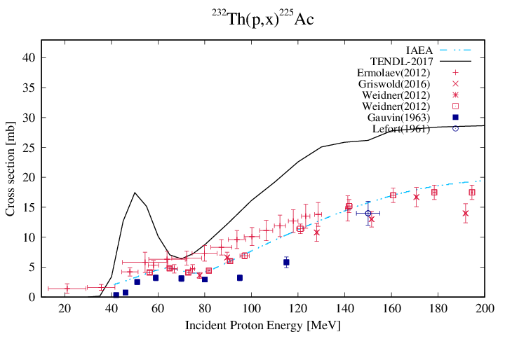
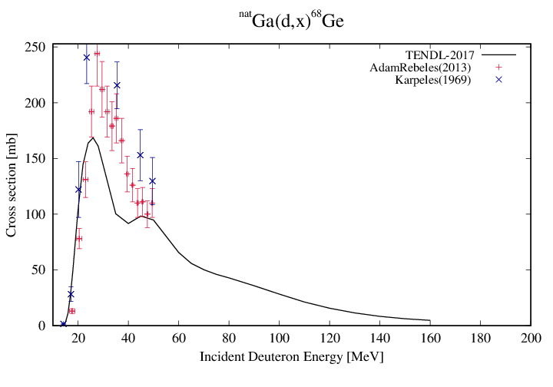
Medical isotope data library: combine the best with the most complete
IAEA high-quality evaluations (150 reaction channels)
TENDL-2017
IAEA-2019 Medical Isotope Data Library

Slide 13
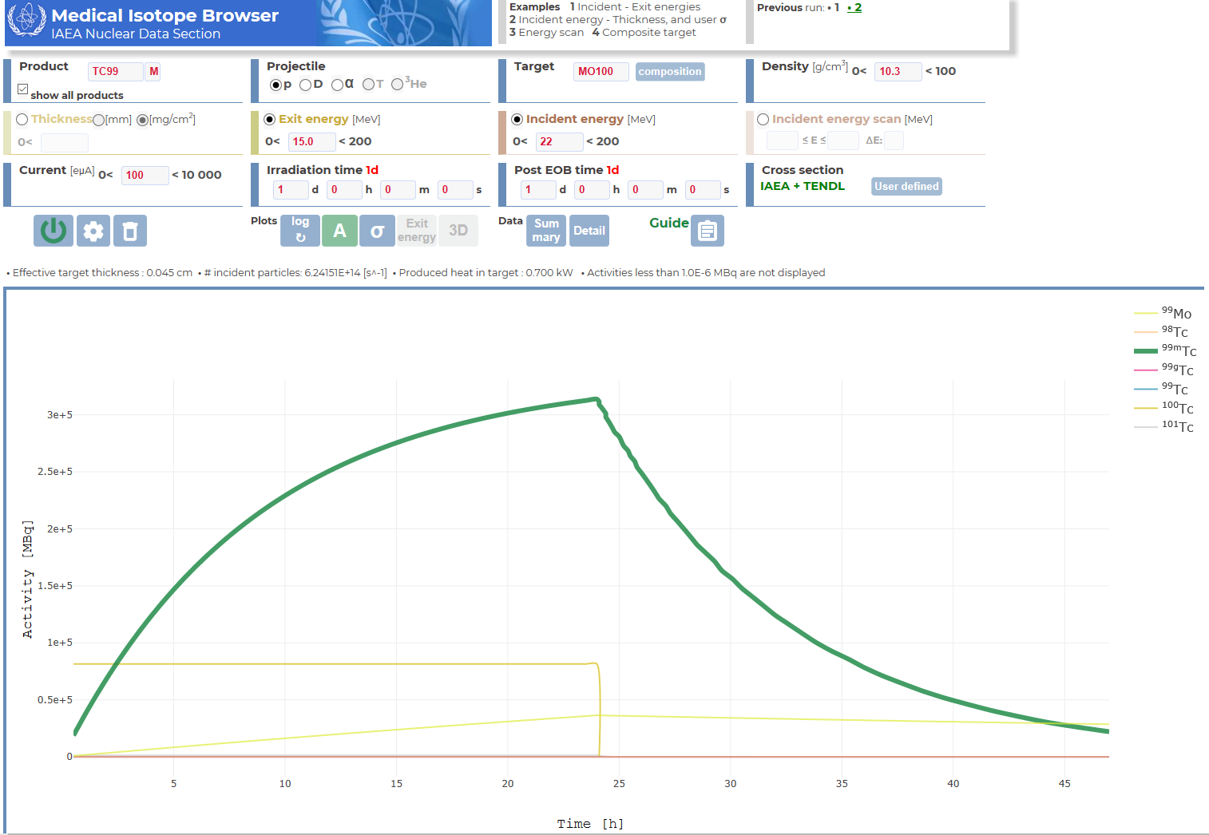
p + Mo-100: production of all isotopes

Slide 14
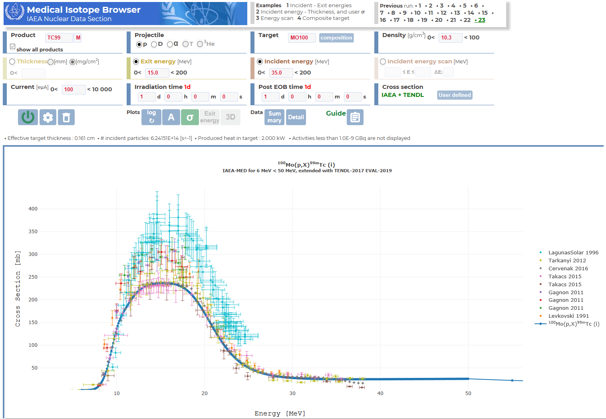
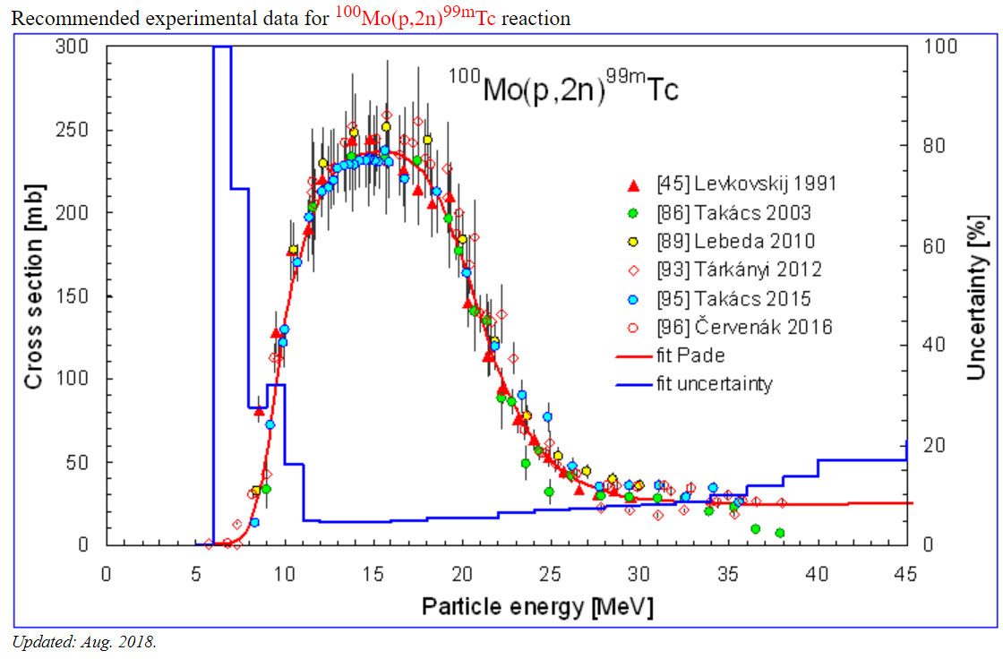
p + Mo-100 → Tc-99m: plot of cross sections
https://www-nds.iaea.org/medical/

Slide 15
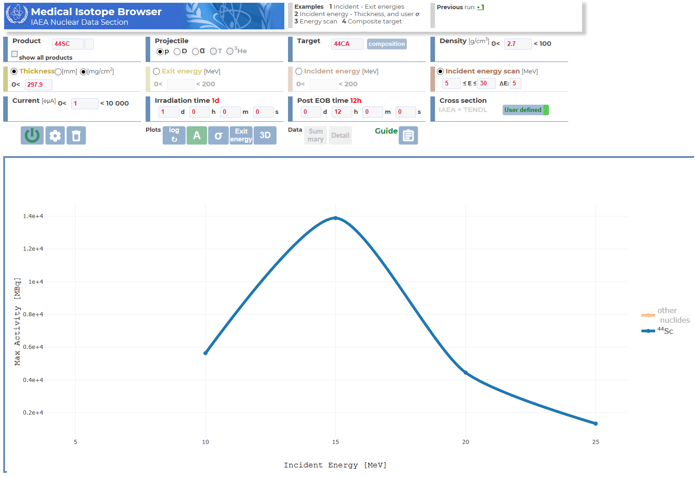
p + Ca-44 → Sc-44 : finding the optimal incident energy

Slide 16
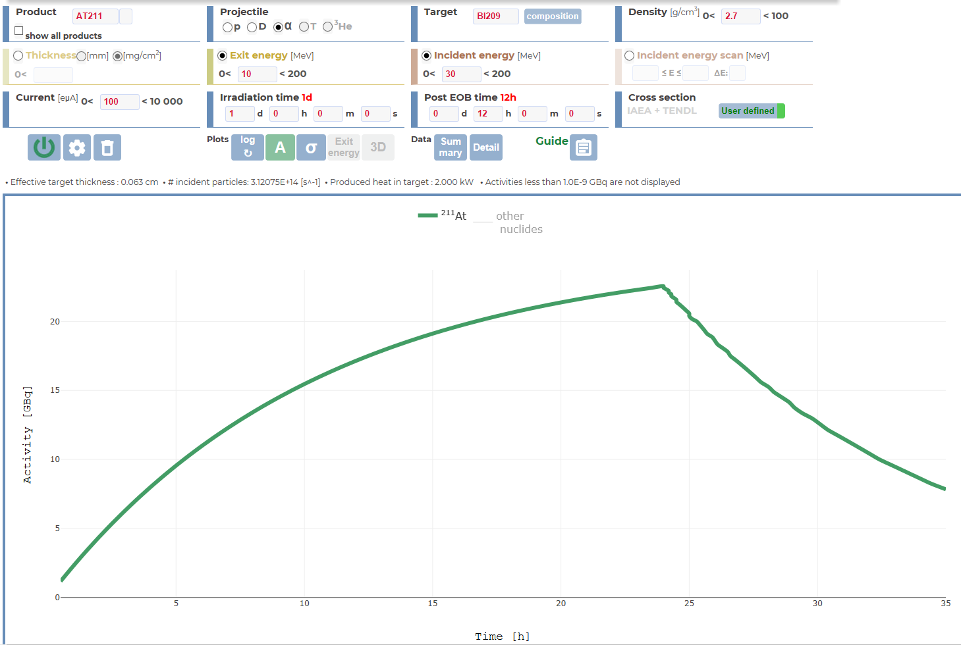
α + Bi-209 → At-211

Slide 17
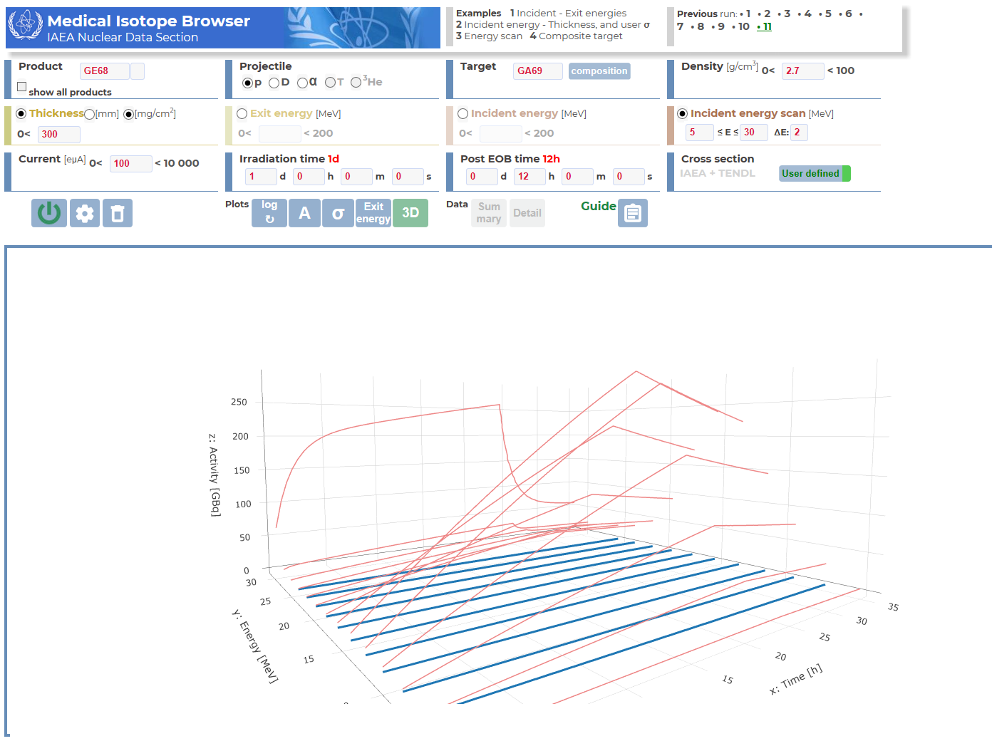
p + Ga-69 → Ge-68: 3D plot – Activity, time, energy

Slide 18
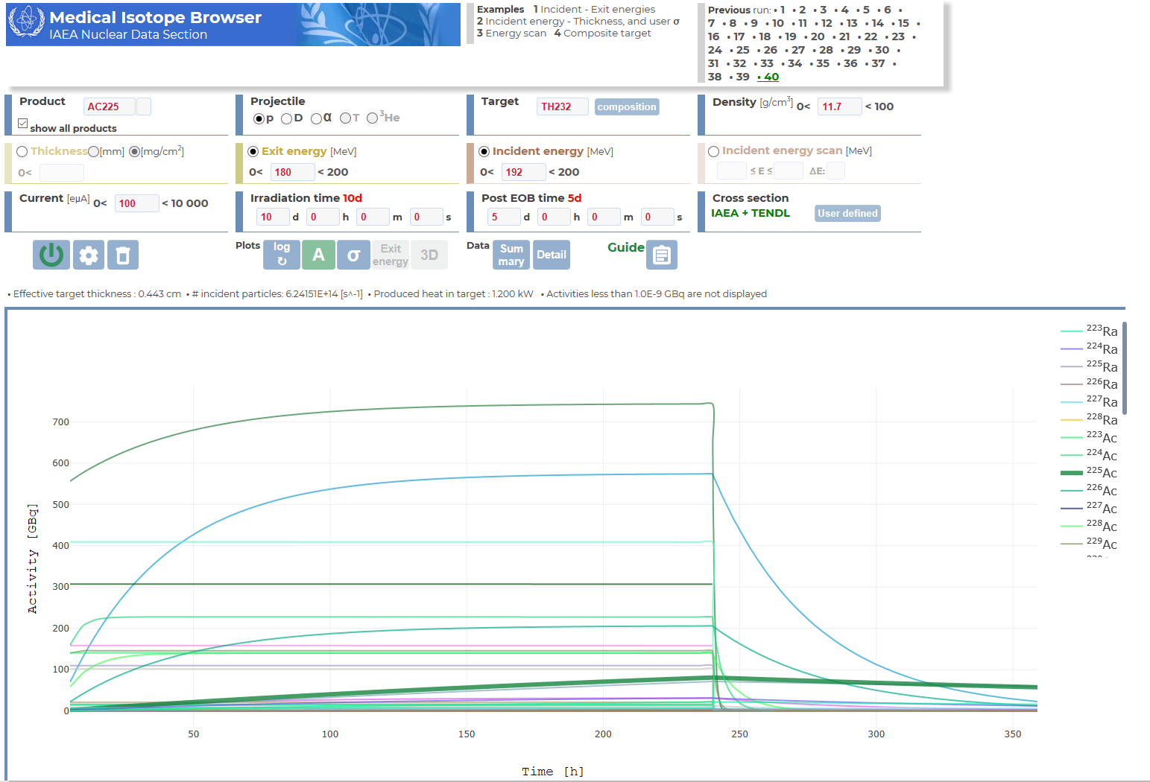
p + Th-232 → Ac-225 at 192 MeV
Fitzsimmons et al 2019, Molecules

Slide 19
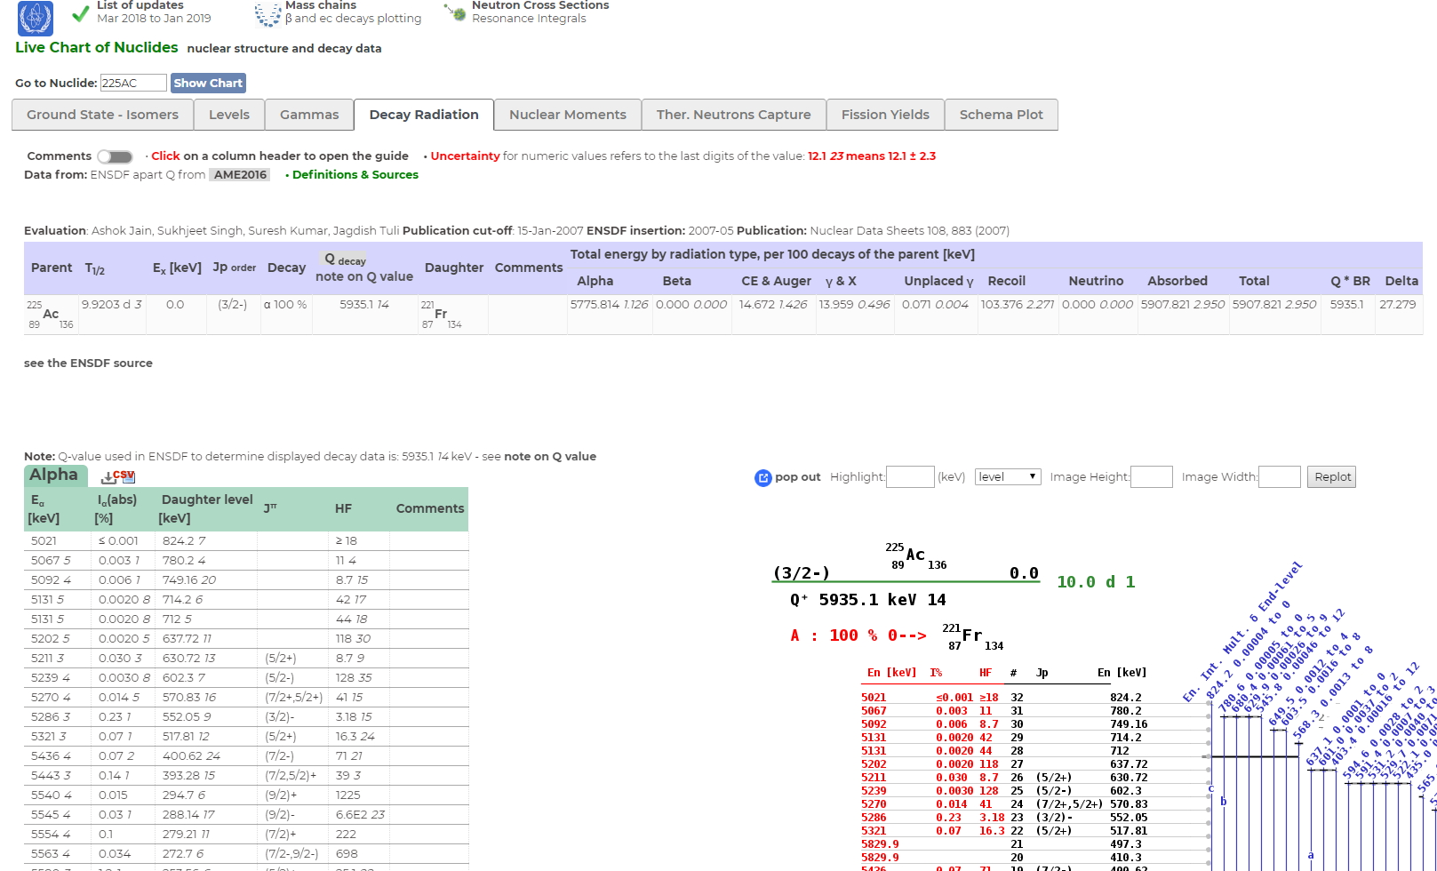
Click on radioisotope: direct link to IAEA’s Livechart webpage with all decay information

Slide 20
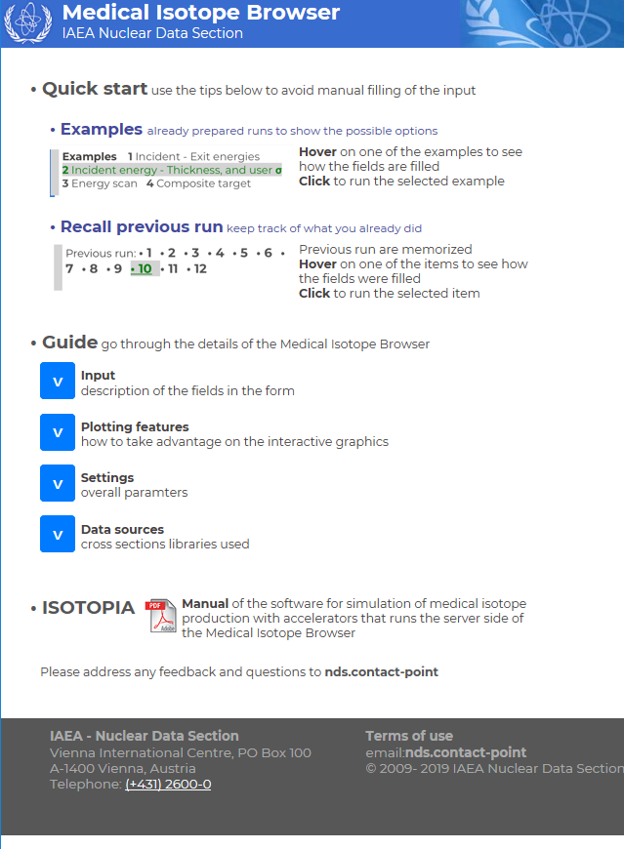
Other features
Specify enriched targets
Insert your own cross section files
All important output also as text files and tables
User guide available on the website

Slide 21

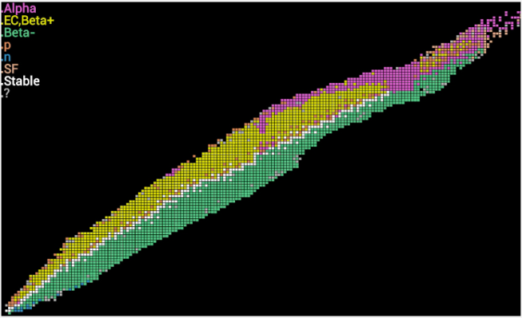
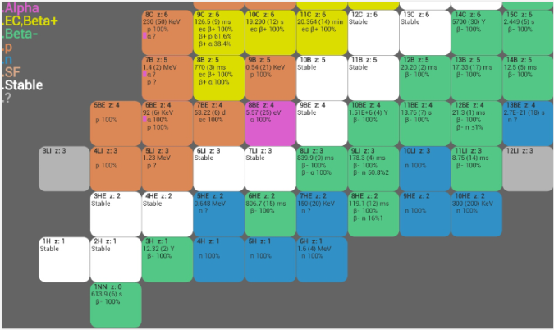

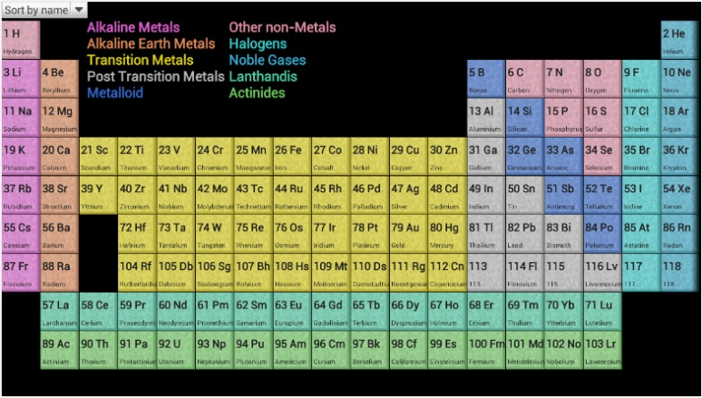
Isotope Browser – App for smart phones
  Isotope Browser; Properties of over 4,000 isotopes; Interactive App for android & Apple i devices. http://play.google.com/store/apps
Independent of internet
~92,000 downloads in 5 y
Now in 10 languages (6 UN + Jap. + Slov. + Ital. + Trad. Chinese)

Slide 22
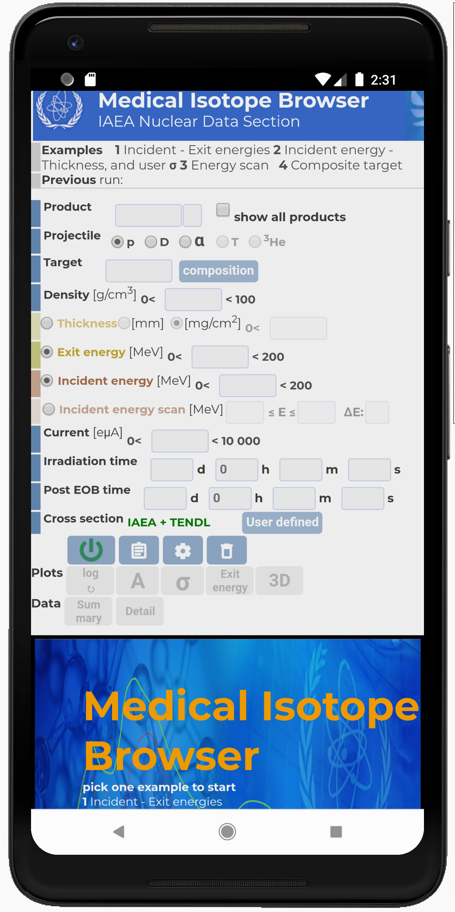
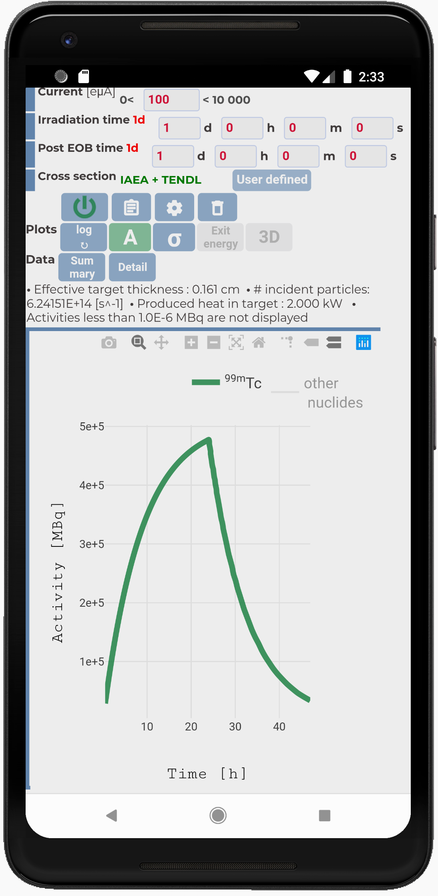
Yes,
it works on your phone

Slide 23
Future options (in order of priority)
Add reactor-based production (neutrons), both for fission products and activation
Add photonuclear route (electron accelerator)
Improvement of the cross section data libraries
Include uncertainties for cross sections and final yields
(Semi-)automatically assess how hazardous the produced impurities are
Medical isotope “funnel”: Automatically find promising radioisotopes on the basis of their decay characteristics
Solve the “inverse problem”: User gives a desired radioisotope and all production routes are calculated and compared

Slide 24
Summary
The Medical Isotope Browser is accessible at https://www-nds.iaea.org/mib
Aims to bring fundamental nuclear data directly to straightforward use in radiopharmaceutical research and industry
Gives a direct first guess whether a production route is viable
Your feedback will make this product better

Slide 25
Finally
If you think this tool is great, tell others
If you have complaints about this tool, tell us*
*nds.contact-point@iaea.org

