Slide 1
ATF Electron Beam Capabilities
Mikhail Fedurin
ATF Science planning workshop
October 15 – 17, 2019

Slide 2
Outline
ATF main beam parameters
ATF beam diagnostics
  Beam profile measurements
  Transverse deflector cavity (TDC)
  Spectrometry
ATF beam manipulation capabilities
  Mask
  Compression
  10 um microbunching with CO2 laser
Future plans for linac and beamlines
  Second TDC for BL1
  Linac energy upgrade
  Advanced compression scheme
More details about advanced e-beam compression
  Zig-zag scheme with two chicane combo (by Yichao Jing)
  New scheme: DWF plates and chicane combo

Slide 3
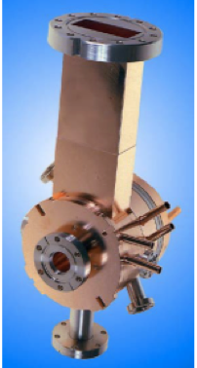
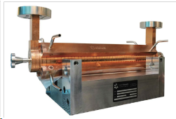
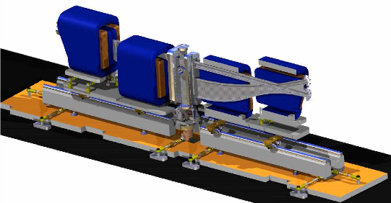
ATF main beam parameters
Parameter | Typical value / range | Best value
Energy | 30-60 MeV | 80 MeV
Charge | 0.1 – 1 nC | 3 nC
Repetition rate | 1.5 Hz | 10 Hz
Electron spot size on cathode | 2.86 mm | 0.2 – 4 mm
Bunch length | 1-8 ps | 100 fs with compression
Average bunch current | 100 A | 1.5 kA with compression
Emittance | 1 – 3 mm mrad | 0.8 mm mrad @ 0.5 nC

Slide 4
Facility Overview (Bldg. 820)
CO₂ Laser Area
Beamline 1:
Experimental stations:
1) Inverse Compton,
2) LWFA with gas jet cell,
3) IGS (big in vacuum space)
Differential pumping (2 stages)
CO2/YAG & e-beam IP
Electron Accelerator Area
Beamline 2:
Experimental station with
plasma cell capillary
Insertion device section
Differential pumping (1 stage)
CO2 & e-beam IP
X-band Deflector cavity (TDC)

Slide 5
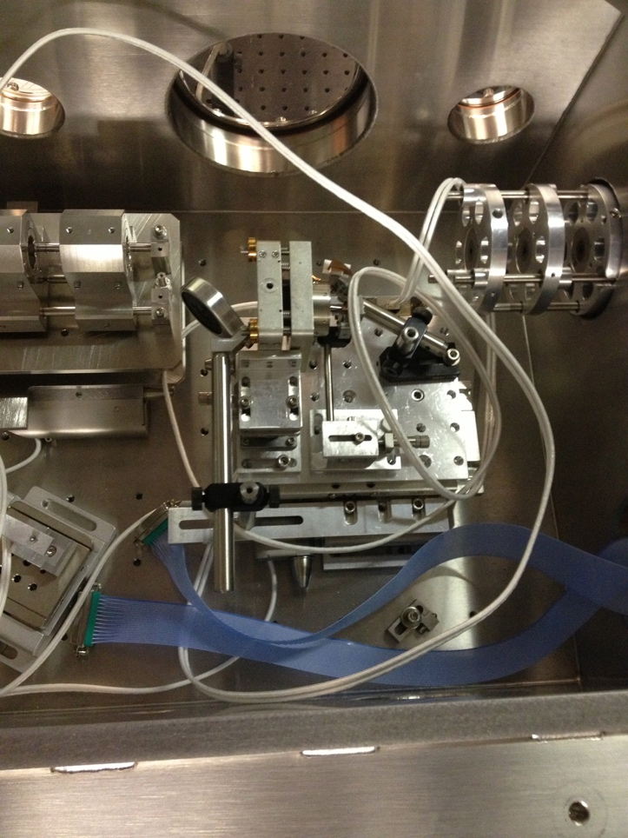
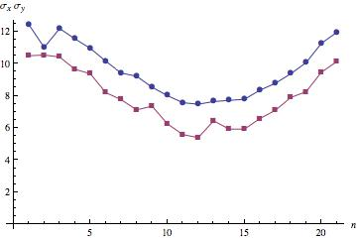
ATF beam diagnostics
  Beam profile measurements
UCLA PMQ triplet assembly:
G=500 T/m,
triplet focal length ~8 cm
Radiabeam PMQ triplet assembly:
G=50 T/m, triplet focal length ~20 cm
Microscope (25-0506 X15 Reflecting Objective NA 0.28, F~13 mm)
Basler Gigabit camera (scA 1400-17gm, F=135 mm).

Slide 6
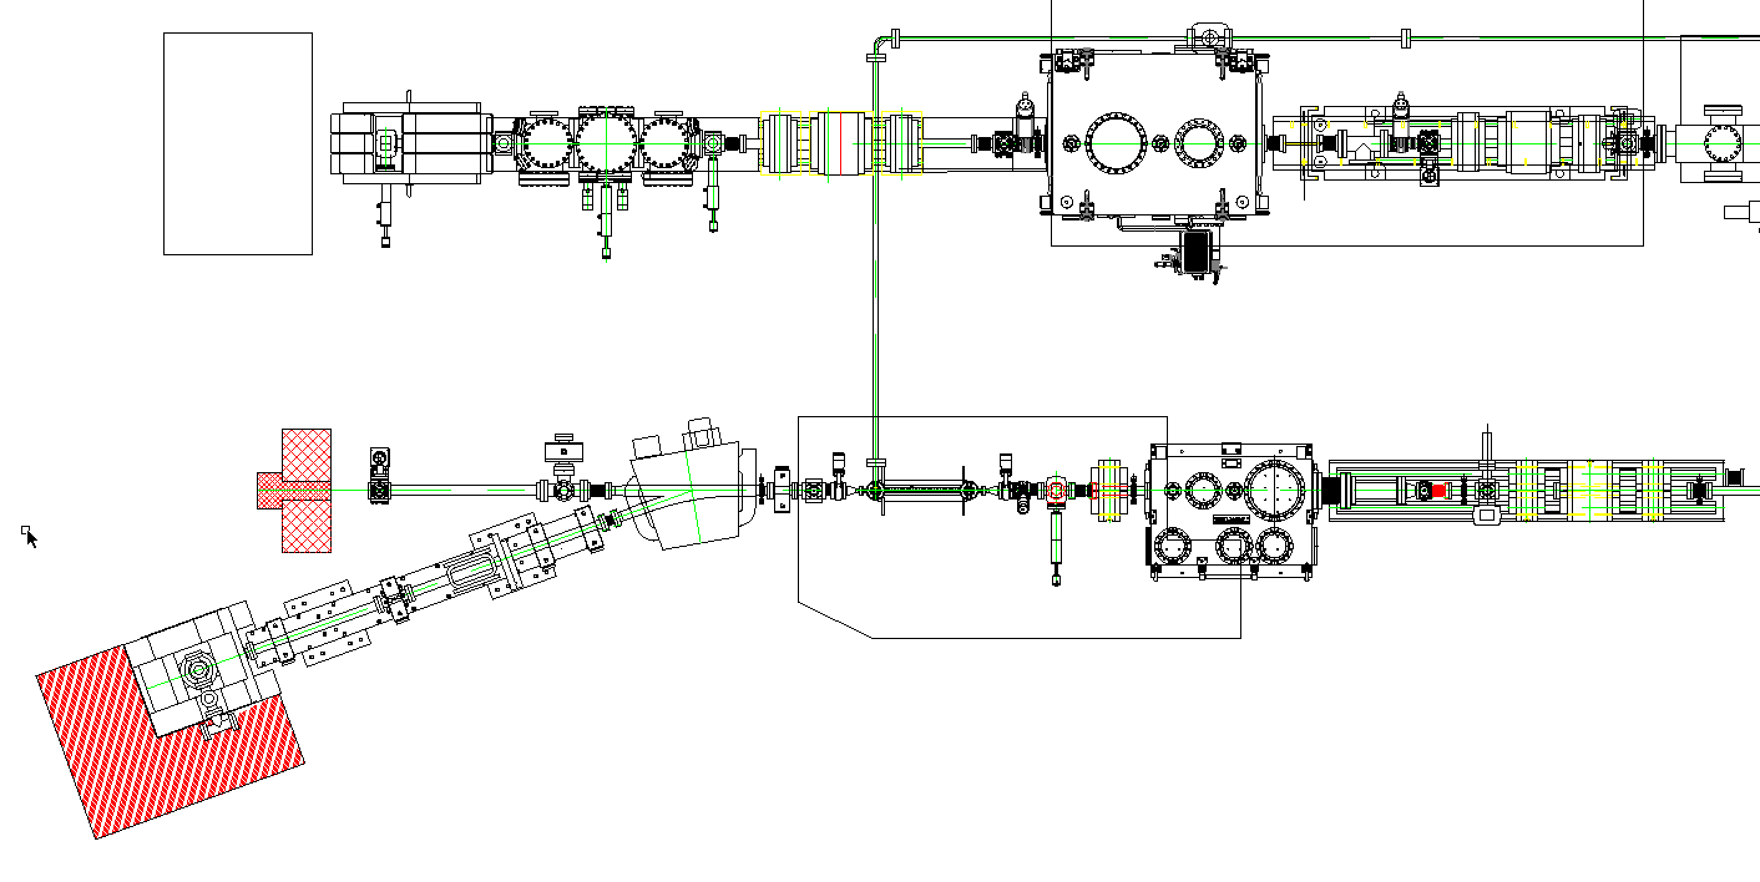
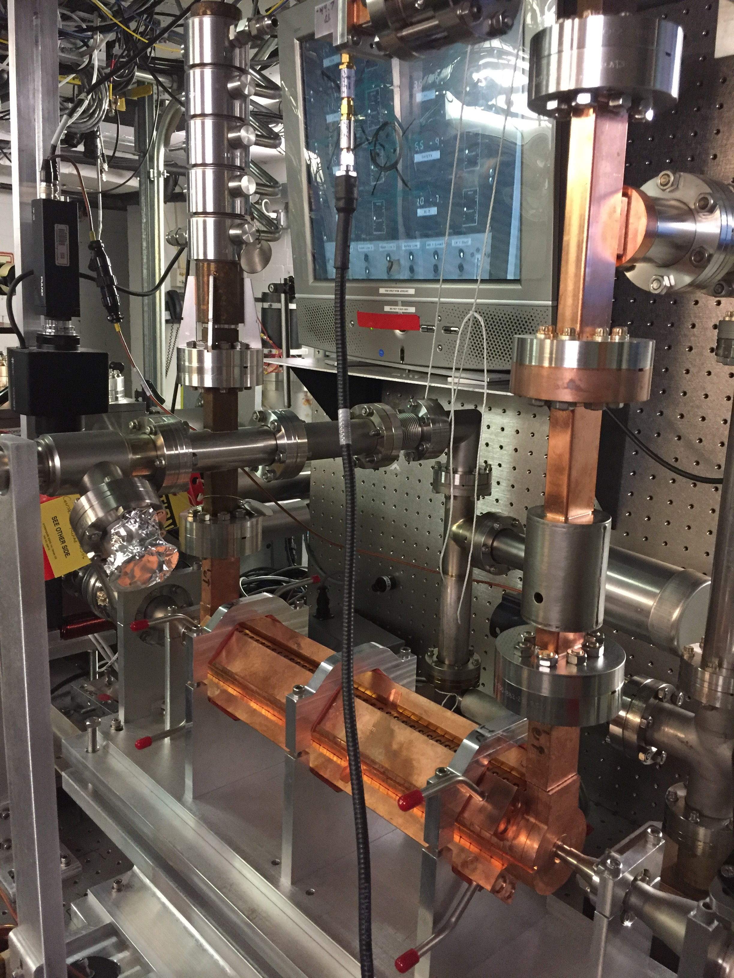
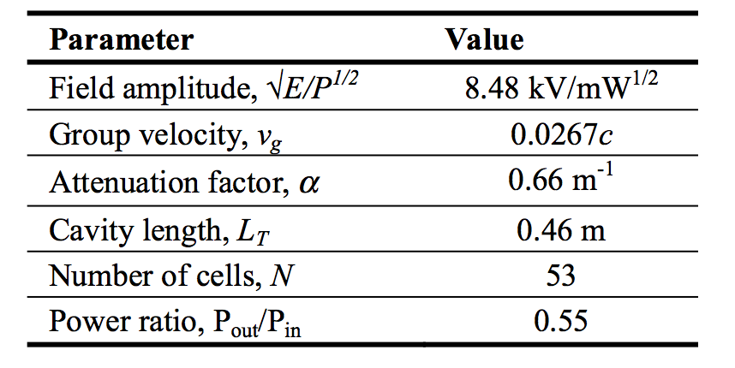
ATF beam diagnostics
  Transverse deflector cavity (TDC)

Slide 7
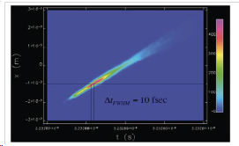
ATF beam diagnostics
Transverse deflector cavity measurements
X-band Deflector cavity by Radiabeam
for longitudinal bunch profile characterization
Images after deflector
Image at mask

Slide 8
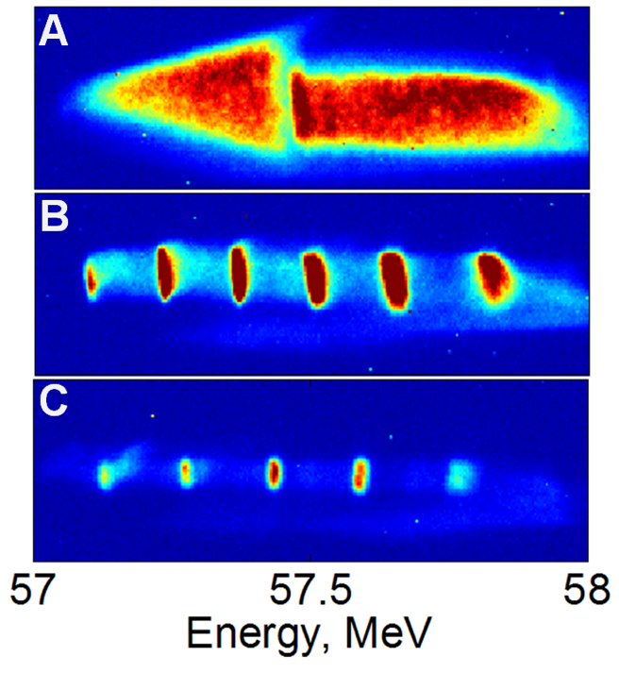
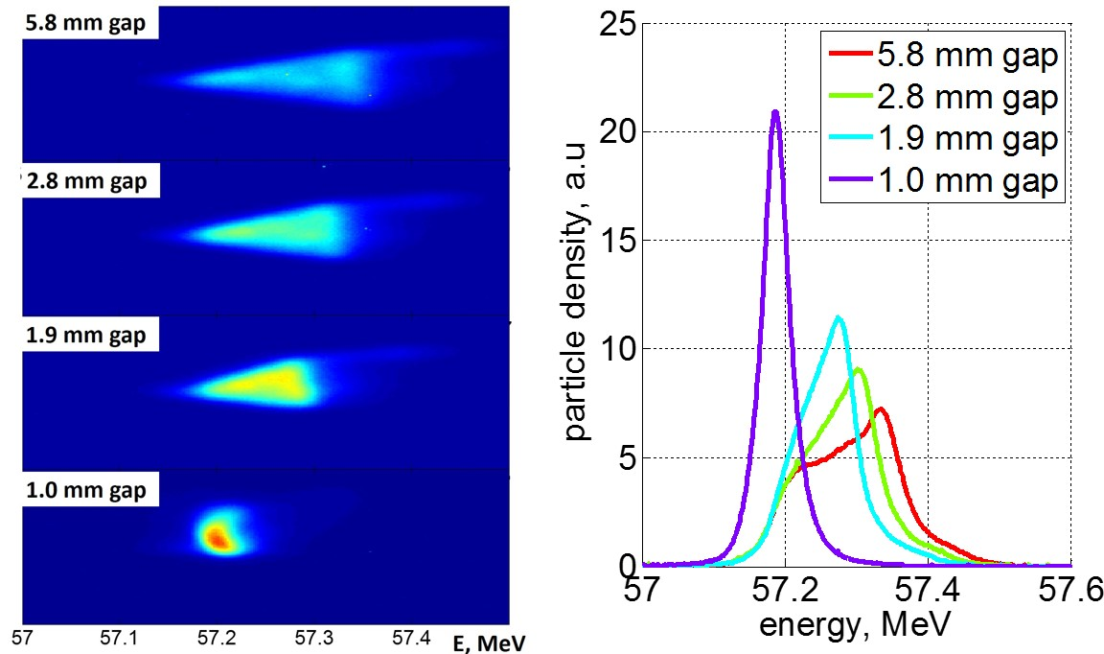
ATF beam diagnostics
  E-beam spectrometry
Original chirped beam
Measurement: spectrometer
0.95 THz structure
0.76 THz structure
Observation of energy modulation
S. Antipov, S. Baturin, C. Jing, M. Fedurin, A. Kanareykin, C. Swinson, P. Schoessow, W. Gai, and A. Zholents, Phys. Rev. Lett. 112, 114801 (2014)
S. Antipov, C. Jing, M. Fedurin, W. Gai, A. Kanareykin, K. Kusche, P. Schoessow, V. Yakimenko, A. Zholents, Phys. Rev. Lett. 108, 144801 (2012)

Slide 9
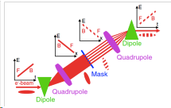
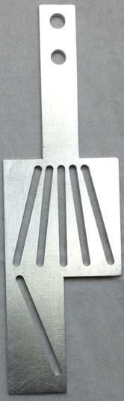
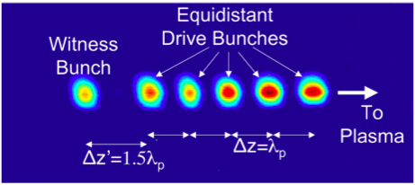
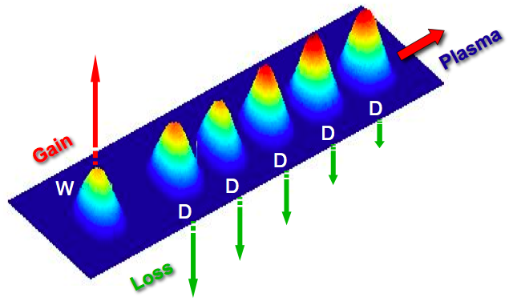
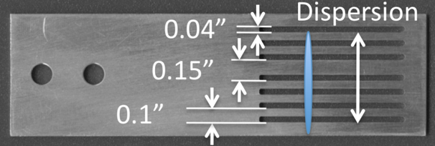
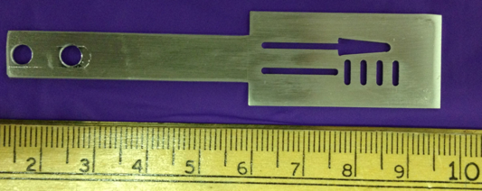
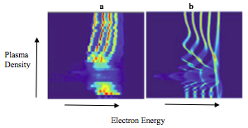
ATF beam manipulation capabilities
  Mask technique
bunch current 100 A
30 μm bunches
Muggli, P., et al., Simple method for generating adjustable trains of picosecond electron bunches. Physical Review Special Topics-Accelerators and Beams, 2010. 13(5): p. 052803
Muggli, P., et al., Generation of trains of electron microbunches with adjustable subpicosecond spacing. Phys Rev Lett, 2008. 101(5)

Slide 10
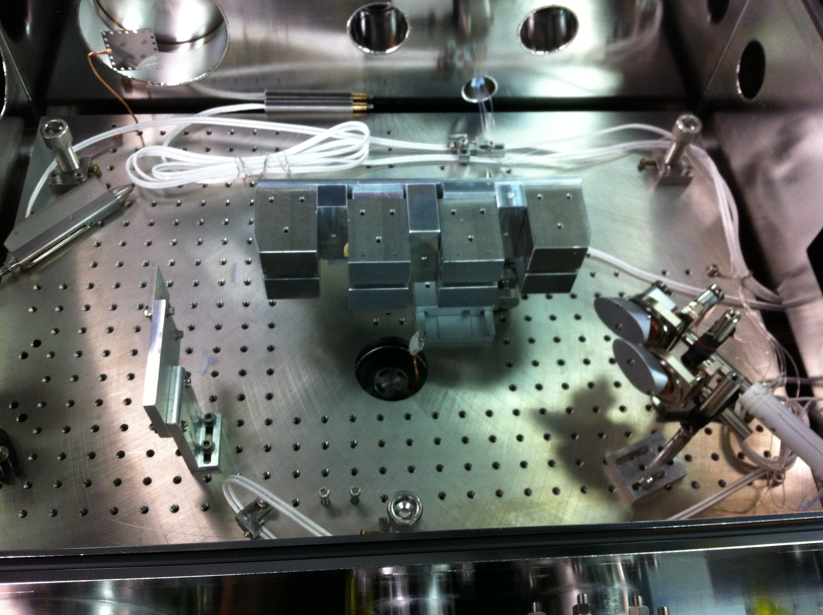
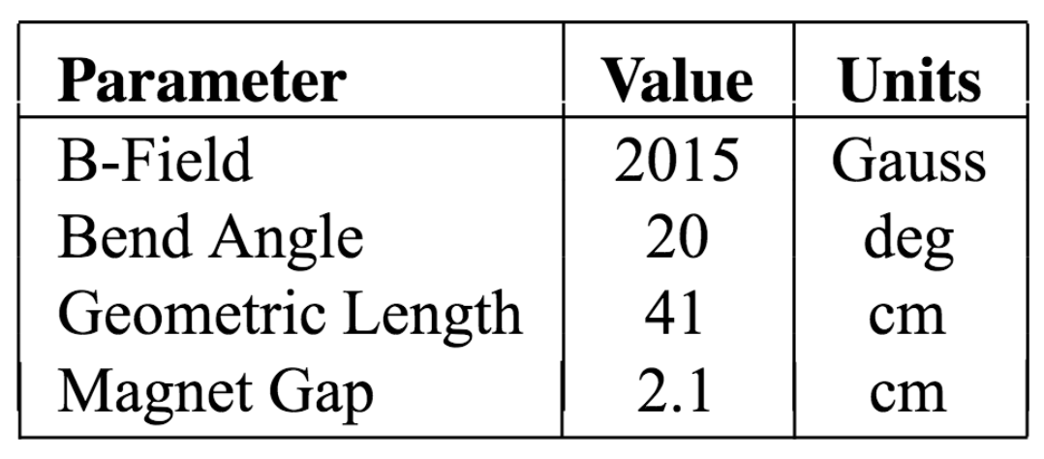
ATF beam manipulation capabilities
  Beam compression
Electromagnet chicane
Permanent Magnet Chicane
~1 Tesla magnetic field
50 mm magnetic length

Slide 11
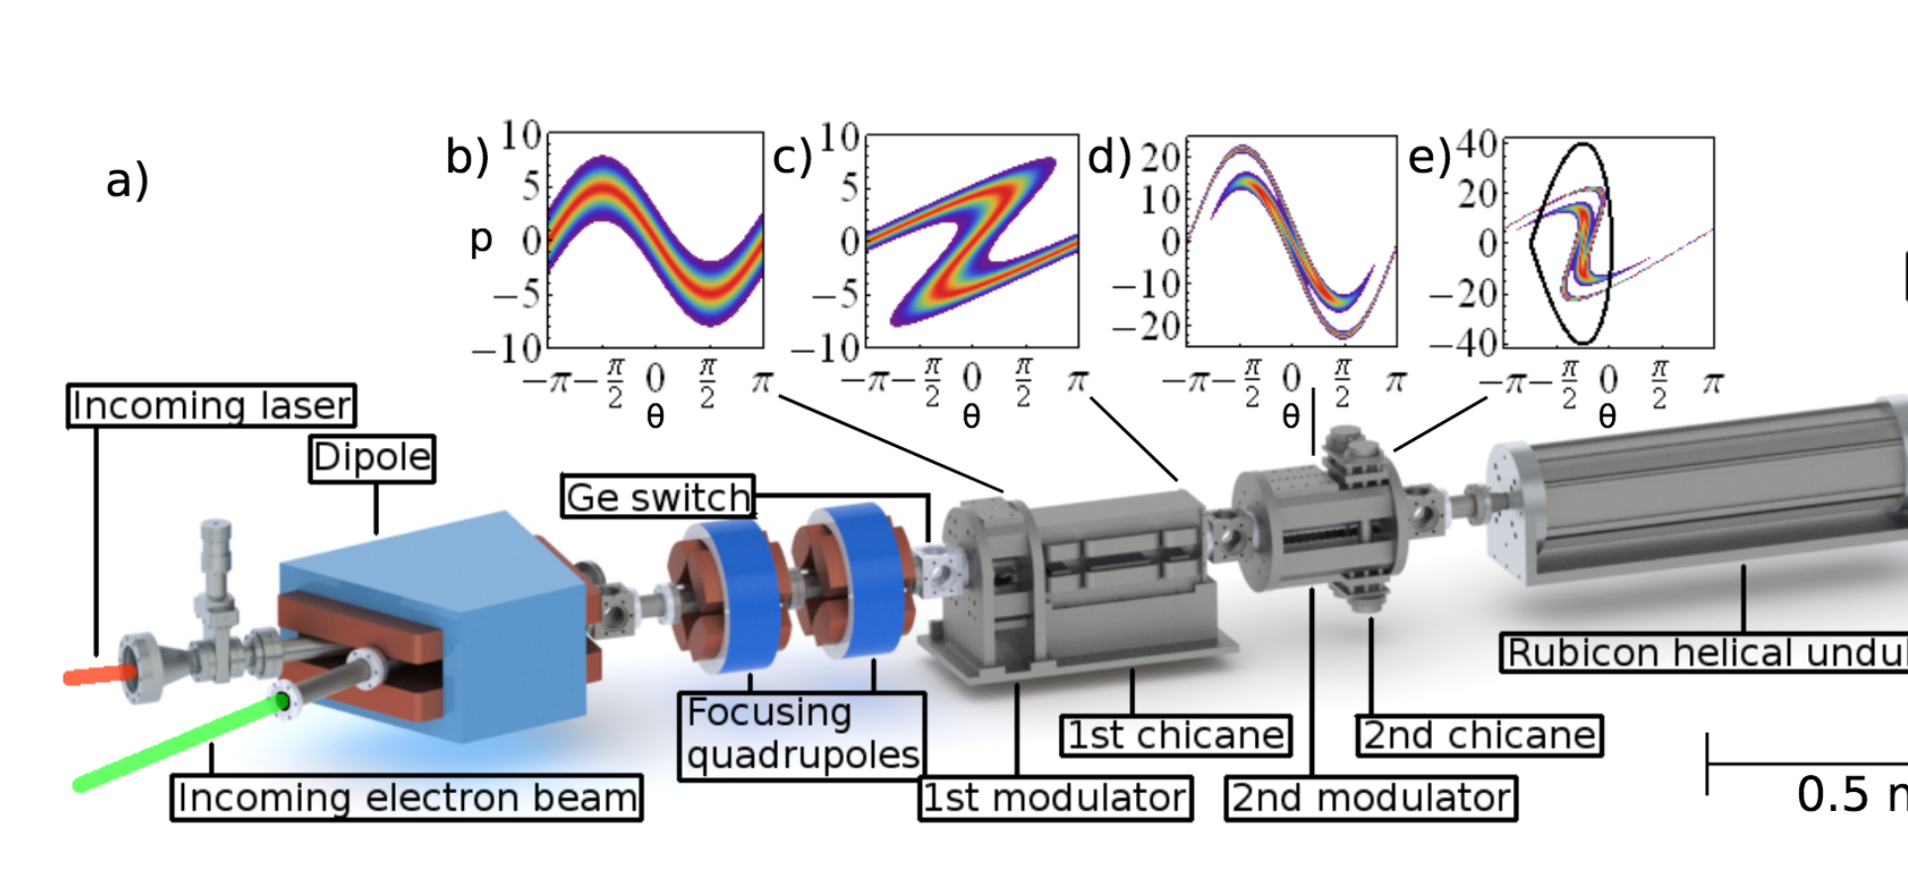
ATF beam manipulation capabilities
  10 um microbunching with CO2 laser
N. Sudar, P. Musumeci, I. Gadjev, et al., PRL 120, 114802 (2018)

Slide 12
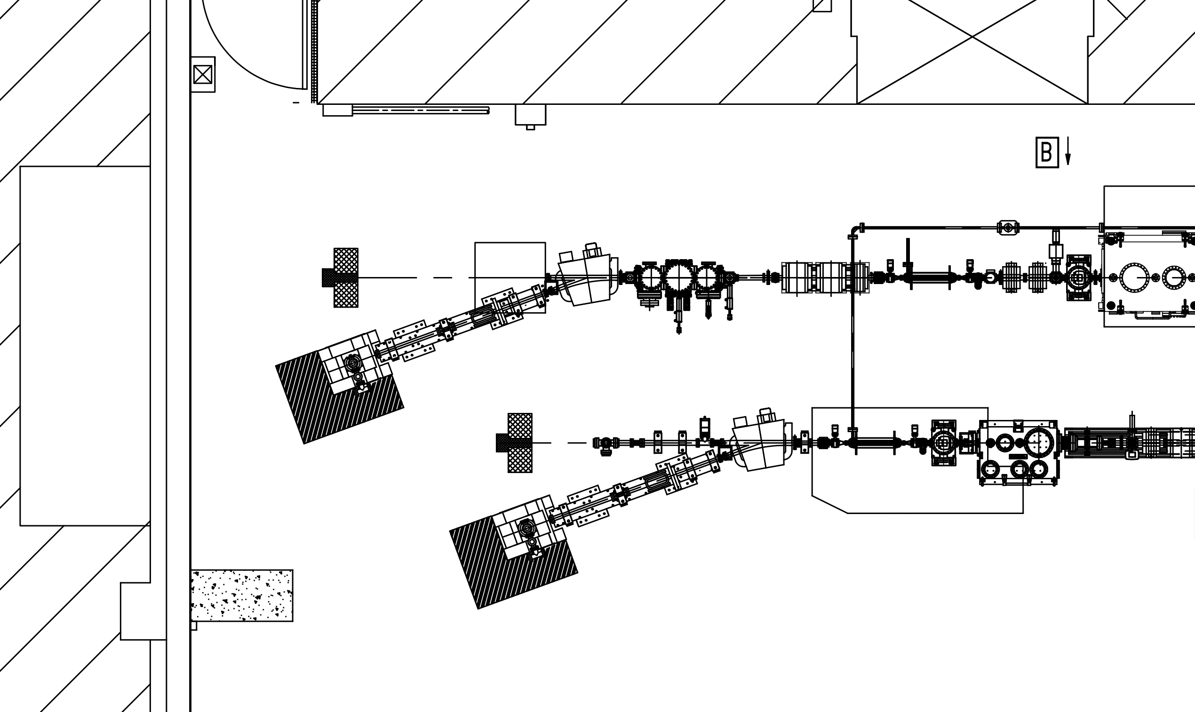
Future plans for Linac and beamline
  Deflector cavity for BL1
TDC BL1
TDC BL2

Slide 13
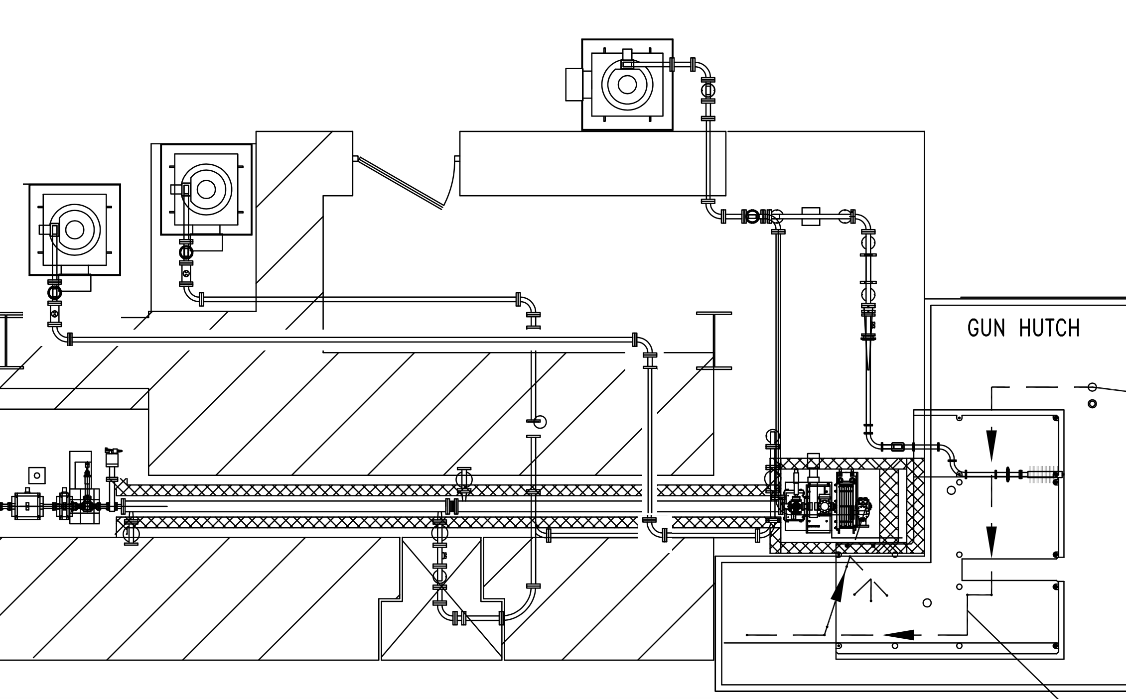
Future plans for Linac and beamline
  Linac energy upgrade
Gun klystron
Linac
klystron #1
Plan to feed linac acceleration sections with separated klystrons to push maximum operational energy to 110-120 MeV
Linac klystron #2

Slide 14
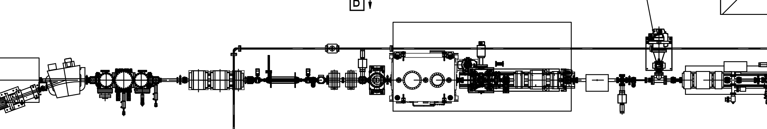
Future plans for Linac and beamline
Advanced compression scheme
DWF plates and
second bunch compressor

Slide 15
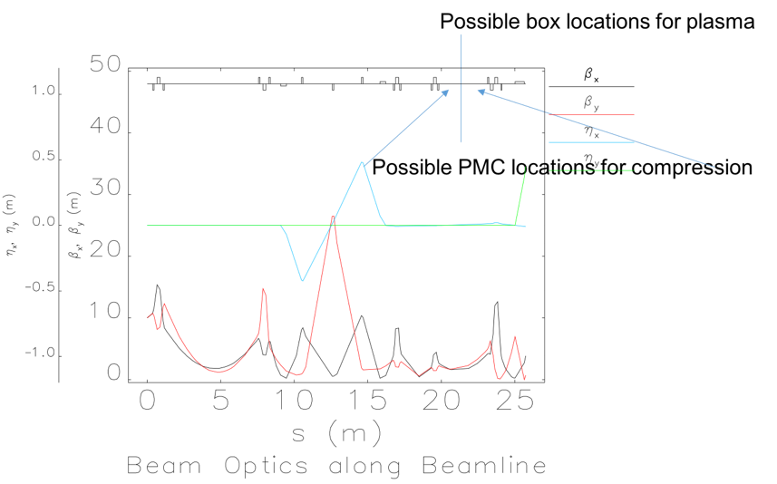
Advanced e-beam compression
  Zig-zag scheme with dual chicane (by Yichao Jing)
Yi.Jin, et al. Phys. Rev. ST Accel. Beams 16, 060704 (2013)

Slide 16
Advanced e-beam compression
Zig-zag scheme with dual chicane (by Yichao Jing)

Slide 17
Advanced e-beam compression
  Zig-zag scheme with dual chicane combo (by Yichao Jing)
beam phase space distribution at initial and after zigzag chicane (two PMCs) shows almost perfect compression (beam was rotated by close to 90 degree in phase space). The twist at the core of the beam (right plot) is caused by CSR effect.

Slide 18
Advanced e-beam compression
  Zig-zag scheme with dual chicane combo (by Yichao Jing)
FWHM bunch length < 20 fs is achievable for higher charge (100 pC in this case) with the combination of the zigzag chicane together with CSR shielding

Slide 19
Advanced e-beam compression
New scheme: DWF plates and chicane combo
Hint: In many DWFA experiments conducted at the ATF, beam energy self-modulation was observed. This feature can be used to tune beam chirp!
G.Andonian, et. al., Phys. Rev. Lett. 113.264801 (2014)

Slide 20
Advanced e-beam compression
New scheme: DWF plates and chicane combo
Simulations by Irina Petrushina

Slide 21
Advanced e-beam compression
New scheme: DWF plates and chicane combo
Collimating slit
A selected portion of the beam can be transmitted through energy collimator between 2nd and 3rd magnet poles in magnet chicane
DWF chirper
PM chicane
Zig-zag configuration with DWF chirper plates:
DWF chirper
PM chicane
EM or PM chicane
Collimating slit

Slide 22
Summary
Beam parameter | Present | Future plans
Transverse bunch size (sigma) - operational: - smallest achieved: | 50-100 μm 5 μm | 50-100 μm 5 μm
Bunch length/peak current - operational: - compressed: | 0.5-7 psec / 100 A 90 fsec / 1000 A | 0.5-7 psec / 100 A 20 fsec / 2000 A
Beam energy | 50-65 MeV | 110 – 120 MeV
New equipment:
Add X-band deflector cavity on beamline #1 and have bunch length diagnostic on both beamlines
Add second klystron for Linac sections to push beam energy up

Slide 23
Thank you!

