Slide 1
The 2019 ATF Science Planning Workshop
Mark Palmer
October 15, 2019

Slide 2
Welcome
The ATF Team appreciates your willingness to take time out of your busy schedules to engage with us on developing and optimizing our facility thrusts for the next several years
We’re looking forward to fruitful discussions over the next 3 days

Slide 3
Introduction and Background
Updating the ATF Programmatic Plan
  2 Imperatives:
    Establish an effective program for our user community at B820
      What are the most critical new capabilities to deliver?
      What does our Facility R&D program need to focus on?
        We want to engage in new collaborative thrusts
      How can we provide the most effective ongoing operations plan?
    Prepare a transition plan for the UED Facility
      Provide unique and attractive user capabilities
      Engage further with the materials science user community
      Prepare a proposal to transition the facility for user science operation (as opposed to accelerator development)
  The first of these items is the topic of this workshop
Continued operation of the ATF has been approved for 5 years: FY19-FY23
  Identifying a high impact scientific plan for the next 3 years is crucial to preparing a proposal to extend ATF operations for our user community beyond FY23

Slide 4
Outcomes of the 2017 ATF Scientific Needs Workshop
The 2017 workshop focused on the potential for deploying advanced LWIR laser capabilities for ATF-II at B912
  With a subsequent delivery of companion electron beam capabilities
  9 Priority Research Directions (PRDs) were identified for LWIR laser research and combined laser + e-beam research
The conclusions of that report remain applicable to the ongoing ATF User Program

Slide 5
2017 SNW: Thrusts
Topics in Mid-IR Laser Research
  Jeff Moses (CU)
  Dan Gordon (NRL)
  Yu-hsin Chen (NRL)
Topics in Laser-Plasma Interactions and Laser Wakefield Acceleration
  Stuart Mangles (ICL)
  Jean-Pierre Delahaye (CERN)
  Navid Vafaei Najafabadi (SUNY-SB)
  Aakash Sahai (ICL)
Topics in Laser-Electron Beam Interactions
  Felicie Albert (LLNL)
  Bruce Carlsten (LANL) – Overall chair
  Gerard Andonian (Radiabeam/UCLA)
Each working group identified a set of Priority Research Directions (PRDs) for their assigned topic

Slide 6
Topics in Mid-IR Laser Research
PRD 1: High-power CO2/Mid-IR laser development
PRD 2: Laser filamentation and propagation in the atmosphere
PRD 3: Secondary sources and expansion of CO2 versatility based on nonlinear optics
Key Conclusions:
Funding agencies and scientific communities covering a wide range of disciplines have recognized the development of mid-IR sources and mid-IR laser science as key to growth.
The characteristics of mid-IR sources desired by the strong-field physics community and for DOD-funded efforts in atmospheric propagation applications are strongly convergent with those desired by high energy physics and accelerator applications.
In terms of laser light sources for high energy physics, the U.S. has remained the leader in high power mid-IR facilities based on CO₂, while Europe has invested heavily in high peak power infrastructure at other wavelengths. Continued research and development at these CO₂ facilities is key to maintaining U.S. leadership.

Slide 7
Topics in Laser-Plasma Interactions and Laser Wakefield Acceleration
  PRD 1: Electron acceleration
  PRD 2: Ion acceleration
  Key Conclusions:
  …there is currently no long wavelength laser laboratory pursuing laser wakefield acceleration. Increasing the power of long wavelength drivers to the ten terawatt level and beyond will allow this field to develop rapidly, allowing some of the significant advantages that long wavelength drivers have over MIR systems to be exploited. We also stress that there is currently no user facility capable of performing experiments in laser wakefield acceleration in the USA.
  An upgraded ATF facility at BNL will therefore provide some important and unique opportunities. In the areas of laser wakefield acceleration and laser-plasma driven ion acceleration we have identified a number of key future directions which the ATF upgrade is ideally positioned to address…

Slide 8
Topics in Laser-Electron Beam Interactions
PRD 1: Inverse Compton Scattering
PRD 2: Inverse Free Electron Laser Acceleration
PRD 3: Dielectric Laser Acceleration
PRD 4: Precision electron beam phase space manipulation on the femtosecond time scale
Key Conclusions:
In conclusion, the ATF (and in the future the ATF-II) is one of the only user facilities in the US where a linear electron accelerator providing a high-brightness electron beam and a high-power laser are co-located. We want to emphasize that in the list of coupled laser and accelerator facilities, ATF and ATF-II are the only facilities offering a 10 µm long wavelength laser. This enables four main research areas, in which the unique capabilities of ATF’s long wavelength CO2 laser will be a clear benefit:
Inverse Compton scattering, for x-ray and gamma-ray source development. Here the long wavelength laser will permit the production of slightly lower energy x-rays than at other facilities (for example the upcoming ELI-NP in Europe), which is an advantage to study finer structures of the ICS radiation spectral properties. Two color ICS experiments (with 1 µm and 10 µm lasers) will also allow better control of the source output for application experiments.
Inverse free electron laser acceleration, which uses a magnetic undulator to couple transverse electromagnetic waves from a laser to electron motion. For this purpose, a 10 µm laser is attractive because it allows for a lower initial electron energy (25-30 MeV).
Dielectric laser acceleration, which uses a laser pulse to accelerate electrons in a dielectric waveguide. Here, the 10 µm wavelength of a CO2 laser is attractive because it relaxes the constraints on the transverse waveguide dimensions (on the order of the laser wavelength).
Electron beam phase space manipulation, which is critical in experiments for high brightness light source generation and advanced acceleration

Slide 9
LWIR Laser Requirements by Experimental Area
From the 2017 ATF SNW Report
Table 5.1- Overview of near- to mid-term laser experimental requirements by topical area
X
Experiment | Requirement | ATF-II Laser Upgrade
Nonlinear Kerr effect | 1-10 TW | Yes
Non-linear LPA | ~2 TW | Yes
Blow-out LPA | 5-10 TW, 0.5 psec | Yes
Bubble LPA | 25-30 TW, 0.5 psec | Yes
Ion acceleration | 25-100 TW; long-term circ. polar. | Yes (power); No* (circ.polar.)
IFEL | 25-100 TW | Yes
DLA | 10-100 GW, lin. polar. | Yes
ICS | 2-10 TW | Yes
ICS OAM | Circ. polar. | No*
Phase space manipulation | ~ TW | Yes
* Circularly polarized laser light is not currently part of the proposed project plan

Slide 10
From the 2017 SNW Survey

Slide 11
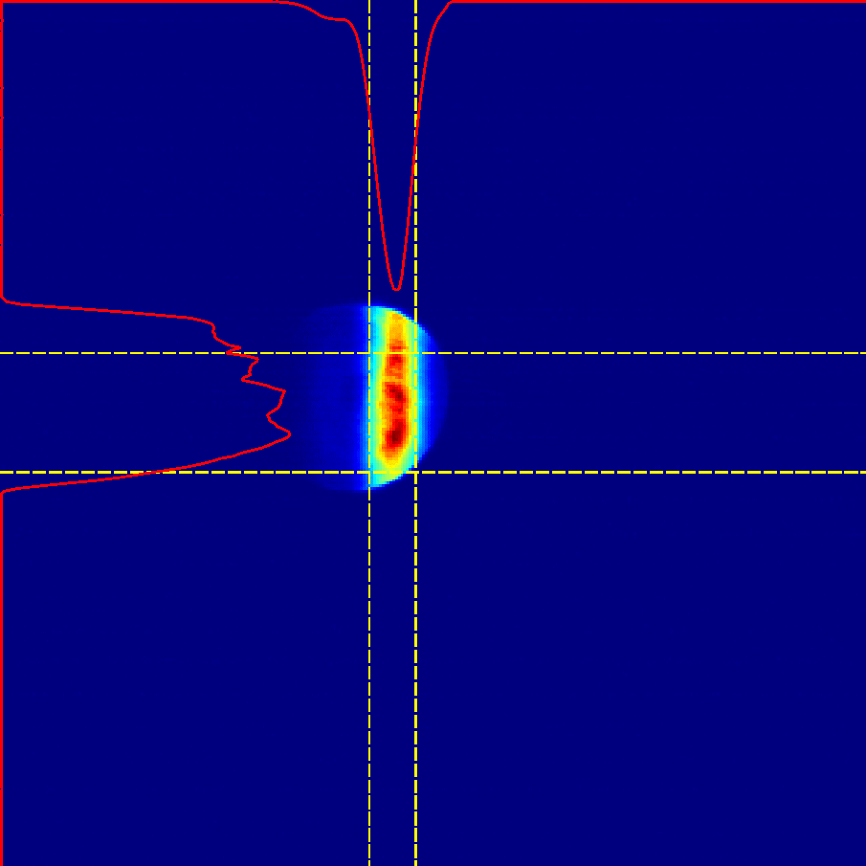
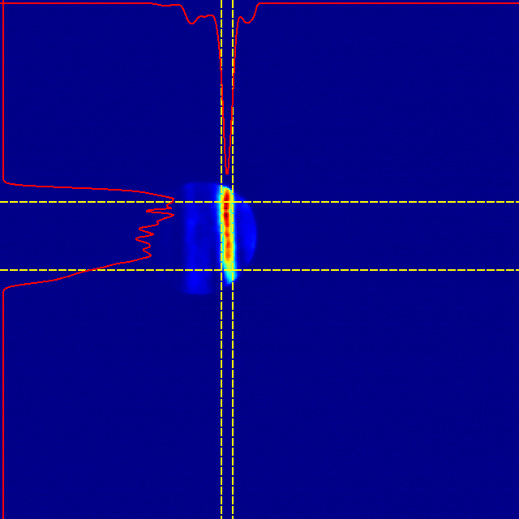
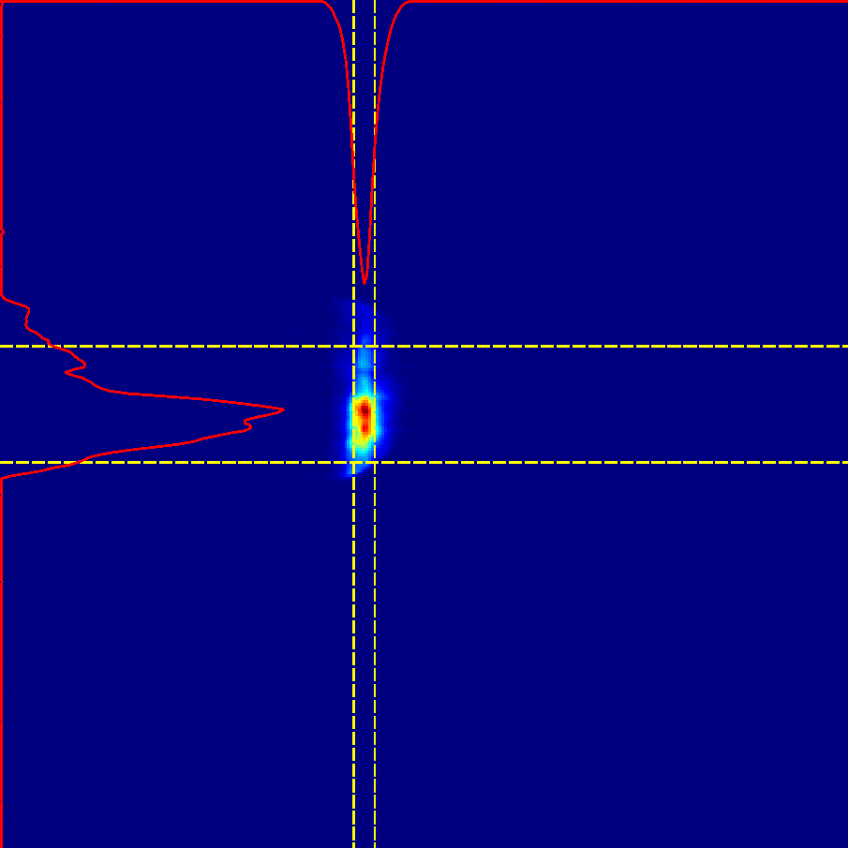
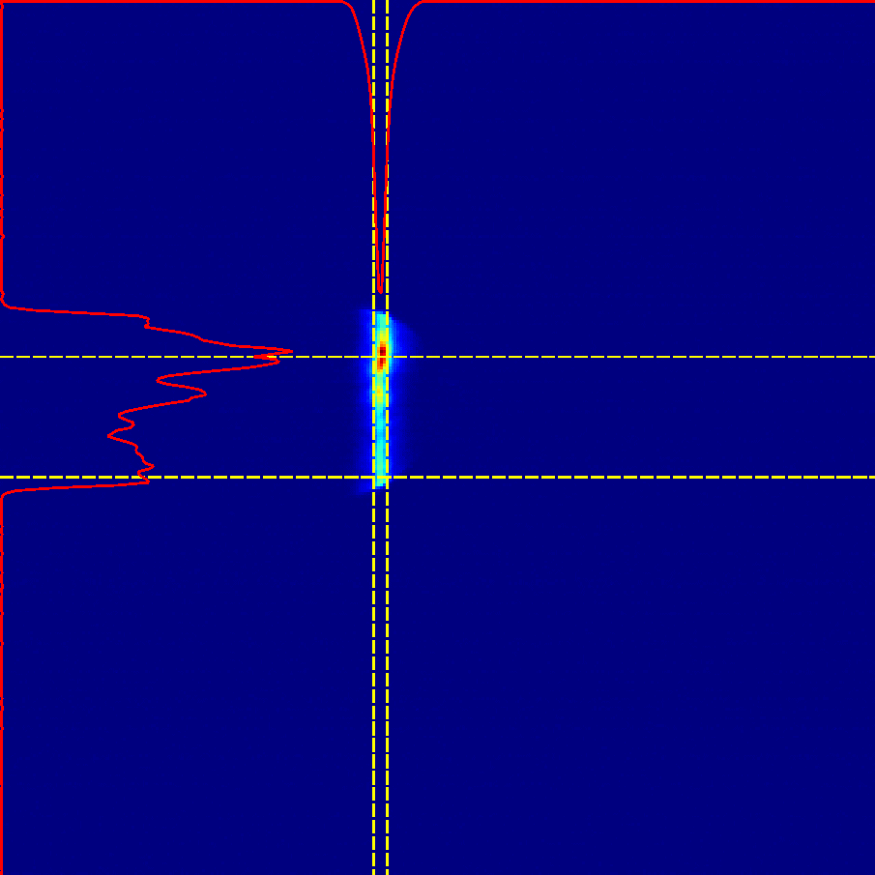
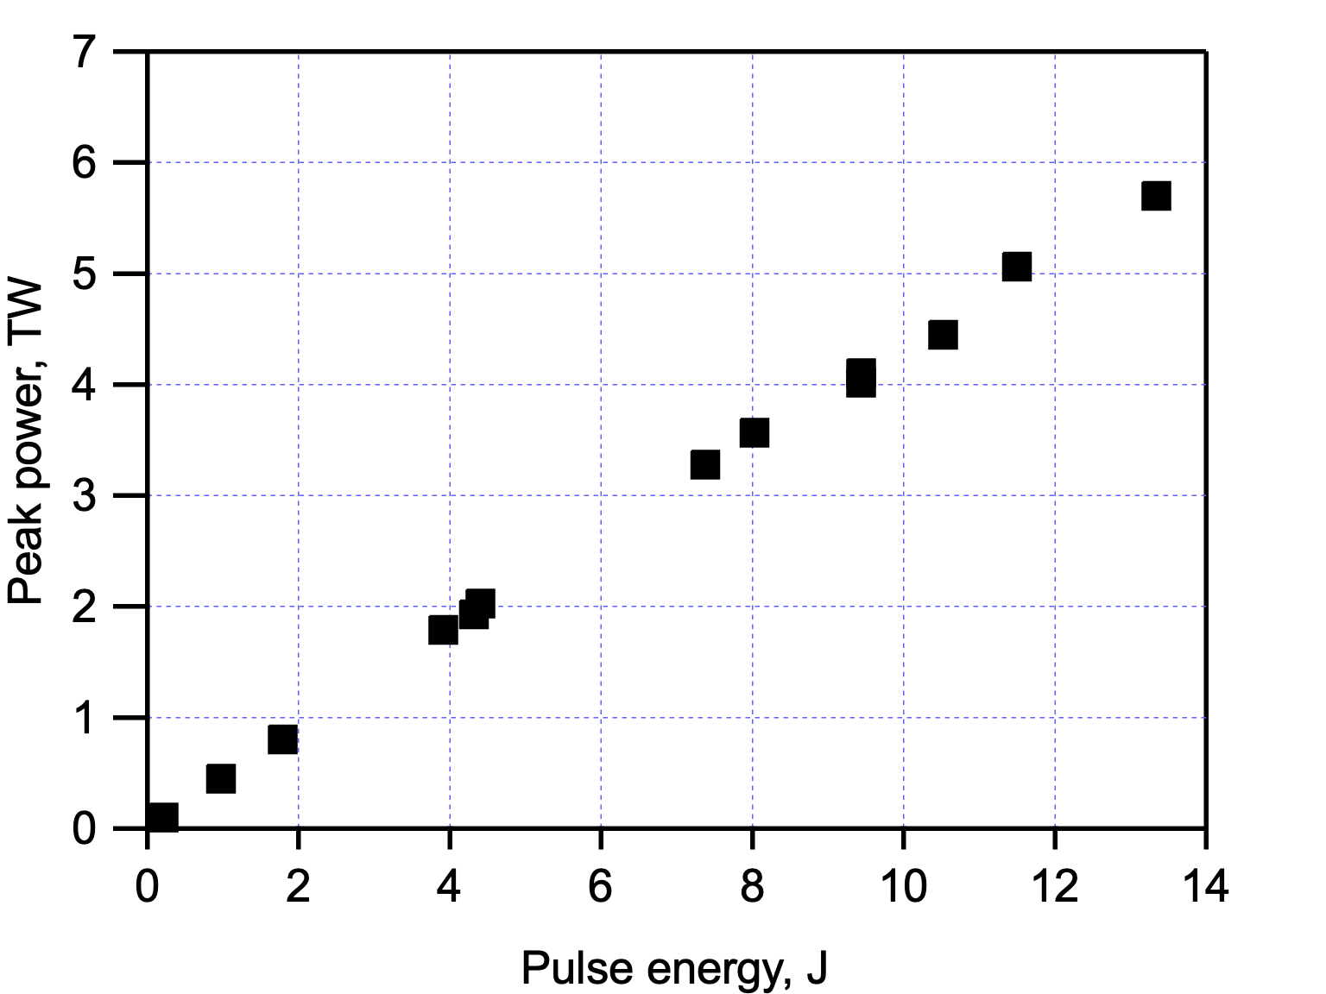
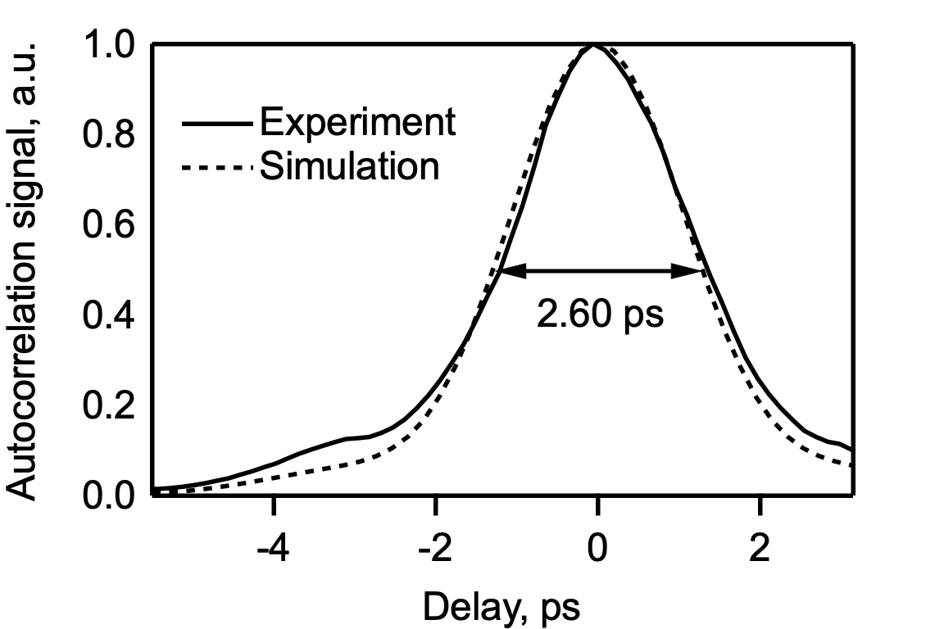
Recent Efforts – LWIR Systems
NLPC Proof-of-Principle
March 2019: 5TW, 2ps output
CPA-only @ 5 TW
NaCl + NaCl
ZnSe(30mm)
+ NaCl
ZnSe(6mm) + NaCl
0.80 ps
11

Slide 12
Recent Efforts – Ti:Sapphire Anticipated Parameters
A new Ti:Sapphire system built around a Coherent Vitara T oscillator is currently being commissioned in collaboration with NRL
Parameter | Units | Stage 1 – Commercial Preamp | Stage 2 – BNL Power Amp
Central Wavelength | nm | 800 | 800
FWHM Bandwidth | nm | 20 | 13
Maximum Compressed FWHM Pulsewidth | fs | 50 | 75
Chirped FWHM Pulsewidth | ps | ≥50 | ≥50
Chirped Energy | mJ | 10 | 200
Compressed Energy | mJ | 7 | 100
Minimum Energy Deliverable to Experiments | mJ | 4.9 | 80
Minimum Power Deliverable to Experiments | GW | 98 | 1067

Slide 13
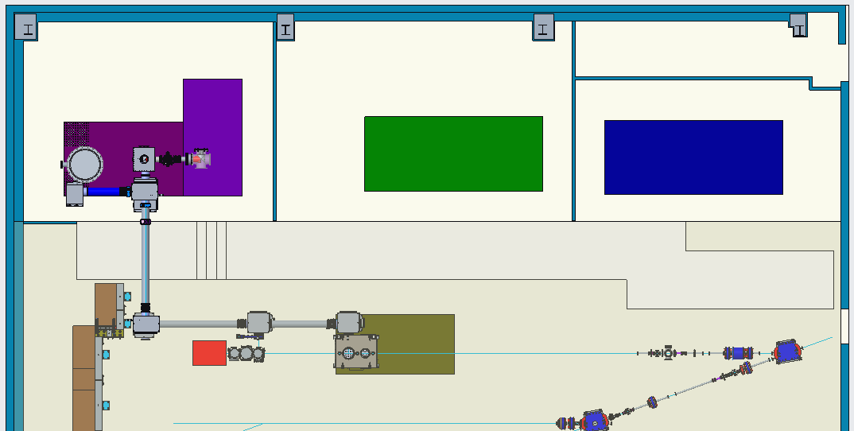
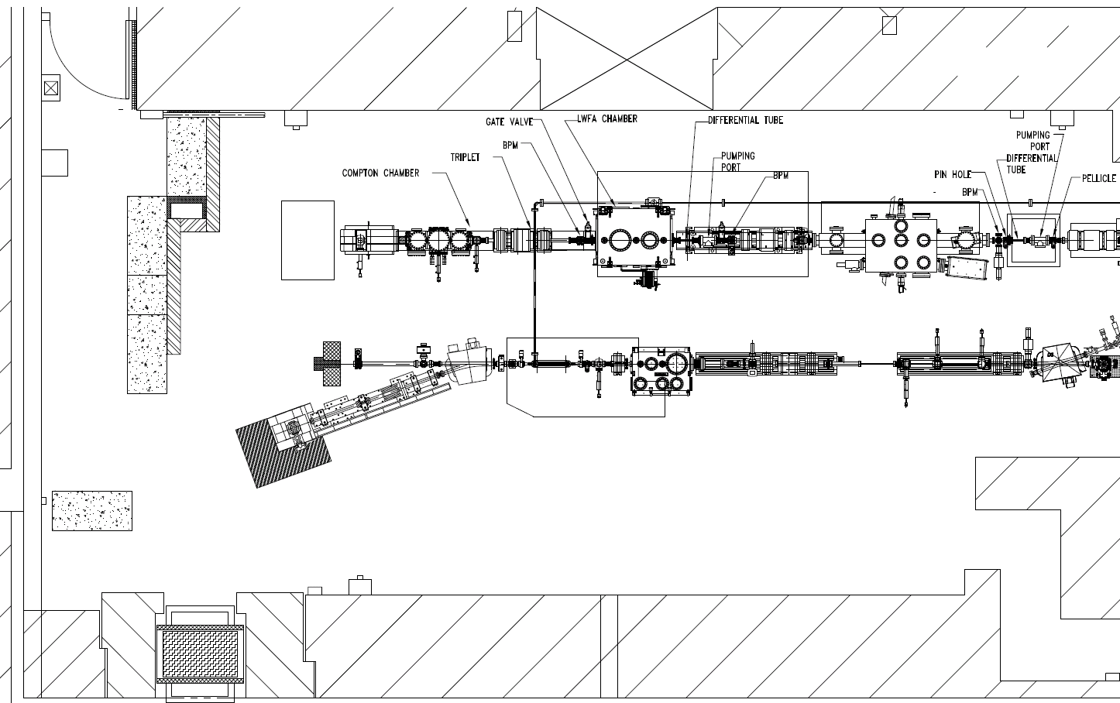
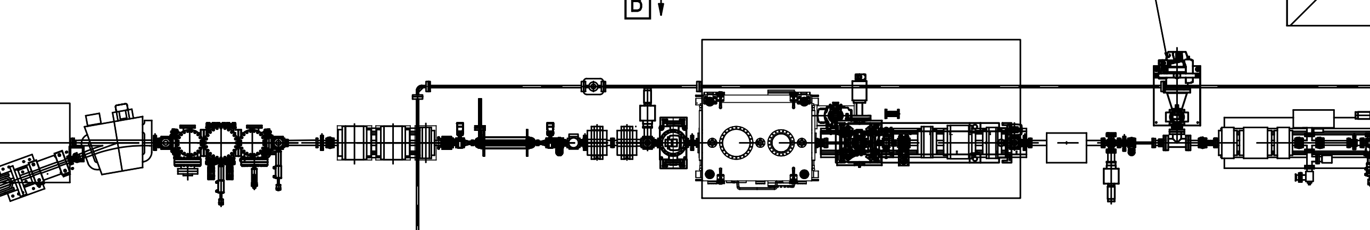
Recent Efforts – Electron Beam/Experimental Hall Improvements
Upgrades to ATF Experimental Hall
  In-vacuum laser transport for high peak power beams
  Optimize IP configuration for current experimental program
Exploration of new compression schemes to achieve σ < 10 fs
Implementation of e-beam diagnostic for plasmas
In-vacuum laser transport to User IPs
Labyrinth/Shielding
FY18 Experimental Hall Re-Configuration
BL1
DWF plates and
second bunch compressor
20° Leg of BL2

Slide 15
Focus of This Meeting
Re-visit the PRDs identified in 2017
  Provide input on how these can be prioritized at the ATF
Identify any critical PRDs for electron beam only
  Incorporate these into an overall prioritized plan
A report will be generated for review by the ATF Program Advisory Committee in December
  Navid Vafaei-Najafabadi (SUNY-SB and ATF Facility Scientist) will coordinate editing of the report
The ATF team will provide a prioritized plan to the APAC in December
The APAC considerations and recommendations will then go to DOE

Slide 16
Next Steps: Prioritize the ATF Development Thrusts
Developments Underway or Under Consideration
  LWIR Laser System
    Provide a full in-vacuum transport system - initially to deliver 5 TW and 2 ps beams with good quality to User IPs
    Non-linear materials R&D
    Non-linear pulse compressor development
      Alternative Method: Plasma compression effort led by NRL (AE89)
  NIR Laser Systems
  75 MeV Electron Beam
    Expanded Diagnostics
    Further beam compression (matching for e-beam + LWIR laser applications)
    Increased beam energy
  Combined capabilities
    Synchronization
    Diagnostic development
    Matched operating parameters
  Facility
    Improvements to make user operations more efficient and more effective

Slide 17
Targeted Outcomes from this Workshop
Key Questions for the ATF Science Planning Effort:
What are the most critical Science Thrusts for the facility over the next 4 years?
  To meet the needs of the community
  To guide prioritization of ATF R&D and upgrade efforts
  a Provide an updated list of Priority Research Directions spanning
    Laser research
    Electron beam research
    Laser + e-beam research
What are the most critical Facility Development Thrusts to pursue over the next 3 years?
  Key technologies to pursue (also those for longer-term needs)
  Supporting efforts to enable the science (e.g., simulation capabilities)
A key challenge will be the balance between Science Thrusts, Facility Development Thrusts and Available Funding

