Slide 1
The Future of Advanced Accelerator R&D
BNL-ATF Science Planning Workshop
October 15-17, 2019
Eric R. Colby
Senior Technical Advisor
Office of High Energy Physics, U.S. Department of Energy
Eric.Colby@science.doe.gov (301)-903-5475

Slide 2
Bottom Line Up Front
Advanced Accelerator R&D has important contributions to make
Compact Accelerators for science, security, medicine, industry
Ultrafast electron and photon probes for material science
Worldwide efforts have grown markedly
Laser centers have proliferated worldwide; many generate secondary particle beams
KPSI, RAL, Peking/IOP, L’OA/LULI, APRI, SIOM/SULF, APOLLON, ELI(3), …
A number of linac-based facilities are also operating or under construction
The US context is shifting
The Agencies have quite different funding strategies and aims
DOE builds and operates big instruments; NSF swings for the fences; Applied agencies ‘forage for technology’
Community Roadmapping and Workshops
GARD Strategy for Advanced Accelerators; NAS Study; Compact Accelerators BRN
A significant constellation of facilities
BELLA, Jupiter, TX-PW, CSU, U MI, UNL, UMD; FACET-II, AWA, NLCTA, UCLA(3); FAST-IOTA, UMER, CBETA,…
What we need from this workshop
Looking for ideas to advance AA R&D, and thoughts on facilities needed to support the R&D
Science opportunity must be commensurate with facility and R&D cost
Cannot spend our way out of this, cannot afford dead end investments
Need great ideas; need to work together to combine unique technical strengths

Slide 3
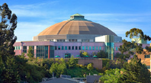
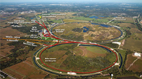
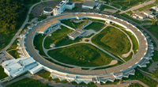
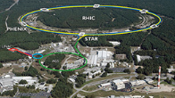
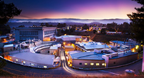
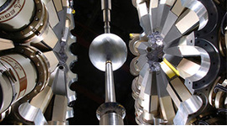
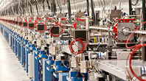
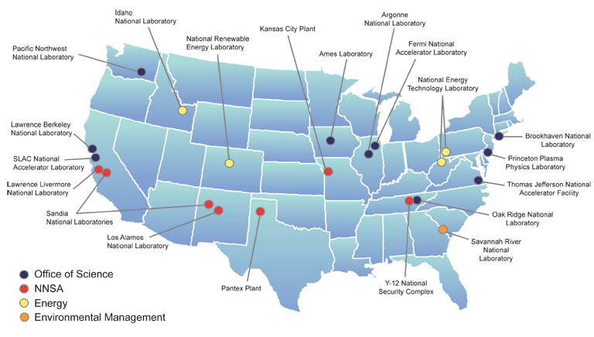
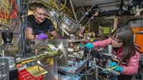
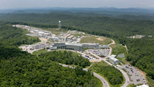
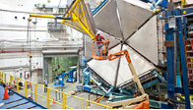
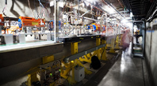
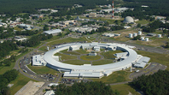
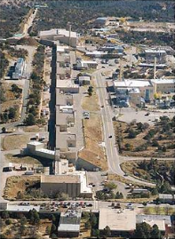
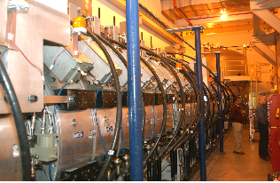
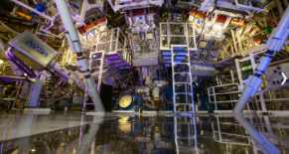
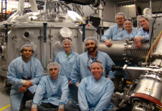
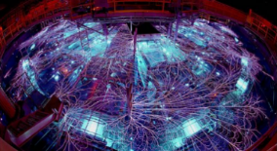
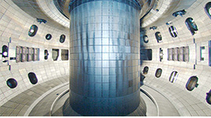
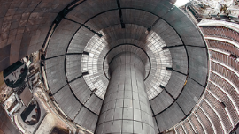
DOE Operates 17 National Laboratories
Particle Accelerators & Related Technology is at the Core of 14 National User Facilities and 5 National Security Facilities
Advanced Light Source
Fermilab Accelerator Complex
Advanced Photon Source
Relativistic Heavy Ion Collider
Stanford Synchrotron Radiation Light Source
ATLAS
Linac Coherent Light Source
BNL Accelerator Test Facility
Spallation Neutron Source
Continuous Electron Beam Accelerator Facility
FACET Beam Test Facility
National Synchrotron Light Source II
LANSCE
DAHRT
NIF
JUPITER
Z Machine
DIII-D
NSTX-U

Slide 4
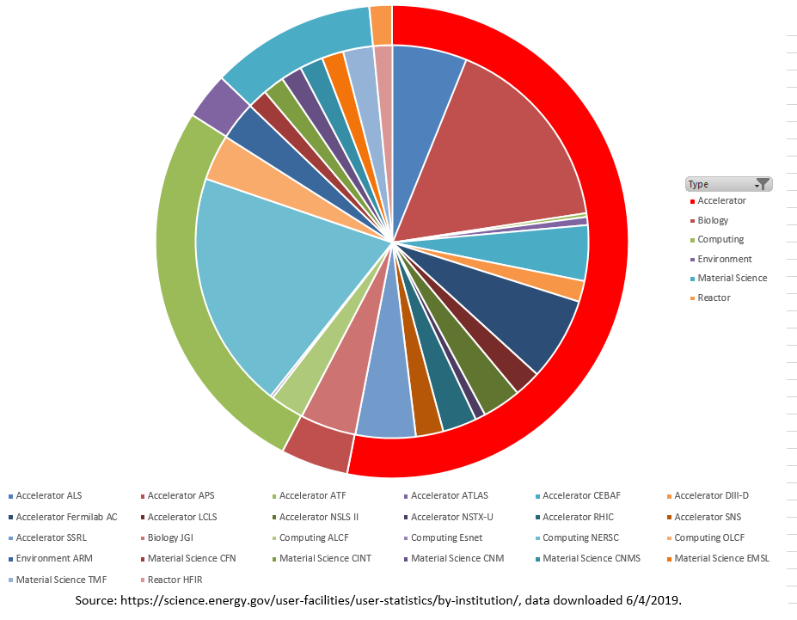
Over Half of All Office of Science Facility Users Depend on Large Accelerator-Based Scientific Instruments
Material Science and
Environment Facilities
Reactor
Accelerator Facilities
18,474 users
Fraction of Users at Each Facility (and by type of facility)
34,823 users in 2017
Ring Legend (Type)
Computing Facilities
9,168 users
Biology Facility
Pie Chart Legend (Facility Name)

Slide 5
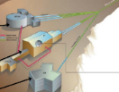
The Leadership of Future DOE Science Facilities Rests Heavily on Accelerator S&T Advances
OPERATING NOW
Basic Energy Sciences
Fusion
High Energy Physics
Nuclear Physics
National Security
Advanced Light Source
Advanced Photon Source
National Synchrotron Light Source II
Stanford Synchrotron Radiation Light Source
Linac Coherent Light Source
Spallation Neutron Source
DIII-D
Fermilab Accelerator Complex
FACET Beam Test Facility
BELLA
BNL Accelerator Test Facility
ATLAS
Relativistic Heavy Ion Collider
Continuous Electron Beam Accelerator Facility
DAHRT
NIF
LANSCE
NSTX-U
JUPITER
2-5 Years
FACET-II
MPEX
HL-LHC
Z Machine
APS-Upgrade
LCLS-II
BELLA-Staging
SNS-PUP
FRIB
Scorpius
5-10 Years
PIP-II
ALS-Upgrade
SNS-STS
EIC
LCLS-II-HE
K-BELLA-Power
>10 Years
FRIB 400 MeV/u Upgrade
MaRIE
SPARC?
Terawatt XFEL
PIP-III
XFEL Oscillator
ITER
HE-LHC

Slide 6
Several areas of Accelerator Technology have Significant Leverage Across DOE’s Mission Space
Advances in superconducting accelerator systems—both radiofrequency accelerators and high field magnets—are a prominent theme shared by all four offices. Advances in superconducting materials, engineering, and cryogenic techniques will expand the capabilities and lower the operating cost of superconducting-based accelerator facilities.
Beam physics and high fidelity computer modeling, together with better diagnostics and advanced control systems—are also a prominent theme shared by all four offices. Advances in theory and simulation to accurately model the next generation of particle accelerators need to be matched by better diagnostics and more sophisticated (and automated) control systems. Advances in particle-collider-specific beam physics including focusing and advanced cooling techniques are essential for HEP and NP science.
Advances in very high brightness and high current electron sources and in high intensity proton and ion sources benefit BES, HEP, and NP science by increasing usable data and extending sensitivity. More robust megawatt-class targets for secondary beam production similarly will benefit the science.
Higher average power radiofrequency and ultrafast laser sources becoming increasingly important to all four offices as time progresses. With improvements in power sources must come improvements in power handling devices—waveguide windows and couplers for radiofrequency systems, high power optics and coatings for laser systems, and high accuracy x-ray optics.
In the future, high-risk high-reward advances in particle sources, beam dynamics (e.g. integrable optics, HPC simulations), acceleration techniques (e.g., plasma wakefield), and materials (e.g., HTS superconductors) will provide the transformative advances needed to keep U.S. facilities at the forefront.

Slide 7
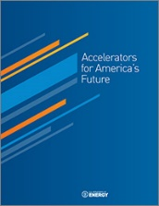
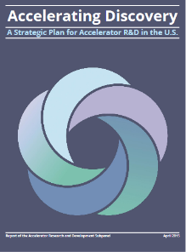
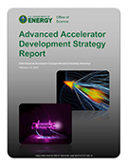
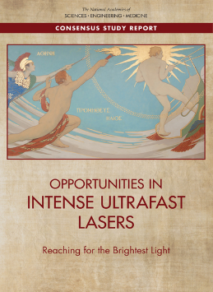
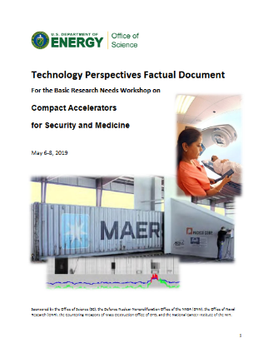
Strategic planning through community-based processes
Accelerators for America’s Future (2009)
Very broad survey uses of accelerators and R&D needs
P5 (2014)/GARD Subpanel (2015)
Mapped out HEP-specific needs and goals
GARD Roadmap Workshop on Advanced Accelerators (2016)
Identified technical goals for PWFAs and TBAs on 10- and 30-year horizons
NAS Brightest Light Study (2018)
Science and Technology of Ultraintense Lasers
BRN on Compact Accelerators for Security and Medicine (2019)
Mostly about 5-year, TRL-4 horizon
Included look-ahead in advanced technology

Slide 8
For your consideration
DOE and the ATF are looking to you—the community—for advice on the next steps
What high-impact science can be done with transformative (e.g. x2, x10) extensions in capabilities?
What is the logical order for this science to progress?
Which provides the best science opportunities: Increased Rep Rate, Peak Power, Intensity, Contrast, Mode Quality…
A 1 TW laser operating at 10 Hz, or a 20 TW laser operating at 0.05 Hz?
A 20 J, 2 psec laser or a 2 J, 200 fsec laser? (same peak P)?
A 20 TW laser with M²=5 or a 1 TW laser with M²=1.2? (~same peak I)
How much must the following S&T areas also advance to make effective use of enhanced capabilities:
Optics, experimental techniques, diagnostics, simulations?

Slide 9
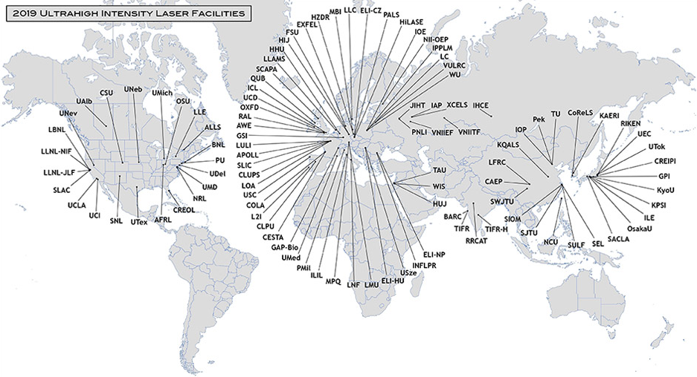
Intense Laser Labs Worldwide
https://www.icuil.org/activities/laser-labs.html accessed 10/11/2019.

Slide 10
Closing Thoughts
In a world that has more than 70 large laser research centers, what are the unique opportunities at Brookhaven?
What science is more readily accessible at 10 microns?
What is the impact of this science?
What science can be done more easily (or earlier) at ATF than elsewhere?
How long will it take for a “turn-key” laser-only electron injector to be developed at 10 microns?
Please don’t focus on designing a facility that you think Uncle Sam can afford. Such answers are rooted in the perceptions of a specific point in time and become quickly out-of-date.
Please do tell us what great science can be done. The answer to this question will be valuable regardless of budget circumstances.
Thank you for your participation--your input is a critical part of planning national R&D resources!

Slide 11
Bottom Line
Advanced Accelerator R&D has important contributions to make
Compact Accelerators for science, security, medicine, industry
Ultrafast electron and photon probes for material science
Worldwide efforts have grown markedly
Laser centers have proliferated worldwide; many generate secondary particle beams
KPSI, RAL, Peking/IOP, L’OA/LULI, APRI, SIOM/SULF, APOLLON, ELI(3),
A number of linac-based facilities are also operating or under construction
The US context is shifting
The Agencies have quite different funding strategies and aims
DOE builds and operates big instruments; NSF swings for the fences; Applied agencies ‘forage for technology’
Community Roadmapping and Workshops
GARD Strategy for Advanced Accelerators; NAS Study; Compact Accelerators BRN
A significant constellation of facilities
BELLA, Jupiter, TX-PW, CSU, U MI, UNL, UMD; FACET-II, AWA, NLCTA, UCLA(3); FAST-IOTA, UMER, CBETA,…
What we need from this workshop
Looking for ideas to advance AA R&D, and thoughts on facilities needed to support the R&D
Science opportunity must be commensurate with facility and R&D cost
Cannot spend our way out of this, cannot afford dead end investments
Need great ideas; need to work together to combine unique technical strengths

