Slide 1


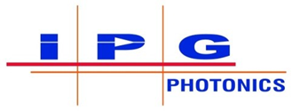

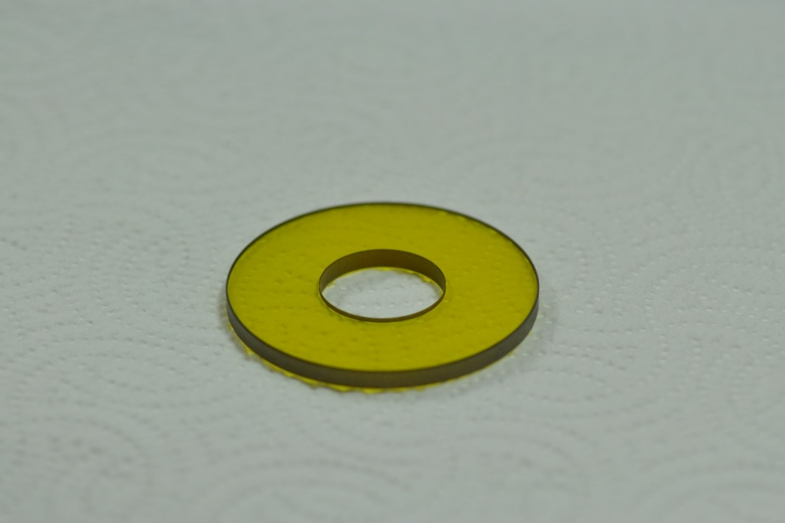
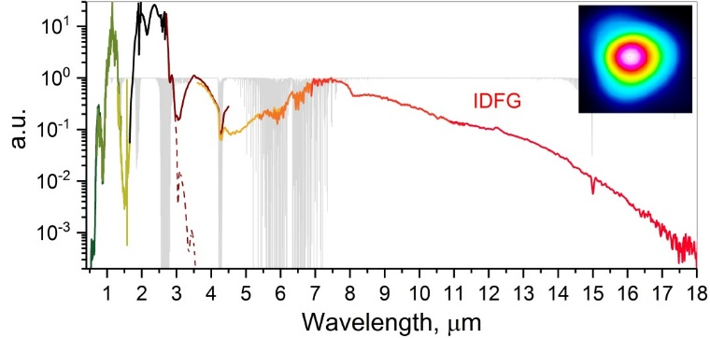






Frontiers of mid-IR lasers based on transition metal doped chalcogenides.
Optically Pumped CO₂ Lasers and Amplifiers
S. Mirov^{1,2}, D. Martyshkin,¹ V. Fedorov,¹ K. Karki,¹
I. Moskalev², S. Vasilyev², M. Mirov², J. Peppers², V. Smolski²
D. Tovey,³ J. J. Pigeon,³ S. Ya. Tochitsky,³ I. Ben-Zvi,⁴ and C. Joshi³,
I. Pogorelsky⁵, M. Polyanskiy⁵
¹Department of Physics, University of Alabama at Birmingham, CH 310, 1300 University Blvd., Birmingham, AL 35294, USA
²IPG Photonics - Southeast Technology Center, 100 Lucerne Ln, Birmingham, Al 35211, USA
³University of California, Los Angeles
⁴Stony Brook University
⁵Brookhaven National lab
Author e-mail address: mirov@uab.edu
Funding:
The work reported here partially involves intellectual property developed at the University of Alabama at Birmingham (UAB). This intellectual property has been licensed to the IPG Photonics Corporation. The UAB co-authors declare competing financial interests.
Department of Energy (DOE) Office of Science Accelerator Stewardship award (DE-SC0018378)
October 15, 2019 ATF Science Planning Workshop, LWIR Laser Capabilities

Slide 2
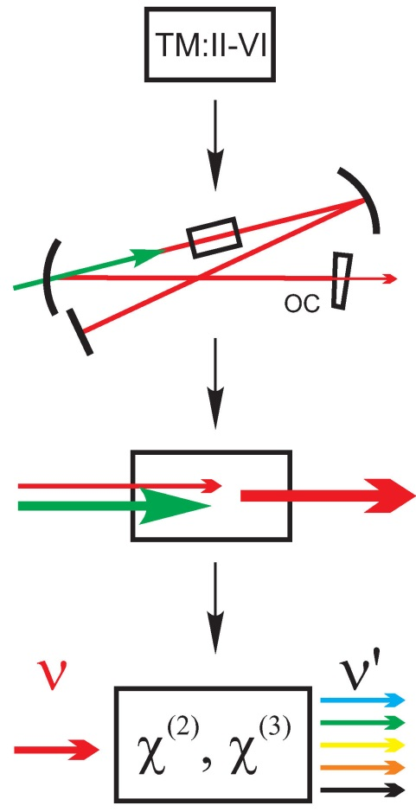
Outline
Motivation. Why Optically pumped CO₂ lasers/amplifiers
TM:II-VI MIR laser materials introduction (Fe:Cr:ZnS/ZnSe )
Cr:ZnS/ZnSe oscillators and amplifiers
Fe:II-VI oscillators and amplifiers at 4-5 μm
Fe:ZnSe pumped CO₂ lasers/amplifiers
Conclusions and Outlook
001
10 μm
4.3 μm
100
000
CO₂ Levels

Slide 3
Ultrafast MIR laser sources : Motivation and Technologies
Goal: produce high power (1 TW), short (<1 ps) pulses in LWIR
Down conversion of near-IR lasers (Ti-S, Yb, Er) in χ⁽²⁾, χ⁽³⁾ materials
Well established near-IR fiber, bulk, thin disk fs lasers
Well established conversion techniques: OPCPA, DFG, OPO, SCG.
Complex setups, difficult to remain efficient for λ > 5 µm
Direct fs lasing in the MIR + OPCPA, DFG, OPO, SCG
Most compact, efficient, and high power fs sources
2 µm Tm-, Ho-doped bulk, thin disk,
silica-based fiber lasers
3 µm Er-, Ho-doped fluoride-based fiber lasers
2—3 µm Cr:ZnS and Cr:ZnSe lasers
3.4—5 µm Fe:ZnS and Fe:ZnSe lasers
4—8 µm Fe:CdZnTe lasers
I. Pupeza et al., Nature Photon. 9, 721 (2015).
J. Zhang et al., Light: Science &
Applications 7, 17180 (2018)
M. Gebhardt et al., Opt. Lett. 42, 4179 (2017)
S. Mirov et al., IEEE JSTQE 24, 1601829 (2018)
A. Ongstad et al., SPIE Defense and Security, 2018
- A.D. Martinez et al., Opt. Mat. Express 5(9). 2036-2046 (2015).
Room-temperature cross-sections of emission of
(i) Cr:ZnS, ii) Cr:ZnSe ; iii) Fe:ZnS, iv) Fe:ZnSe,
v) Fe:Cd_{0.75}Mn_{0.25}Se, vi) Fe:CdTe,
vii) Fe:Zn_{0.5}Cd_{0.5}Te, and viii) Fe:Cd_{0.5}Mn_{0.5}Te
55-80 μs radiative lifetime - High energy storage capability. Promising mid-IR amplifiers of ns-fs pulses!

Slide 4
Alternative approach - optically pumped high pressure CO₂ lasers/amplifiers
High pressure is needed for broad bandwidth amplification to broaden rotational spectral lines. Very difficult to operate electric discharge pumped CO₂ lasers at high pressure.
Our solution: optically pumped CO₂ lasers
O
C
O
Boltzman Distribution
10 μm
Δν_{col}=3.5 GHz x atm
00⁰1
9 μm
4.3 μm pumping
10⁰0
At 10 atm 2x35 GHz > 55GHz line spacing
02⁰0
00⁰0
~20 atm CO₂
is desirable but
super difficult by
e⁻ discharge
Δν~1.2THz
Normalized Ampl..
Wavelength (μm)

Slide 5
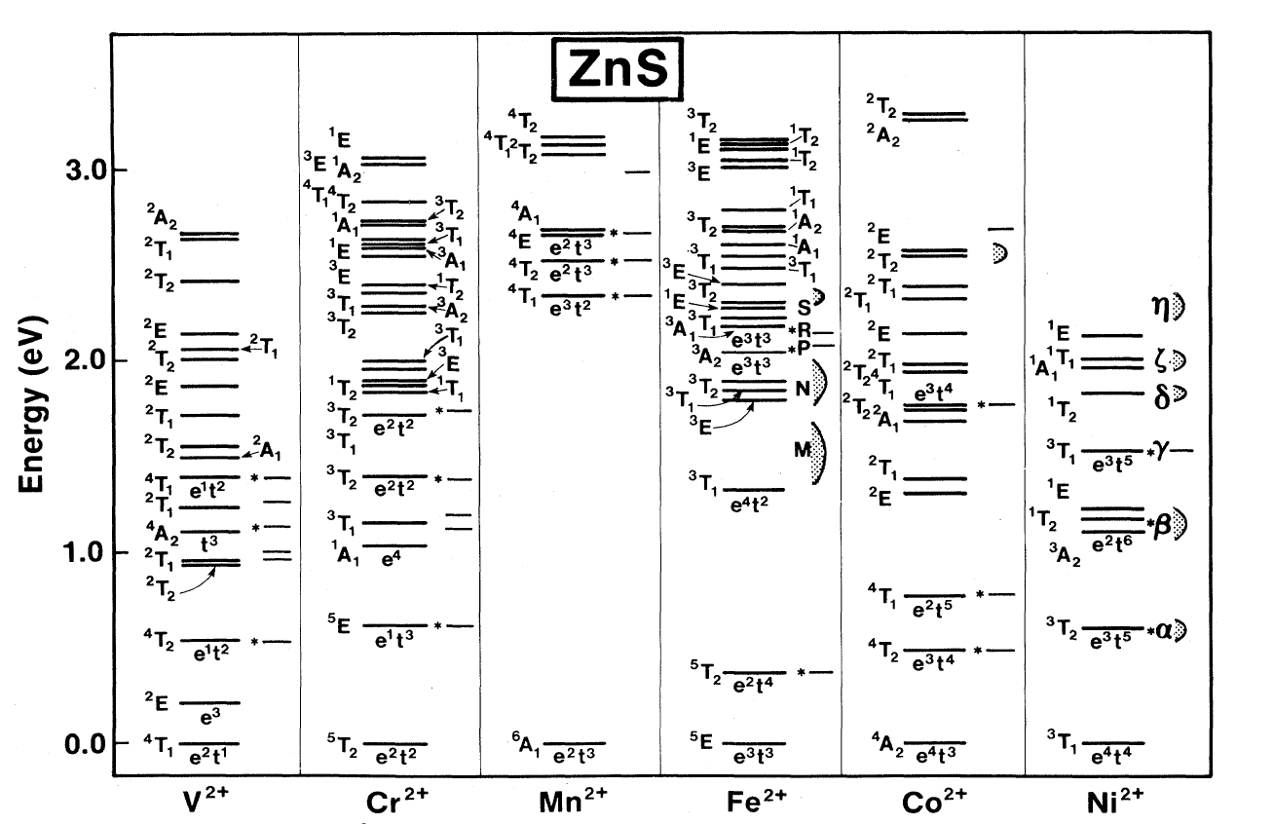
TM:II-VI materials: Introduction
TM dopants: Cr²⁺, Fe²⁺, Co²⁺, V²⁺, Mn²⁺, Ni²⁺
II-VI compounds: ZnSe, ZnS, CdSe, CdS, ZnTe,
CdMnTe, CdZnTe, ZnSSe
Typical representatives: Cr and Fe doped ZnS and ZnSe
Features of II-VI semiconductors
Wide bandgap
Low phonon cutoff
Tetrahedral coordination
Features of Cr²⁺ and Fe²⁺ dopants
‘Right’ multiplet structure
Broad absorption and emission bands
High cross-sections
Absence of excited state absorption
Energy Structure of Transition Metal Ions in ZnS
DeLoach et al., IEEE J. Quantum Electron., 32, 885 (1996).
S. Mirov et al., IEEE JSTQE 24, 1601829 (2018)
TM:II-VI crystals being mid IR analogs of Ti:S are unique solution for Mid-IR Lasing

Slide 6
Cr doped ZnSe and Cr:ZnS
Fe doped ZnSe and ZnS
Key Advantages
Access to 1.8 – 3.4 µm range
Convenient pumping by
Er-, Tm- fiber lasers
Potentially electrically pumped
Room temperature operation
Other Features
Supports all laser regimes
cw, ms, µs, ns, ps, fs
Direct pumping by laser diodes
Cr:ZnS (vs. Cr:ZnSe)
Very similar spectroscopically
Better thermo-optics
Broader bandgap (3.9 vs. 2.7 eV)
Lower nonlinearity (4 vs. 15 pm/V)
Key Advantages
Access to 3.4 – 5.2 µm range
Pumping by Cr:ZnS/ZnSe lasers
Other Features
Pumping at 2.94 µm by Er:YAG lasers
Pumping at 2.7 µm by HF lasers
Supports all laser regimes
cw, ms, µs at T < 220 K
ns at room temperature
mode-locked [work in progress]
60 μs lifetime – high energy storage capability.
Q-switching and amplification of ns-fs pulses in the mid-IR
Fe:ZnS vs. Fe:ZnSe
Very similar spectroscopically

Slide 7
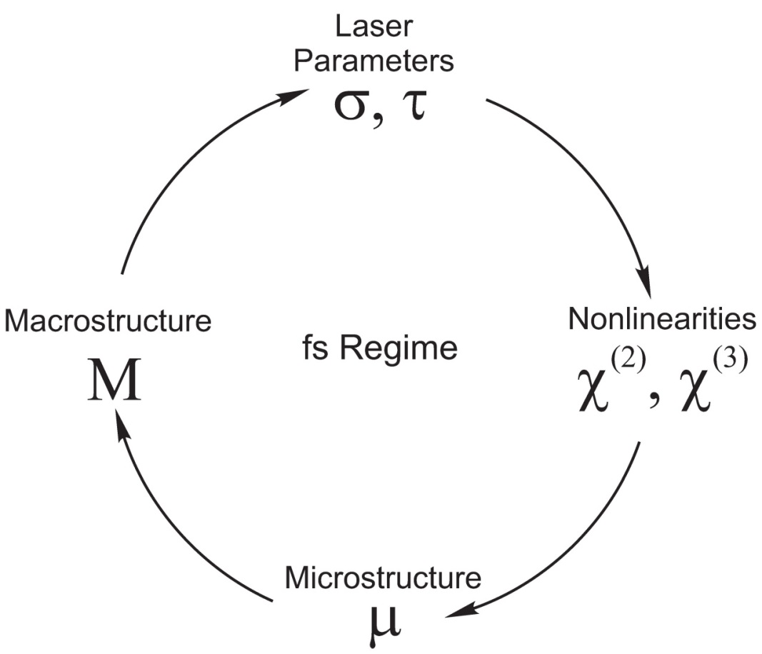
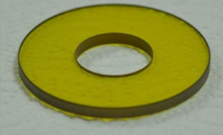
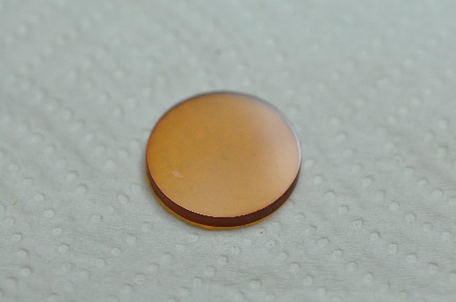
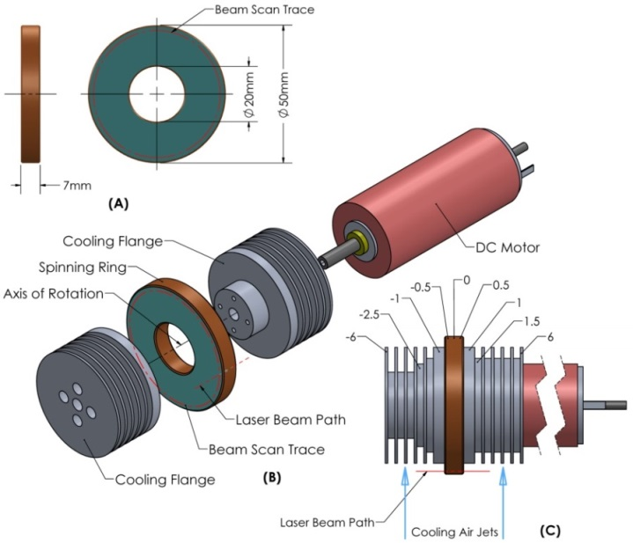
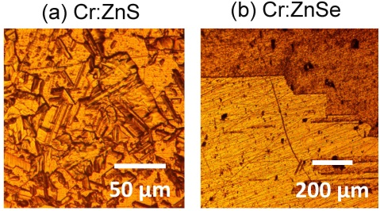
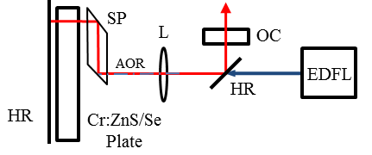
Polycrystalline Cr²⁺:ZnSe, Cr²⁺:ZnS and Fe:ZnSe: Unique combination of parameters
Superb ultra-fast laser capabilities are blended with
High nonlinearity of II-VI semiconductors
Controllable polycrystalline microstructure that enables random quasi-phase matching (RQPM)
Fabrication technology that
enables power scaling
Spinning ring – spinning cavity oscillator/amplifier platforms to control thermal management
I. Moskalev et al., Opt. Express 24, 21090 (2016)
S. Mirov et al., IEEE JSTQE 24, 1601829 (2018)

Slide 8
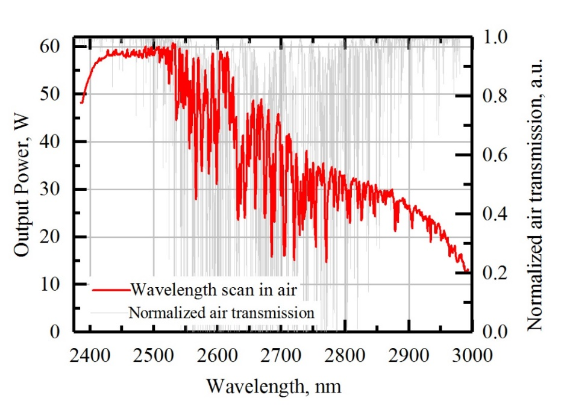
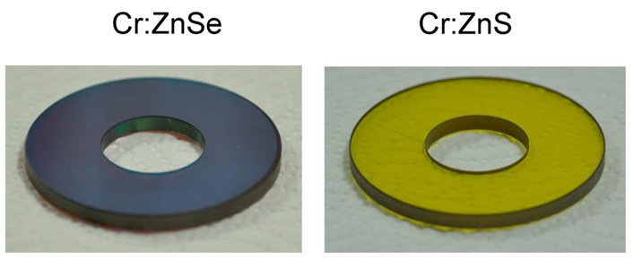
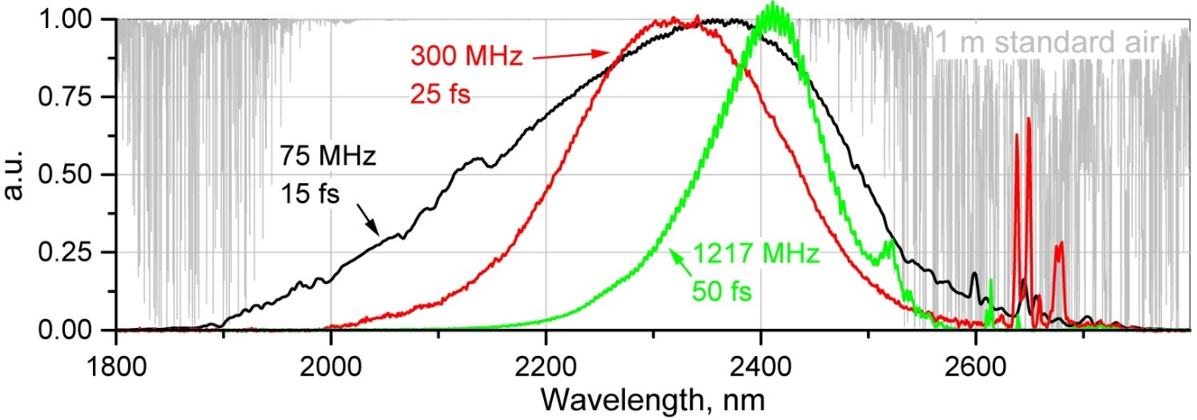
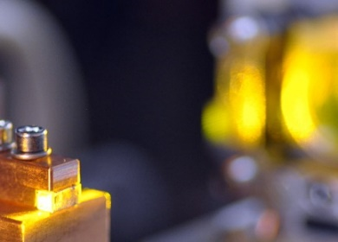
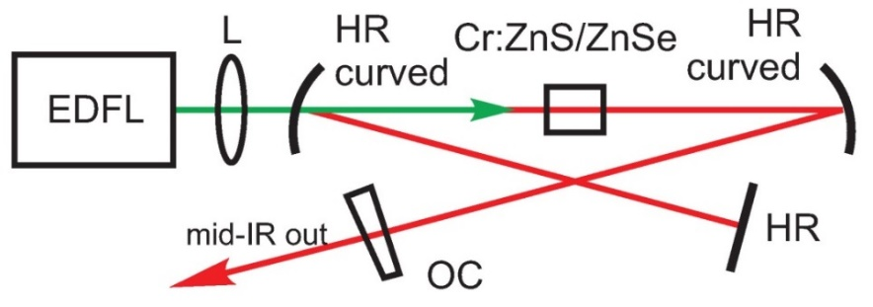
Cr:ZnS/ZnSe lasers at 2-3 µm: State-of-the-art
CW regime
140 W (spinning ring technology, μ=62%)
ms, and µs pulses
1.1 J (at 0.1 Hz rep rate)
ns pulses
20 mJ (at kHz rep rate)
fs pulses
Highest average power 30 W
Highest peak power 8 MW
Highest pulse energy 400 nJ
Broadest range of repetition rates 75 MHz – 1.2 GHz
2 optical cycles (at multi-Watt power)
20 – 25% conversion efficiency
5 GW (1 mJ, 100 fs) Cr:ZnSe CPA
Typical tuning curve of cw oscillator

Slide 9
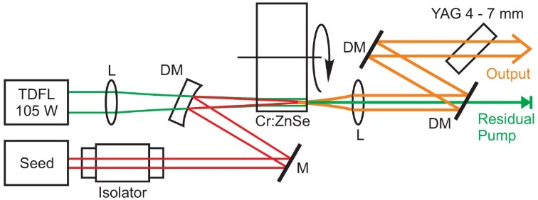
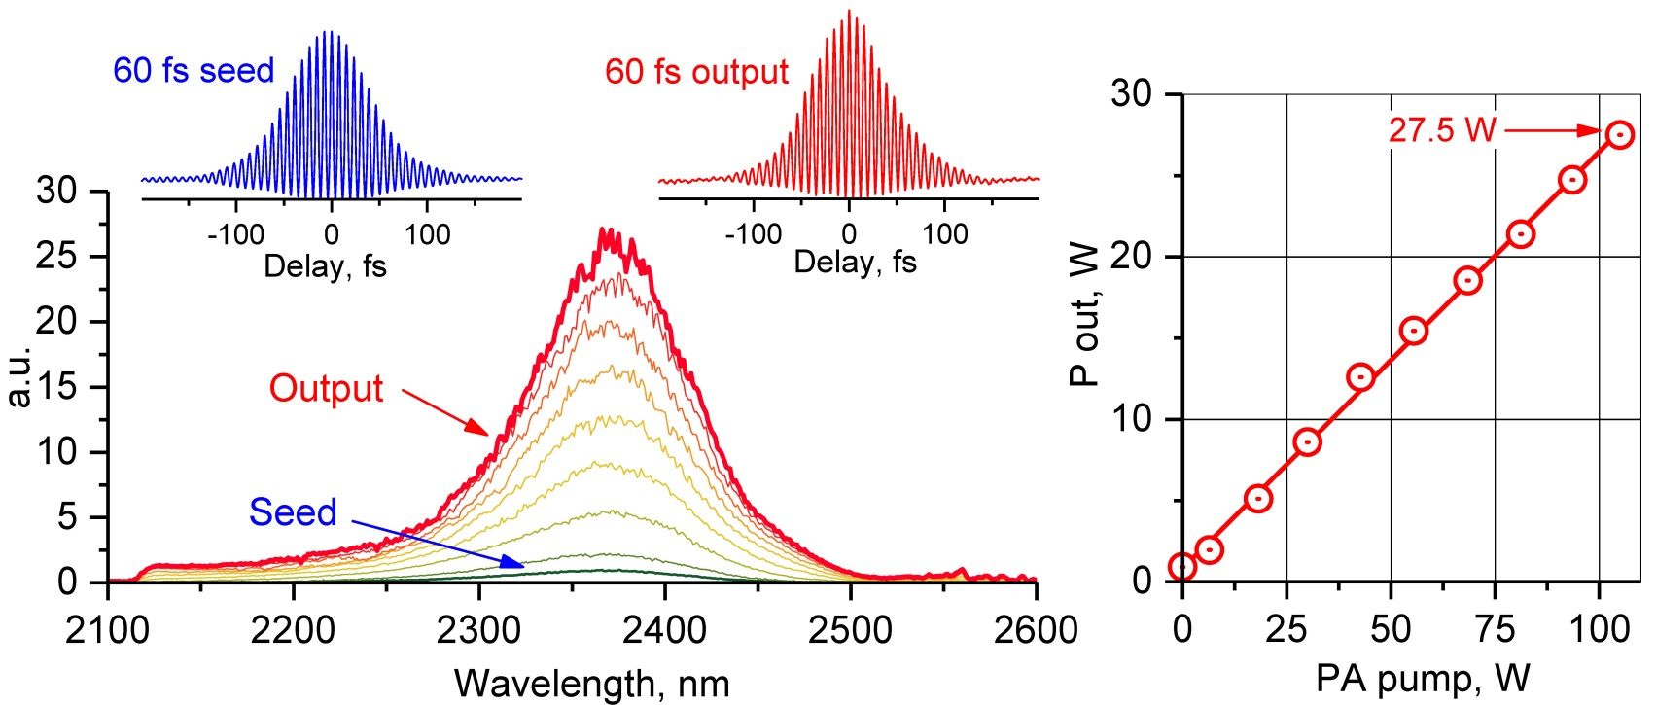
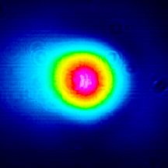
SR Cr:ZnSe amplifier: Optimization for high average power
Output parameters of multi-cycle Spinning Ring Cr:ZnS + Cr:ZnSe MOPA
Seed pulses: 60 fs (8-cycle), 11 nJ at f = 81 MHz, P = 0.9 W
Output pulses: 60 fs, 0.34 µJ, P = 27.5 W, P_{Pk} = 5 MW
Cw TDFL → fs MIR conversion: 25% efficiency at G = 31
Measured output parameters of 28 W 60 fs SR MOPA

Slide 10
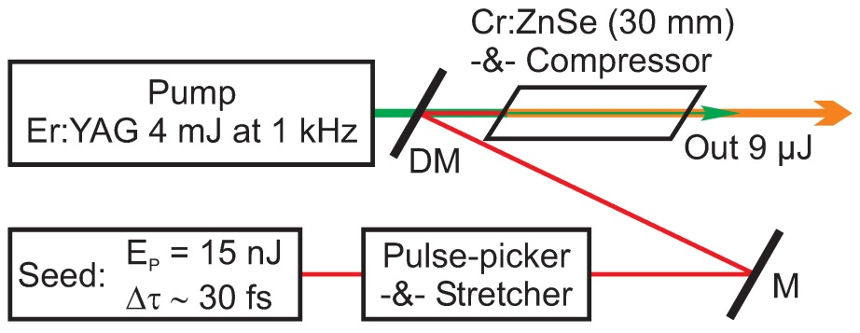
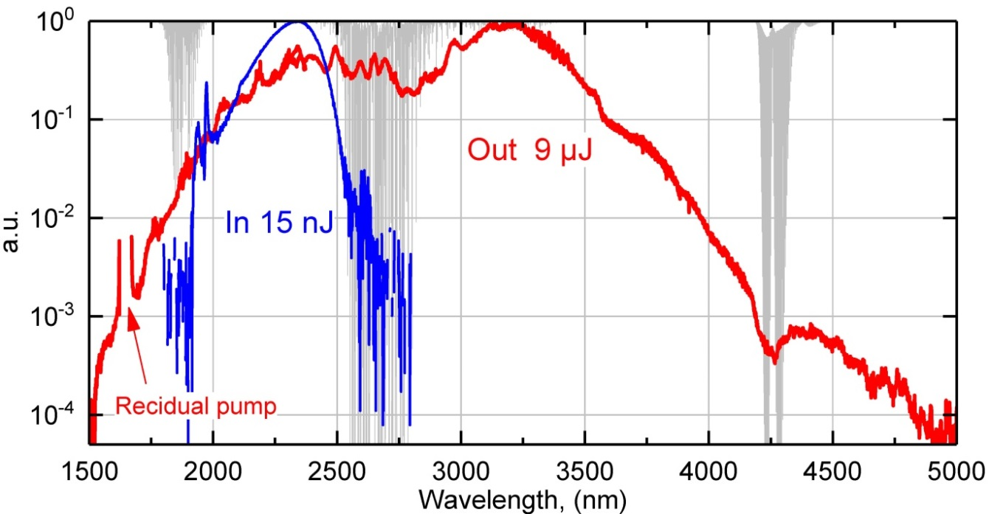
Single-pass energy amplifier (Cr:ZnSe) with high nonlinearity
Goal: Sub-two-cycle MIR pulses
Features of single-pass Cr:ZnSe
energy amplifier
Seed pulses: 30 fs, 15 nJ, down-picking to 1 kHz
High single-pass gain (30 dB) +
fs-SCG in bulk medium
Output pulses: 9 µJ with
Δν = 41 (110) THz
Options for recompression to sub-2-cycle pulses with P_{Pk} = 1 GW
Schematic of single-pass energy amplifier
Measured spectra of seed (blue) and output (red) pulses

Slide 12
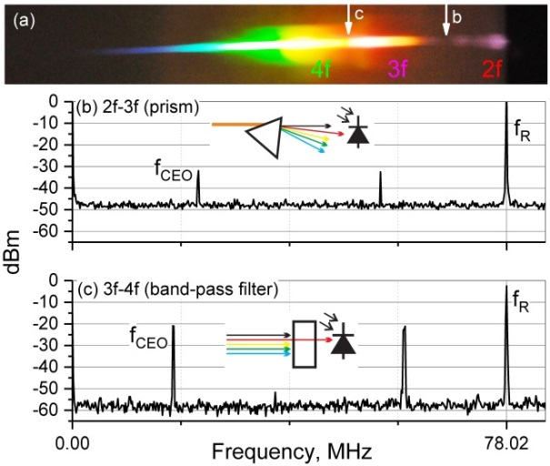
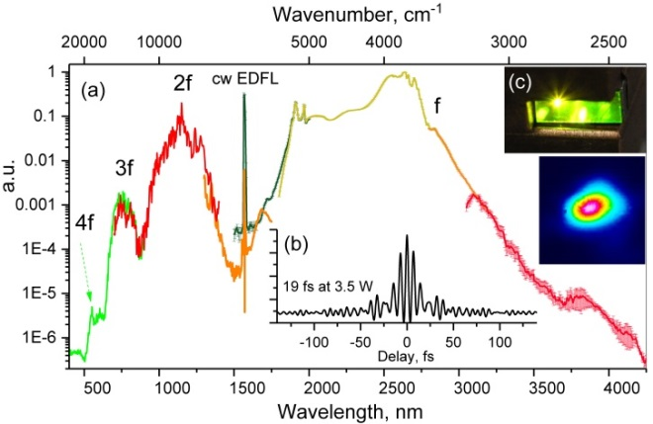
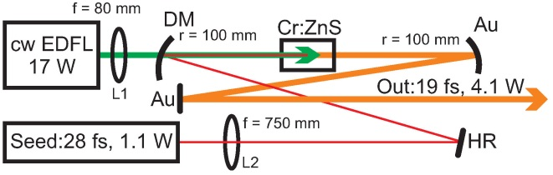
Single-pass Cr:ZnS/Se amplifiers : Enabling Technology
↑ Detected f_{CEO} signal↑
Simultaneous amplification, SCG, three-wave mixing via RQPM
Multi-octave frequency combs with Intrinsic nonlinear interferometry
↑ Spectrum of 3-octave VIS to MIR continuum ↑
Laser setup
S. Vasilyev et al, Optica 6(2), 126 (2019).

Slide 13
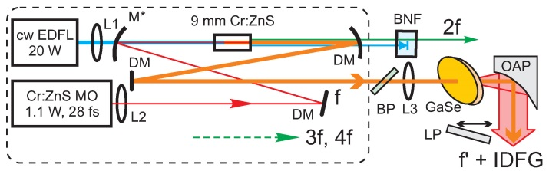

Multi-Octave visible to long-wave IR femtosecond continuum generated in Cr:ZnS-GaSe tandem
Intrapulse DFG with Cr²⁺-based lasers
Perfect match for ZGP, GaSe, OP-GaP
Enables exceptionally efficient IDFG >5% in ZGP)
Enables exceptionally broadband
and flexible IDFG (GaSe)
S. Vasilyev, et al., Optica 6(1), 111 (2019)
S. Vasilyev, et al., Optica (memorandum), 6(2), 126 (2019)
The obtained average power levels include several mW in the 0.4–0.8 µm visible, 0.23 W in the 0.8–2 µm near-IR, up to 4 W in the 2–3 µm IR, and about 17 mW in the 3–18 µm long-wave IR bands, respectively.
Cr:ZnS/Se fs oscillators and amplifiers are enabling technology for frequency combs covering 2-20 μm spectral range!!!
Advantages over near IR pump for IDFG:
IDFG efficiency ~L_{eff}² ;
Limiting factor - group velocity mismatch between pump and mid-IR pulses. It narrows down when the pump wavelength increases.
For GaSe , assuming IDFG center wavelength ~ 10 µm and pump pulse duration 15 fs, L_{eff} = 22 µm for 1-µm pump and as large as 1.5 mm for 2.5 µm pump. With the L_{eff}² scaling, shifting to a longer wavelength pump gives 5,000 times increase in the IDFG conversion efficiency.
Access to NL materials with broad mid-IR transparency and high figure of merit.

Slide 14
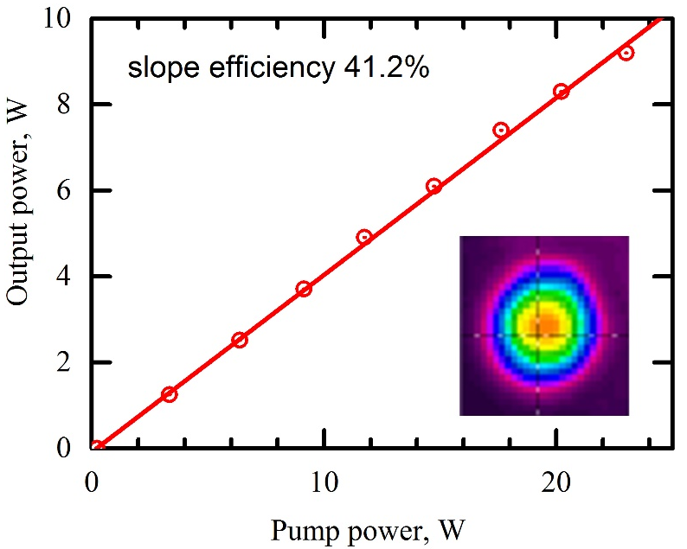
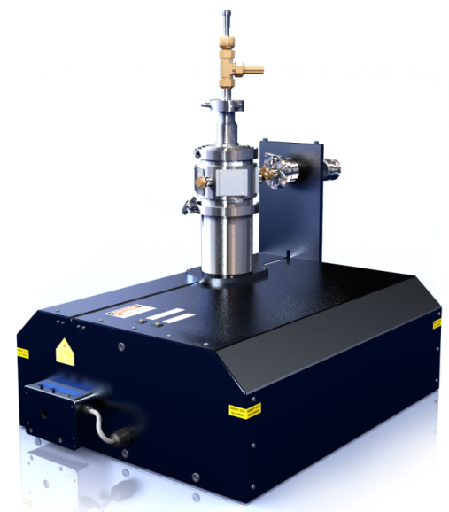
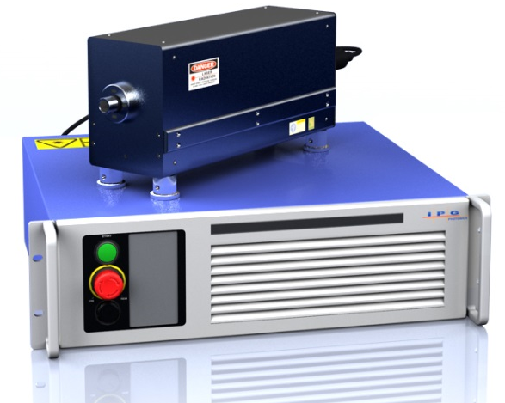
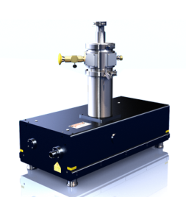
Fe:ZnS/ZnSe lasers at 3-5 µm : State-of-the-art
CW regime
10 W (77 K)
ms, and µs pulses
10.5J (77 K)
ns pulses
1.6 J single pulse (RT)
K. Firsov et al.,
Applied Physics B (2016)
fs pulses Work in progress
Tuning curve of pulsed RT Fe:ZnSe laser
Output-Input of cw Fe:ZnSe laser
High power (35 W, 100 Hz) pulsed Fe:ZnSe laser Pulsed, RT (1 mJ @5 ns@1 kHz) Fe:ZnS laser CW, 10W, 3.7-5 um tunable Fe:ZnSe
S. B. Mirov et al., IEEE J. of Sel. Topics in Quantum Electron. 24, 1601829 (2018) DOI: 10.1109/JSTQE.2018.2808284.

Slide 15


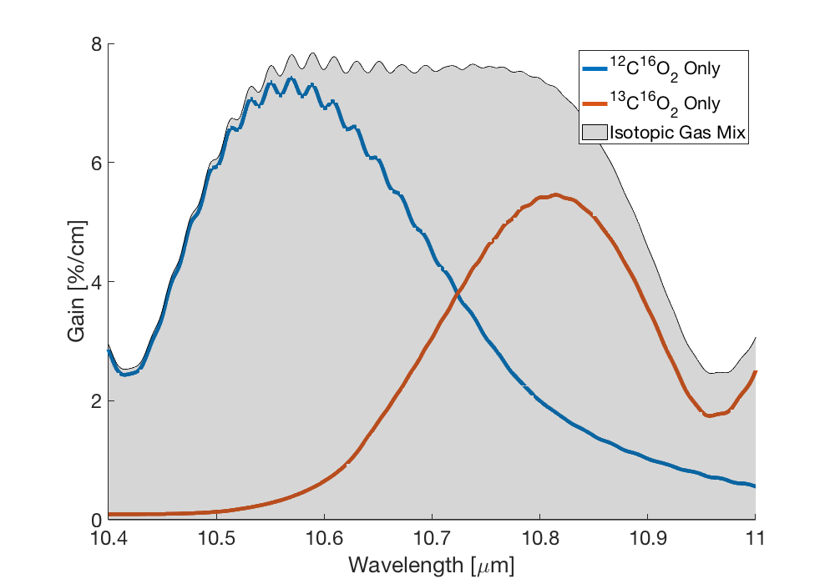
20 atm Optically Pumped CO₂ Laser
UCLA
We will combine the best of gas laser and SSL technologies to generate a~1ps, 100 GW LWIR pulses: dramatic reduction of size and amplification of shorter pulses. Ultimate goal is a compact TW power CO₂ laser pumped by 4.3 mm Fe:ZnSe laser.
001
4.3 μm
Fe:ZnSe
Laser
10 μm
10 μm
500 fs
OPA
Seed
10 μm
1 ps, 10-100 GW
4.3 μm
100
000
CO₂ Levels
20 atm
¹²CO₂--¹³CO₂—He
Gain Spectrum
Collaboration between UCLA/BNL/UAB

Slide 16
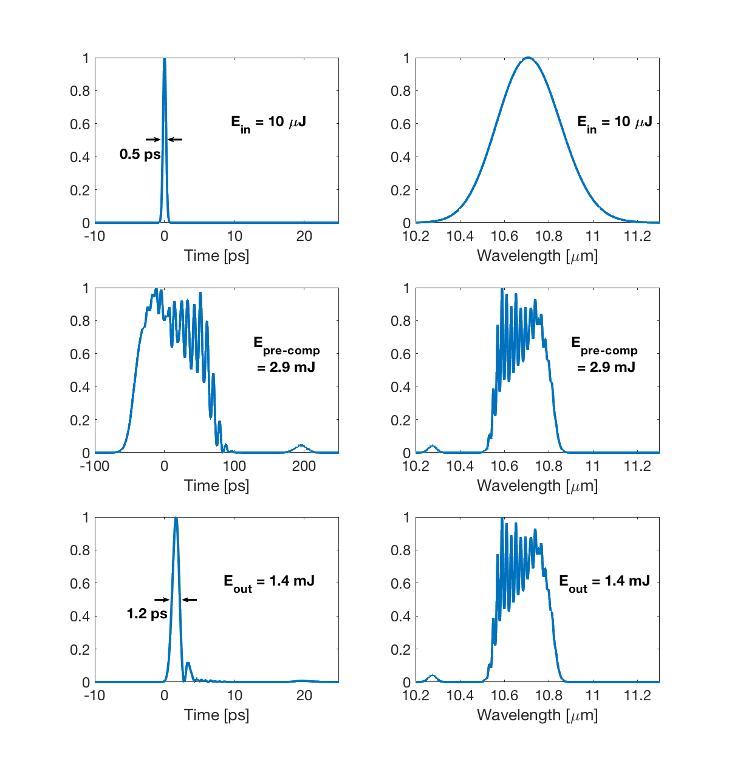
Picosecond CO₂ Regenerative
Amplifier (simulations)
UCLA
4.3 μm Pump: 200-300 mJ, pulse from Fe:ZnSe laser
10 μm Seed:10 μJ
300 fs - 500 fs
20 atm
CO₂ cell
10cm-long picosecond amplifier
IN
OUT
Feasibility study of a compact GW class CO₂ amplifier at 20 Hz.
D. Tovey et al. Applied Optics, 58, 5756-5763, 2019

Slide 17
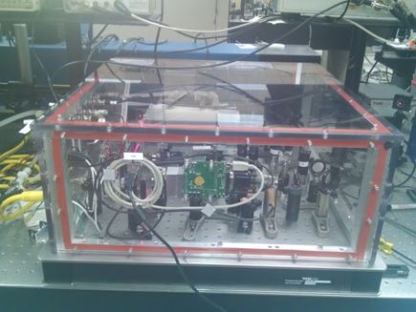
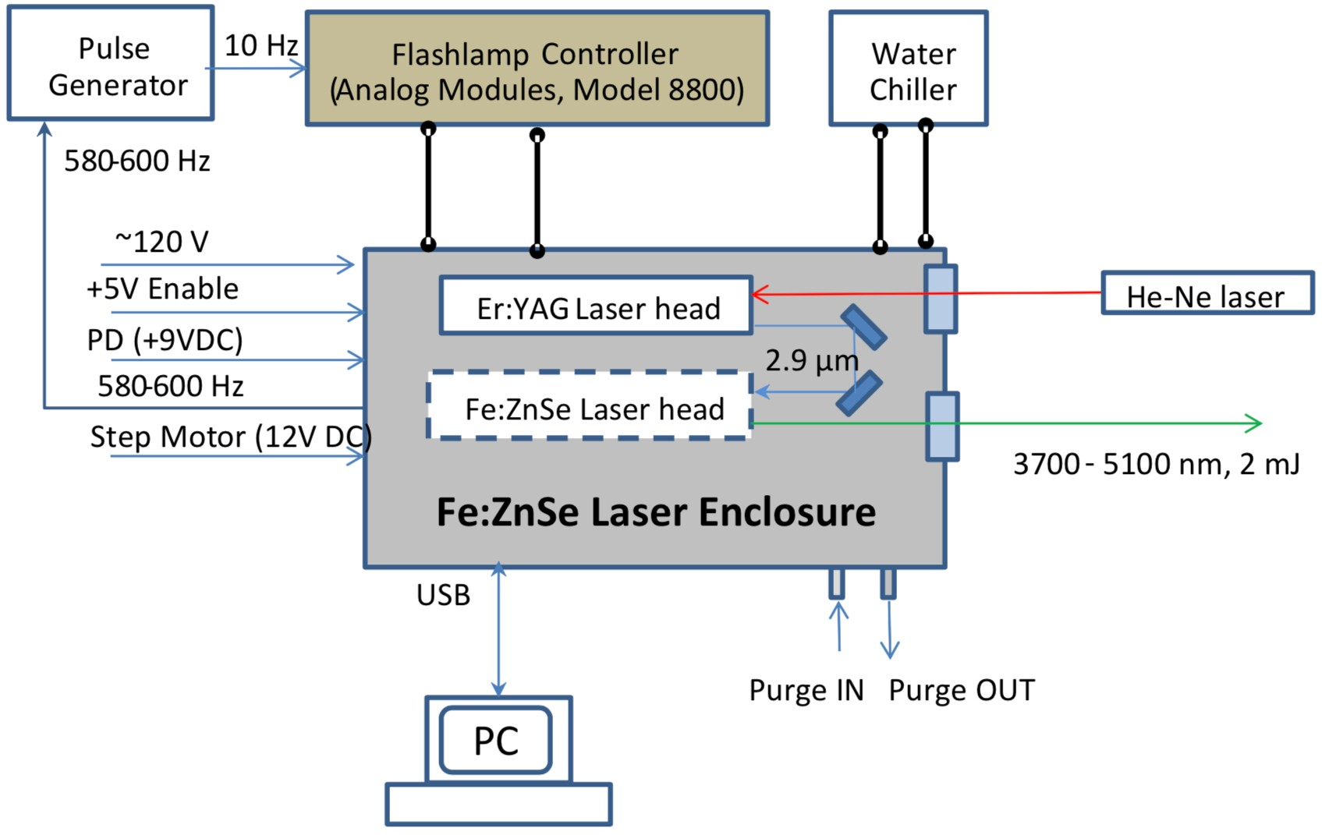
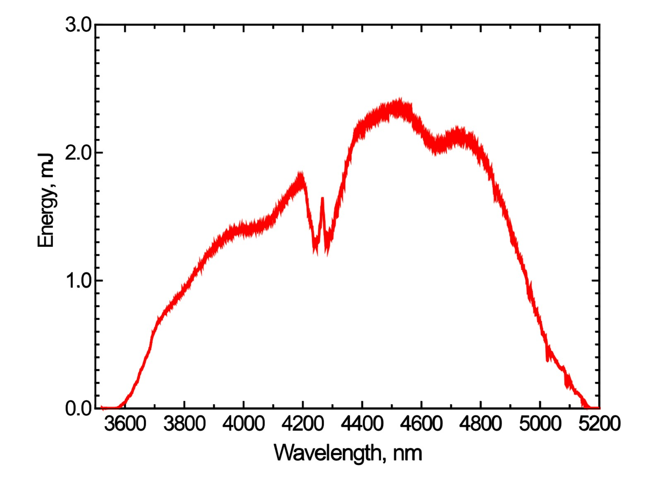


Fe:ZnSe 4.3 µm Pump Laser
Laser Setup
Tuning Curve
Tunable across entire 4.3 µm absorption branch of CO₂
Produces ~2-3 mJ, ~40 ns pulses at 10 Hz rep rate
V. Fedorov, et. al., Opt. Express 27(10), 13934-13941 (2019)

Slide 18
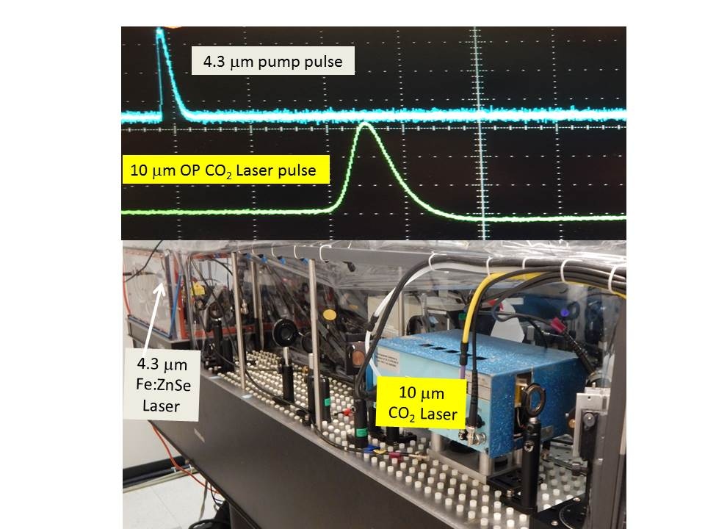
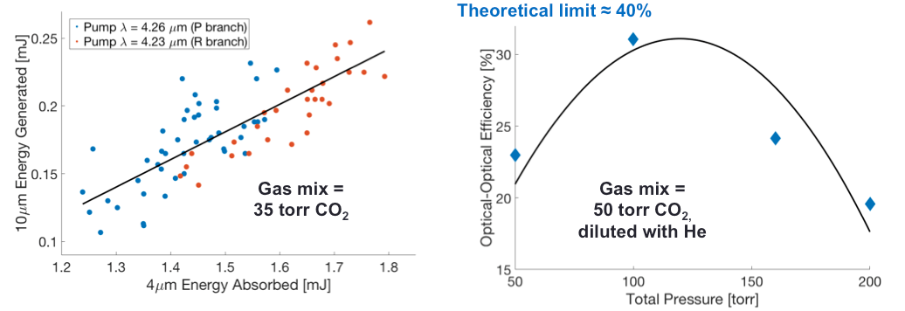
Optically Pumped CO₂ Laser 0.2 atm
UCLA
MARS
Pump 2 mJ Fe:ZnSe laser, Optical-to-optical 10 μm/4.3 μm≤30%.
Need 200-300 mJ for 20 atm CO₂ laser. D. Tovey et al, CLEO, 2019, paper STh1E4

Slide 19
Compact OP CO₂ TW Laser
UCLA
10 Hz 4.3 μm
Fe:ZnSe Laser
10 Hz 4.3 μm
Fe:ZnSe amplifier
4 J
100 ns
1 J
3 J
10 mJ
MARS
Mode-locked
20 atm OPCO₂
Laser
~mJ
0.5 ps
20 atm
OPCO₂
Preamp
20 atm
OPCO₂
Amplifier
1 J
1 ps
+++) Table-top electrical discharge-free compact TW LWIR
laser system will be suitable for self-guiding in air over km range, etc.
+++) Optical-to-optical conversion efficiency 0.1-0.4 is far above
any state-of-the-art LWIR OPA.
- - - ) Physics of Optically Pumped high-pressure CO₂ medium needs to be studied.
Optically pumped high-pressure CO₂ lasers can be the game changer in LWIR USP:100 ns pump and 0.3-3 ps LWIR pulse.
At present our goal is GW level of power from OP CO2 laser and only after reaching this goal one can consider a higher TW powers. More energetic Fe:ZnSe systems and Fe:ZnSe pump sources are needed.
Even higher power of 10-20 TW we leave to existing discharge pumping.

Slide 20
Home-made Er:YAG 25 J at 2940 nm
pumping
Fe:ZnSe output energy 7.5J at 220K
(10.6J at 77K)
Fe:ZnSe rep rate – single pulse
Pulse duration 700 μs
Efficiency 30%

Slide 21
nonchain electric-discharge
HF laser pumping
Fe:ZnSe output energy 1 J
Fe:ZnSe rep rate 20 Hz
Fe:ZnSe output power 20W
Pulse duration 150 ns
RT operation with efficiency 40%

Slide 22
Multipass RT Fe:ZnSe amplifier feasibility

Slide 23
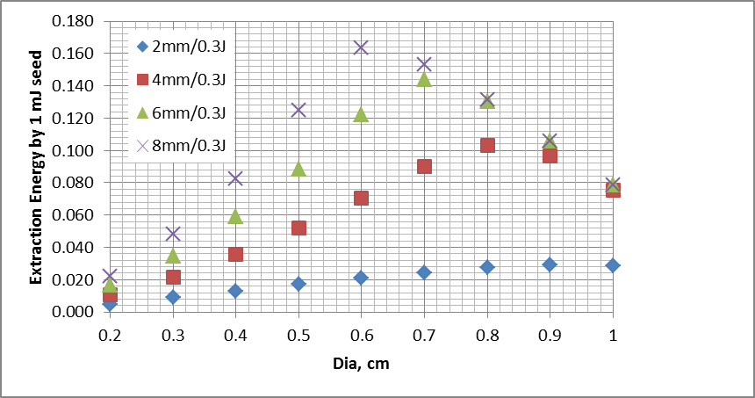
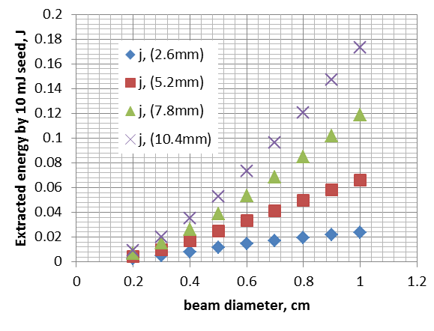
Low temperature Fe:ZnSe long-pulse (100 μs) pumped amplifier
1 stage amplifier Fe:ZnSe 2x10¹⁹ cm⁻³ pumped by 0.3J at 2.9 um
1 stage Fe:ZnSe 2x10¹⁹ cm⁻³
2nd stage Fe:ZnSe 6x10¹⁸ cm⁻³
1 mJ@4.1µm
0.3J@2.9µm
SM
10mJ@4.1µm
SM
150mJ@4.1µm
0.5.J @2.9µm
Er:YAG@2.9 µ /2J/100µs/10Hz
SM
1.2J@2.9µm
SM
2nd stage amplifier Fe:ZnSe 6x10¹⁸ cm⁻³ pumped by 0.5J at 2.9 um
SM
Nitrogen
Cryostat
500mJ@4.1µm
φ 3x0.5cm Fe:ZnSe gain element developed at the UAB

Slide 24
Principal laser scheme based on Electro-Optical QS Nd:YAG@ 1.064 μm
48’’
EO QS Nd:YAG laser
F:ZnSe
Amplifier
1.064 μm
LN
Tank
Free Running Er:YAG
2.94 μm
24’’
OPO KTA
3.0 μm
3.9-5.0 μm
3.9-5.0 μm
F:ZnSe
Tunable Laser

Slide 25
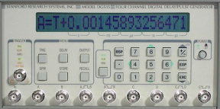
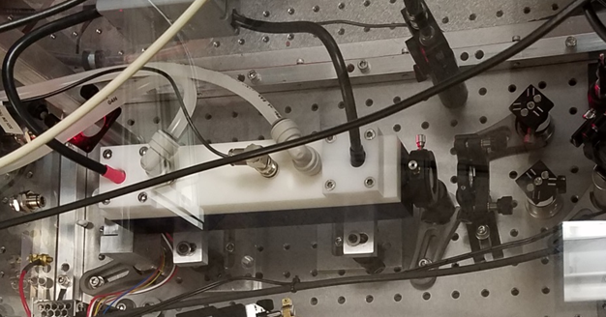
Mechanically Q-switched (spinning mirror) Er:YAG laser
@ 2.94 µm
Flash Lamp Driver
Power Meter
f/60
f~ 600Hz
2.94 μm
PD
10 mm Er:YAG 50%
Pulse Generator
BM
365 mm
OC 75%
He-Ne laser
DC, Motor
Nominal Voltage | 24 V
Nominal torque | 20mNm
Nominal speed | 55600 rpm

Slide 26
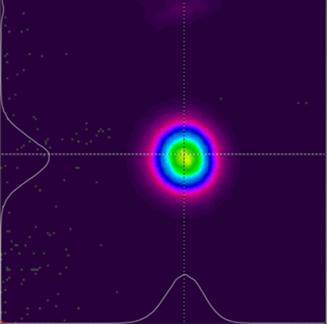
Mechanically Q-switched (spinning mirror) Er:YAG laser
Dimension of rod: 7mm * 120 mm
Cavity length = 365mm. PRR = 5Hz
Laser driver: KALD Megawatt laser
Temperature of chiller = 17⁰ C
Maximum output energy in a single pulse = 260 mJ (mirror damage limited)

Slide 27
Summary and outlook
Optically pumped high pressure CO₂ offers potential for compact, efficient generation/amplification of high power, picosecond pulses at 10 µm
Experimental demonstrations of low pressure lasing in CO₂ pumped by an Fe²⁺:ZnSe laser indicate high optical- optical conversion efficiencies are possible
Scaling to higher pressure requires better understanding of physics behind CO2 lasing (self-focusing of pump, CO₂ relaxation processes) and/or more energetic pump source
Plan to submit DOE proposal to demonstrate and optimize a short pulse OP lasers, focusing on a shorter pulse length down to 300 fs, and power scaling.

Slide 28
THANK YOU FOR YOUR ATTENTION
Laser regime | Cr:ZnSe/ZnS, λ = 1.8 – 3.4 µm | Fe:ZnSe/ZnS, λ = 3.4 – 5.2 µm
Continuous wave | 140 W with 60% efficiency (RT) | ~ 10 W (77 K)
ms pulses | 1.1 J (single-shot) (RT) | 10.6J
µs pulses | NA | 0.35 J at 100 Hz (77 K)
ns pulses | 20 mJ at 1000 Hz (RT) | 1.6 J at single pulses (RT)
fs pulses | <20 fs, up to 30W (RT) | < 1 ps (77K)

Slide 29
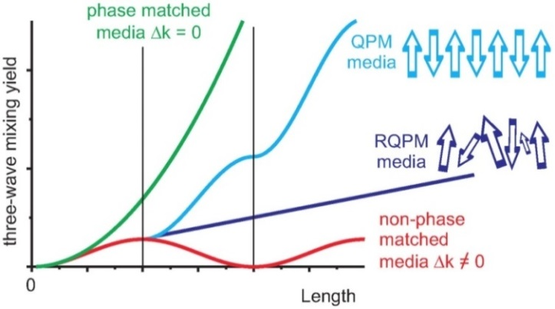
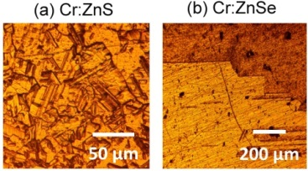
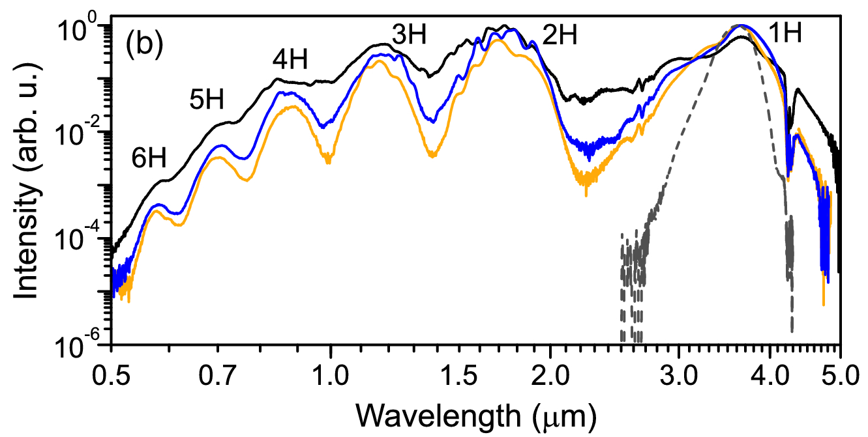
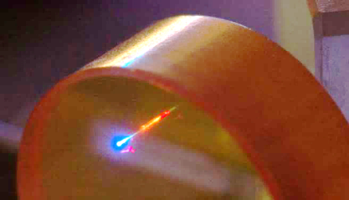
Cr²⁺:ZnSe and Cr²⁺:ZnS: laser and nonlinear materials
χ⁽²⁾
High d₃₆ ≈ 20 pm/V
All types of three-wave mixing
via RQPM
SHG, SFG, OPO, DFG/IDFG
χ⁽³⁾
High n₂ ≈ 10⁻¹⁴ cm²/W at λ = 2.4 µm
Low critical power for self-focusing
P_{Crit} = 0.4 MW at 2.4 µm
2—3 µm lasing in normal group velocity
dispersion (GVD) regime
GVD ≈ 0 fs²/mm at 3.6 µm (ZnS) and at 4.81 µm (ZnSe)
χ⁽³⁾ + χ⁽²⁾ + RQPM = multi-octave SCG
Different regimes of three-wave mixing
Harmonics-enhanced SCG in ZnSe pumped by a µJ kHz CPA
R. Šuminas et al., JOSA B 36, A22 (2019)
R. Šuminas et al., Appl. Phys. Lett. 110, 241106 (2017)

Slide 30
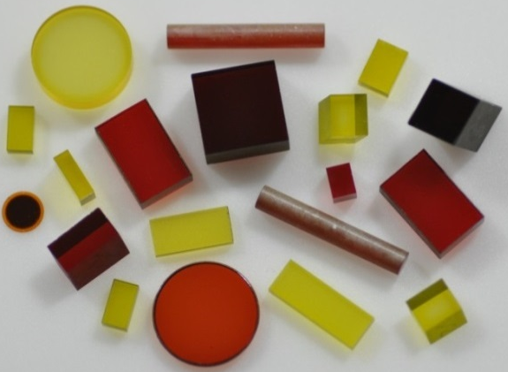
TM:II-VI materials: Fabrication
Single crystals by Bridgman technique
Requires high temperature, pressure (e.g. 1600 K at 75 bar)
Single crystals by chemical vapor transport (CVT) and
physical vapor transport (PVT) methods
Hard to reach high dopant concentration
Hard to get good optical quality
Hard to grow large size crystals
Polycrystalline by post-growth thermal diffusion doping
Uniformly-doped, large samples with high dopant concentration
Mass-production of the gain elements with pre-assigned parameters
Hot-pressed ceramics
Enables engineering of the parameters (dopant distribution, microstructure)
Promising future technology
Nano & micropowders, composite II-VI-liquid, II-VI-polymer and II-VI-glass gain media
S.B. Mirov, V.V. Fedorov, (November 1, 2005) Mid-IR microchip laser: ZnS:Cr2+ laser and saturation absorption material”, US Patent No 6,960,486

Slide 31
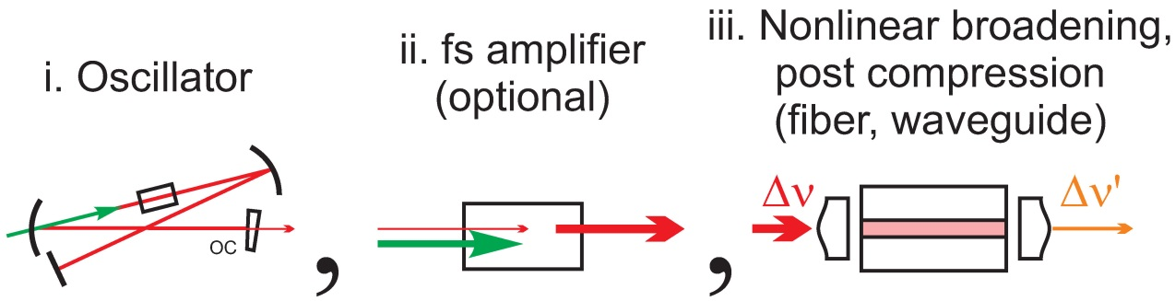
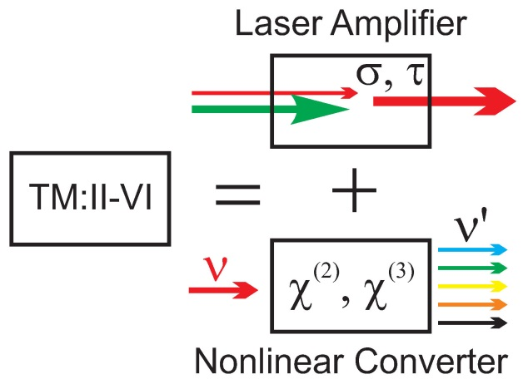
Approaches to super-octave sub-2-cycle Cr²⁺:ZnS and Cr²⁺:ZnSe lasing
Standard technique →
N. Tolstik et al., Proc. SPIE 8599 (2013)
Chalcogenide and germanate fiber
S. Xie et al., Opt. Express 24, 12406 (2016)
As2S3-silica double-nanospike waveguide
D. Martyshkin et al., Opt. Mater. Exp. (2019)
Silicon nitride waveguide
N. Nagl et al., Opt. Lett. (2019)
fluoride fibers
Singe-pass Cr:ZnS and Cr:ZnSe amplifiers
“All-in-one” bulk architecture
S. Vasilyev et al., Opt. Express 22 , 5118 (2014)
S. Vasilyev et al., Opt. Express 24, 1616 (2016)
S. Vasilyev et al., Opt. Mat. Express 7, 2636 (2017)
→
Concept of a single-pass TM:II-VI amplifier

Slide 32
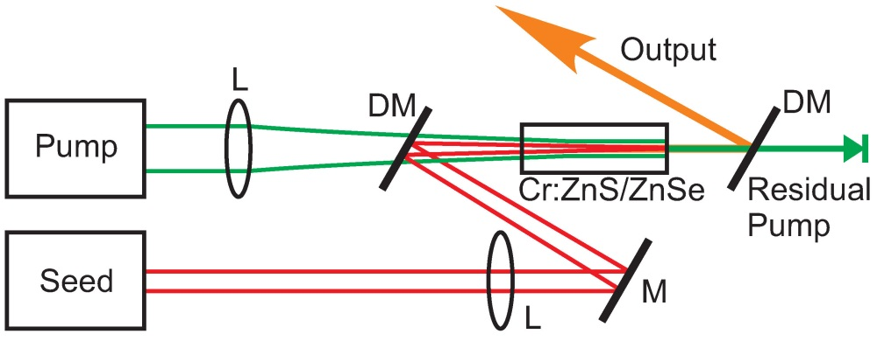
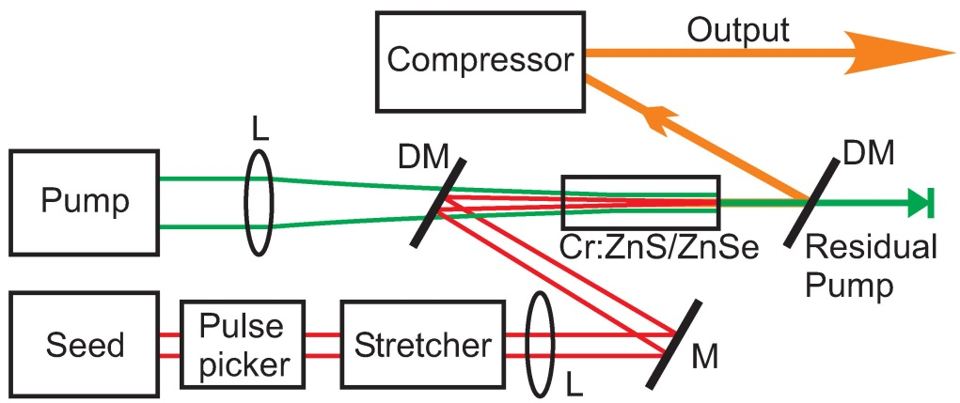
Single-pass ultrafast Cr:ZnS and Cr:ZnSe amplifiers
Main features
Simple yet efficient
σ_{ab} = 1.1⋅10⁻¹⁸ cm²
τ = 5.4 µs
I_{Sat} = 20 kW/cm²
F_{Sat} = 0.1 J/cm²
Variety of options for optical pumping
EDFLs (cw)
TDFLs (cw)
Er:YAG, Ho:YAG, Ho:YLF (ns)
Great flexibility:
f = repetition rate = 10⁰ – 10⁹
γ = Pump/Seed = 10⁰ – 10⁶
κ = P_{pk}/P_{Crit} = 10⁻² – 10²
Generic single-pass power amplifier at full repetition rate
Generic single-pass energy amplifier at kHz—MHz repetition rate

Slide 33



Single-pass fs amplifier (Cr:ZnS) at GHz repetition rate
Goal: Compactness-&-Efficiency
Features of GHz fs Cr:ZnS MOPA
Seed pulses: 80 fs, 1 nJ at f = 0.9 GHz, P = 0.9 W
Output pulses: 76 fs, 8 nJ, P = 7.3 W (100 kW peak power)
Cw EDFL → fs MIR conversion: 38% amplifier (31% overall)
Footprint: 20×20 cm² (excluding EDFLs)
Ideal pump for subharmonic fs OPOs:
GHz power amplifier
V. Smolski et al., ASSL2017, AM4A.6
→
Parameters of 7.3 W MIR fs source at
0.9 GHz repetition rate

Slide 34
Summary and outlook
Middle-IR lasers based on Cr and Fe doped ZnS and ZnSe have come of age
Advances in fabrication of ceramic/polycrystalline laser materials
Availability of cost efficient fiber pump lasers at 1.5—2 µm
Advances in laser design and thermal management
Important milestones have been reached
0.15 kW level in cw laser power
>J-level energy
Ultrafast Cr²⁺-based lasers and amplifiers provide unique combination of parameters in the spectral range 2—3 µm
Short Pulses: 2—3 optical cycles (Outlook sub-2 cycle)
High power: in excess of 27 W (Outlook 100 W)
Very high efficiency : 20 – 40 % conversion from cw EDFL and TDFL to fs MIR

Slide 35
Summary and outlook
Cr²⁺:ZnS(Se)—GaSe tandems enable generation of 5-octave (0.4—20 µm) continua
First bulk, multi-octave continuum at full 80 MHz repetition rate of a fs oscillator
First implementations of new SCG regimes:
Harmonics-enhanced supercontinuum generation in RQMP media
IDFG-enhanced supercontinuum generation
Direct f_{CEO} measurements confirm high spatio-temporal coherence of the continuum
Future TW-class Cr,Fe:ZnS/ZnSe and Fe:ZnS/ZnSe/ZnCdTe amplifiers at 2 – 8 µm
Future electrically pumped TM:II-VI lasers
Increasing interest from various fields
Spectroscopy and sensing
Processing of materials
Medicine-, defense-related applications, etc.
Strong field physics and nonlinear optics, atto-science

