Slide 1
A SM-like Higgs from
Technicolor

Slide 2
Outline
Mass of the TC-Higgs
Couplings of the TC-Higgs
Fit to the LHC Higgs data
Conclusions

Slide 3
Mass of the TC-Higgs

Slide 4

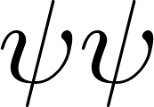
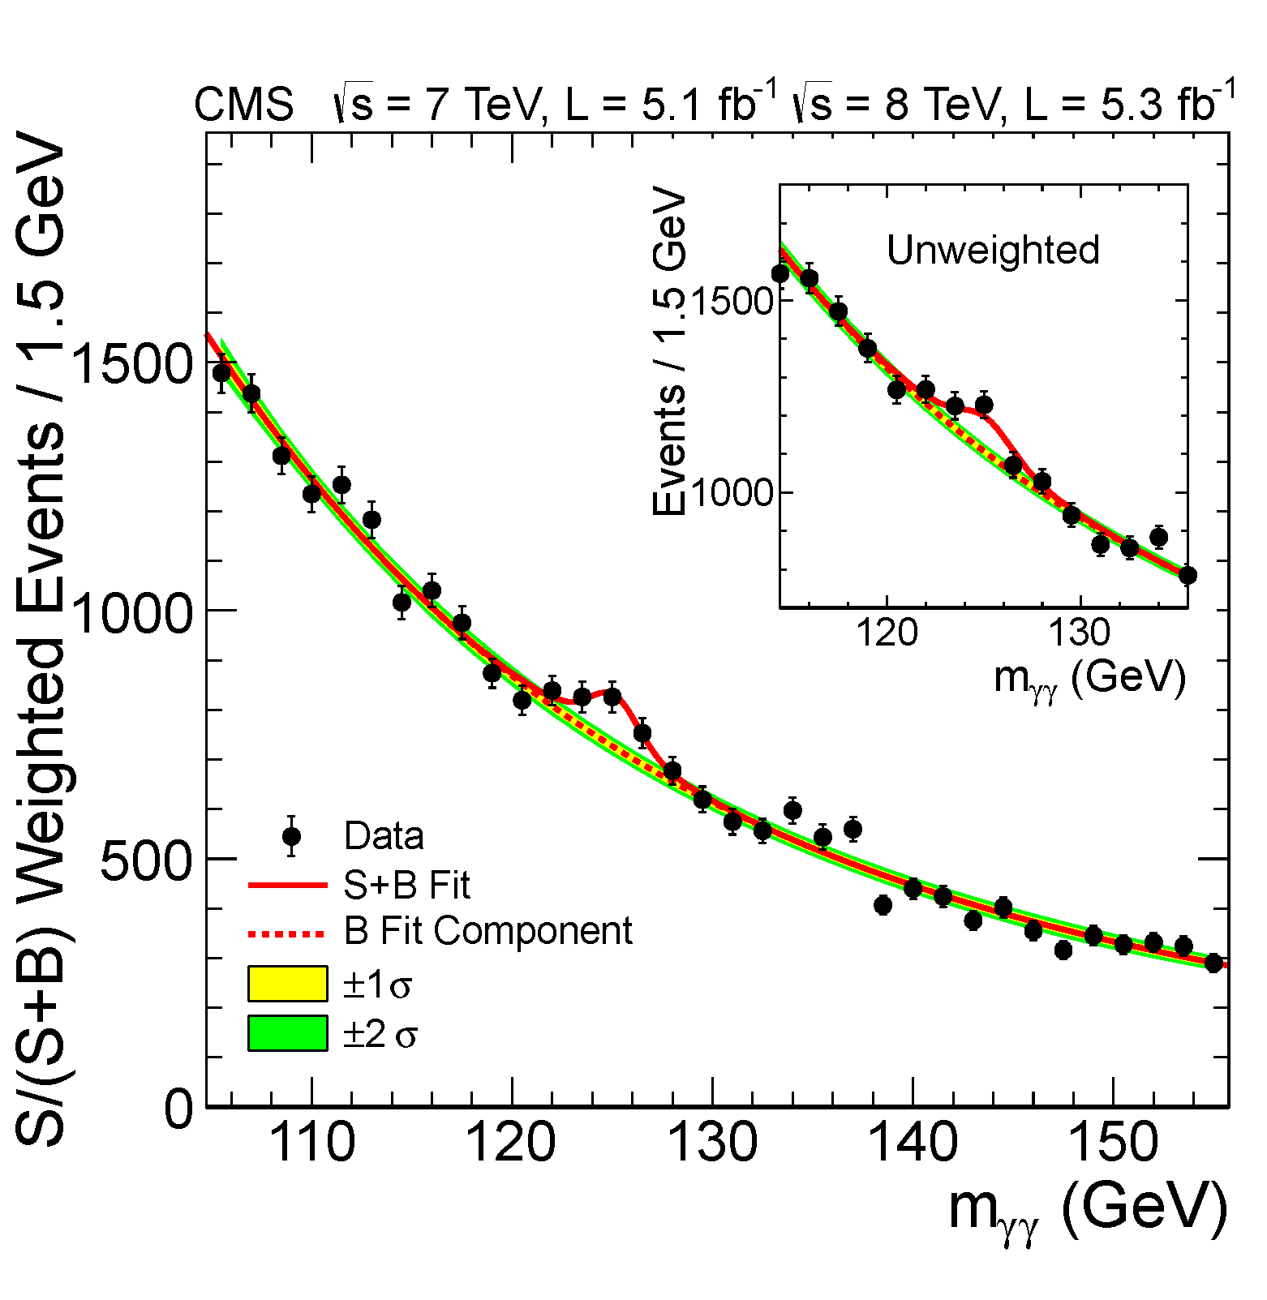
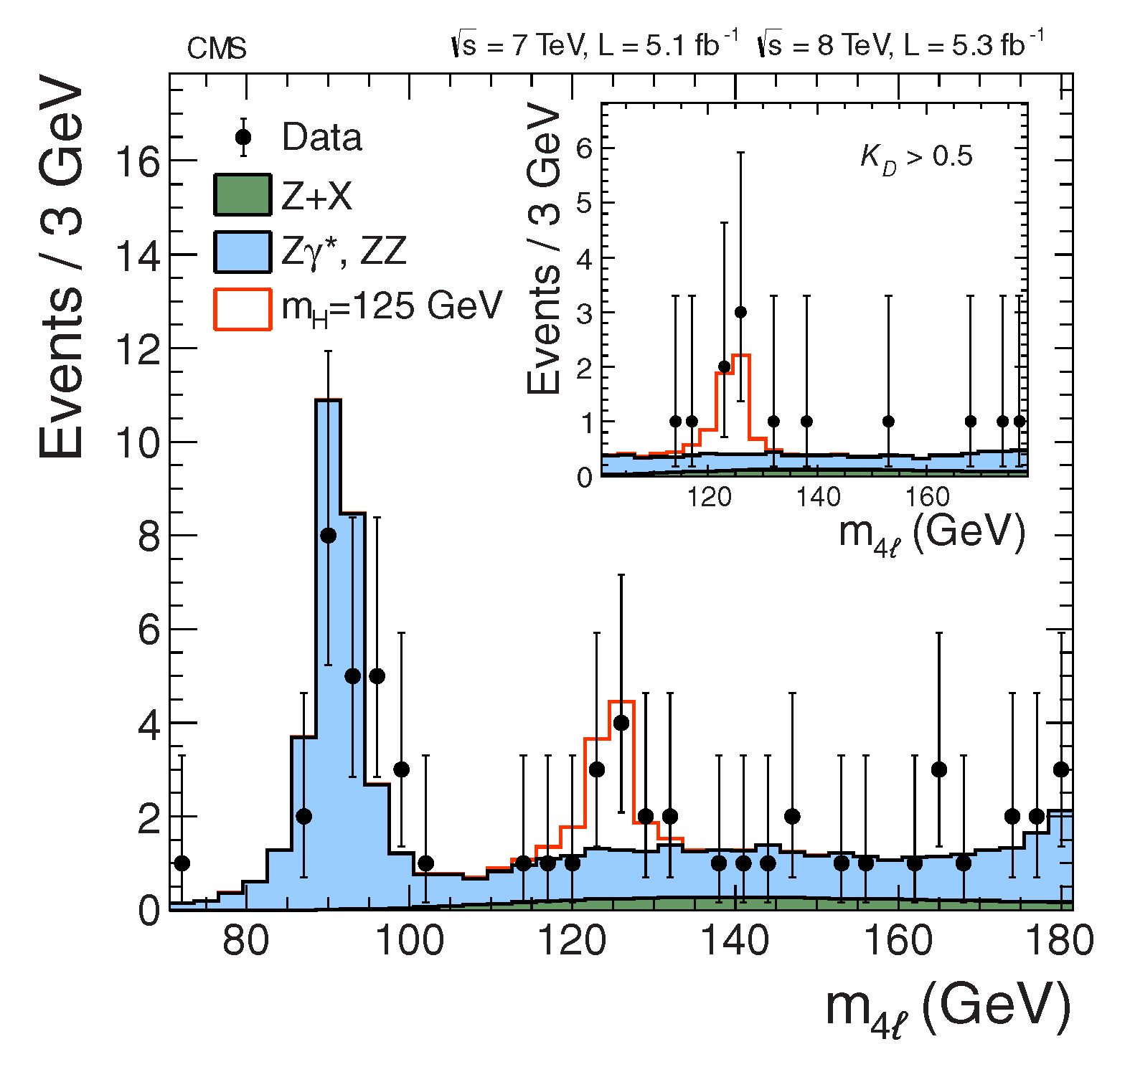
The discovery of the 125 GeV scalar
Excesses observed in the and channels at 125 GeV suggest we have discovered a new scalar particle

Slide 5
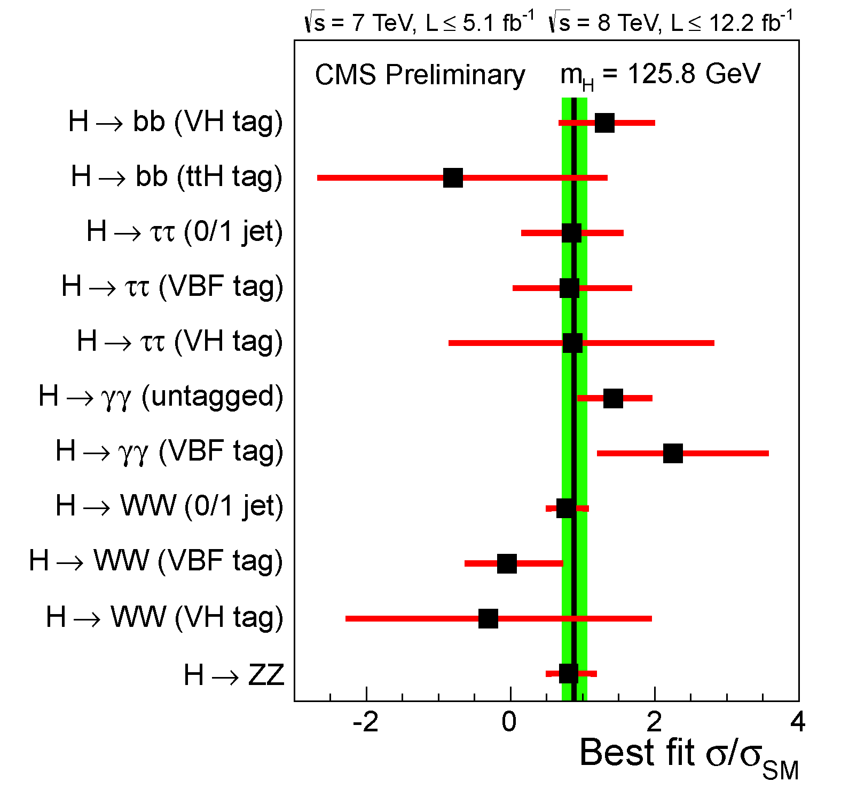
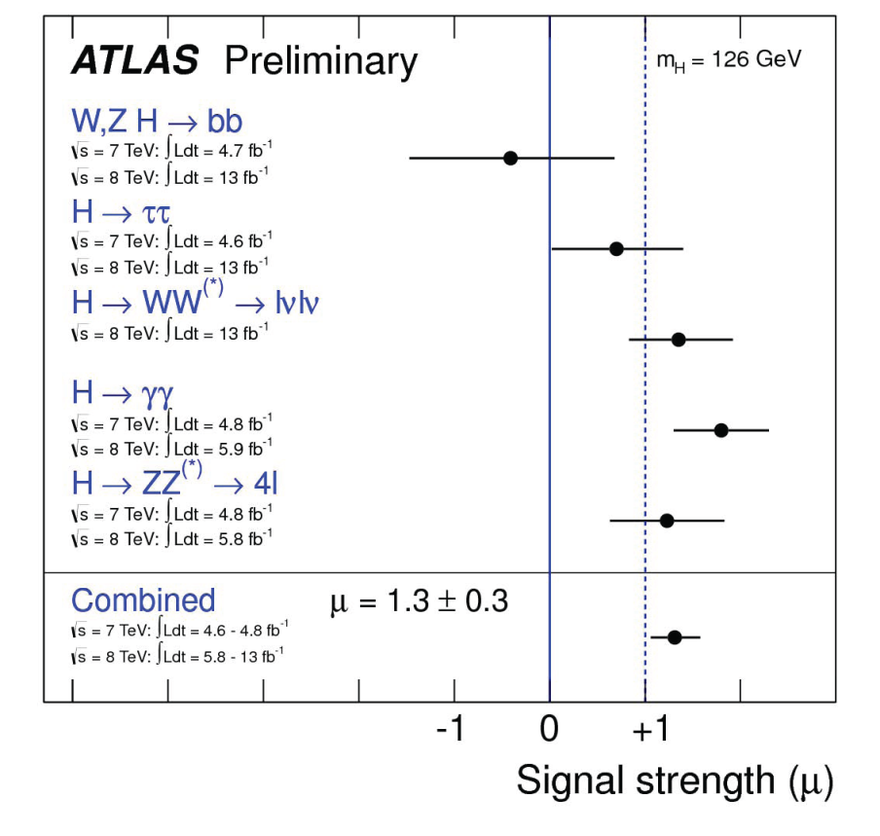
The discovery of the 125 GeV scalar
The signal strengths in each channel suggest that the couplings of the 125 scalar particle are close to those expected for the SM Higgs

Slide 6
The discovery of the 125 GeV scalar
Can technicolor theories realistically feature a scalar particle with these properties?

Slide 7

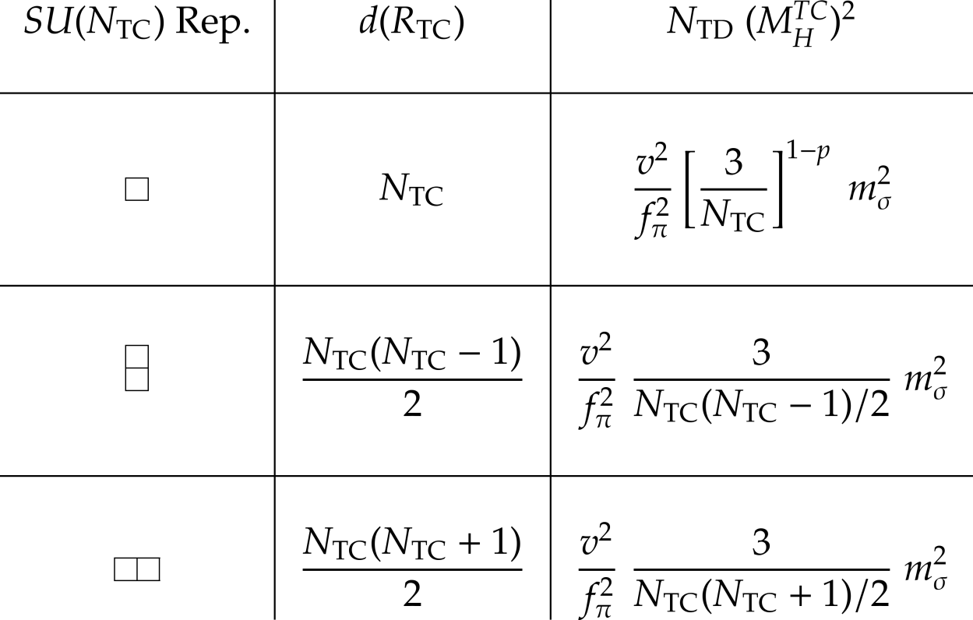
125 GeV scalar in TC
Consider the mass first. To estimate the mass of the lightest scalar in TC scale up the mass of the lightest scalar in QCD, the sigma meson.
This can be meaningfully done in a large- expansion for three different representations.

Slide 8


125 GeV scalar in TC
Consider the mass first. To estimate the mass of the lightest scalar in TC scale up the mass of the lightest scalar in QCD, the sigma meson.
This can be meaningfully done in a large- expansion for three different representations.

Slide 9
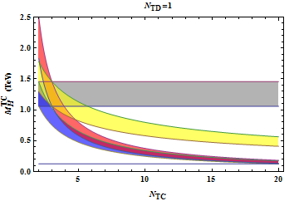
125 GeV scalar in TC
Walking not taken into account in these predictions:
125 GeV scalar not realistic! However……
2AS
F, p=1
F, p=0
2S

Slide 10
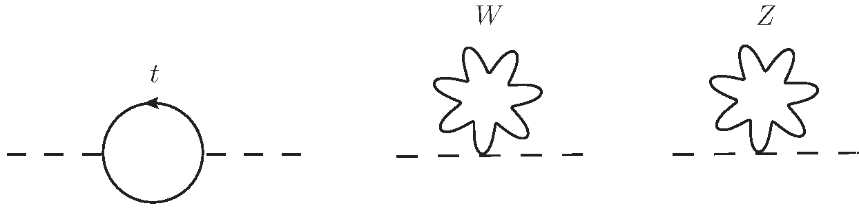
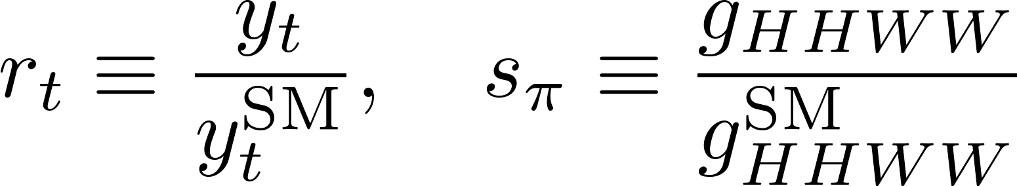
125 GeV scalar in TC
These estimates are for TC theories in isolation.
There are external contributions to the scalar mass from the fundamental SM fields (RF-Frandsen-Sannino 12):

Slide 11
125 GeV scalar in TC
These estimates are for TC theories in isolation.
There are external contributions to the scalar mass from the fundamental SM fields (RF-Frandsen-Sannino 12):
Not a new phenomenon: pion mass splitting in QCD, and Higgs mass in the minimal composite Higgs model.

Slide 12
125 GeV scalar in TC
These estimates are for TC theories in isolation.
There are external contributions to the scalar mass from the fundamental SM fields (RF-Frandsen-Sannino 12):
ETC

Slide 13
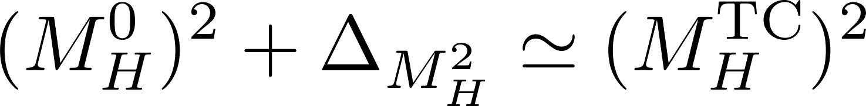



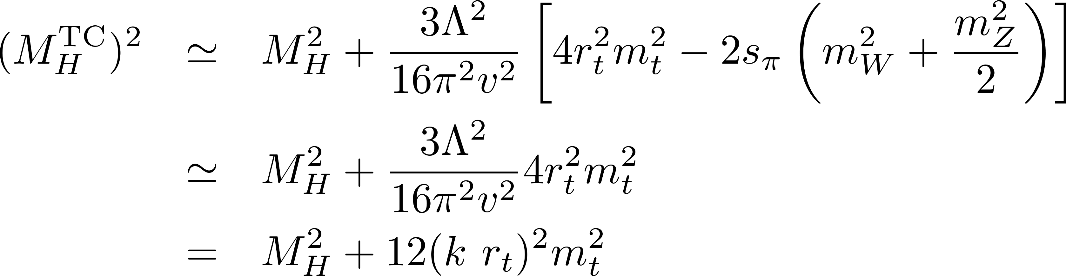

125 GeV scalar in TC
Assumption:
(However there might be contributions to between and )

Slide 14
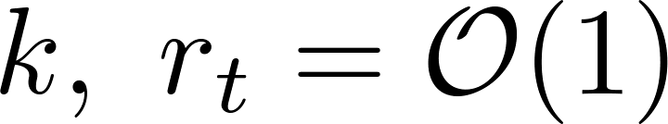
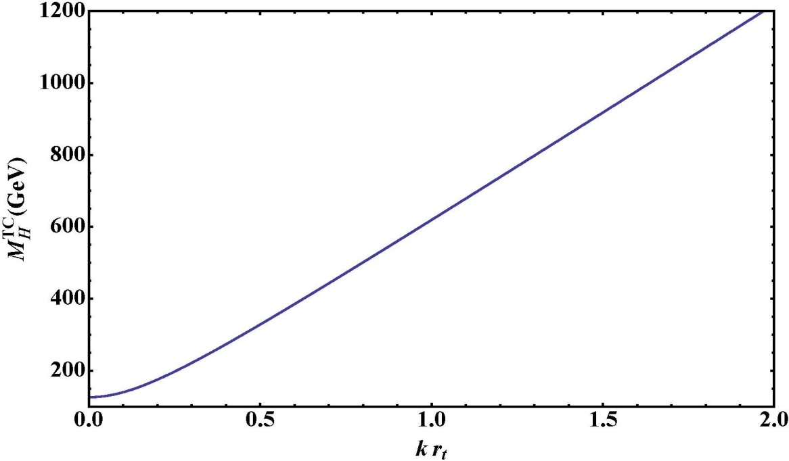



125 GeV scalar in TC

Slide 15

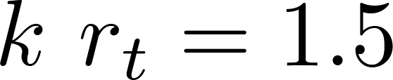
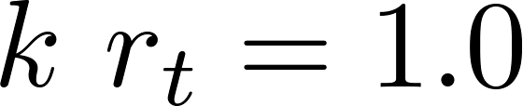
125 GeV scalar in TC
125 GeV scalar attainable for small values of even without walking!

Slide 16
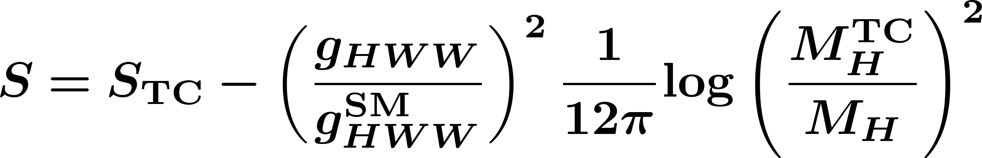
125 GeV scalar in TC
The difference between dynamical and physical mass implies also a
Reduction of the S parameter relative to the intrinsic S:

Slide 17
Couplings of the TC-Higgs

Slide 18
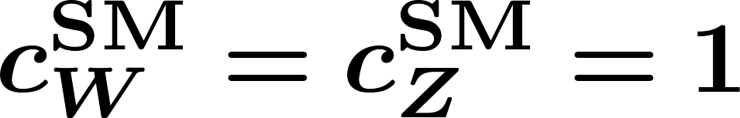
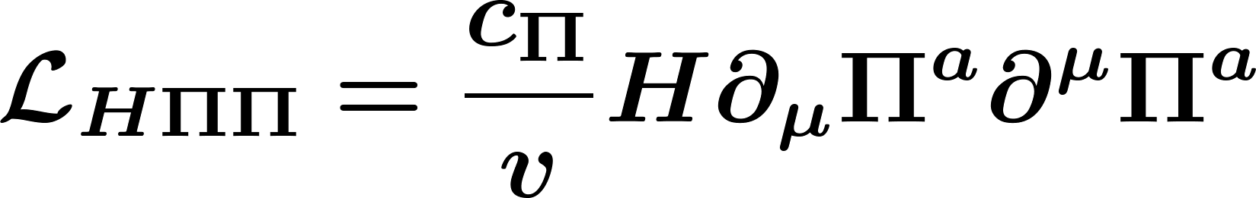

Coupling of the TC-scalar to WW and ZZ
The TC-Higgs coupling to W and Z boson can be inferred from the coupling to the eaten Goldstone bosons.
Assuming custodial symmetry:
Agreement with ATLAS and CMS data requires .

Slide 19

Coupling of the TC-scalar to WW and ZZ
However there is no reason a priori for .
Let’s extract the coupling from QCD data and see what we obtain…

Slide 20
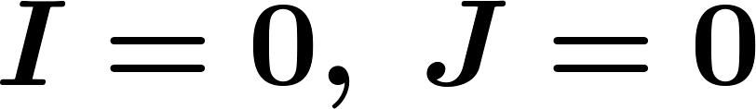


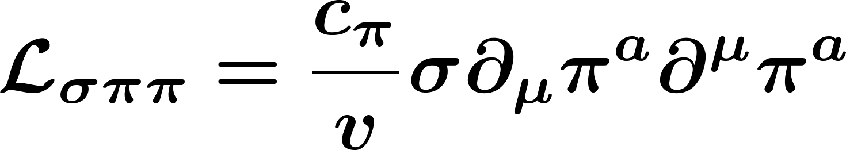


Coupling of the TC-scalar to WW and ZZ
A coupling can be defined as the partial wave projection of the elastic scattering amplitude at the pole.
Compute this using the interaction vertex
Then extract from data, and from .

Slide 21
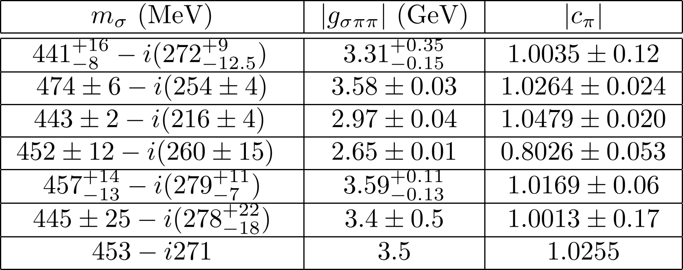
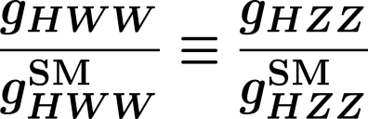
Coupling of the TC-scalar to WW and ZZ
Remarkable results from data (Belyaev-Brown-RF-Frandsen 13):
A QCD-like TC has SM-like couplings to W and Z!

Slide 22
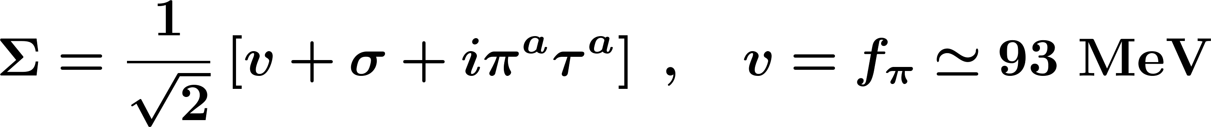
Coupling of the TC-scalar to WW and ZZ
This shows that the linear sigma model is a good description of the sigma-pion sector.
Maybe a consequence of QCD classical scale invariance?

Slide 23
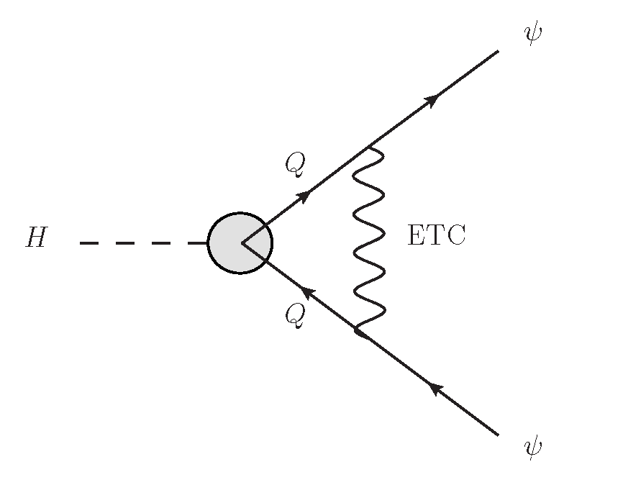
Coupling of the TC-scalar to fermions
The couplings of the TC scalar to the SM fermions are induced by ETC:
There are no corresponding quantities we can scale up from QCD. However:
  The coupling of the eaten technipions to the SM fermions is standard, as imposed by Ward identities.

Slide 24
Coupling of the TC-scalar to fermions
The couplings of the TC scalar to the SM fermions are induced by ETC:
There are no corresponding quantities we can scale up from QCD. However:
  The results from WW and ZZ coupling seem to imply that the linear sigma model is a good approximation to low-energy TC.

Slide 25
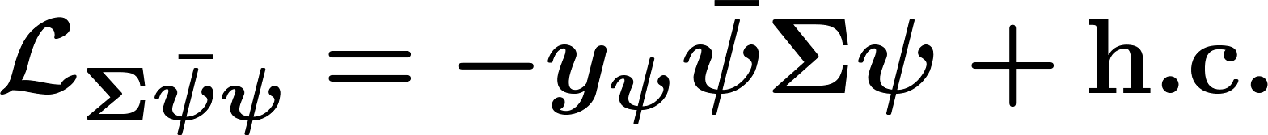
Coupling of the TC-scalar to fermions
The couplings of the TC scalar to the SM fermions are induced by ETC:
Thus we expect SM-like coupling to the SM fermions

Slide 26
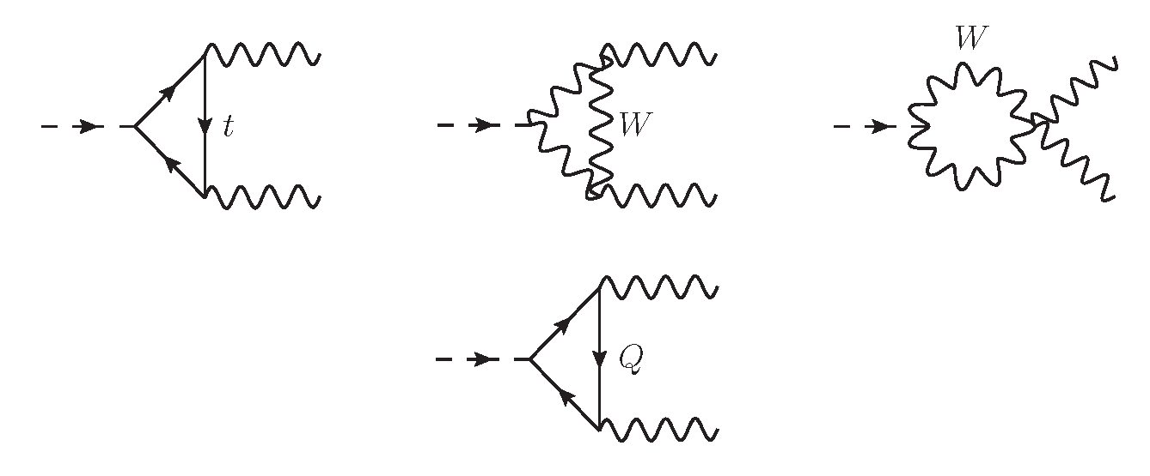
Coupling of the TC-scalar to γγ

Slide 27
Coupling of the TC-scalar to γγ
Landau gauge, transverse
components only
Dominant contribution in the
large-N limit

Slide 28
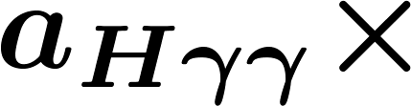
Coupling of the TC-scalar to γγ
Landau gauge, transverse
components only
Dominant contribution in the
large-N limit

Slide 29
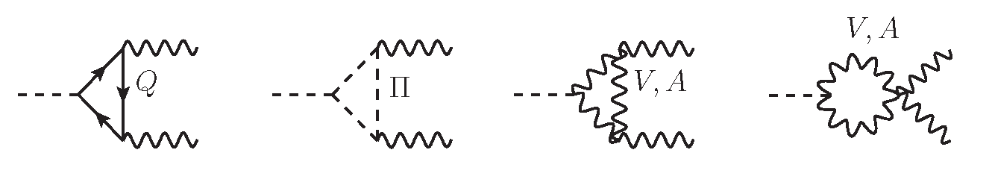
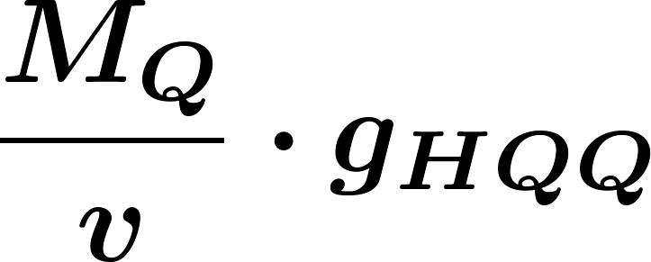

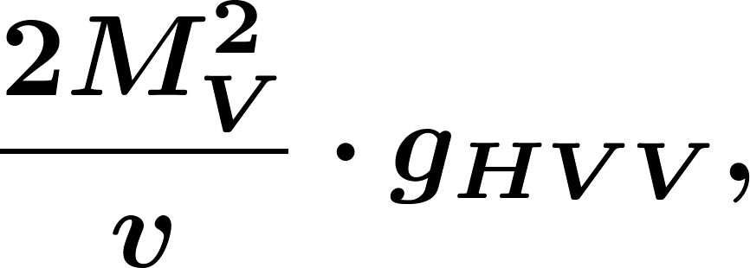
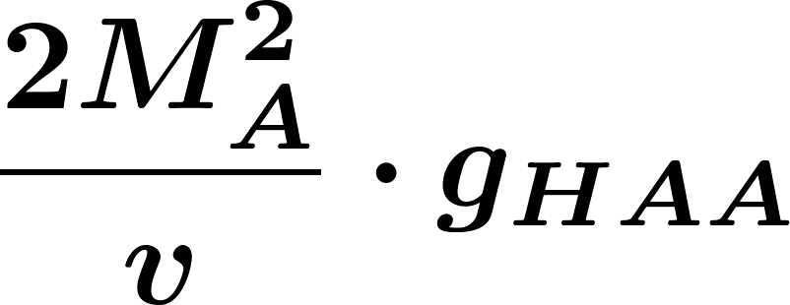
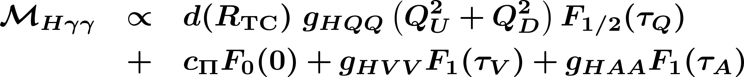
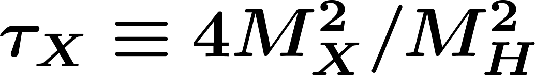
Coupling of the TC-scalar to γγ

Slide 30
Coupling of the TC-scalar to γγ

Slide 31
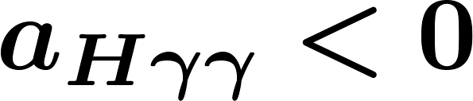
Coupling of the TC-scalar to γγ

Slide 32
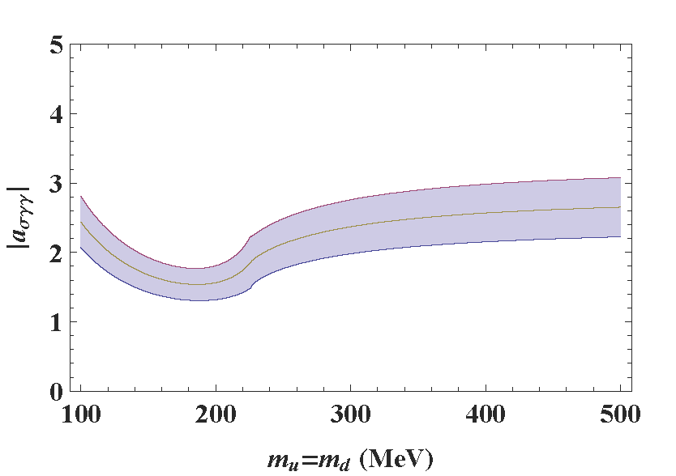
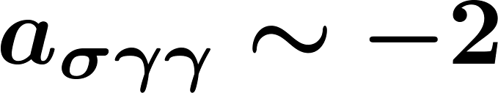
Coupling of the TC-scalar to γγ
How to estimate the form factor? Once again, look at QCD:

Slide 33
Fit to the LHC Higgs data

Slide 34
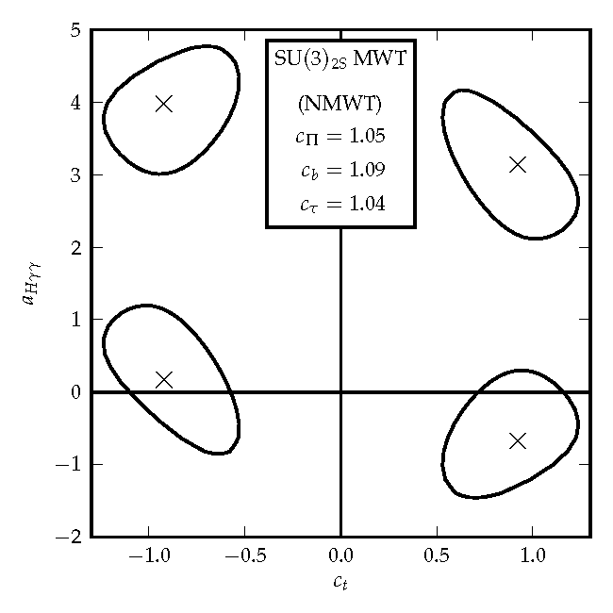
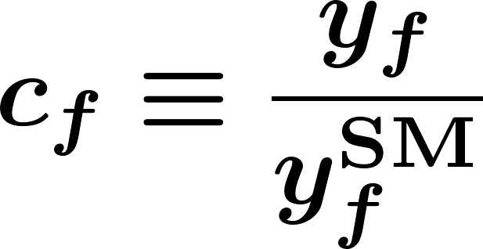
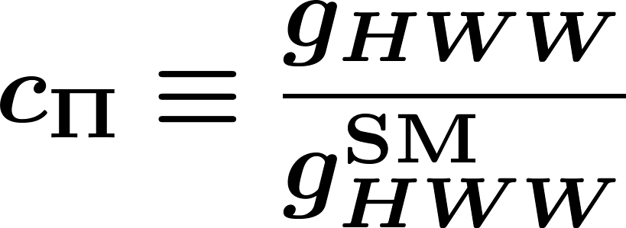
Fit of TC theories
The sextet (Sannino- Tuominen 05, Dietrich-Sannino 06, Belyaev-RF-Frandsen-Jarvinen-Pukhov-Sannino 08), Fodor-Holland-Kuti-Nogradi-Schroeder-Wong 12, Belyaev-Brown-RF-Frandsen 13)

Slide 35
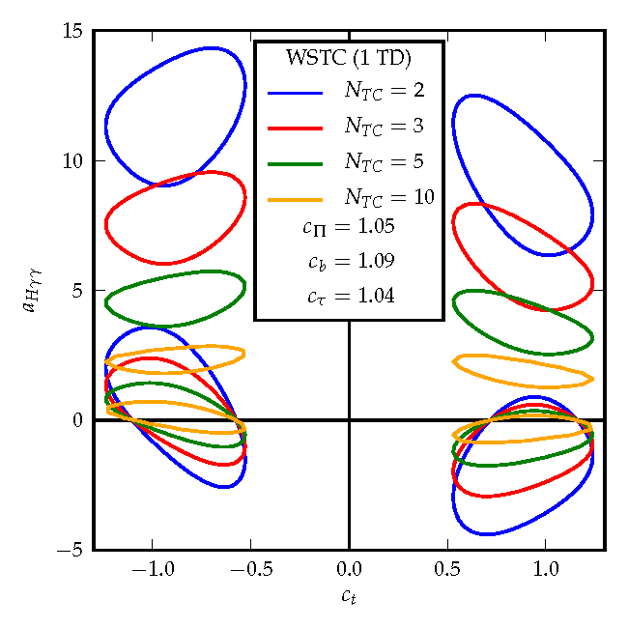
Fit of TC theories
Weinberg-Susskind TC (SU(N) with uncolored fundamental fermions)

Slide 36
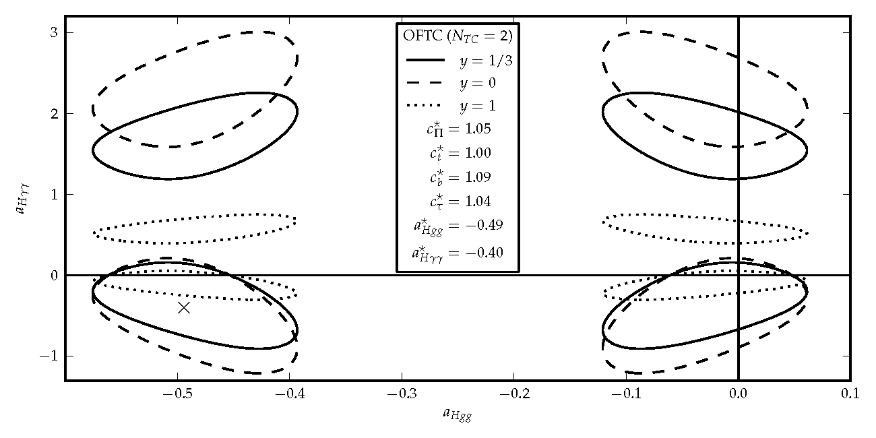
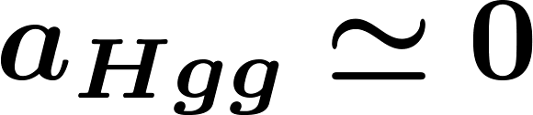
Fit of TC theories
One-family TC (SU(N) with one new family carrying TC charge)
not realistic. However the colored technifermions might be decoupled from the TC scalar!

Slide 37
Conclusions

Slide 38
Technicolor has an intrinsically heavy Higgs. However, radiative corrections from the top may lower its mass to 125 GeV, with acceptable fine-tuning.
The TC-Higgs coupling to WW and ZZ is SM-like in a QCD-like TC theory. We expect this to be true for any TC theory, maybe as a consequence of scale invariance.
Ward identities for the eaten technipions, together with the linear-sigma model hypothesis suggest SM-like couplings to the SM fermions.
The TC-Higgs coupling to photons is arguably expected to be enhanced. This is due to loop exchanges of technimesons.
Fits to LHC Higgs data yield couplings and form factors compatible with the TC hypothesis.

Slide 39
Multi-Scale Technicolor

Slide 40
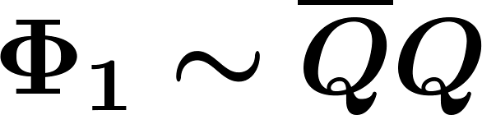
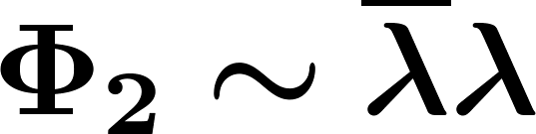
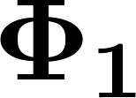
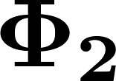
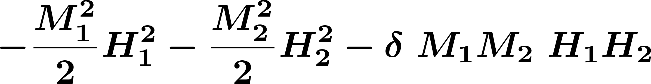
If the TC theory has multiple representations, then we expect more low-lying scalar singlets than just one
Example: ultra-minimal TC: SU(2) with two fundamental and two adjoint fermions
In general, two different condensation scales, and therefore, two different masses for and . But also a mass mixing!

Slide 41
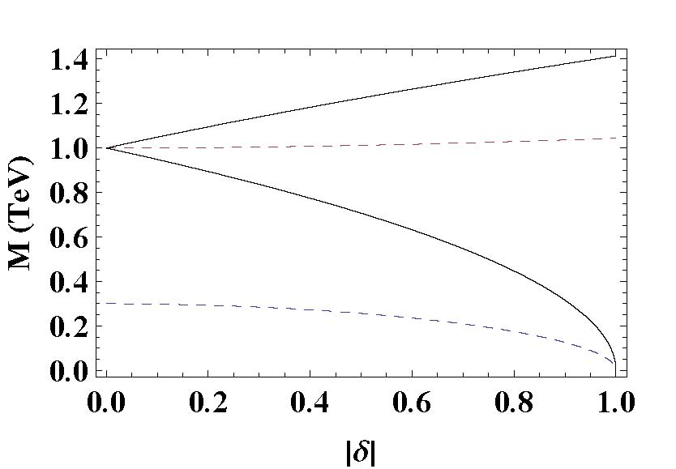

Slide 42
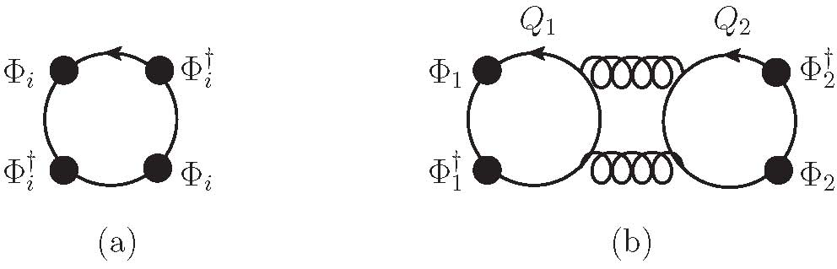
Mining term higher order in a large-N expansion, but order-one for small N

Slide 43
Additional negative contributions from the top quark, and from near-conformal dynamics
Couplings to SM fields slightly smaller than one in ultra-minimal TC

