Slide 1
PMG Topics
sPHENIX Update
Reconvene the HCAL review committee to discuss the HCAL closing as explained in the minutes and set a date for this review. Sept 17
Infrastructure upgrade review dates. Oct 17-18
Set up a regular meetings with the relevant experts to discuss machine-detector interface aspects.
Discuss with the magnet division the possibility to perform the field map of the sPHENIX magnet
Status of MoA
Recommendations from MVTX review and timeline to address them
Monitor the next item in the critical path (after the cradle carriage)
Define the month in CY23 that sPHENIX project is scheduled to be completed (POB recommendation)
Present plans for finishing the sPHENIX project earlier

Slide 2
sPHENIX Project Calendar
SAMPA (TPC) chip Design Review Aug 6
Visit to UIUC for EMCal Block discussions Aug 28-29
Meeting with BNL PD-2/3 Response committee Sept 3
DOE Monthly for July Sept 4
sPHENIX Software and Computing Review Sept 5-6
PMG Sept 5
BNL POB meeting Sept 6
sPHENIX Cryo RFP Initial Scoring Meeting Sept 11
OHCal Final Design Review Sept 17
RHIC Program S&T (DOE-ONP) Review Sep 17-19
2.X Cost and Schedule Review Oct 16-17 (17-18)

Slide 3
Recent Accomplishments
Passed the PD-2/3 approval review. Getting Concurrence/Approval signatures now.
Hired new Infrastructure engineer. Starts Oct 7.
Completed EMCal Sector 0
Instrumented OHCal Sector 1

Slide 4
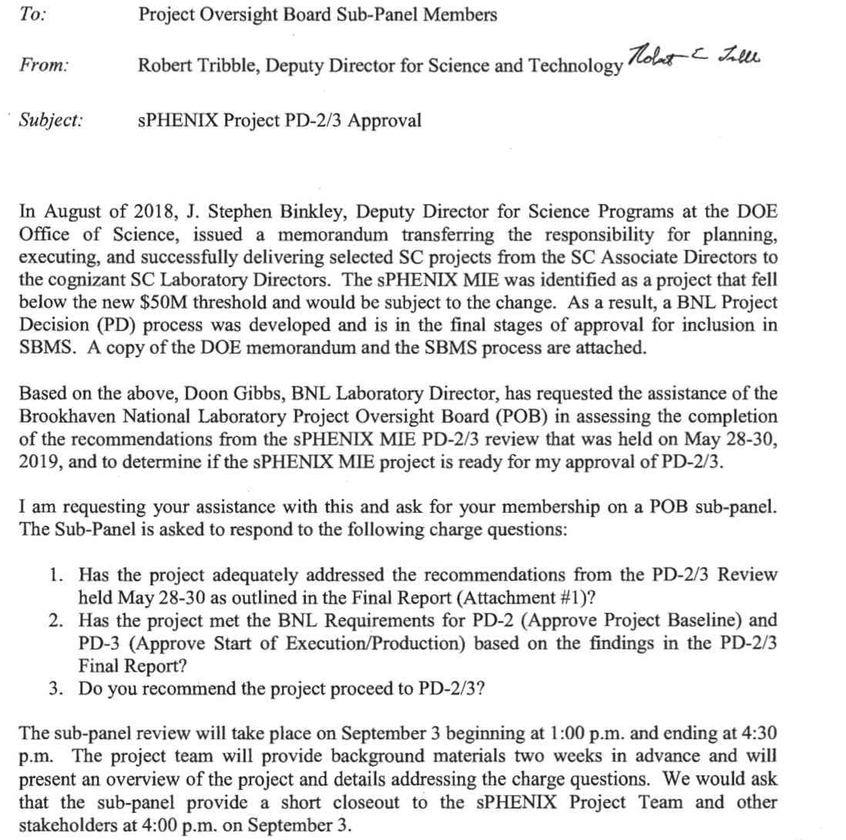
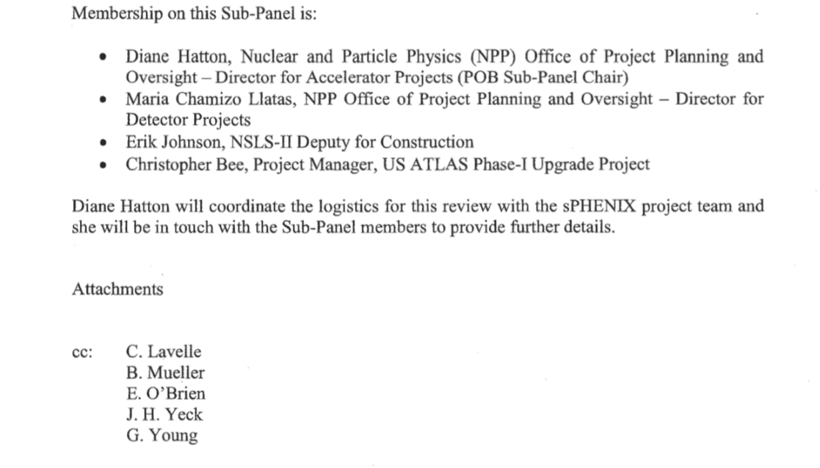
Charge for PD-2/3 Response Review

Slide 5
sPHENIX Technical Accomplishments
All 32 Outer Magnet Steel/HCal sectors now at BNL.
All LLP’s approved at CD-3A have been placed. They are: 100k SiPMs, 2500km of Scintillating fiber for EMCal, 7000 Scin tiles for HCal, 19 metric tons of tungsten powder for EMCal.
Partial delivery of LLP-1 orders, 60k/100k SiPMs, have arrived at Univ. of Michigan. Partial deliver of LLP-2 scintillating fibers, 600/2500 km, have arrived at UIUC. Fab work on LLP-3 has started at vendor
Testing of 1560 Preproduction scintillating HCal tiles complete at GSU. Yield >97%.
Assembly of 1st six OHCal sectors begun with preproduction parts.
Time Projection Chamber working point established using FNAL test beam data and Yale GEM Test Facility.
SAMPA v5 (TPC ASIC) engineering run chip order ready to submit to vendor. Funds being transferred to SBU for order. FDR complete.
EMCal preproduction Sector 0 assembly complete. Sector 1 blocks > 85% complete as UIUC.
MBD Prototype Discriminator/Shaper Board completed at Nevis Labs. At BNL for further testing.
Components needed to bring cryogenics into Bldg 1008 RFP ($1.1 M). Bids at BNL. Award pending.
Carriage/Cradle FDR held in August. Checking and sign-off of final drawings ongoing.
R&D work progressing on all sPHENIX detector components.

Slide 6
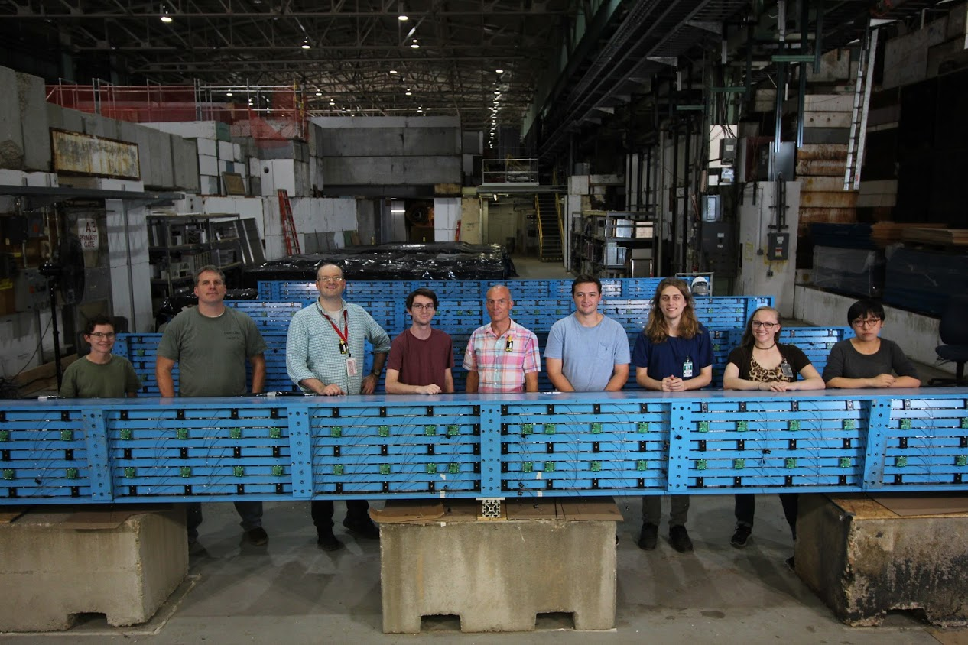
OHCal Instrumented Sectors
Collaborators from
Baruch, ISU, Lehigh, Ohio U, Rutgers & Wayne State working on instrumenting the first 6 sectors of the OHCal.
All electronics for 6 sectors exist. Waiting for delivery of a few sheet metal parts.

Slide 7
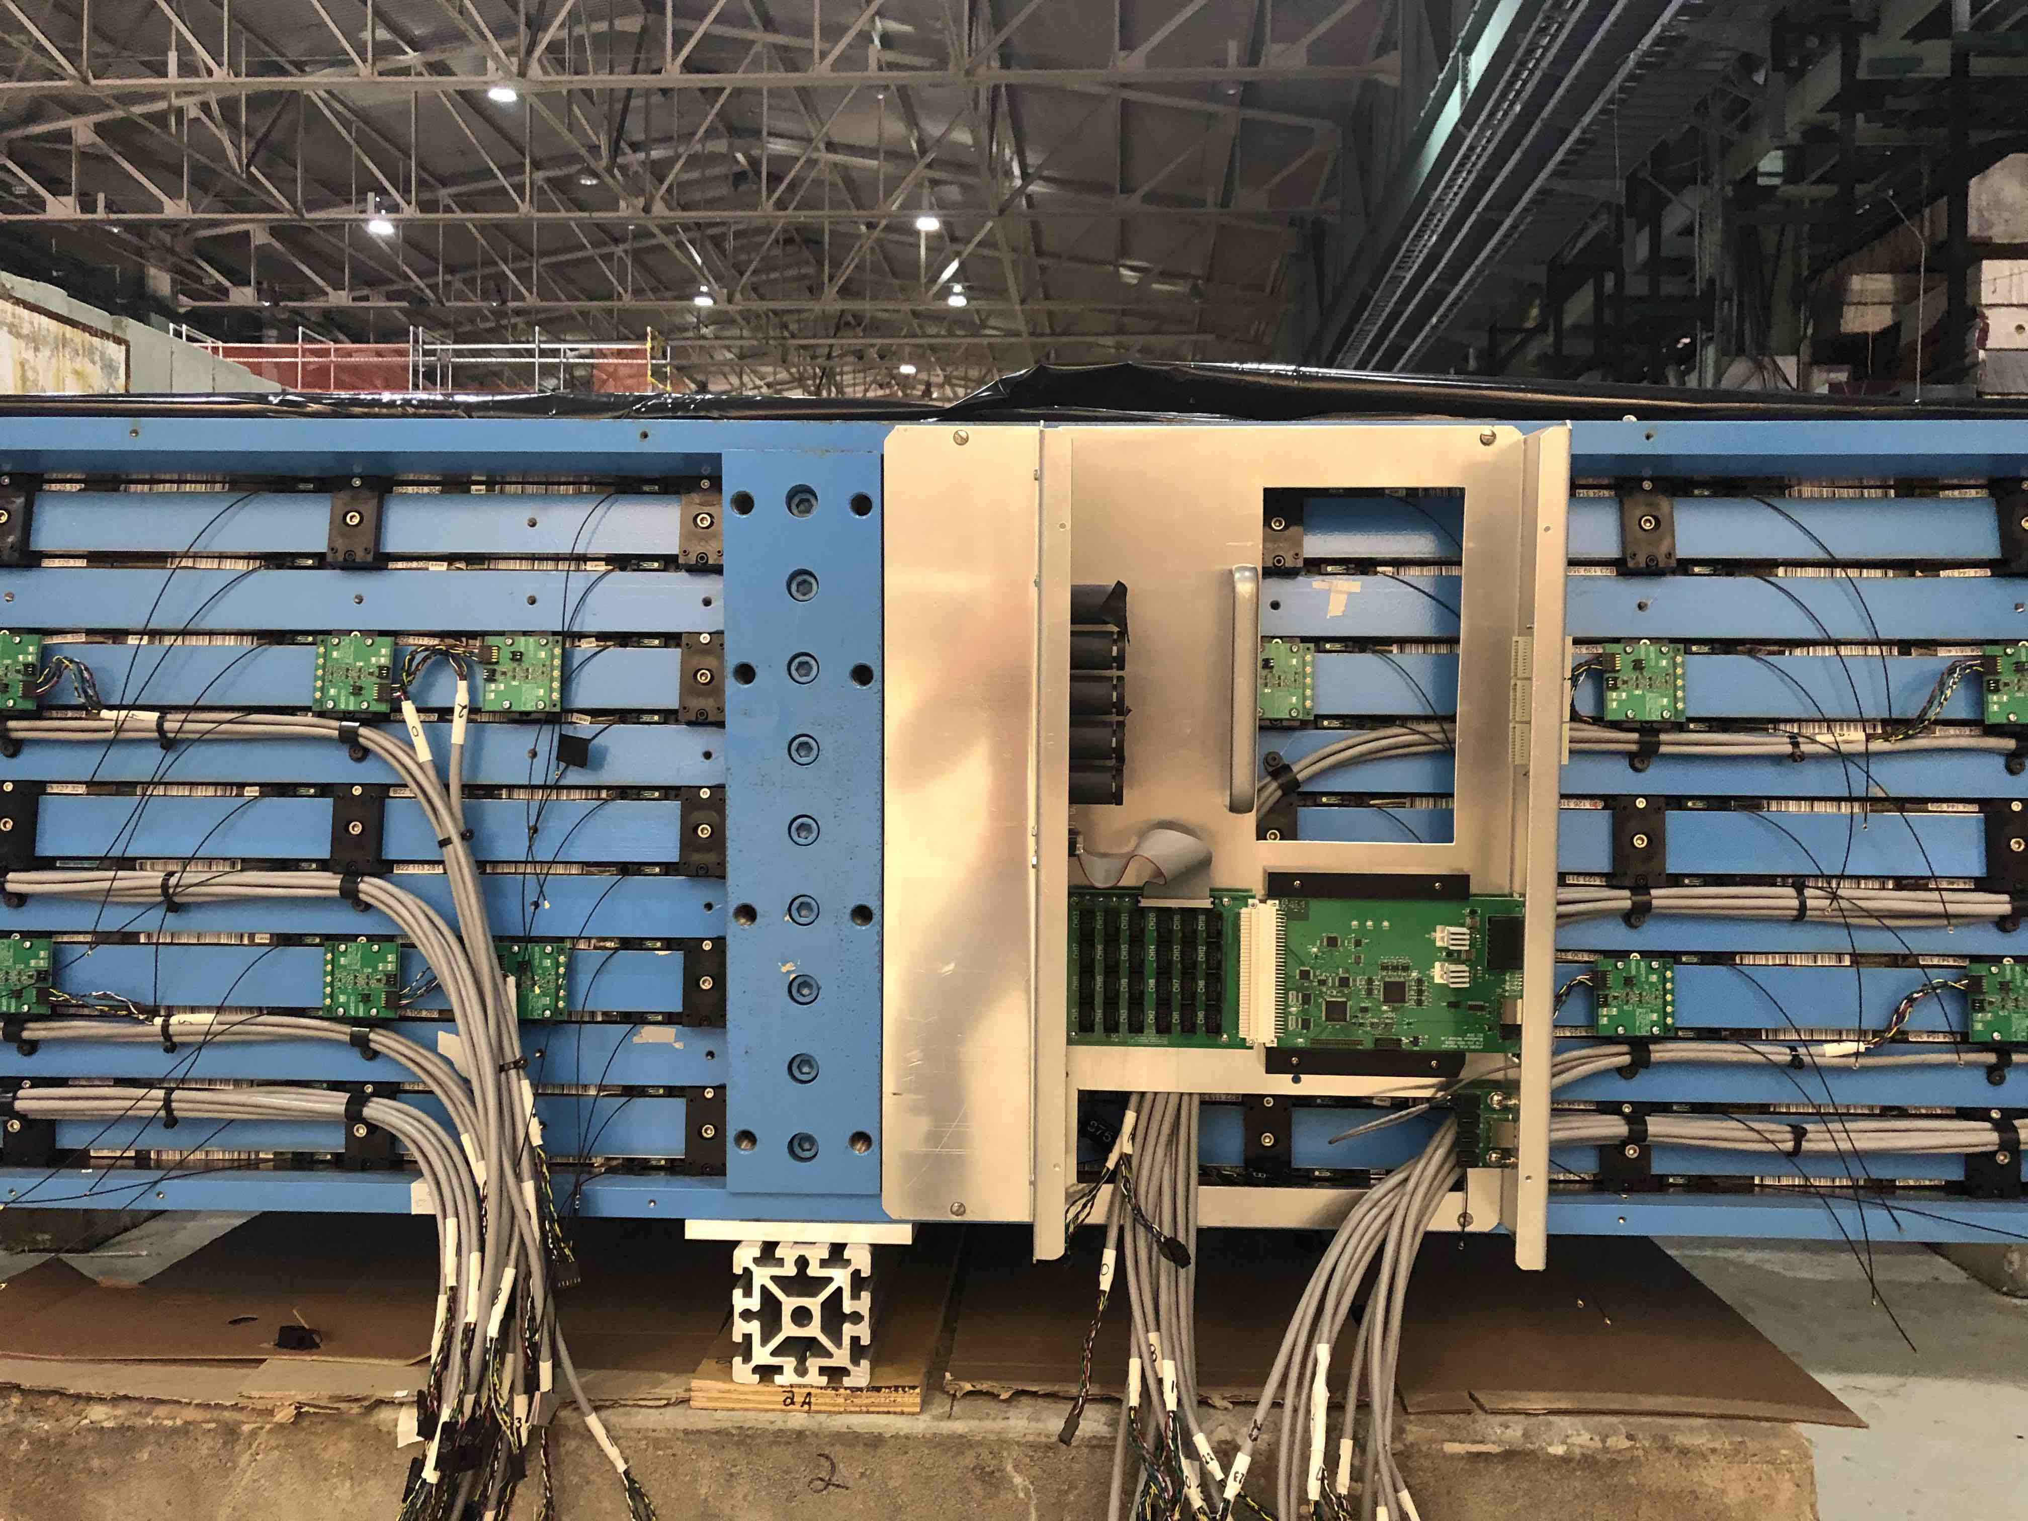
Calorimeter Electronics
HCal Module 1 during the installation of electronics and interior cabling. All SiPMs and preamps for 48 towers have been installed. Power cabling and installation of the north electronics box is in progress.

Slide 8
Regular sPHENIX-CAD Machine Meeting
Set up a regular meetings with the relevant experts to discuss machine-detector interface aspects.
John Haggerty has set up a regular monthly meeting to discuss sPHENIX Machine issues with Angelika Drees, Wolfram Fischer and Mike Blaskiewicz and other.
Issues to be covered:
Crossing angle
Diamond size
Maximum luminosity
Backgrounds, both chronic and acute
Abort kicker pre-fires

Slide 9
SMD Mapping of sPHENIX SC- Magnet
Discuss with the magnet division the possibility to perform the field map of the sPHENIX magnet.
John held an initial meeting with Piyush Joshi this week. SMD will develop a cost estimate for mapping the SC-Magnet and provide it to sPHENIX Management.

Slide 10
Status of the Final MoA with CAD
The one incomplete MoA with CAD includes:
Fab of new conventional beam pipes built to drawings provided by sPHENIX
Modification of central Be beam pipe based on drawings provided by sPHENIX
Management of Craft and Surveyors for 1008 Installation and Infrastructure
Mechanical support system for cryo installation
1008 HVAC
Electronics cooling water
Support for any mods to the AC power system including Arc flash calculations
Building safety systems and assist with detector safety systems
Any necessary 1008 building modification
Glenn Young and Jim Mills have provided Charlie Folz and Bill Christie with a detailed spreadsheet and P6 file plus a Requirements document written by the sPHENIX Project team.
We are ready to sign as soon as CAD responds with any requested revisions to the M&S cost and labor hour estimates in the spreadsheet. We’ll make the mods to the MoA after CAD review and sign.

Slide 11
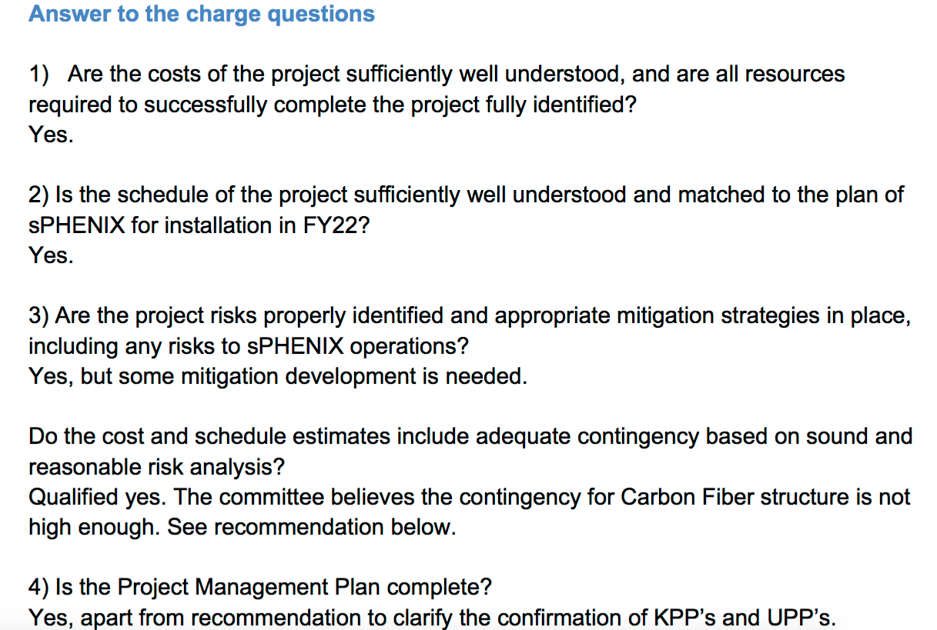
MVTX Review
A Director’s Cost and Schedule Review was held for the sPHENIX MVTX July 29-30 at BNL. The review committee was: David Lynn, Andrei Nomerotski, Sergio Rescia, Flemming Videbaek (Chair)
The charge questions:

Slide 12
MVTX Review Recommendations
The contingency for several of the carbon fiber fabrications should be increased to 60% in accordance with the methodology for assigning contingency. Update the budget ASAP so concurrence from BNL can be obtained for the overall budget. Complete
The project should pursue, in parallel to LBNL efforts, getting quotations from commercial vendors for the CF parts that at this point is the highest cost and risk in the project. Report to BNL management by this fall for selection of the optimal path forward. In Process
Removing the beam pipe flange and welding an extension section that places the flange outside the magnet volume is necessary to the existing insertion plan. C-AD is needed both to show it is possible and to do the work. sPHENIX and MVTX should continue discussions with the C-AD vacuum group to resolve the issue. Ensure that this activity of modifying the beam pipe is captured by an MOU with C-AD. In pending MoA with CAD
We recommend to add the full scale insertion mockup to the sPHENIX P6 cost and schedule. To be added
Include an appendix in the PMP that for each KPP and for each UPP has a paragraph that describes its precise definition, and the method by which it will be determined. Complete and submit the updated PMP to BNL management by the end of August. Complete

Slide 13
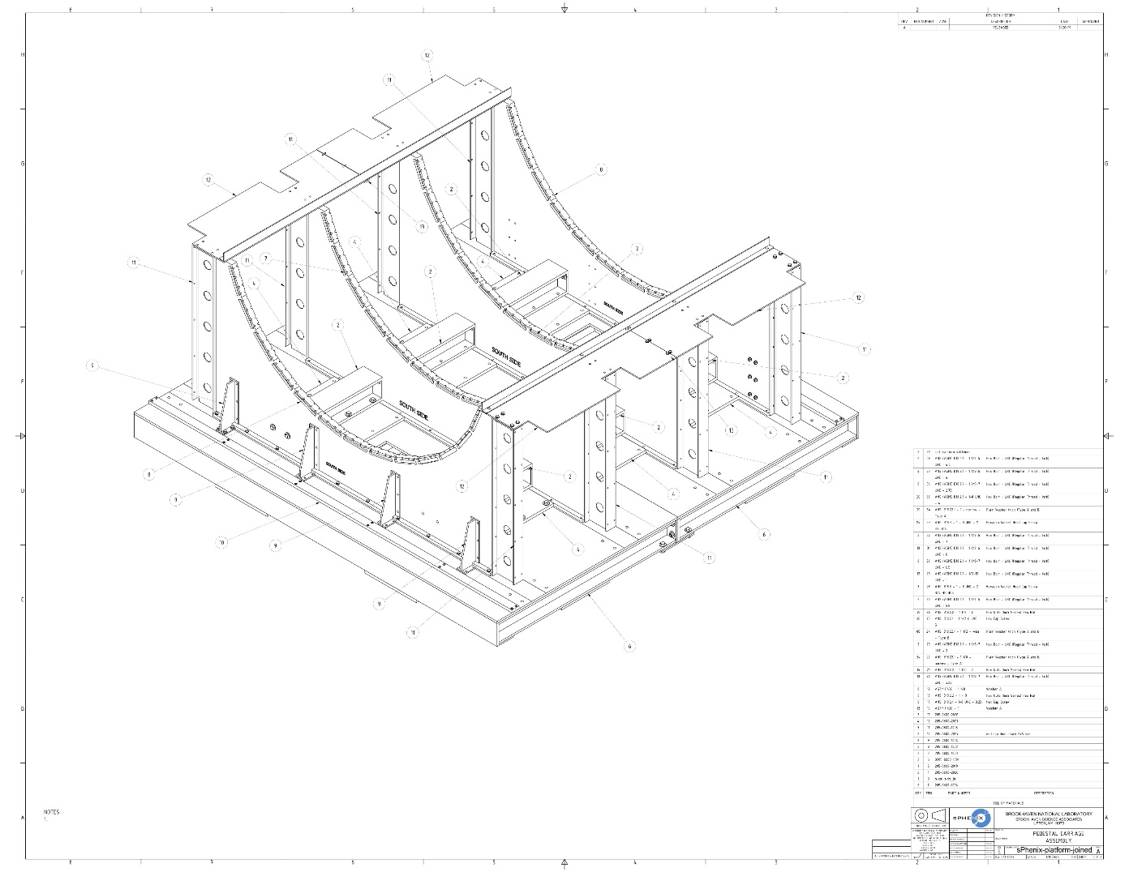
Carriage Cradle Status, 2.X Critical Path
Checking the final drawings prior to signatures. Will prepare bid package for PPM to be submitted in October
Early arrival of the carriage/cradle will allow us to generate schedule contingency on the 2.X
WEIGHT:132 TONS
DWG COUNT: 37

Slide 14
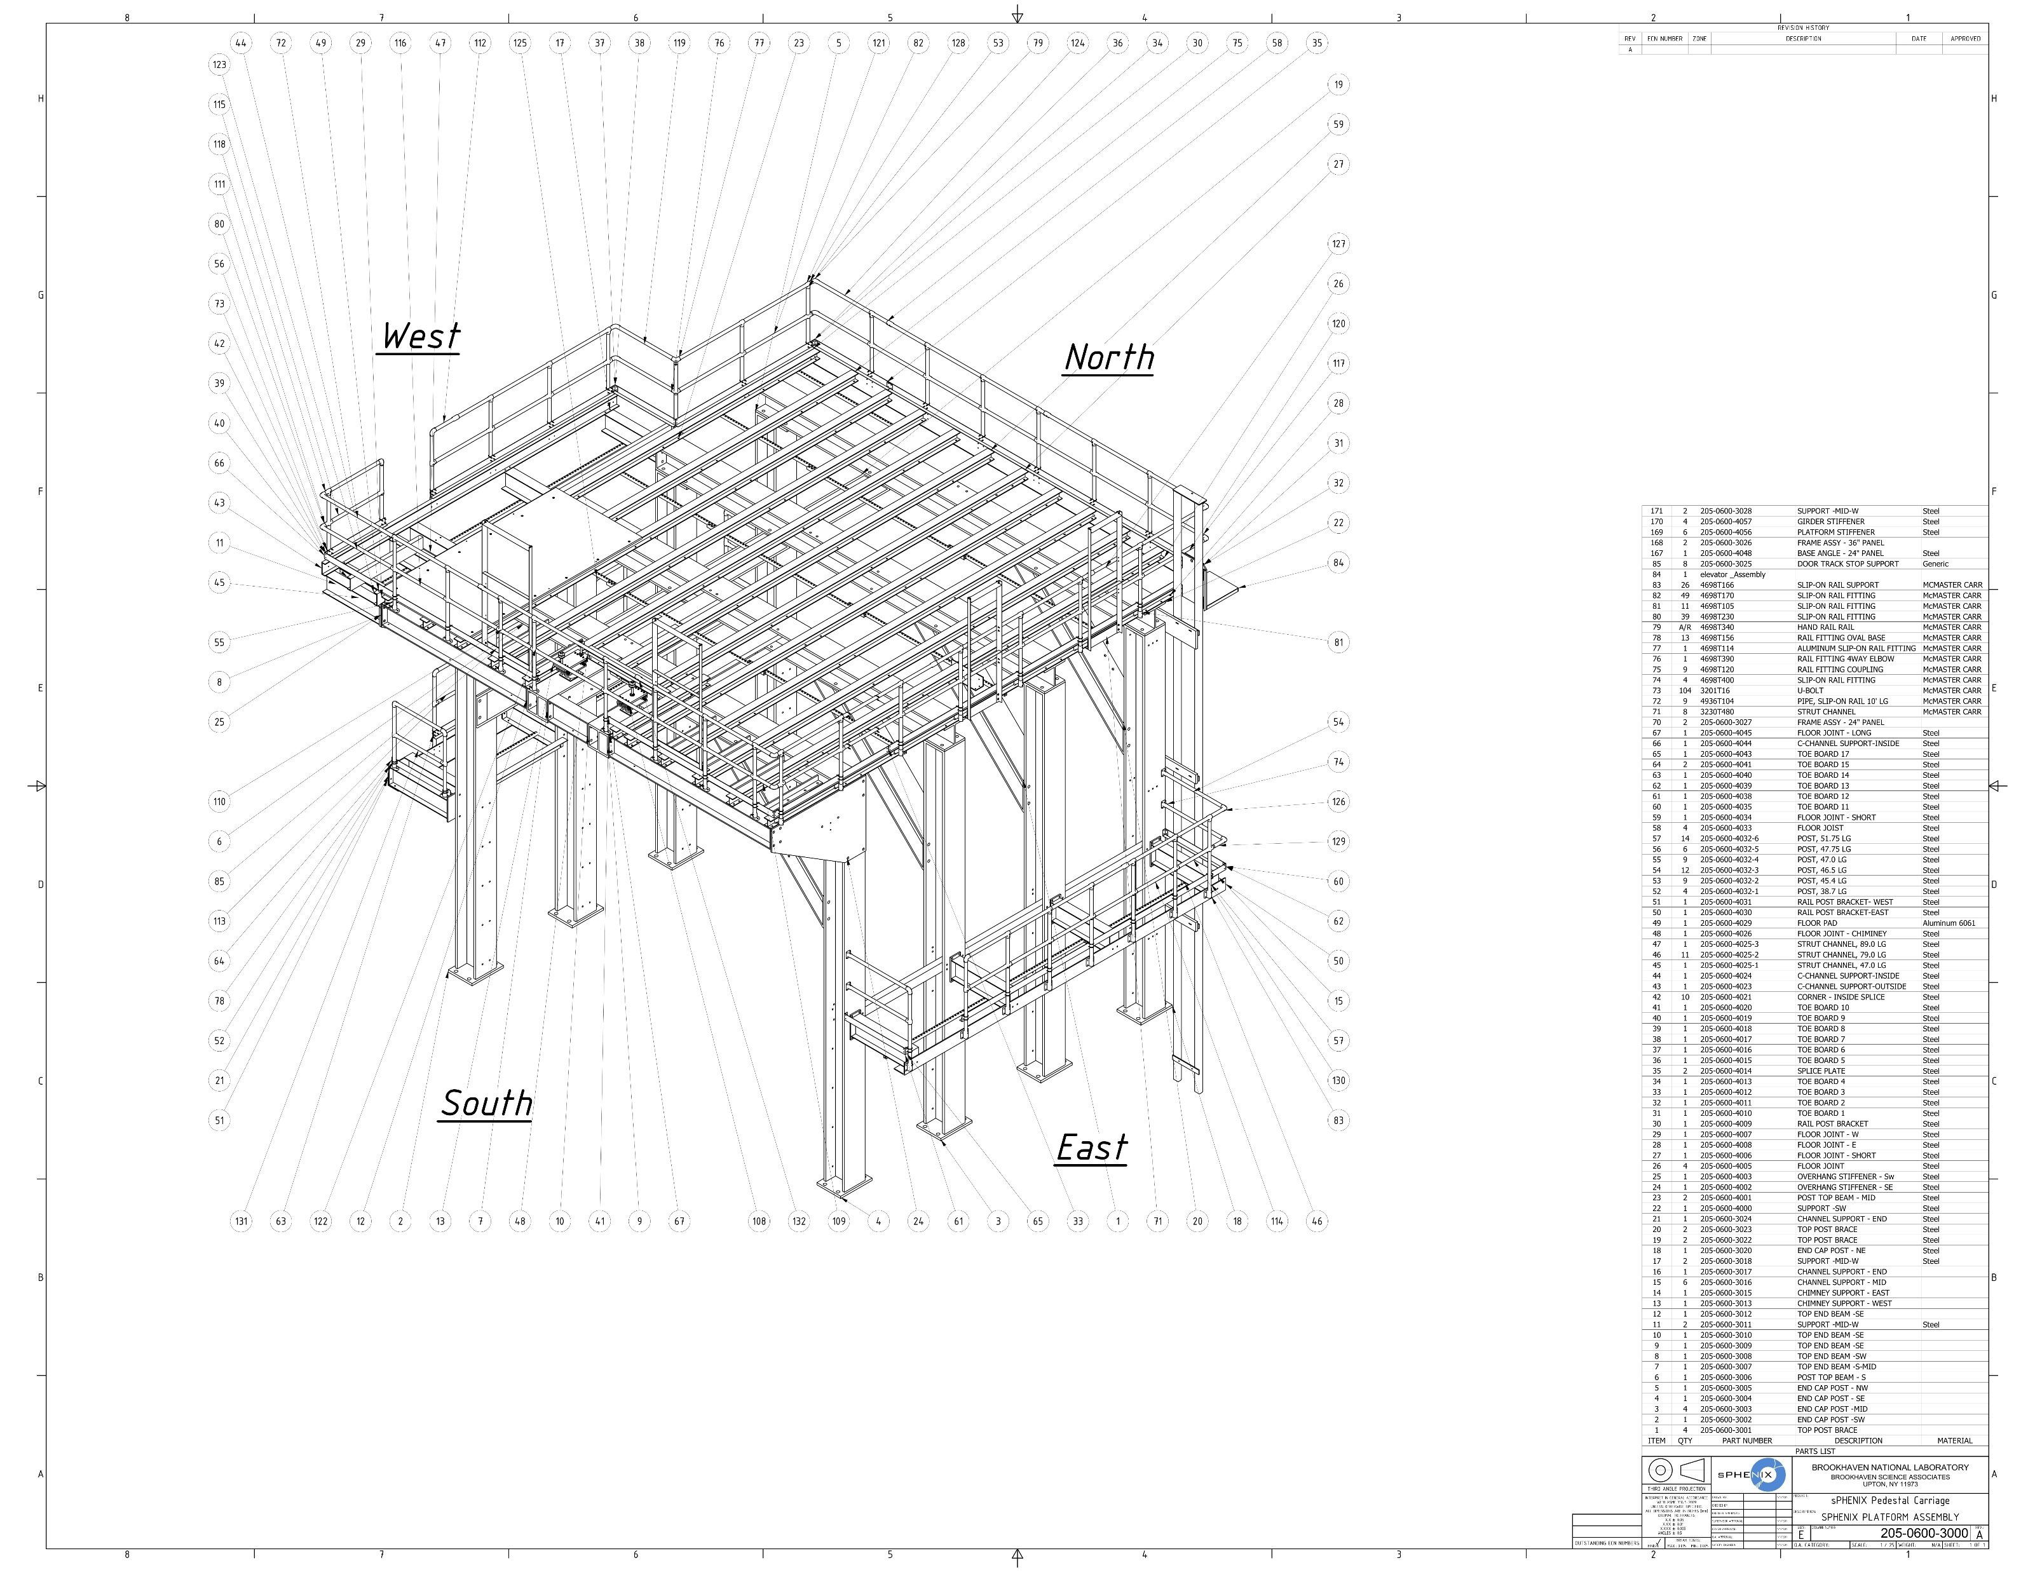
Platform Support Structure Next to Critical Path
The Platform construction schedule is the closest to the carriage/cradle 2.X critical path
We will look to move up the schedule for placing the platform order. Needs further P6 analysis.
WEIGHT:45 TONS
DWG COUNT: 78

Slide 15
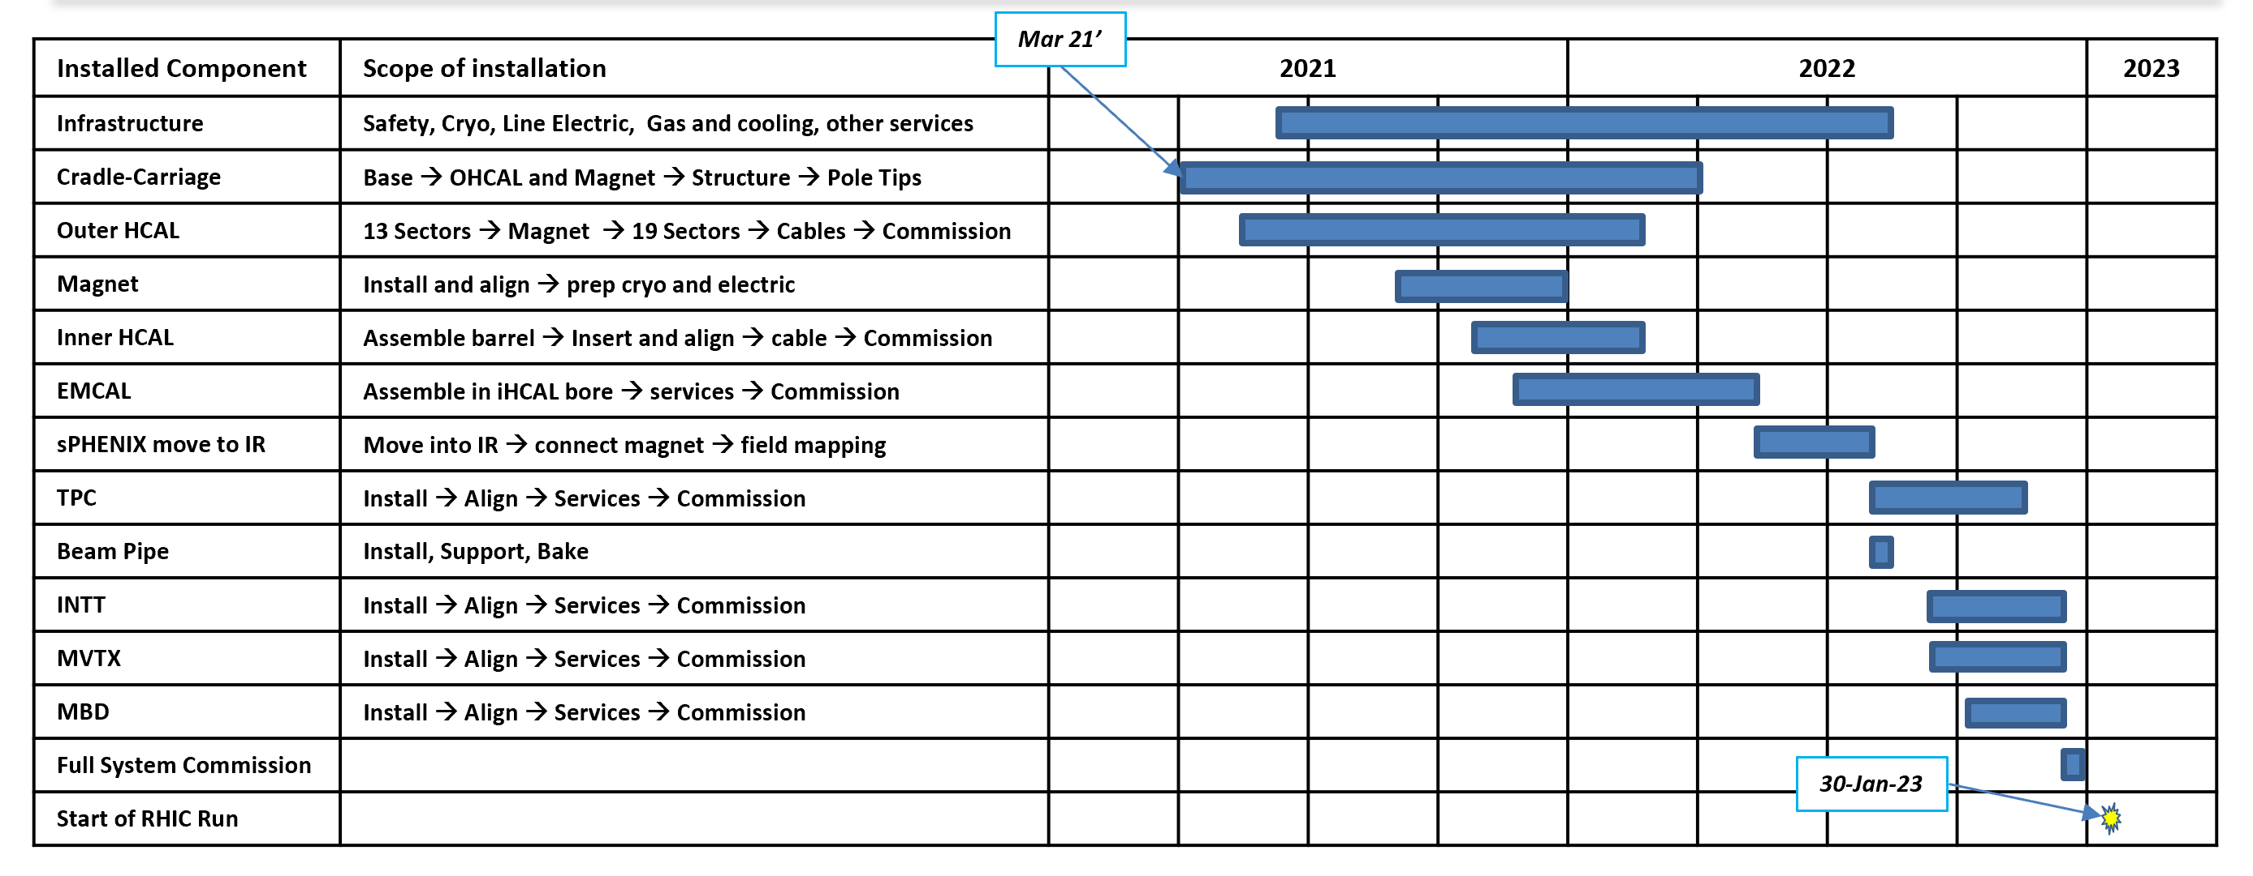
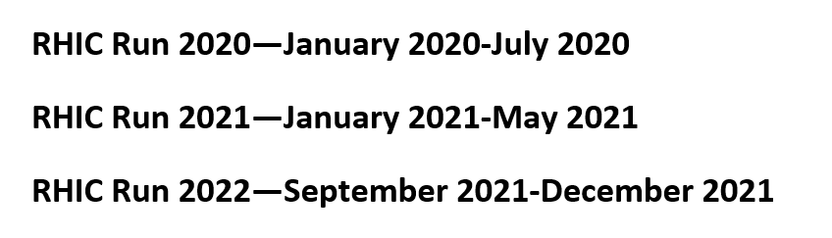
sPHENIX Installation/RHIC Run Schedule
Calendar Year

Slide 16
sPHENIX 2.X Schedule Improvement
There is 6 weeks schedule contingency between “sPHENIX installed, cabled and powered w/ subsystem commissioning complete” in mid-December 2022 and a Jan 31, 2023 start of Run-23.
We will work to increase the schedule contingency in preparation for the 2.X review.
Plan includes accelerating the Carriage/cradle, platform and cryo installation.
Moving the magnet mapping earlier.
Running double shifts with technicians doing subsystem installation during the day shift and students and scientists cabling and debugging during the swing shift.
Many if not all large experiments employ this procedure

Slide 17
Summary
We successfully completed the PD-2/3 Approval review this week and are waiting for final signatures on the approval document.
A lot of MIE and 2.X progress is being made on R&D, design, preproduction
Responses to MVTX Review recommendations in draft form
Preparing for 2.X review in mid-October
Regular CAD-sPHENIX meeting set up to discuss machine issues.
sPHENIX is ready to sign the final MoA with CAD once they suggest revisions if any to Cost and Labor estimates.
As part of the preparation for the 2.X review we would like to increase the 2.X schedule contingency if possible.

