Slide 1
LSST sensors: How will dark energy be constrained with lensed photo-conversions?
Andy Rasmussen, SLAC
131118

Slide 2
Scope
phenomena noticed to date in LSST sensor development program that may impact precision astronomy goals of the experiment
Summary of some modeling efforts and how parameters of those models may be estimated using data from the characterization program
list includes the following effects that are seen in flat field response. Impacts to astrometry may be inferred or measured directly:
  Tree rings
  Midline charge redistribution
  Edge rolloff
  Effects associated (?) with onset of tearing
  Effects associated with pixel-to-pixel variation in conversions collected at the channel

Slide 3
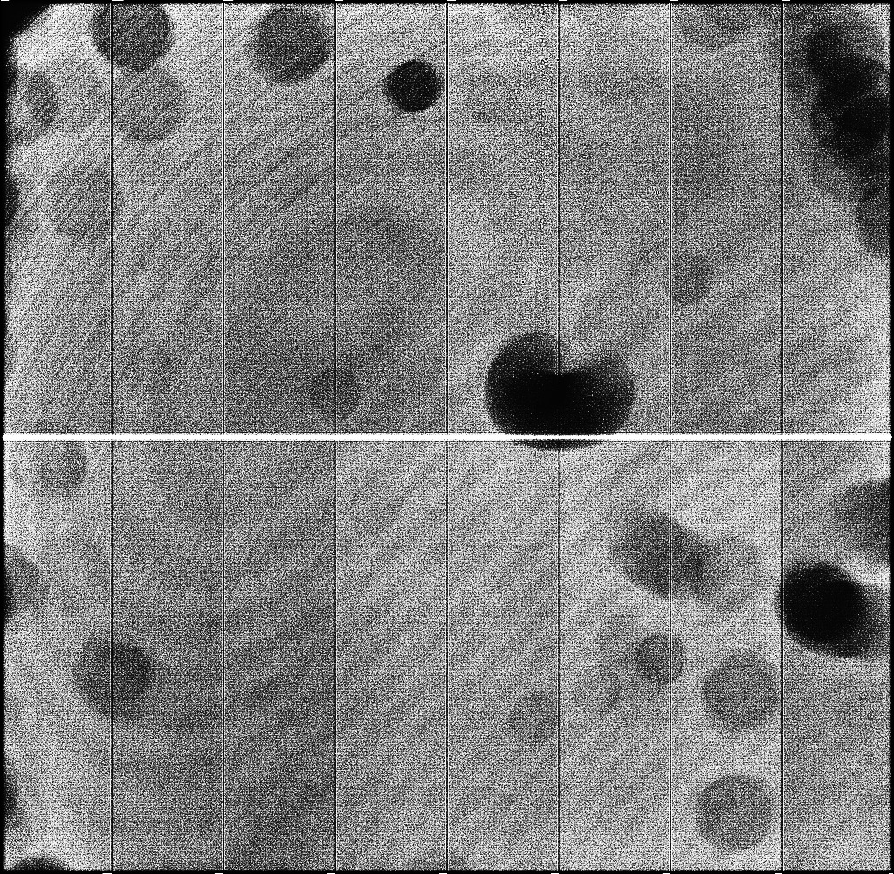
Distortion effects seen in flat field illumination: fixed pattern (1)
Fringing (expected to not an issue on LSST)
Tree rings (~30 pixel period), approx. parallel to fringes
Water marks on AR coating? Projections of dust particles?
Stretch (light grey:dark grey) ~ 1.005
Notes:
All,
Not to detract from the time-critical FDR preparation, but from a first
look at the "tear-free" BNL acquired image sequence taken March 22 from
sensor 112-04:
Indeed, the acquisition conditions of this data set do not show the
tearing features that traverse the imaging region. This alone would
suggest that either:
1) the holes populating volumes of the channel stops have saturated (or
fully bloomed within the implant), so that they are not efficiently
transferred toward the serial register of each amplifier. This would be
the same as the "outer" state we've seen in images that show tearing.
2) there are no holes occupying the channel stops, so no field free
volume. no holes are transported. This would be the same as the "inner"
state we've seen in images that show tearing.
By assembling the 16 amplifier segments, we clearly see pairs of columns
(first and last column on each amplifier) that contain roughly 5% less
signal than subsequent and previous columns. This points strongly to
possibility case (1) above: The imaging section has channel stops
saturated with holes, except for the channel stops that connect to
conductors on the segment boundary. Those channel stops appear to be
depleted of holes (they're swept away by the parallel clocks, never to
be seen again) - and a net negative line charge density compared to
adjacent channel stops.
This results in artifacts in the image where we clearly see the segment
boundary, much like the midline charge redistribution artifact, in fact
with the same polarity - the absence of holes there repels roughly 5% of
photoelectrons from collection at those columns. The number of pixels
affected is approximately 16*2048, plus the pixels in the a few adjacent
columns for each. The astrometric error may be 10-15% of the midline
feature's astrometric feature but this also affects 16 times as many
pixels.
These features described here may disappear if any of the following are
possible:
1] fully deplete the sensor (channel stop volumes included) with a
brief, strong field there. If that's possible, this would remove all
holes from the the potential wells enjoyed by the holes - response
variations between segments would vanish. This would be "inner state"
operation;
2] alter the parallel clock timing so that transport of positive charges
would be frustrated. If done right, this would keep the holes from being
swept out of the channel stops that delimit segments. This would be
"outer state" operation.
A third option would be to eliminate the "wire" between segments that
permits conduction of holes out of that one channel stop. This would
remove the uniqueness of those 8 channel stops, making them more like
the other 4000. I think we should go for having no holes in the channel
stops ("inner state"), or holes saturating the channel stops everywhere
("outer state"). If we are already undergoing a mask change to remove
the midline/bloomstop feature, we should also discuss/consider removing
this other "feature" that makes segment boundaries stand out like a sore
thumb. That is, unless we can demonstrate [1] above, that the holes
pervading the image section channel stops can be removed (and we run in
"inner state" operation).
Doing this should make the segment boundary become smooth as a baby's
butt-butt.
Does anybody foresee any problems that might arise from removing these
"wires", that can't be fixed by a regenerative clock sequence?
andy

Slide 4
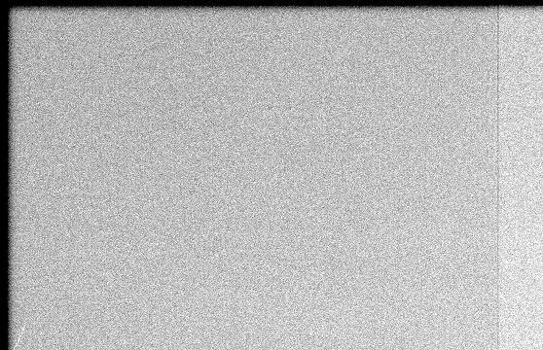

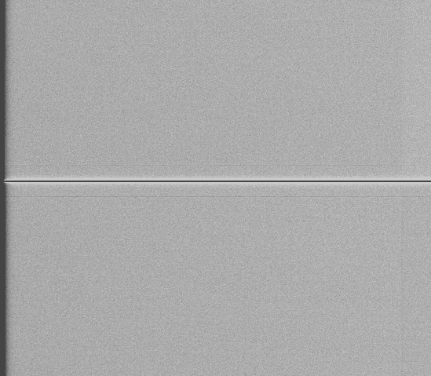
Distortion effects seen in flat illumination: fixed pattern (2)
“edge rolloff”: guard ring drain bias induced lateral field distortions (flat field response, corresponding astrometric and shape transfer errors)
9
10
11
12
13
14
15
16
“midline charge redistribution”: bloom stop implant induced lateral field distortions (flat field response, corresponding astrometric and shape transfer errors)
8
7
6
5
4
3
2
1

Slide 5
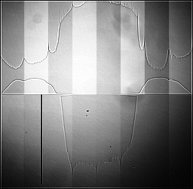
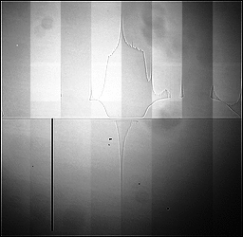
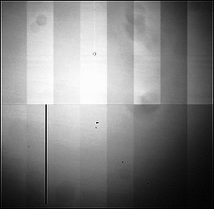
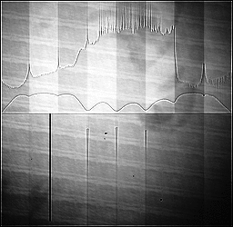
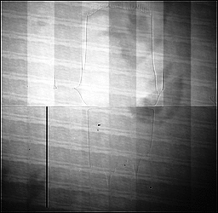
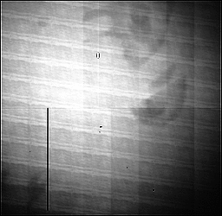
Distortion effects seen in flat field illumination: non-fixed pattern, “tearing”. Stretch ~ 1.05:1
bss00_700nm
bss25_700nm
bss50_700nm
bss00_500nm
bss25_500nm
bss50_500nm

Slide 6
Distortion effects seen in flat field illumination: nonlinear isotropic mean-variance relation and anisotropic autocorrelation

Slide 7
tools
The backdrop of this investigation is a strawman 1-D electrostatic solution to Poisson’s equation given externally applied boundary conditions (V_{BSS})
Implementation of this model is coupled to a ray trace simulator so it also includes:
  EM modeling of AR coating layers and dimensions of the photosensitive volume [QE(λ,T,θ) incl. fringing]*
  Drift time computation and isotropic diffusion estimation**
*e.g. Groom et al., Rajkanan et al. etc.
  **e.g. Prigozhin et al., Canali et al., Jacobini et al. etc.

Slide 8
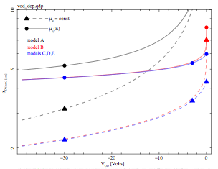
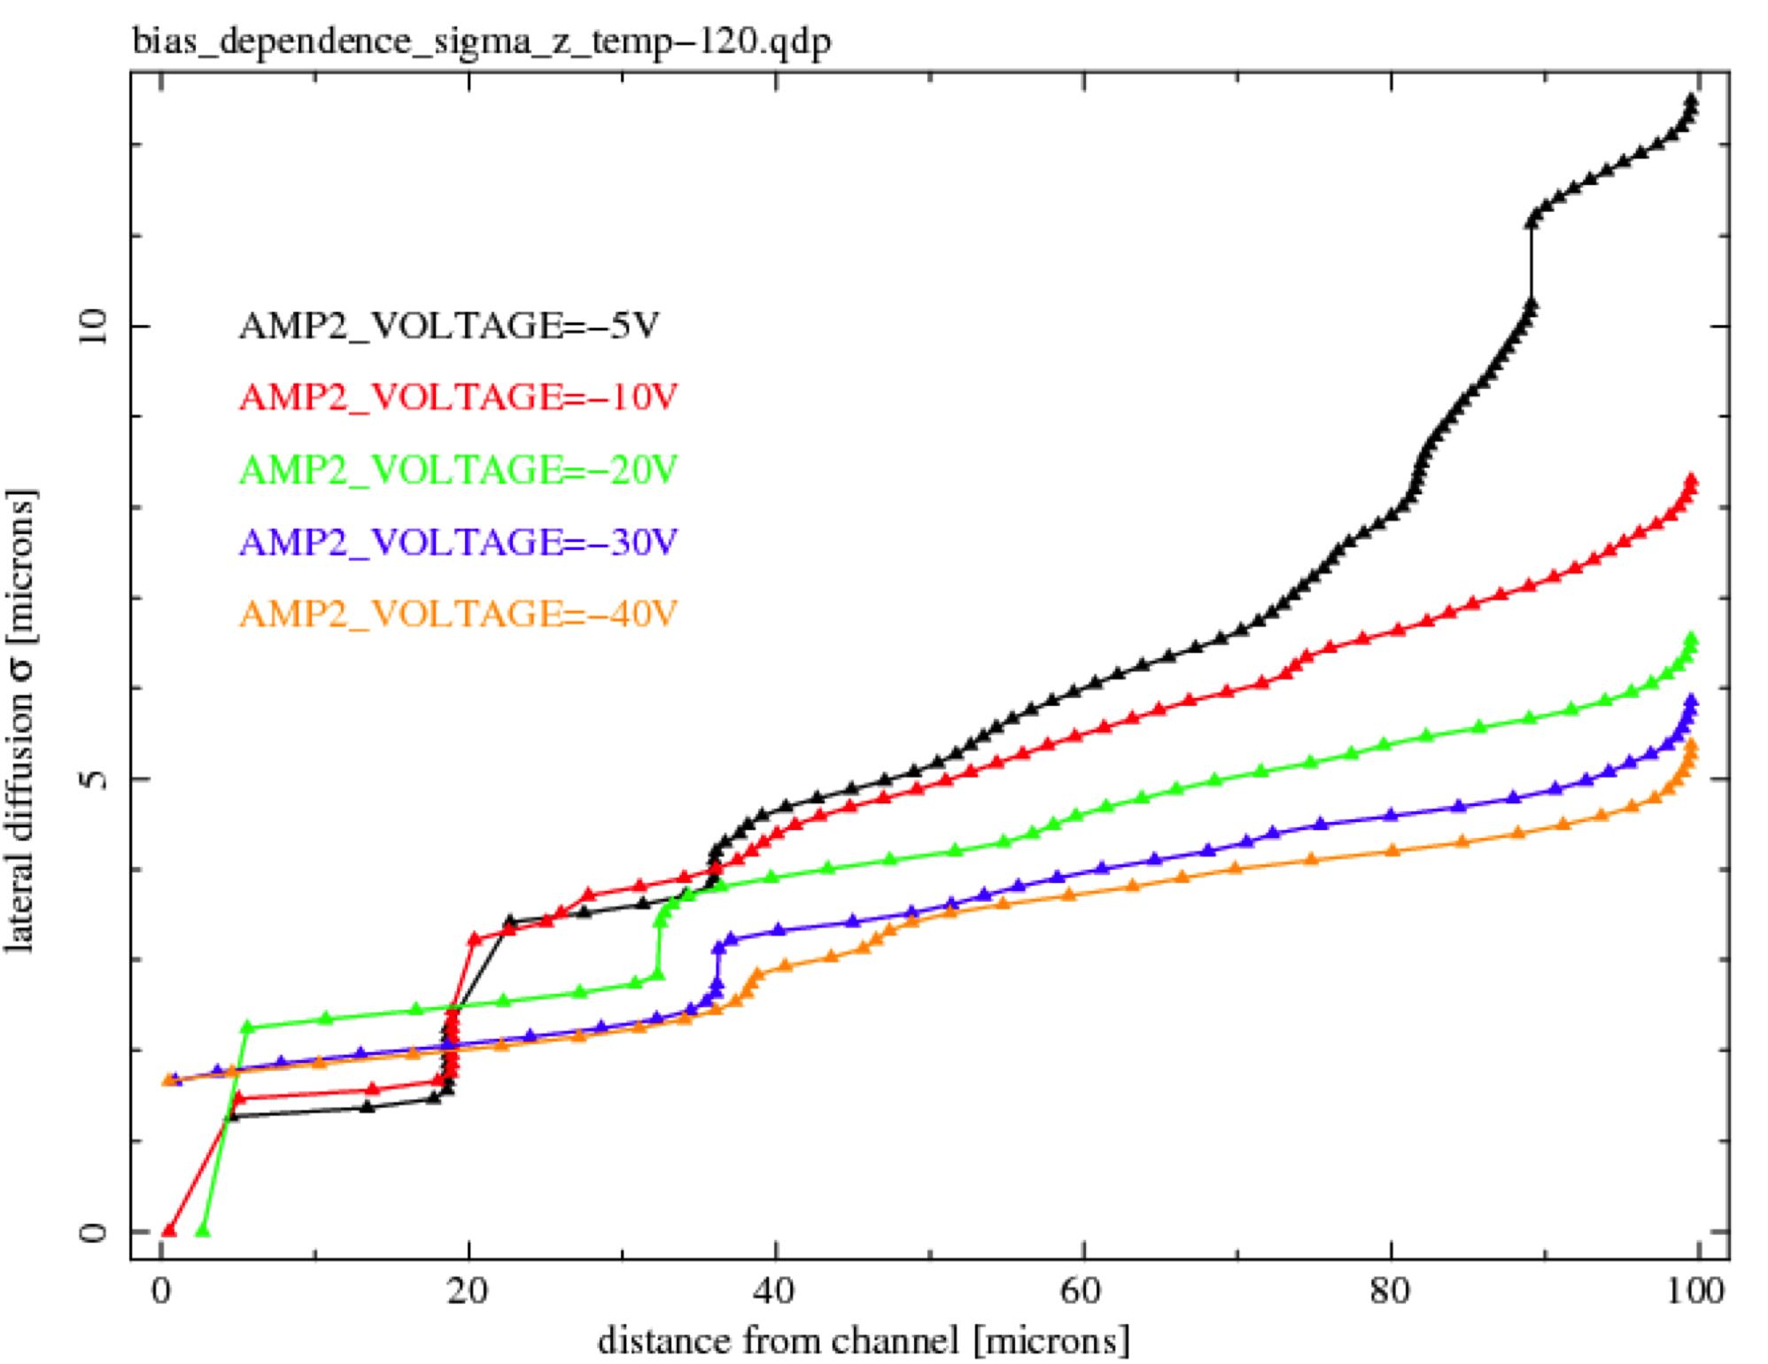
Sensor Diffusion contribution to PSF – veocity saturation
Strong constraints to σ(z) provided by Fe⁵⁵ data for various bias voltages
Predicted surface conversion diffusion scale: σ(z=100μ) for different doping profiles & bias voltages (transport theory vs. carrier velocity saturation)

Slide 9
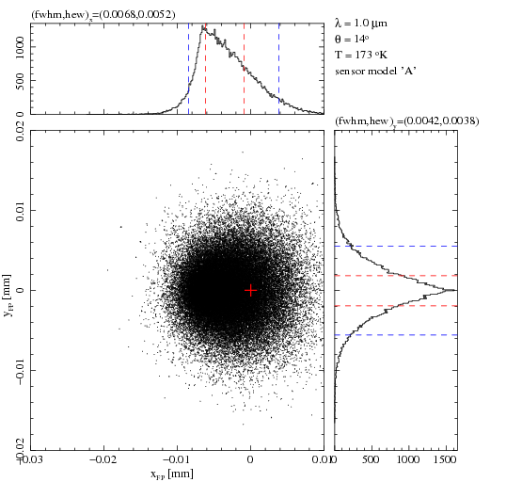
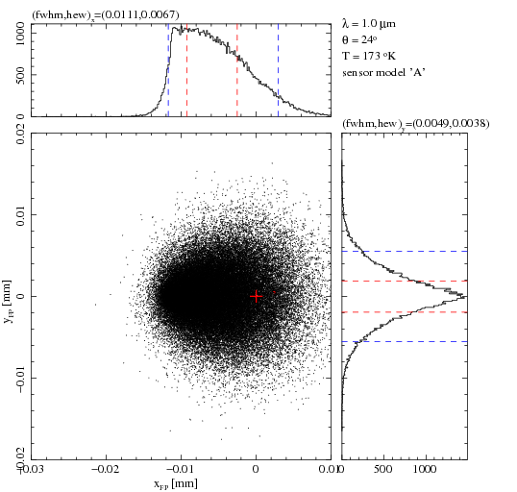
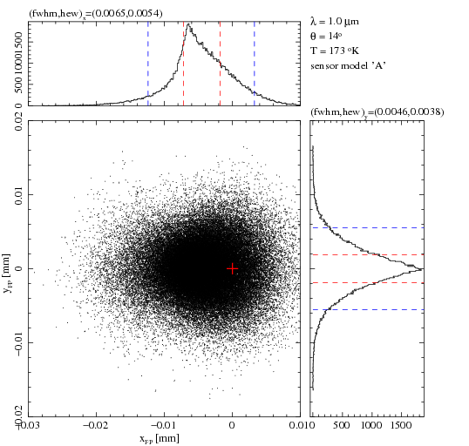
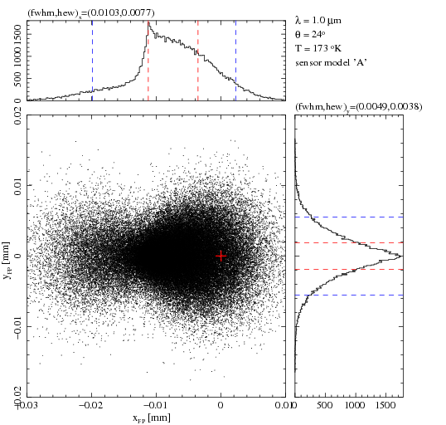
Potential fringing effects on science:
pencil beam computations
λ = 1.0μm; 100μm thick
1 pixel = 0.2”
No reflection from final interface:
No fringing.
Final medium = Si
shift
Pencil beam aim point
Θ=14°
Θ=24°
Finite reflection from final interface:
Finite fringing.
Final medium = SiO₂
Ratio & shift modulated by fringing..

Slide 10
tools (2)
On top of the CCD/Si drift model backdrop, additional mechanisms that modify drift of the conversions are required to mimic the phenomena listed above:
  Tree rings – variations in N_{A} of the Si wafer cause lateral fields (due to δρ_{b} in depleted medium)
  midline charge redistribution, edge rolloff – presence of isolated charge confining features or abrupt change in the layout of those features
  Onset of tearing – transient variations in hole capacity and/or their saturation in channel stops
  Apparent channel carrier occupancy gradients
Dirichlet boundary conditions at the backside electrode and at the clocks were applied together with plausible field distortion terms. Poisson equation still holds in the photosensitive medium

Slide 11
tools (3)
Lateral drift due to is handled approximately by combining 1-D Poisson solutions and applying equipotential boundary conditions at backside window and at the clocks. This is justified because the displacement field strength is small compared to the externally applied field
All other field distortions were applied in the form of electrostatic line charge (and point charge) distributions – with corresponding image charge distributions placed about the planes of symmetry (cf. Jackson, standard electrostatics trick)
  Channel stop p+ implants, when depleted, form a negatively charged line charge density
  It has a positively charged image opposite the clocks
  The two form a dipole in 2 dimensions
  The dipole has an image opposite the backside window, 2*thickness away. A dipole’s image is the dipole itself, just in a different location. Etc..
  Dipoles at z=0, +/-2t, +/-4t, +/-6t, .. +/-2(n-1)t, +/- 2nt.
To “dipole lattice” field is added the “backdrop” 1-D drift field
Test particles are followed, drift times integrated, ultimate resting locations for the conversions are recorded
NB – values of dipole moments can be calibrated. A priori knowledge requires both charge counts and their standoff positions relative to equipotential planes. Standard dipole strengths were as follows:
Unit 2D dipole: ξ=5e5 q distributed over pixel dimension, a depth 100nm from clocks
Unit 3D dipole: P=1e5 q in channel a depth 500nm from clocks
Notes:
Field parameters: -7 kV/cm @ backside; Na ~ 1e12; T = -173K; Jacobini/Canali mobility model (velocity saturation)
Xi moment = 1e5 * 1e3 * q * 1e-3/10.0 [coul*cm/cm] = 1e4 e- pix/pix = 1e6 e-*(0.1um)/10um (1e6 e- over 10um with implant at 50nm)
P moment = 1e5 * q * 1 * 1000e-7 (FW 10nm from surface) [coul*cm] = 1e5 e- * 1um (channel located at 500nm)
q= 1.6e-9 coul
CS = 40 Xi
Ck = 1 Xi
Channel: 1 P

Slide 12
Tree rings results (amplitude dependence on BSS)

Slide 13
ΔN_{a} ≈ 130 mm⁻² (p/2π)² x 10¹⁰ cm⁻³ ≈ 4E9 cm⁻³
bss00 corresponds to field strength of ~ 0.8 kV/cm near backside
Reduction in tree rings with increased bss should almost exactly follow reduction in isotropic diffusion with bss

Slide 14
Fourier decomposition of connects astrometric error, shape transfer & apparent flat field response variation (due to ingot impurity var)
u
g
r
i
Astrometric error amplitude
z
y4
(point response only;
does not include ellipticity due to
pixel elongation)
Shape transfer amplitude
Calib. point
Flat field response amplitude

Slide 15
Results (eyeball comparisons)

Slide 16
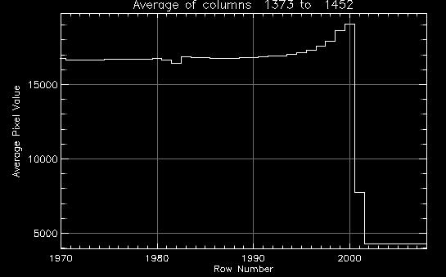
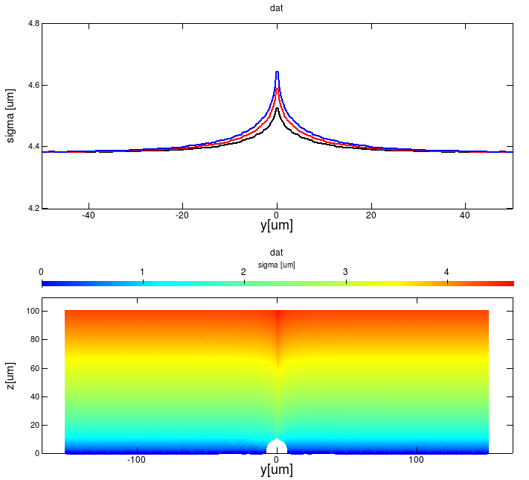
Midline charge redistribution

Slide 17
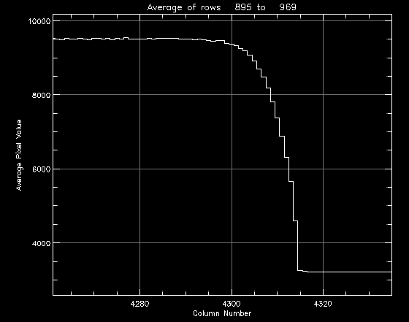
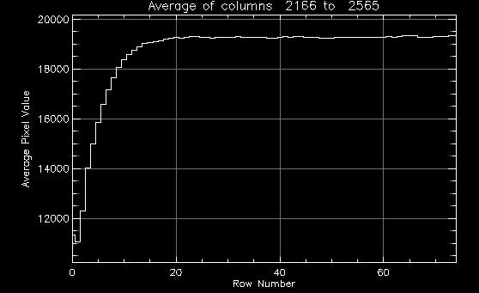
Edge roll-off effects
Last (or first) columns
First rows

Slide 18
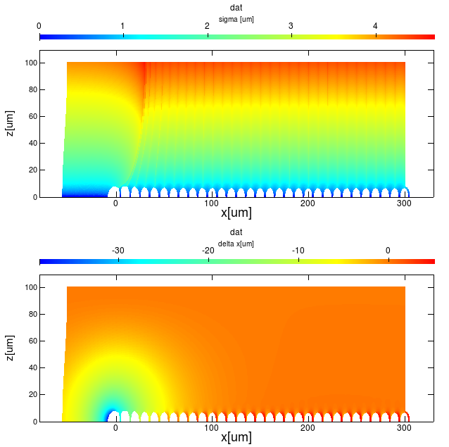
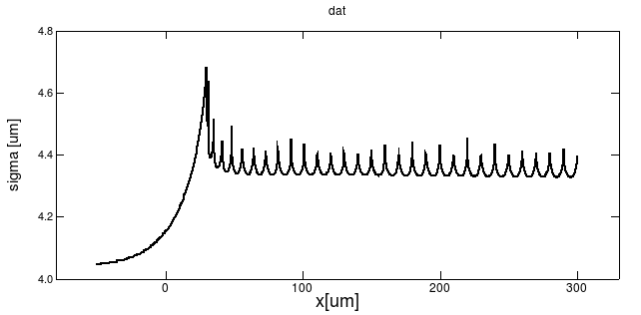
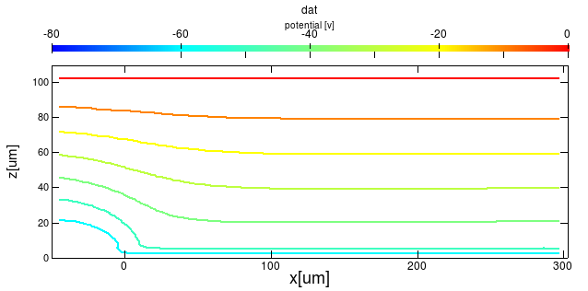
Edge rolloff effects
NB: no guard ring..
σ(x,z)
moment = 20ξ & 40ξ
flat field response (pix)
astrometric shift (pix)
Δx (x,z)
NB: specific predictions for diffusion-position coupling!
σ_{max}(x)
φ (x,z)
Notes:
Field parameters: -7 kV/cm @ backside; Na ~ 1e12; T = -173K; Jacobini/Canali mobility model (velocity saturation)
Xi moment = 1e5 * 1e3 * q * 1e-3/10.0 [coul*cm/cm] = 1e4 e- pix/pix = 1e6 e-*(0.1um)/10um (1e6 e- over 10um with implant at 50nm)
P moment = 1e5 * q * 1 * 1000e-7 (FW 10nm from surface) [coul*cm] = 1e5 e- * 1um (channel located at 500nm)
q= 1.6e-9 coul
CS = 40 Xi
Ck = 1 Xi
Channel: 1 P

Slide 19
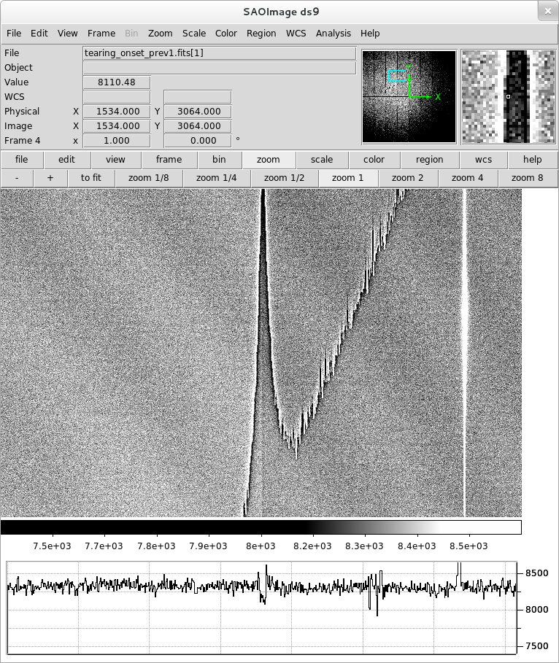
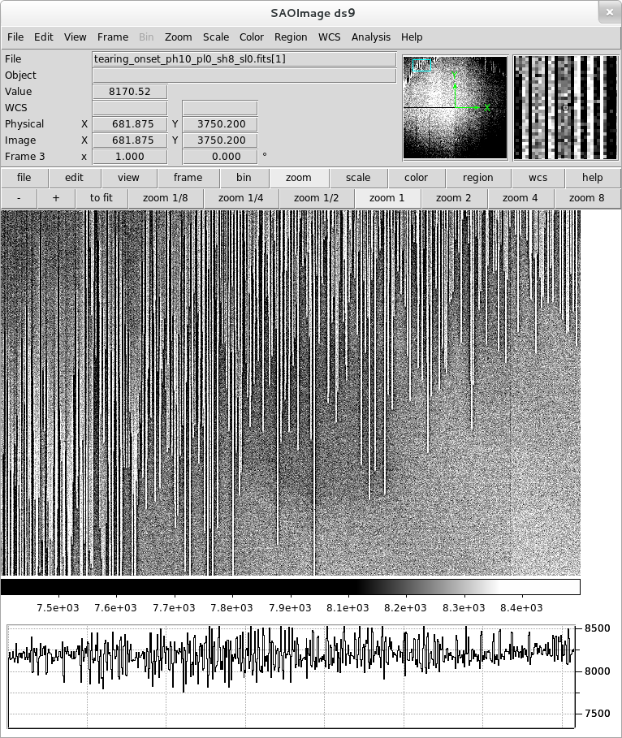
‘Tearing’ onset
PH10.0_PL0.00_SH8.00_SL0.50
1301160209
PH10.0_PL0.00_SH8.00_SL0.00
1301160207

Slide 20
Tearing onset “knows” about parallel transfer: bright finger
ΔlnC ~ 5e-2 between adjacent columns and over 500 rows !!

Slide 21
Tearing onset doesn’t “know” about serial transfer: bright finger
ΔlnC = 5e-2
data
Drift calculation

Slide 22
‘Tearing’ onset
PH10.0_PL0.00_SH8.00_SL0.50
1301160209
PH10.0_PL0.00_SH8.00_SL0.00
1301160207

Slide 23
Tearing onset at amplifier border
Channel 11
Channel 12
ΔlnC = 5e-2

Slide 24
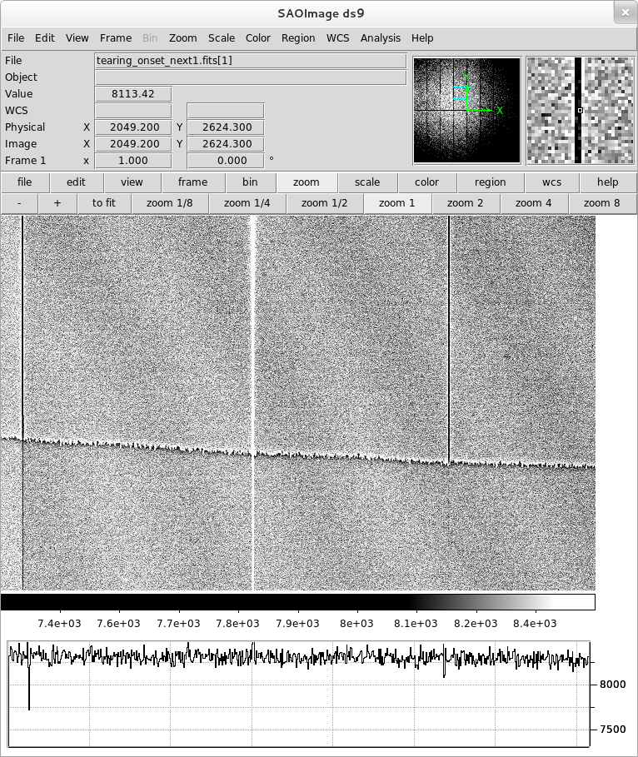
‘Tearing’ onset (dark border)
“outer” state
“inner” state
PH9.50_PL2.00_SH10.00_SL2.00
1301160205

Slide 25
“Tearing” onset (dark border)
Channel 12
Channel 13
ΔlnC = 5e-2
“outer” state
“inner” state
data
Drift calculation

Slide 26
‘Tearing’ onset (dark border)
News flash!
Clock inversion prior to exposure appears to remove tearing feature(s) in the subsequent readout.
-> “outer” state operation for entire sensor including dark border?
“outer” state
“inner” state
PH9.50_PL2.00_SH10.00_SL2.00
1301160205

Slide 27
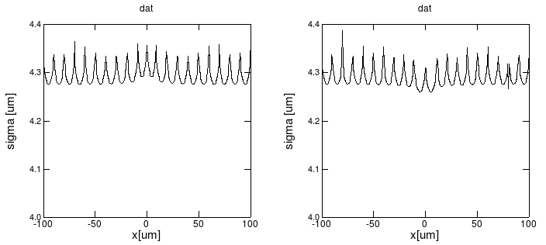
Tearing onset: dark borders (left) & bright fingers (right)

Slide 28
Channel carrier occupancy gradient
Response to collected charge is computed in the presence of the two lateral containment fields that produce saddle surfaces due to the superposition of the dipole expansion and the backdrop drift field
Pixel boundary locus is mapped by forward folding backside surface positions that bracket the boundary (drift to adjacent pixels) and then doing a binary search

Slide 29
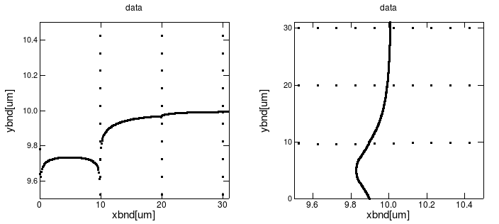
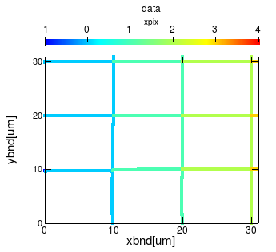
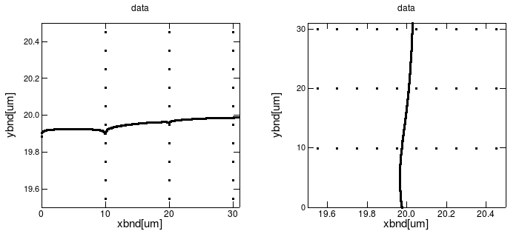
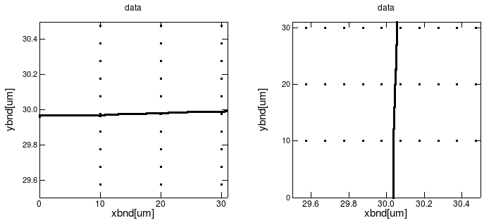
Channel distortion: dynamic pixel boundaries at back surface
Equiv. drift coefficients:
A: 0.3; B: 0.15 pix²/P
A
B
E
C
C
D
B
D
F
A
x
distorted (central) pixel boundaries:
Reduce pixel area
Alter aspect ratio
Become convex between rows
Become concave between columns
Provide both drift coefficients to compare against autocorrelation values using an intermediate FF simulator
E
F

Slide 30
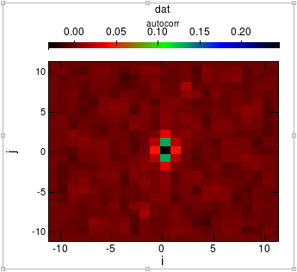
“Uncalibrated” comparison to Astier et al. anisotropic flat field autocorrelation study
25kADU/pix
data
calculation
Modeled autocorrelation, normalized to R(0,0)=1
Final counts per pixel = 250ke- and using these
drift coefficients:
(x): 6E-7 pix^2/e-
(y): 2E-6 pix^2/e-
j \ i | -3 | -2 | -1 | 0 | 1 | 2 | 3
-3 | 0.012 | 0.005 | 0.002 | 0.017 | -0.010 | 0.007 | 0.013
-2 | 0.008 | 0.019 | 0.011 | 0.078 | 0.009 | 0.001 | -0.007
-1 | 0.000 | 0.011 | 0.052 | 0.310 | 0.049 | -0.003 | -0.014
0 | -0.011 | 0.003 | 0.103 | 1.000 | 0.103 | 0.003 | -0.011
1 | -0.014 | -0.003 | 0.049 | 0.310 | 0.052 | 0.011 | 0.000
2 | -0.007 | 0.001 | 0.009 | 0.078 | 0.011 | 0.019 | 0.008
3 | 0.013 | 0.007 | -0.010 | 0.017 | 0.002 | 0.005 | 0.012
Notes:
Drift coefficient values: xresp_1000=6e-4; yresp_1000=2e-3. integrate to 250000. cf. prev. plot
Reference:
Document-14327,
Study of the e2v ccd 250 :
PSF and pixels response sensitivity to light intensity
Pierre Astier, Augustin Guyonnet, Nicolas Regnault, Sylvain Baumont, Pierre Antilogus, LPNHE (Paris)1

Slide 31
Drift coefficients also predict a specific nonlinear (isotropic) gain-variance relation for free..
Notes:
Ref:
[1] M. Downing et. al. CCD riddle: a) signal vs time: linear; b) signal vs variance: non-linear. Proc SPIE, pages 6276–09, 2006.

Slide 32
Next steps (fixed pattern charge redistribution & tearing onset)
As the edge rolloff effect is modestly sensitive to the guard ring drain bias, this measurement will probably place strongest constraints on the channel stop dipole moment. Indications are moment ~ 40ξ or possibly as low as ~20ξ depending on guard ring is “on” and its geometry is known
Midline charge redistribution appears to have moment of ~ 20ξ
Isolated channel stop carrier occupancy variation (tearing onset features) can be calibrated, but appear to be roughly 2ξ or 5% of base channel stop

Slide 33
CS moment = 40ξ
 |  | fractional area – 1
 |  | X coordinate
 |  | -2 | -1 | 0 | 1 | 2
Y coordinate | -2 | 0.0014 | 0.0021 | 0.0031 | 0.0020 | 0.0015
 | -1 | 0.0020 | 0.0013 | 0.0100 | 0.0013 | 0.0020
 | 0 | 0.0029 | 0.0008 | -0.0902 | 0.0009 | 0.0029
 | 1 | 0.0020 | 0.0012 | 0.0101 | 0.0012 | 0.0020
 | 2 | 0.0015 | 0.0022 | 0.0031 | 0.0021 | 0.0015
 |  | astrometric shift (along y direction) [mas]
 |  | X coordinate
 |  | -2 | -1 | 0 | 1 | 2
Y coordinate | -2 | 0.36 | 0.77 | 1.14 | 0.77 | 0.36
 | -1 | 0.31 | 1.03 | 3.57 | 1.03 | 0.31
 | 0 | 0.00 | 0.00 | 0.00 | 0.00 | 0.00
 | 1 | -0.31 | -1.03 | -3.56 | -1.03 | -0.31
 | 2 | -0.36 | -0.77 | -1.13 | -0.77 | -0.36
 |  | Pixel Aspect Ratio X/Y-1 [dimensionless]
 |  | X coordinate
 |  | -2 | -1 | 0 | 1 | 2
Y coordinate | -2 | 0.001 | -0.002 | -0.006 | -0.002 | 0.001
 | -1 | 0.004 | 0.000 | -0.028 | 0.000 | 0.004
 | 0 | 0.008 | 0.023 | 0.019 | 0.023 | 0.008
 | 1 | 0.004 | 0.000 | -0.029 | 0.000 | 0.004
 | 2 | 0.001 | -0.002 | -0.006 | -0.002 | 0.001
 |  | astrometric shift (along x direction) [mas]
 |  | X coordinate
 |  | -2 | -1 | 0 | 1 | 2
Y coordinate | -2 | 0.08 | 0.17 | 0.00 | -0.17 | -0.08
 | -1 | 0.48 | 0.86 | 0.00 | -0.85 | -0.48
 | 0 | 0.84 | 2.52 | 0.01 | -2.52 | -0.84
 | 1 | 0.48 | 0.86 | 0.00 | -0.85 | -0.48
 | 2 | 0.08 | 0.17 | 0.00 | -0.17 | -0.08

Slide 34
CS moment = 20ξ
 |  | fractional area – 1
 |  | X coordinate
 |  | -2 | -1 | 0 | 1 | 2
Y coordinate | -2 | 0.0010 | 0.0016 | 0.0026 | 0.0016 | 0.0010
 | -1 | 0.0016 | 0.0015 | 0.0152 | 0.0015 | 0.0017
 | 0 | 0.0026 | 0.0060 | -0.1064 | 0.0061 | 0.0027
 | 1 | 0.0016 | 0.0015 | 0.0152 | 0.0015 | 0.0016
 | 2 | 0.0010 | 0.0015 | 0.0027 | 0.0015 | 0.0010
 |  | astrometric shift (along y direction) [mas]
 |  | X coordinate
 |  | -2 | -1 | 0 | 1 | 2
Y coordinate | -2 | 0.30 | 0.65 | 0.98 | 0.65 | 0.30
 | -1 | 0.26 | 0.92 | 3.89 | 0.92 | 0.26
 | 0 | 0.00 | 0.00 | 0.00 | 0.00 | 0.00
 | 1 | -0.26 | -0.92 | -3.89 | -0.92 | -0.26
 | 2 | -0.29 | -0.65 | -0.98 | -0.65 | -0.29
 |  | Pixel Aspect Ratio X/Y-1 [dimensionless]
 |  | X coordinate
 |  | -2 | -1 | 0 | 1 | 2
Y coordinate | -2 | 0.000 | -0.002 | -0.006 | -0.002 | 0.000
 | -1 | 0.003 | 0.000 | -0.033 | 0.000 | 0.003
 | 0 | 0.006 | 0.026 | 0.020 | 0.026 | 0.006
 | 1 | 0.003 | 0.000 | -0.033 | 0.000 | 0.003
 | 2 | 0.000 | -0.002 | -0.006 | -0.002 | 0.000
 |  | astrometric shift (along x direction) [mas]
 |  | X coordinate
 |  | -2 | -1 | 0 | 1 | 2
Y coordinate | -2 | 0.19 | 0.21 | 0.00 | -0.21 | -0.18
 | -1 | 0.54 | 0.86 | 0.00 | -0.85 | -0.54
 | 0 | 0.87 | 2.93 | 0.00 | -2.93 | -0.87
 | 1 | 0.54 | 0.86 | 0.00 | -0.85 | -0.54
 | 2 | 0.19 | 0.21 | 0.00 | -0.21 | -0.18

Slide 35
Modeling approach
Modeling approach: compute Greens function, in this case is a distortion of the boundaries
Drift coefficients for the neighboring pixels can be tested against reproducing the observed isotropic gain-variance relation and anisotropic autocorrelation matrix R(k,l) of Astier et al
Since channel stop dipole moment is already tightly constrained by edge rolloff, these two (?) degrees of freedom can be used to obtain the effective moment ratio (channel stops – to – clocks) and to set the channel moment scale (i.e. position of the buried channel)
Specific predictions to Greens function (pixel boundary distortion) naturally follow given supported values for these three parameters

Slide 36
Summary
With the motivation to understand better a handful of physical effects seen in the flat field illumination of candidate LSST sensors, we developed a strawman charge drift model based on 2- and 3-D dipole electrostatics vector arithmetic
Using plausible choices for available parameters, the model generates predictions for variations in the fixed pattern effects: pixel size, pixel centroid, and pixel aspect ratio or ellipticity
Greens functions were calculated to make specific predictions for similar variations in pixel properties that would respond to signal content at the channel during integration – i.e. dynamic response. Preliminary indications suggest a reasonable match to flat field autocorrelation maps
Plan to generate point source- and flat field-distortion predictions using Greens function – to test correction matrix retrieval from distorted flat fields: do we need reasonably constrained drift models, or do flat fields provide enough information – to correct swollen PSFs??
Will investigate how well the distortion matrices can be used with raw (distorted) pixel data to recover (undistorted) source parameters.

Slide 37
backups

Slide 38
“tearing free image” of 112-04, Mar22 2013
Notes:
All,
Not to detract from the time-critical FDR preparation, but from a first
look at the "tear-free" BNL acquired image sequence taken March 22 from
sensor 112-04:
Indeed, the acquisition conditions of this data set do not show the
tearing features that traverse the imaging region. This alone would
suggest that either:
1) the holes populating volumes of the channel stops have saturated (or
fully bloomed within the implant), so that they are not efficiently
transferred toward the serial register of each amplifier. This would be
the same as the "outer" state we've seen in images that show tearing.
2) there are no holes occupying the channel stops, so no field free
volume. no holes are transported. This would be the same as the "inner"
state we've seen in images that show tearing.
By assembling the 16 amplifier segments, we clearly see pairs of columns
(first and last column on each amplifier) that contain roughly 5% less
signal than subsequent and previous columns. This points strongly to
possibility case (1) above: The imaging section has channel stops
saturated with holes, except for the channel stops that connect to
conductors on the segment boundary. Those channel stops appear to be
depleted of holes (they're swept away by the parallel clocks, never to
be seen again) - and a net negative line charge density compared to
adjacent channel stops.
This results in artifacts in the image where we clearly see the segment
boundary, much like the midline charge redistribution artifact, in fact
with the same polarity - the absence of holes there repels roughly 5% of
photoelectrons from collection at those columns. The number of pixels
affected is approximately 16*2048, plus the pixels in the a few adjacent
columns for each. The astrometric error may be 10-15% of the midline
feature's astrometric feature but this also affects 16 times as many
pixels.
These features described here may disappear if any of the following are
possible:
1] fully deplete the sensor (channel stop volumes included) with a
brief, strong field there. If that's possible, this would remove all
holes from the the potential wells enjoyed by the holes - response
variations between segments would vanish. This would be "inner state"
operation;
2] alter the parallel clock timing so that transport of positive charges
would be frustrated. If done right, this would keep the holes from being
swept out of the channel stops that delimit segments. This would be
"outer state" operation.
A third option would be to eliminate the "wire" between segments that
permits conduction of holes out of that one channel stop. This would
remove the uniqueness of those 8 channel stops, making them more like
the other 4000. I think we should go for having no holes in the channel
stops ("inner state"), or holes saturating the channel stops everywhere
("outer state"). If we are already undergoing a mask change to remove
the midline/bloomstop feature, we should also discuss/consider removing
this other "feature" that makes segment boundaries stand out like a sore
thumb. That is, unless we can demonstrate [1] above, that the holes
pervading the image section channel stops can be removed (and we run in
"inner state" operation).
Doing this should make the segment boundary become smooth as a baby's
butt-butt.
Does anybody foresee any problems that might arise from removing these
"wires", that can't be fixed by a regenerative clock sequence?
andy

Slide 39
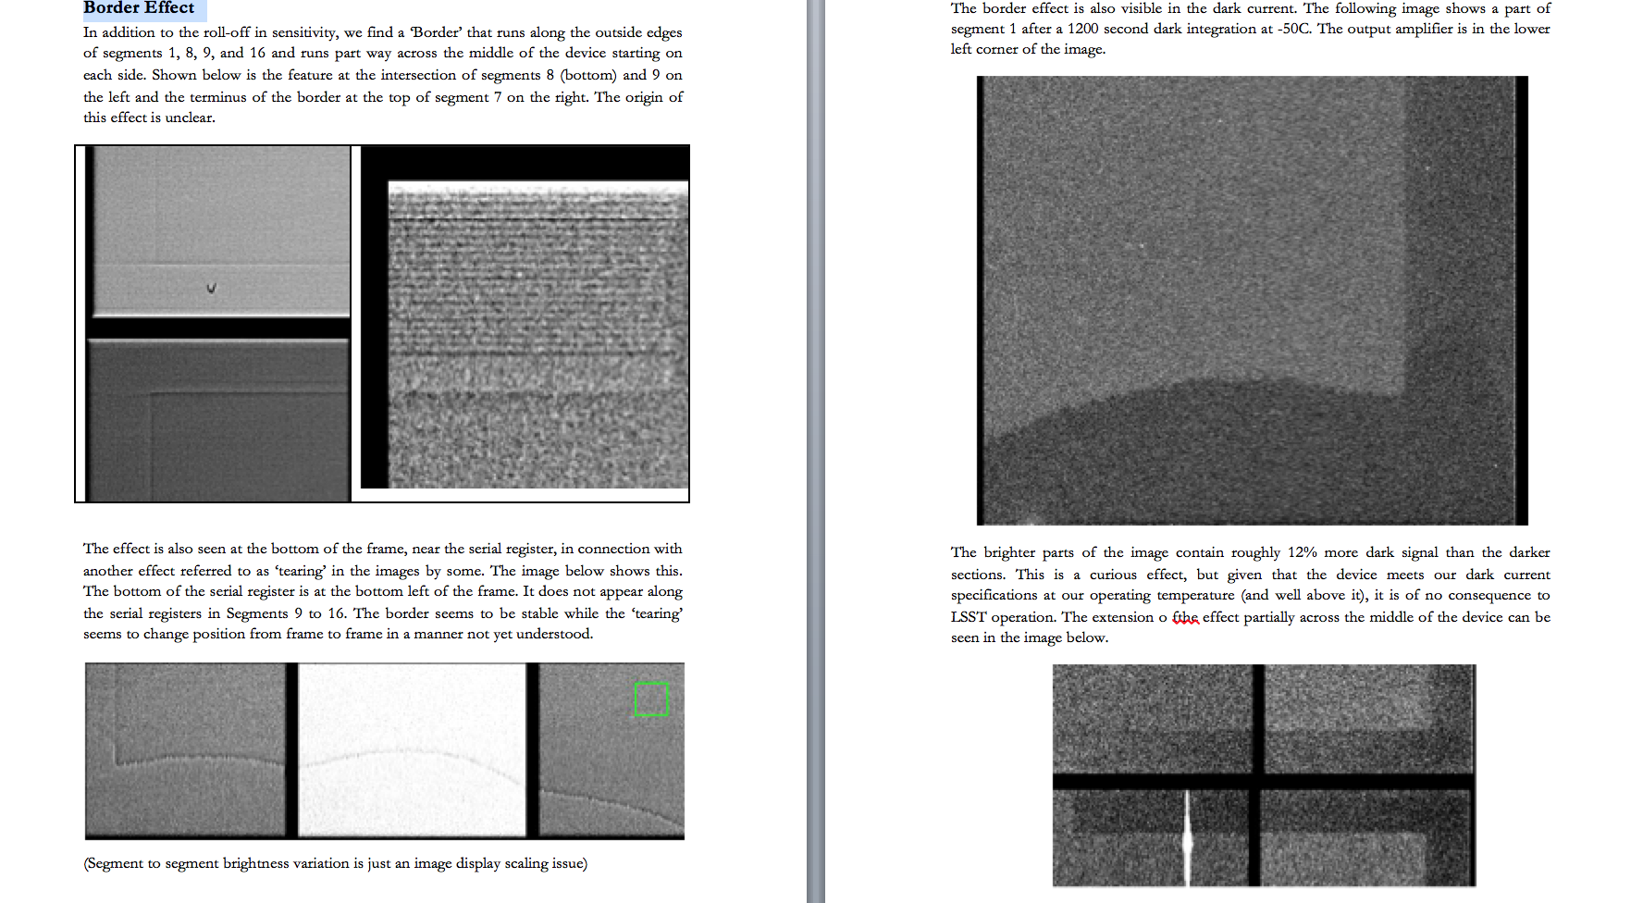
Feb 4 2013
Notes:
Peter, Paul, James..
I just came across this page in the CCD250 report and realized that the excess dark current shown follows at least some of the tearing contours. suggestive of it, at least between the lower image on the first page and the first image of the next. I guess nobody made the connection at the time. Peter, is this the same thing as what you saw in the wee hours prior to our first day at E2V? The polarity appears right.
I'm also wondering how we can ensure that all charge transfer occurs without exposure to surface states. Was there anything out of the ordinary (other than the ubiquitous tearing feature) that set 112-02 aside from the others? e.g., voltage combinations for which the device was exactly depleted? Maybe it's not something you routinely measure. Maybe you can remember something else that was different.
andy

Slide 40
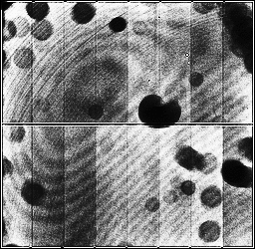
112-02, 700nm, 121227
Light:Dark ~ 1.05:1
Transient features:
Tearing (1-2%)
amplifier jitter (1%)
112-04, 830nm, 130322
Light:Dark ~ 1.005:1
Transient features:
shot-noise
cosmic rays
Tearing is absent down to fringing & tree ring levels
However: dark columns between segments are related to the tearing phenomenon and may be fixable

Slide 41
CS moment = 10ξ
 |  | fractional area – 1
 |  | X coordinate
 |  | -2 | -1 | 0 | 1 | 2
Y coordinate | -2 | 0.0008 | 0.0015 | 0.0026 | 0.0014 | 0.0007
 | -1 | 0.0015 | 0.0019 | 0.0213 | 0.0019 | 0.0014
 | 0 | 0.0025 | 0.0129 | -0.1309 | 0.0129 | 0.0025
 | 1 | 0.0014 | 0.0019 | 0.0212 | 0.0020 | 0.0014
 | 2 | 0.0008 | 0.0015 | 0.0025 | 0.0014 | 0.0007
 |  | astrometric shift (along y direction) [mas]
 |  | X coordinate
 |  | -2 | -1 | 0 | 1 | 2
Y coordinate | -2 | 0.28 | 0.62 | 0.94 | 0.62 | 0.28
 | -1 | 0.25 | 0.90 | 4.49 | 0.90 | 0.25
 | 0 | 0.01 | 0.00 | 0.00 | 0.00 | 0.01
 | 1 | -0.25 | -0.90 | -4.49 | -0.90 | -0.25
 | 2 | -0.28 | -0.61 | -0.94 | -0.61 | -0.28
 |  | Pixel Aspect Ratio X/Y-1 [dimensionless]
 |  | X coordinate
 |  | -2 | -1 | 0 | 1 | 2
Y coordinate | -2 | 0.000 | -0.002 | -0.006 | -0.003 | 0.000
 | -1 | 0.003 | 0.000 | -0.040 | 0.000 | 0.003
 | 0 | 0.006 | 0.033 | 0.018 | 0.033 | 0.006
 | 1 | 0.003 | 0.000 | -0.040 | 0.000 | 0.003
 | 2 | 0.000 | -0.002 | -0.006 | -0.003 | 0.000
 |  | astrometric shift (along x direction) [mas]
 |  | X coordinate
 |  | -2 | -1 | 0 | 1 | 2
Y coordinate | -2 | 0.22 | 0.22 | 0.01 | -0.22 | -0.22
 | -1 | 0.57 | 0.87 | 0.00 | -0.86 | -0.56
 | 0 | 0.88 | 3.62 | 0.00 | -3.62 | -0.89
 | 1 | 0.57 | 0.87 | 0.00 | -0.86 | -0.56
 | 2 | 0.22 | 0.22 | 0.01 | -0.22 | -0.22

Slide 42
CS moment = 5ξ
 |  | fractional area – 1
 |  | X coordinate
 |  | -2 | -1 | 0 | 1 | 2
Y coordinate | -2 | 0.0007 | 0.0014 | 0.0025 | 0.0014 | 0.0007
 | -1 | 0.0015 | 0.0022 | 0.0272 | 0.0021 | 0.0014
 | 0 | 0.0026 | 0.0213 | -0.1589 | 0.0211 | 0.0025
 | 1 | 0.0015 | 0.0022 | 0.0272 | 0.0022 | 0.0014
 | 2 | 0.0008 | 0.0014 | 0.0025 | 0.0014 | 0.0008
 |  | astrometric shift (along y direction) [mas]
 |  | X coordinate
 |  | -2 | -1 | 0 | 1 | 2
Y coordinate | -2 | 0.27 | 0.60 | 0.94 | 0.60 | 0.27
 | -1 | 0.24 | 0.91 | 5.12 | 0.91 | 0.24
 | 0 | 0.00 | 0.00 | 0.00 | 0.00 | 0.00
 | 1 | -0.24 | -0.91 | -5.13 | -0.91 | -0.24
 | 2 | -0.27 | -0.60 | -0.93 | -0.60 | -0.27
 |  | Pixel Aspect Ratio X/Y-1 [dimensionless]
 |  | X coordinate
 |  | -2 | -1 | 0 | 1 | 2
Y coordinate | -2 | 0.000 | -0.003 | -0.006 | -0.003 | 0.000
 | -1 | 0.003 | 0.000 | -0.046 | 0.000 | 0.003
 | 0 | 0.006 | 0.042 | 0.013 | 0.042 | 0.006
 | 1 | 0.003 | 0.000 | -0.046 | 0.000 | 0.003
 | 2 | 0.000 | -0.003 | -0.006 | -0.003 | 0.000
 |  | astrometric shift (along x direction) [mas]
 |  | X coordinate
 |  | -2 | -1 | 0 | 1 | 2
Y coordinate | -2 | 0.25 | 0.23 | 0.00 | -0.23 | -0.25
 | -1 | 0.58 | 0.90 | 0.00 | -0.90 | -0.58
 | 0 | 0.92 | 4.52 | 0.01 | -4.52 | -0.92
 | 1 | 0.58 | 0.90 | 0.00 | -0.90 | -0.58
 | 2 | 0.25 | 0.23 | 0.00 | -0.23 | -0.25

Slide 43
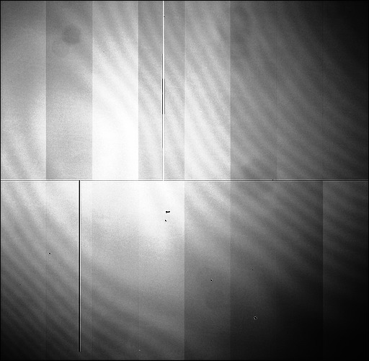
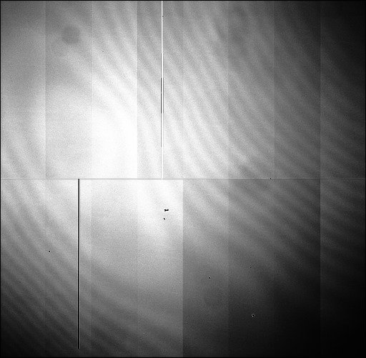
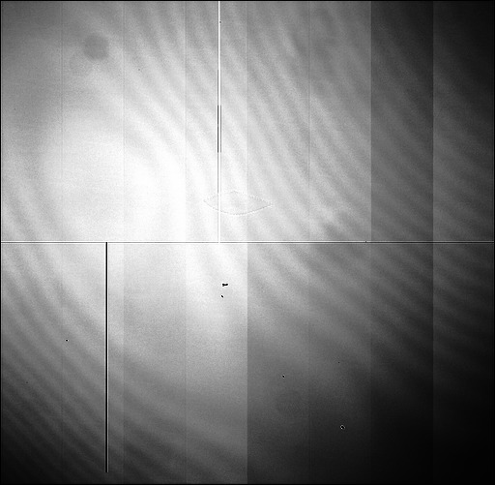

3 images, identical settings acquired 130115
06:12
06:38
08:26
PH8.00_PL0.00_SH8.00_SL0.00
Feature is absent
After breakfast, feature opens up

