Slide 1
The Relativistic Heavy Ion Collider
RHIC Operations
RHIC overview
Recent performance of RHIC
Low energy RHIC electron cooling
Capital and accelerator improvement projects
Action items from previous S&T review
Michiko Minty
DOE NP RHIC Science & Technology Review
17 – 19 September 2019

Slide 2
Summary
Operation of RHIC: met or exceeded integrated luminosity goals in the last 3 years
  Run-17 p↑+p↑ at 255 GeV and Au + Au 27.2 GeV/n
  Run-18 Zr + Zr / Ru + Ru at 100 GeV/n, Au + Au at 13.5 GeV/n
  + fixed target runs (at 3.85 GeV/n)
  Run-19 Au + Au at 9.8 GeV/n, 7.3 GeV/n, 3.85 GeV/n
  + fixed target runs (multiple energies)
New and unique operation (e.g. Ru+Ru / Zr+Zr) enabled by previous upgrades
Flexibility of operations substantially increased: many and interleaved modes is now routine
Operation of RHIC: exceeded accelerator availability goals
First (in the world) electron cooling with RF accelerated electron bunches demonstrated in support of Beam Energy Scan II - LEReC, presentation by A. Fedotov
Facility upgrades and maintenance ongoing to maintain high accelerator availability
Future BES-II operations will employ the newly developed LEReC technology
2

Slide 3
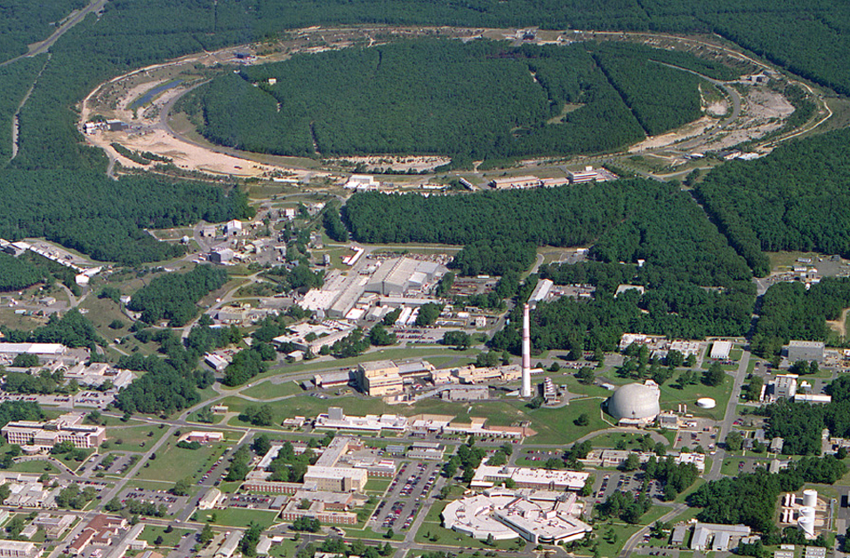
Relativistic Heavy Ion Collider (RHIC) Overview
Polarized Jet Target
Electron lenses
RHIC
Electron cooling
sPHENIX
RF
STAR
LINAC
NSRL
Circumference : 3.8 km
Max dipole field : 3.5 T
Energy : 255 GeV p
: 100 GeV/nucleon Au
Species : ph to U (incl. asymmetric)
Experiments : STAR, PHENIX (g sPHENIX)
EBIS
ATF II
Booster
ERL
BLIP
AGS
TPL
Tandems
ATF

Slide 4
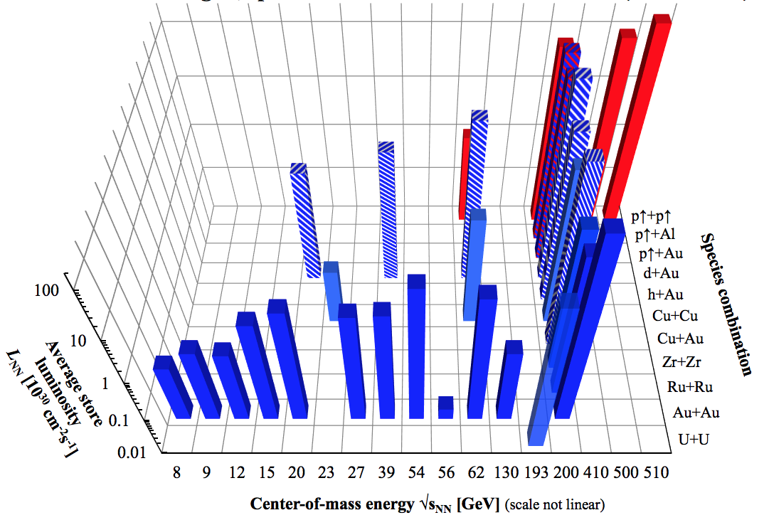
RHIC Overview - all colliding-mode physics runs to date (2001 to 2019)
Wolfram Fischer
2019-21 BES-II with LEReC and operation below nominal RHIC injection energy
The RHIC facility provides unparalleled flexibility in terms of ion species and energies for nuclear physics research in the US
4

Slide 5
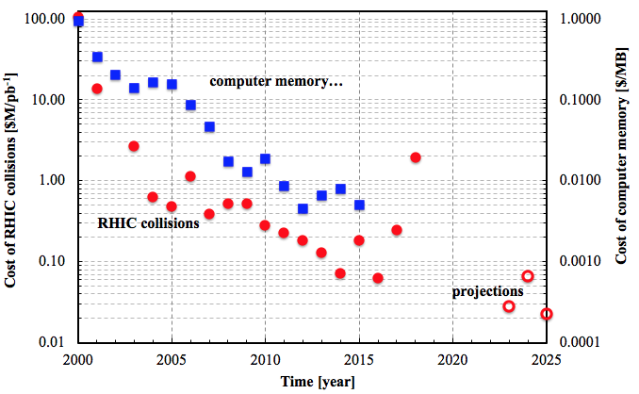
RHIC overview - time evolution of unit cost to operate RHIC
Wolfram Fischer
Ru+Ru/Zr+Zr
Productivity gain of RHIC operations (>1E3) is comparable with
state-of-the-art developments in industry
5

Slide 6
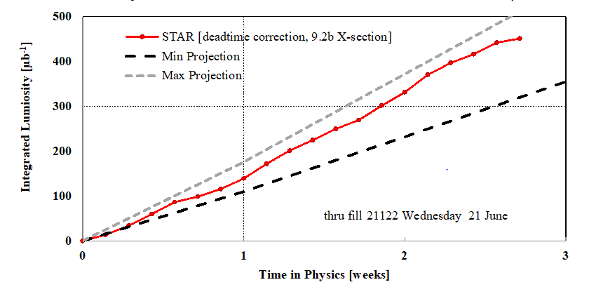
c
Recent performance of RHIC: Run-17
3 modes of operation
p↑ + p↑ at 255 GeV 15 weeks
Au + Au 27.2 GeV/n 3 weeks
p↑ + p↑ at 255 GeV for RHICf 0.9 weeks
+ CeC and LEReC gun commissioning
Run-17 p↑ + p↑ at 255 GeV
Run-17 Au + Au at 27.2 GeV/n
STAR L_{max} limited to ≈ 1.4x10³² cm⁻²s⁻¹ => 1st p↑+p↑ run with L-leveling
Met integrated luminosity goals of 400 pb⁻¹ (p↑ + p↑) and 300 μb⁻¹ (Au + Au)
6

Slide 7
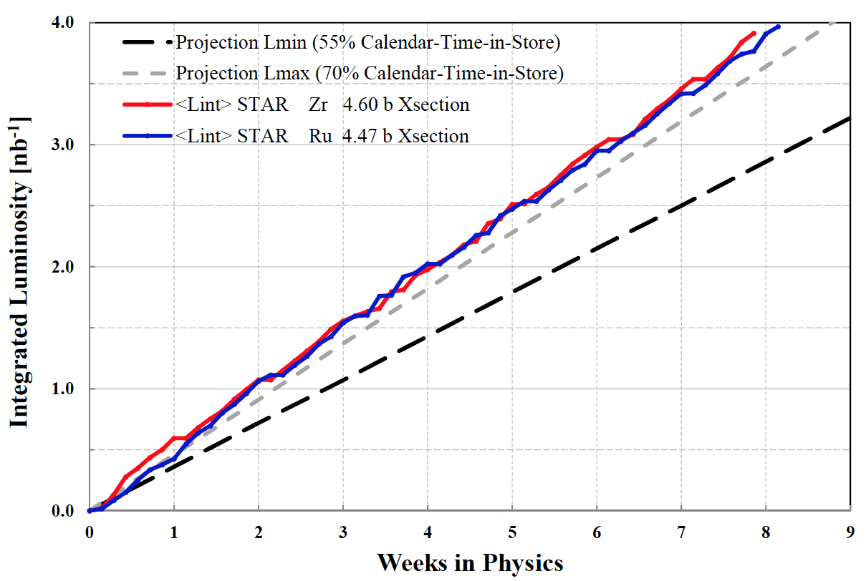
Recent performance of RHIC: Run-18
4 modes of operation
Zr + Zr and Ru + Ru at 100 GeV/n (interleaved) 12 weeks
Au + Au at 13.5 GeV/n 4 weeks
Au + Au at 3.5 GeV/n (fixed target) 0.6 weeks
Au + Au at 3.85 GeV/n, LEReC commissioning 13 weeks
Au + Au at 26.5 GeV/n, Coherent electron Cooling (CeC PoP) 1.1 weeks
Run-18 Zr + Zr / Ru + Ru at 100 GeV/n
Exceeded integrated luminosity goals
7

Slide 8
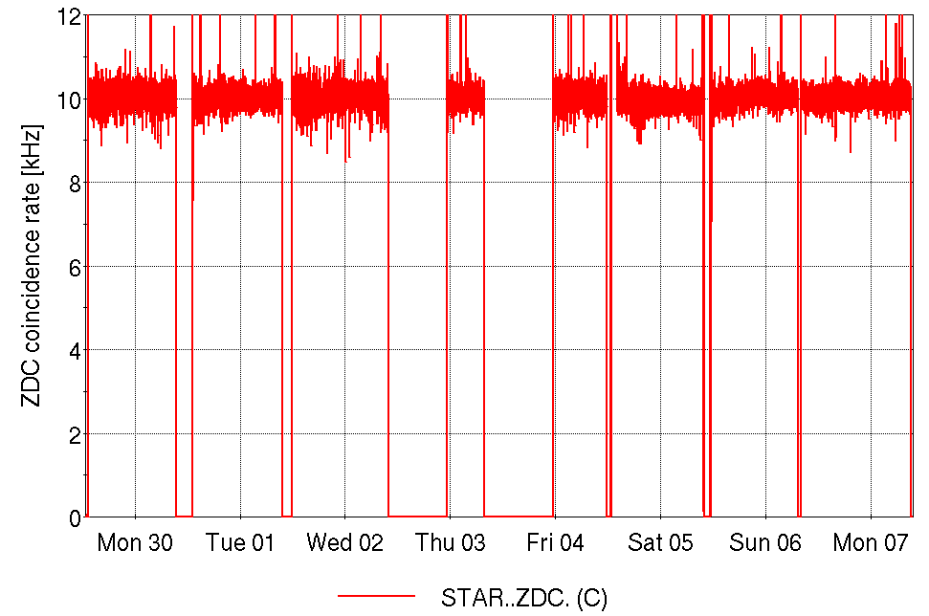
Recent performance of RHIC: Run-18, Zr+Zr / Ru+Ru
Zr
Zr
Zr
Zr
Ru
Ru
Ru
Ru
CeC PoP
dedicated
scheduled
maintenance
Unique operations / flexibility of RHIC met challenging requirements:
flat and equal conditions for Zr + Zr and Ru + Ru
constant (levelled) luminosity of 21.5×10²⁶ cm⁻²s⁻¹
turn-key, store-by-store species changes
8

Slide 9
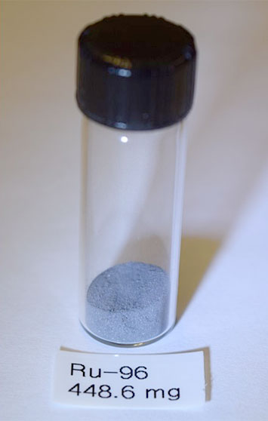
New and unique operation (e.g. Ru+Ru / Zr+Zr) enabled by previous upgrades
Recent performance of RHIC: Run-18
Zr-96 and Ru-96 preparation
Zr-96
  Natural abundance: 2.78%
  From LION/EBIS (sintered ZrO₂) => M. Okamura et al.
  Enriched ZrO₂ powder commercially
  available, processing using RIKEN technology
  MIRP chemists could recycle unused ZrO₂
Ru-96
  Natural abundance: 5.52%
  From Tandem (metallic) => P. Thieberger et al.
  Enriched Ru-96 not commercially available,
  provided by DOE using new isotope
  separation facility at ORNL (500 mg)
ZrO₂ tablet (RIKEN)
Ru-96 (ORNL)
Unique isobar run enabled with support from DOE, ORNL and Riken
9

Slide 10
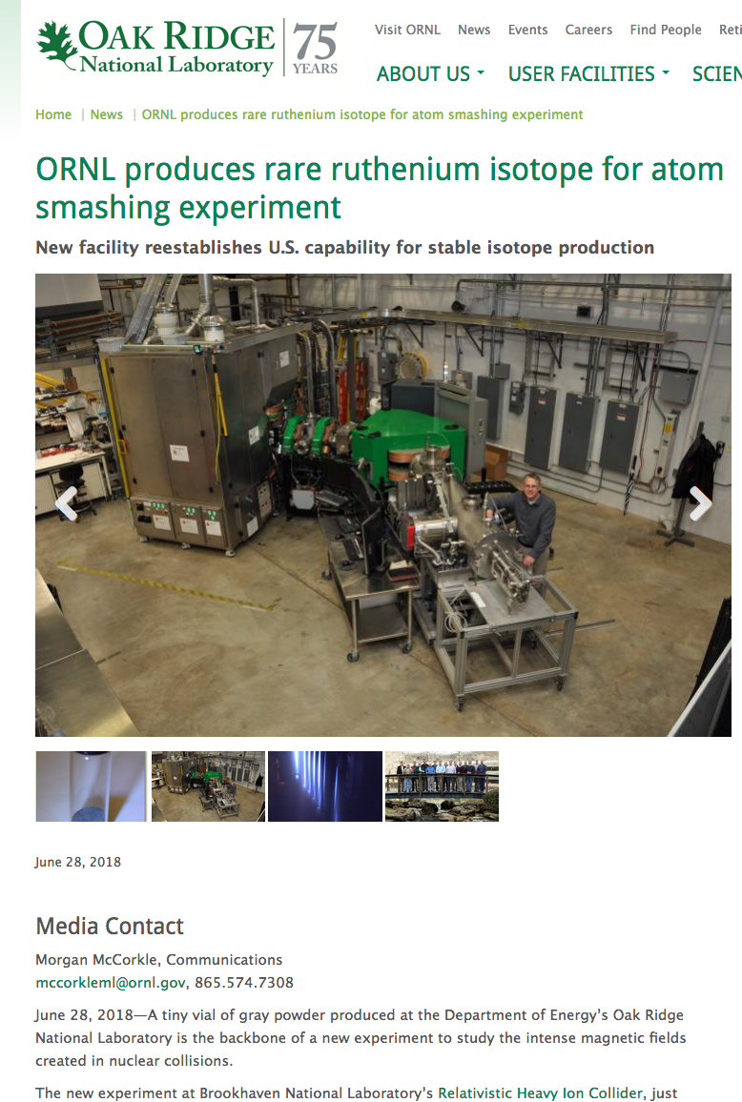
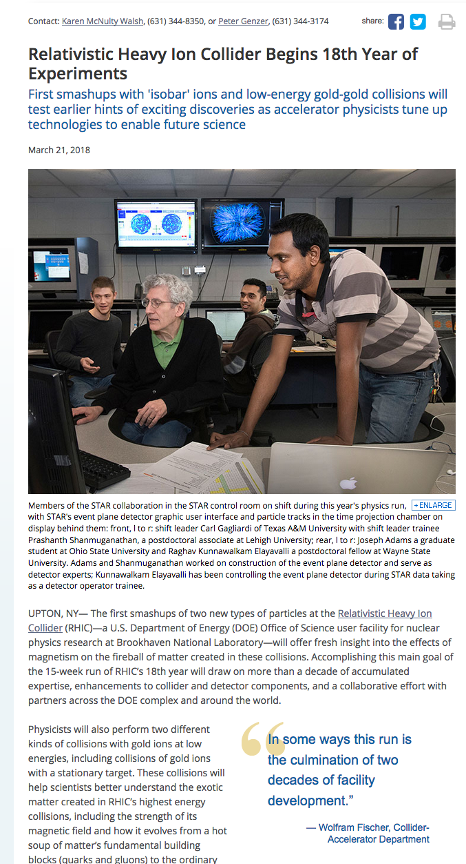
Recent performance of RHIC: Run-18
Zr-96 and Ru-96 preparation
Unique isobar run enabled with support from DOE, ORNL and Riken
10

Slide 11
Recent performance of RHIC: Run-19
Au + Au for Beam Energy Scan II (BES-II)
LEReC cooling commissioning
Colliding beam modes
Au + Au at 9.8 GeV/n 6.1 weeks
Au + Au at 7.3 GeV/n 8.7 weeks
Au + Au at 4.59 GeV/n 0.9 weeks
Au + Au at 3.85 GeV/n 3.4 weeks
Au + Au at 100 GeV/n (accelerator studies) 0.4 weeks
Fixed target modes
Au on Au at 31.2 GeV/n (18.5 hours), 7.3 GeV/n (13 hours),
4.59 GeV/n (4 days), 3.85 GeV/n (2 hours)
LEReC cooling commissioning (dedicated)
Au at 3.85 GeV/n 24 weeks
Au at 4.59 GeV/n 2.6 weeks
Multiple modes of operation per year (11 modes in Run-19) now routine
11

Slide 12
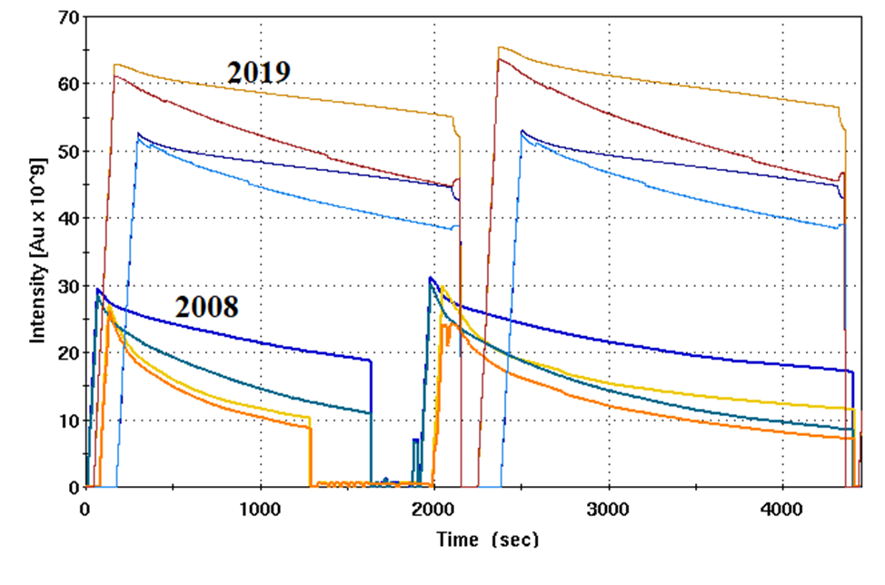
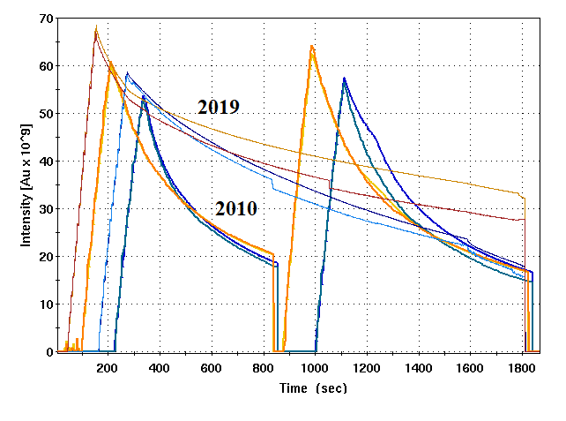
Recent performance of RHIC: Run-19
Main challenges
intrabeam scattering (IBS) – causing rapid emittance growth with
beam energy below transition energy (~24 GeV/n for Au beam)
space charge – causing large incoherent and incoherent tune shifts
persistent current in the superconducting magnets
4.59 GeV/n
3.85 GeV/n
Highlights
Low Energy RHIC Electron Cooling (LEReC) to mitigate IBS
new 9 MHz cavities to reduce space charge effects (longer bunches)
new lattice to accommodate larger tune shifts
new magnet demagnetization cycle to reduce persistent current effects
12

Slide 13
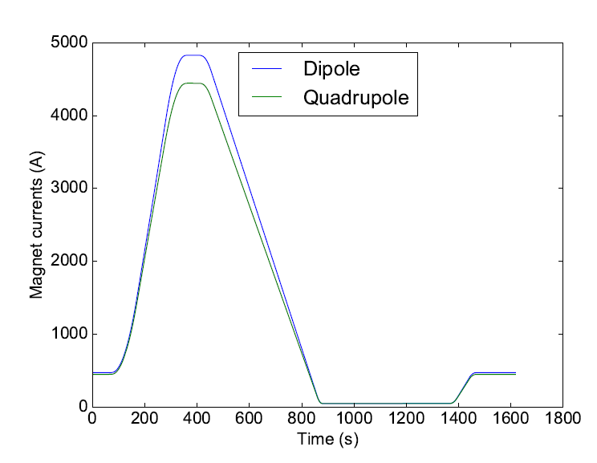
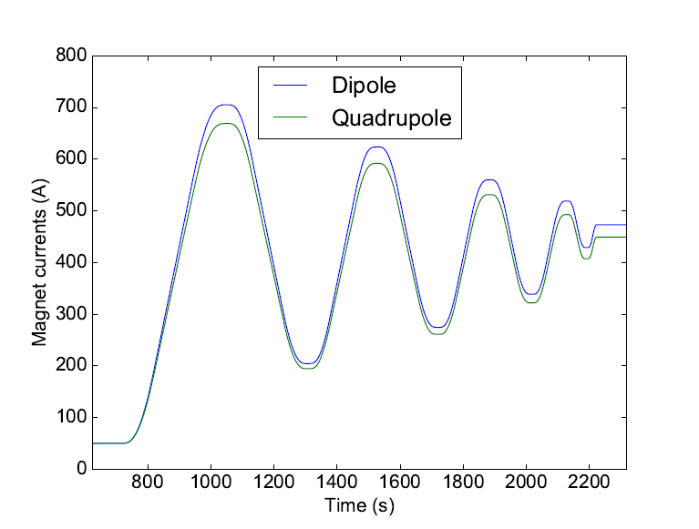
Run-19 new magnet demagnetization cycle
A demagnetization cycle was developed and implemented to reduce persistent current effects in the RHIC superconducting magnets
regular cycle
demagnetization cycle
reduced sextupole components in dipoles reduced
reduced orbit, tune and chromaticity drifts
demagnetization cycle provided stable and reproducible conditions and enabled frequent energy changes needed for operations and LEReC commissioning
13

Slide 14
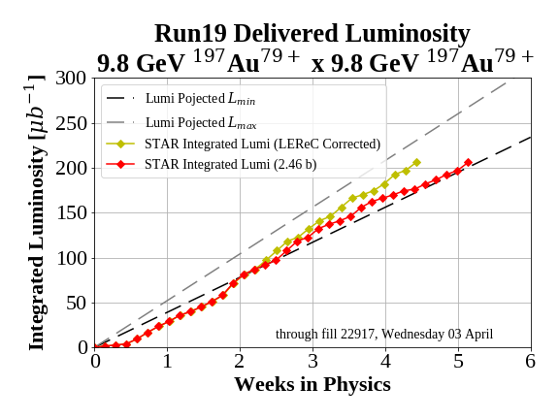
Recent performance of RHIC: Run-19 (BES-II)
Integrated luminosity for highest priority colliding beam modes
Run-19 Au + Au at 9.8 GeV/n
Run-19 Au + Au at 7.3 GeV/n
Met integrated luminosity goals
14

Slide 15
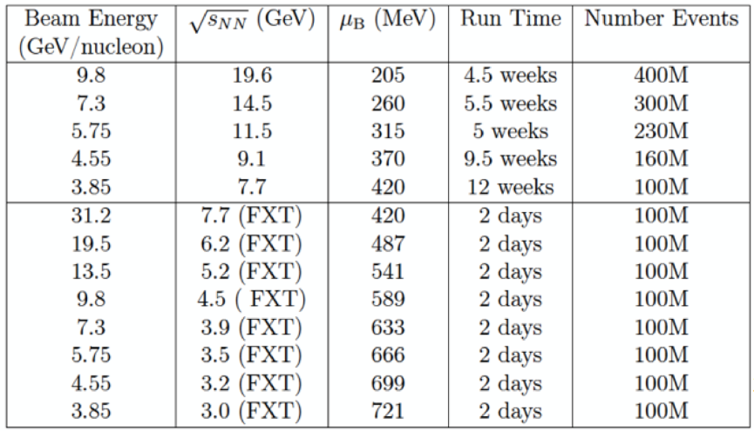
Beam Energy Scan II --- beam delivery overview
582M
324M
51M
53M
201M
3.7M
+ 300 M (run18)
+ FXT at √ S_{NN} = 7.7 GeV (2.9M)
√ S_{NN} = 9.2 GeV (1.0M)
acquired parasitic to LEReC commissioning
15

Slide 16
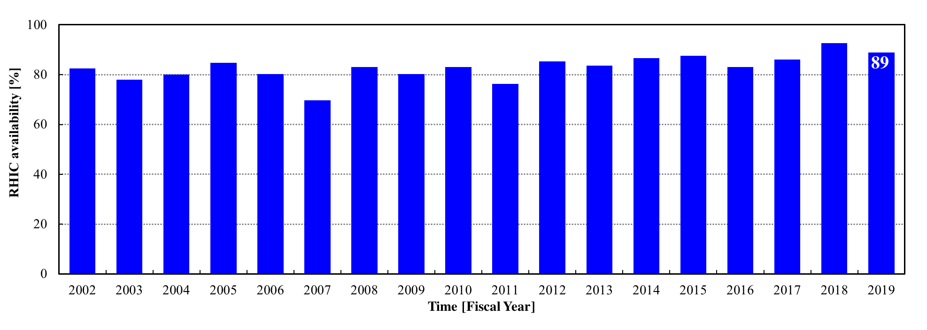
RHIC availability reported to DOE (2002-2019)
availability = beam time / scheduled beam time
(scheduled time excludes scheduled maintenance)
93
86
Typical time allocations 50K to 4K cool-down 0.5 week
initial set-up 1-2 weeks
changing species 0.5 week
accelerator studies (APEX) 16h every 2 weeks
maintenance 14h every 2 weeks
warm-up 0.5 week
Exceeded availability goal (80%) for 8 consecutive years (goal will be raised)
16

Slide 17
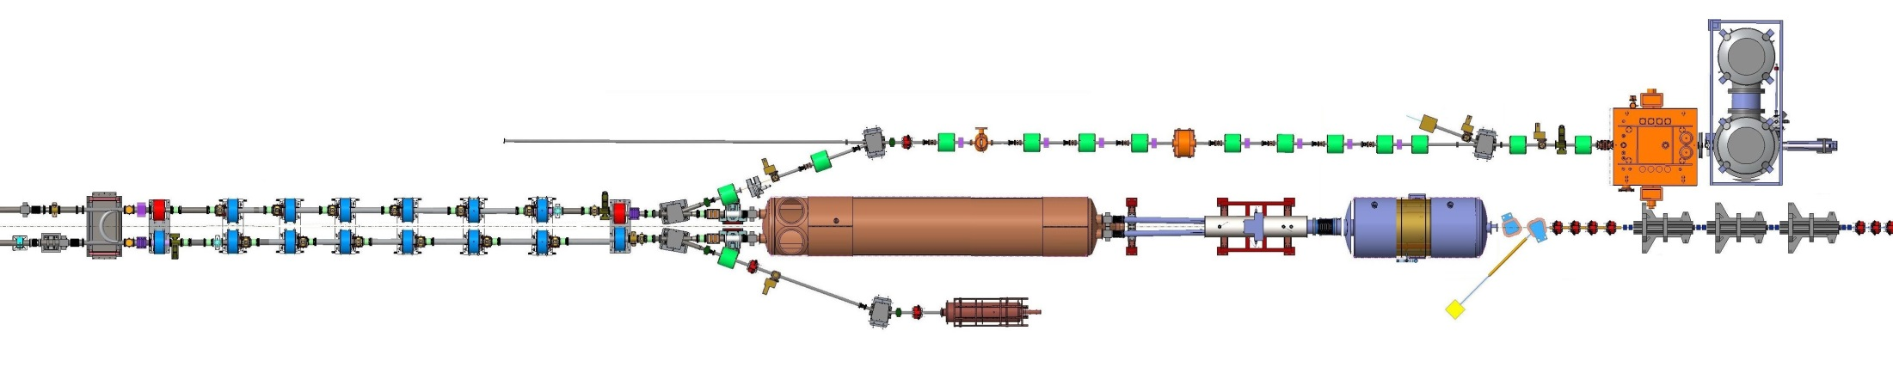



LEReC was a $8.3M AIP, completed on schedule and within budget.
(Close-out report was signed by J. Gillo on 1/17/19.)
Low Energy RHIC electron Cooling (LEReC)
A. Fedotov
64 m to IP2
(not to scale)
Commissioning
Diagnostic Line 1
704 SRF
Booster Cavity
Commissioning
Diagnostic Line 2
704 MHz
Cu Cavity
9 MHz
Cu Cavity
2.1 GHz
Cu Cavity
DC
e⁻ Gun
e⁻
COOLING
in Yellow RHIC ring
e⁻
RHIC TRIPLET
RHIC DX
e⁻
COOLING
in Blue RHIC ring
LEReC Solenoids
Compensating (LF)
Matching (HF)
Merger/Transport
20° Bending Magnets
Beam Dump
180° Bending Magnet
energies E 1.6, 2.0 MeV
average current I_{avg} 27 mA
momentum δp/p 5×10⁻⁴
luminosity gain factor 4
LEReC completed on schedule and within budget (8.3M$ AIP)
17

Slide 18
LEReC accomplishments in Run-19
World’s first electron cooling with rf-accelerated bunched beam for BES-II
first “non-magnetized” electron cooling (all previous coolers used magnetization on the cathode, i.e. solenoid field)
first cooling of ion bunches in two rings using the same electron beam
first electron cooling of colliding beams
electron cooling was commissioned at
electron energy of 1.6 MeV with ion energy 3.85 GeV/n
electron energy of 2 MeV with ion energy of 4.58 GeV/n
electron cooling of RHIC stores with 111 ion bunches in both rings demonstrated at both 3.85 and 4.59 GeV/nucleon ion beam energies
18

Slide 19
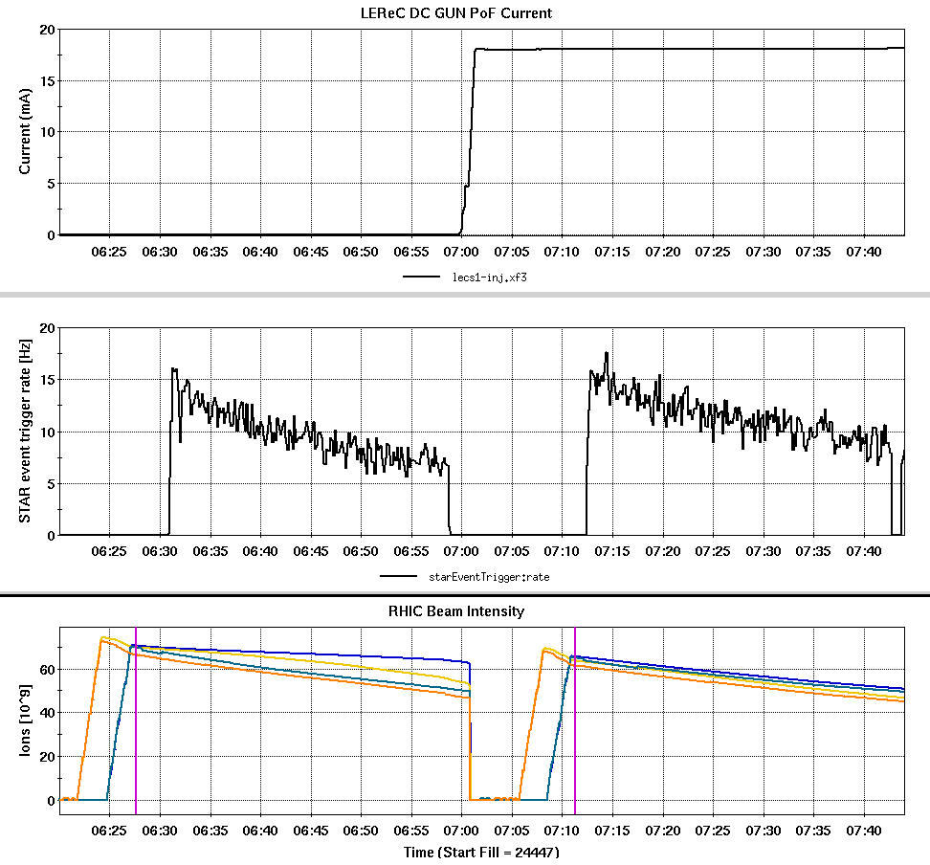
Effect of cooling at 4.59 GeV/nucleon
without cooling
with cooling
With cooling demonstrated 22% increase in STAR event integral over ~ ½ hour

Slide 20
Colliding mode projections for Run-20
5.75 x 5.75 GeV/n
L_{avg} improvement factor, total = 2.4x Run-10
L_{avg} improvement factor, +- 70 cm = 2.3x Run-10
bunch intensity N_{b} : 1.1 → 1.35e9
rms emittance ε_{n} : 2.5 → 2.5 mm
bunch length σ_{s} : 1.4 → 1.4 m
envelope function β* : 6.0 → 4.0 m
electron cooling : OFF
4.59 x 4.59 GeV/n
L_{avg} improvement factor, total = 1.5x Run-19
L_{avg} improvement factor, +/- 70 cm = 2.4x Run-19
bunch intensity N_{b} : 0.8 → 0.9e9
rms emittance ε_{n} : 1.5 → 1.6 mm
bunch length σ_{s} : 3.8 → 2.3 m
envelope function β* : 4.5 → 4.5 m
electron cooling : ON

Slide 21
Improvements for increased efficiency in Run-20
reduced filling times reduction
reduced number of mode changes
shortest possible bunches at space charge limit (x = -0.06 ?)
fixed and reliable Au beam parameters for cooling at 4.59 GeV
(requires some intensity margin)
beam conditions that allow STAR to stay on during injection
longer STAR beryllium beam pipe (4 m) for increased longitudinal acceptance (deferred)
Run-20 will be very challenging with
Au + Au at 5.75 GeV/n (without cooling)
Au + Au at 4.59 GeV/n (with cooling)
up to 6 fixed - target energy runs
continued cooling commissioning at 3.85 GeV/n
21

Slide 22
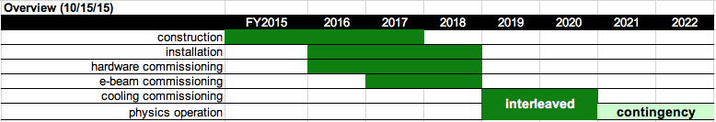
RHIC Run-20 and beyond
LEReC/BES-II plan from 2015 still holding
↓
complete
complete
complete
complete
in progress
in progress
Plan
2018: complete LEReC electron beam commissioning (DONE)
2019: LEReC cooling commission interleaved with physics (DONE)
2020: Use cooled beams at 2 (possibly 3) lowest energies
2021: contingency if event number goals not met
22

Slide 23
Capital and accelerator improvement projects
Extended EBIS (CP)
2nd sc solenoid + gas cell
completion for Run-20
RHIC cryo control system
upgrade (CP)
RHIC quench detection (CP)
Linac vacuum system upgrade (AIP)
RHIC turbo pump upgrade (AIP)
RHIC cryo plant cold expander train upgrade (AIP)
Booster AC dipole (He-3↑)
PS: Booster sextupoles, Booster RF tuning (band III), AGS quad and sextupoles, H10/L20, BtA and LtB, RHIC IR8 tq (sPHENIX)
Siemens fire suppression system
AGS MM evaporation cooler
Vacuum lab equipment (ultrasound cleaner, oven)
trap length
extension
Ongoing facility upgrades and maintenance for high accelerator availability

Slide 24
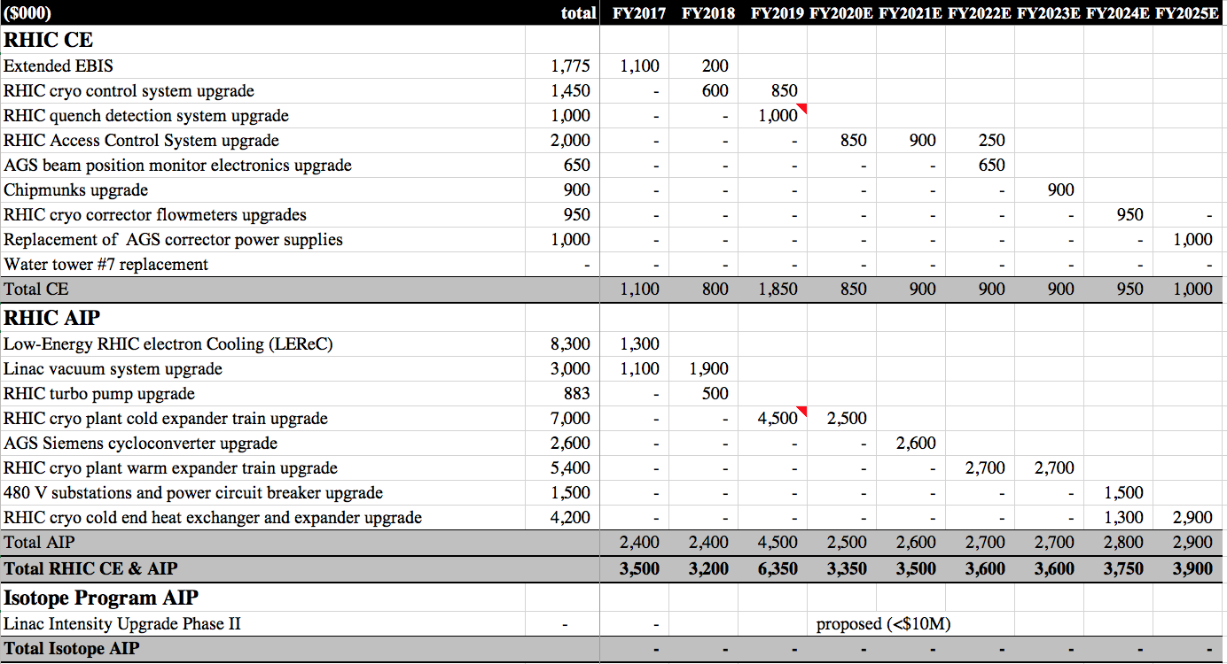
Capital and Accelerator Improvement Projects Funding (FY2017-2025)
remaining performance upgrade (until 2020)
Previous upgrades in 2 categories:
  Performance upgrades
  Maintenance/upgrades of technical infrastructure
New upgrades now focus on 2. category
M&S+25 FTE is approx. 0.5% of RHIC
hadron complex replacement value
24
Notes:
AIP funding in place before start – DOE Financial Handbook, Chap. 24, issued May 2018 (also raises AIP max to $20M)

Slide 25
Action items from 2014 and 2016 S&T reviews
2014 no accelerator related recommendations
2016
“Develop a plan to improve the machine protection system for operation at ultimate luminosity and intensity of ion and proton beams. Submit to DOE NP by January 1, 2017.”
Detailed response submitted in August, 2016. Upgrade with two principle components identified:
Implementation of slow (30-40 ms – now 6 ms) mechanical switch in series with the existing fast (<1 ms) thyratron high-voltage switch (DONE)
Additional MPS inputs to provide added protection
beam loss monitors (DONE)
fast orbit correctors power supplies (will be completed in Run-20)
beam position monitors (DONE)
radiofrequency cavities (DONE)
To complete prior to resuming high energy operation:
test delayed dump and energy extraction in operation (reduced risk in low energy operation)
test delayed energy extraction with higher intensity and full energy (end of run)
Notes:
2016 recommendation: MPS upgrade
“Develop a plan to improve the machine protection system for operation at ultimate luminosity and intensity of ion and proton beams. Submit to DOE NP by January 1, 2017.”

Slide 26
Summary
Operation of RHIC: met or exceeded integrated luminosity goals in the last 3 years
  Run-17 p↑+p↑ at 255 GeV, run coordinator Vahid Ranjbar
  Au + Au 27.2 GeV/n, run coordinator: Greg Marr
  Run-18 Zr + Zr / Ru + Ru at 100 GeV/n, Au + Au at 13.5 GeV/n
  + fixed target runs (at 3.85 GeV/n), run coordinator: Greg Marr
  Run-19 Au + Au at 9.8 GeV/n, 7.3 GeV/n, 3.85 GeV/n
  + fixed target runs (multiple energies), run coordinator Chuyu Liu
New and unique operation (e.g. Ru+Ru / Zr+Zr) enabled by previous upgrades
Flexibility of operations substantially increased: many and interleaved modes is now routine
Operation of RHIC: exceeded accelerator availability goals
First (in the world) electron cooling with RF accelerated electron bunches demonstrated in support of Beam Energy Scan II - LEReC, presentation by A. Fedotov
Facility upgrades and maintenance ongoing to maintain high accelerator availability
Future BES-II operations will employ the newly developed LEReC technology
26

Slide 27
Back-up material

Slide 28
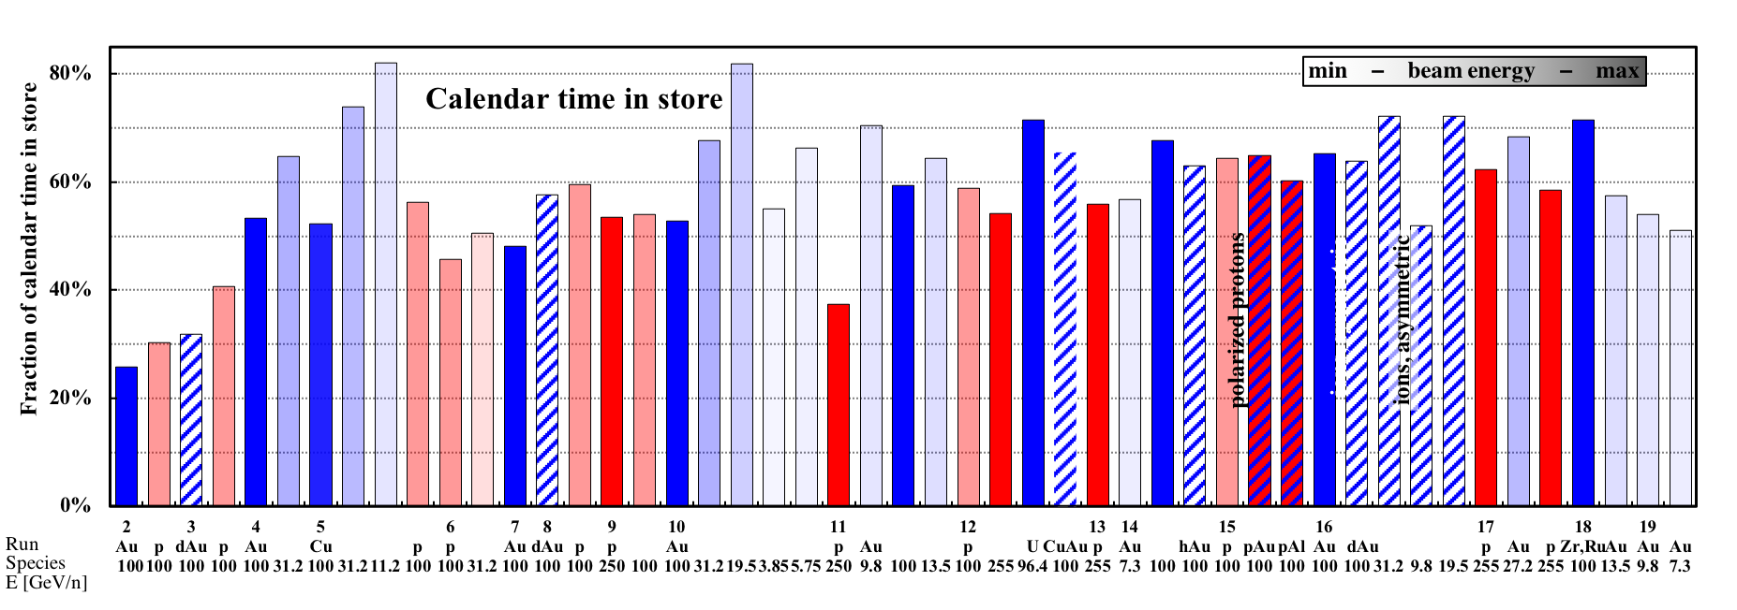
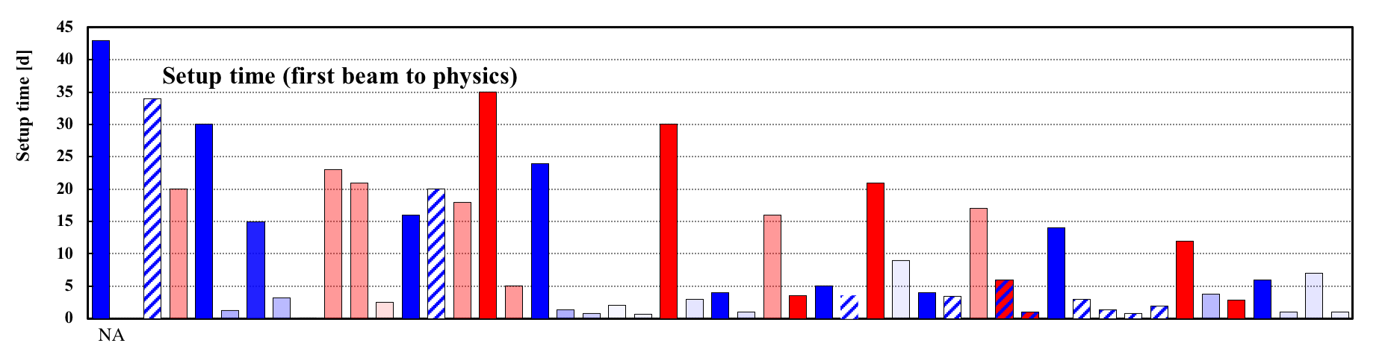
Operational efficiency setup time
Setup time:
- for 1st species in run: from both rings cold to 1st physics store
- for following species: from beginning of setup to 1st physics store
Run-17
Run-19
7 days Au+Au 9.8 GeV
1 day for Au+Au 7.3 GeV
TRANSPARENT: low energy
BLUE: heavy ion runs
INTRANSPARENT: high energy
RED: polarized proton runs

Slide 29
Operational efficiency availability reported to DOE
Need to update through 2019
Facility Operations | FY2002 | 2003 | 2004 | 2005 | 2006 | 2007 | 2008 | 2009 | 2010 | 2011 | 2012 | 2013 | 2014 | 2015 | 2016
Research (physics, machine development) | 1379 h | 1238 | 1611 | 2282 | 1920 | 1117 | 1198 | 1352 | 2194 | 1563 | 1752 | 1290 | 2116 | 1909 | 1775
Beam Studies (APEX) | 58 h | 92 | 136 | 158 | 129 | 104 | 103 | 163 | 173 | 64 | 118 | 75 | 90 | 112 | 70
Setup/Tuning | 739 h | 2111 | 1439 | 1422 | 775 | 820 | 1228 | 1639 | 1163 | 1486 | 1202 | 1291 | 852 | 1368 | 851
Total Operating Hours | 2176 h | 3441 | 3186 | 3862 | 2824 | 2041 | 2529 | 3154 | 3530 | 3113 | 3072 | 2655 | 3060 | 3389 | 2696
Failure | 461 h | 975 | 791 | 696 | 699 | 882 | 516 | 773 | 721 | 762 | 526 | 517 | 466 | 485 | 554
Availability (%) | 82.5% | 77.9 | 80.1 | 84.7 | 80.2 | 69.8 | 83.1 | 80.3 | 83.0 | 76.3 | 85.4 | 83.7 | 86.6 | 87.5 | 83.0
Scheduled shutdown (maintain cool-down) | 252 h | 378 | 287 | 803 | 509 | 604 | 158 | 273 | 451 | 262 | 301 | 187 | 195.3 | 254.8 | 528
Injectors/RHIC Beam Operations | 17.2 wks | 28.5 | 25.4 | 31.9 | 24.0 | 21.0 | 19.3 | 25.0 | 28.0 | 25.5 | 26 | 20.0 | 22.1 | 25 | 25
Cryogenic Operation | 17.0 wks | 30.4 | 26.7 | 31.4 | 21.2 | 18.4 | 19.0 | 22.0 | 27.1 | 24.4 | 22.9 | 17.0 | 22.0 | 22.4 | 22
Availability = beam time / scheduled beam time
(denominator excludes scheduled maintenance)
Availability goal: 80%
Typical times:
50K to 4K cool-down : 0.5 weeks
Initial set-up : 2 weeks
Changing species : 0.5 weeks
Beam studies (APEX): 16h / 2 weeks
Maintenance : 14h / 2 weeks
Warm-up : 0.5 weeks

Slide 30
RHIC Run-17 detail
3 modes for physics
p↑+p↑ at 255 GeV, 15 weeks (2/12/17-5/30/17)
STAR only
luminosity leveling
larger aperture beampipes at STAR and PHENIX
MPS tests
9 MHz cavity commissioning
Au + Au at 27.2 GeV/nucleon, 3 weeks (5/30/17 – 6/19/17)
energy selection for concurrent operation with Coherent Electron Cooling Proof of Principle (CeC PoP)
p↑+p↑ at 255 GeV – RHICf, 6 days (6/21/17 - 6/27/17)
radial polarization using spin rotators
CeC and LEReC gun commissioning
90 hours dedicated CeC PoP time

Slide 31
Run-17 p↑+p↑ at 255 GeV Notable items
all DX magnets moved back to symmetric position
only one experiment STAR (PHENIX being converted to sPHENIX)
STAR experimental beam pipe changed (from 4 cm ID Be NEG coated to 8 cm ID Be without coating; adjacent Al pieces are NEG coated on both cases); PHENIX experimental beam pipe changed (from 4 cm ID Be to 12.2 cm ID SS, both NEG coated)
1 of 3 new 9 MHz cavities installed in each ring and made operational
(60 kV/cavity design, operated at 26 kV/cavity)
new ion optical system increases OPPIS beam by 20% (03/01/2017)
lens cryo upgrade - both superconducting solenoids run stably at 6 T
use of dual harmonic acceleration in AGS to reduce space charge near injection
MPS upgrade with additional permit inputs: RF, orbit correctors, 10 Hz orbit feedback, fast BPM readings (coherence signal); also lowered BLM thresholds at store
only transversely polarized beams at IP6 (no rotators)
many Yellow quenches after 4 of 5 new mechanical serial switches failed to close after beam dump (03/13/2017); as a result yi7-d6 shows small bypass current in a quench protection diodes - reduced ramp rate by factor of 2 to reduce the bypass current
β* squeeze from 1.5 to 1.2 m nominally 3 h into the store (beginning 03/13/2017)
special Yellow Au ramp for CeC PoP (γ = 29.229); 90 h dedicated CeC PoP time
beam from LEReC DC gun to gun line beam dump

Slide 32
RHIC Run-18 detail
5 modes for physics
Zr + Zr and Ru + Ru at 100 GeV/nucleon, 12 weeks (3/8/18 – 5/10/18)
store-by-store changes in ion species with Zr from LION/EBIS
Ru from Tandem
Au + Au at 13.5 GeV/nucleon, 4 weeks (5/10/18 – 5/30/18 and 6/4/18 – 6/18/18)
133 hours dedicated CeC PoP time (parasitic fixed target operation in parallel)
LEReC electron beam commissioning in parallel
Au at 3.85 GeV/nucleon on fixed target Au foil inside STAR, 4 days (5/30/18 - 6/4/18)
BBQ for constant STAR event rate
BES-II preparation (injection and abort kicker tests, new hysteresis cycle)
Au in Yellow ring for CeC PoP at 26.5 GeV/nucleon, 186 hours
parasitic fixed target operation in parallel
Dedicated LEReC electron beam commissioning at 1.6 MeV
CeC electron beam development, 13 weeks (6/19/18 – 9/17/18)

Slide 33
RHIC Run-19 detail
11 modes for physics
Mode 1A: LEReC cooling commissioning with ¹⁹⁷Au⁷⁹⁺ at 3.85 GeV/nucleon
Mode 1B: ¹⁹⁷Au⁷⁹⁺ on ¹⁹⁷Au⁷⁹⁺ at 9.8 GeV/nucleon particle energy
Mode 1C: ¹⁹⁷Au⁷⁹⁺ on ¹⁹⁷Au⁷⁹⁺ at 7.3 GeV/nucleon particle energy
Mode 1D: ¹⁹⁷Au⁷⁹⁺ at 7.3 GeV/nucleon particle energy on fixed target
¹⁹⁷Au foil inside STAR (3.93 GeV/nucleon COM energy)
Mode 1E: ¹⁹⁷Au⁷⁹⁺ on ¹⁹⁷Au⁷⁹⁺ at 3.85 GeV/nucleon particle energy
Mode 1F: ¹⁹⁷Au⁷⁹⁺ at 3.85 GeV/nucleon particle energy on fixed target
¹⁹⁷Au foil inside STAR (3.22 GeV/nucleon COM energy)
Mode 1G: LEReC cooling commissioning with ¹⁹⁷Au⁷⁹⁺ at 4.59 GeV/nucleon
Mode 1H: ¹⁹⁷Au⁷⁹⁺ at 4.59 GeV/nucleon particle energy on fixed target
¹⁹⁷Au foil inside STAR (3.00 GeV/nucleon COM energy)
Mode 1I: ¹⁹⁷Au⁷⁹⁺ on ¹⁹⁷Au⁷⁹⁺ at 4.59 GeV/nucleon particle energy
Mode 1J: ¹⁹⁷Au⁷⁹⁺ at 31.2 GeV/nucleon particle energy on fixed target
¹⁹⁷Au foil inside STAR (7.74 GeV/nucleon COM energy)
Mode 1K: ¹⁹⁷Au⁷⁹⁺ on ¹⁹⁷Au⁷⁹⁺ at 100 GeV/nucleon particle energy

Slide 34
Run-19 Au+Au for Beam Energy Scan II (BES-II) and LEReC cooling commissioning
To do – make chart and timeline like on slide 7 (standardize presentation method)
11 modes for physics (largest number to date)
To do – standardize plots
Mode 1A: LEReC cooling commissioning with Au at 3.85 GeV/nucleon, 168 days
Mode 1B: Au on Au at 9.8 GeV/nucleon, 43 days
Mode 1C: Au on Au at 7.3 GeV/nucleon, 61 days
Mode 1D: Au at 7.3 GeV/nucleon, fixed Au target, 13 hours
Mode 1E: Au on Au at 3.85 GeV/nucleon particle energy, 24 days
Mode 1F: Au at 3.85 GeV/nucleon particle energy, fixed Au target, 2 hours
Mode 1G: LEReC cooling commissioning with Au at 4.59 GeV/nucleon, 18 days
Mode 1H: Au at 4.59 GeV/nucleon, fixed target, 4 days
Mode 1I: Au on Au at 4.59 GeV/nucleon, 6 days
Mode 1J: Au at 31.2 GeV/nucleon, fixed target, 18.5 hours
Mode 1K: Au on Au at 100 GeV/nucleon for APEX, 3 days
Run Coordinator: Chuyu Liu

Slide 35
Need to update
Extended EBIS
trap length
extension
Scope
Add superconducting solenoid
for trap length extension,
expect +40% Au intensity
(early completion would shorten time for 2
highest energies in BES-II; also allows for
next step in polarized ³He R&D)
Cost and funding
Schedule
2016 started solenoid acquisition
2020 planned completion
largest risk (cost, schedule and performance):
superconducting solenoid magnet
FY2016 | 2017 | Total
$475k | 1350k (P) | 1.8M
High-field ³He cell
for polarization
(collaboration with
R. Milner et al. MIT)

Slide 36
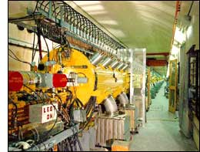
Linac / BLIP upgrades
Need to update
RHIC provides main support (takes ~10% of pulses, polarized)
Isotope program is incremental user (~90% of pulses)
RHIC upgrades
Reliability – D. Raparia (RHIC funded CE)
5 kW solid state amplifiers, instrumentation, LLRF
$1.5M – complete FY2016 as planned
Vacuum upgrade (planned RHIC AIP, FY2017/18)
replacement of 50 original ion pumps, power supplies
and controllers, $3.0M total cost, completion in 2021
First beam 1970
Notes:
6 tube amplifiers in operation at Linac:
7651: 1 per tank, 5 kW pulsed power, need about 15/year (total $35k/year w/o overhead)
4616: 1 per tank, 200 kW pulsed power, need about 4/year (total $135k/year w/o overhead)
7835: 1 Per tank, 2.5 MW pulsed power, need about 4/year (total $520k/year w/o overhead)
8616: 1 Per tank, ?? kW pulsed power, need about 9/year (total $80k/year w/o overhead)

Slide 37
RHIC MPS upgrade Run-18 progress
Serial switches
  shortened closing time from 30 ms to 7 ms
  (2350 to 550 turns)
  installed redundant trigger units in Blue and Yellow
  (prevents a failure mode observed in Run-17 test)
  modified hardware test protocol
Delayed energy extraction from sc magnets
  measured orbit and tune without and with delayed energy extraction (9 ms) – single bunch at store
New beam permit inputs
  All implemented except fast corrector PS input
  Control board designed – in production, alcove cable installation under way, software being developed
Test delayed dump and energy extraction in operation (reduced risk in low energy operation)
Test delayed energy extraction with higher intensity
and full energy (end of run)

Slide 38
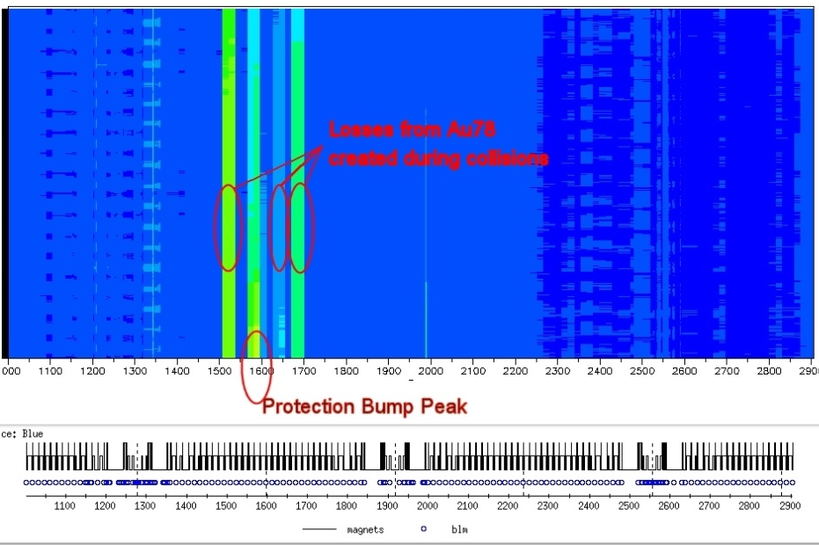
RHIC Machine Protection upgrade Background
10-20 abort kicker pre-fires per year
Some pre-fires have damaged detector
components, notably in asymmetric
Cu+Au and p+Au operation
In Run-16, large orbit bumps installed
to protect experiments concentrated
off-momentum losses, QP diode
damaged after beam abort and quench,
required warm-up and replacement.
Another QP diode damaged in MPS
upgrade test in Run-17 (did not affect run).
Problem most severe with Au+Au
at highest energies
(~90% of beam loss from off-momentum secondary
BFPP and EMD created beams)
Need a solution for sPHENIX
(stored beam energy reduced in BES-II)
PHENIX MPC
start of run
after Yellow
pre-fire 05/11/15
after Yellow
pre-fire 06/01/15
M. Purschke
Notes:
orbit bumps first installed in Run-14
bo6-qd3-ps failure on 03/18/2016 led to beam abort, quench, and damaged diode in Run-16

Slide 39
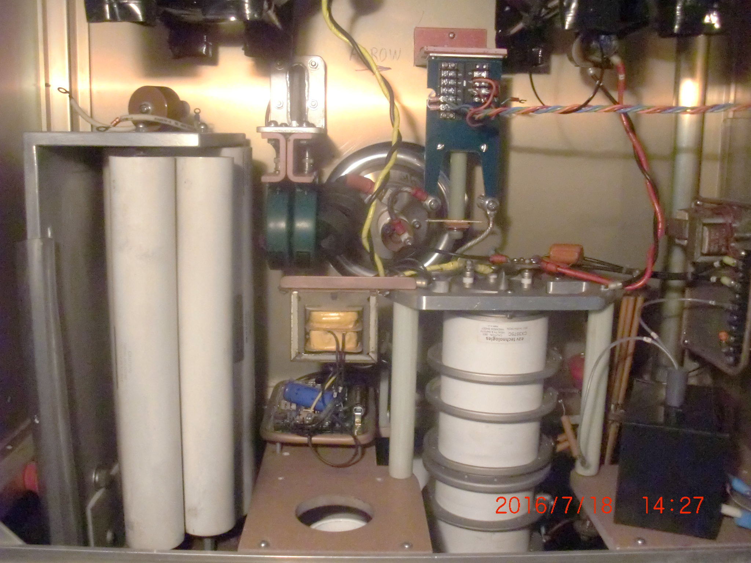
RHIC MPS upgrade Approach
Abort kicker pre-fires can be greatly reduced by moving HV switches out of tunnel, and by momentum collimation (also protects the QP diodes)
=> would be expensive upgrades (several $M)
More cost effective upgrade:
  Add serial switches to RHIC abort kickers to suppress pre-fires (+7 ms delay)
  Delay energy extraction from sc magnets after quench (necessity not recognized initially)
  New and modified inputs to permit link detecting precursors of large losses
  lower BLM thresholds at store, RF systems, Orbit corrector PS (fast and slow),
  fast BPM readings (coherence signal from 10 Hz feedback system)
  Monitor QP diode condition (measure voltage when diode becomes conductive)
  with sPHENIX run plan expect ~3-4x increase in distributed losses due to secondary beams
  from Au+Au luminosity over lifetime of RHIC
Abort kicker switches schematic
redundant mechanical
relays (added)
thyratron
tube
PFN
abort
kicker
slow (550 turns)
no pre-fires
fast (< 1 turn)
pre-fires
closes 1st
not synchronized
closes 2nd
synchronized with abort gap

Slide 40
RHIC MPS upgrade Run-18 progress
Serial switches
  shortened closing time from 30 ms to 7 ms
  (2350 to 550 turns)
  installed redundant trigger units in Blue and Yellow
  (prevents a failure mode observed in Run-17 test)
  modified hardware test protocol
Delayed energy extraction from sc magnets
  measured orbit and tune without and with delayed energy extraction (9 ms) – single bunch at store
New beam permit inputs
  All implemented except fast corrector PS input
  Control board designed – in production, alcove cable installation under way, software being developed

Slide 41
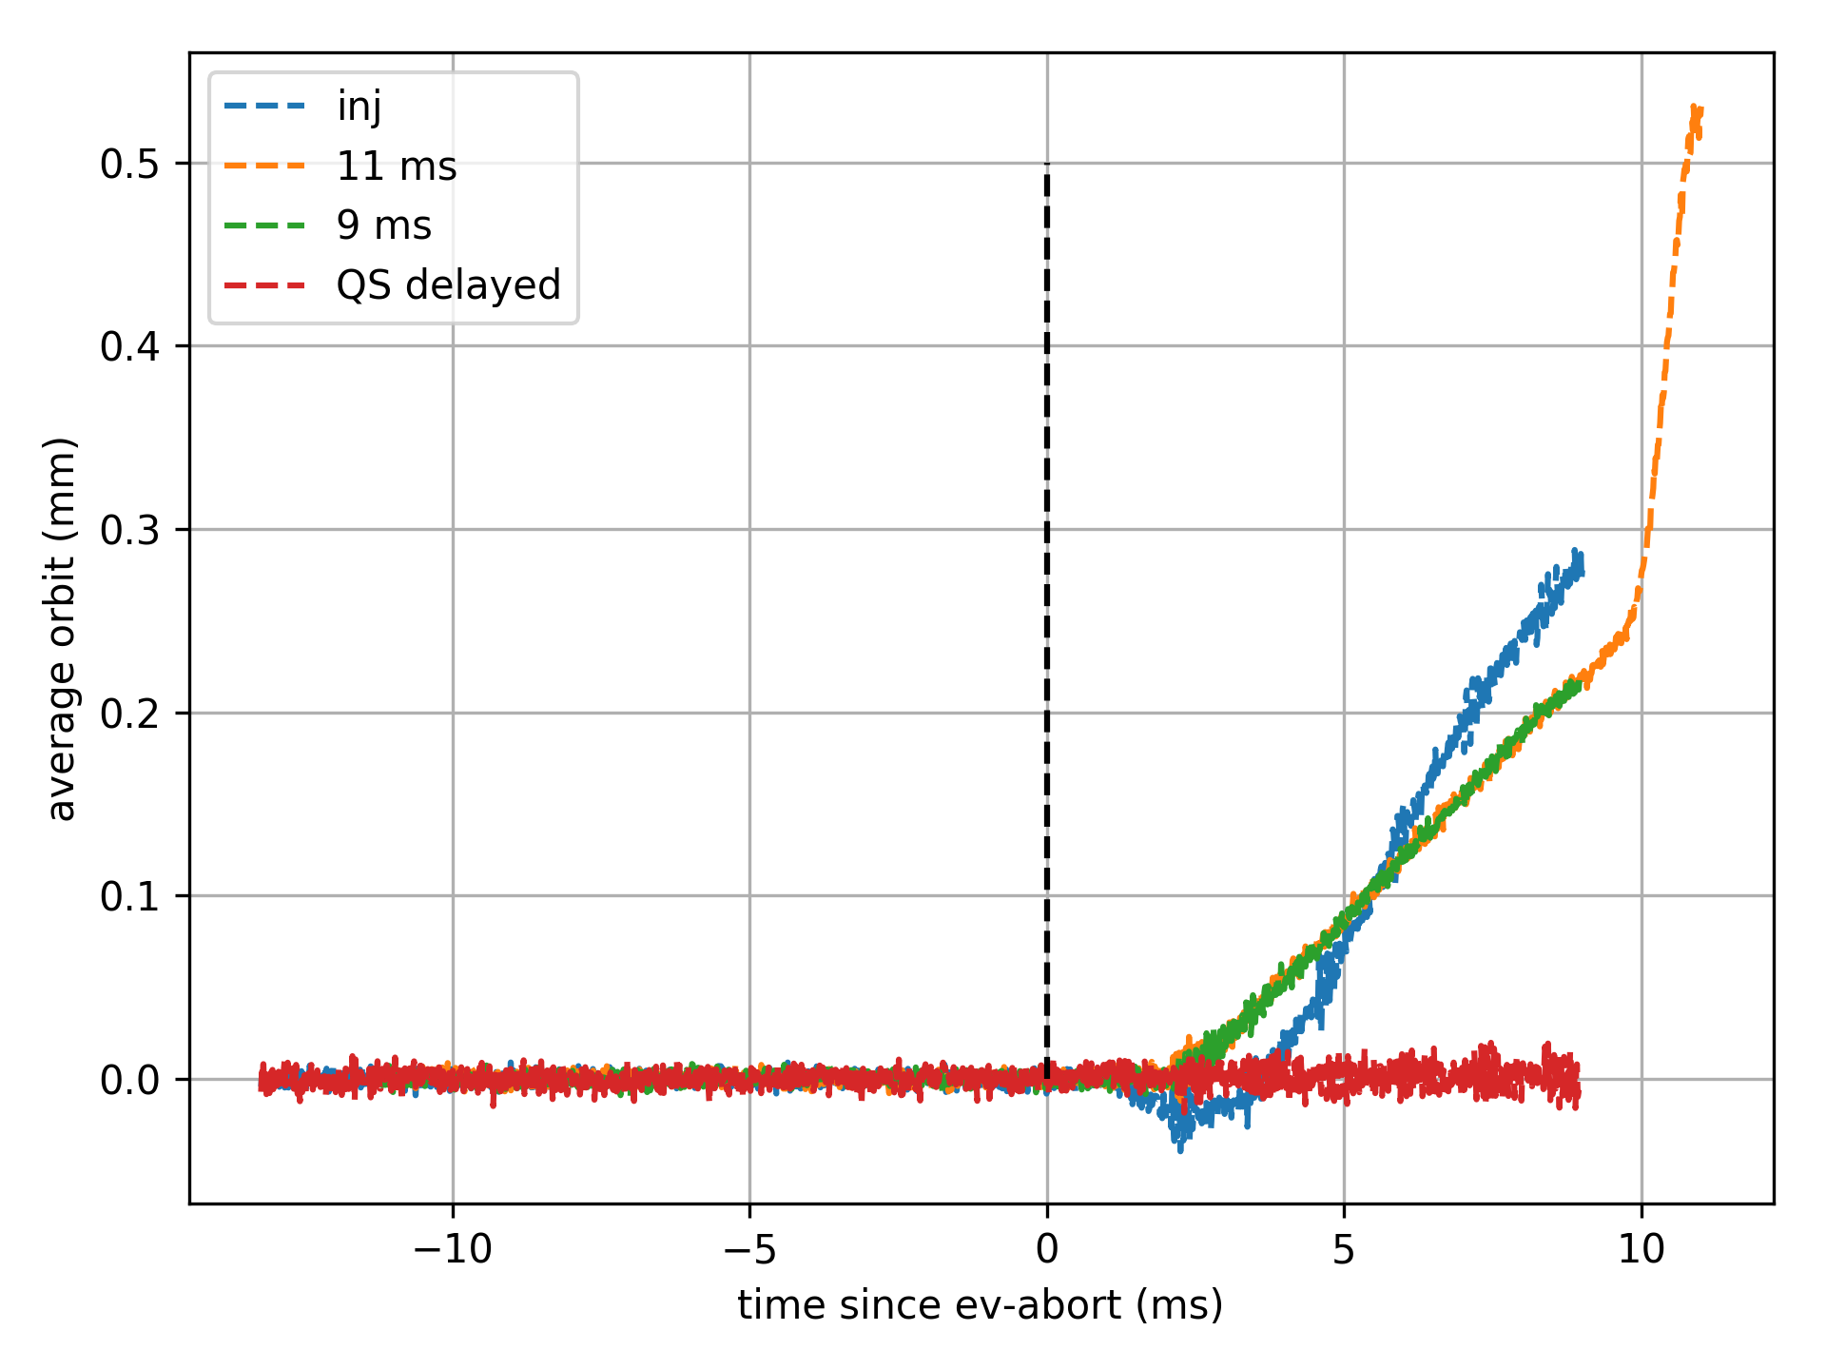
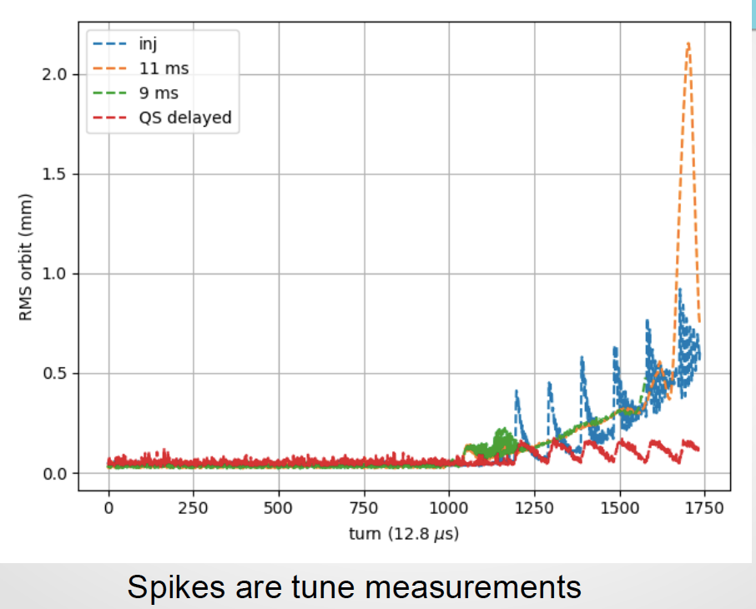
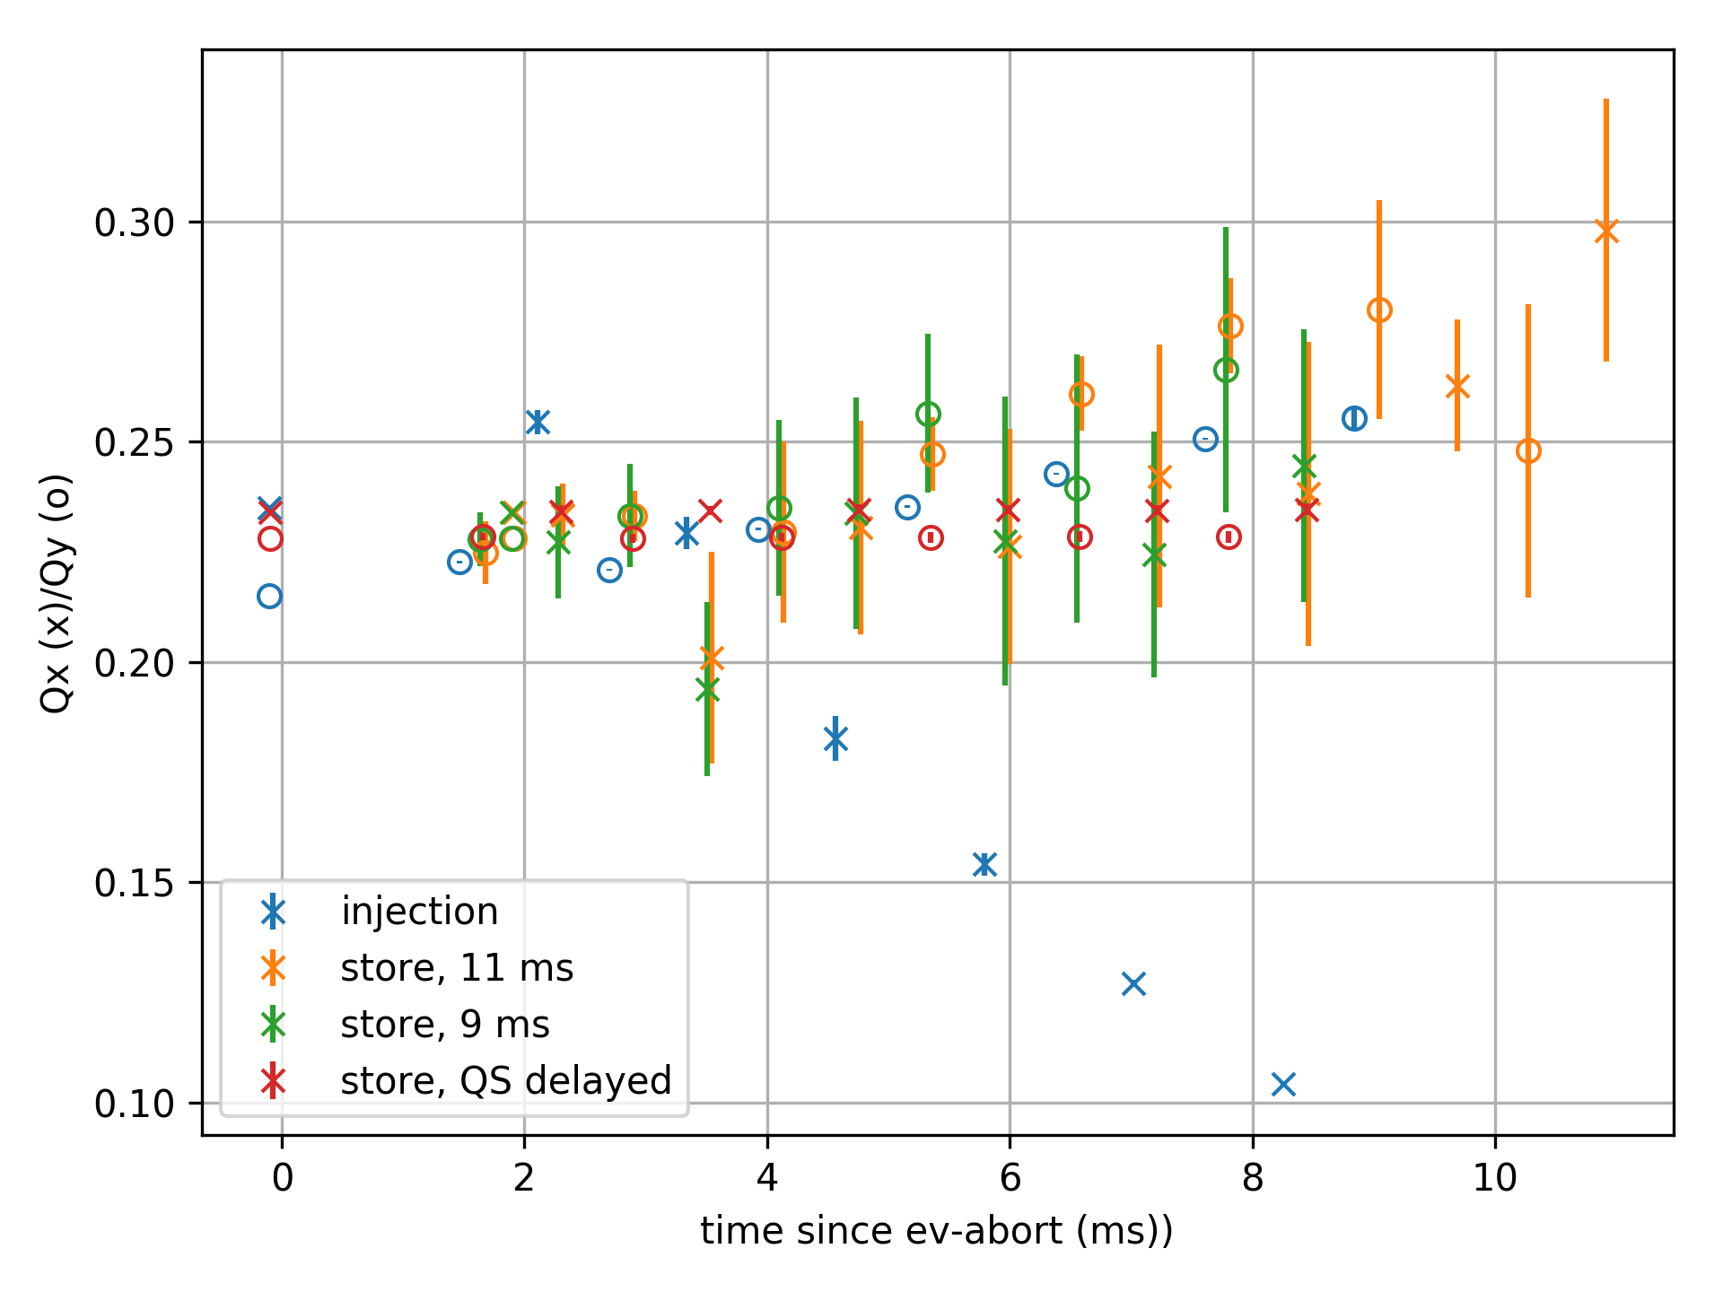
RHIC MPS upgrade Run-18 tests
orbit and tunes after pulling quench link
rms orbit
average orbit
No avg orbit changes with QS delayed
tunes
7 ms delay in energy extraction
of superconducting magnets is acceptable

Slide 42
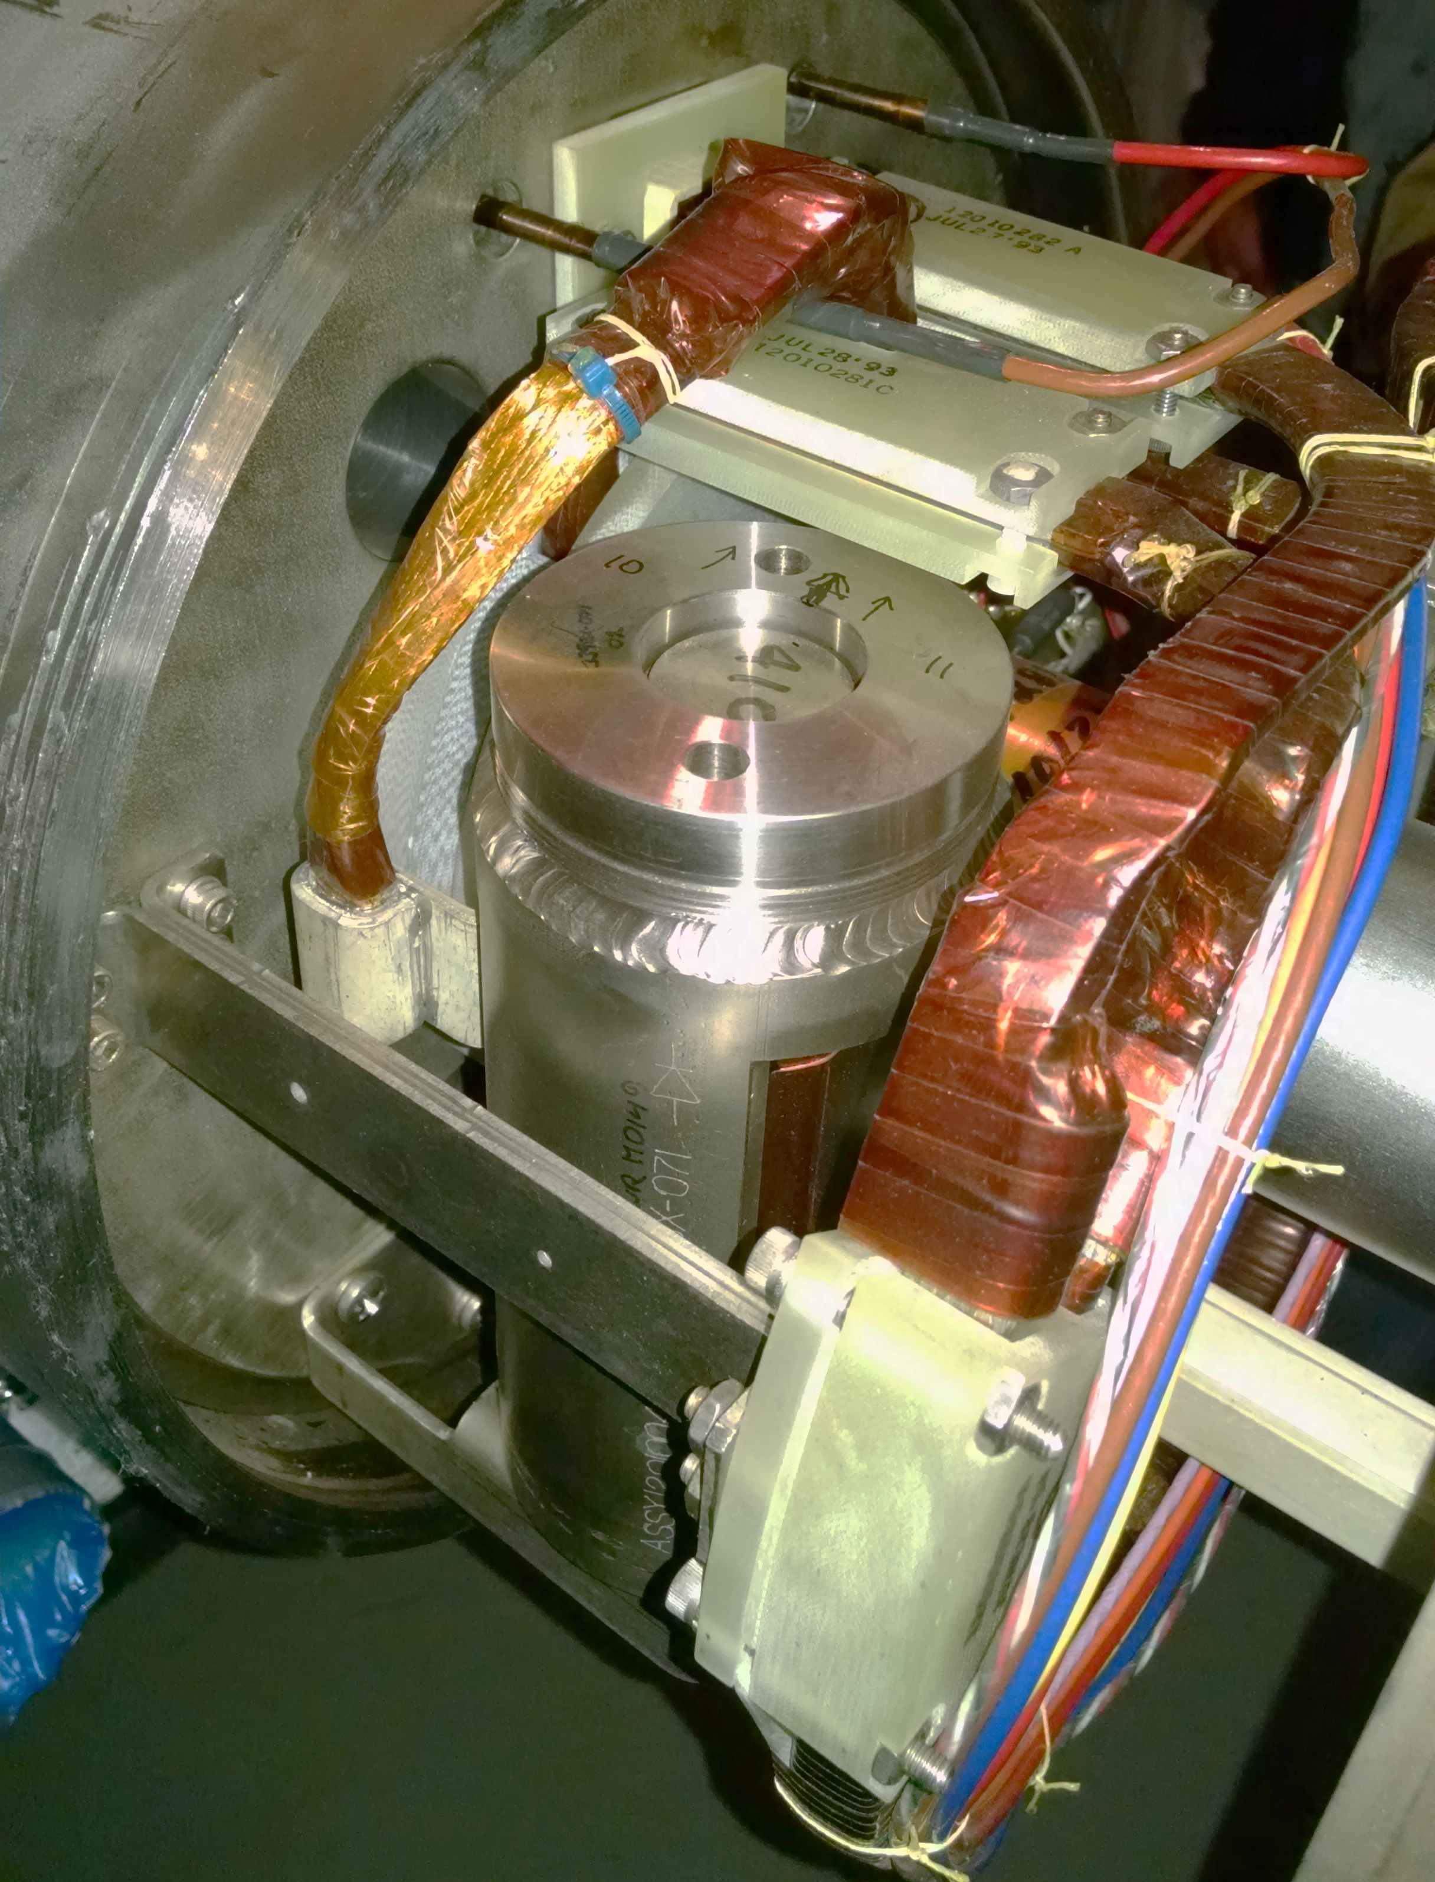
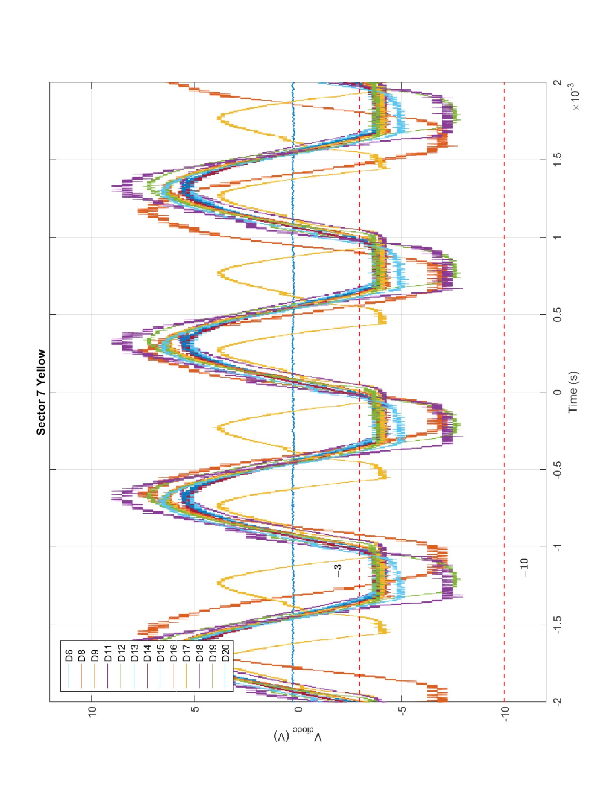
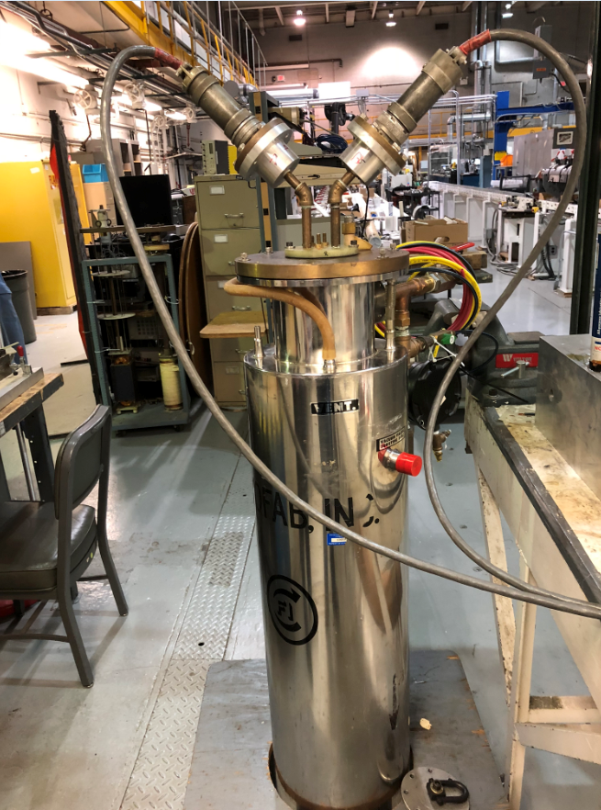
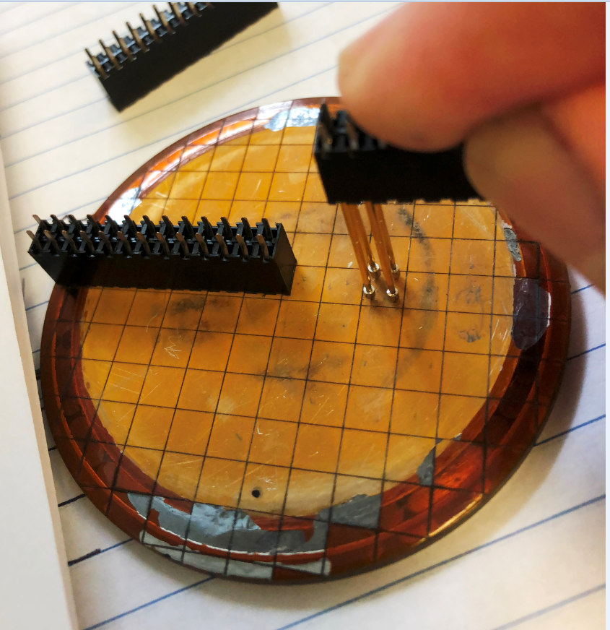
RHIC Quench Protection (QP) diodes monitoring
One QP damaged each in Run-16 and Run-17
became partially conductive due to radiation damage
after heavy beam loss exposure, weakened dipoles strength
Continue program to test diodes
measure voltage when diode become conductive
(forward bias voltage)
900 QP diodes total
=> tested 18/166/168 in Run-16/17/18 (all dipole)
Only B10-D9 not in 3-10 V range (2.1V, 1.8V)
Diodes repeated: B10-D19 and B10-D9
After 18 years of operation no sign of systematic radiation damage,
2 diodes damaged in special events
Also work on measuring spacial distribution of forward
bias voltage (warm complete, cold in preparation)
<= segmented damaged diode
Dewar for cold measurement =>

Slide 43
RHIC MPS upgrade Run-19/20 Plans
Add outstanding permit input (fast corrector PS)
Complete cold measurements of damaged diode
(spacial distribution of forward bias voltage)
Test delayed dump and energy extraction in operation (reduced risk in low energy operation)
Test delayed energy extraction with higher intensity
and full energy (end of run)

Slide 44
Summary
Operation of RHIC: met or exceeded integrated luminosity goals in the last 3 years
  Run-17 p↑+p↑ at 255 GeV, run coordinator Vahid Ranjbar
  Au + Au 27.2 GeV/n, run coordinator: Greg Marr
  Run-18 Zr + Zr / Ru + Ru at 100 GeV/n, Au + Au at 13.5 GeV/n
  + fixed target runs (at 3.85 GeV/n), run coordinator: Greg Marr
  Run-19 Au + Au at 9.8 GeV/n, 7.3 GeV/n, 3.85 GeV/n
  + fixed target runs (multiple energies), run coordinator Chuyu Liu
New and unique operation (e.g. Ru+Ru / Zr+Zr) enabled by previous upgrades
Flexibility of operations substantially increased: multiple modes / year is now routine
Operation of RHIC: exceeded accelerator availability goals
First (in the world) electron cooling with RF accelerated electron bunches demonstrated in support of Beam Energy Scan II - LEReC, presentation by A. Fedotov
Facility upgrades and maintenance ongoing to maintain high accelerator availability
Future BES-II operations will employ the newly developed LEReC technology
44

