Slide 1
Safety Performance in C-AD Biennial Science and Technology Review of RHIC
Lee Hammons
Directorate Chief Operating Officer for C-AD
September 2019

Slide 2
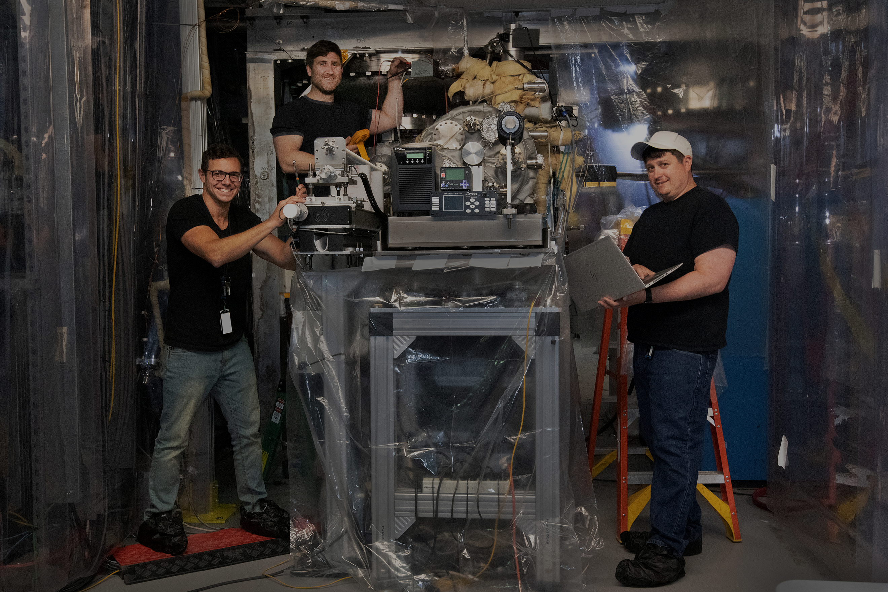
Agenda
Safety Values and Culture
Safety Organization and Programs
Safety Performance Successes
Challenges
Vision for the Future

Slide 3
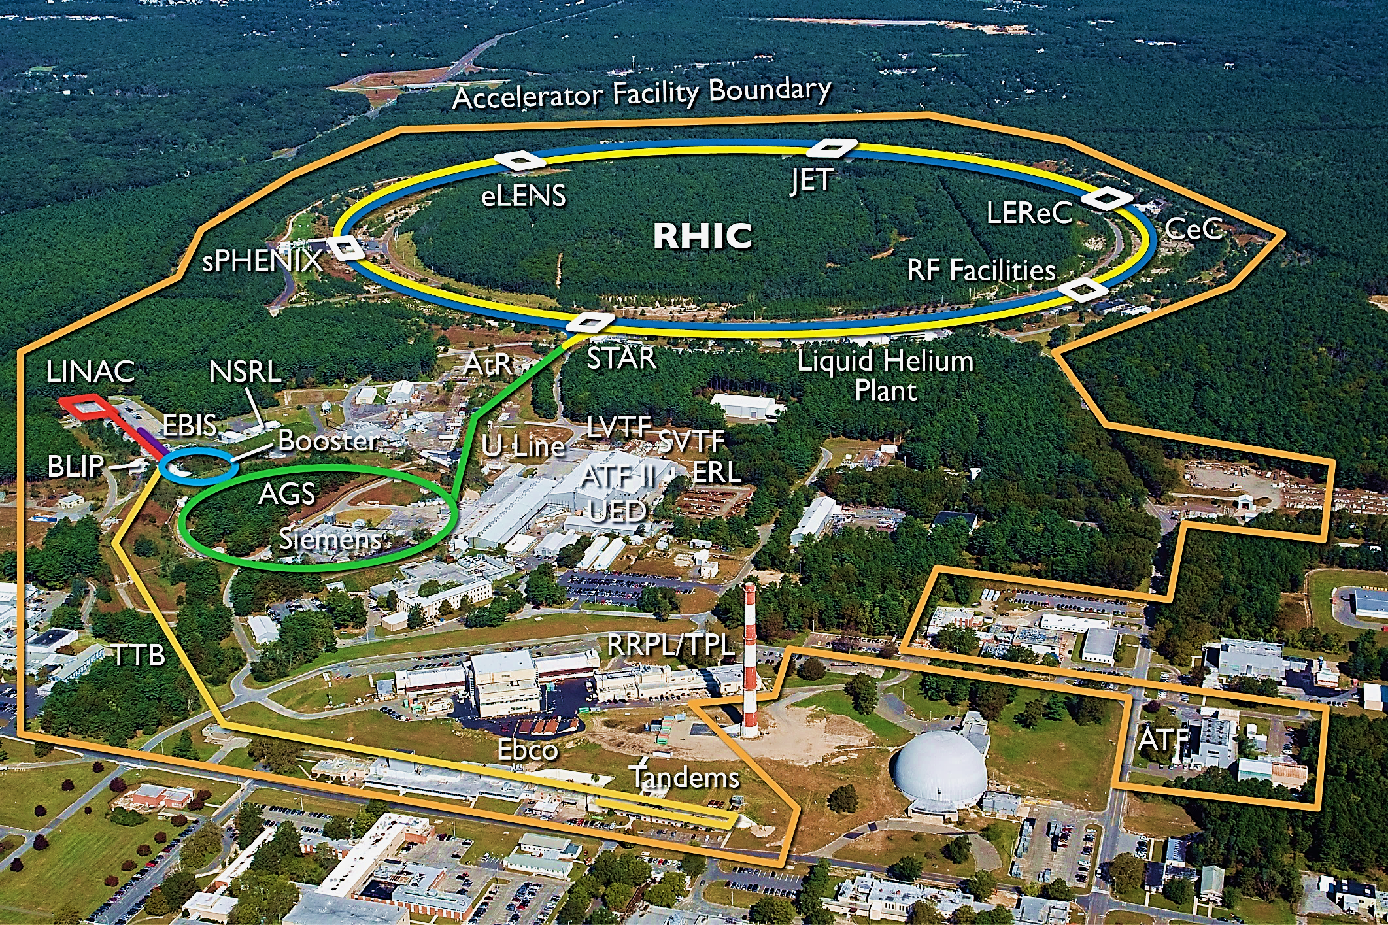

Slide 4
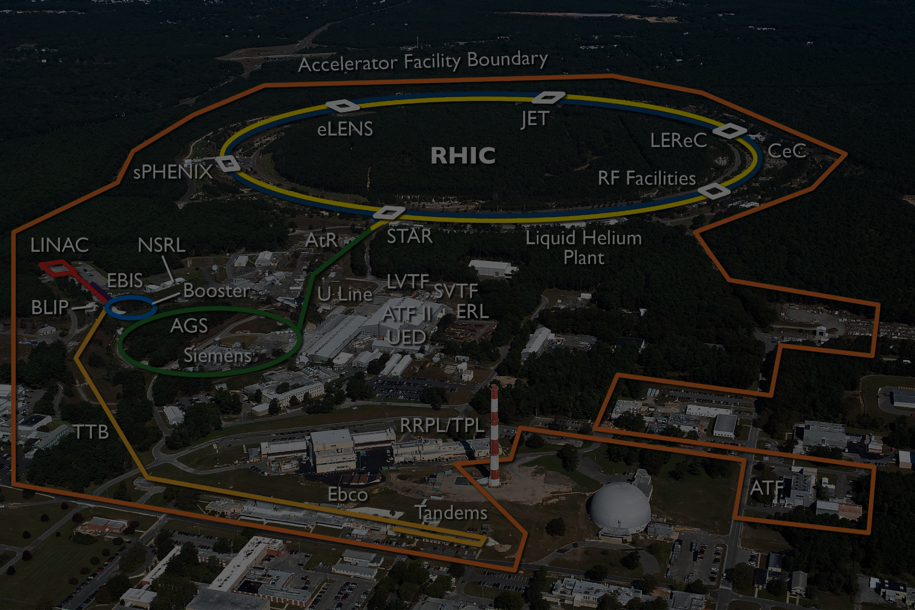
Safety and the C-AD Mission
Collider-Accelerator Department Mission:
Improve and operate accelerators, support the experimental program, and design and construct new accelerator facilities in an environmentally responsible and safe manner under a rigorous conduct-of-operations approach.
Safety is the highest priority for our operations
Integral part of the mission
Operations are conducted with an understanding of the hazards
Conducted with adherence to procedure
Each worker is responsible for maintaining an awareness of safety
Deep respect for our co-workers
Deep respect for the environment

Slide 5
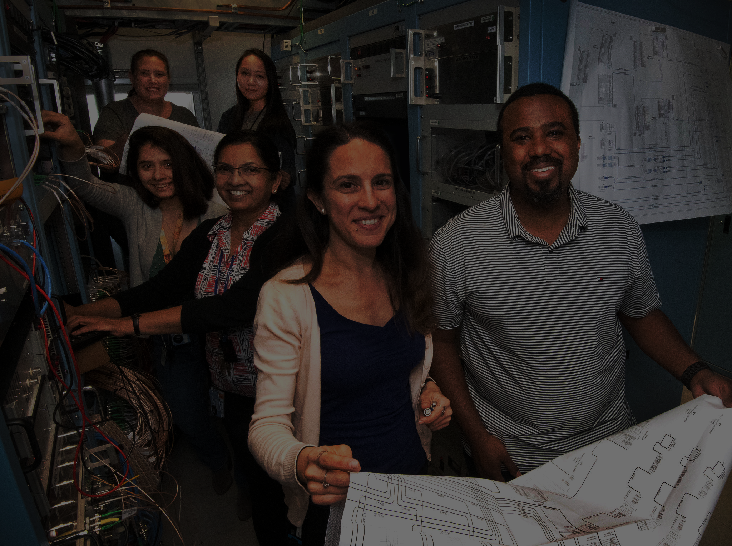
Profile of C-AD
~345 FTEs in C-AD
742,913 C-AD working hours in 2018
28 Groups
1,000 Acres
100+ Buildings
1,500 Users at C-AD Facilities

Slide 6
C-AD Safety Values
Management Committed to Excellence
Establish vision and goals
Line Responsibility for Safety
Executive, manager, supervisor all responsible to prevent injuries and events within jurisdiction
Everyone is Involved
Respect for coworkers and stakeholders
Establish safety improvement objectives
Track performance
Maintain personal involvement
Individuals responsible for their safety and that of coworkers
Integrity of operations
Responsibility for outcomes
Operational discipline
Maintain learning organization
Training is Essential
Broad Array of Safety Systems and Practices
No single practice or safety system is perfect
Multiple practices ensure some barriers remain even if some are defeated
Training compliments but cannot replace learning by doing
Training fosters discipline and excellence
Implement best practices that demonstrate success
Safe Conduct of Research Principles

Slide 7
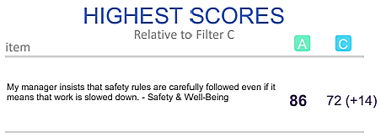
Our Values
Safety highly valued at Brookhaven and within the NPP Directorate
Survey results indicate a strong commitment to safety
My manager insists that safety rules are carefully followed even if it means that work is slowed down.
NPP
Lab
Best Companies to Work For

Slide 8
ESH Practices
Performance and Project Reviews
3 programs
Events and Issues Management
3 programs
Internal Assessments
16 programs
External Assessments
9 programs
Operational ESSHQ Activities
12 programs

Slide 9
ESSHQ Groups in C-A
T. Roser, Chair
P. Cirnigiliaro,
Assoc. Chair ESSHQ
L. Hammons, DCOO
ESSHQ Division P. Cirnigliaro, Head
Conduct of Operations L. Hammons, Head
Work Planning and Control
Safety
Training and Procedures
Environmental Protection
Assurance and Configuration Management
Authorization Basis Documents
Quality
Radiological Control Division

Slide 10
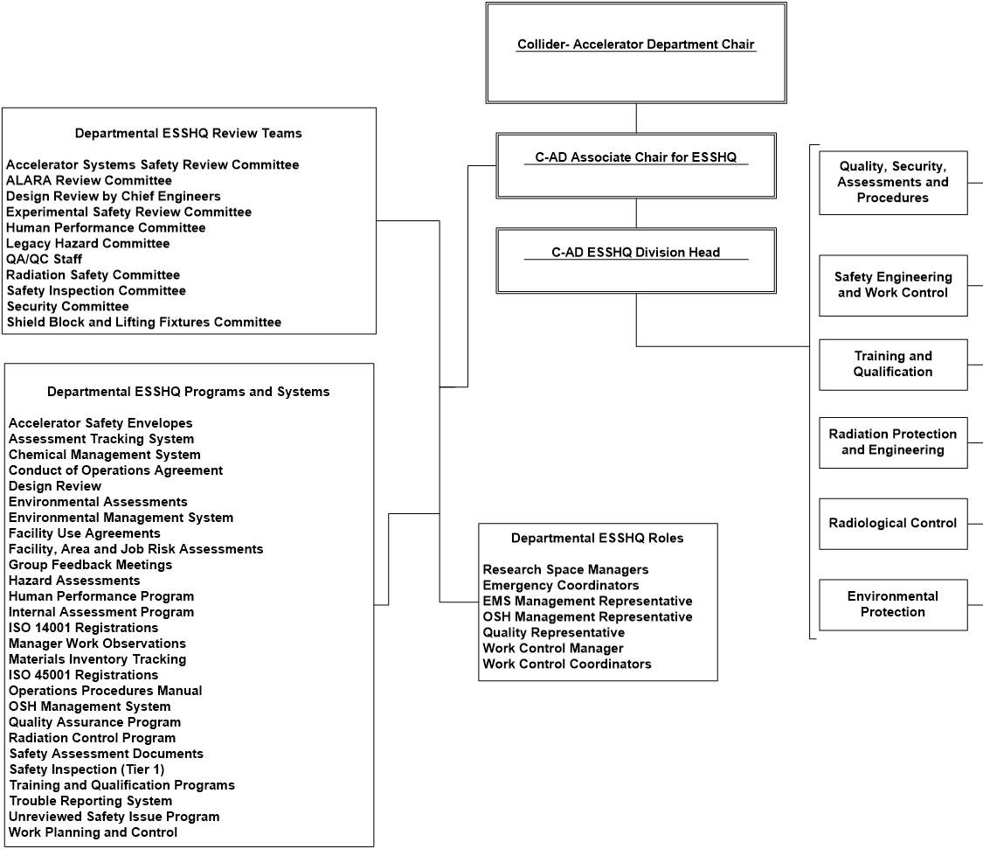
Safety Organizations in C-A
Review Teams
Working Groups
ESSHQ Programs and Systems
Roles

Slide 11
Safety Performance Successes
New Projects at RHIC
Low-Energy RHIC Electron Cooler (LEReC) Readiness Review
Approval for commissioning in March 2018
Coherent Electron Cooling (CeC) Readiness Review
Approval for commissioning and operation in May 2016
STAR Experiment Upgrades
Completed successfully and without incidents
PHENIX Removal and Repurposing
Removal of experiment, structural components, and shielding without incidents
sPHENIX PD 2/3 Safety Reviews
Completion of important initiatives:
Implementation of new requirements in electrical safety
Human performance refresher training of entire C-AD staff
Support of BNL’s effort to reregister to ISO (EMS and OSH) standards
Disposal of legacy gas cylinders
Successes are result of years of steady, persistent work on the part of entire department including safety teams

Slide 12
Environmental and Sustainability Objectives
Reduce greenhouse gas emissions by improving energy efficiency in day-to-day operations
Reduce or eliminate the acquisition, use, and release of hazardous chemicals and materials
Regulatory Objectives
Zero Notices of Violation
Zero Permit Violations
Zero Lost Workdays
Zero Total Recordable Injuries

Slide 13
Environmental Monitoring and Waste Disposal
ERM CVS Audit 2018
One institutional non-conformance
Compressed gas storage
Two institutional opportunities for improvement
Two minor spills in 2018
No wastewater discharge exceedances in 2018

Slide 14
Challenges to Safety Performance
Small uptick in injuries over last four years
Aging workforce – greater frequency of minor injuries
Redouble efforts to raise safety awareness
Plans for additional human performance training
Succession planning and changes in leadership
Aging workforces means higher priority to plan for succession and insure knowledge transfer
Retirement of Ed Lessard, former Associate Chair of ESSHQ
Responsibilities divided between Peter Cirnigliaro and Lee Hammons
Ed worked to put in place a robust set of programs that have built a strong and a lasting safety culture
Response to Accelerator Safety Assessment of November 2018
Notes:
How is C-A addressing this?
Increased awareness of safety:
All-hands discussions of safety performance
Mandatory slip simulator training for all C-A staff (completion rate near 85%)
Human performance training
Continue to stress and value safety performance
Maintaining awareness of legacy concern

Slide 15
Events in C-AD
2019
Plugging in Extension Cord to Power Chemical Insertion Pump at 1005 Cryo Cooling Tower Results in Spark at Pump-End of Cord, 7-15-19
Employee Receives Minor DC Elec Discharge to Hand, 6-24-19
Improper Escort into Radiological Area, 2-27-19
2018
An Improper Electrical LOTO Procedure was Discovered During a Post Job Review, 7-25-18
Guest slips in STAR Parking Lot, 3-23-18
1005P Mech Tech Fractures Left Shoulder, 11-2-18
Minor Injury to Worker from a Falling Object from Crane, 7-30-18
Employee Received Minor Discharge from Capacitor, 6-27-18
Radiation Alarm Response Did Not Follow Procedure, 4-17-18

Slide 16
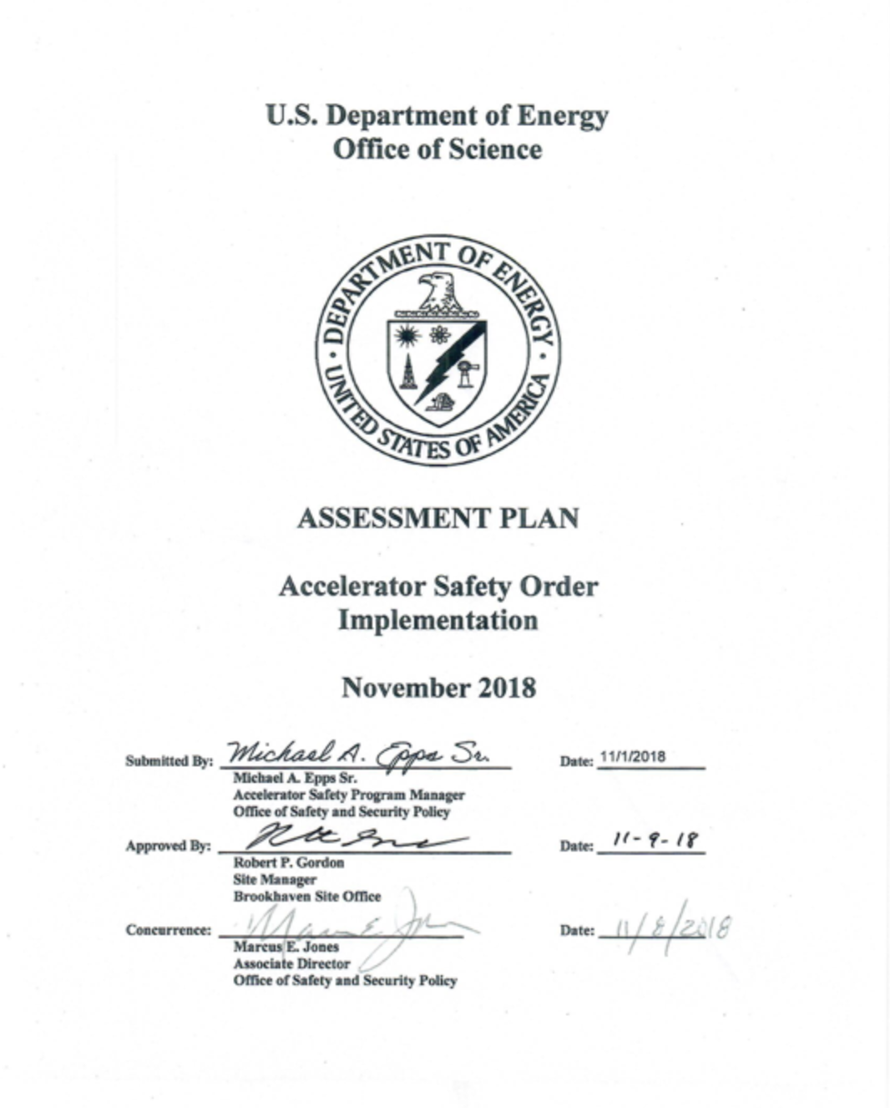
Accelerator Safety Assessment
Completed November 2018
Objectives:
Evaluate implementation of Accelerator Safety Order
Examine SCMS
Examine SBMS
Elements of assessment included:
SAD and ASE
USI
ARR
Training and Qualifications
Procedures and Plans
Approvals

Slide 17
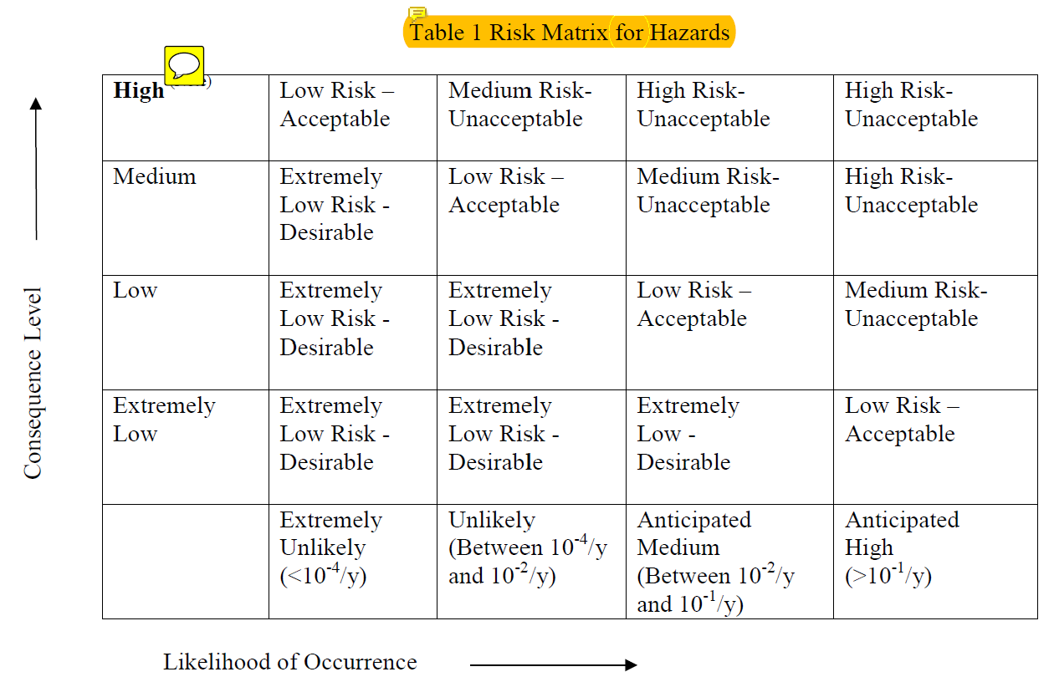
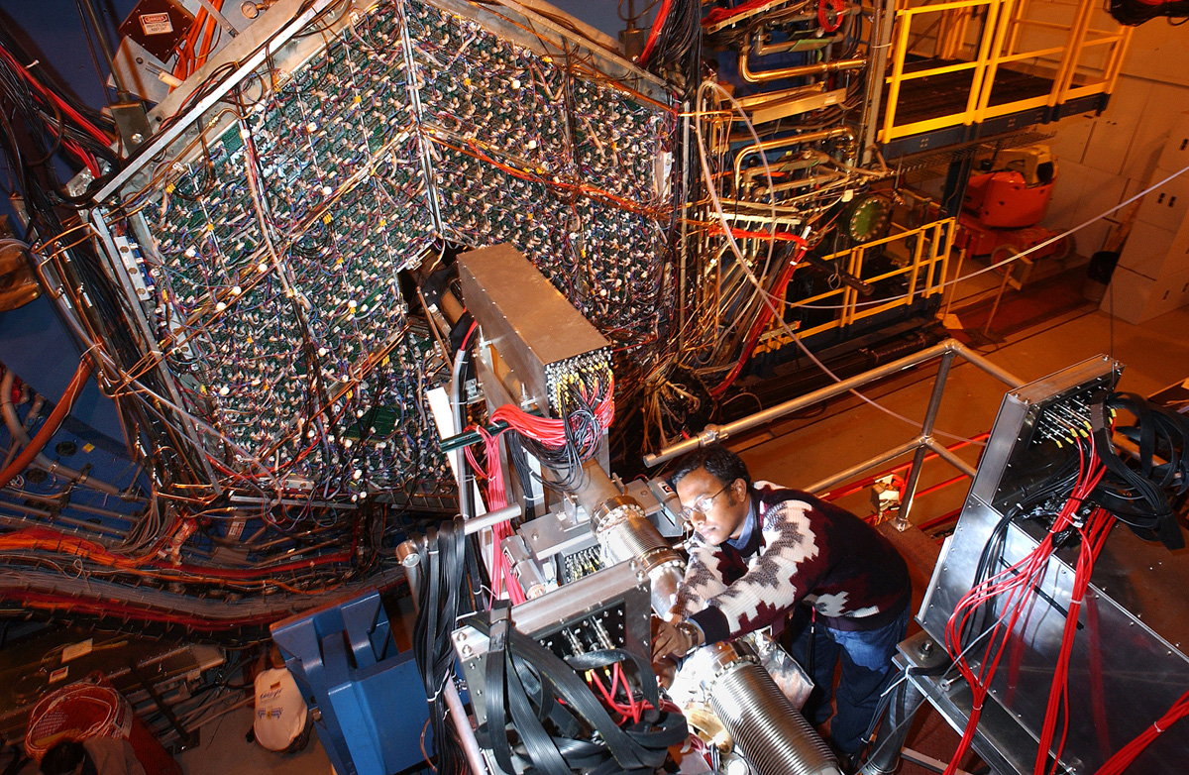
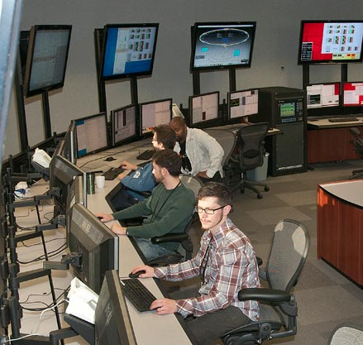
Key Areas of Concern
Safety Documentation
Operational Limits
Change Management
Conduct of Operations
Self Assessment

Slide 18
Key Questions
Do we understand the hazards and the risks?
Is the safety analysis adequate?
Are facility operations and procedures adequately documented and managed?
Does the staff have an adequate understanding of procedures and controls?

Slide 19
SC Management Review
Completed in July
Charged with determining safety of operations and ways that process could be improved
Conclusions:
Operations are safe
Procedures and work controls maintain the safety envelope
Staff is competent
Improvements:
Enhance clarity of safety documentation
Improve flowdown of credited controls into operating procedures
Use self review of procedures and activities to drive continuous improvement
Improve quality and clarity of procedures
Benchmark USI process against other SC sites

Slide 20
Answers
Do We Understand the Hazards and Risks?
Yes, and C-AD is working to improve our safety documentation and procedures to more effectively address and identify hazards and risks
Is the Safety Analysis Adequate?
Yes, the safety analyses of our facilities have been developed over many years and with the help of many experts
Successful reviews and robust processes attest to the adequacy
C-A has comprehensively analyzed the safety of our facilities, but we are working to improve the quality and the clarity of our analysis for the future
Are Facility Operations and Procedures Adequately Documented and Managed?
Yes, but C-AD is working to improve the documentation and procedures
Does the Staff Have an Adequate Understanding of Procedure and Controls?
Yes, but training and continuous improvement is an important part of C-A culture
Succession planning and knowledge transfer is critical to maintaining our programs
Continuous improvements require ongoing efforts to train and raise awareness of staff about hazards and risks
C-AD is always working to improve our training and engage staff in identifying hazards

Slide 21
Vision for the Future
Operational Excellence
Procedures and programs that that demonstrate best practices in the DOE complex
Safety leadership
Best management tools and practices to manage present and future programs
Best tools and technologies to manage safety of facilities
Full engagement of staff in managing safety of facilities
Continued open and honest dialogue about challenges
Vigorous communication with all stakeholders regarding safety performance
Partnership with our Site Office to ensured continued successful operations
Fully resourced commitment to safety excellence
Thoughtful succession planning and knowledge transfer
Full complement of staff to manage safety programs

Slide 22
Conclusions
C-AD, NPP, and BNL are committed to maintaining a culture of safety
Values and culture are aligned
All stakeholders understand and value our safety commitment
C-AD has been successful in maintain RHIC operations and bringing new operations online
LEReC, CeC, STAR Upgrade, PHENIX R & R
C-AD maintains are large number of safety programs and initiatives that provide for safe and environmentally sound operations
Challenges include:
Aging workforce
Small uptick in injuries in past several years
Heightened awareness of staff
Additional training
Transition to new leadership with retirement of longtime Associate Chair for ESSHQ
Continuous improvement of operations to address concerns of accelerator safety assessment now and into future
C-AD is committed to a future of operational excellence through commitment to Safe Conduct of Research Principles

Slide 23
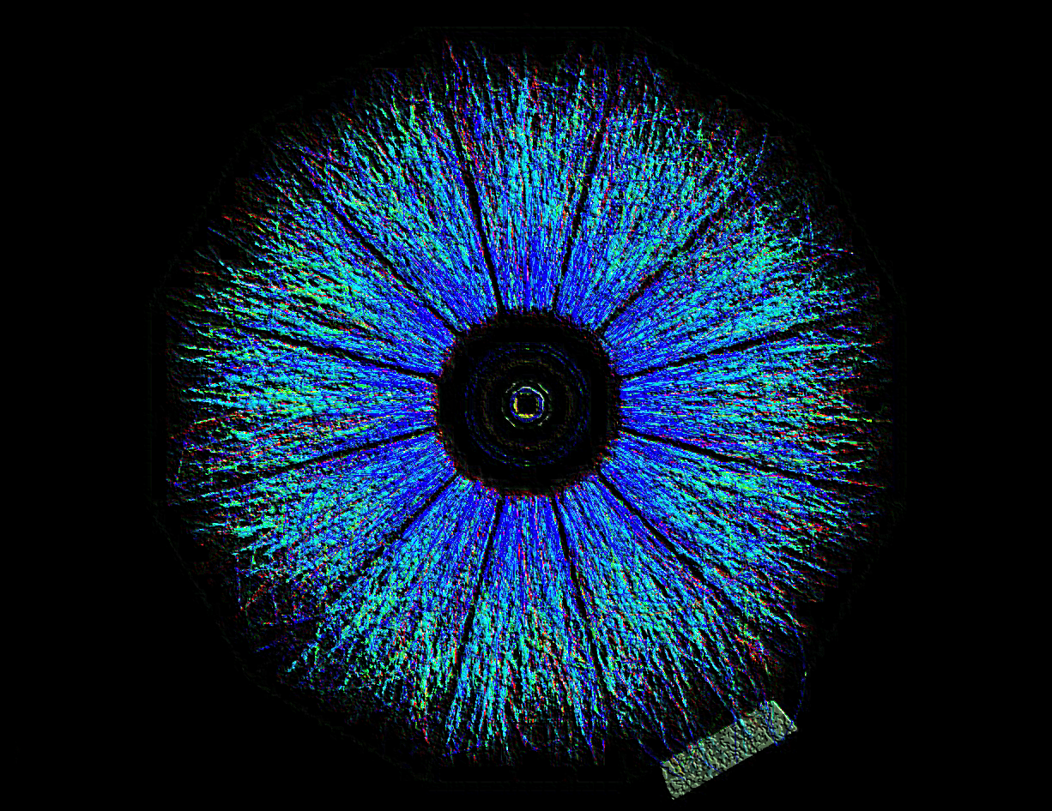
END

