Slide 1
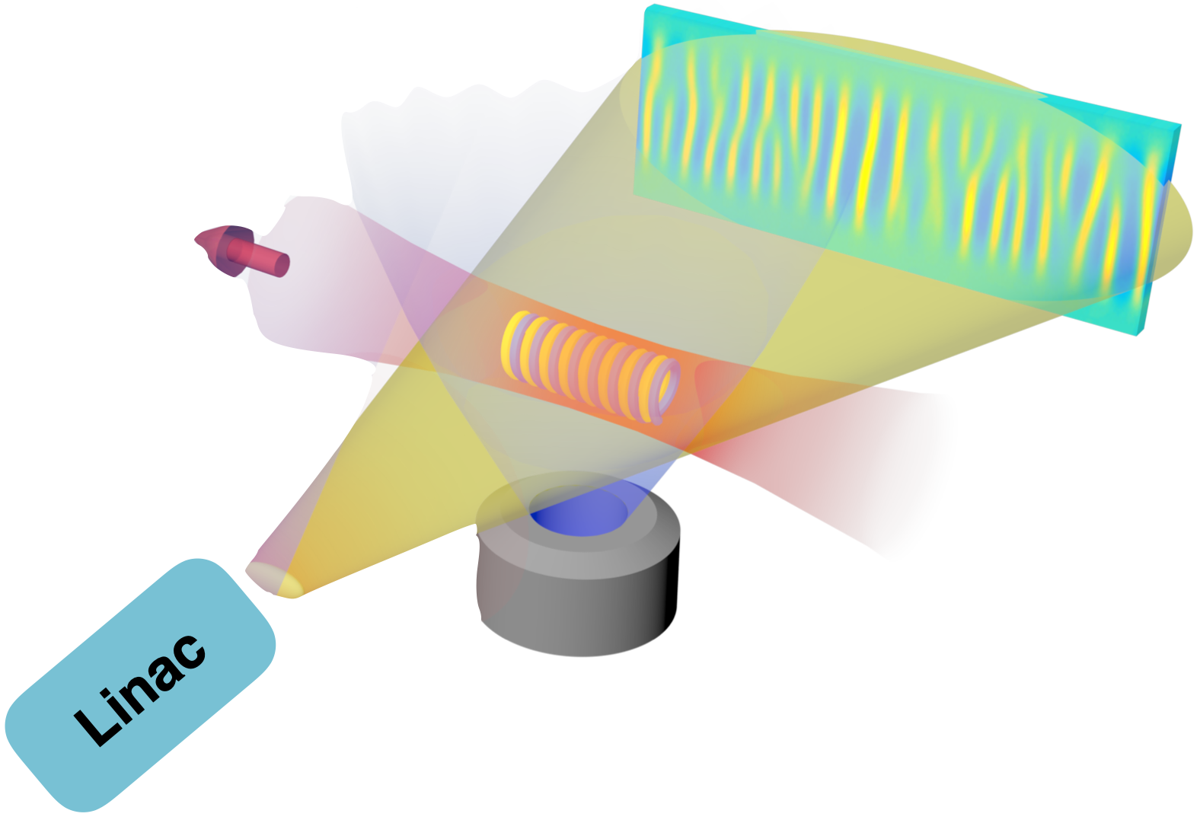
Probing electron Weibel instability in optical field-ionized plasmas using ultrashort electron beams (ID 306033)
PIs: Chaojie Zhang and Chan Joshi
UCLA
Weibel B fields
e- beam profile
CO2 laser
Collaborators:
Chen-Kang Huang, Ken A. Marsh, Warren B. Mori (UCLA)
More people will get involved in the future
Fundings: NSF, proposed
H2/He/N2 …
Dec 4, 2019, ΑΤF User Meeting

Slide 2
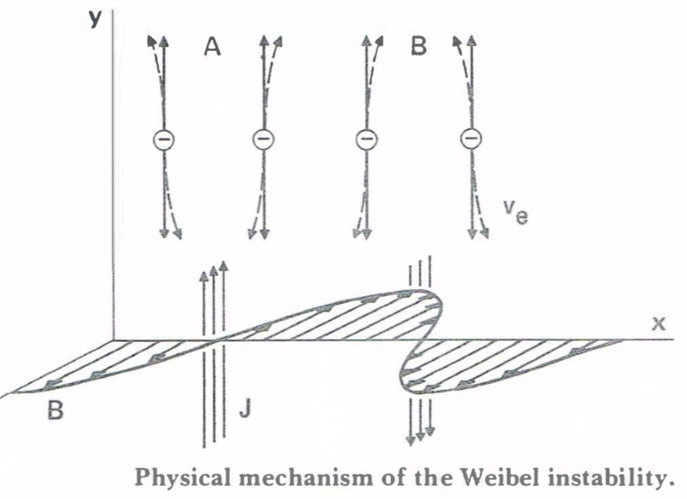
What is Weibel instability
Weibel instability grows in plasmas having temperature anisotropy (temperatures differ in different directions)
Weibel:
noise B fields
hot
vy
vx
current filaments
bend e- trajectory
Characteristics of Weibel instability:
Electromagnetic mode (no δne)
none-oscillating: Re[ω]=0
k is along the low-temperature direction
growth rate γ/ωp depends on temperatures
cold
E. S. Weibel PRL 1959
B. D. Fried PRL 1959

Slide 3
What is Weibel instability
Weibel instability grows in plasmas having temperature anisotropy (temperatures differ in different directions)
Weibel:
noise B fields
Filamentation:
hot
vy
vy
vx
current filaments
bend e- trajectory
vx
Characteristics of Weibel instability:
Electromagnetic mode (no δne)
none-oscillating: Re[ω]=0
k is along the low-temperature direction
growth rate γ/ωp depends on temperatures
cold
E. S. Weibel PRL 1959
B. D. Fried PRL 1959

Slide 4
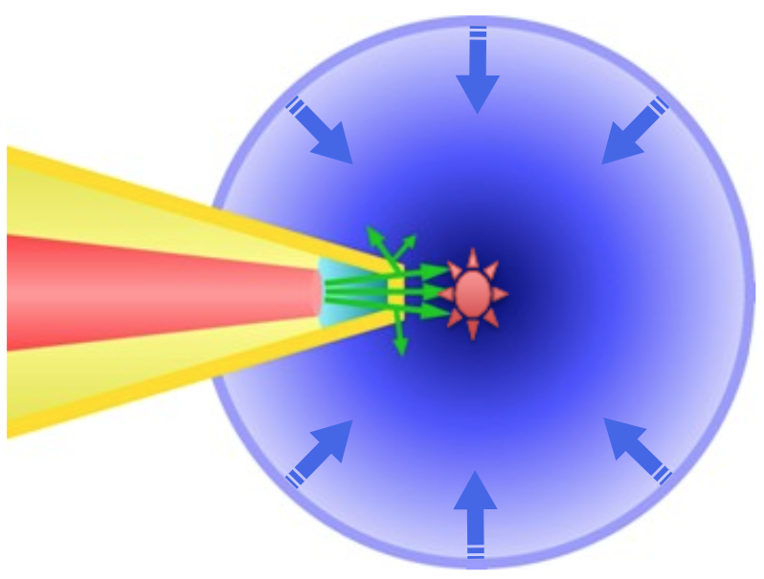
Where we can find Weibel instability important?
Weibel instability driven by anisotropic electron/ion velocity distributions is relevant in many important physical processes. The self-generated magnetic fields may
Mediate collisionless shocks (possible accelerator for cosmic rays)
Generate bright gamma ray flashes (novel light sources)
Affect energy deposition in the fast ignition scenario
Acceleration: Collisionless shock¹
Light source: Gamma ray flash²
Energy: Laser-driven fusion³
the galaxy Cygnus a
colliding plasma creates collisionless shocks
laser
compressed fuel
filamentation of dense e- beam in plasma generates bright γ-ray flashes
electron/proton tranport in dense plasma
1, J. Meinecke et al., Nat. Phys. 2014; C. M. Huntington et al., Nat. Phys. 2015, etc.
2, A. Benedetti et al., Nat. Photonics 2018, etc.
3, M. Tabak et al., PoP 1994; A. Pukhov et al., PRL 1997; M. Honda et al., PRL 2000; M. Roth et al., PRL 2001, etc.

Slide 5
The scientific opportunity
As an important mechanism of self-generating magnetic fields in anisotropic laboratory and space plasmas, Weibel instability
Has been intensively studied in theory and simulations
No direct measurement on its linear growth rate and wave vector spectrum yet
Lack of quantitative study of its nonlinear stage evolution
Recent experiments:
(incomplete list)
Most of these experiments involved laser-solid interaction
Hard to know the exact initial condition of the plasma
Difficult to track the detailed dynamics of the instability
Involve colliding beams/plasmas, CFI
We have a very good opportunity to make systematically study of electron thermal Weibel instability

Slide 6
Probing electron Weibel instability using ultrashort e- beams
Conceptual sketch of the experiment
Probing Weibel instability at ATF (proposal)
Methodology:
Initialize anisotropic plasmas using optical field ionization
Take snapshots of Weibel magnetic fields using e- beams
Physics we can explore:
growth rate, k-spectrum evolution
different plasma temperatures/densities
effect of collisions
effect of finite width plasma
etc
Weibel B fields
e- beam profile
CO2 laser
H2/He/N2 …

Slide 7
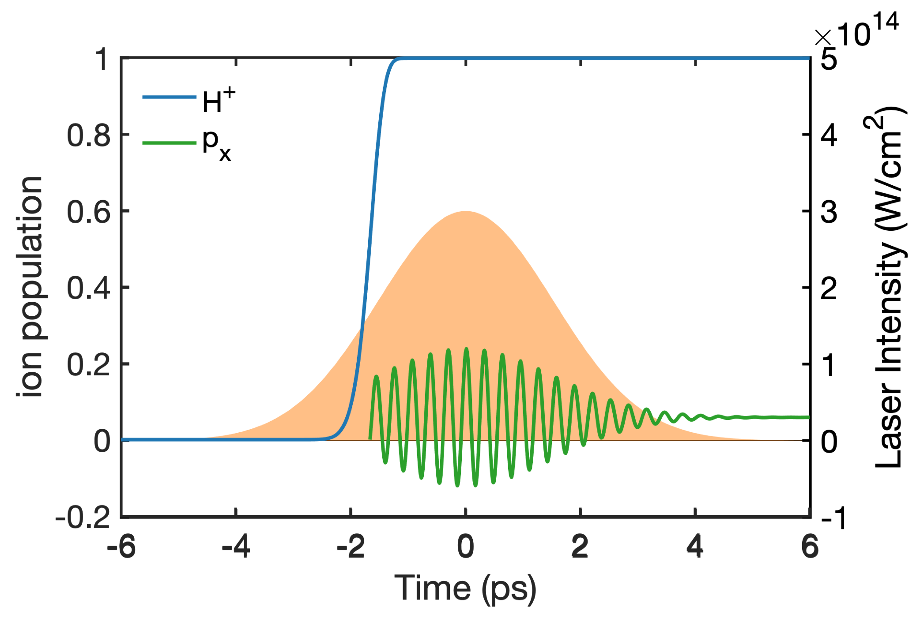
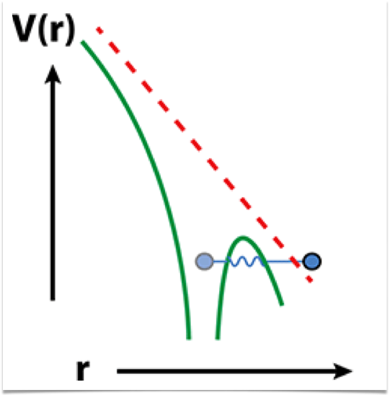
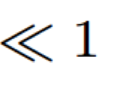
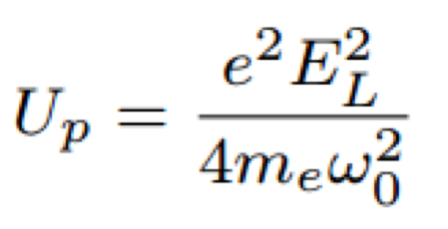
Initialize anisotropic plasmas using optical field-ionization
ionization threshold of H2 ~ 2e14 W/cm²
Tunnel ionization
ion yield
3-ps CO2 laser
e- momentum
(not to scale)
After being ionized, the electron starts oscillating inside the laser field;
By the time the laser has passed, the electrons pick up some residual momenta depending on ionization phase according to canonical momentum conservation.

Slide 8
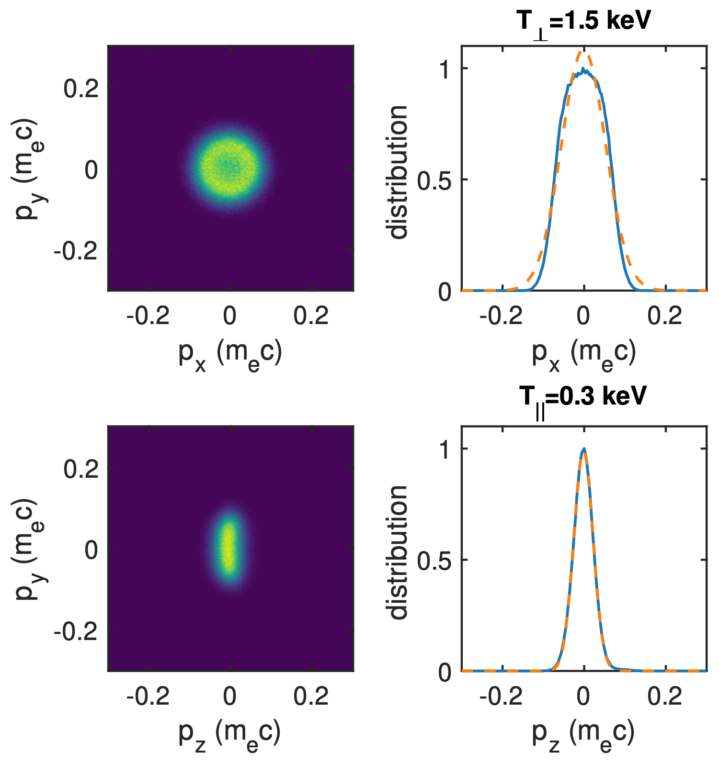
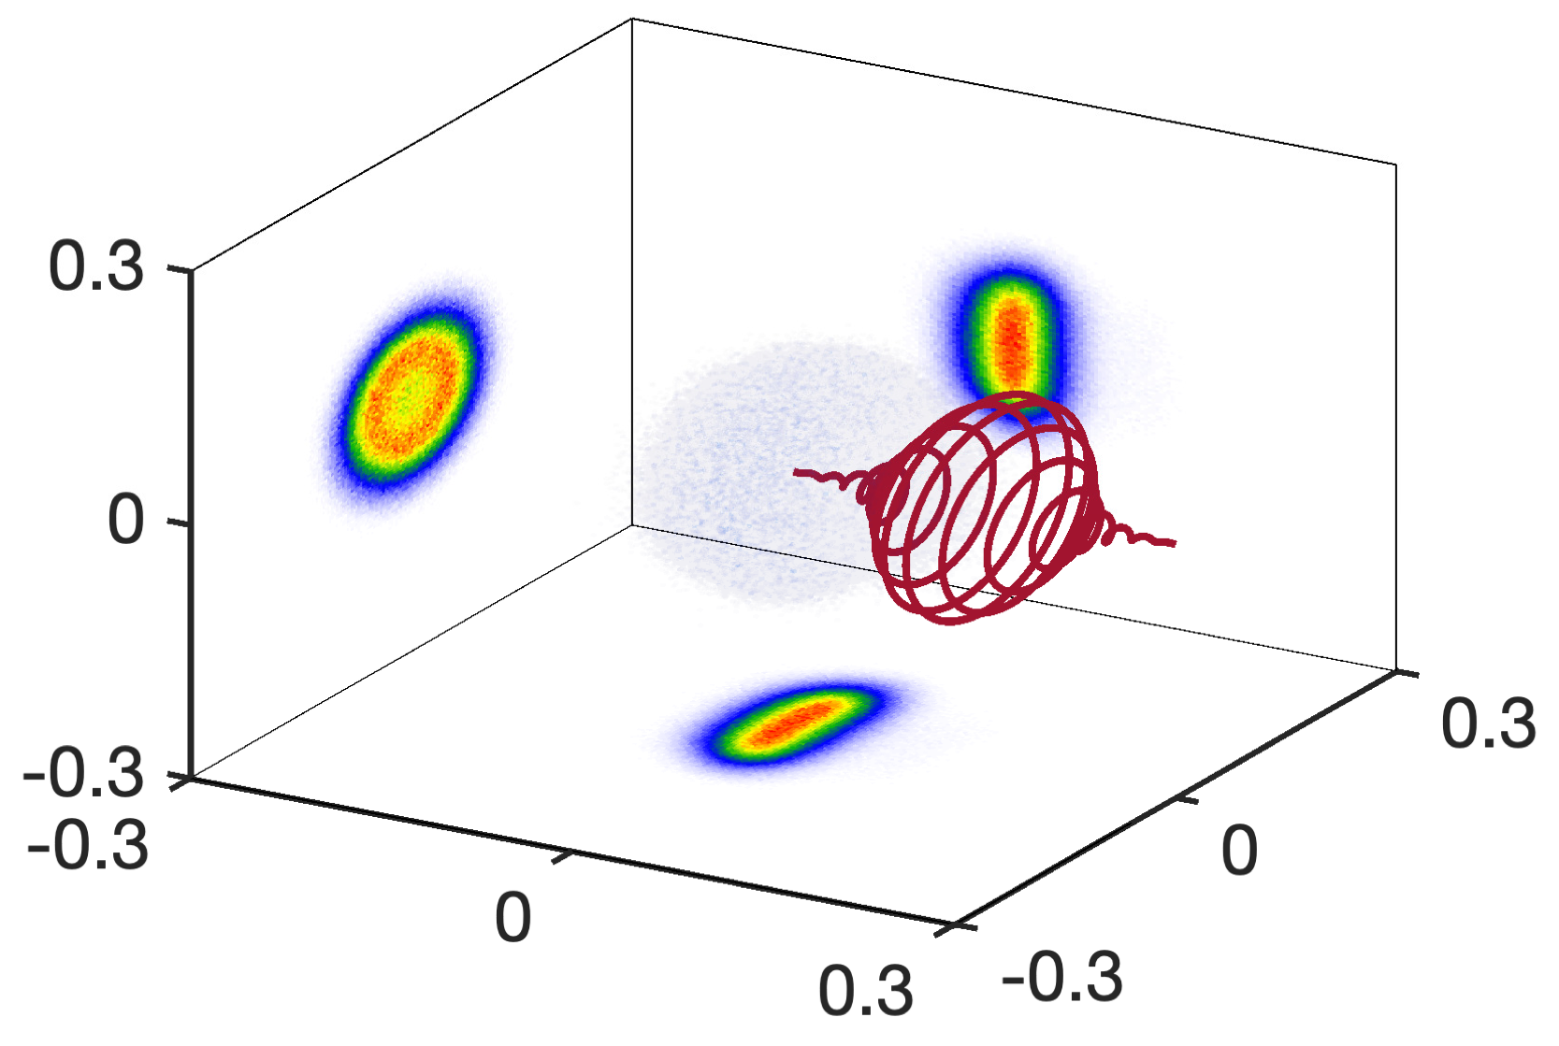
Initialize anisotropic plasmas using optical field-ionization
Self-consistent 3D PIC simulation
Laser: CO2 laser, 3 ps (FWHM), w0=100 µm, Peak intensity 3e14 W/cm² (CP), a0=0.1
Gas: Atomic hydrogen, ne=2e17 cm⁻³
Electron velocity distribution (momentum space)
Py (mec)
Px (mec)
Pz (mec)
C. Zhang et al, Science Advances, eaax4545 (2019)
C.-K. Huang et al, PPCF, under review

Slide 9
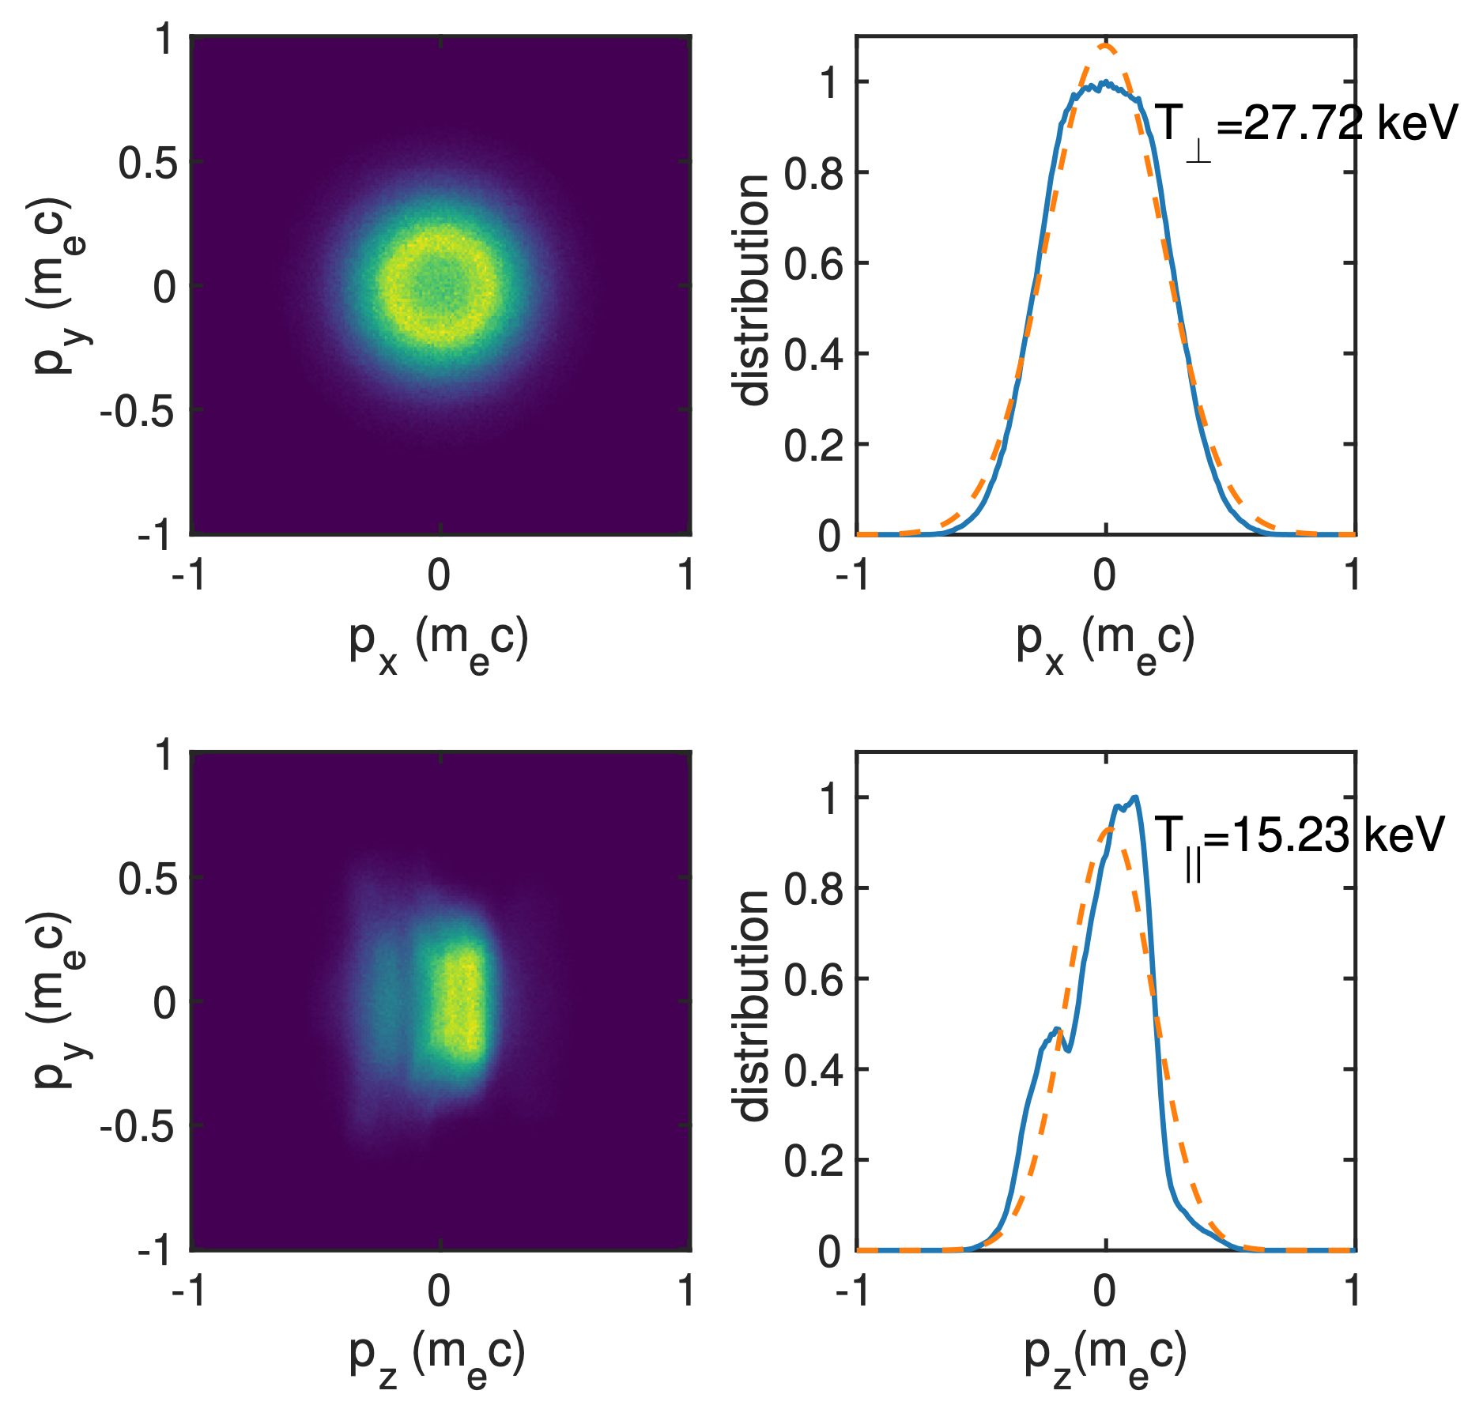
Initialize anisotropic plasmas using optical field-ionization (Helium)
Laser: CO2 laser, 3 ps (FWHM), w0=50 µm, P=0.8 TW, Peak intensity 2e16 W/cm² (CP), a0=0.86, ne=1e17 cm⁻³
Electron velocity distribution:
Thermal ring distribution in the transverse plane
Gaussian distribution in the longitudinal direction
Quasi-relativistic temperatures (10s keV), v⊥~0.3c
There should be two rings correspond to He¹⁺ and He²⁺ electrons, but somehow they have merged into one ring after the 3-ps laser has passed
pulse duration | T⊥ | T∥ | growth rate
3 ps | 28 keV | 15 keV | 0.06 ωp
0.3 ps | 47 keV | 8 keV | 0.18 ωp

Slide 10
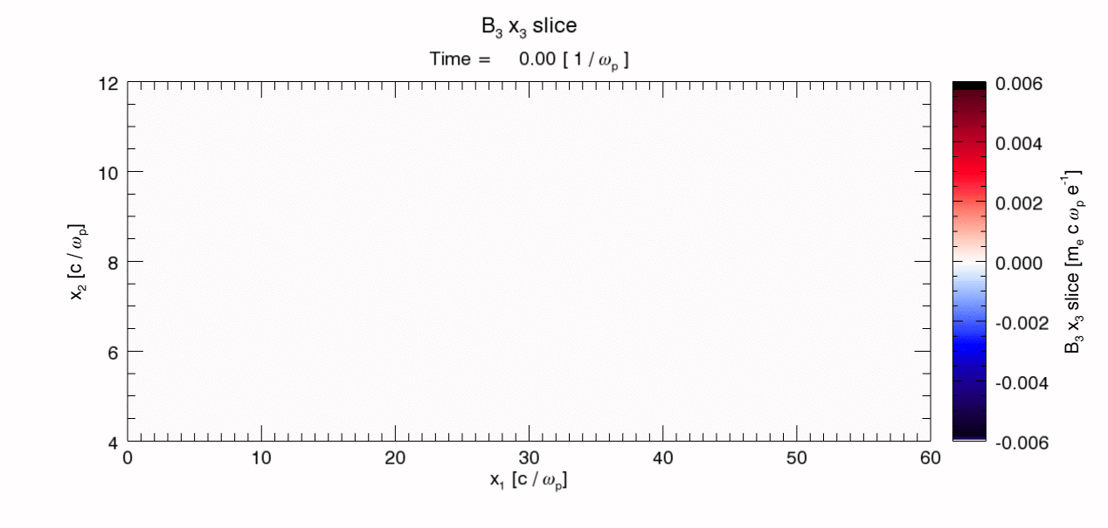
3D simulation using pre-ionized plasma (bi-Maxwellian velocity distribution)
Practical reason: self-consistent full 3D simulations are very time consuming
Physical reason: our previous study shows that the ring distribution will approach to a quasi-Maxwellian distribution very rapidly due to other instabilities (e.g. two-stream and filamentation)
C. Zhang et al, Science Advances, eaax4545 (2019)
3D simulation, pre-ionized plasma with T⊥=47 keV and T⫽=7.5 keV, ne=1e17 cm⁻³
evolution of B3 field (a slice thru x3=0) as a function of time:
(time step 2π/ωp=0.35 ps)
0.6 Tesla
-0.6 Tesla

Slide 11
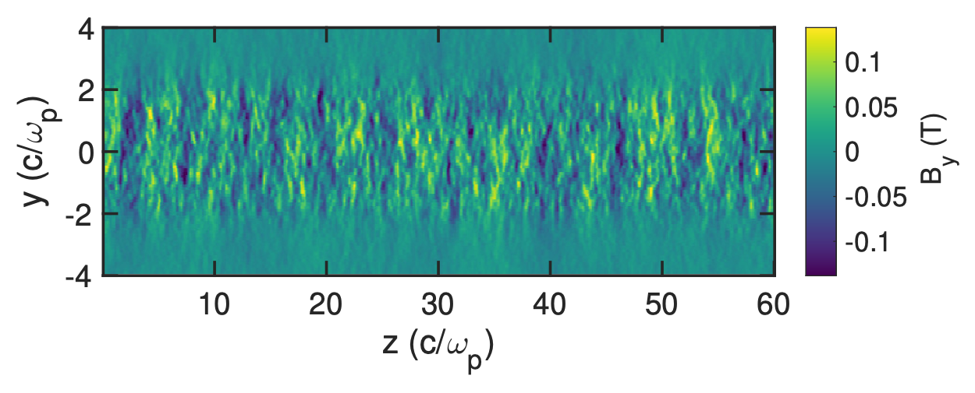
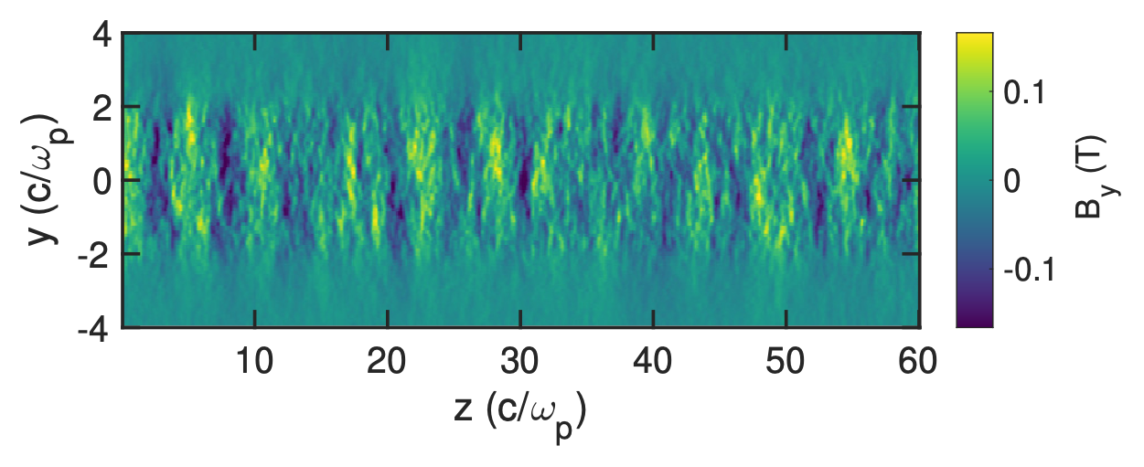
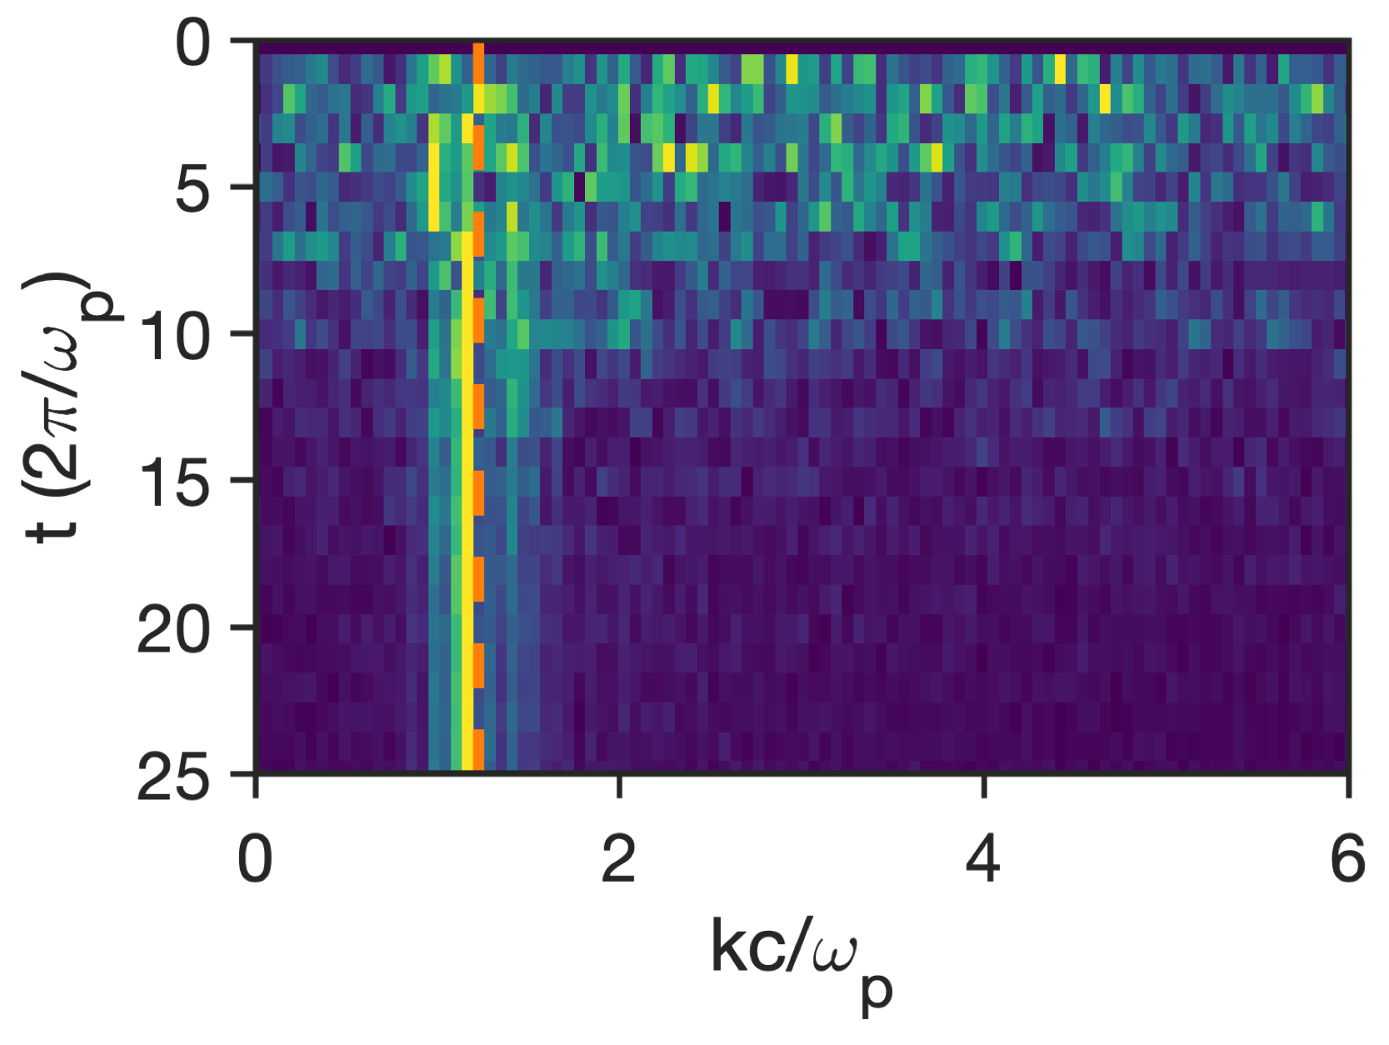
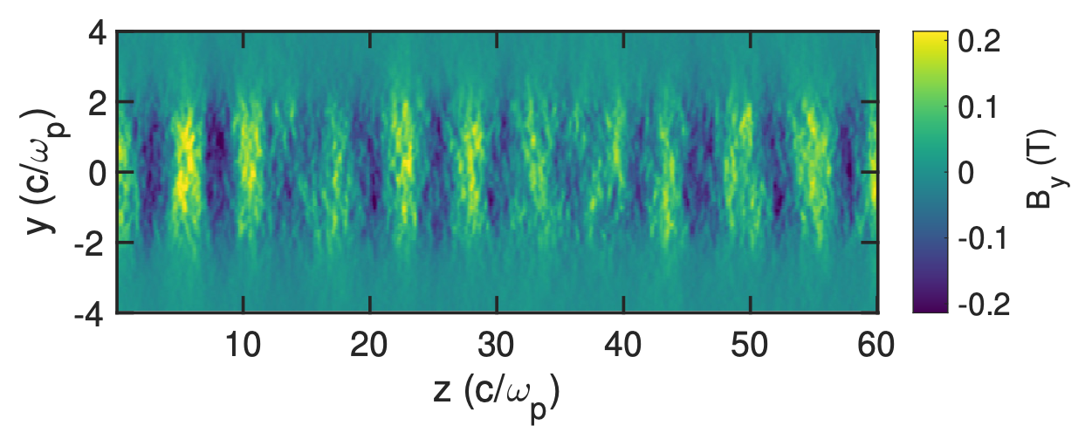
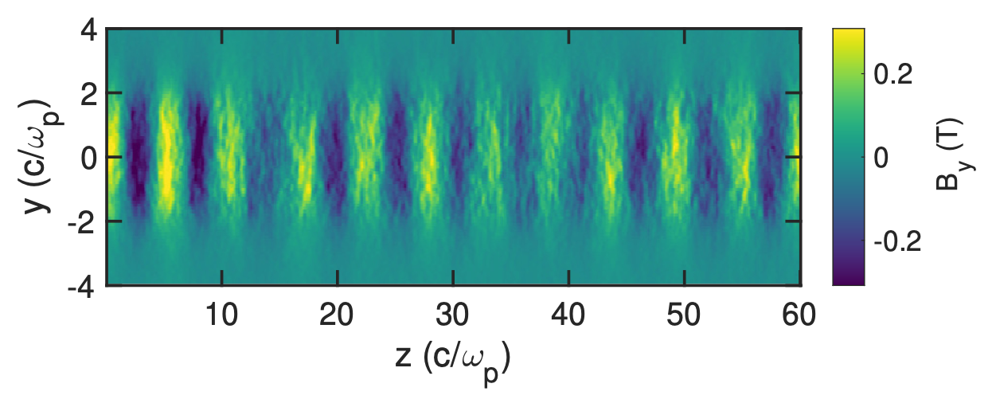
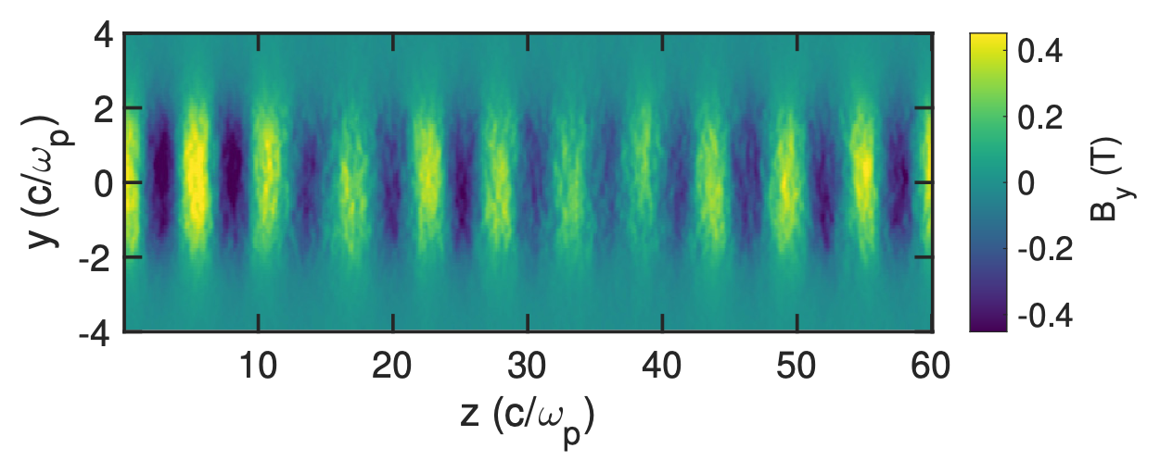
Evolution of magnitude and k-spectrum of the magnetic fields
slice of magnetic field from 3D simulation:
Tp~0.35 ps
t=5 Tp
The most unstable k~1.2kp predicted by theory
t=10 Tp
t=15 Tp
t=20 Tp
Simulation
t=25 Tp
km~((T⊥/T⫽)^{1/2}-1)^{1/2}
D. V. Romanov et al., PRL 2004

Slide 12
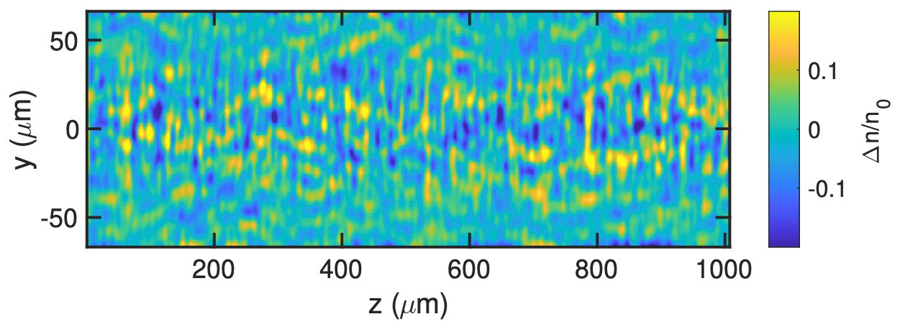
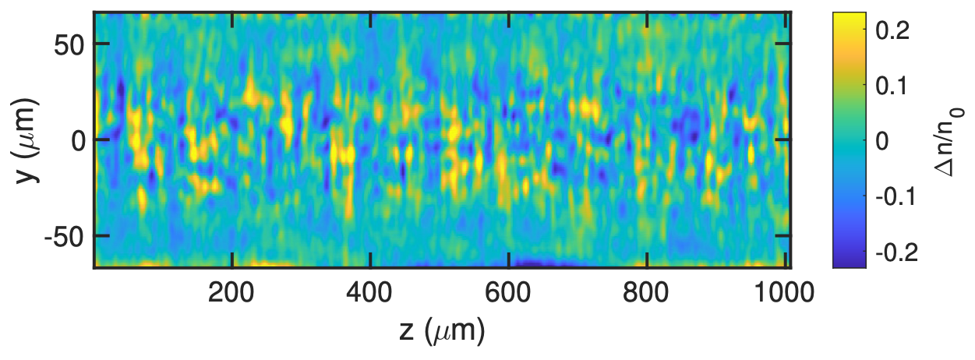
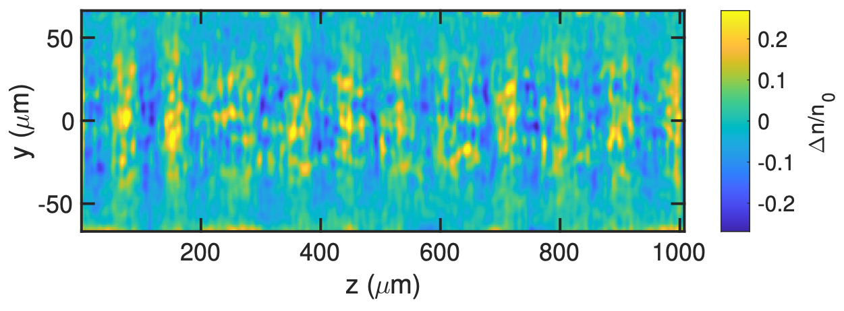
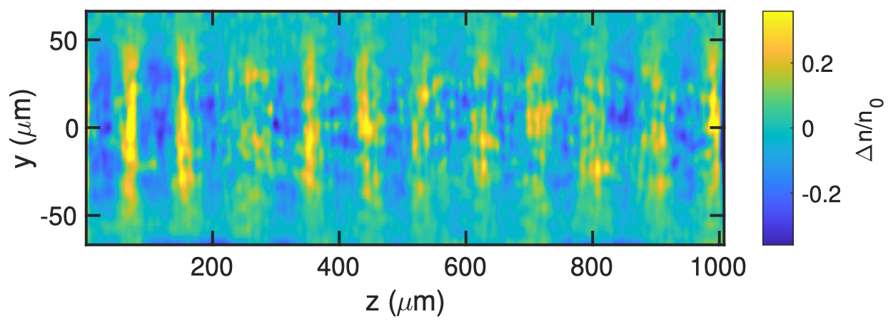
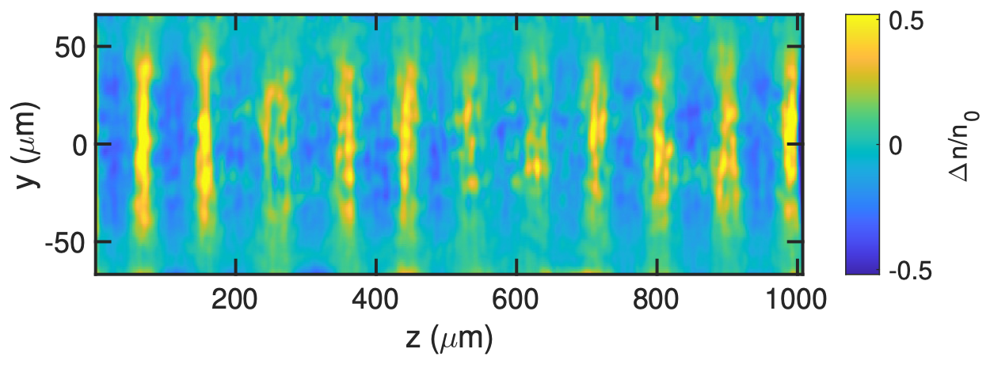
Take snapshots of magnetic fields using ultrashort e- beams
3D structure of B3 (By) magnetic field:
synthetic electron probe data:
Tp~0.35 ps
t=5 Tp
t = 30 Tp (10.6 ps)
t=10 Tp
E=50 MeV
Distance between plasma and detector: 70 mm
Ideal beam (ΔE=0, τ=0, εn=0)
t=15 Tp
t=20 Tp
t=25 Tp
blue to red: -0.4 to 0.4 Tesla

Slide 13
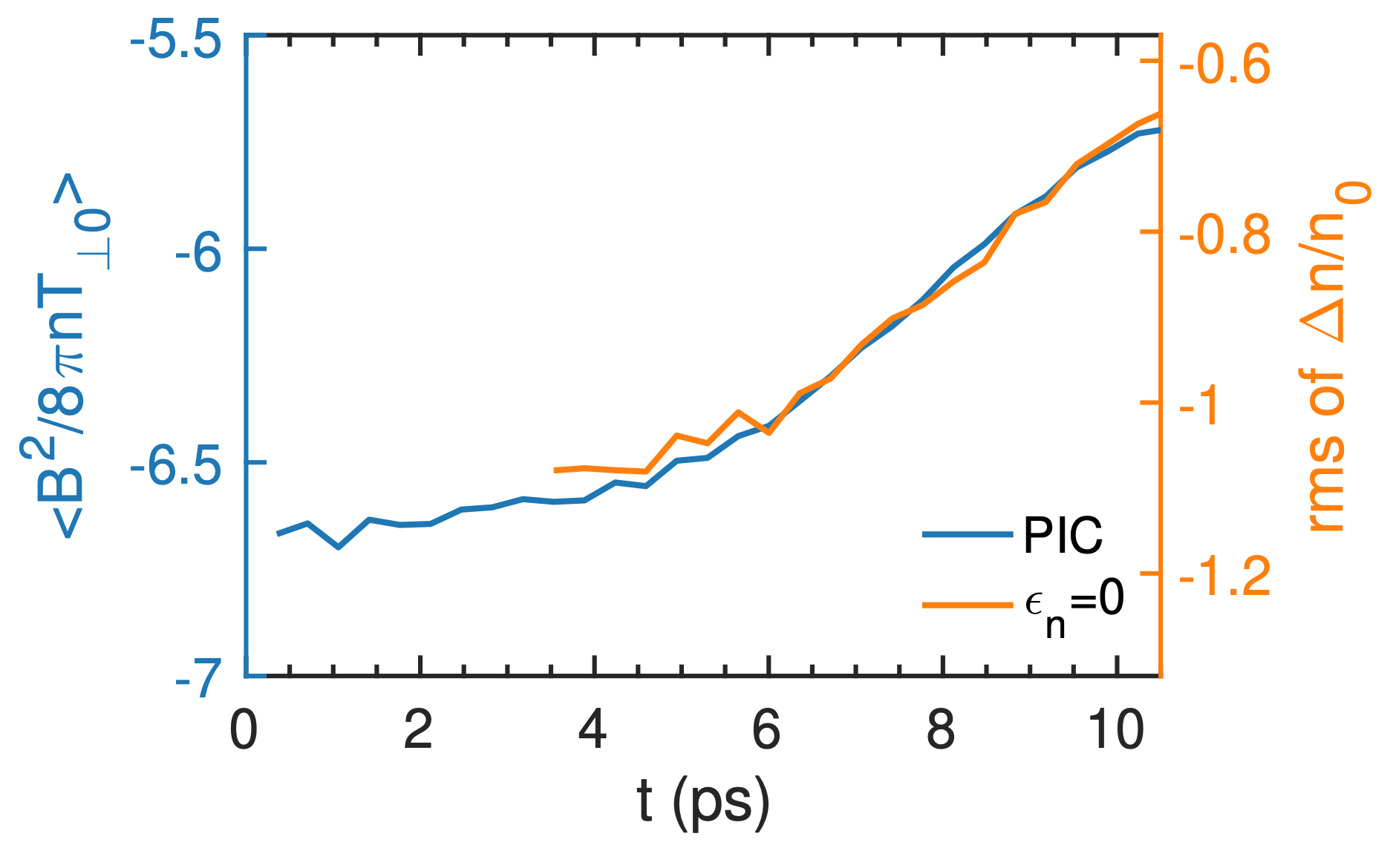
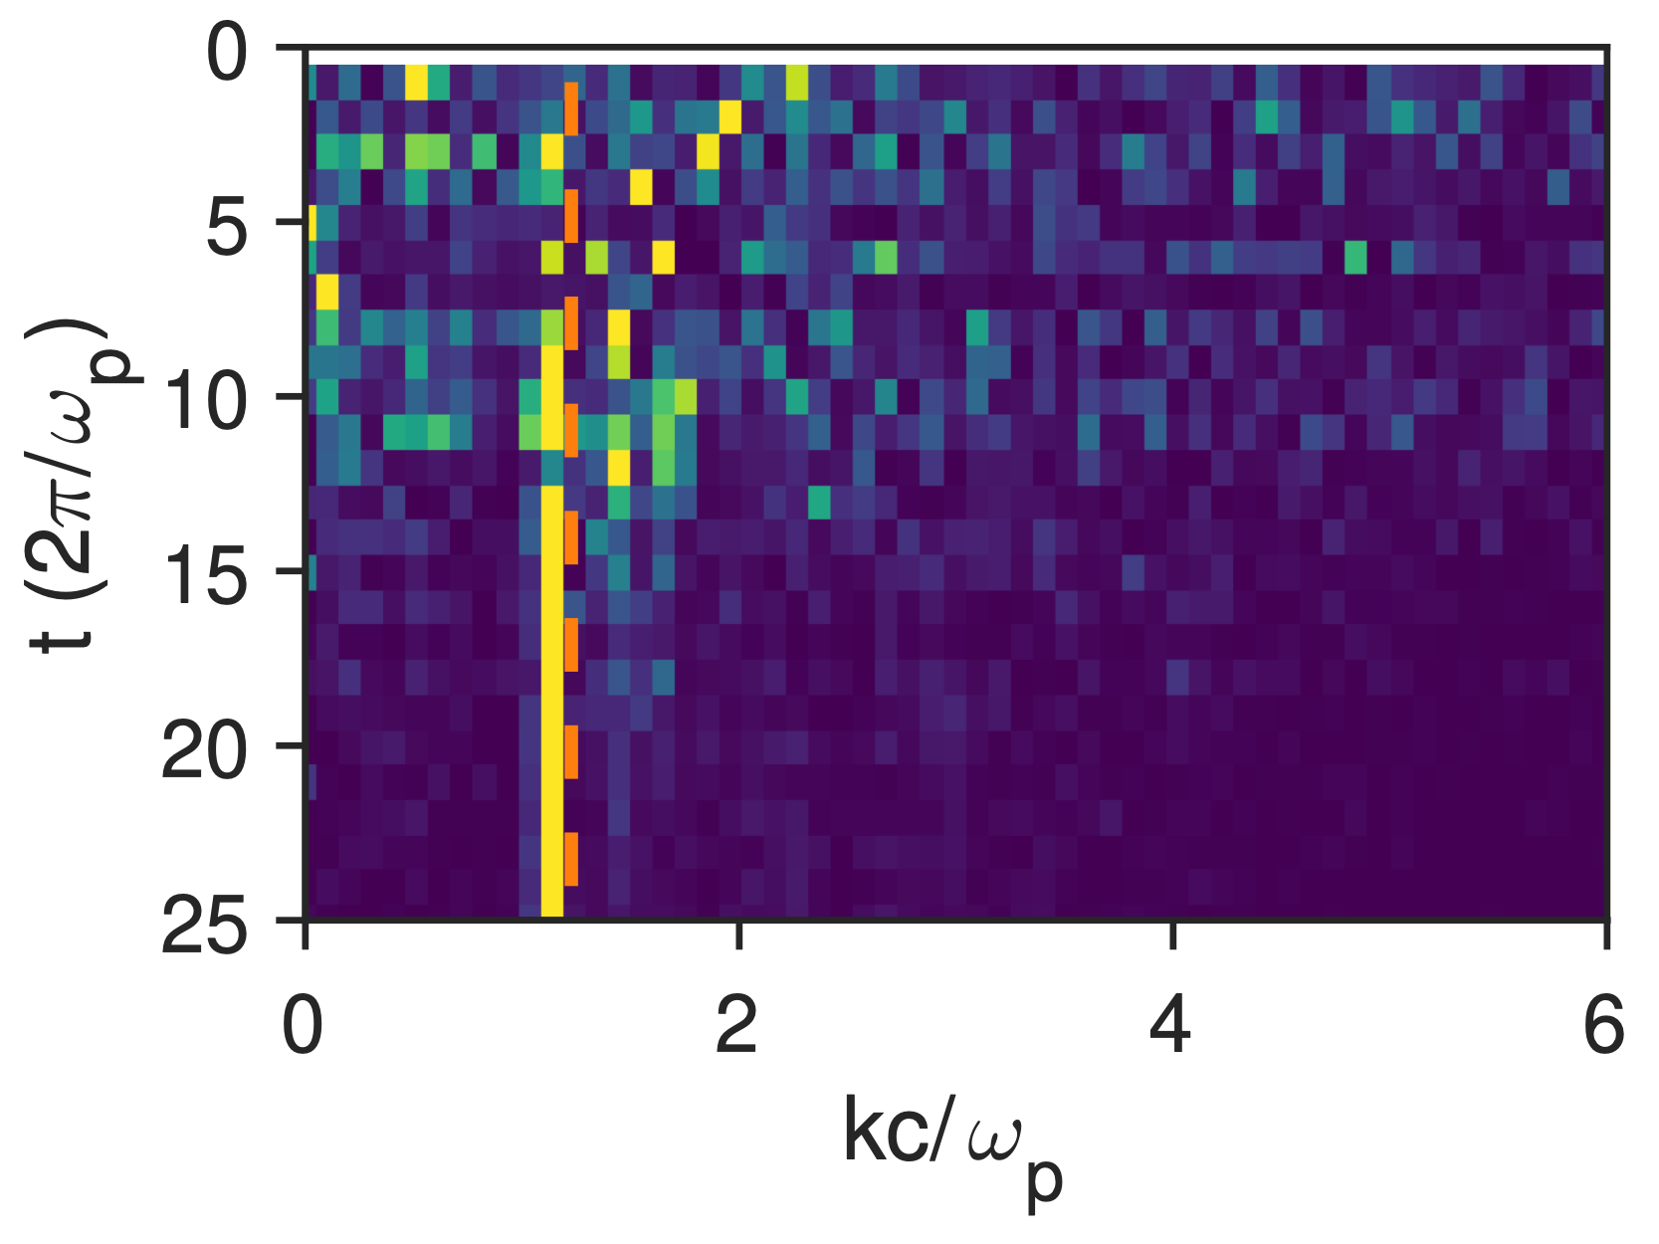
Deduce the growth rate and k-spectrum of the B-fields
The growth of density modulation magnitude of the e- probe beam maps out the growth of B-field
The evolution of density modulation wavelength of the e- probe beam shows the k-spectrum evolution of the B-field
Theory
y axes: log scale
e- probe data
e- probe data
3D PIC simulation

Slide 14
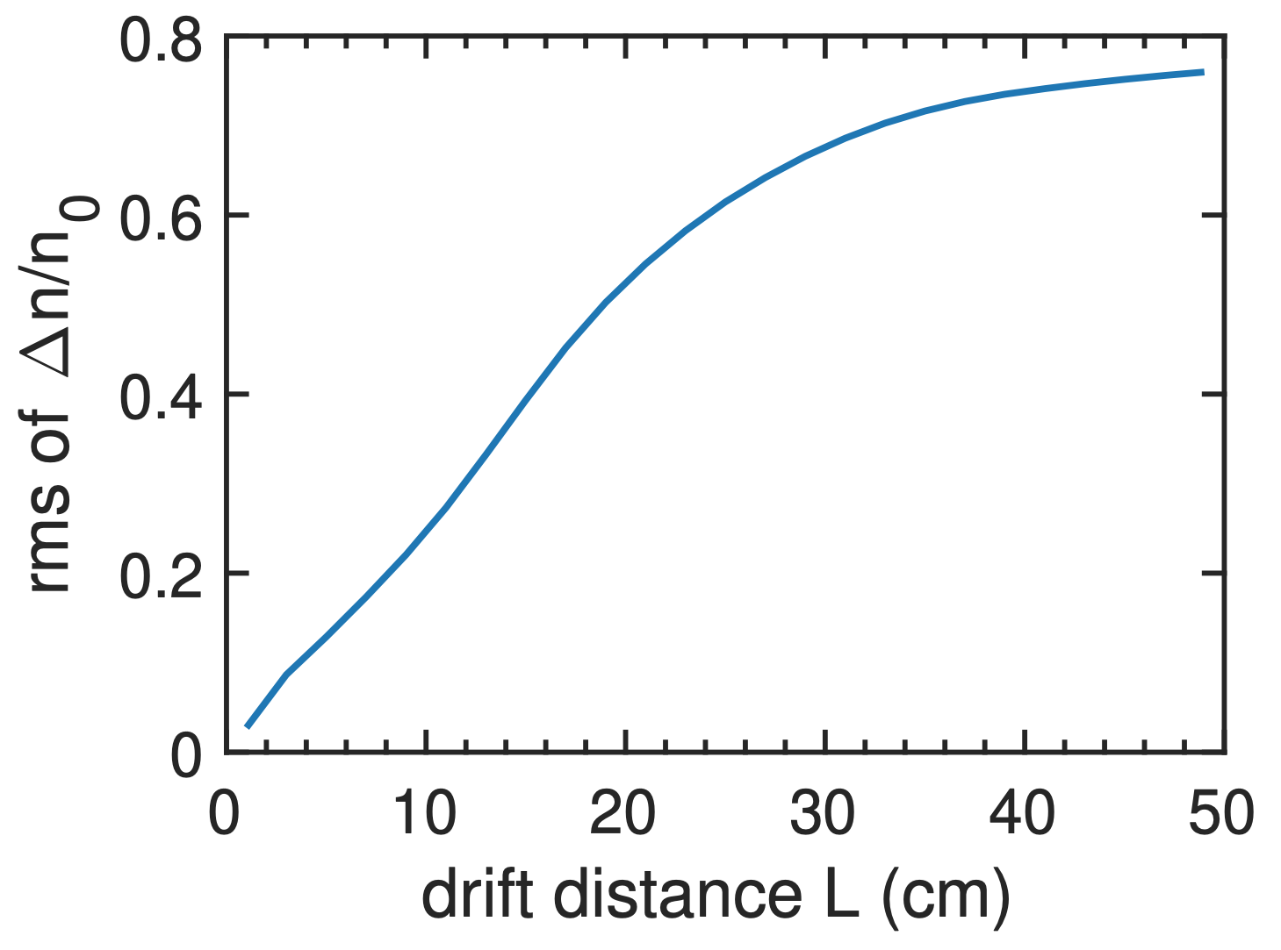
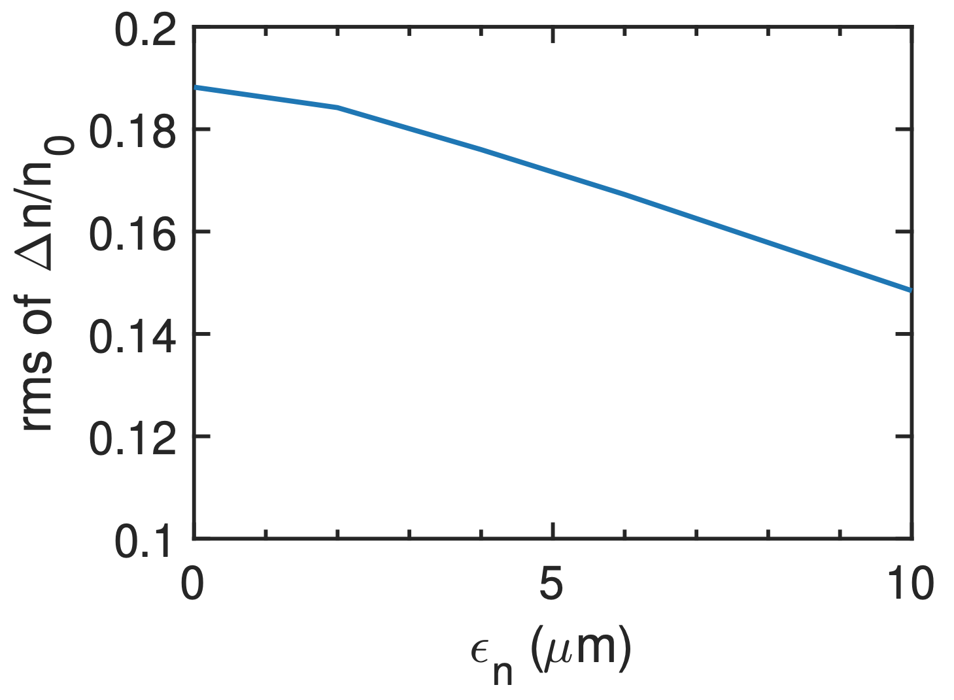
Non-ideal electron beam
The detector should be close to the plasma to avoid trajectory crossing so that
not to generate artificial structure
density modulation magnitude is proportional to magnetic field strength
A finite emittance will reduce the density modulation magnitude, however
for a given emittance, the reduction factor is fixed, will not affect the measurement on γ
for εn<<10 µm, the reduction is negligible
E=50 MeV
εn=0
E=50 MeV
L=7 cm
σr=1 mm
C. Zhang et al, PRL (2017)
C. Zhang et al, Sci. Reports (2016)
For linac beams the effect of energy spread (~0.1%) is completely negligible.

Slide 15
Non-ideal electron beam: bunch length
The bunch length is limited by two constraints:
short enough to resolve the linear growth (e.g. γτ<1)
long enough to suppress the wake contribution (e.g., kpcτ>>1).
y axes: log scale
The deflection of the electrons by the electric field of the wake can be minimized by using a relative long probe beam because:
the wake travels at c, a long probe will see many periods and the net contribution approaches to zero
the Weibel magnetic field is quasi-static therefore is insensitive to this average effect
e- probe data
3D PIC simulation

Slide 16
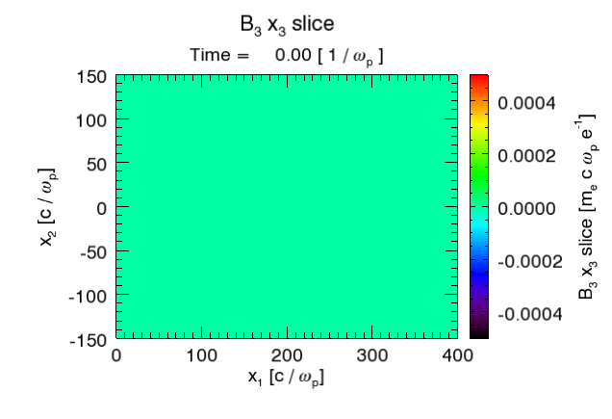
Self-consistent 3D simulation
Laser: CO2 laser, 3 ps (FWHM), w0=100 µm, Peak intensity 3e14 W/cm² (CP), a0=0.1
Gas: Atomic hydrogen, ne=2e17 cm⁻³

Slide 17
Physics we can explore using this platform
There are very rich physics that we can explore using this platform
As we have shown in previous slides, we can possibly test kinetic theory of Weibel instability by measuring the
linear growth rate
k-spectrum evolution
self-organization of magnetic fields in the non-linear stage
Other physics:
effect of collisions on growth rate
finite-width plasma effect
dependence of topological structures of the B fields on plasma parameters
magneto-static mode (see Chan’s talk)

Slide 18
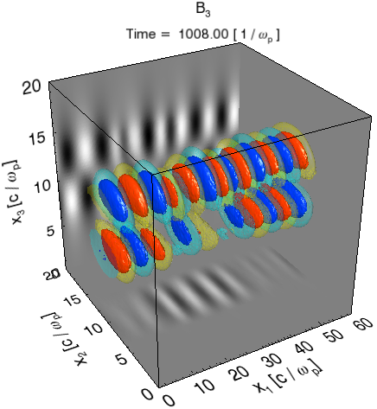
Magnetic field structure depends on initial distribution
3D structure of B3 (By) magnetic field:
T⊥= 47 keV, T∥=7.5 keV (He plasma), d=67 µm
3D structure of B3 (By) magnetic field:
T⊥= 1.5 keV, T∥=0.3 keV (H2 plasma), d=95 µm
t = 30 Tp (10.6 ps)
blue to red: -0.4 to 0.4 Tesla

Slide 19
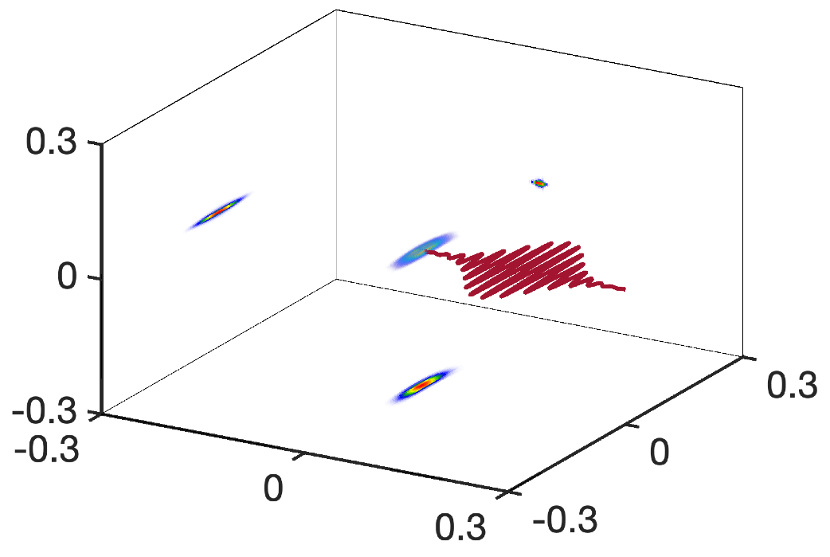
CO2, linear polarization
Tx = 7 keV, Ty = 2.3 keV, Tz = 0.8 keV
Py (mec)
evolution of B3 field (a slice thru x3=0) as a function of time
Pz (mec)
Px (mec)
0.6 Tesla
(time step 2π/ωp=0.35 ps)
-0.6 Tesla

Slide 20
A rough layout of the experiment and required laser&e- beam parameters
EMCCD
tube lens
laser diagnostic
window
10x objective
Linac
Quads
BPM
gas jet
Beam dump
mirror
IP
YAG:Ce
e- diagnostic
Requirements at the IP:
e- beam | CO2 laser
E=50 MeV | P~1-2 TW
τ<0.2 ps | τ~2 ps
Q>50 pC | w0~50-200 µm
εn<10 mm.mrad | Jitter<0.3 ps
σr~1 mm
delay line
CO2 laser

Slide 21
Summary
We propose to combine the ultrashort e- beam and the intense CO2 laser of ATF to develop a platform to study Weibel instability
WI-related research
Measurement of growth rate and k-spectrum of Weibel magnetic fields
Topological structure of the B field in nonlinear stage
Collisional effect
Finite width plasma effect
relativistic regime (10s keV to ~MeV)
Note: this experiment will have a similar setup to that already exists
Probing CO2 self-modulated wake (existing, see Navid’s talk)
May also be used as a diagnostic for probing magneto-static mode in plasmas (see Chan’s talk)
Conceptual sketch of the experiment
Weibel B fields
e- beam profile
CO2 laser
H2/He/N2 …

Slide 23
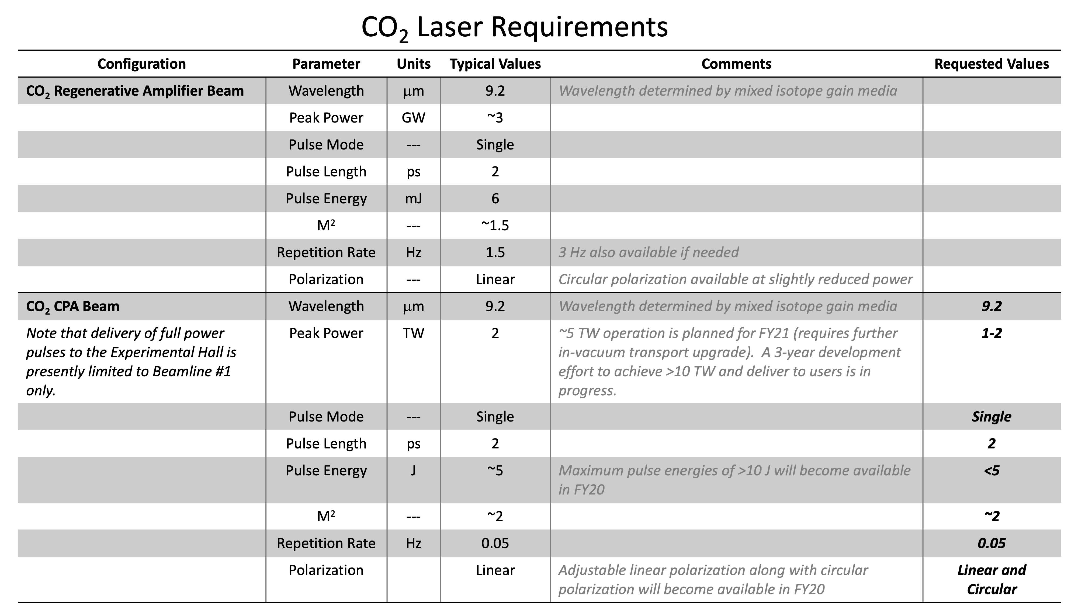

Slide 26
