Slide 1
Two-Color Ionization-Injection LWFA at ATF
Rotem Kupfer

Slide 2
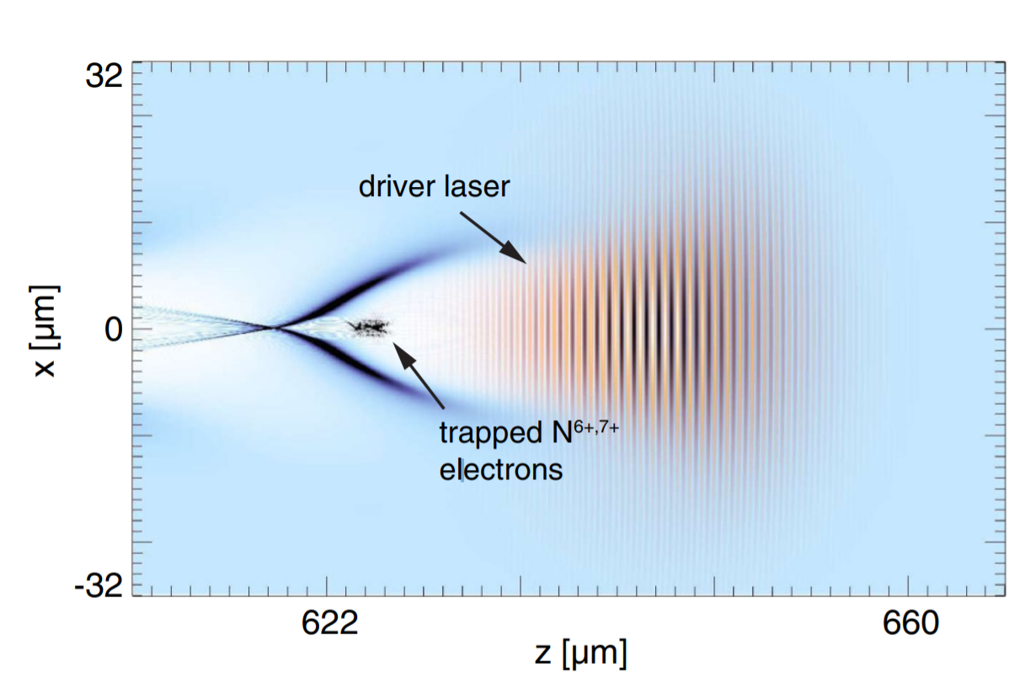
LWFA at the blowout regime with a LWIR driver
$a_{0}=8.6×{10}^{−10}\sqrt{I\left[Wcm^{−2}\right]λ^{2}\left[μm^{2}\right]}>4$
(and matching conditions on the pulse length, spot size, plasma density etc.)
$I_{CO_{2}}\sim 3×{10}^{17}Wcm^{−2}$
Can be achieved with the CO₂ laser at 20TW, 1ps pulse
Larger bubble with a LWIR driver
Only a small fraction of electrons gets trapped and accelerated
Emittance grows with intensity $ε_{n}∝a_{0}$
X. L. Xu et. Al Phys. Rev. ST. Accel. Beam. 17, 061301 (2014)

Slide 3
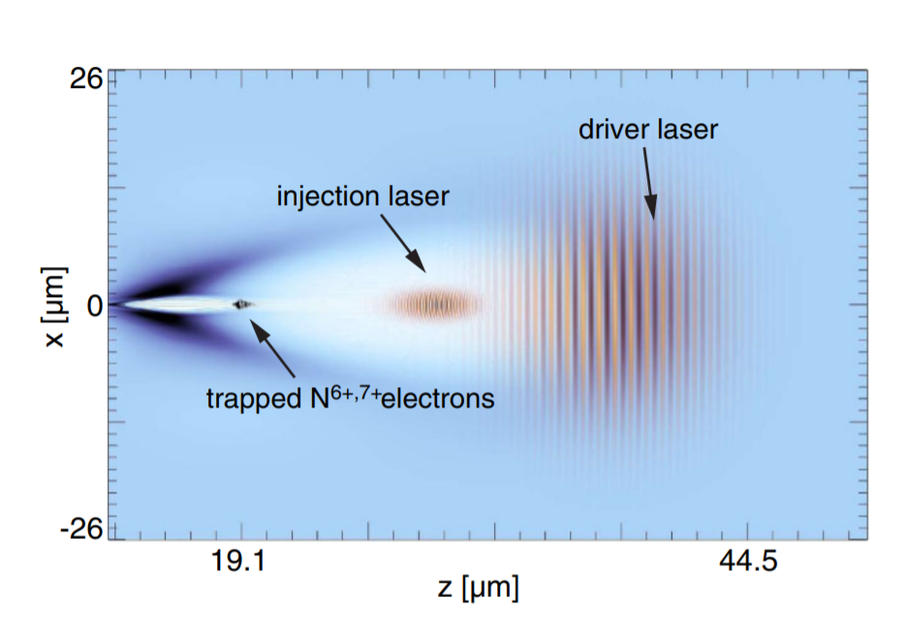
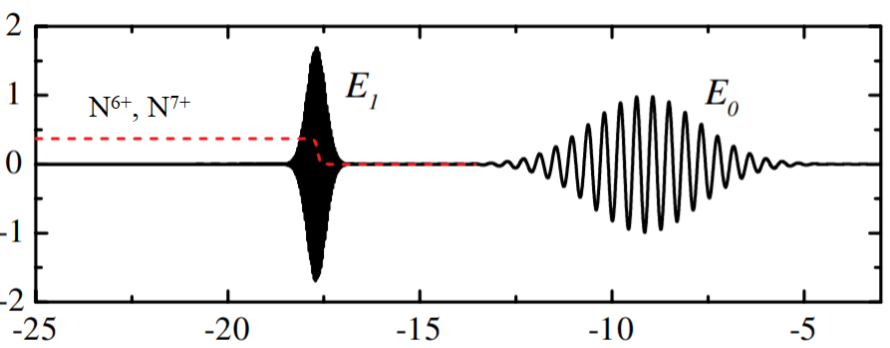
Ionization injection – separating the driving and injection
LWIR, high a₀, ‘low’ intensity, drive the bubble
NIR, Low a₀, ‘high’ intensity, inject electrons through ionization inside the bubble
High acceleration gradient, high flux and low emittance

Slide 4
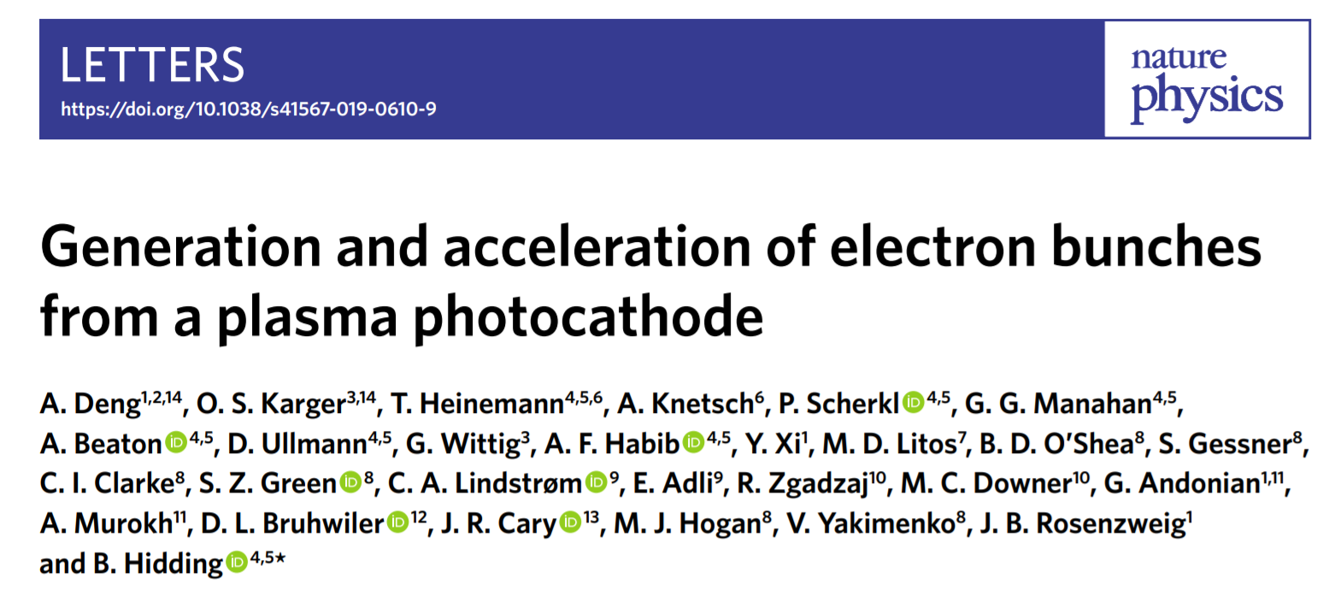
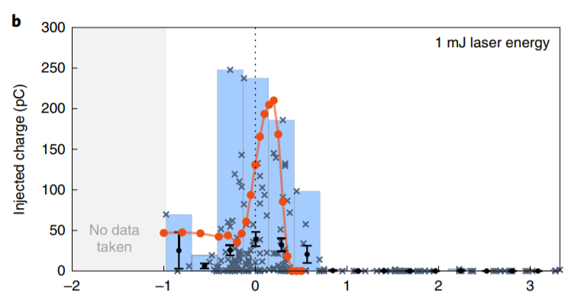
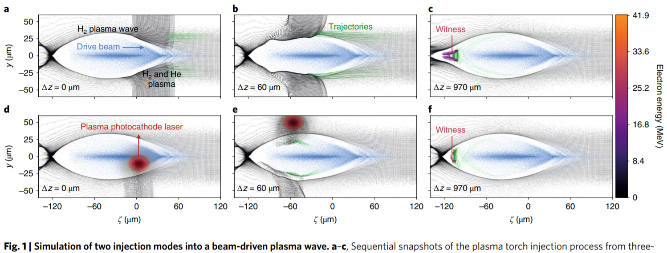
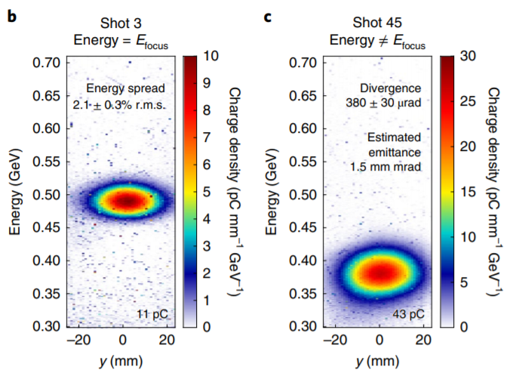
Transverse ionization injection with an e-beam driver

Slide 5
Requirements for the experiment at ATF
A LWIR driver with a₀ > 4
The intensity of the NIR pulse at the focus should be higher than the CO₂ to allow higher ionization states on top of the LWIR
Minimize NIR interaction with the plasma – we would like to reach high intensity only inside the bubble
A suitable gas target with ionization threshold (for some higher ionization state) above that of the CO₂’s field but below NIR intensity – Krypton doping is a candidate
- Demonstration of collinear injection is the goal
- Transverse injection is technically simpler

Slide 6
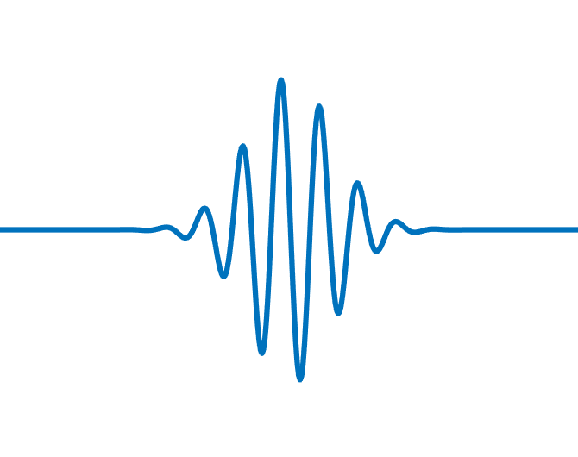
Proposed transverse injection experiment at ATF
NIR pulse
High NIR intensity only inside the bubble
Plasma “bubble”
LWIR pulse
NIR beam waist with tight focusing

Slide 7
Observables for the experiment at ATF
Low emittance beam when NIR injection is applied
More charge in the accelerated electron bunch when NIR injection is applied
Electron spectrum
Possible additional diagnostics:
Optical probing of the interaction – Raman shifts from plasma waves
E-beam probing of the interaction - can show the site of the injection

Slide 8
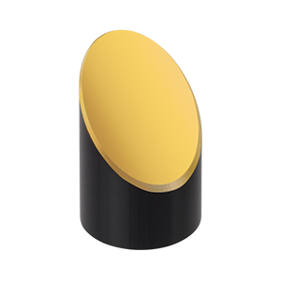
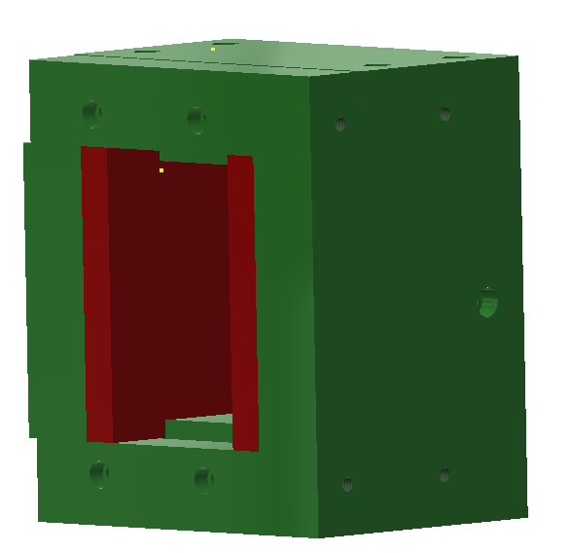
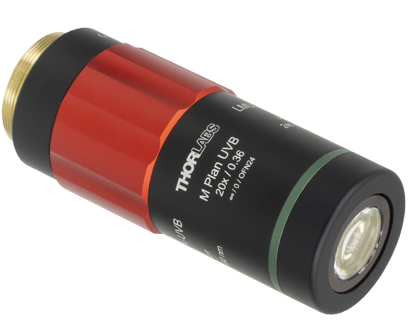
Proposed transverse injection experiment at ATF
NIR pulse
LWIR pulse
Dipole
magnet
LANEX
Slit
f/#1 focusing
Faraday cup
Nozzle
LWIR focus diagnostic
NIR focus diagnostic
f/#2 focusing

Slide 9
Summary and ongoing work
We plan to implement transverse two-color ionization-injection LWFA
We expect the CO₂ intensity to reach a₀ > 4 in the next couple of years
A 7mJ, 60 fs Ti:Sa systems was installed at ATF
We started working on an additional amplification stage to boost energy up to 100mJ
A transport line to the experimental chamber will be completed soon (for the stretched beam)
The A compressor will be constructed next to the experimental chamber to avoid nonlinear beam distortions in the transport line
Vacuum transport line is in progress

Slide 10
LWIR and NIR laser specifications
Ti:Sapphire Laser System | Units | Stage I | Stage II | Comments
Central Wavelength | nm | 800 | 800 | Stage I parameters should be achieved by mid-2020, while Stage II parameters are planned for late-2020.
FWHM Bandwidth | nm | 20 | 13
Compressed FWHM Pulse Width | fs | <50 | <75 | Transport of compressed pulses will initially include a very limited number of experimental interaction points. Please consult with the ATF Team if you need this capability.
Chirped FWHM Pulse Width | ps | ≥200 | ≥200
Chirped Energy | mJ | 10 | 200
Compressed Energy | mJ | 7 | 100
Energy to Experiments | mJ | >5 | >80
Power to Experiments | GW | >98 | >1067
CO₂ CPA Beam | Wavelength | μm | 9.2 | Wavelength determined by mixed isotope gain media
Note that delivery of full power pulses to the Experimental Hall is presently limited to Beamline #1 only. | Peak Power | TW | 20 | ~5 TW operation is planned for FY21 (requires further in-vacuum transport upgrade). A 3-year development effort to achieve >10 TW and deliver to users is in progress.
 | Pulse Mode | --- | Single
 | Pulse Length | ps | 1

Slide 12
Back of the envelope calculations
For 800nm laser and f/#1 focusing: $ω_{0}\sim 1μm$ (radius), $Z_{r}\sim 4μm$
Intensity (@100fs) ~ $1mJ →8×{10}^{16}\frac{W}{cm^{2}},10mJ →8×{10}^{17}\frac{W}{cm^{2}}$
$$a_{0}\sim 0.2 − 0.65$$
For Blow Out Regime LWFA: $cτ\sim λ_{plasma}$, $P>P_{c}=\frac{0.148λ^{2}}{n n_{2}}$
$$r_{b}=(\frac{4π}{λ_{plasma}})\sqrt{a_{0}}$$

Slide 13
Back of the envelope calculations - Gas target selection
We are looking for a target gas with*:
$$E_{L}\sim E_{ion}=3.4×{10}^{11}\left[\frac{V}{m}\right]{\left(\frac{U_{ion}}{U_{H}}\right)}^{\frac{3}{2}}$$
$E_{L}=\sqrt{\frac{2I}{c n ε_{0}}}\sim 8×{10}^{12}\frac{V}{m} @10mJ, 100fs,f/\#1$
$$U_{H}=13.6eV$$
$${→U}_{ion}\sim 110eV$$
Krypton: Kr⁶⁺ - 78.5eV, Kr⁷⁺ - 110.0eV
*M. Chen et al. Phys. Plasmas 19, 033101 (2012)

Slide 14
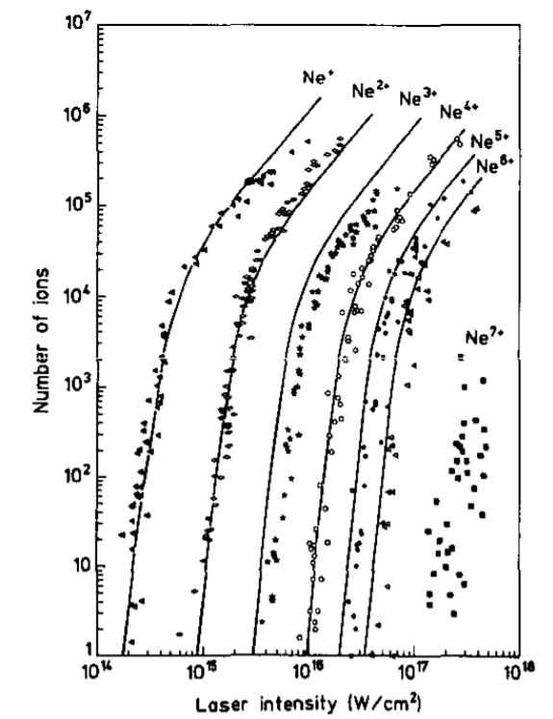
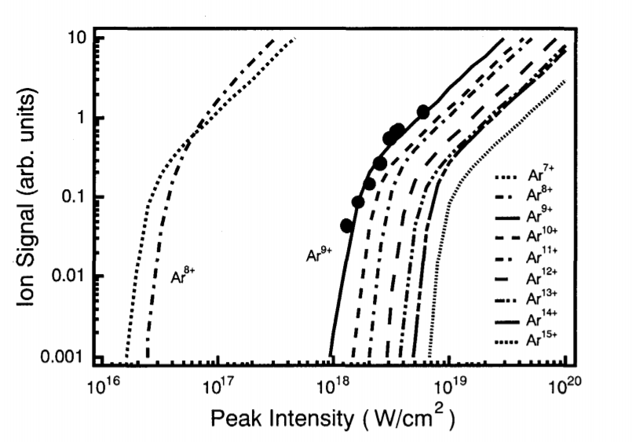
More stuff
T Auguste et al J. Phys. B. 25 4181 (1992 )
A. Sagisaka, et al JAERI-Conf 2001-011

