Slide 1

Experiment ID: AE-93
Title: Direct Measurements of Fields and Radiation in the Self-Modulated Plasma Wakefield Regime
PIs: V.N. Litvinenko, N. Vafaei-Najafabadi, C. Joshi, M. Downer
Funding source: DOE (Received)
Irina Petrushina
on behalf of AE-93

Slide 2
AE-93 Collaboration
I. Petrushina, J. Yan, P. Iapozzuto, P. Kumar, R. Samulyak, V. N. Litvinenko, and N. Vafaei-Najafabadi | @ Stony Brook University, US
I.V. Pogorelsky, R. Kupfer, M. Babzien, Y. Jing, K. Kusche, M. Polyanskiy, M. Fedurin, M. Palmer | @ Brookhaven National Laboratory, US
J. Welch, R. Zgadzaj, M. Downer | @ University of Texas at Austin, US
W.B. Mori and C. Joshi | @ University of California Los Angeles, US
Acknowledging funding from DOE Grant DE-SC0014043
CORI @ NERSC facility operated under Contract DE-AC02-05CH11231
SEAWULF @ Stony Brook University

Slide 3
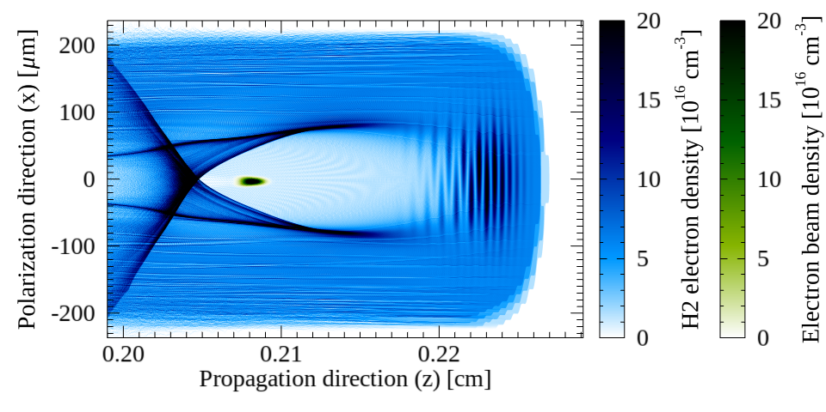
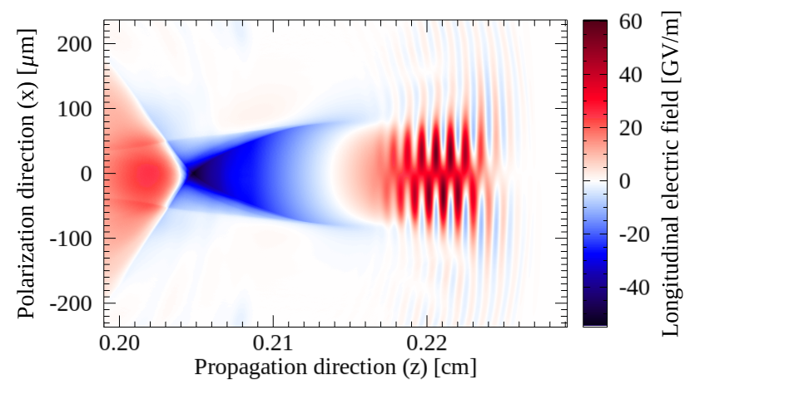

Bubble Regime of LWFA Remains the Long-Term Goal
Unique ATF’s CO2 laser system has
λ0≈10 µm and TW-class pulses
If compressed to ≈200 fs, it will drive plasma wakefields with bubbles as long as 170µm
Enabling external injection of ATF’s e⁻ beam into accelerating phase with ≈25 GeV/m

Slide 4
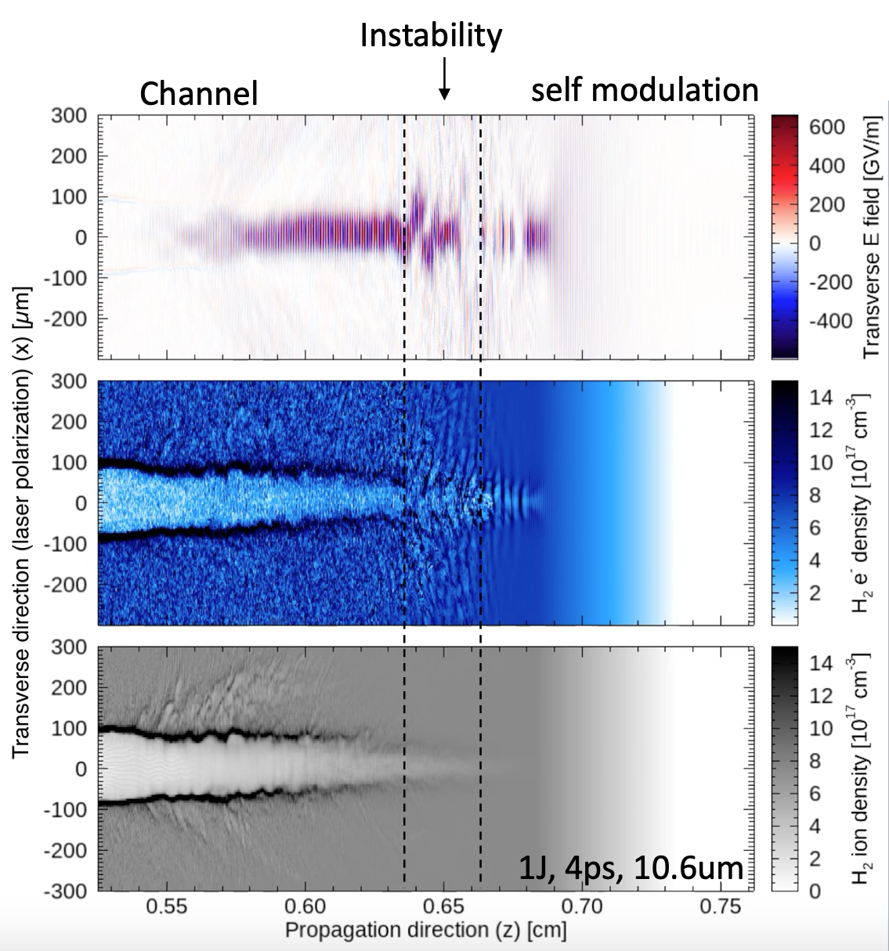
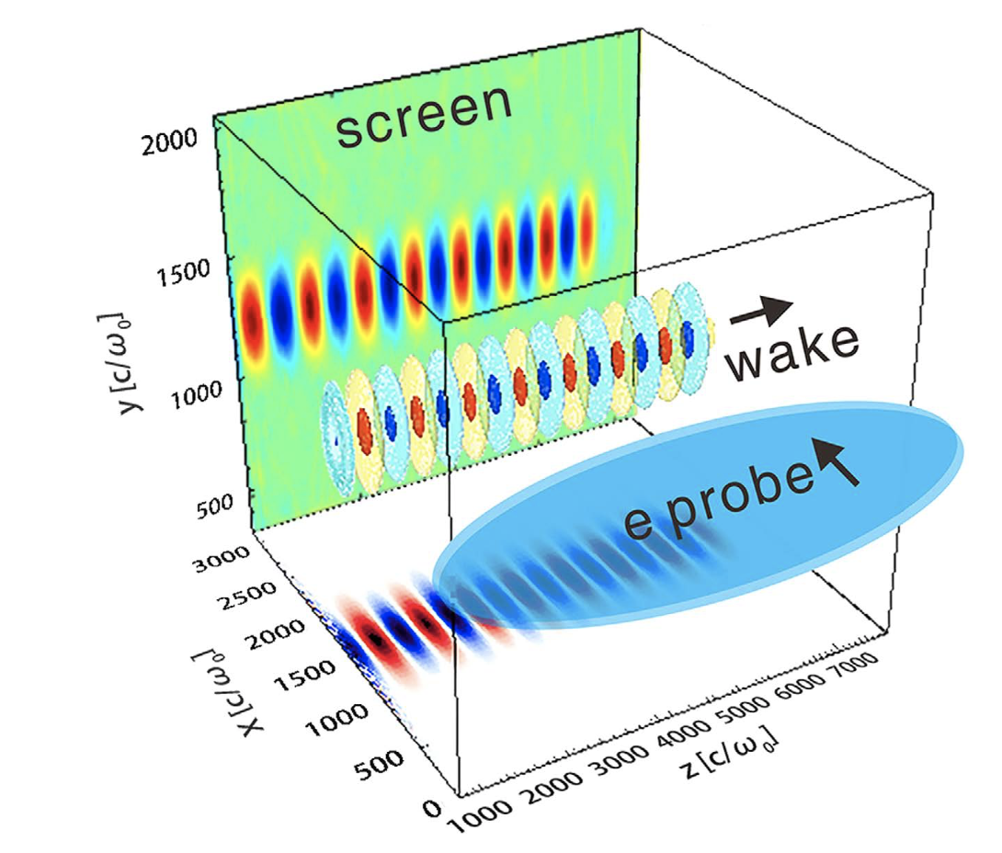
Meanwhile: Self-Modulation Regime
Current 2 ps, 2 TW laser enables the exploration of LWFA in the self-modulation regime (SM-LWFA)!
Zhang, C. J. et al. Capturing relativistic wakefield structures in plasmas using ultrashort high-energy electrons as a probe. Sci. Rep. 6, 29485; doi: 10.1038/srep29485 (2016).

Slide 5
Timeline proposed last year
2019
Direct measurement of the fields in a self-modulated (SM) laser wakefield accelerator (LWFA) using linac electron beam as a transverse probe.
2019/2020
Parametric study of laser evolution in the SM regime and study of novel physics predicted by simulations in this interaction.
2020
Coordinate electron characterization, wake visualization and simulations to achieve comprehensive understanding of CO2-laser-driven wakefield acceleration in nonlinear regime.
Characterization of radiation-generation capability of the channel region in SM-LWFA using longitudinal probe. In particular, the role of direct laser acceleration (DLA) in enhancing the gamma radiation will be investigated
2021

Slide 6
CO₂ in
CO₂ out
“High Resolution”
BPM
“Low Resolution”
BPM
Gas Jet
Electron Beam Probe
CO₂ parabolic mirror
CO₂ mirror

Slide 7
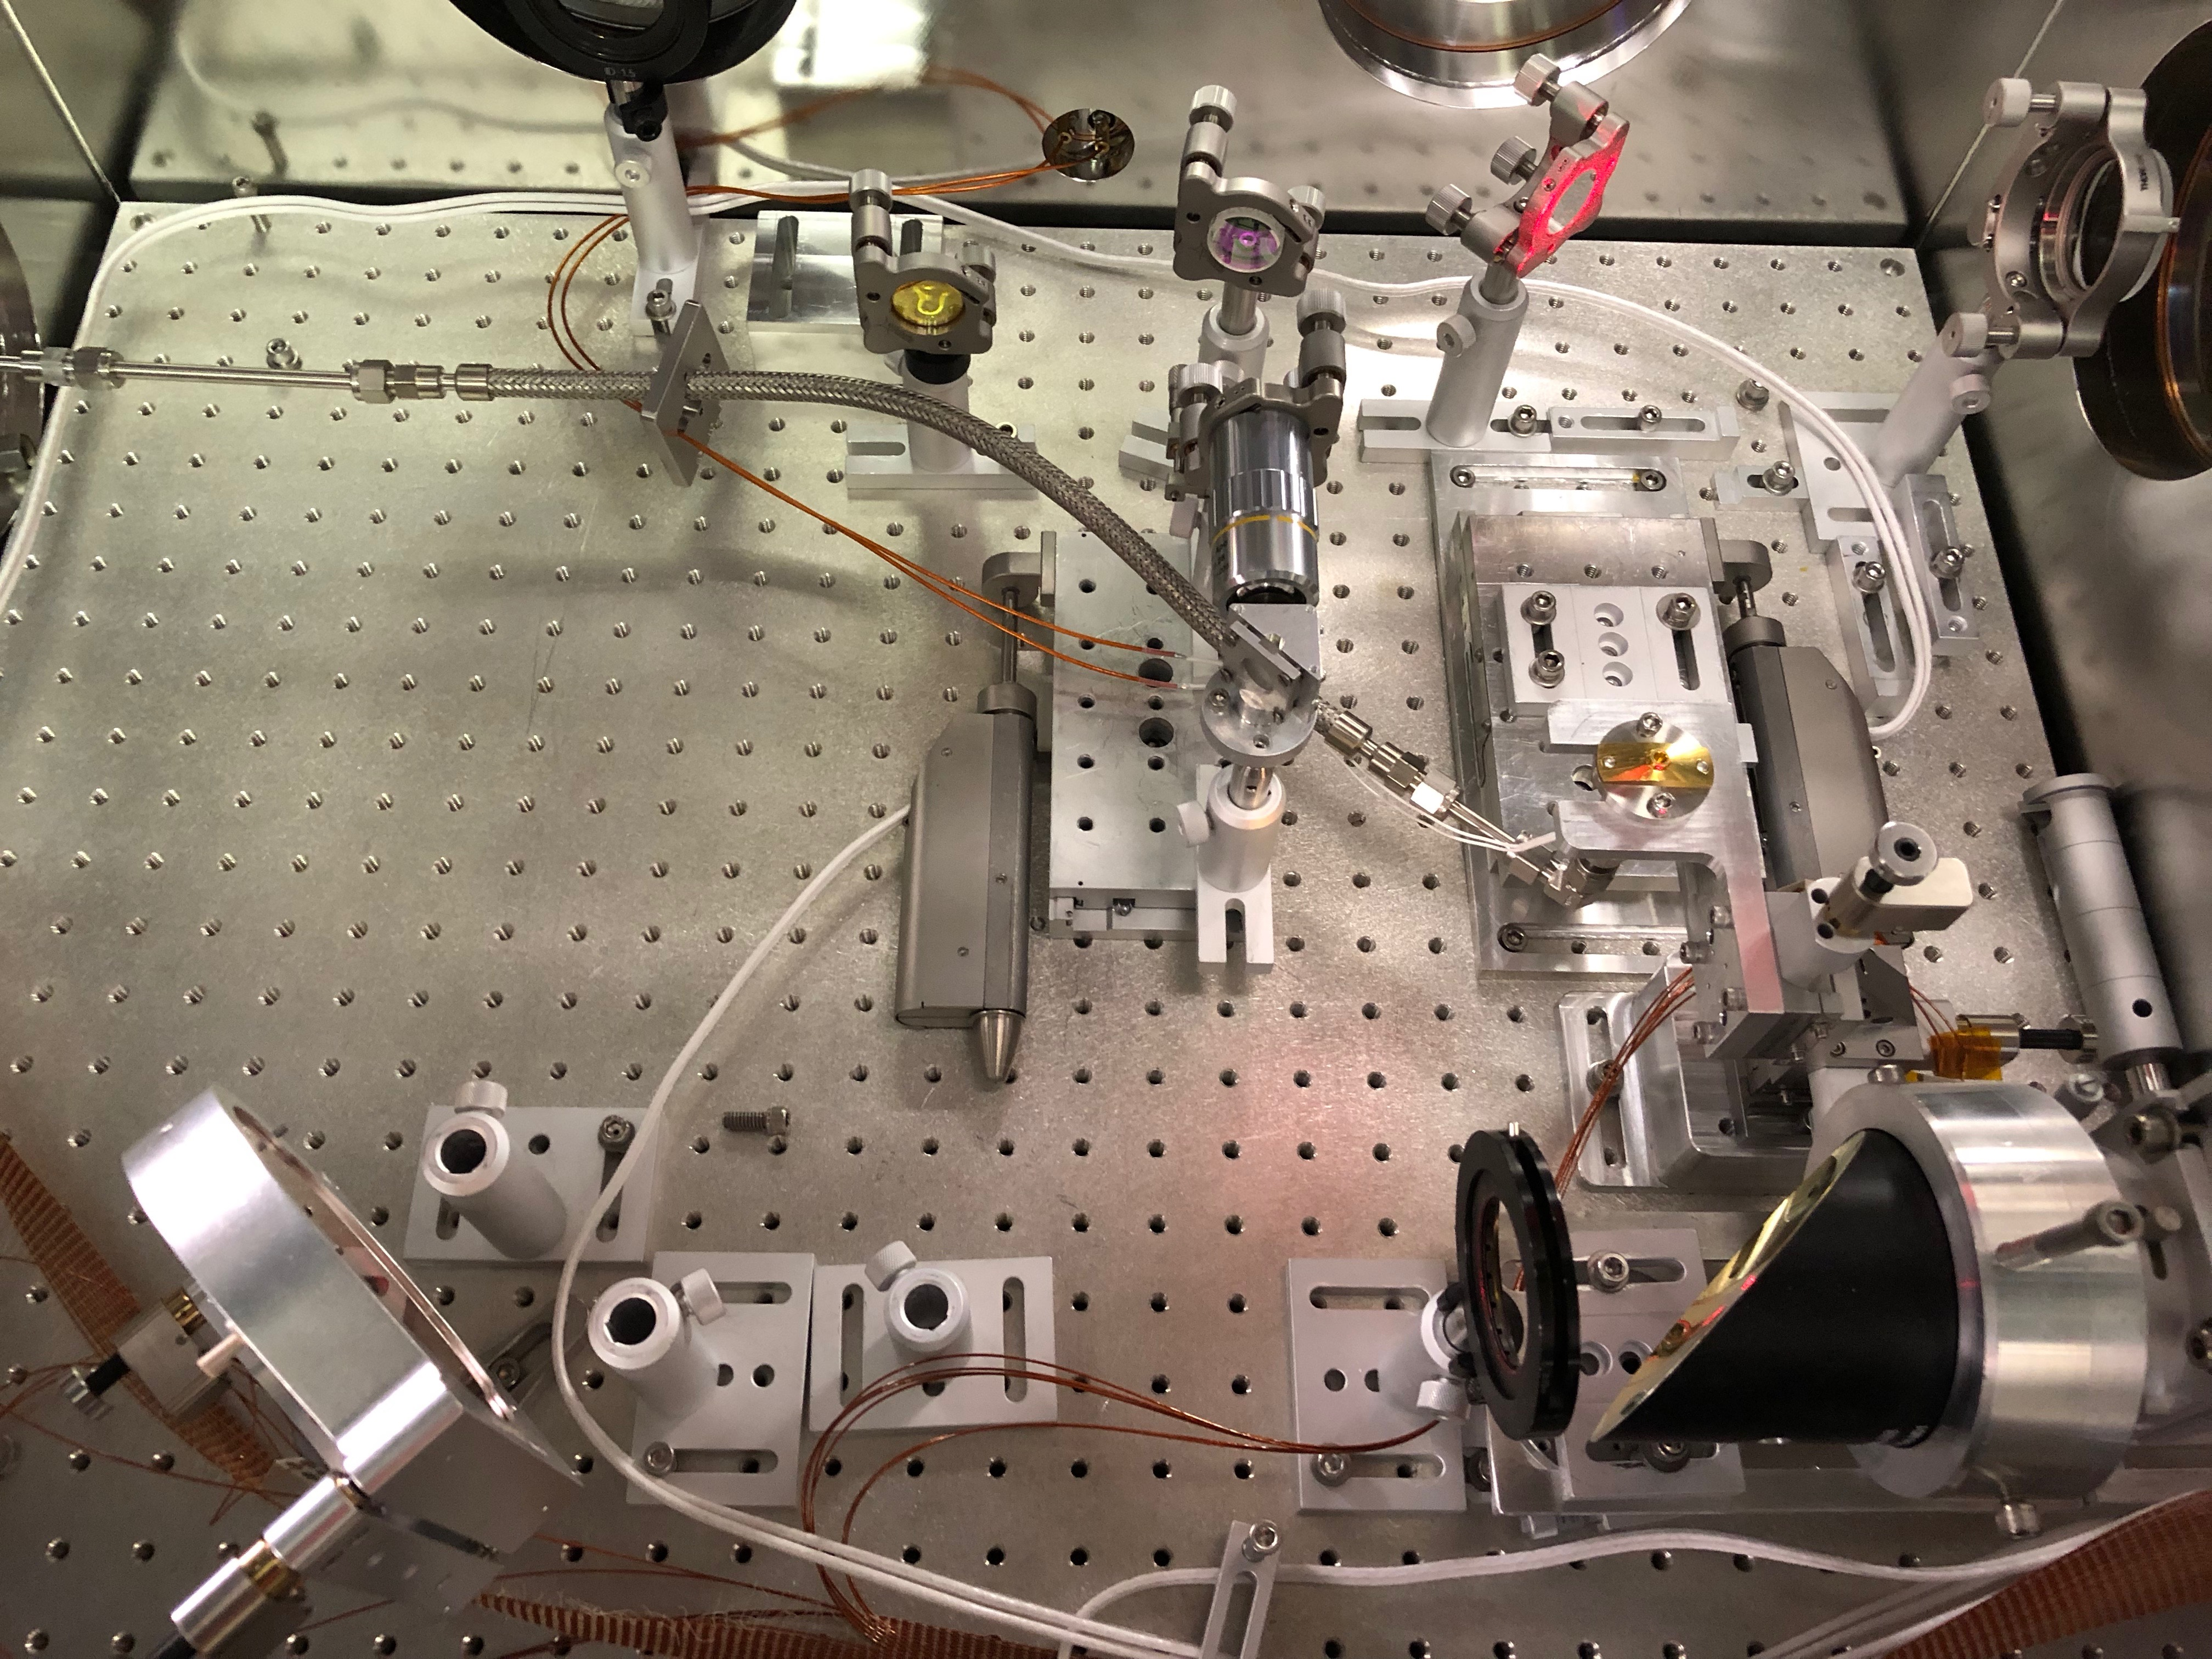
CO₂ in
CO₂ out
“High Resolution”
BPM
“Low Resolution”
BPM
Gas Jet
Electron Beam Probe
CO₂ parabolic mirror
CO₂ mirror

Slide 8
Preliminary results:
typical image observed at the “Low Resolution” BPM
15 mm
Laser

Slide 9
Preliminary results:
typical image observed at the “Low Resolution” BPM
15 mm
No gas released
E_{L} = 4 J
Laser propagation
Laser

Slide 10
Preliminary results:
typical image observed at the “Low Resolution” BPM
15 mm
19.6 psi, E_{L} = 2.5 J, e-beam 0.25 ps
Laser propagation
Laser

Slide 11
Preliminary results:
typical image observed at the “Low Resolution” BPM
Electron probe beam has revealed periodic focusing and defocusing structures as well as unique features that potentially point to new physics for relativistic picosecond LPI
19.6 psi, E_{L} = 2.5 J, e-beam 0.25 ps
Defocusing
Wakefield
Laser
Laser
Laser propagation
Focusing

Slide 12
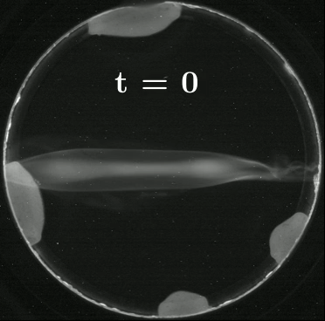
Preliminary results: time evolution
Laser

Slide 13
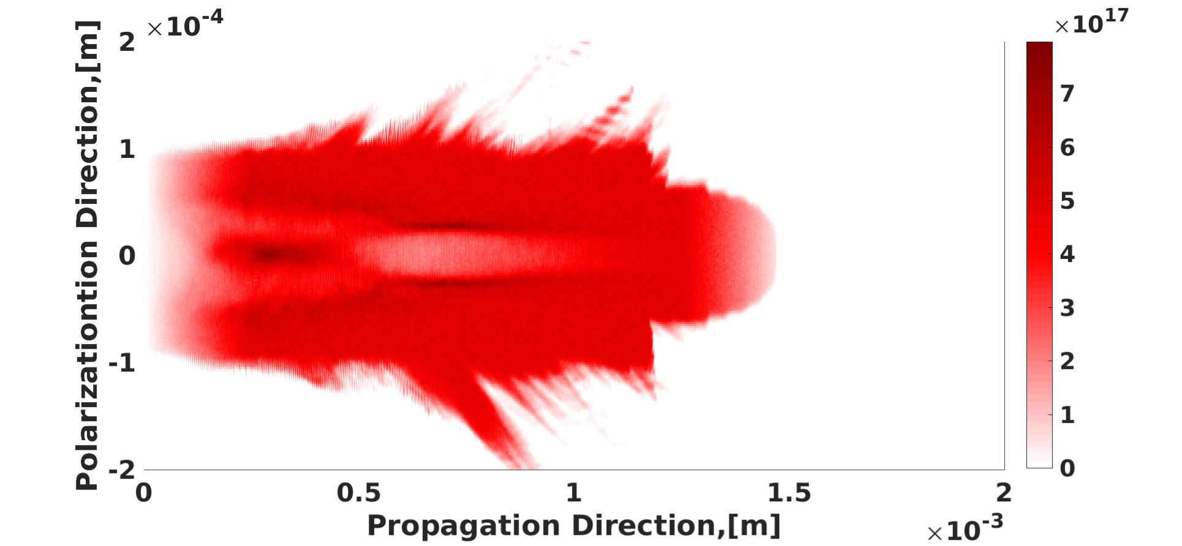
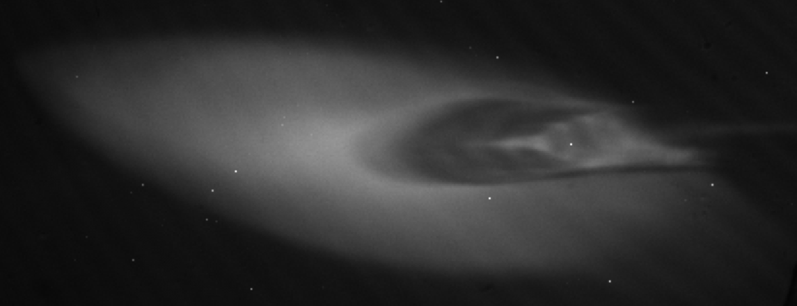
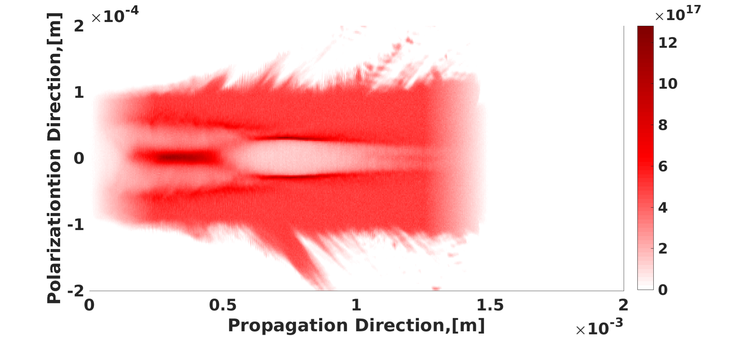
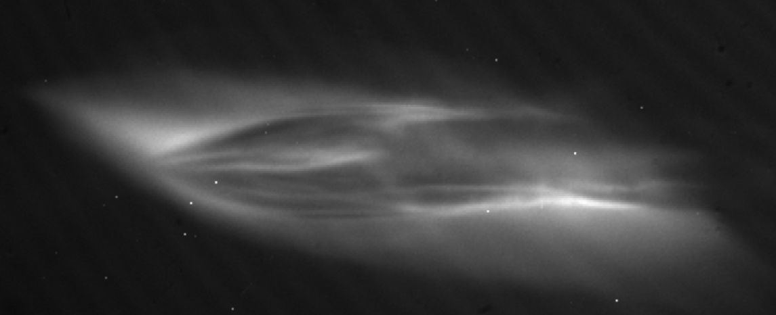
Channel Formation and Ion Collapse:
The electron probe is able to resolve the long term evolution of the ion channel
5e17, E_{L} = 15 J, 2 ps
0.2
t = 0
Wake region
0.1
x (mm)
0
t = 0
-0.1
Ion collapse
-0.2
2
1.5
1
0.5
0
z (mm)
Channel edges
0.2
t = +1 ps
0.1
x (mm)
0
t = +3 ps
-0.1
-0.2
2
1.5
1
0.5
0
z (mm)
13
The electron probe is able to resolve the longer term evolution of the ion channel
13

Slide 14
Plan for next year
Implement high resolution BPM measurement for detailed study of fields in SM-LWFA with spatial resolution on the scale of the laser wavelength
Improve gas targets and diagnostics to enable simultaneous observation of e-beam probe diagnostic, YAG laser diagnostic, and forward electron spectrum
Obtain required data for a complete analysis of density and laser power scaling in SM-LWFA
Prepare plans for longitudinal CO2 injection of linac e-beam in preparation of blowout regime experiments
The electron probe is able to resolve the longer term evolution of the ion channel
14

Slide 15
Electron Beam Requirements
Parameter | Units | Typical Values | Comments | Requested Values
Beam Energy | MeV | 50-65 | Full range is ~15-75 MeV with highest beam quality at nominal values | Nominal (50-65 MeV)
Bunch Charge | nC | 0.1-2.0 | Bunch length & emittance vary with charge | ~1
Compression | fs | Down to 100 fs (up to 1 kA peak current) | A magnetic bunch compressor available to compress bunch down to ~100 fs. Beam quality is variable depending on charge and amount of compression required. NOTE: Further compression options are being developed to provide bunch lengths down to the ~10 fs level | 100 fs
Transverse size at IP (σ) | μm | 30 – 100 (dependent on IP position) | It is possible to achieve transverse sizes below 10 um with special permanent magnet optics. | 100 um (longitudinal probe) 1 mm (transverse probe)
Normalized Emittance | μm | 1 (at 0.3 nC) | Variable with bunch charge | 1
Rep. Rate (Hz) | Hz | 1.5 | 3 Hz also available if needed | Up to 1.5
Trains mode | --- | Single bunch | Multi-bunch mode available. Trains of 24 or 48 ns spaced bunches. | Single bunch

Slide 16
CO₂ Laser Requirements
Configuration | Parameter | Units | Typical Values | Comments | Requested Values
CO₂ CPA Beam | Wavelength | μm | 9.2 | Wavelength determined by mixed isotope gain media | 9.2
Note that delivery of full power pulses to the Experimental Hall is presently limited to Beamline #1 only. | Peak Power | TW | 2 | ~5 TW operation is planned for FY21 (requires further in-vacuum transport upgrade). A 3-year development effort to achieve >10 TW and deliver to users is in progress. | 2
 | Pulse Mode | --- | Single |  | Single
 | Pulse Length | ps | 2 |  | 2
 | Pulse Energy | J | ~5 | Maximum pulse energies of >10 J will become available in FY20 | 5
 | M² | --- | ~2 |  | ~2
 | Repetition Rate | Hz | 0.05 |  | 0.05
 | Polarization |  | Linear | Adjustable linear polarization along with circular polarization will become available in FY20 | Linear

Slide 17
Special Equipment Requirements and Hazards
Electron Beam
  Please indicate any special equipment that you expect to need, including (but not limited to) the transverse deflecting cavity, shaped bunch using mask technique, plasma capillary discharge system, bolometer/interferometer setup etc.:
CO₂ Laser
  Please note any specialty laser configurations required here:
Ti:Sapphire and Nd:YAG Lasers
  Please note any specialty non-CO₂ laser configurations required here: N/A
Hazards & Special Installation Requirements
  Large installation (chamber, insertion device, etc.): N
  Cryogens: N
  Introducing new magnetic elements: Magnetic Spectrometer
  Introducing new materials into the beam path: Y (Yag BPM & Mirror)
  Any other foreseeable beam line modifications: Y (Permanent magnet chicane for beam compression)

Slide 18
Experimental Time Request
CY2020 Time Request
Capability | Setup Hours | Running Hours
Electron Beam Only | 0 | 0
Laser* Only (in FEL Room) | 0 | 0
Laser* + Electron Beam | 80 | 240
Time Estimate for Remaining Years of Experiment (including CY2020)
Capability | Setup Hours | Running Hours
Electron Beam Only
Laser* Only (in FEL Room)
Laser* + Electron Beam | 240 | 720
* Laser = Near-IR or LWIR (CO₂) Laser

Slide 19
Thank you for listening!

Slide 20
20191105 Estimate of the general scale at the GPOP10 and the gas jet.
Laser energy: 2.4 J
Backing pressure: 18.3 psi
1 mm
1.3 mm
Corresponds to $\sim$0.375 mm and 0.506 mm @ the gas jet

Slide 21
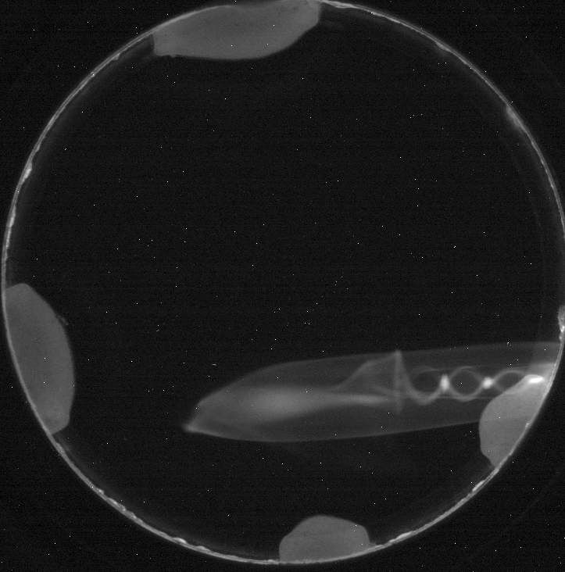
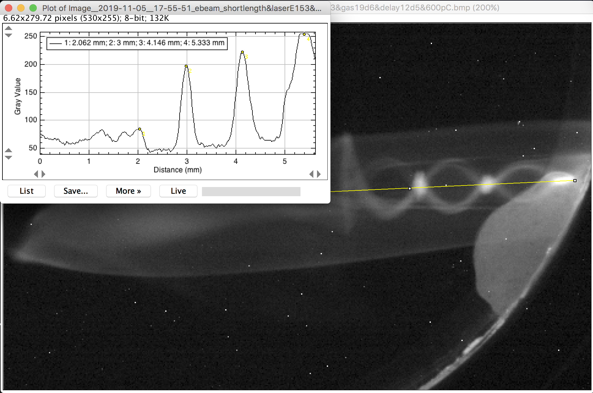
20191105 Estimate of the general scale at the GPOP10 and the gas jet.
Laser energy: 2.5 J
Backing pressure: 19.6 psi
0.94 mm
1.15 mm
1.19 mm
Corresponds to $\sim$0.352 mm, 0.431 and 0.446 mm @ the gas jet

Slide 22
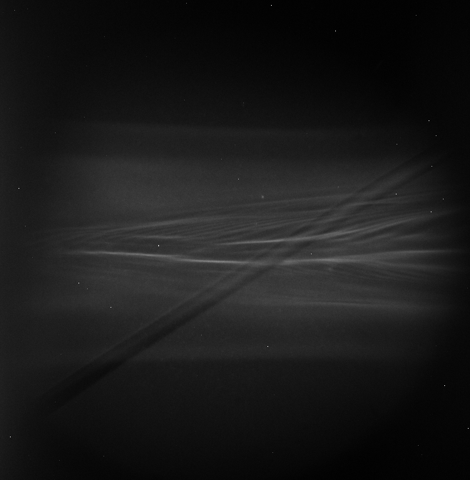
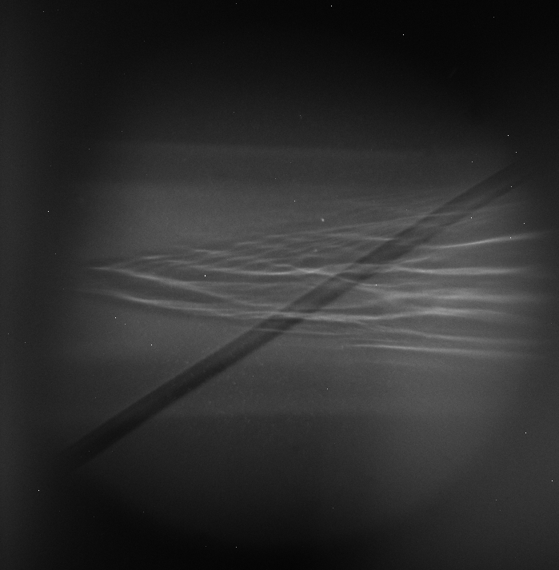
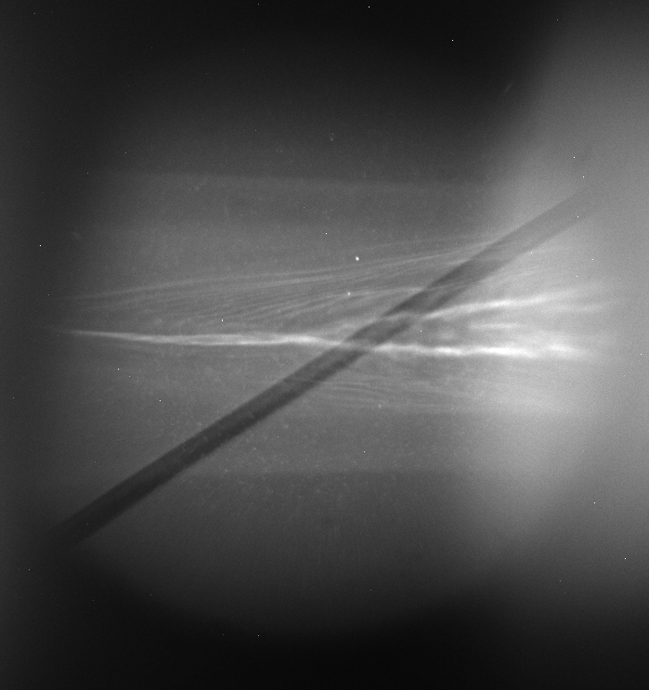
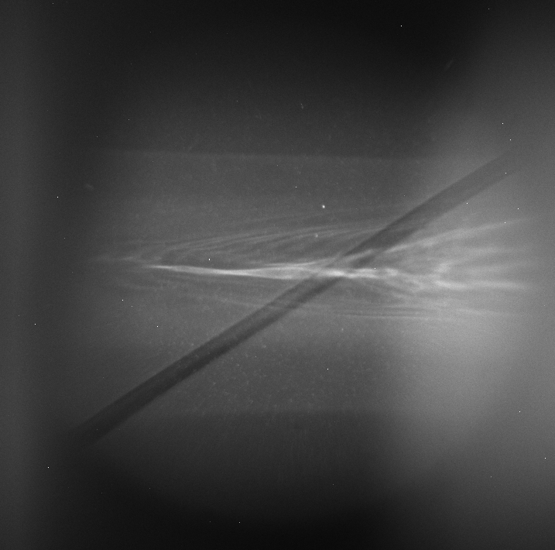
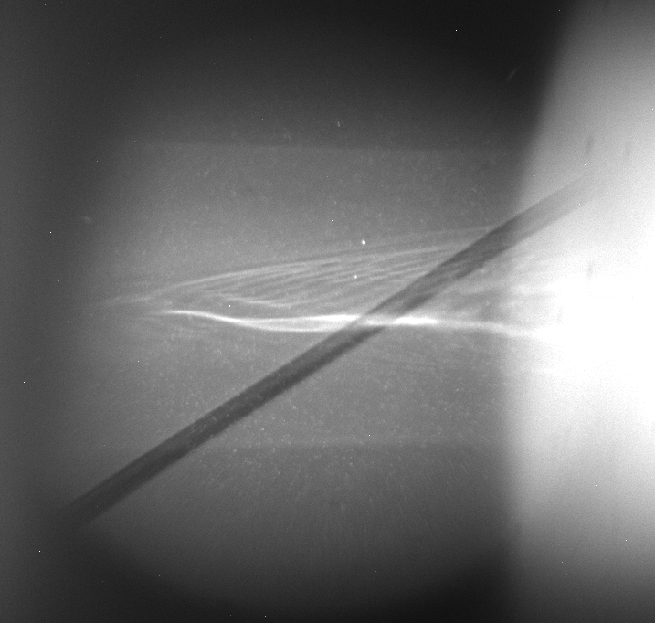
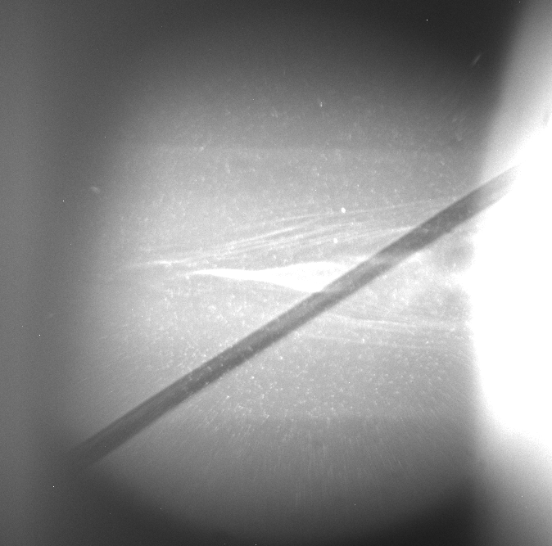

20191107: LWFA eProbe. Delay 12.1 mm. Energy dependence.
16:57:32
0.94 J
16:54:54
1.73 J
16:45:31
1.98 J
16:44:18
1.84 J
16:36:09
2.65 J
16:40:18
3.58 J
50 $μ$m

