Slide 1

Proposal ID: UED 306056
Proposal title: Structural phase transition and phonon excitation in non-equilibrium Cu₂S
PI: Jing Tao
Co-PI: Junjie Li, Yimei Zhu
Condensed Matter Physics & Materials Science Division
Brookhaven National Laboratory
Funding Source (Received): U. S. DOE, BES, Division of Materials Science and Engineering, and Early Career Award
Collaborators:
Brookhaven National Laboratory
PM: L. Wu, W-G. Yin, R. Konik, M. Dean, I. Robinson
ATF: M. Babzien, M. Fedurin, R. Malone, M. Palmer
CFN: D. Lu
University of Arkansas
J-Y. Chen
American Physical Society
Y. Li
Princeton University
R. J. Cava
University of Michigan
K. Sun
ATF Users’ Meeting 2019

Slide 2

Outline
Objective: understanding the mechanism of structural phase transition in Cu₂S
Introduction: a background of the material
Justification: 1) why UED; 2) experimental plan
Benefit to DOE and potential impact
ATF Users’ Meeting 2019

Slide 3
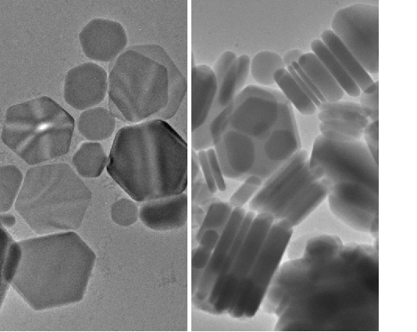
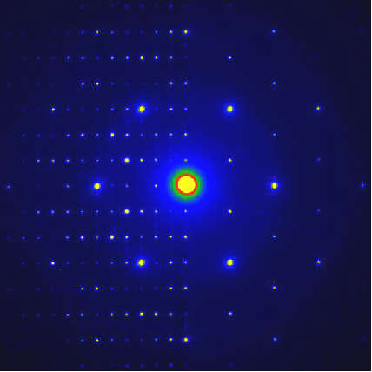
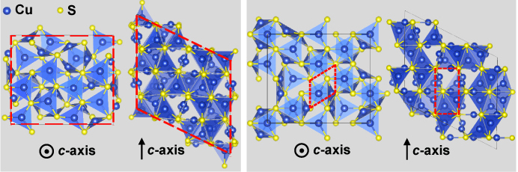
Reversible structure manipulation in Cu₂S
°
°
T = 20 C
T = 90 C
100 nm
100 nm
Room temperature: low-chalcocite phase (L-phase; space group P2₁/c; semiconductor)
Above 90 °C: high-chalcocite phase (H-phase; space group P6₃/mmc; insulator)
ATF Users’ Meeting 2019

Slide 4
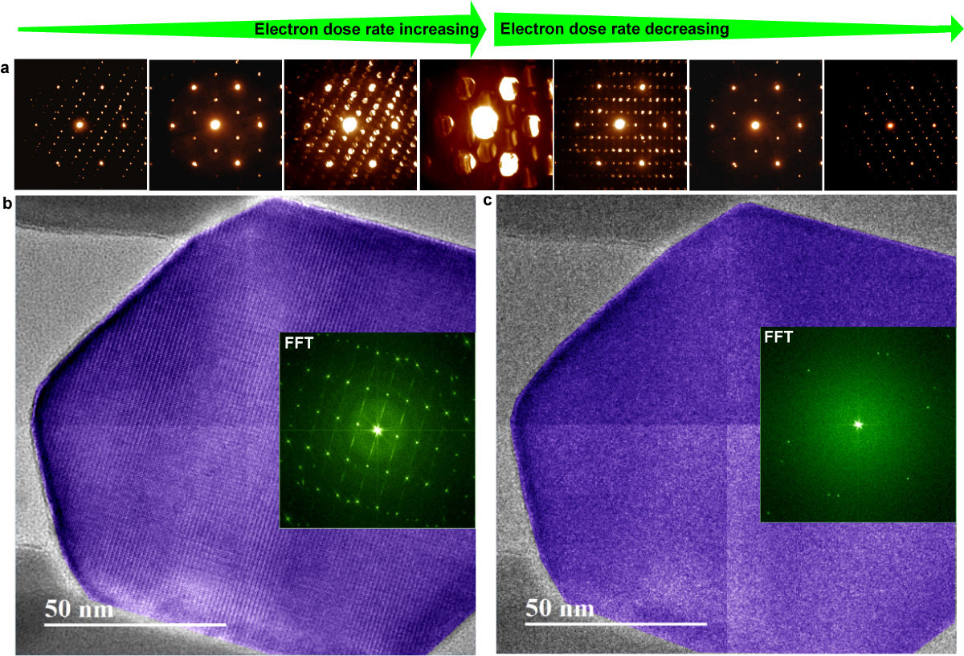
Reversible structure manipulation in Cu₂S
J. Tao et al., PNAS 114, 9832 (2017)
ATF Users’ Meeting 2019

Slide 5


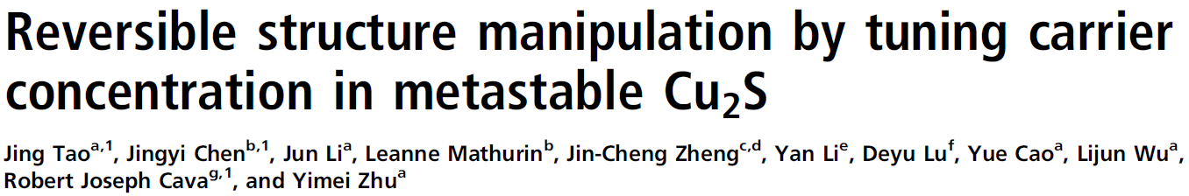
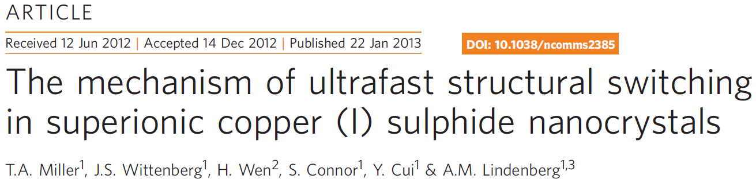
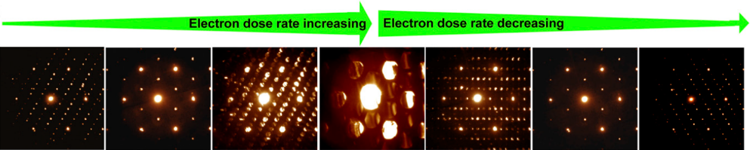
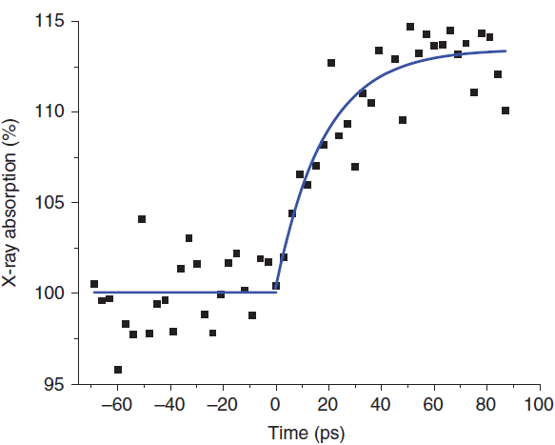
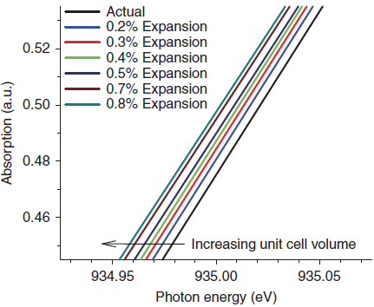
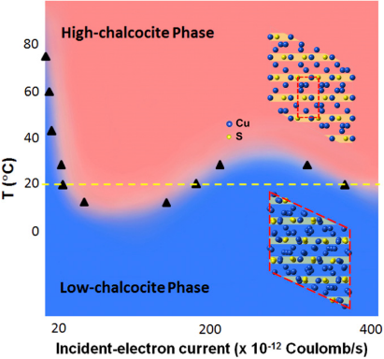
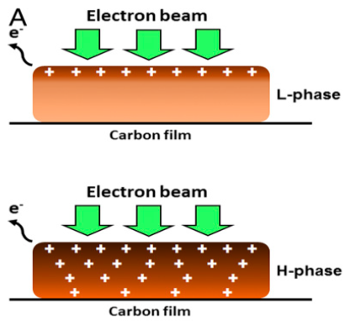
Motivation for UED study in Cu₂S
Ultrafast x-ray absorption work suggests the transition is not governed by electronic mechanisms but by the copper ion self-diffusion rate.
TEM study implies an intimate interplay between electronic degrees of freedom and the lattice during the structural phase transition.
Solution:
Direct probes of the structural evolution using momentum-resolved techniques in the ultrafast time domain.
ATF Users’ Meeting 2019

Slide 6
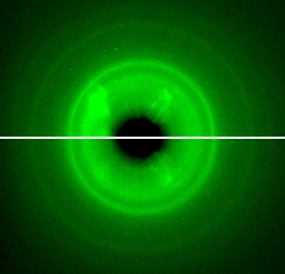
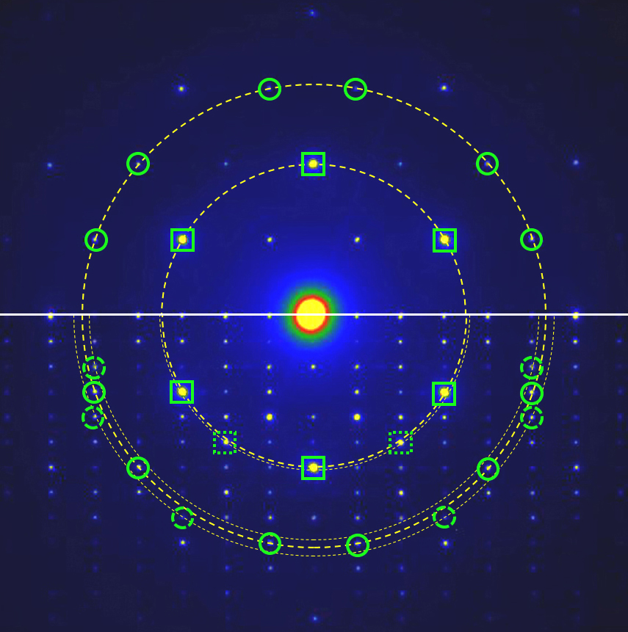
A comparison of UED and ED patterns
UED patterns
ED patterns
t = 80 ps
H phase
(120)
(110)
t = -10 ps
L phase
The peak width (reflecting the change of crystal symmetry) and peak center (reflecting the change in lattice constants)
ATF Users’ Meeting 2019

Slide 7
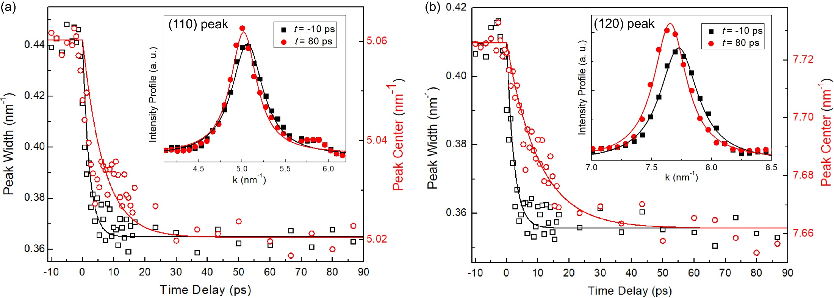
Peak width and peak center position measurements
Time constant ~ 2.3 ± 0.2 ps for the peak width and ~ 10.2 ± 0.3 ps for the peak center for the (120) peak. The temporal characteristic in crystal symmetry change is the same as in electronic structures.
Illustrated that crystal symmetry changes first, followed by lattice expansion.
Suggested the transition mechanism in Cu₂S to be electron-phonon coupling.
ATF Users’ Meeting 2019

Slide 8
Outline
Objective: understanding the mechanism of structural phase transition in Cu₂S
Introduction: a background of the material
Justification: 1) why UED; 2) experimental plan
Benefit to DOE and potential impact
ATF Users’ Meeting 2019

Slide 9
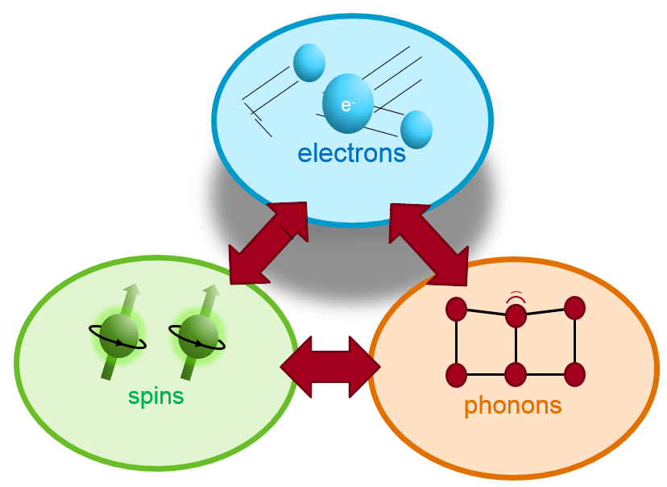
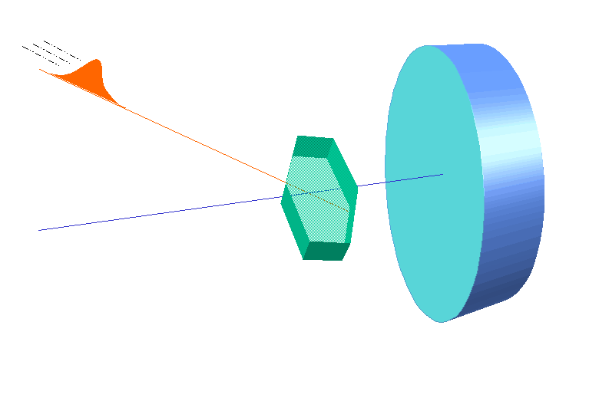
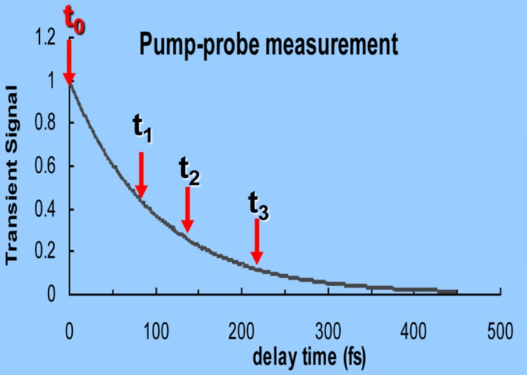
Ultrafast electron diffraction: the pump-probe method
Camera speed: 1000 frame/s = 10⁻³ s Ultrafast: 100 fs = 10⁻¹³ s
Optical pump
electrons
Pump
Detector
~10fs
~1ps
Sample
spins
~100ps
phonons
Electron probe
Probe
Time Delay
Pump: initiate the process and set the time zero
Probe: take snapshot at different delay times
Delay time: optical length difference, 1um ~3.3fs
ATF Users’ Meeting 2019

Slide 10
MeV UED at Brookhaven
SPECS
Acceleration voltage ~ 3 MeV
10⁶ electrons per pulse
Temporal resolution ~ 130 fs
800 nm laser pumping
Room temperature to liquid nitrogen cooling
ATF Users’ Meeting 2019

Slide 11
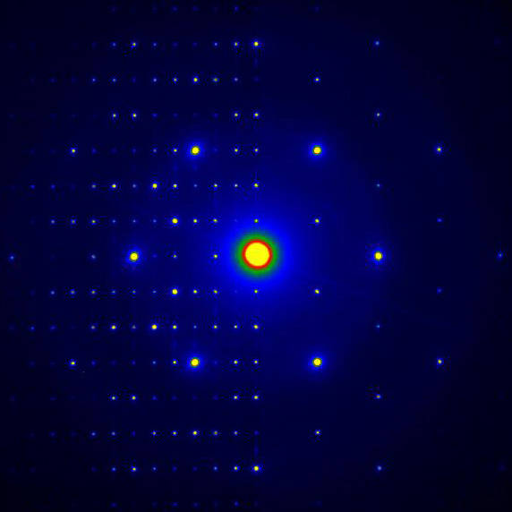
Ring patterns vs. single-crystal patterns
H phase
H phase
L phase
L phase
Pros – better momentum sensitivity and structural characterizations.
Using single-crystal UED results:
Cons – less precision for lattice-constant measurements and more difficulty in UED sample preparation.
ATF Users’ Meeting 2019

Slide 12
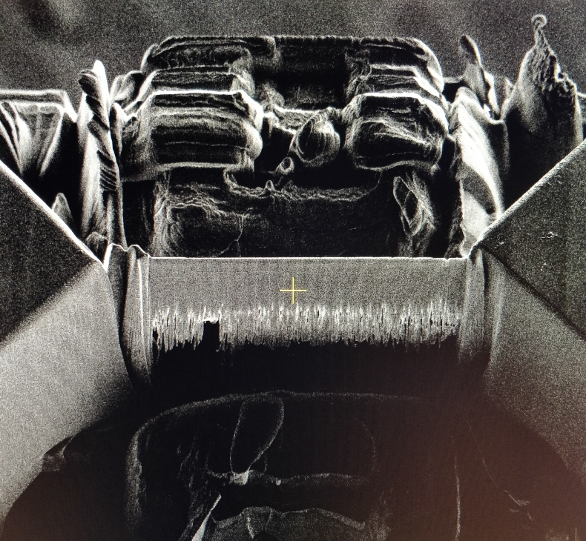
UED sample prep from 3D single crystals
Challenges in MeV-UED sample preparation from single crystals:
A Fe₃O₄ UED sample prepared by FIB
Uniformly thin for electron transparence (< 100 nm along beam direction)
Large lateral size of thin area (> 100 µm as diameter)
Approaches:
Mechanical polishing, focused ion beam milling, noble-gas ion sputtering
Nano-fabrication, lithography, and plasma etching
ATF Users’ Meeting 2019

Slide 13
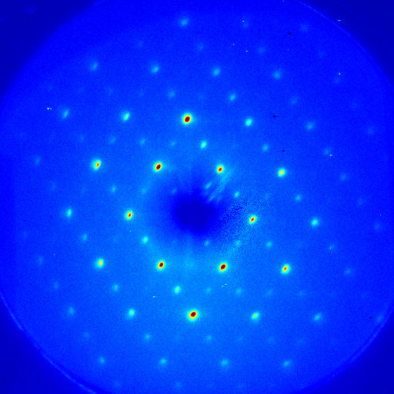
UED patterns from 3D single crystals
Single crystal VO₂
Single crystal Fe₃O₄
MeV-UED, BNL-ATF
MeV-UED, SLAC
ATF Users’ Meeting 2019

Slide 14
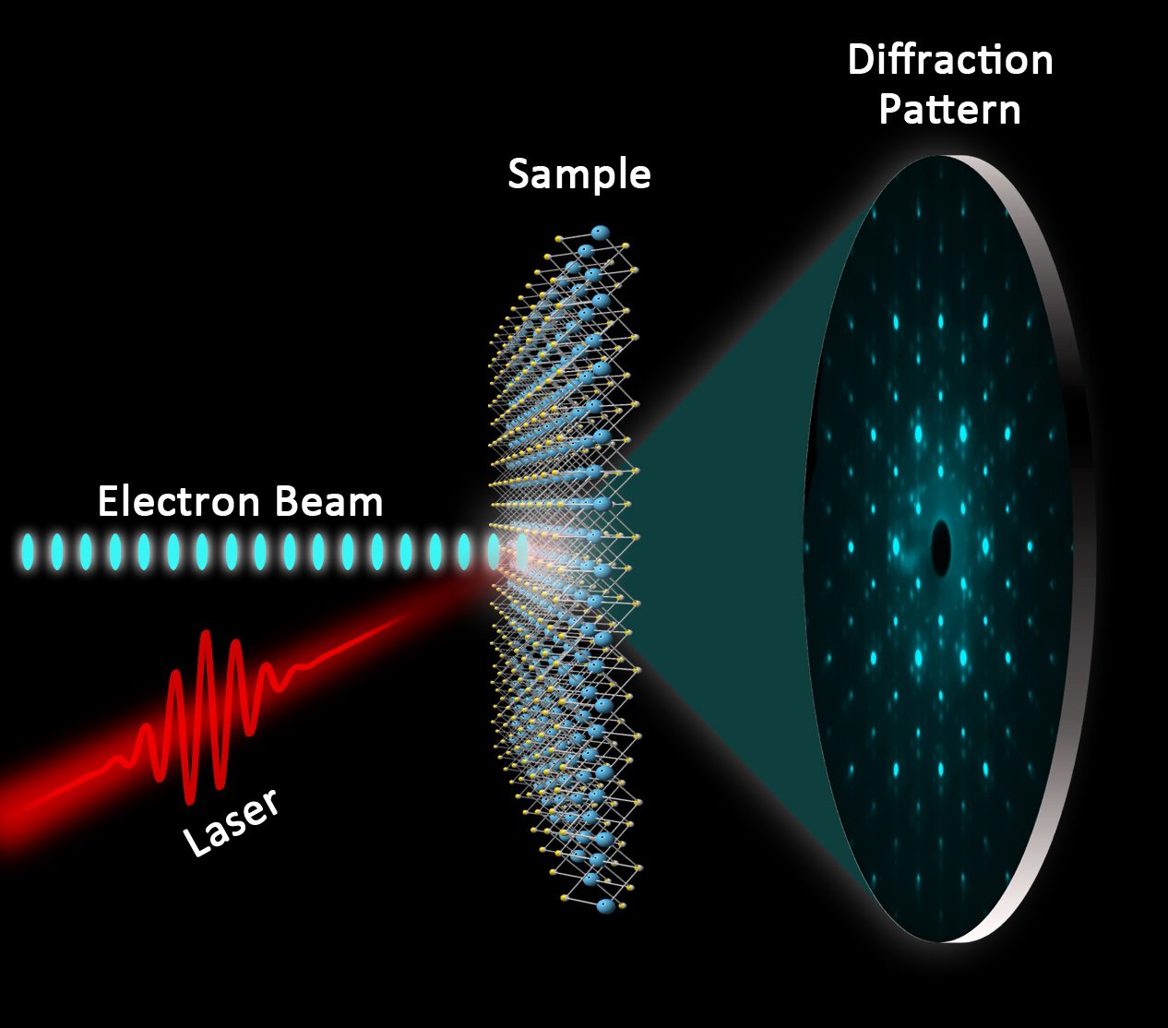
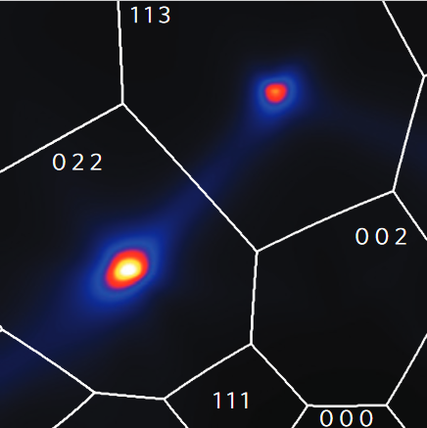
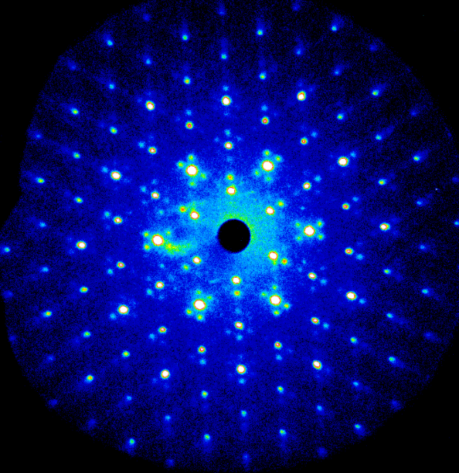
Capabilities enabled by single-crystal UED patterns
A comparison
An XFEL pattern
M. Trigo et al., Nat. Phys. 9, 790 (2013)
An MeV-UED pattern
Single-crystal 1T-TaSeTe
T = 26 K
ATF Users’ Meeting 2019
submitted

Slide 15
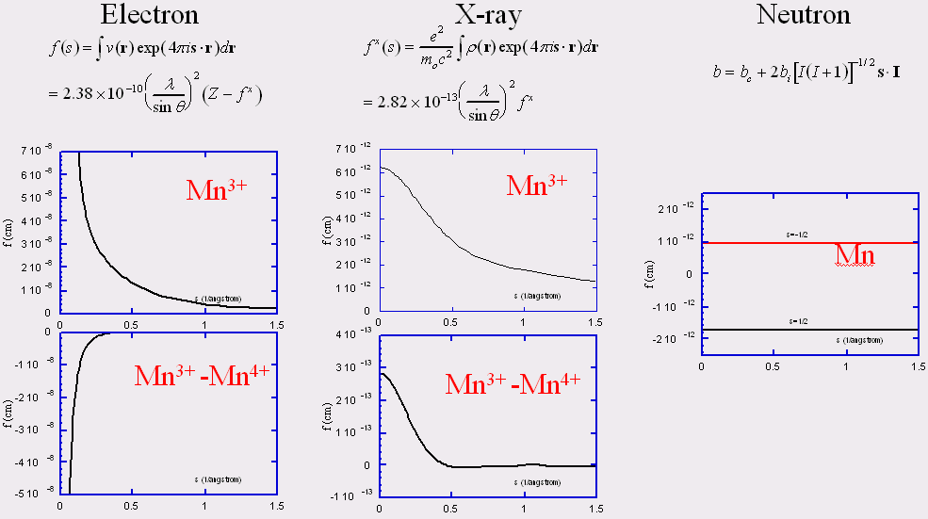
Large cross sections from electron scattering
From J. M. Zuo’s Group, http://cbed.matse.illinois.edu
ATF Users’ Meeting 2019

Slide 16
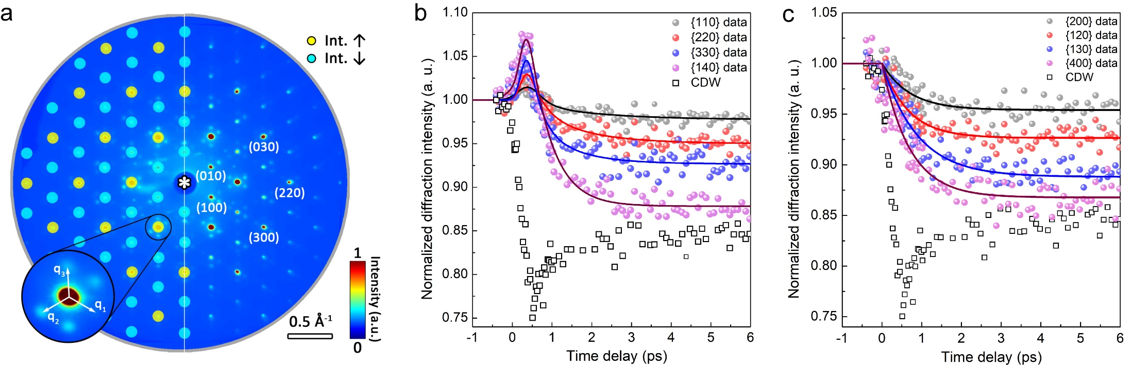

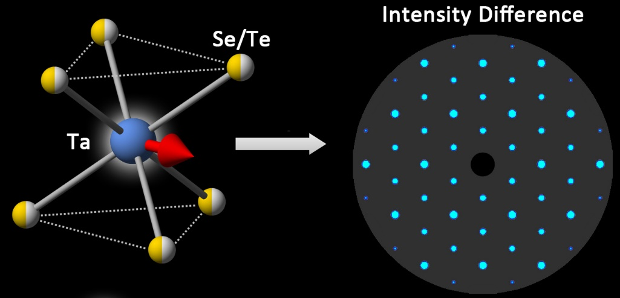
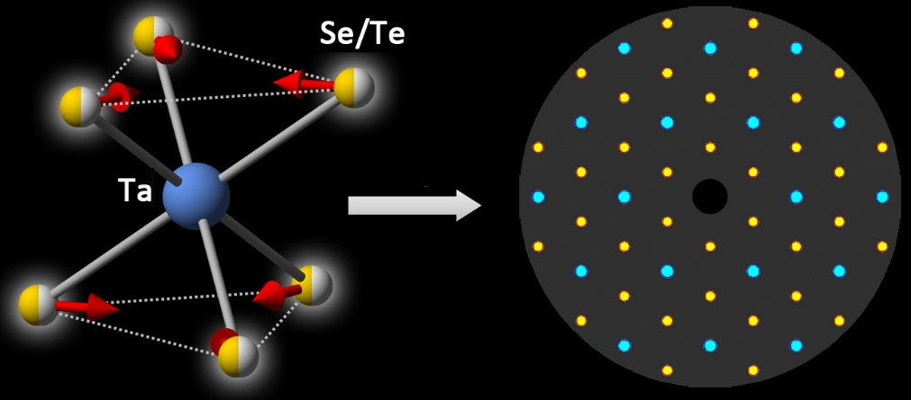
Momentum sensitivity to distinct atomic displacements
Our results indicate the primary role of the chalcogen sublattice during the dynamics.
J. Li, … J. Tao, submitted
ATF Users’ Meeting 2019

Slide 17
Capabilities enabled by single-crystal UED patterns
A MeV-UED pattern
The pattern symmetry is corresponding to structure symmetry.
The intensity distributions are sensitive to atomic displacements / structure distortion.
The role of phonon excitation or relaxation in structural phase transition can be revealed during photoexcitation.
UED results and structural interpretations will be correlated to time-resolved observations of electron dynamics to understand the charge-lattice interactions.
ATF Users’ Meeting 2019

Slide 18
Special Equipment Requirements and Hazards
Sample Cu₂S and Setup
  Experimental setup is normal. No special equipment is needed.
Pump Laser Requirements
  800 nm (1.55 eV) with various pump fluence.
  Up to 9 μm (140 meV) using OPA for selective phonon excitation.
Hazards & Special Installation Requirements
  Double-tilt sample stage.
  Cryogens: liquid nitrogen.
  No new magnetic elements.
  No new materials into the beam path.
  No beam line modifications.
ATF Users’ Meeting 2019

Slide 19
Experimental Time Request
CY2020 Time Request
Capability | Setup Hours | Running Hours
UED Facility | 2 - 3 days (48 – 72 hours) | 1 - 2 weeks (40 – 80 hours)
Time Estimate for Remaining Years of Experiment (including CY2020)
Capability | Setup Hours | Running Hours
UED Facility | 10 days (240 hours) | 3 – 6 weeks (120 – 240 hours)
ATF Users’ Meeting 2019

Slide 20
Timeline
Year 1: Single-crystal Cu₂S UED samples would be prepared and MeV-UED patterns with good quality will be obtained. Time-resolved UED results will be tested.
Year 2: Complete sets of time-resolved UED results will be collected. Data analysis and the structural interpretation(i.e., how are the intensity measurements associated with the structures, atomic displacements, and phonon modes)will be done.
Year 3: Time-resolved UED results will be collected and data analysis will be completed in a parameter space, i.e., under various temperatures and pumping fluences for a better understanding of photoexcitation mechanism.
ATF Users’ Meeting 2019

Slide 21
Benefit to DOE
Cu₂S is an energy-related material since it can be used in super-ionic conductors, memory, battery and thermoelectric devices. The outcomes of the project, i.e., a future understanding of the transition mechanism, will incubate additional applications in multiple areas by taking advantage of the extreme sensitivity in Cu₂S structures/properties to certain external stimuli such as electric currents and fields.
Cu₂S is also a quantum material, in which strong interplay between competing degrees of freedom, such as charge and lattice, is essential in the materials' functionality. The understanding of the electron-phonon coupling in this material will shed light in a wide group of materials in the future.
ATF Users’ Meeting 2019

Slide 22


Thank you!
ATF Users’ Meeting 2019
Notes:
Thank you very much!

