Slide 1

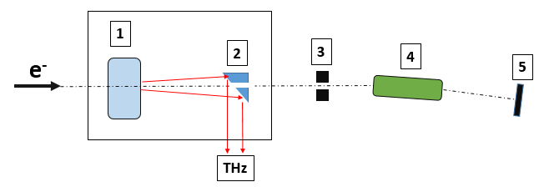
Collinear wakefield accelerator based on corrugated waveguide
A new proposal: 306051
Funded by LDRD at ANL
drhgfdjhngngfmhgmghmghjmghfmf
A conceptual diagram for a proposed experiment at ATF
PI: A. Zholents, APS/ANL
W. Jansma, S. Sorsher, K. Suthar, E. Trakhtenberg, G. Waldschmidt (APS/ANL)
S. Doran (HEP/ANL)
S. Siy (University of Wisconsin)
S. Baturin (Northern Illinois University)
P. Carriere, A. Murokh (Radia Beam Technology)
ATF User meeting, December 4, 2019

Slide 2
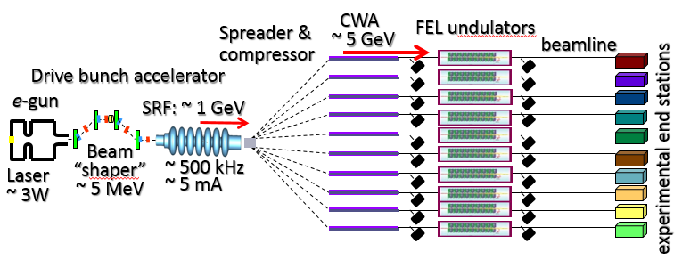
A big picture …
A concept of a high repetition rate multi-user FEL facility based on a collinear wakefield accelerator CWA
Expanded list of collaborators:
W. Jansma, A.Nassiri, S. Sorsher, K. Suthar, E. Trakhtenberg, G. Waldschmidt, J. Xu, A. Zholents(APS/ANL)
S. Doran, G. Ha, J. Power (HEP/ANL)
S. Siy, N. Behdad (University of Wisconsin)
S. Baturin, P. Piot ,W.-H. Tan, (Northern Illinois University)
P. Musumeci (UCLA)
T. Campese, P. Carriere, A. Murokh (Radia Beam Technology)
S. Antipov (Euclid Techlabs)
P. Bado, (Translume, Inc.)

Slide 3

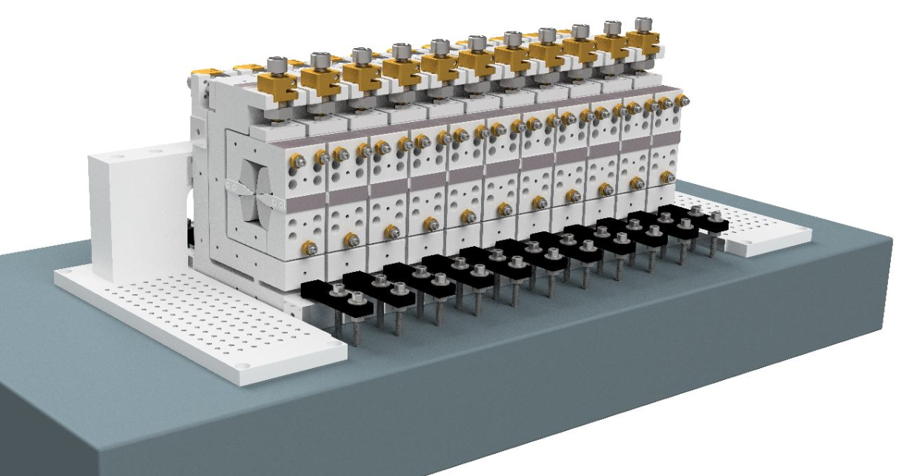
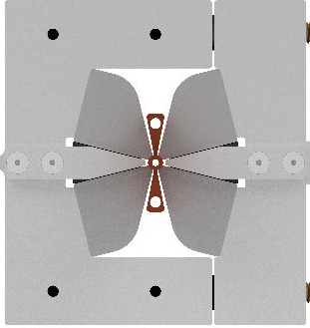
Current R&D focus
Design and construction a collinear wakefield accelerator module based on the corrugated waveguide
Front view
0.5 m
85 mm
Vacuum chamber with corrugations
NdFeB
Accelerator module
Electrons produce Čerenkov radiation moving with almost the speed of light down of the corrugated waveguide located inside of the quadrupole wiggler
A strong beam focusing from the quadrupole wiggler ensures beam stability (BNS damping)

Slide 4
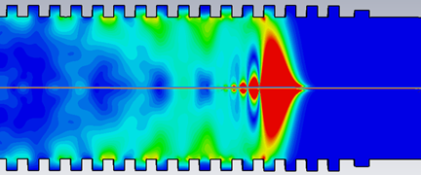
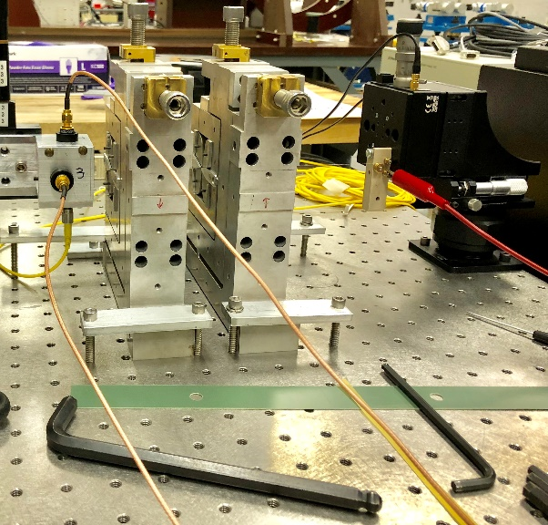
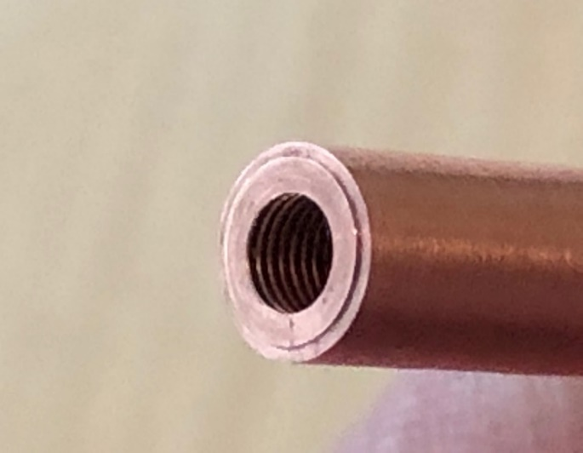
Progress to date
Advanced a theory of a co-linear wakefield accelerator¹⁾
  Accelerator efficiency, transformer ratio, ultimate accelerating gradient,
  Analyzed BBU, refined BNS damping for a case of strong wakes, found stable solution.
Designed and built a hybrid quadrupole with a high gradient ~ 0.95 T/mm
Developed a high precision pulsed wire magnetic measurement technique ²⁾
Conceived and tested seven methods for a fabrication of a corrugated waveguide
Developed a concept and designed a transition section³⁾
Prepared a preliminary design of a “drive” bunch accelerator⁴⁾
ECHO
2 mm
1) Baturin, Zholents, PRAB, 061302 (2017); Baturin, Zholents, PRAB, 031301 (2018); Baturin, et al., PRAB, 121302 (2018).
2) Kasa, Zholents, IPAC18, p.1257, (2018).
3) Siy, Waldschmidt, Zholents, NA-PAC19, (2019);
4) Tan, Piot, Zholents, invited talk at IPAC’2019, (2019);

Slide 5
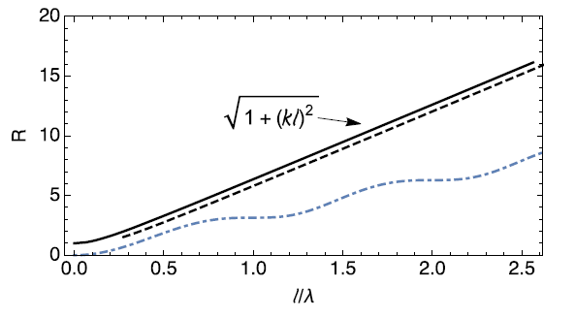
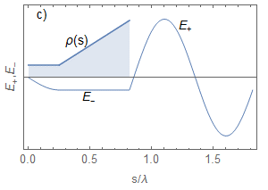


Theoretical studies
“Door step triangle distribution” [1]
ρ(z)
E⁺
Transformer ratio
Theoretical maximum
R =
E₊ , E₋ (rel. units)
door step
E ⁻
pure triangle
z (mm)
loss factor;
total charge
R_{single mode} > R_{multi-mode}
|E₊|_{single mode} > |E₊|_{multi-mode}
K. Bane et. al., IEEE Trans. Nucl. Sci. NS-32, 3524 (1985)

Slide 6
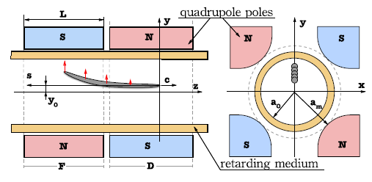

Theoretical studies cont’d
1. BNS-like damping condition for strong wakefields
wakefield
quadrupole pole tip field
energy chirp magnitude
quadrupole focusing strength
Two particle model
2. Adaptive focusing
3. Adaptive energy chirp
relative magnitude of the chirp remains constant with the deceleration of the drive bunch

Slide 7
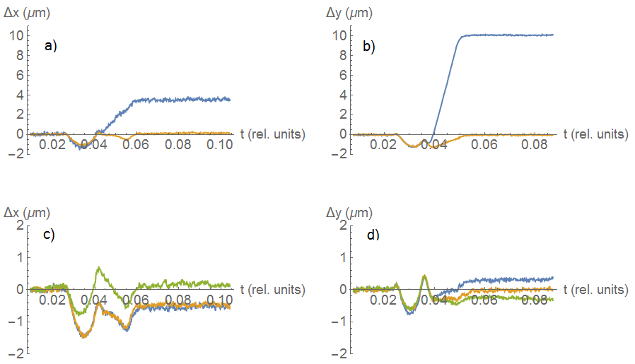
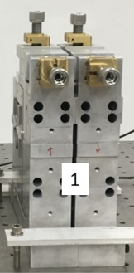
quadrupole wiggler will be used to suppress BBU
Alignment of two quads with a sub-micron precision
Pulsed Wire Measurement technique
Q2 Q1
(begin)
aligned the wire to magnetic center of Q2
aligned Q1 to the wire using adjusters
Q2 Q1
(begin)
Rough alignment
(end)
(end)
Gradient: 0.95 T/mm
Bore radius: 1.5 mm
Fine alignment
Plots (a) and (b): beginning and ending of the first iteration in the alignment in x and y.
Plots (c) and (d): three steps of the final tuning (green) of the quadrupoles both in x and y.
A small "crosstalk", i.e., non-orthogonality of the adjustment assemblies was observed.

Slide 8
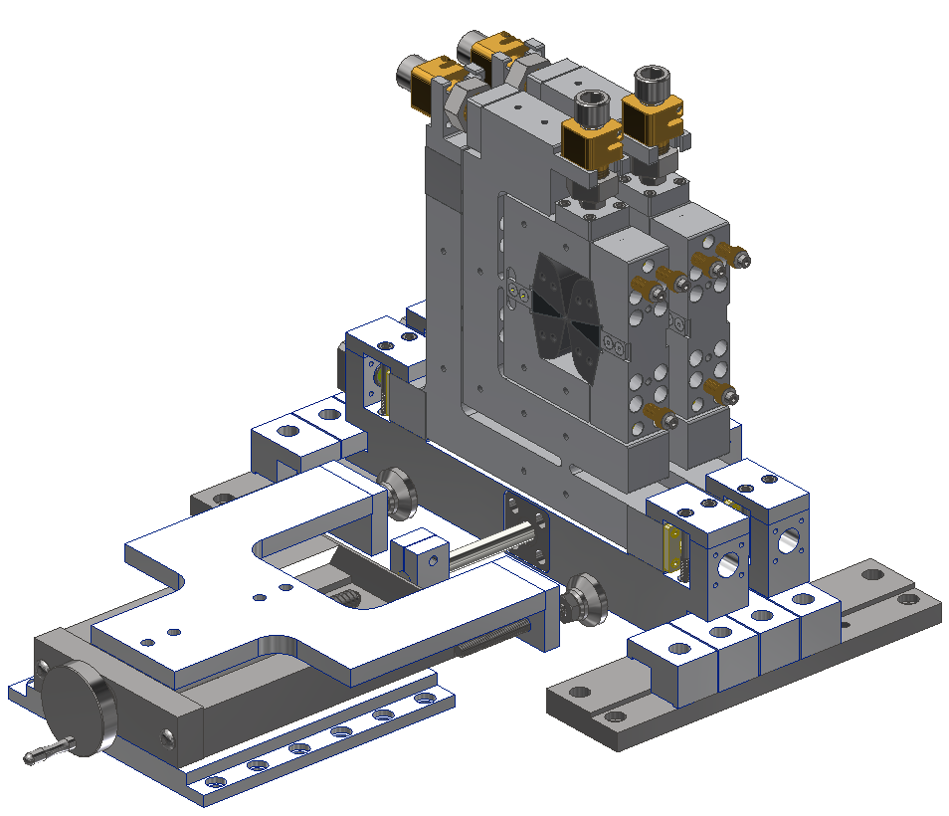
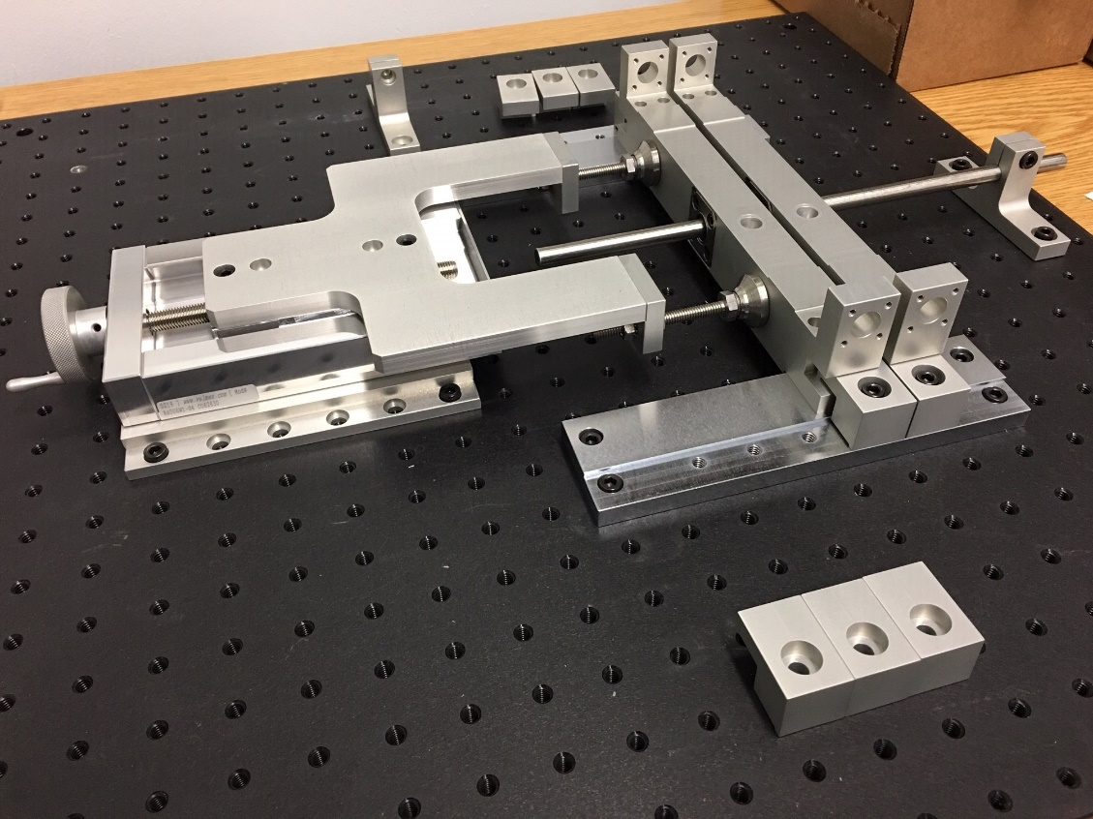
Wiggler assembly
Second generation design
Quad assembly
Z-Carriage
Z-Pusher
Pusher testing

Slide 9
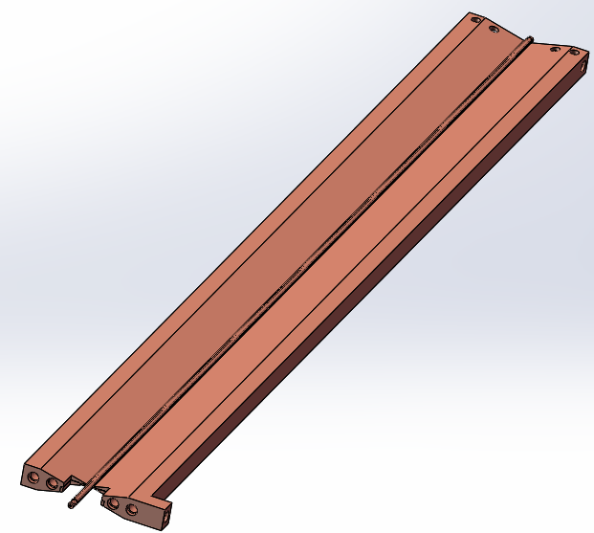
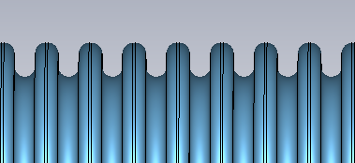
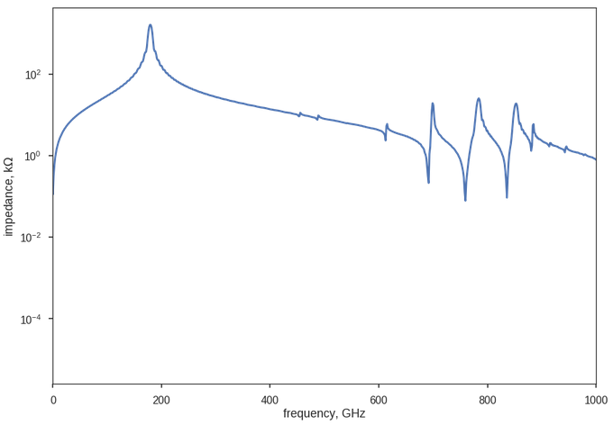
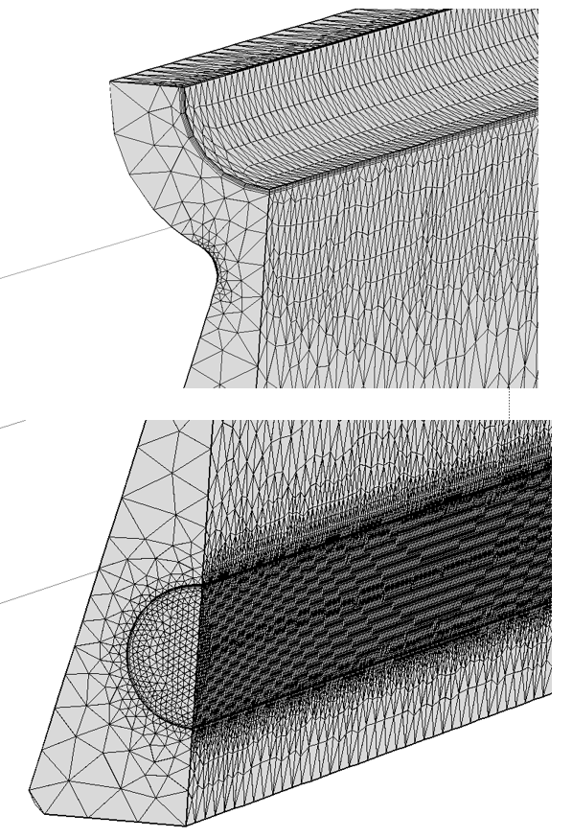
Vacuum chamber
P
G
Corrugated structure
Vacuum
P (period) = 340 μm
G (gap) = 180 μm
D (depth) = 263 μm
Corner radius = 80 μm
Internal diameter = 2 mm
0.5 m
D
Max heat load on corrugations 20 W/cm
Thermal and mechanical stress analysis of the chamber has been performed
Water cooling channels
Impedance of corrugated wave guide with the main mode centered at 178.73 GHz per ECHO calculation

Slide 10
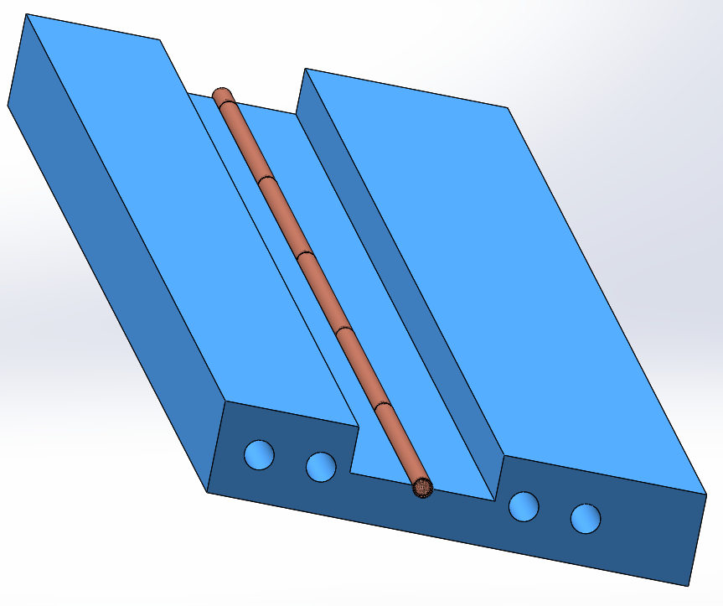
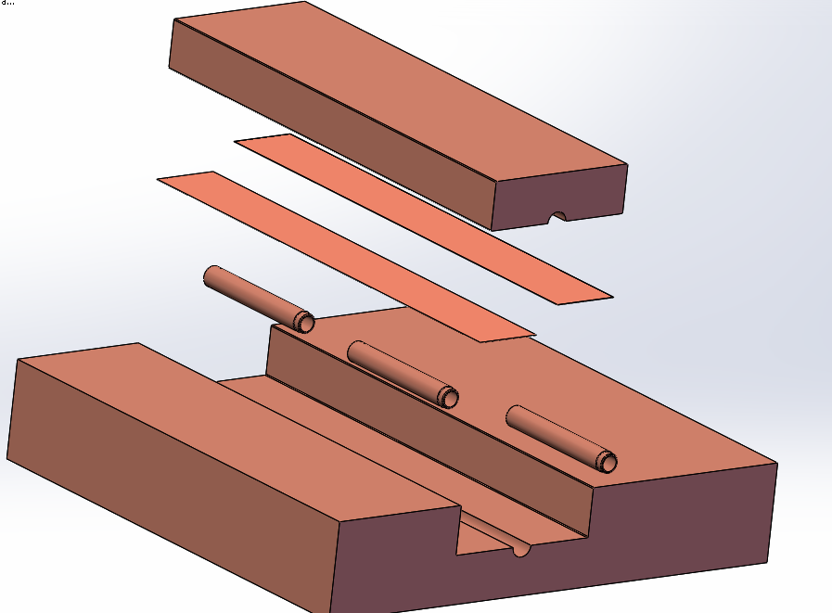
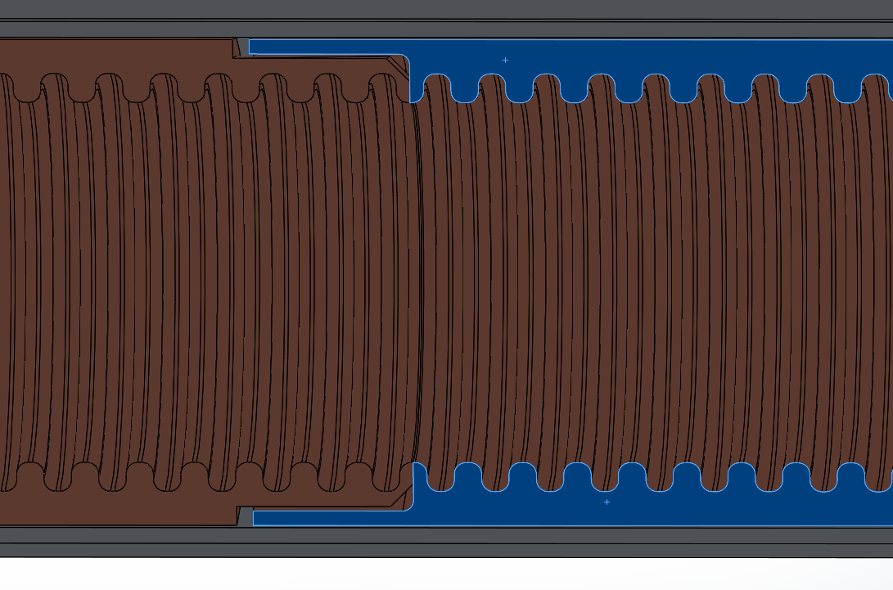
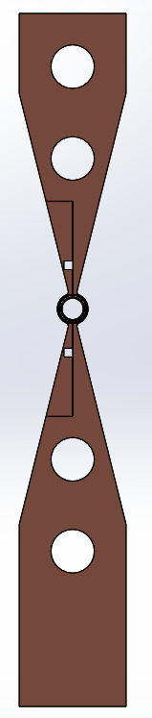
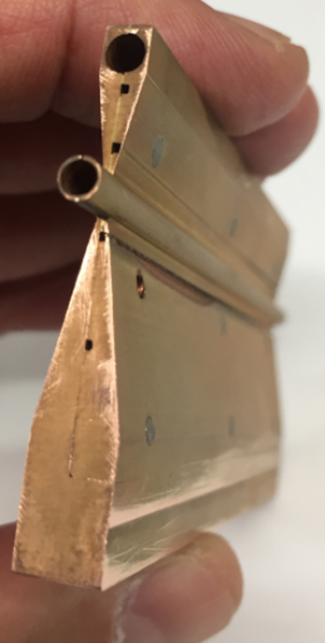
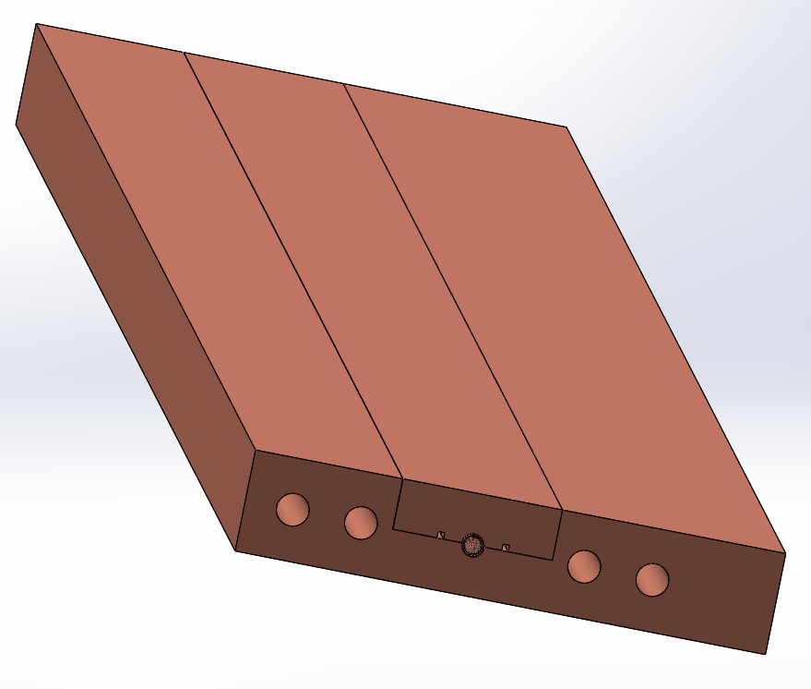
Vacuum chamber fabrication^{*)}
1
2
Electroforming of corrugations
Top block
CuSil braze shim
EF cylinders w/ lap mating feature
Bottom block
w/ cylinder registration bore
2.900
2.322
AL mandrel
2.000
3
4
copper
WG Stack:
  520mm long assembly: 5 x100mm WG +20mm
  Mating interface
    Female: 80 μm thick
    Outer cylinder: 87 μm thick

Slide 11
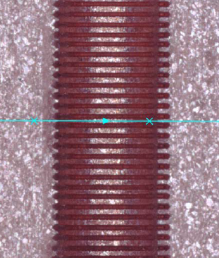
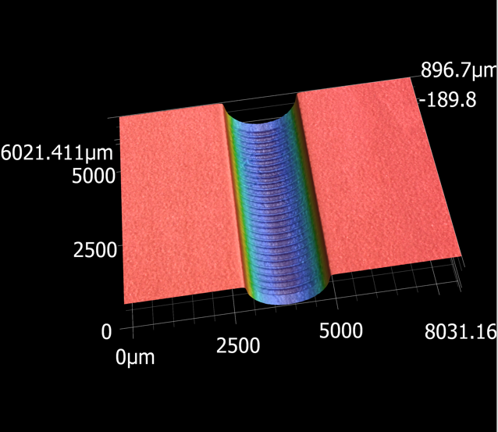
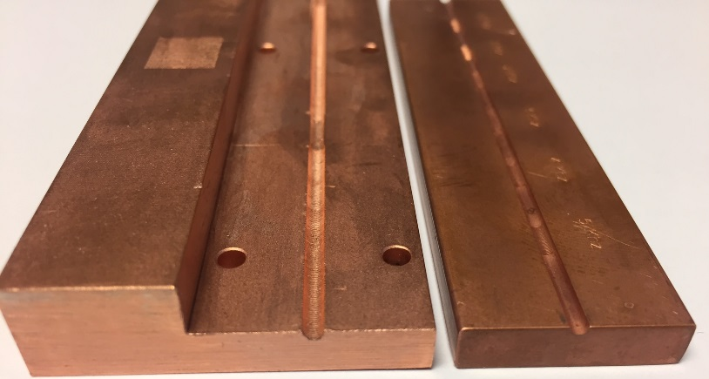
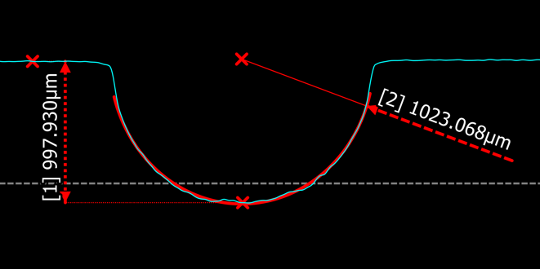
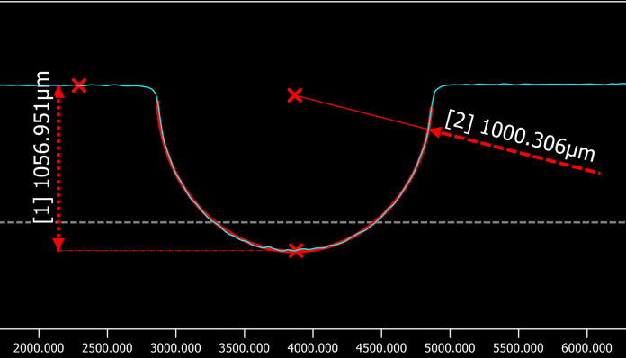
Vacuum chamber fabrication cont’d
Laser ablation in the pre-machined groove
Image under the microscope
Digital rendering
203 ±15 μm
Cross-sectional profile through a raised tooth marked by the blue line in the above photo.
Cross-sectional profile through a groove.

Slide 12
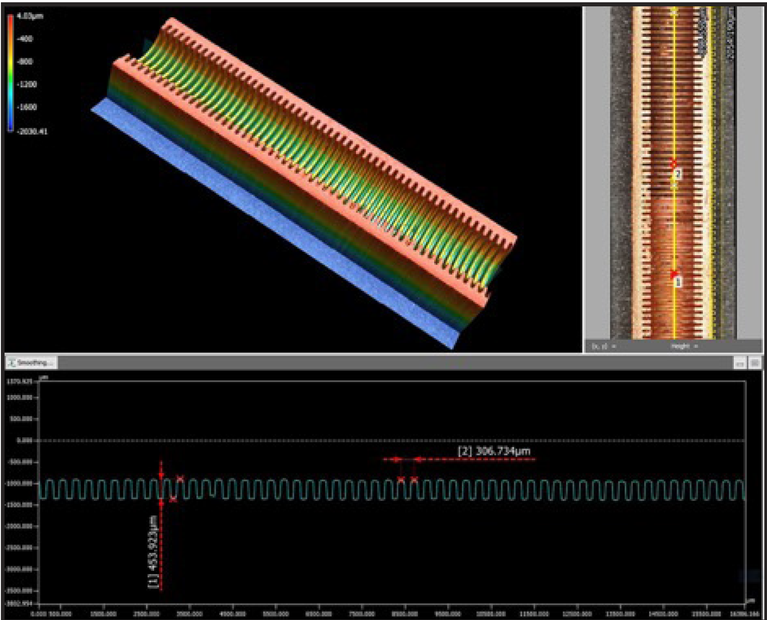
Vacuum chamber fabrication cont’d
Profile of electroformed corrugations showing uniform periodicity and groove depth

Slide 13
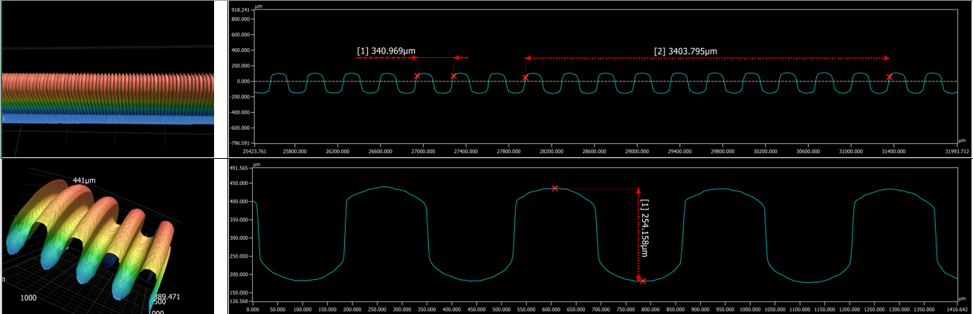
Vacuum chamber fabrication cont’d
Profile of aluminum mandrel

Slide 14
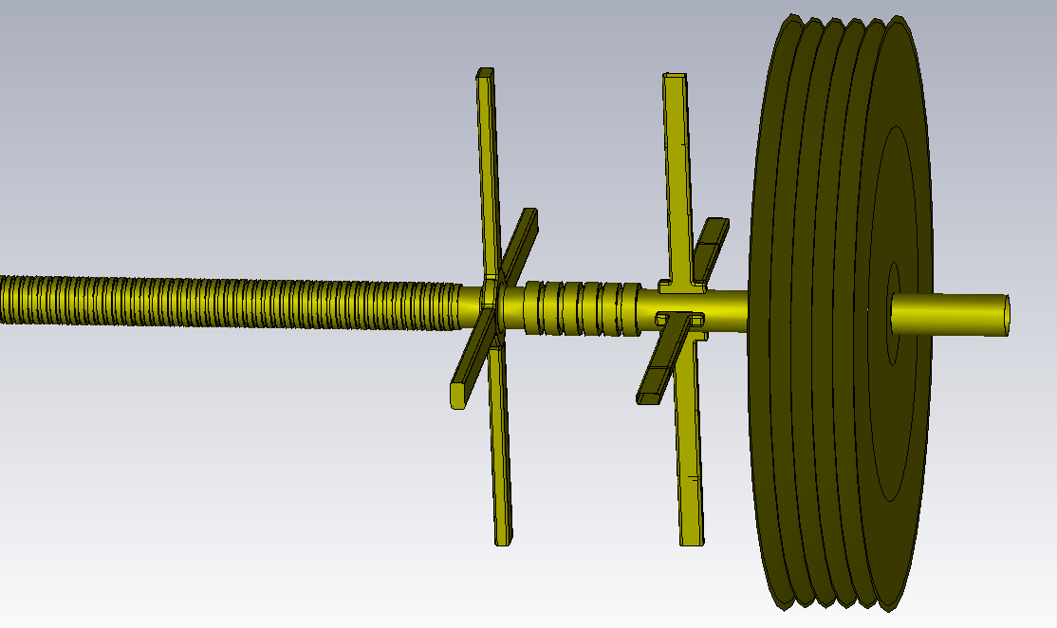
Layout of Corrugated Waveguide and Transition Section
9.16 mm
Output Coupler
Integrated Offset Monitor
Bellows
Beam direction
Corrugated Waveguide
2.5 mm
Notch
Filter
1.3x0.65 mm²
RF Dampers
RF Windows
Pyrometer

Slide 15
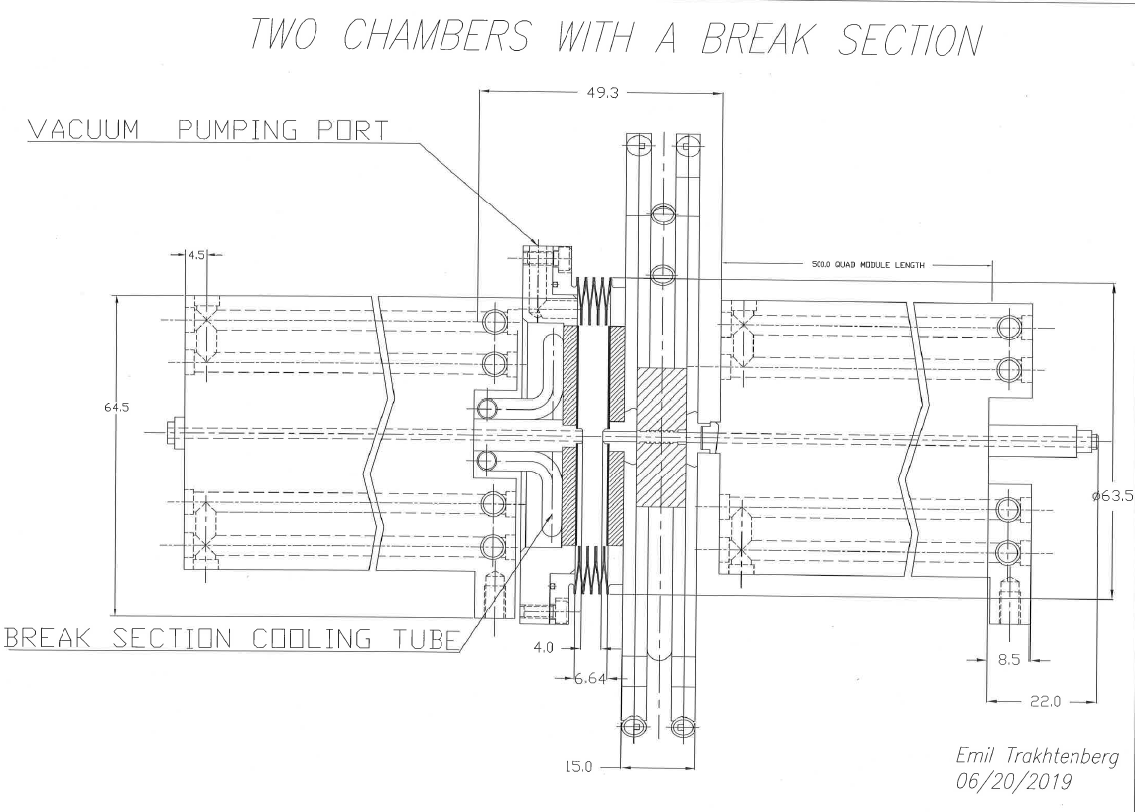
Layout of Corrugated Waveguide and Transition Section (2)
two waveguide chambers and transition section
49.3 mm
Vacuum pumping port
Beam direction
Transition sections increase the accelerator length by < 10%
Water cooling tube
Integrated Offset Monitor
RF coupler

Slide 16
ATF experiment
1
2
3
4
e⁻
5
THz
A conceptual diagram for a proposed experiment at ATF
1) device under the test,
2) paraboloid mirror with the hole in the middle,
3) horizontal slit,
4) spectrometer magnet,
5) diagnostic screen.

Slide 17
ATF experiment
Our immediate goal is to characterize several corrugated waveguide samples with the electron beam. We plan:
to measure both longitudinal and transverse wakefields that they produce and compare them with the wakefields produced by a similar tube without corrugations;
to measure spectrum and intensity of the sub-THz Čerenkov radiation produced by the electron beam passing the structure that is expected to be in the range of 180-200 GHz;
to observe if the wakefield can cause a breakdown in the structure.
.

Slide 18
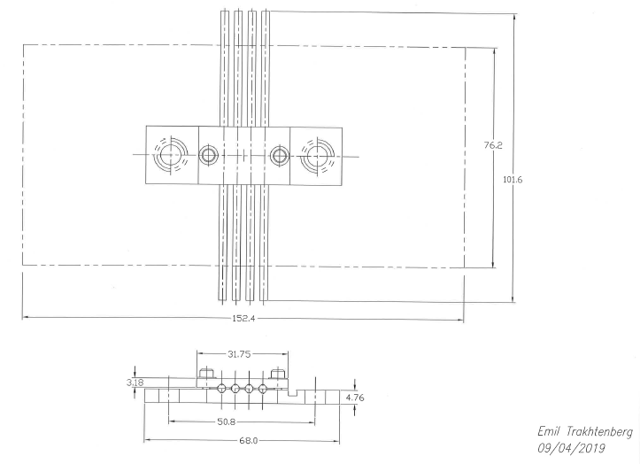
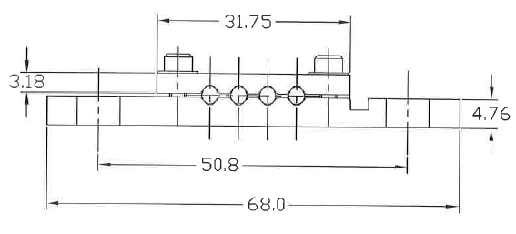
Device under the test
2 mm
1
101.6
152.4
Holder for three pipes with corrugations and one pipe without corrugations

Slide 19
Electron Beam Requirements
^{*)}
*) depending on the beam energy chirp produced by compression

Slide 20
Special Equipment Requirements and Hazards
Electron Beam
  A special equipment that we expect to need:
    shaped bunch using mask technique (likely),
    bolometer/interferometer setup,
    horizontal translation stage (levered at the beam height)
    the horizontal slit,
    diagnostic screen
Hazards & Special Installation Requirements
  No known hazards

Slide 21
Experimental Time Request
CY2020 Time Request
Capability | Setup Hours | Running Hours
Electron Beam Only | 16 hours^{*)} | 24 hours^{*)}
Laser* Only (in FEL Room)
Laser* + Electron Beam
*) we may need a second run using two shifts for a setup and three shifts for the experiment
Time Estimate for Full 3-year Experiment (including CY2020)
Capability | Setup Hours | Running Hours
Electron Beam Only | tbd | tbd
Laser* Only (in FEL Room)
Laser* + Electron Beam
* Laser = Near-IR or LWIR (CO₂) Laser

Slide 22
Thank you for your attention

