Slide 1
The ATF Science Planning Workshop
Editors:
Navid Vafaei-Najafabadi (SBU)
Dave Sutter (UMD)
Mike Downer (UT)
Aakash Sahai (CU)
Gerard Andonian (Radiabeam/UCLA)
Ben Cowan (Tech-X)

Slide 2
Acknowledgements
The participation of a large number of subject-matter experts was very much appreciated
Special thank you to people sending us summaries of topics
Sergey Antipov
Chaojie Zhang
Ben Cowan
Craig Siders
Ollie Etlinger
Dan Gordon
Joel England
Sergey Mirov
Sergei Tochitsky
Wayne Kimura
Yu-hsin Chen
S. V. Shchelkunov

Slide 3
Summary
ATF is a unique facility serving research activities that span cutting-edge laser science and technology, particle acceleration, and advanced diagnostics
As a user facility, ATF is the only place that provides access to a number of multi-beam experiments that can only be performed here
LWIR is a unique source that once developed to a particular maturity, will enable new research avenues.
ATF possesses a unique driver for advanced acceleration research of positive and negative charged particles. This is important for ATF facility’s mission of advancing accelerator technology

Slide 4
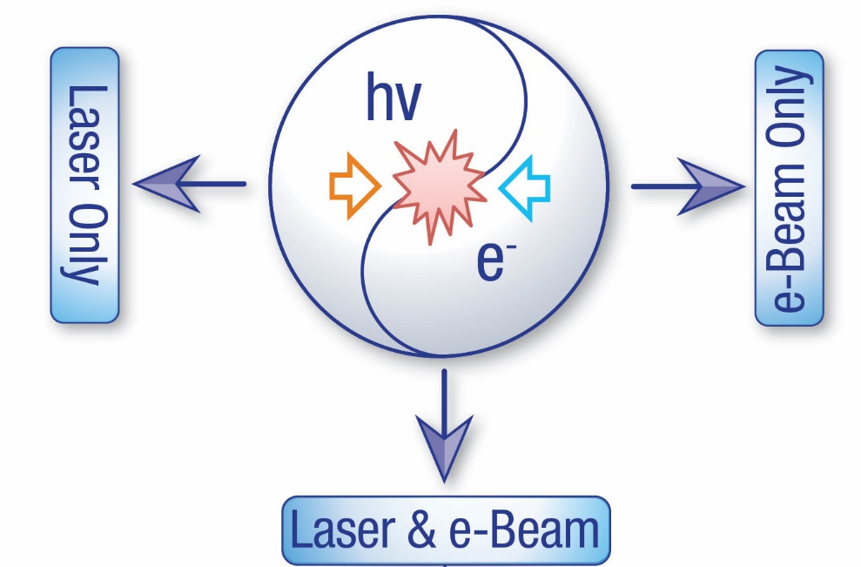
ATF Provides Unique Electron Beam + Laser Capabilities
High-brightness photocathode linac: 80 MeV
Emittance - 1μm
Energy spread - 0.1%
Charge ~ 1.5 nC
Single bunch 10 ps – 200 fs
Multi-bunch trains
CO₂ laser system
λ = 9-11 μm
>2 TW peak power
5J @ 2ps pulse width
0.05 Hz repetition rate
4

Slide 5
Workshop Deliverables
  A summary of scientific needs for the ATF facilities to pursue for exploration of new physics
  A summary of capability upgrades required for enabling key research thrusts in the near term
  A prioritized list of upgrades that will enable a long-term path for the facility.
  For Each Topic Presented:
  Uniqueness/Advantage of ATF facilities to science proposed
  Required LWIR/electron beam parameters needed for the science proposed

Slide 6
Science Thrusts
Long-Wave InfraRed (LWIR) Driven Science
E-beam Driven Science
Combined Laser and Electron Beam
Methods, Diagnostics, and Tools

Slide 7
Science Thrusts
Long-Wave InfraRed (LWIR) Driven Science
E-beam Driven Science
Combined Laser and Electron Beam
Methods, Diagnostics, and Tools

Slide 8
LWIR Driven Science
Electron acceleration
Ions and positron acceleration
Novel plasma physics
Novel particle sources

Slide 9
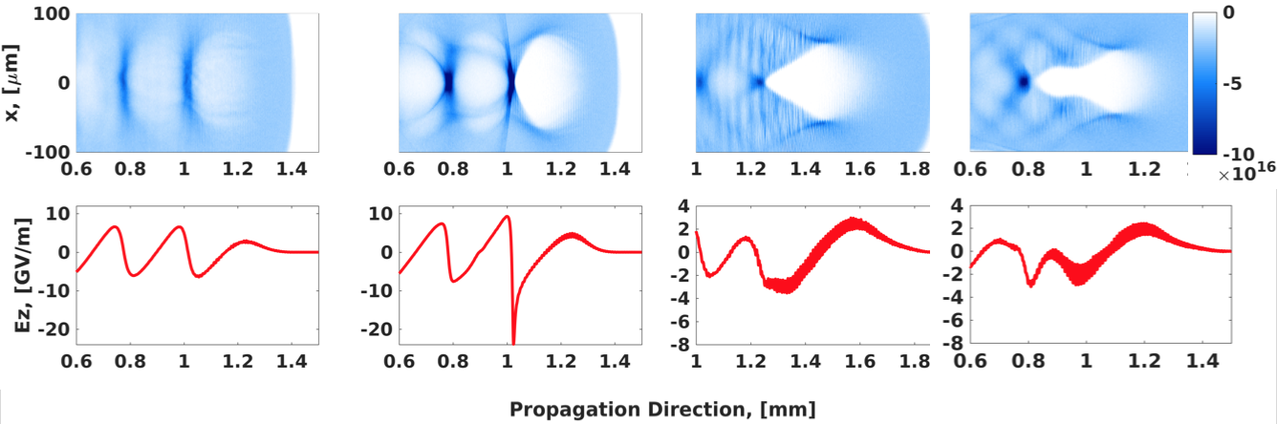


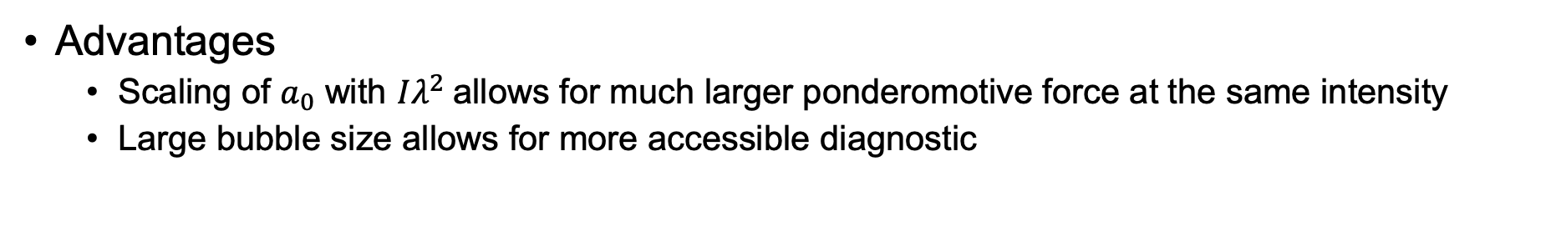



Electron Acceleration (LWFA)
Advantages
  Scaling of $a_{0}$ with $Iλ^{2}$allows for much larger ponderomotive force at the same intensity
  Large bubble size allows for more accessible diagnostic
Matched: 20 TW, 0.5 ps, $a_{0}$ =2.4
20 TW, 0.5 ps, $a_{0}$ =3.8
20 TW, 1 ps, $a_{0}$ =3.8
20 TW, 1 ps, $a_{0}$ =3.8
$n_{e}∼2×{10}^{16}cm^{−3}$ in all cases

Slide 10
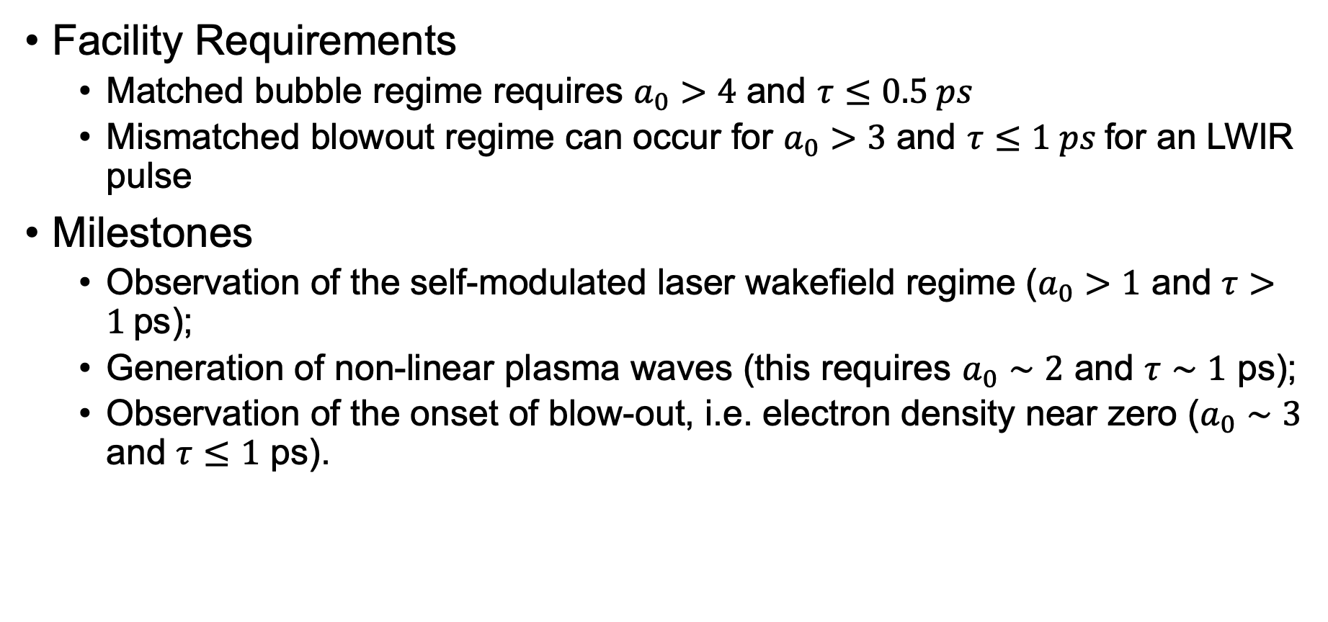
Electron Acceleration (LWFA)
Facility Requirements
  Matched bubble regime requires $a_{0}>4$ and $τ≤0.5 ps$
  Mismatched blowout regime can occur for $a_{0}>3$ and $τ≤1 ps$for an LWIR pulse
Milestones
  Observation of the self-modulated laser wakefield regime ($a_{0}>1$ and $τ>1$ps);
  Generation of non-linear plasma waves (this requires $a_{0}∼2$ and $τ∼1$ ps);
  Observation of the onset of blow-out, i.e. electron density near zero ($a_{0}∼3$ and $τ≤1$ ps).

Slide 11
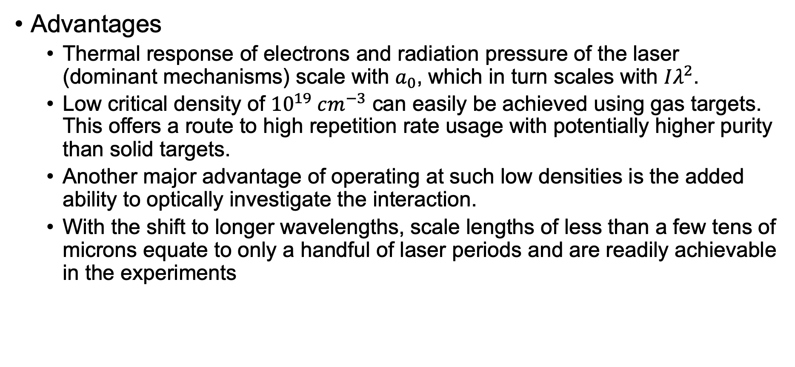
Ion Acceleration
Advantages
  Thermal response of electrons and radiation pressure of the laser (dominant mechanisms) scale with $a_{0}$, which in turn scales with $Iλ^{2}$.
  Low critical density of ${10}^{19} cm^{−3}$ can easily be achieved using gas targets. This offers a route to high repetition rate usage with potentially higher purity than solid targets.
  Another major advantage of operating at such low densities is the added ability to optically investigate the interaction.
  With the shift to longer wavelengths, scale lengths of less than a few tens of microns equate to only a handful of laser periods and are readily achievable in the experiments
Notes:
100x higher 𝑎_0 can be reach at LWIR regime than the same intensity at 1 𝜇𝑚.

Slide 12


Ion Acceleration
Milestones and Facility Requirements
  Currently a few MeV proton beams, often with monoenergetic features down to few % energy spread, for $a_{0}$ up to ∼ 1.8
  The recently upgraded CO₂ laser now provides peak powers around 10 times higher than previously ($a_{0}$ up to ∼ 10) and should provide protons up to around 10 MeV.
  With higher intensities available in the future ($a_{0}$of ∼ 13 – 18), monoenergetic ion beams with peak energies greater than 30 MeV should be realized

Slide 13
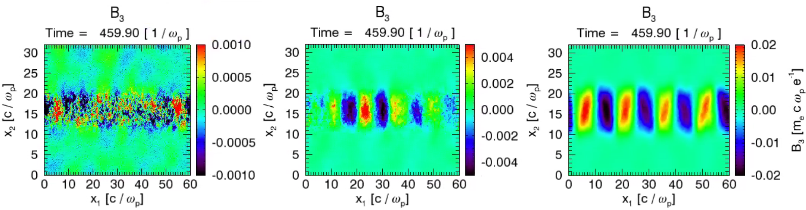
Novel Plasma Physics – Weibel Instability
Weibel instability is a kinetic instability that grows in plasmas with anisotropic velocity distributions or temperatures.
The goal is to do the first measurements of the growth rate and k-spectrum evolution of electron Weibel magnetic fields

Slide 14
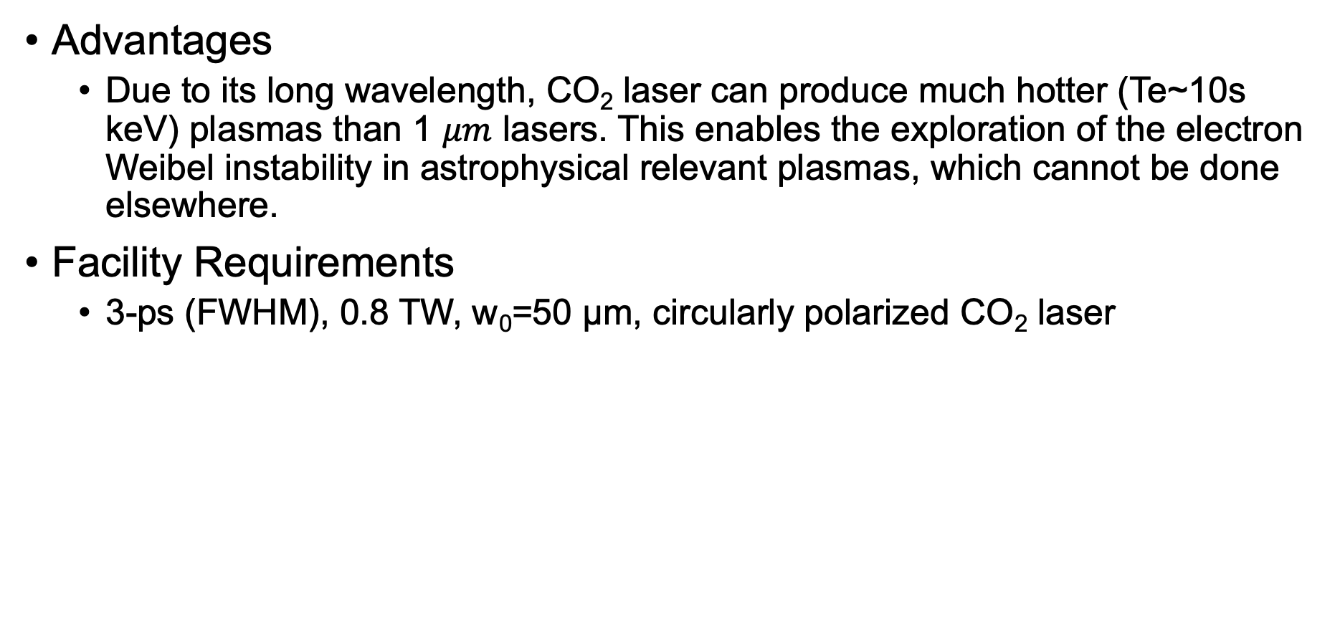
Novel Plasma Physics – Weibel Instability
Advantages
  Due to its long wavelength, CO₂ laser can produce much hotter (Te~10s keV) plasmas than 1 $μm$ lasers. This enables the exploration of the electron Weibel instability in astrophysical relevant plasmas, which cannot be done elsewhere.
Facility Requirements
  3-ps (FWHM), 0.8 TW, w₀=50 µm, circularly polarized CO₂ laser

Slide 15
Novel Plasma Physics – Backwards Raman Amplification (BRA) of Short Pulses
The apparatus of BRA consists of a low-energy, femtosecond seed pulse and a high-energy, long-duration, counter-propagating pump pulse in the plasma
BRA may be able to produce high-power, ultrashort LWIR pulses by overcoming the limitation of the CO₂ laser gain bandwidth, which cannot be achieved by any other known methods.
Facility Requirement: A microjoule, femtosecond LWIR seed pulse and a 3 J, 3 ps CO₂ pump pulse

Slide 16
Development of Field Emission Cathodes
Laser beam is directed across the tip of the cathode rather than illuminating the cathode
The laser field, i.e., polarization, is oriented along the same direction as the DC field applied across the anode-cathode (A-K) gap.
Quasi-monoenergetic e-beams are possible by controlling the A-K gap spacing such that the transit time of the electrons crossing the gap equals a multiple number of laser periods.
This particular scheme is also conducive to using non-traditional cathode materials, in particular, carbon nanotubes (CNTs).
CNTs can have very high enhancement factors (e.g., β = 2,500-10,000), which means high emission is possible at relatively low applied DC and AC fields, where the latter is provided by the laser beam.

Slide 17
Science Thrusts
Long-Wave InfraRed (LWIR) Driven Science
E-beam Driven Science
Combined Laser and Electron Beam
Methods, Diagnostics, and Tools

Slide 18
E-beam Driven Science
Dielectric wakefield acceleration
Structure-based beam driven acceleration
Diamond electron amplifiers

Slide 19
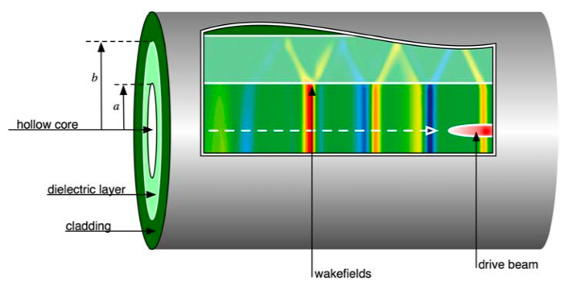
Dielectric Wakefield Acceleration
A relativistic drive beam traverses a dielectric-lined waveguide establishing a wakefield which is then sampled by a witness beam.

Slide 20
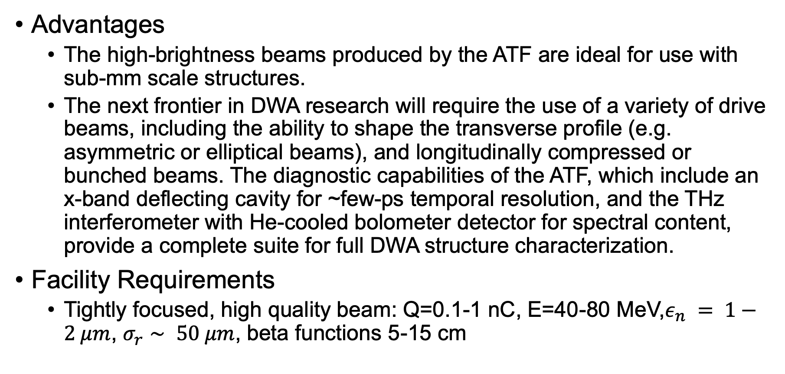
Dielectric Wakefield Acceleration
Advantages
  The high-brightness beams produced by the ATF are ideal for use with sub-mm scale structures.
  The next frontier in DWA research will require the use of a variety of drive beams, including the ability to shape the transverse profile (e.g. asymmetric or elliptical beams), and longitudinally compressed or bunched beams. The diagnostic capabilities of the ATF, which include an x-band deflecting cavity for ~few-ps temporal resolution, and the THz interferometer with He-cooled bolometer detector for spectral content, provide a complete suite for full DWA structure characterization.
Facility Requirements
  Tightly focused, high quality beam: Q=0.1-1 nC, E=40-80 MeV,$ε_{n} = 1−2 μm$, $σ_{r}∼ 50 μm$, beta functions 5-15 cm

Slide 21
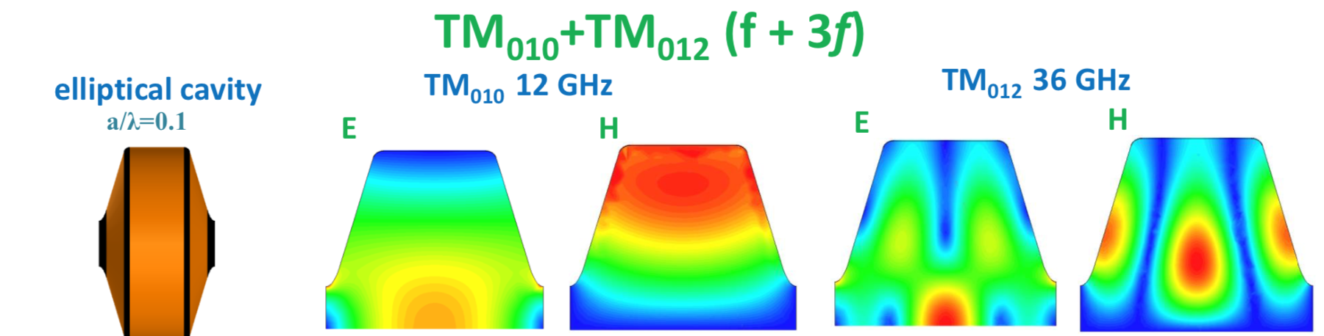
Structure-based Beam Driven Acceleration
A multi-harmonic cavity (MHC) can support the fundamental mode TM010 as well as the higher mode, e.g. the TM012 mode with the eigen-frequency equal to the harmonic (e.g. the third one) of the fundamental mode. Both are the acceleration modes
The time varying nature of RF fields with multiple-frequency mode superposition introduces a possibility to suppress RF breakdown

Slide 22
Structure-based Beam Driven Acceleration
Advantages
  Realization of two beam acceleration (TBA) structure with low breakdown probability
  Allowing a reliable acceleration gradient in an X- band structure to reach 200 MV/m
  Expected transformer ratio (for an inductively detuned structure) larger than 10, resulting in the high beam-to-beam efficiency of energy transfer.
Facility Requirements
  Ideal experiment: A detuned version that supports modes at 11.4 and 34.2 GHz is excited by a train of bunches spaced at 2.856GHz requires high bunch charge of at least 16nC.
  Proof-of-principle prototype without detuning can operate at drive bunch charges below 1nC. Yet, to reach steady-state, the number of drive (relativistic) bunches should be in excess of 350.

Slide 23
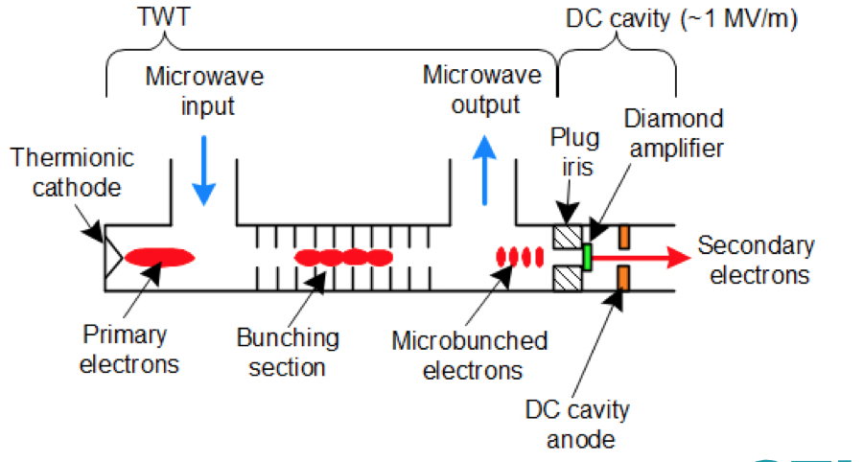
Diamond Electron Amplifiers
The DEA essentially converts a low-quality e-beam from a conventional cathode into a high-quality e-beam with higher charge.
The primary electrons impinge upon a diamond wafer, generating >200 secondary electrons for every primary one.
These secondary electrons emerge from the backside of the diamond wafer with low emittance and low energy spread.
STI Optronics, Inc. (STI) together with BNL recently won a Phase I STTR award to develop the DEA into a practical electron source.

Slide 24
Science Thrusts
Long-Wave InfraRed (LWIR) Driven Science
E-beam Driven Science
Combined Laser and Electron Beam
Methods, Diagnostics, and Tools

Slide 25
Combined Laser and Electron Beam
LWFA injector
Dielectric laser acceleration
Positron generation and acceleration
Radiation Generation in LWFA
Inverse Compton scattering
e-beam as diagnostic
  Field structures in laser plasma interactions

Slide 26
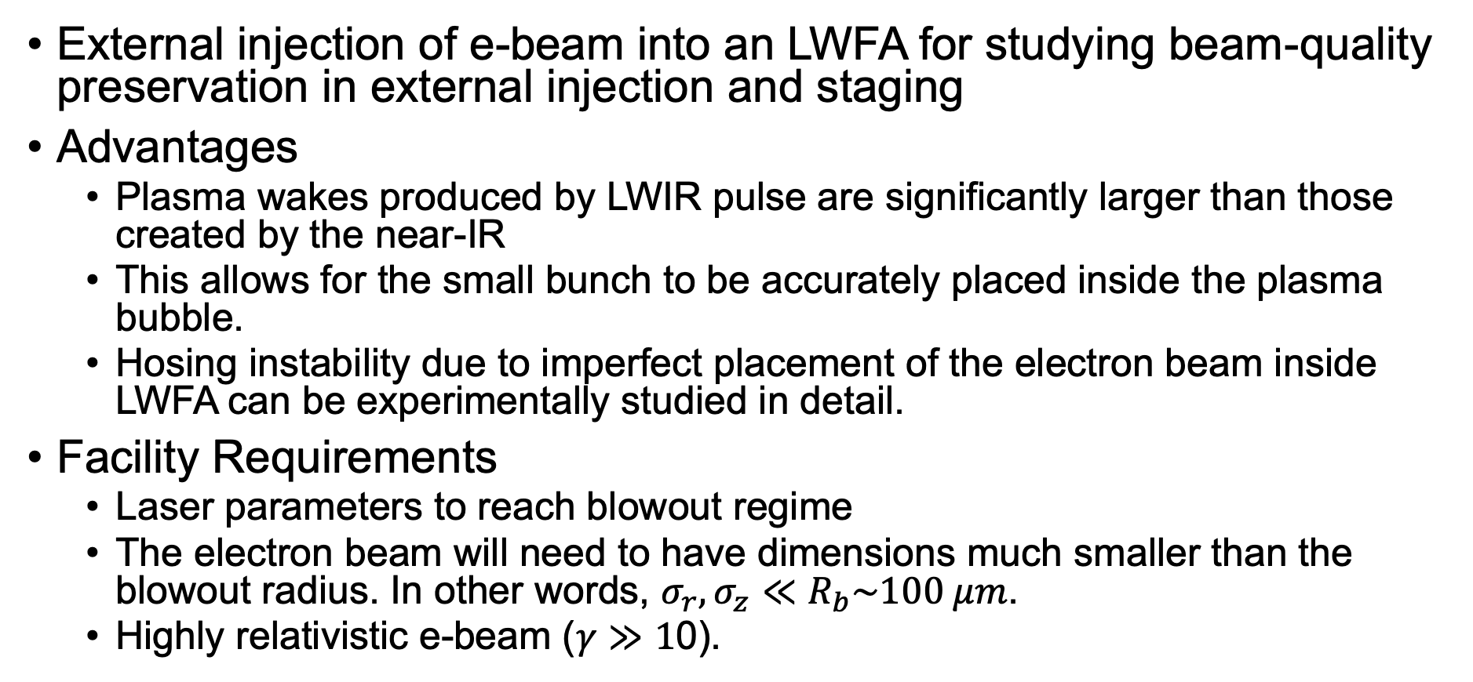
LWFA Injector
External injection of e-beam into an LWFA for studying beam-quality preservation in external injection and staging
Advantages
  Plasma wakes produced by LWIR pulse are significantly larger than those created by the near-IR
  This allows for the small bunch to be accurately placed inside the plasma bubble.
  Hosing instability due to imperfect placement of the electron beam inside LWFA can be experimentally studied in detail.
Facility Requirements
  Laser parameters to reach blowout regime
  The electron beam will need to have dimensions much smaller than the blowout radius. In other words, $σ_{r},σ_{z}≪R_{b}\sim 100 μm$.
  Highly relativistic e-beam ($γ≫1$0).

Slide 27
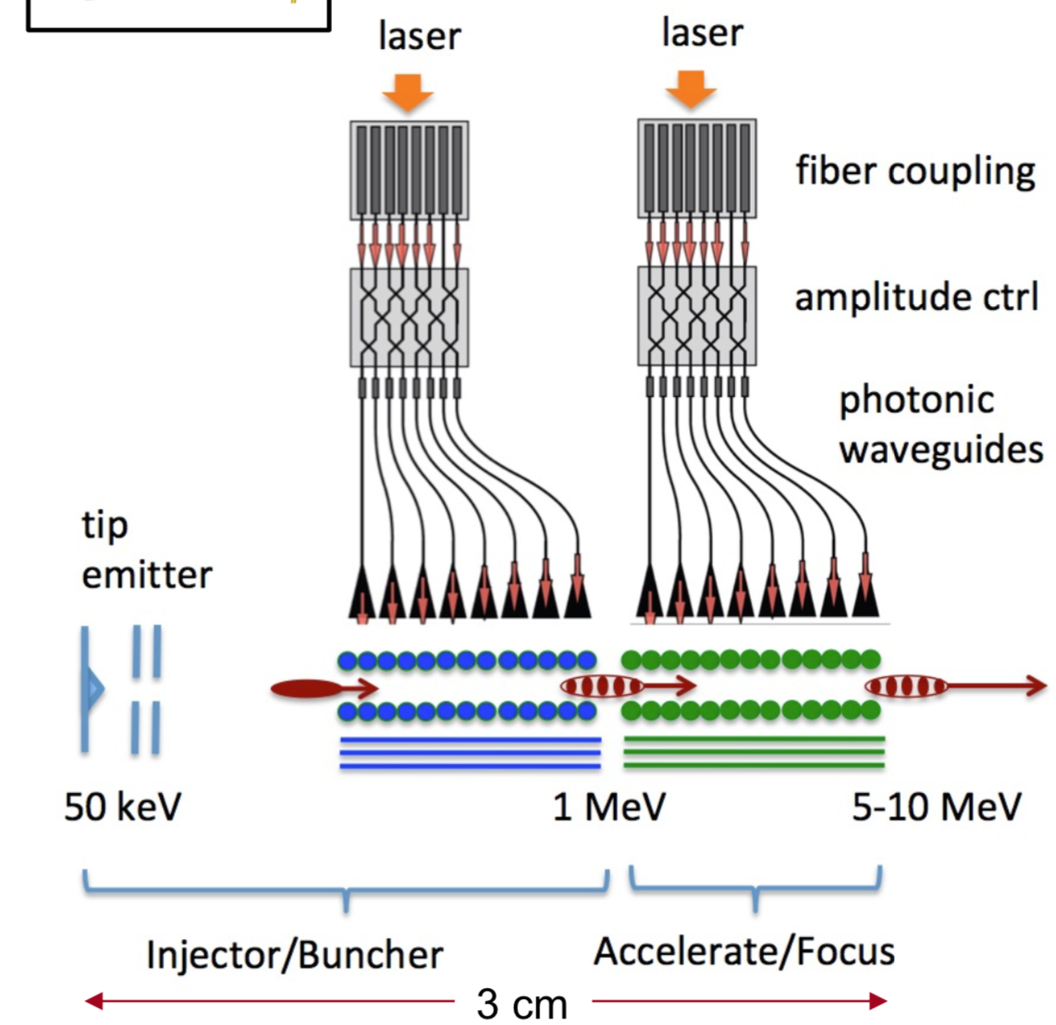
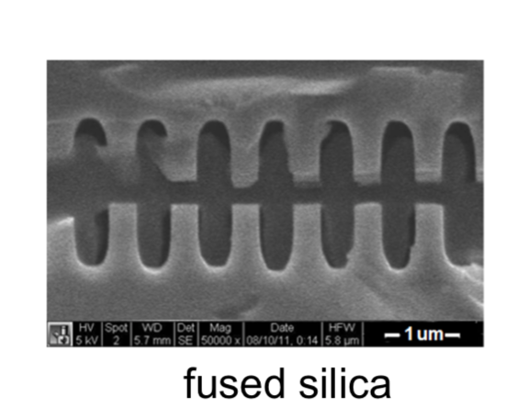
Dielectric Laser Acceleration
Parameter | Demonstration | Ideal
Bunch Charge | 1 pC | 1-5 fC
Beam Energy | 50 MeV | -
Emittance (norm) | 20 nm | 1-5 nm
RMS Spot Size | 5 µm | 10 to 100 nm
Laser Wavelength | 10 µm | 1 to 2 µm
Laser Pulse Length | 2 ps | 0.1 to 1 ps
Laser Pulse Energy | 20 mJ | 1 to 10 µJ
Rep Rate | 10 Hz | 10-100 MHz

Slide 28
Dielectric Laser Acceleration
Compact accelerator based on micron scale photonic structures driven with laser light
Advantages
  The aperture of the accelerating channel is on the order of the driving wavelength
  Small apertures needed for near-IR pose challenges for particle transport, limiting the electron charge to a few fC per bunch, and requiring the development of compatible nano-emission sources of extremely low emittance and exceptional brightness.
  ATF LWIR allows for a factor of 100 higher charge throughput, reduced requirements on external focusing, and factor of 10 relaxation in tolerances on structure fabrication and co-alignment of successive structures.
  optically microbunched beams and laser recirculation, used e.g. in inverse free electron laser (IFEL) experiments at ATF, enables phase-synchronous net acceleration of pre-bunched beams and high repetition rate operation.
  These capabilities would facilitate key demonstrations to study beam dynamics, wakefield effects, and acceleration over centimeter-scale distances with multi-MeV energy gains.

Slide 29
Positron Generation and Acceleration
Interaction between the micron-scale low-emittance sub-picosecond electron beams at BNL-ATF with a high-Z target produces a positron-electron shower primarily via high-energy bremsstrahlung radiation.
The specific post-processing step at ATF is to use a CO₂ laser-driven plasma wave matched to the shower, with inherently Maxwellian energy spectra, for trapping, acceleration or deceleration of a positron beam with peaked energy spectrum
Advantages
  The level of control that is offered by the facilities at BNL-ATF uniquely allows for tunable positron bunches while optimizing for the trapped positron number:
    Shot-to-shot stability of the RF linac e-beam
    Large size of the 10-micron wavelength CO₂ laser-driven wakefield acceleration structures in plasma enables efficient trapping and manipulation of the properties of shower positrons to produce positron beams.
Facility Requirements
  e- beam: >60 MeV, energy spread <1%, waist-size σ_{r}<50 µm, charge >250 pC, emittance ε_{n}<10 µm, bunch length σ_{z}/c <0.2 ps
  CO₂ laser: peak power P~0.5-5 TW, pulse duration τ~2 ps, spot size w₀~50-100 µm
  Synchronization: CO₂ laser and e- beam within 100 fs

Slide 30
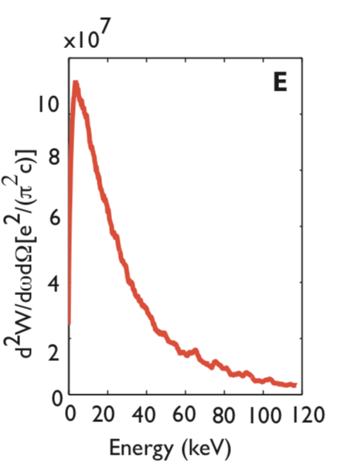
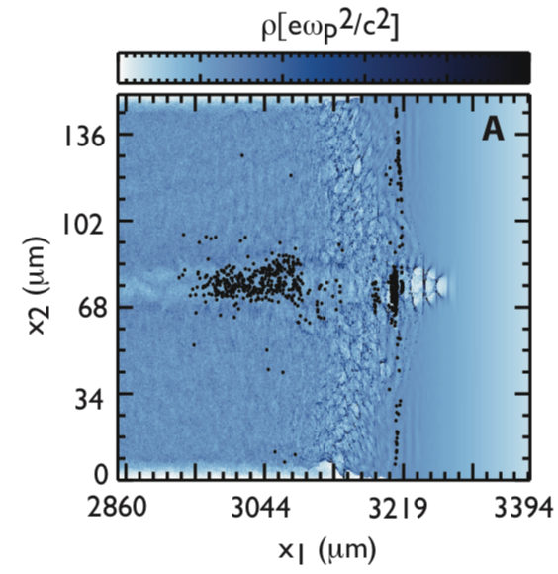
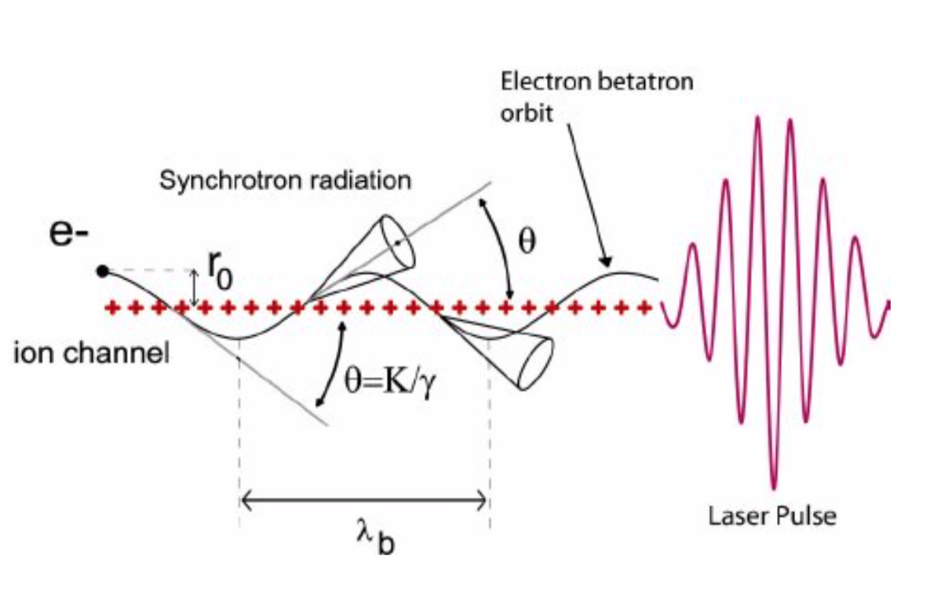
Radiation generation in LWFA
Blowout regime: off-axis injection of linac electron beam
Self-modulated regime: injected or trapped electrons in the channel region
Phuoc, et al. Physics of Plasmas, 12, 023101 (2005)
Albert, et al. Phys. Rev. Lett. 118, 134801 (2017)

Slide 31
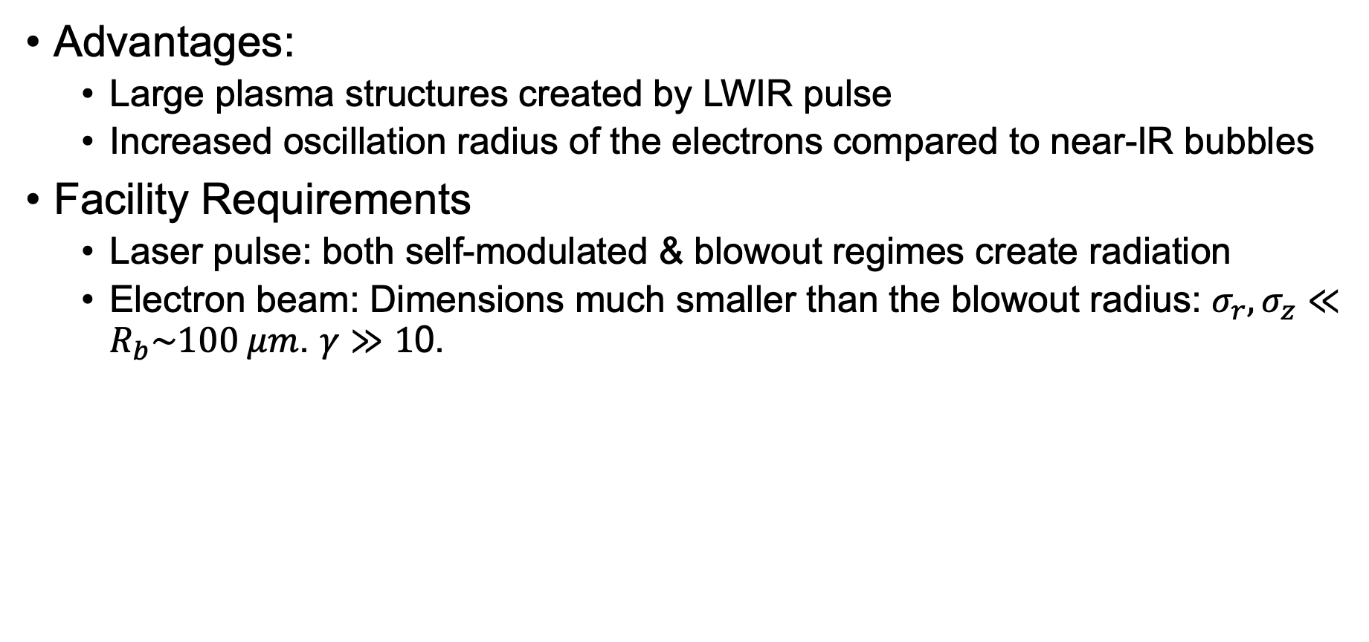
Radiation generation in LWFA
Advantages:
  Large plasma structures created by LWIR pulse
  Increased oscillation radius of the electrons compared to near-IR bubbles
Facility Requirements
  Laser pulse: both self-modulated & blowout regimes create radiation
  Electron beam: Dimensions much smaller than the blowout radius: $σ_{r},σ_{z}≪R_{b}\sim 100 μm$. $γ≫1$0.

Slide 32
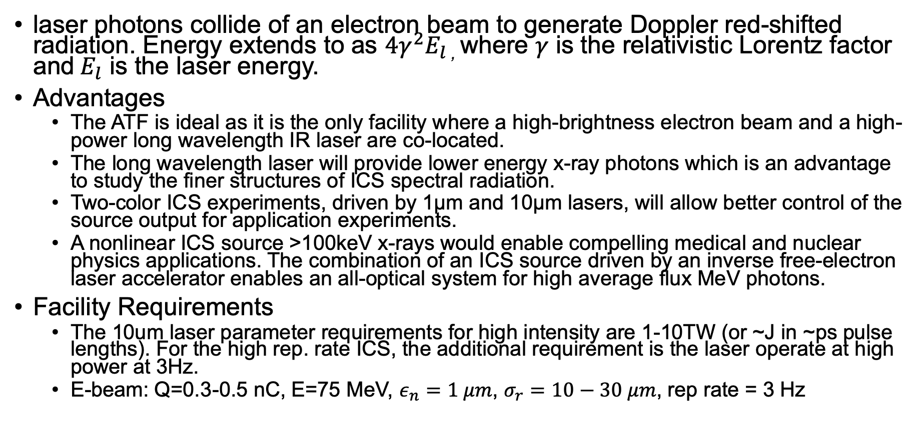
Inverse Compton Scattering
laser photons collide of an electron beam to generate Doppler red-shifted radiation. Energy extends to as $4γ^{2}E_{l}$, where $γ$ is the relativistic Lorentz factor and$E_{l}$ is the laser energy.
Advantages
  The ATF is ideal as it is the only facility where a high-brightness electron beam and a high-power long wavelength IR laser are co-located.
  The long wavelength laser will provide lower energy x-ray photons which is an advantage to study the finer structures of ICS spectral radiation.
  Two-color ICS experiments, driven by 1µm and 10µm lasers, will allow better control of the source output for application experiments.
  A nonlinear ICS source >100keV x-rays would enable compelling medical and nuclear physics applications. The combination of an ICS source driven by an inverse free-electron laser accelerator enables an all-optical system for high average flux MeV photons.
Facility Requirements
  The 10um laser parameter requirements for high intensity are 1-10TW (or ~J in ~ps pulse lengths). For the high rep. rate ICS, the additional requirement is the laser operate at high power at 3Hz.
  E-beam: Q=0.3-0.5 nC, E=75 MeV, $ε_{n}=1 μm$, $σ_{r}=10−30 μm$, rep rate = 3 Hz

Slide 33
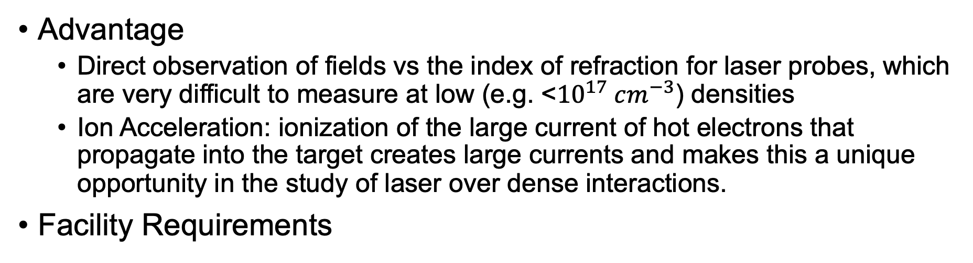
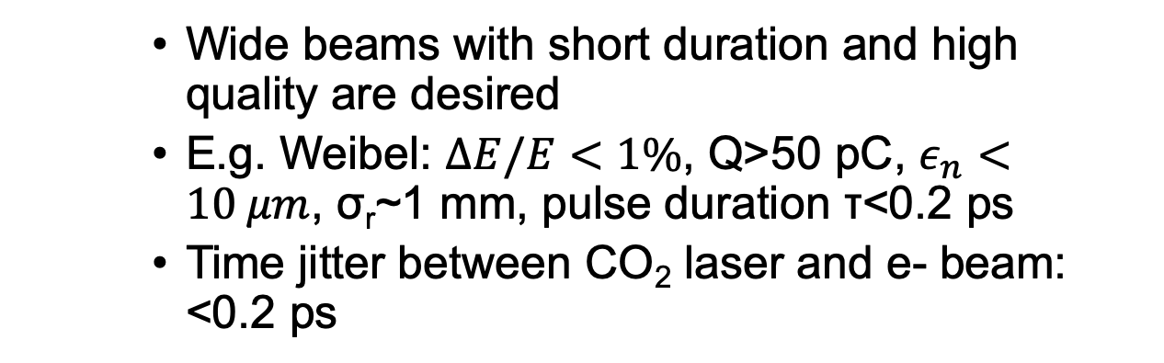
E-beam as Diagnostic
Advantage
  Direct observation of fields vs the index of refraction for laser probes, which are very difficult to measure at low (e.g. <${10}^{17} cm^{−3}$) densities
  Ion Acceleration: ionization of the large current of hot electrons that propagate into the target creates large currents and makes this a unique opportunity in the study of laser over dense interactions.
Facility Requirements
    Wide beams with short duration and high quality are desired
    E.g. Weibel: $ΔE/E<1\%$, Q>50 pC, $ε_{n}<10 μm$, σ_{r}~1 mm, pulse duration τ<0.2 ps
    Time jitter between CO₂ laser and e- beam: <0.2 ps

Slide 34
Science Thrusts
Long-Wave InfraRed (LWIR) Driven Science
E-beam Driven Science
Combined Laser and Electron Beam
Methods, Diagnostics, and Tools

Slide 35
Methods, Diagnostics, and Tools
Laser and electron beam Diagnostics
High rep-rate capabilities
Technical methods
  Plasma lens
  Optically pumped CO₂ amplifiers
  Laser microfabrication
Simulation tools

Slide 36
Diagnostics – Electron Beam
Measuring sub-1% energy spread of GeV e-beams
  Full e-trajectory recovery within the spectrometer’s energy-dispersion plane using e.g. multiple screen detection or fiducial grids
  E-beam polarimeters based on Møller e-e scattering from polarized ferromagnetic targets (standard on conventional accelerators) will have to be adapted for the first time to the unique challenges of LWFA beams.
Verification of low-emittance for e-bunches
  Coherent transition radiation (CTR) methods including multi-octave spectroscopy, imaging, and interferometry
  Computational advances in reconstructing e-bunch profiles from CTR data are also needed.

Slide 37
Diagnostics – Plasma
Ultrafast electron radiography to profiles internal electric fields of wakes using transverse fs e-bunches (particularly important at densities be low 10¹⁷ cm⁻³)
Optical techniques: ultrafast holography and shadowgraphy. The challenge lies in scaling such techniques, originally demonstrated in n_{e} ~ 10¹⁹ cm⁻³ plasma, to n_{e} ~ 10¹⁶ cm⁻³.
Ultrafast Faraday rotation: magnetic fields within wakes

Slide 38
High Rep Rate Capabilities
Precision control needed for next generation progress requires high repetition rate sources. This control is required for
  Precision guiding and injection: Tuning and preparation requires thousands of shots!
  Precision control for overlap between two beams
  Near field mode: control for Gaussian or shaped pulse matched guiding
  Laser pointing: kHz front end pilot beam
  Intensity control: feedback
  Multi-parameter optimization: Collecting data with statistical significance

Slide 39
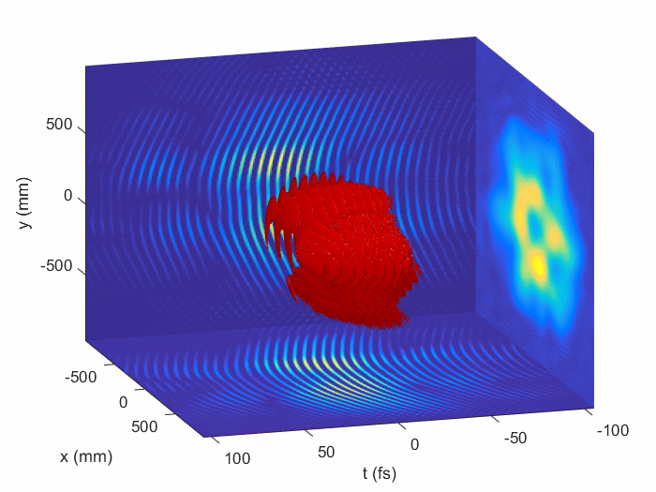
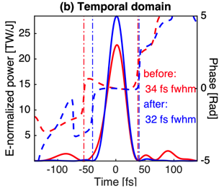
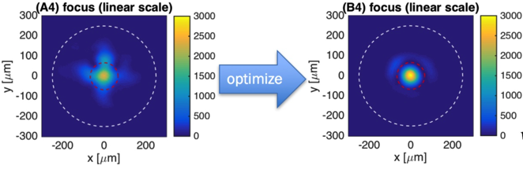
High Rep Rate Capabilities
Pulse front tilt
Nakamura et al.,IEEE JQE (2017)
Improved Deformable Mirror Loop

Slide 40
High Rep-rate Capabilities
Adaptive control and machine learning for tuning the behavior of the system for desired outcome is the other benefit of high rep rate. Examples include
  Adaptive control of LWFA with DAZZLER & Deformable Mirrors via Genetic Algorithm
  Implement Convolutional Neural Network Architecture
  Optimization: quicker than grid search and capable of more dimensions
  Active feedback: can adjust for unseen drift in laser parameters
  Analysis: once you have the data, you can always use it to train predictive models
High rep rate prepares us for an eventuality of precision control being outsourced to neural-networked computers

Slide 41
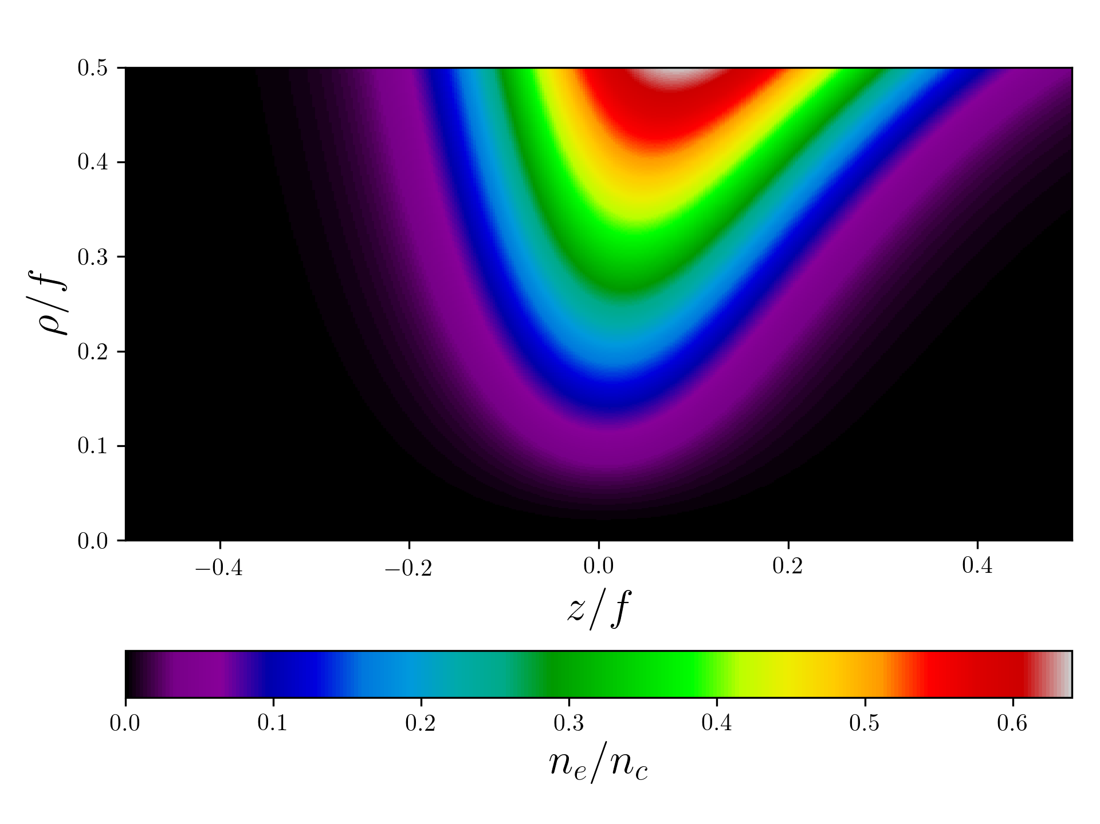
Plasma Lens
Plasma optics: use of the plasma medium for manipulating the state of a laser pulse, particularly for focusing, guiding, and compression.
The goal is to implement plasma sources where a conventional optic would be too costly or impractical
Density structure of F/1 ideal lens
Ray tracing through ideal plasma lens

Slide 42
Plasma Lens
Advantages
  The density of a strongly focusing plasma lens has to be a substantial fraction of the critical density. This is easier to achieve in the long wavelength regime.
  The use of short pulse is important because it allows one to test the limitations imposed by plasma dispersion.
The parameter regime where a plasma lens is useful is constrained by dispersive and nonlinear effects. Minimizing dispersion generally requires narrowing the bandwidth of the laser pulse, which means using longer transform-limited pulses. This is natural for CO₂ lasers, since one generally deals with a relatively narrow bandwidth comparable to that achieved in the near infrared

Slide 43
Optically Pumped CO₂ Amplifiers
CO₂ lasers operating at 10 µm are currently the most viable candidates for reaching very high relativistic intensity (>10¹⁶ W/cm²) and high energy pulses in the long wavelength portion of the IR spectrum because of their ability to store a great deal of energy within the active medium.
O
C
O
Room-temperature cross-sections of emission of
(i) Cr:ZnS, ii) Cr:ZnSe ; iii) Fe:ZnS, iv) Fe:ZnSe, v) Fe:Cd_{0.75}Mn_{0.25}Se, vi) Fe:CdTe, vii) Fe:Zn_{0.5}Cd_{0.5}Te, and viii) Fe:Cd_{0.5}Mn_{0.5}Te
10 μm
00⁰1
9 μm
4.3 μm pumping
10⁰0
02⁰0
00⁰0

Slide 44
Optically Pumped CO₂ Amplifiers
Advantages:
  ATF is a test-bed for advanced CO₂ laser concepts that ultimately lead to an improvement in efficiency, repetition rate, and size of TW-class CO₂ lasers.
  Switching from the traditional electrical discharge pumping to an optical pumping of a high-pressure centimeter-scale CO₂ cell could drastically decrease the size of such a system and the pulse length by 10X, simultaneously increasing the repetition rate to 10-100 Hz.
  To this end, the upper laser level in the 10 micron lasing channel 001-100 of a CO₂ molecule is pumped directly from the ground state (by a novel 4.3-4.8 µm Fe:ZnSe laser)
  The main advantage of this approach in comparison with OPAs is that the energy of a ~100 ns long pump pulse can be effectively channeled into almost million times shorter pulse amplified in the inverted CO₂ medium.

Slide 45
Optically Pumped CO₂ Amplifiers
Scaling the peak power up to ~1TW for 300 fs pulses will require:
Better understanding of physics behind CO₂ excitation by energetic 4.3 um pulses including self-focusing of the pump, optimization of upper laser level lifetime at high-pressures and relaxation processes in vibrationally excited CO₂.
Detailed studies of gain tailoring in a mix of CO₂ isotopes to create a multi-THz banwidth at high pressures.
Development of energetic (≤1 J) ~100 ns pulse duration 4.3 um Fe:ZnSe pump sources

Slide 46
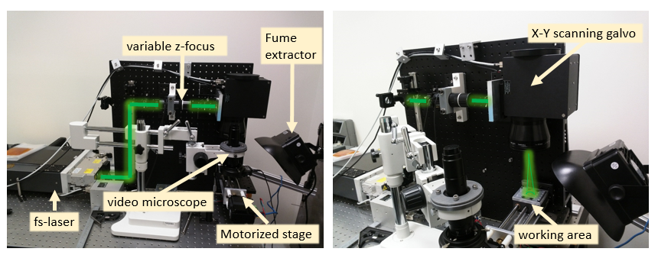
Laser Microfabrication
Availability of extremely short pulse, femtosecond lasers now makes possible the process of ablation without melting.
Surfaces processed in this manner exhibit less structural damage and are expected to have a very high optical damage threshold.
Laser microfabrication can be potentially used for fast prototyping and development of compression gratings, large area dispersive mirrors and power samplers.

Slide 47
Laser Microfabrication
Currently an area of 2x2 in² can be covered with laser beam rastering using precision translation stages
Laser microfabrication allows feature control on the scale from 1 micron to sub-mm. i.e. suitable for fabrication of components for handling THz wavelengths all the way to 10um
Sharp corners produced by a traditional diamond knife-based technology are avoided which should make such gratings more resilient to electric breakdown.
Such ATF-CO₂ centric development is extremely valuable for community, because availability of high power components in turn will drive the development of high power industrial CO₂ lasers

Slide 48
Simulation Tools
One of the principal methods used for simulating ATF experiments is particle-in-cell (PIC). The PIC algorithm models fields and charged particles self consistently
Fields are represented on a grid and particles in continuous space, with fields interpolated to particle positions for the computation of the Lorentz force and charge and current deposition.
Several codes were discussed, each with its own unique capabilities
WarpX (LBNL) is a general PIC code developed under the Exascale Computing Project, and includes a host of features including adaptive mesh refinement, ionization, and support for advanced architectures. Notably for ATF, WarpX has features specifically developed to aid boosted frame simulations of laser-plasma acceleration, namely a pseudo-spectral solver to prevent the numerical Čerenkov instability.
FBPIC (LBNL) is a quasi-3D r-z code, modeling 3D fields as an expansion of cylindrical modes around a propagation axis. As such, it is specialized for laser-plasma simulation, with a spectral solver, ionization, and GPU support.

Slide 49
Simulation Tools
OSIRIS (UCLA and IST): General PIC code with new features for interaction of charged particles with extremely intense fields. These include classical radiation reaction and quantum processes such as pair production.
Vsim (TechX) provides many multiphysics features, including an advanced dielectric algorithm, an electromagnetic eigenmode solver, and secondary electron emission from material surfaces.
FLASH (RadiaSoft): a magnetohydrodynamics code for modeling the evolution of plasmas in plasma lenses and gas jets and discharge capillaries for laser-plasma acceleration. These, other simulation codes, and accelerator control tools are available through RadiaSoft’s Sirepo cloud-based interface.

Slide 50
Simulation Tools
LW3D: a parallel code for computing the Lienard-Wiechert fields from the history of particle trajectories. LW3D can be used, for instance, to model undulator radiation or betatron radiation from LPA-accelerated particles used as a diagnostic.
Commercial codes (e.g. Vsim), provide many ease-of-use features so that researchers who are not simulation experts can get started quickly. These include a graphical user interface, complete online documentation, and dozens of user examples. In this context, experimentalists at the meeting expressed interest in having ATF initial conditions, such as laser pulse profiles and electron phase space distributions, available with the simulation tools.

Slide 51
Discussion and Summary
ATF is a unique facility with activities that span cutting edge laser science and technology, particle acceleration, and advanced diagnostic
As a user facility, ATF is the only place that provides access to a number of multi-beam experiments that can only be performed here
LWIR is a unique source that once developed to a particular maturity, will enable new research avenues.
ATF possesses a unique driver for advanced acceleration research of positive and negative charged particles. This is important for ATF facility’s mission of advancing accelerator technology forefront

Slide 52
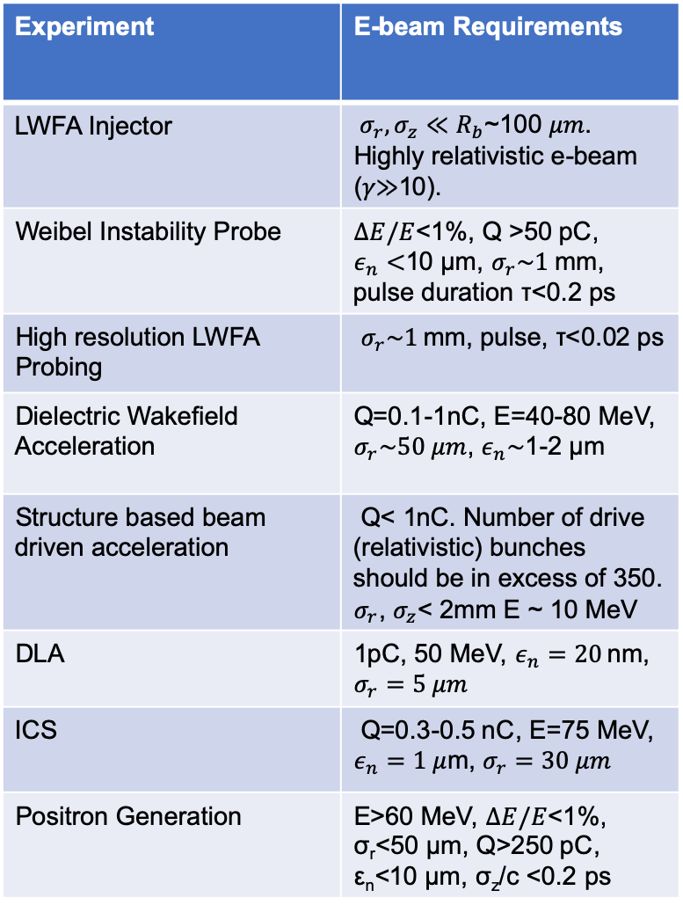
Parameters Desired by Users
Experiment | Laser Requirement
Non-linear LPA | ~2 TW
Blow-out LPA | 10 TW, 1 psec
Bubble LPA | 25-30 TW, 0.5 psec
Ion acceleration (>20 MeV) | >10 TW, long-term circ. polar.
Weibel Instability | 0.8 TW, 3 ps
Backwards Raman Amplification | 1 TW, 3 ps
Plasma channel radiation source | 2TW, 2 ps
DLA | 10-100 GW, 0.1-2 ps, lin. polar.
ICS | 2-10 TW
ICS OAM | Circ. polar.
Positron Generation | 0.5-5 TW, 2 ps
Phase space manipulation | ~ TW
Nonlinear Kerr | 1-10 TW
IFEL | 25-100 TW
Experiment | E-beam Requirements
LWFA Injector | $σ_{r},σ_{z}≪R_{b}$~100 𝜇𝑚. Highly relativistic e-beam (𝛾≫10).
Weibel Instability Probe | $ΔE/E$<1%, Q >50 pC, $ε_{n}<$10 µm, $σ_{r}\sim 1$mm, pulse duration τ<0.2 ps
High resolution LWFA Probing | $σ_{r}\sim 1$mm, pulse, τ<0.02 ps
Dielectric Wakefield Acceleration | Q=0.1-1nC, E=40-80 MeV, $σ_{r}\sim 50 μm$, $ε_{n}\sim$1-2 µm
Structure based beam driven acceleration | Q< 1nC. Number of drive (relativistic) bunches should be in excess of 350. $σ_{r}$, $σ_{z}$< 2mm E ~ 10 MeV
DLA | 1pC, 50 MeV, $ε_{n}=20$nm, $σ_{r}=5 μm$
ICS | Q=0.3-0.5 nC, E=75 MeV, $ε_{n}=1 μ$m, $σ_{r}=30 μm$
Positron Generation | E>60 MeV, $ΔE/E$<1%, σ_{r}<50 µm, Q>250 pC, ε_{n}<10 µm, σ_{z}/c <0.2 ps

Slide 53
Upgrades to Meet User Needs
Legend for next slide
Current state is satisfactory
Strong Need
Some improvement or improvement in certain situations

Slide 54
Upgrades to Meet User Needs
Experiment/ capability | Double energy (same pulse length) | Reduce pulse length by half (same energy) | Increase repetition rate
Electron acceleration
Ion Acceleration
ICS
Novel Plasma Physics
DLA
Radiation Generation in LWFA
Positron generation
Legend
Current state is satisfactory
Strong Need
Some improvement or improvement in certain situations

Slide 55
The End

