Slide 1
ATF Plans
Mark Palmer

Slide 2
Outline
Introduction
Themes from the Science Planning Workshops
Next Steps
UED
Final Comments

Slide 3
Introduction

Slide 5
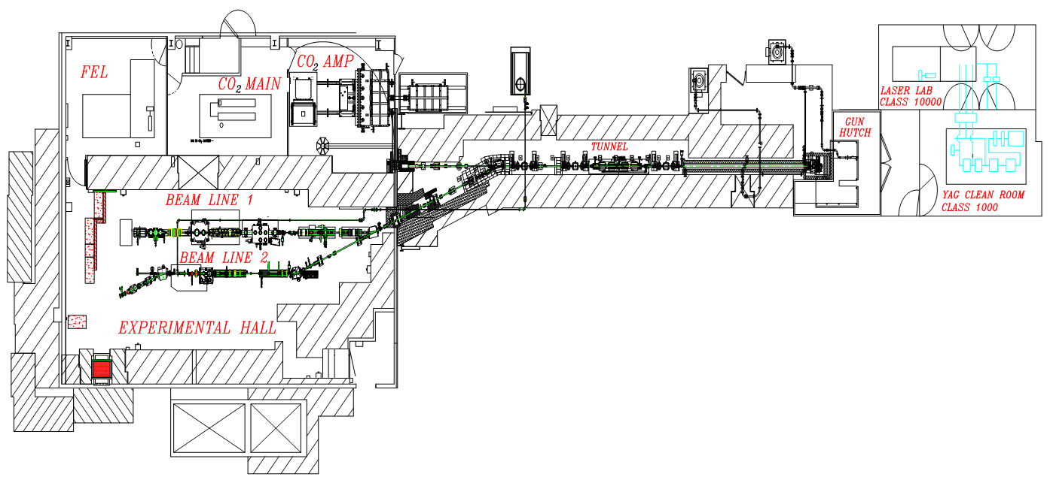
ATF Experimental Hall as Presently Configured
Beamline 1
Experimental stations
Accelerator sections
What are the prioritized
next steps?
Reconfigure this region for stronger bunch compression
Photocathode gun
Beamline 2
Experimental stations
Deflector
cavity

Slide 6
Planning Goals
Key Questions for the ATF Science Planning Effort:
What are the most critical Science Thrusts for the facility over the next 4-5 years?
  To meet the needs of the community
  To guide prioritization of ATF R&D and upgrade efforts
  a Provide an updated list of Priority Research Directions spanning
    Laser research
    Electron beam research
    Laser + e-beam research
What are the most critical Facility Development Thrusts to pursue over the next ~3 years?
  Key technologies to pursue (also those for longer-term needs)
  Supporting efforts to enable the science (e.g., simulation capabilities)
A key challenge will be the balance between Science Thrusts, Facility Development Thrusts and Available Funding

Slide 7
Themes from the Science Planning Workshops

Slide 8
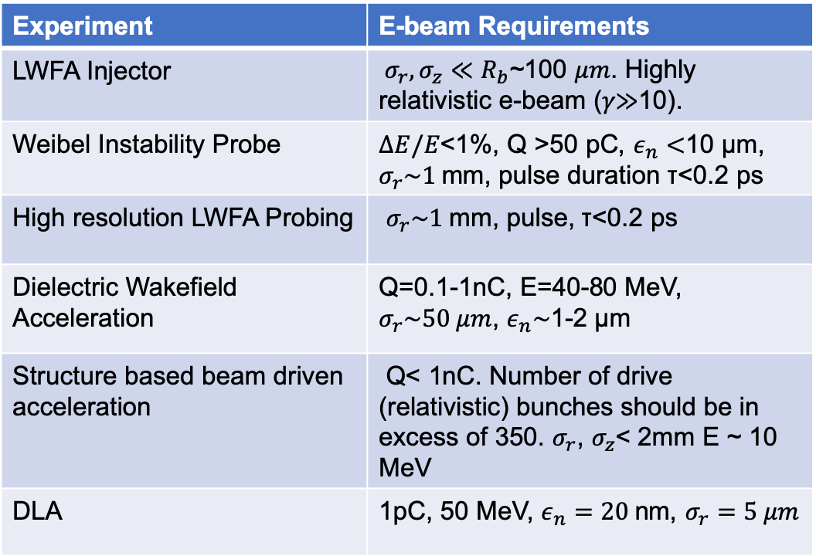
Laser Requirements
Electron Beam Requirements
Experiment | Laser Requirement
Non-linear LPA | ~2 TW
Blow-out LPA | 10 TW, 1 psec
Bubble LPA | 25-30 TW, 0.5 psec
Ion acceleration (>20 MeV) | >10 TW, long-term circ. polar.
Weibel Instability | 0.8 TW, 3 ps
Backwards Raman Amplification | 1 TW, 3 ps
Plasma channel radiation source | 2TW, 2 ps
DLA | 10-100 GW, 0.1-2 ps, lin. polar.
ICS | 2-10 TW
ICS OAM | Circ. polar.
Phase space manipulation | ~ TW
Nonlinear Kerr | 1-10 TW
IFEL | 25-100 TW
Experiment | E-beam Requirements
LWFA Injector | $σ_{r},σ_{z}≪R_{b}$~100 𝜇𝑚. Highly relativistic e-beam (𝛾≫10).
Weibel Instability Probe | $ΔE/E$<1%, Q >50 pC, $ε_{n}<$10 µm, $σ_{r}\sim 1$mm, pulse duration τ<0.2 ps
High resolution LWFA Probing | $σ_{r}\sim 1$mm, pulse, τ<0.2 ps
Dielectric Wakefield Acceleration | Q=0.1-1nC, E=40-80 MeV, $σ_{r}\sim 50 μm$, $ε_{n}\sim$1-2 µm
Structure based beam driven acceleration | Q< 1nC. Number of drive (relativistic) bunches should be in excess of 350. $σ_{r}$, $σ_{z}$< 2mm E ~ 10 MeV
DLA | 1pC, 50 MeV, $ε_{n}=20$nm, $σ_{r}=5 μm$

Slide 9
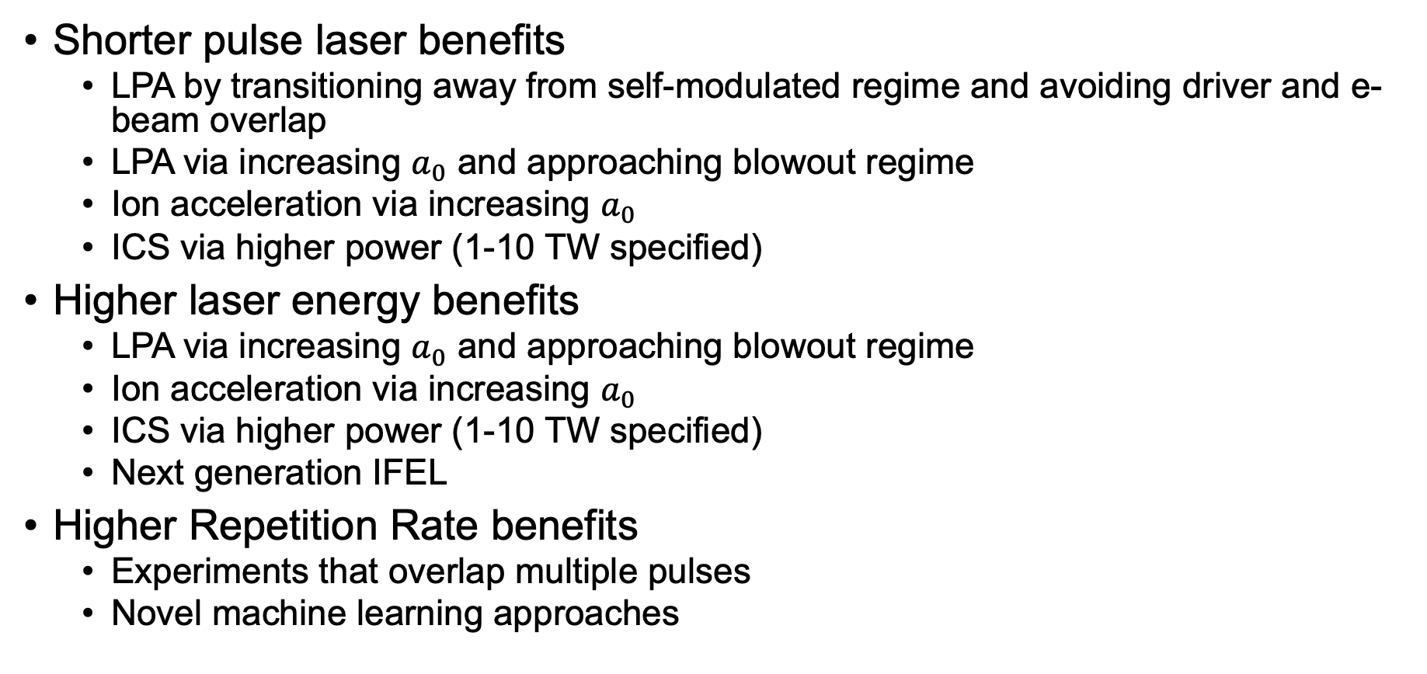
Some Specific Benefits
Shorter pulse laser benefits
  LPA by transitioning away from self-modulated regime and avoiding driver and e-beam overlap
  LPA via increasing $a_{0}$ and approaching blowout regime
  Ion acceleration via increasing $a_{0}$
  ICS via higher power (1-10 TW specified)
Higher laser energy benefits
  LPA via increasing $a_{0}$ and approaching blowout regime
  Ion acceleration via increasing $a_{0}$
  ICS via higher power (1-10 TW specified)
  Next generation IFEL
Higher Repetition Rate benefits
  Experiments that overlap multiple pulses
  Novel machine learning approaches

Slide 10
Next Steps
A proposed list of the near-term priorities

Slide 11
Priority 1
Effective delivery of available laser power to User IPs a Deploy an all in-vacuum system (both LWIR & NIR)
  Broad range of user interest in LWIR beams > or >> 10 TW
  Strong user interest in compressed near-IR beams alongside the LWIR
  R&D Program is ready to start delivering these beams
  Implementation will support the next several years of higher power R&D
  The science goals are compelling
R&D into further pulse compression and pulse energy improvement
  Funded compression R&D program
  Improvements for LWIR technology are compelling
Continued focus on diagnostics
  Major area for collaborative effort

Slide 12
Priority 2
Provide compressed electron beams and high-quality diagnostics (e.g. TCAV)
  Enable next-generation combined e-Beam + Laser operation
  Develop advanced diagnostic schemes given the multiple experimental laser and particle beams that are available
Characterize and prepare the full engineering design for the next-generation ATF synchronization system
  The next steps in operation with compressed bunches will drive this issue

Slide 13
Priority 3
Matching Laser and Electron Beam Repetition Rates
  Requires:
    A more closely integrated control system for electron beam + lasers
    Mature and robust synchronization systems
  Will enable a new regime of “steady state” user operation
    More consistent with “traditional” user facility operations
    Advanced controls
    New methodology – machine learning and automatic operation as opposed to an operator controlled model
  Will push the technology
    Stability
    Reliability
    Hardware Lifetimes
    Etc.

Slide 14
Funding & Manpower
Preliminary cost & labor estimates clearly indicate that we are unlikely to be able to execute Priorities 1-3 to their ultimate limits
  This should not be interpreted as not being able to achieve our critical goals
Nor do we want to interrupt the path of science and technology development to the degree required to carry those priorities out to their ultimate limits
We do want to set the stage for a potential transformation of the facility for the next generation of accelerator & laser research

Slide 15
Priority 4 (and Priority ”0”)
Propose a path, potentially with a significant upgrade element, for the continuation of ATF Science and Technology development through the last half of the decade
Leverage what we learn from the efforts on the previous priorities to develop a compelling plan for 2024 onwards…

Slide 16
UED

Slide 17
Some comments on UED
The next year+ will be completely dominated by exploiting:
  RF Stability Improvements
  Rep. Rate Upgrade
  New OPA Pump
  UEM demonstration
Dedicated improvement funding is now fully committed
Major focus will be on finalizing a facility transition plan

Slide 18
Concluding Comments

Slide 19
FY2020 Plans
Engineering Design and Cost Estimates are in hand
  Major thrusts
    Full vacuum transport system
      LWIR: CPA, transport/NLPC section, FPR (everything from the final amplifier to the plasma shutter)
      NIR transport and compressor
      What about delivery to User IPs?
    Transverse Deflector Cavity system
    Design studies for next steps
      E-beam compression
      NLPC
      Synchronization
    Non-linear materials R&D Program
  Supplemental funding required to complete all of these tasks
    Will likely have to roll some activities into early FY21 (funding and manpower)

Slide 20
Beyond FY2020
Need to fully commission and evaluate operations with the planned activities
Need to gather next R&D results and evaluate
And adjust the priorities accordingly…
  Must deliver both excellent science and strategic technology development to lay the groundwork for a vibrant future
  Must not lose sight of delivering a new and compelling plan

