Slide 1
Partow Electro-Optic Bunch Characterization
CEO: Payam Rabiei
Partow Technologies LLC, Vista, CA

Slide 2
Project description
Title:
  Lithium niobite thin film modulators for electron beam characterization
DOE SBIR Phase I funded
DOE SBIR Phase II pending
Collaborators
  Rensaelear Polythechnic Institute, Prof. Ingrid Wilkei
  Argonne Wakefiled Accelerator, Dr. John Power

Slide 3
Existing beam characterization method
Using electro-optic crystals a femtosecond pulse is modulated by electron beam electric field
The beam duration is characterized non-destructively
E-O crystal used
ZnTe(4pm/V),
or GaP (0.5pm/v)

Slide 4
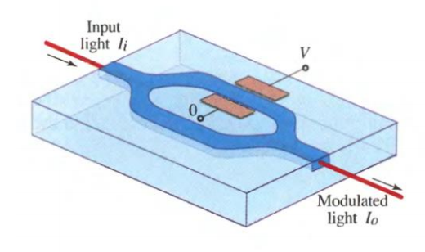
Proposed Electro-optic Mach-Zehnder modulator
An optical waveguide is used.
By applying electric field light phase is modulated
The circuit convert phase to intensity signal

Slide 5
Proposed idea
Lithium niobite has much higher electro-optic coefficient (30pm/V) -> much better sensitivity
However it has not been used due to limitation for phase matching between electron-beam velocity and optical signal
Using our thin film lithium niobate on quartz this problem can be solved
It is fiber based so is much cheaper and easier to operate
Detection scheme is a simple spectrometer
  Allows characterization of beams as short as 0.1psec

Slide 6
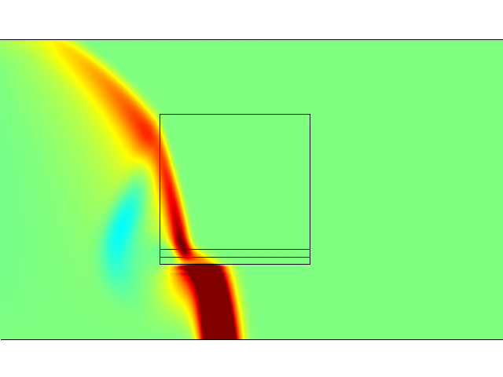
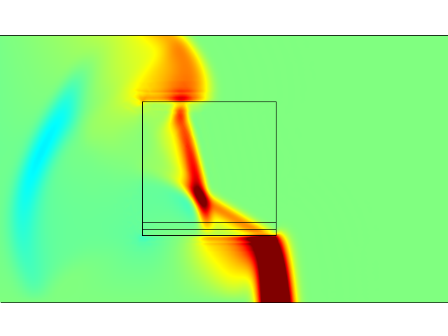
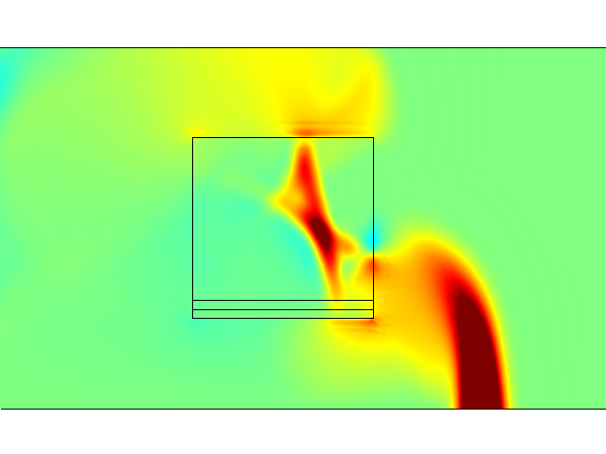
Calculated field profile in sensor

Slide 7
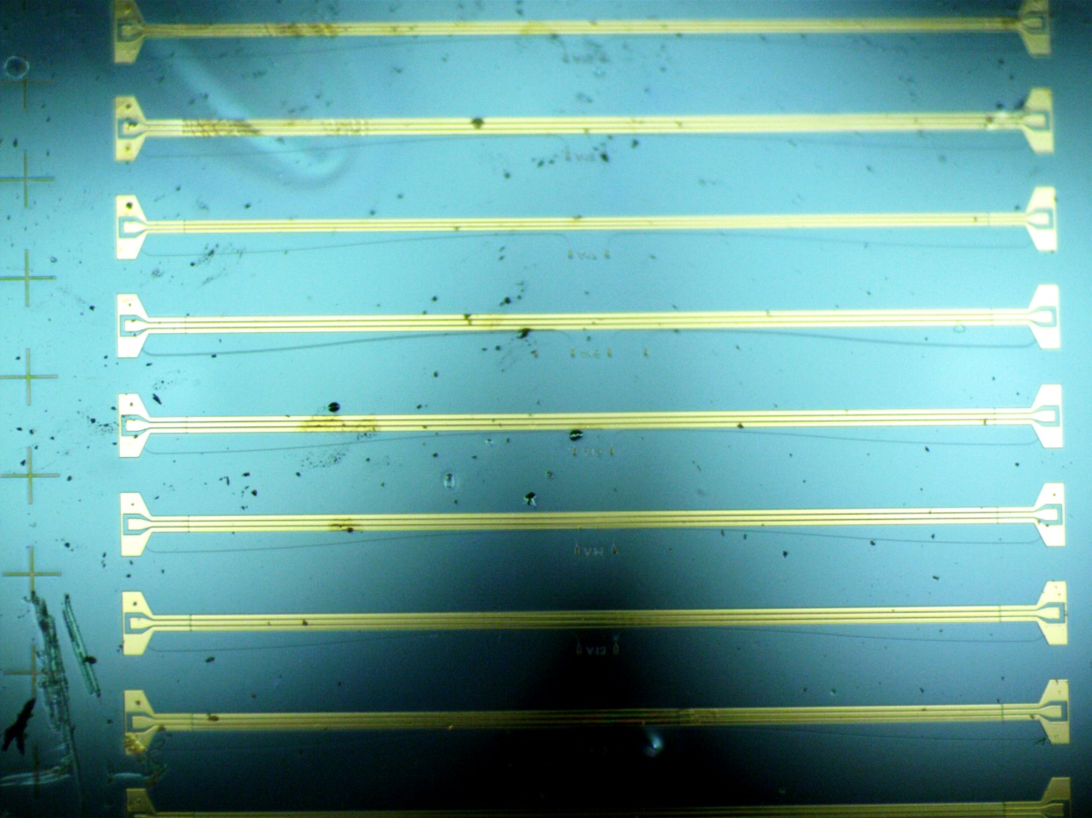
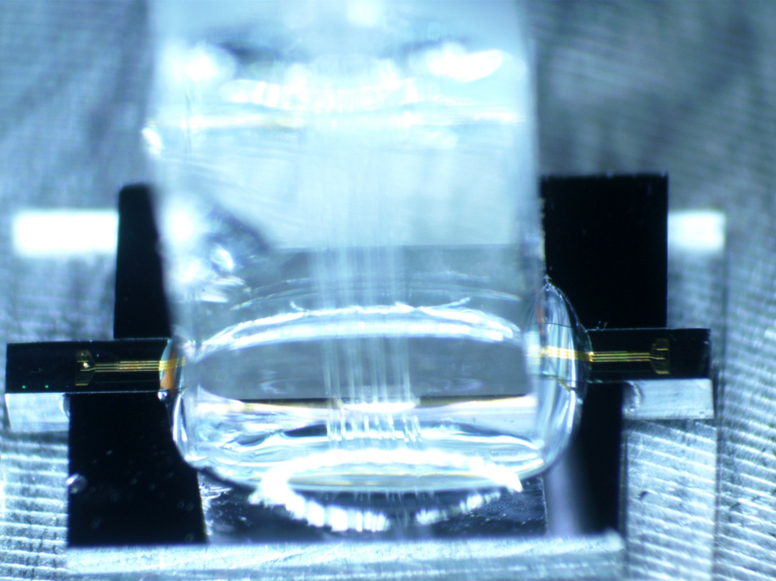
Fiber-attached modulator (on Silicon)
6mm

Slide 8
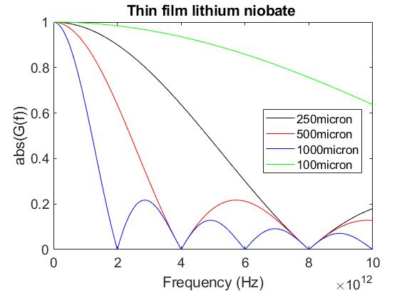
Calculated sensor bandwidth

Slide 9
Proposed sampling device for DOE
Fiber coupler
Fiber coupler
Poling direction
Lithium niobate
E
Modulating arms
E
E
Quartz substrate

Slide 10
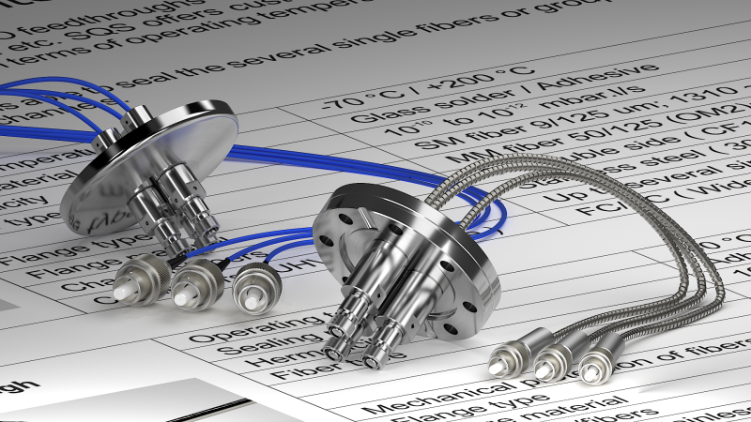
Vacuum feedthrough
Available form several suppliers

Slide 11
Measurement system
F-sec laser
Variable delay
Optical fiber
Detector
Synchronization

Slide 12
Measurement system
Laser
Optical fiber
High resolution spectrometer

Slide 13
Time-line for experiment
Last quarter of 2020
Beam parameters
  We should be able to characterize most beams but higher charge and higher repetition rate is advantageous
No hazard for oue equipment
Estimated beam time is 40-80 hours.
Need help from ATF to setup and perform tests

