Slide 1

An Update on Helicity Evolution at Small x
Yuri Kovchegov
The Ohio state university
Based on work done with Dan Pitonyak and Matt Sievert (2015-2018), with Florian Cougoulic (2019-2020), and with Josh Tawabutr (2020)

Slide 2
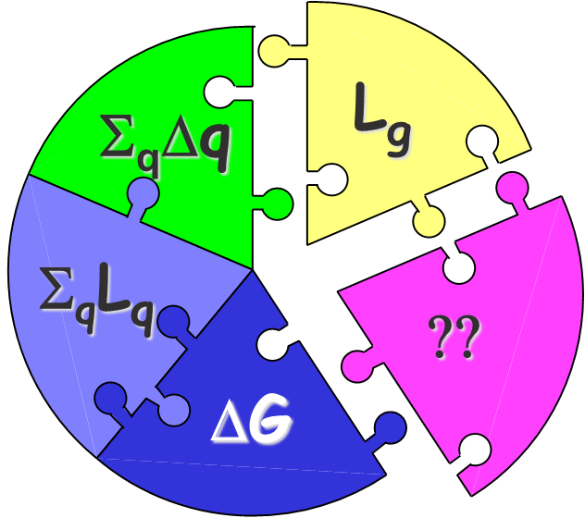
Proton Spin Puzzle
Helicity sum rule (Jaffe-Manohar form):
with the net quark and gluon spin
The helicity parton distributions are
with the net quark helicity distribution
L_{q} and L_{g} are the quark and gluon orbital angular momenta

Slide 3
Our goal
The goal is to constrain theoretically the amount of proton spin and OAM coming from small x.
Any existing and future experiment probes the helicity distributions and OAM down to some x_{min} .
At very small x (for the proton), saturation sets in: that region likely carries a negligible amount of proton spin. But what happens at larger (but still small) x?

Slide 4
Philosophy of our approach
DGLAP equation evolves in Q², it does not evolve in x.
Hence, DGLAP-based analyses (DSSV, NNPDF, standard JAM) cannot predict the x-dependence of PDFs.
If we want to predict helicity PDFs at small x, we need a different evolution equation evolving in x.
Such equations were constructed by D. Pitonyak, M. Sievert, and YK, 2015-2018 using an approach similar to the BK/JIMWLK evolution.

Slide 5
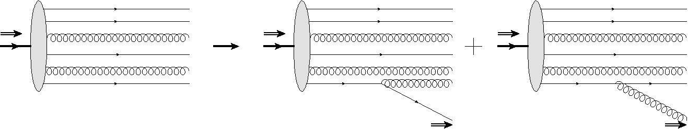
Helicity Evolution at Small x
To understand how much of the proton’s spin is at small x one can construct a helicity analogue of the BFKL equation:
This new helicity evolution equation is subtle,
since it must keep track of both quark and
gluon helicities. (BFKL/BK/JIMWLK only have
gluons at leading order.)
polarized
proton
polarized
quark
polarized
gluon
D. Pitonyak, M. Sievert, Y.K. ‘15-’18

Slide 6

Quark Helicity Observables at Small x
One can show that the g₁ structure function and quark helicity PDF (Δq) and TMD at small-x can be expressed in terms of the polarized dipole amplitude (flavor singlet case):
Here s is cms energy squared, z_{i}=Λ²/s,
$$=ΔΣ\left(x,Q^{2}\right)$$

Slide 7
Polarized Dipole: non-eikonal small-x physics
All flavor-singlet small-x helicity observables depend on one object, “polarized dipole amplitude”:
Double brackets denote an object with energy suppression scaled out:
unpolarized quark
polarized quark: eikonal propagation,
non-eikonal spin-dependent interaction

Slide 8
Polarized fundamental “Wilson line”
In the end one arrives at (KPS ‘17; YK, Sievert, ‘18; cf. Chirilli ’18; Altinoluk et al, ‘20)
We have employed an adjoint light-cone Wilson line
Note the simple physical meaning of the first term:

Slide 9
Evolution for Polarized Quark Dipole
One can construct an evolution equation for the polarized dipole:
Spin-dependent (non-eikonal) vertex
polarized
particle
similar to the
unpolarized
BK evolution
box =
target shock
wave (proton)

Slide 10
Large-N_{c} Evolution
Resummation parameter:
Double-logarithmic approximation (DLA)
In the strict DLA limit and at large N_{c}, we get (here Γ is an auxiliary function we call the ‘neighbor dipole amplitude’) (KPS ‘15)
The initial conditions are given by the Born-level graphs

Slide 11
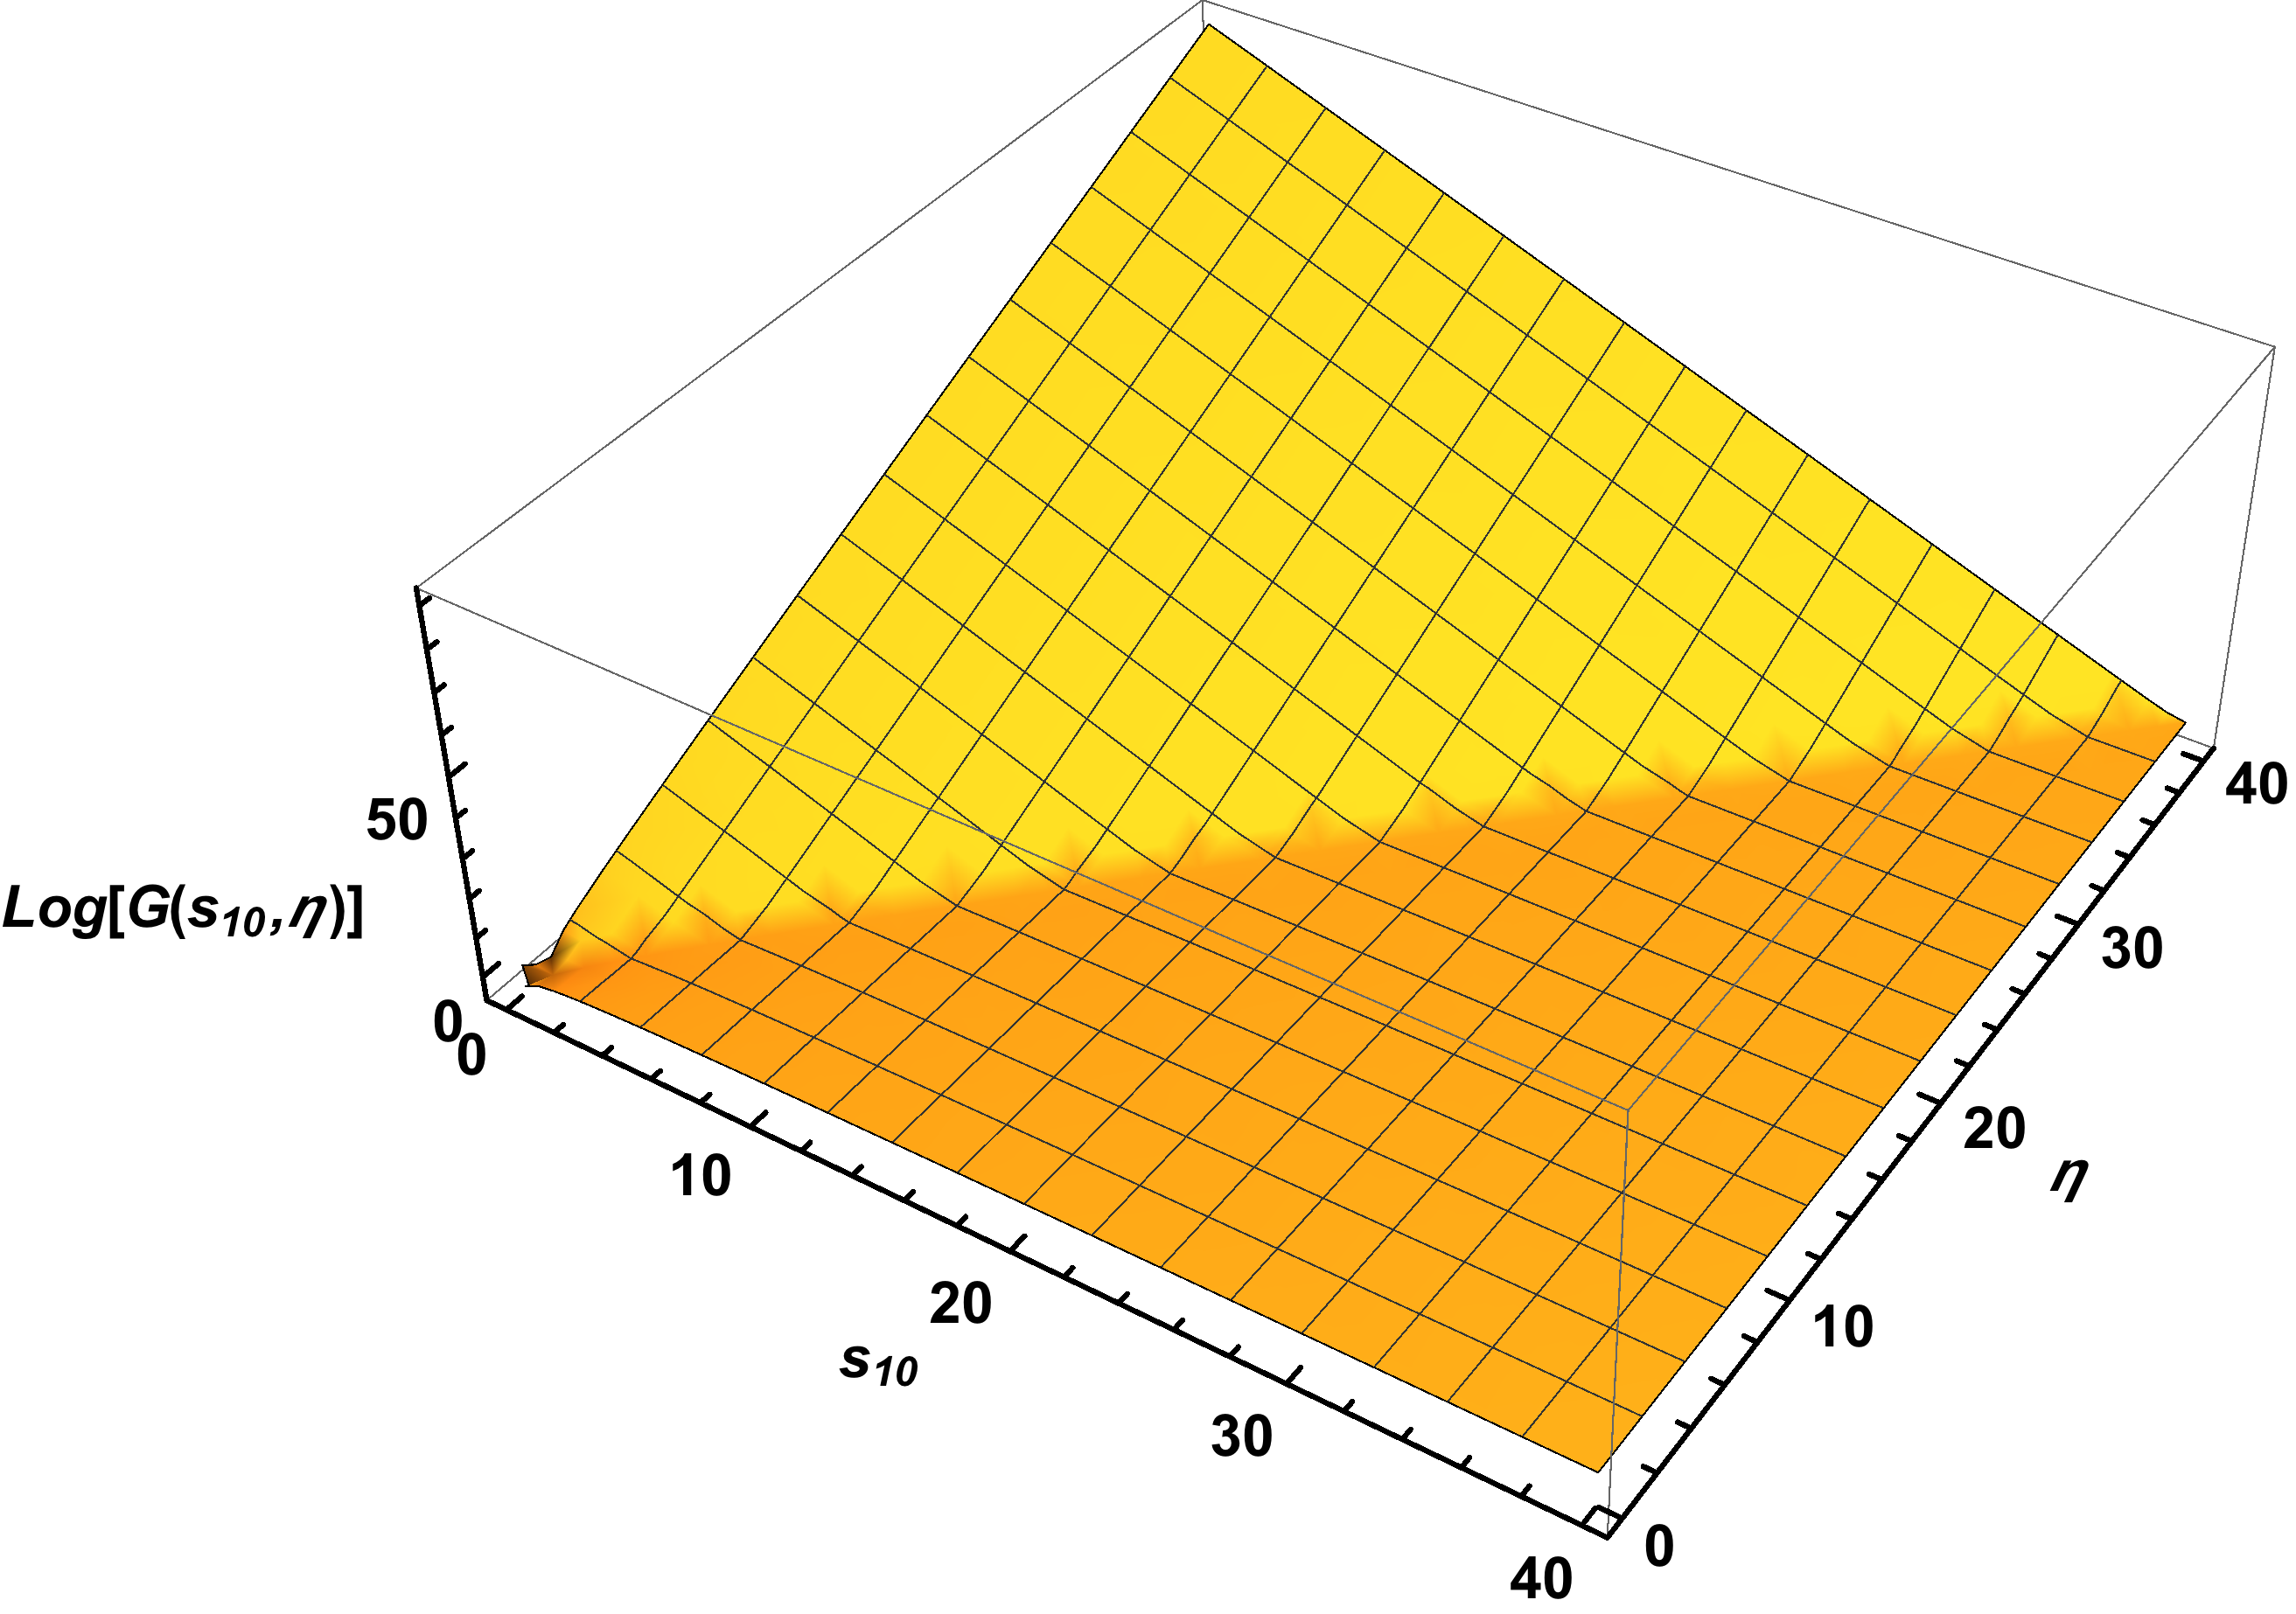
Quark Helicity at Small x
These equations can be
solved both numerically
and analytically.
(KPS ‘16-’17)
The small-x asymptotics of quark helicity is (at large N_{c})

Slide 12
Small-x Helicity Evolution at large N_{c}&N_{f}
The resulting equations are (KPS ‘15)

Slide 13
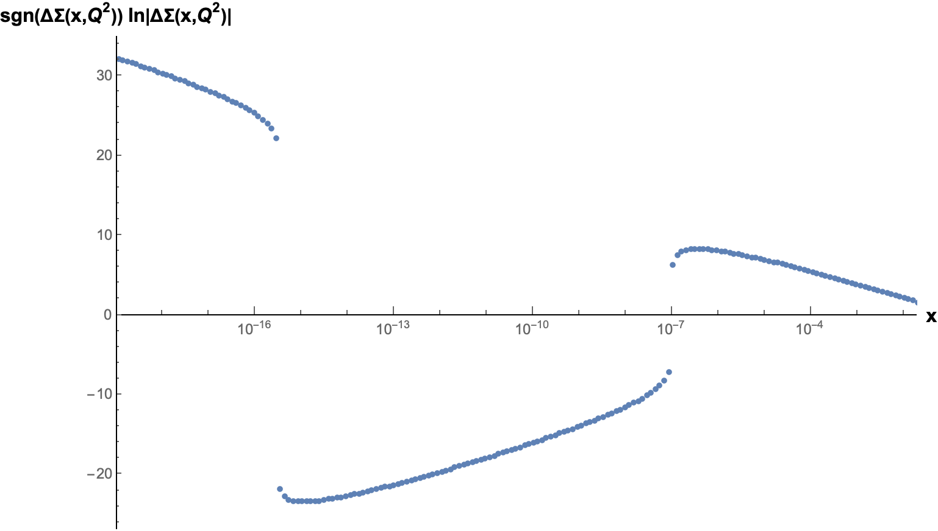
Small-x Helicity Asymptotics at large N_{c}&N_{f}
New since QCD Evolution 2019
Large N_{c}&N_{f} equations can be solved only numerically, due to their complexity. This was done by Y. Tawabutr & YK in arXiv:2005.07285 [hep-ph].
The solution exhibits an interesting qualitative change compared to large-N_{c}: it oscillates with ln(1/x)!

Slide 14
Helicity JIMWLK
New since QCD Evolution 2019
To go beyond the large-N_{c} and large-N_{c}&N_{f} limits need to write down a helicity analogue of JIMWLK evolution.
This has been done recently (F. Cougoulic, YK, arXiv:1910.04268 [hep-ph], arXiv:2005.14688 [hep-ph]):
with and the kernel
Life-time ordered!
Regular (spin-averaged) JIMWLK
Polarized gluon emissions
Polarized quark emissions

Slide 15
Helicity McLerran-Venugopalan Model
New since QCD Evolution 2019
The initial conditions for helicity JIMWLK are given by the helicity MV model, with the weight functional (F. Cougoulic, YK, 2005.14688 [hep-ph])
Here
The parameters are ~ “saturation scales” of helicity-plus and helicity-minus partons.
Standard MV

Slide 16
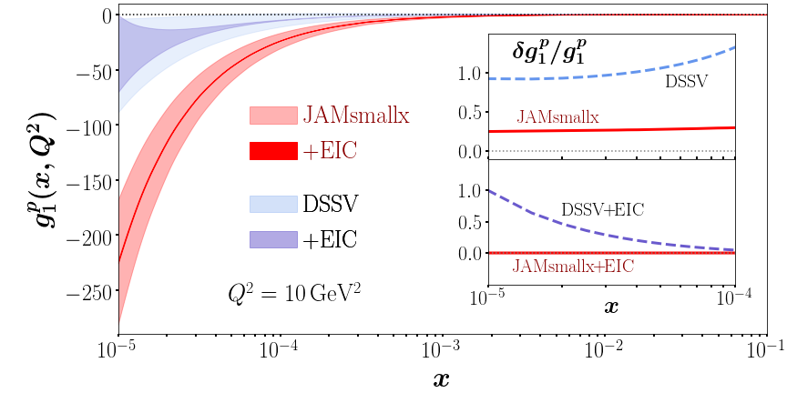
New results to be presented at this QCD Evolution
DLA large-N_{c} equations with Born-inspired initial conditions have been used to describe the world polarized DIS data for x<0.1 (Adamiak, Melnitchouk, Pitonyak, Sato, Sievert, YK, 2102.06159 [hep-ph] = JAMsmallx) – see the talk by Daniel Adamiak on Thursday.
Small-x helicity evolution equations have been constructed to the single-logarithmic order (SLA) + running coupling (Tarasov, Tawabutr, YK) – see the talk by Josh Tawabutr next.
DLA:
SLA:
Include exact LO DGLAP splitting functions. Unprecedented precision for small-x helicity evolution.

Slide 17
Musings on gluon helicity
Small-x evolution for helicity mixes two operators (in the DLA):
and
See for instance the polarized fundamental Wilson line:
This is different from polarized DGLAP evolution in Q² , which mixes
and
This difference may be related to the difficulties in defining the gluon helicity PDF.
Or small-x evolution simply avoids it. Any thoughts from the experts?

Slide 18
Musings on gluon helicity
At SLA (subleading to DLA), the two gluon operators
and
appear to mix with each other (KPS ‘17; Cougoulic, YK, Tarasov, Tawabutr, in preparation).
The above operators involved in small-x evolution,
and
were independently confirmed by Chirilli (2018, 2020), Altinoluk et al (2020), and by Tarasov (unpublished).

Slide 19
Musings on gluon helicity
Certainly, is a local operator and has no collinear limit…
However, one can make a TMD out of it (cf. Chirilli ‘20):
At LO this TMD scales as
The k_{T} integral of this TMD is zero, but only due to the delta-function, the TMD itself looks “healthy” for non-zero k_{T}. Easy to confuse with the standard gluon helicity TMD.
F¹²

Slide 20
Beyond Helicity
Similar small-x analysis was applied to transversity (Sievert, YK, 2018), yielding
and to the quark Sivers function, obtaining the spin-dependent odderon contribution (see the talk by M. Gabriel Santiago later this morning), such that
with the non-perturbative accuracy it seems.

Slide 21
Conclusions
Small-x helicity evolution has now been studied at large-N_{c} and large-N_{c}&N_{f} at DLA, yielding the small-x asymptotics of ΔΣ(x, Q²) and ΔG(x, Q²).
Beyond those limits: helicity JIMWLK is written down, yet to be solved.
Helicity evolution has been derived at DLA+SLA: +
First successful fit of polarized world DIS data for x<0.1 done using small-x helicity evolution (JAMsmallx).
Theoretical challenge: the interplay between and needs to be understood.

Slide 22
Backup Slides

Slide 23
Gluon Helicity at Small x
Yu.K., D. Pitonyak, M. Sievert, arXiv:1706.04236 [nucl-th]

Slide 24
Dipole Gluon Helicity TMD
Now let us repeat the calculation for gluon helicity TMDs.
We start with the definition of the gluon dipole helicity TMD:
Here U^{[+]} and U^{[-]} are future and
past Wilson line staples (hence
the name `dipole’ TMD,
F. Dominguez et al ’11 – looks
like a dipole scattering on a
proton):

Slide 25
Dipole Gluon Helicity TMD
At small x, the definition of dipole gluon helicity TMD can be massaged into
Here we obtain a new operator, which is a transverse vector (written here in A⁻=0 gauge, cf. Hatta et al, 2016):
Note that can be thought of
as a transverse curl acting on
and not just on -- different
from the polarized dipole amplitude!

Slide 26

Dipole TMD vs dipole amplitude
Note that the operator for the dipole gluon helicity TMD
is different from the polarized dipole amplitude
We conclude that the dipole gluon helicity TMD does not depend on the polarized dipole amplitude! (Hence the ‘dipole’ name may not even be valid for such TMDs.) This is different from the unpolarized gluon TMD case.
F^{+j}
F¹²
$$≠$$
F^{+i}

Slide 27
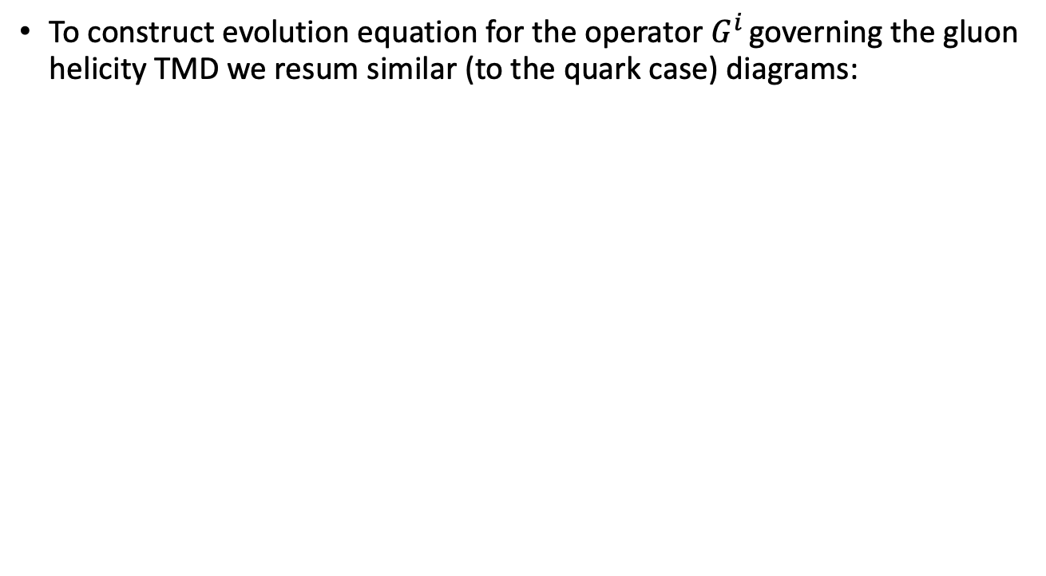
Evolution Equation
To construct evolution equation for the operator $G^{i}$ governing the gluon helicity TMD we resum similar (to the quark case) diagrams:

Slide 28
Large-N_{c} Evolution: Equations
This results in the following evolution equations:

Slide 29
Large-N_{c} Evolution Equations: Solution
These equations can be solved in the asymptotic high-energy region yielding the small-x gluon helicity intercept
We obtain the small-x asymptotics of the gluon helicity distributions:

