Slide 1

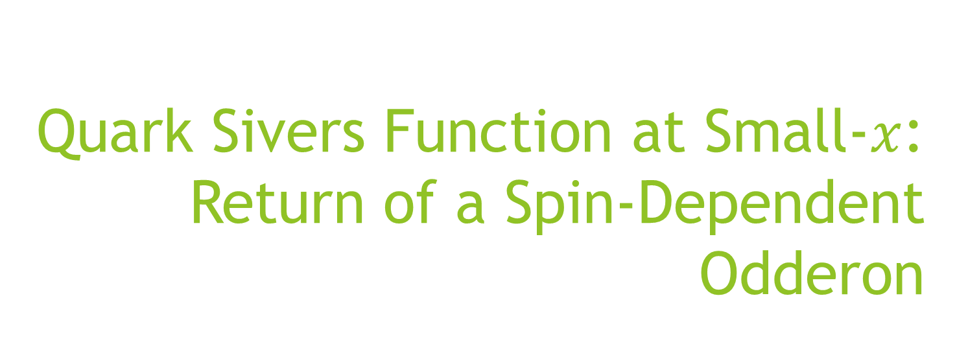
Quark Sivers Function at Small-$x$: Return of a Spin-Dependent Odderon
M. Gabriel Santiago
With Yuri Kovchegov

Slide 2
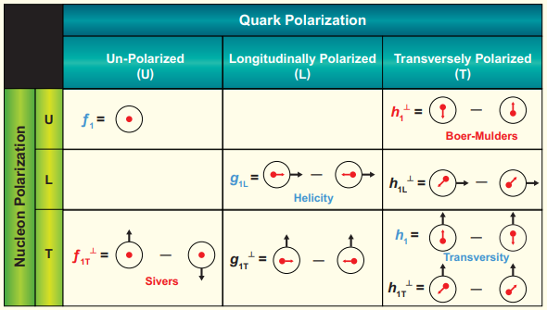




Quark Sivers function
TMDs give the transverse momentum part of the three-dimensional structure of hadrons
Finding the small-$x$ asymptotics of these functions is an ongoing effort
The Sivers TMD is the density of unpolarized quarks with transverse momentum and longitudinal momentum fraction in a proton with transverse polarization

Slide 3
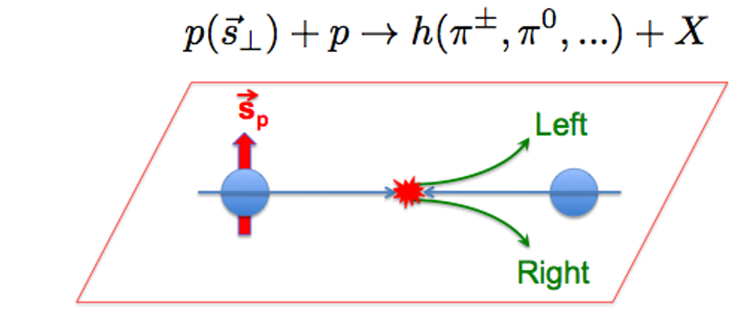
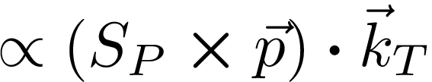

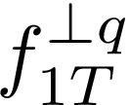
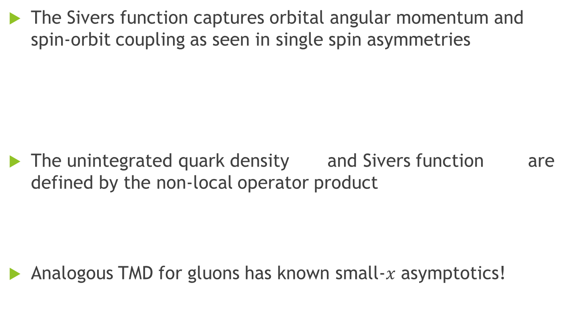
Quark Sivers function
The Sivers function captures orbital angular momentum and spin-orbit coupling as seen in single spin asymmetries
The unintegrated quark density and Sivers function are defined by the non-local operator product
Analogous TMD for gluons has known small-$x$ asymptotics!

Slide 4
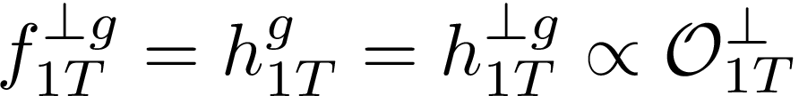



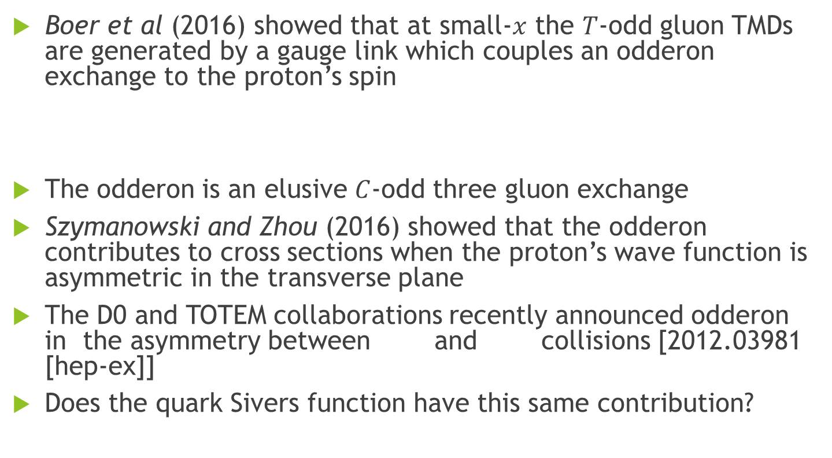
Spin-Dependent Odderon
Boer et al (2016) showed that at small-$x$ the $T$-odd gluon TMDs are generated by a gauge link which couples an odderon exchange to the proton’s spin
The odderon is an elusive $C$-odd three gluon exchange
Szymanowski and Zhou (2016) showed that the odderon contributes to cross sections when the proton’s wave function is asymmetric in the transverse plane
The D0 and TOTEM collaborations recently announced odderon in the asymmetry between and collisions [2012.03981 [hep-ex]]
Does the quark Sivers function have this same contribution?

Slide 5
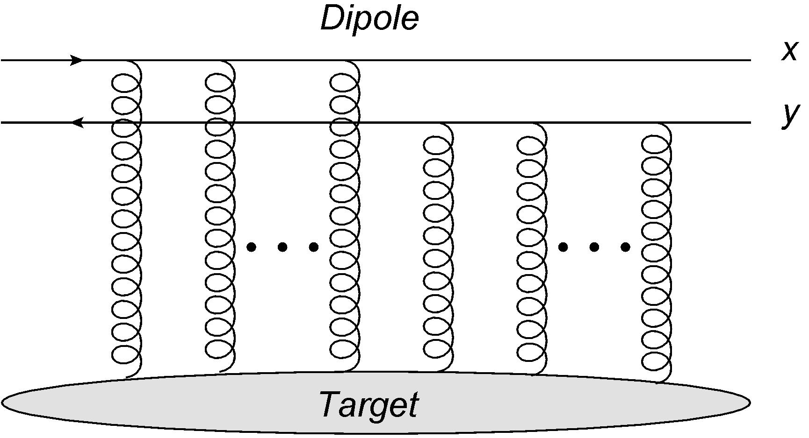
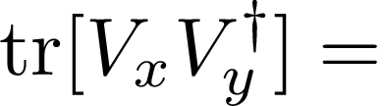
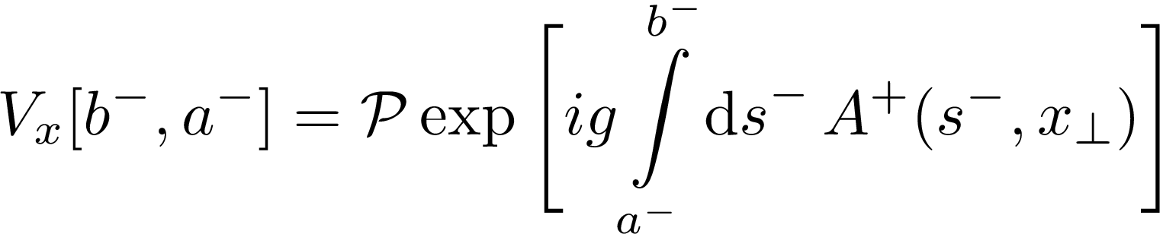




Small-$x$ TMDs from polarized Wilson lines
Kovchegov and Sievert (2018) constructed the helicity and quark transversity TMDs using a high-energy scattering operator formalism
The strategy is to rewrite the TMD operator definitions as dipole correlators
*in
or gauge

Slide 6
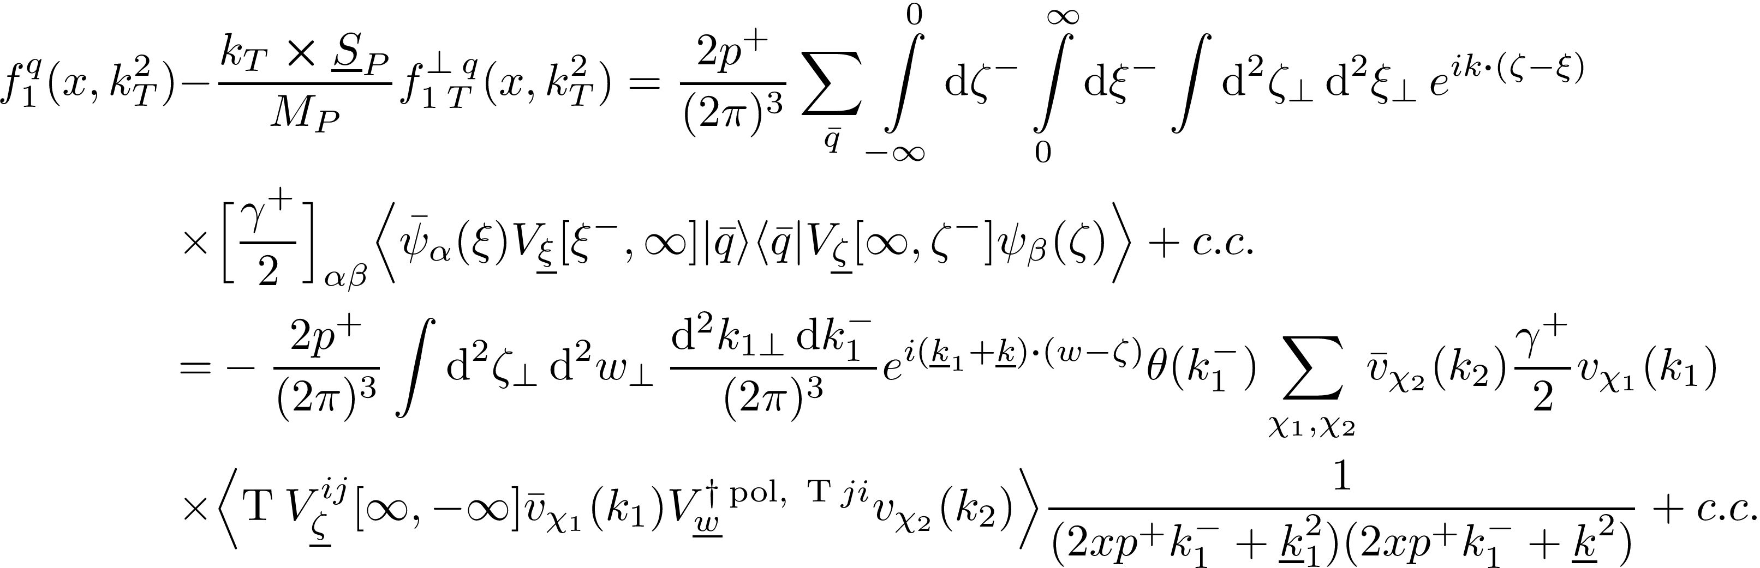
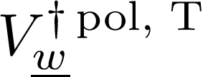
Small-$x$ TMDs from polarized Wilson lines
The quark correlator can be rewritten in terms of Wilson lines
The polarized Wilson line makes the correlator a transverse polarized dipole

Slide 7
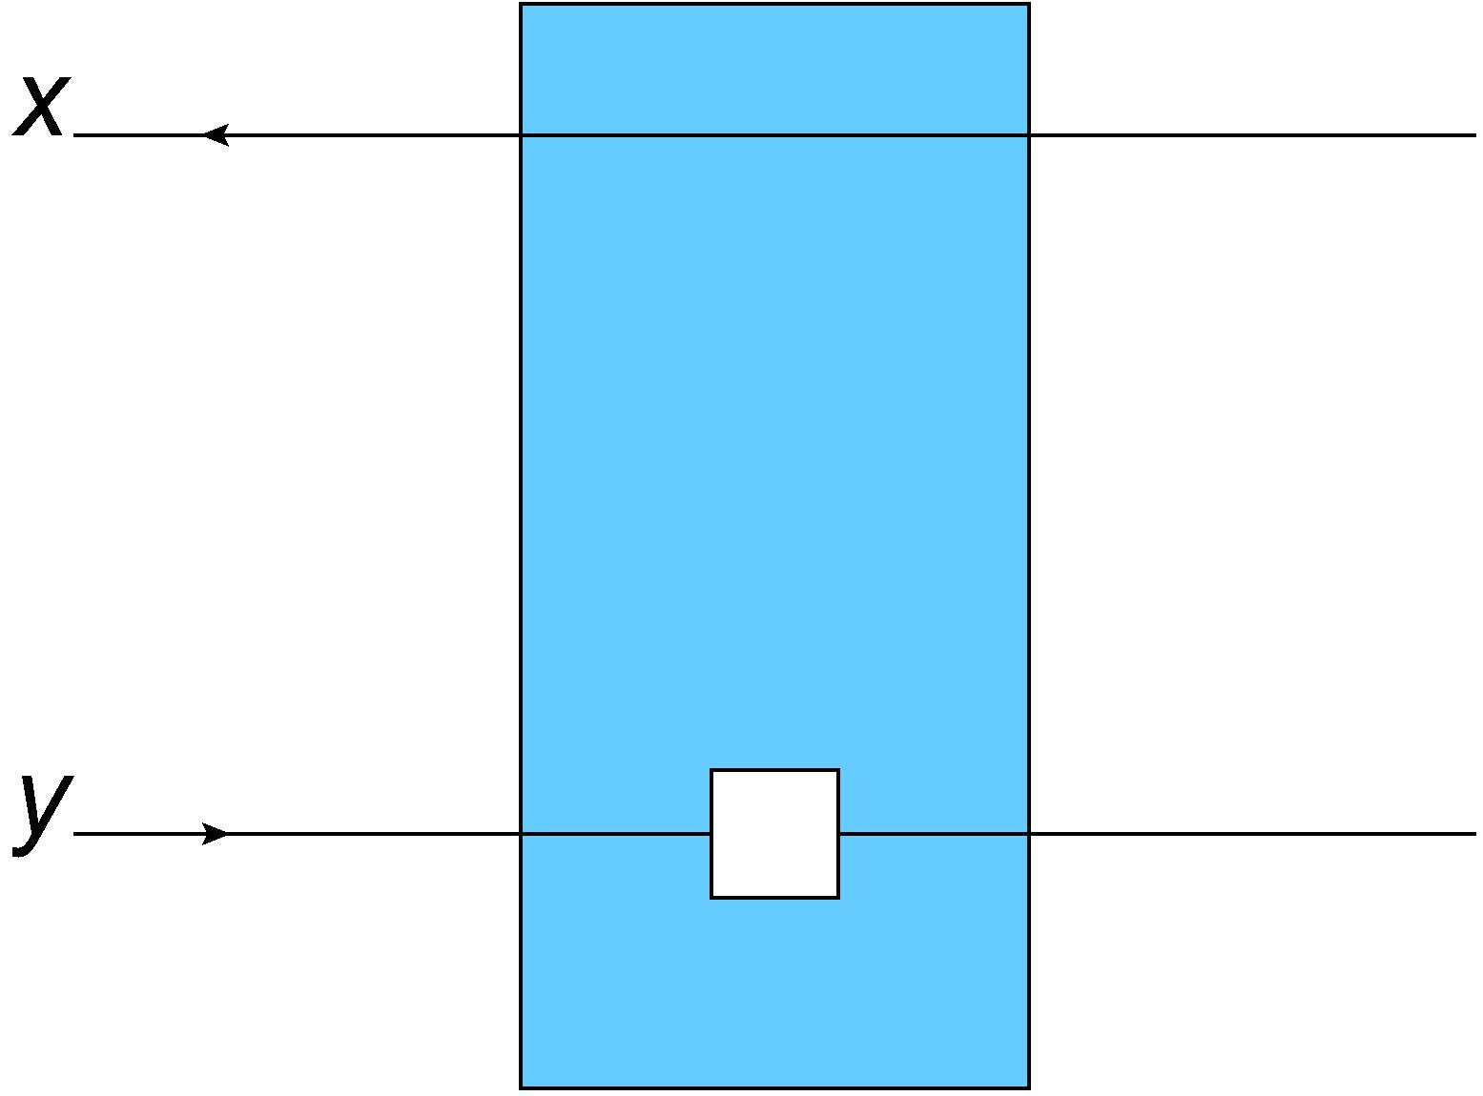
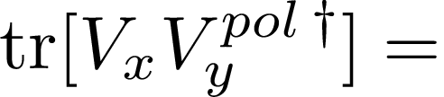
Small-$x$ TMDs from polarized Wilson lines
Define new polarized dipoles by adding spin-dependent interaction
Helicity interaction comes at sub-eikonal level, transversity at sub-sub-eikonal
Define evolution for new polarized dipoles to get TMD evolution!
Can we apply this formalism to the Sivers function?

Slide 8
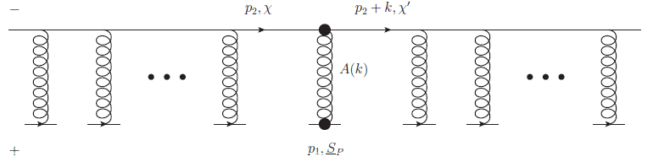
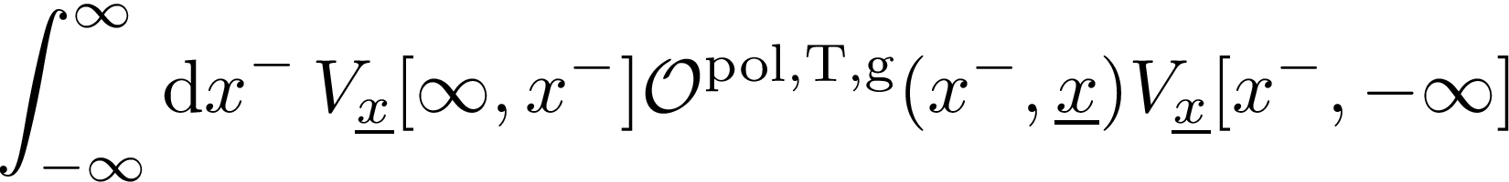
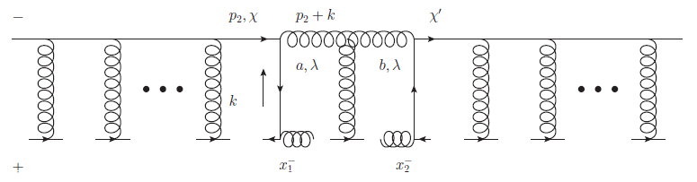
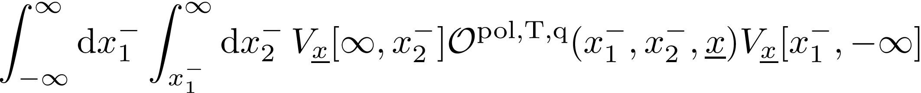
Transverse polarized Wilson line
Insert sub- or sub-sub-eikonal operator into ordinary Wilson lines

Slide 9
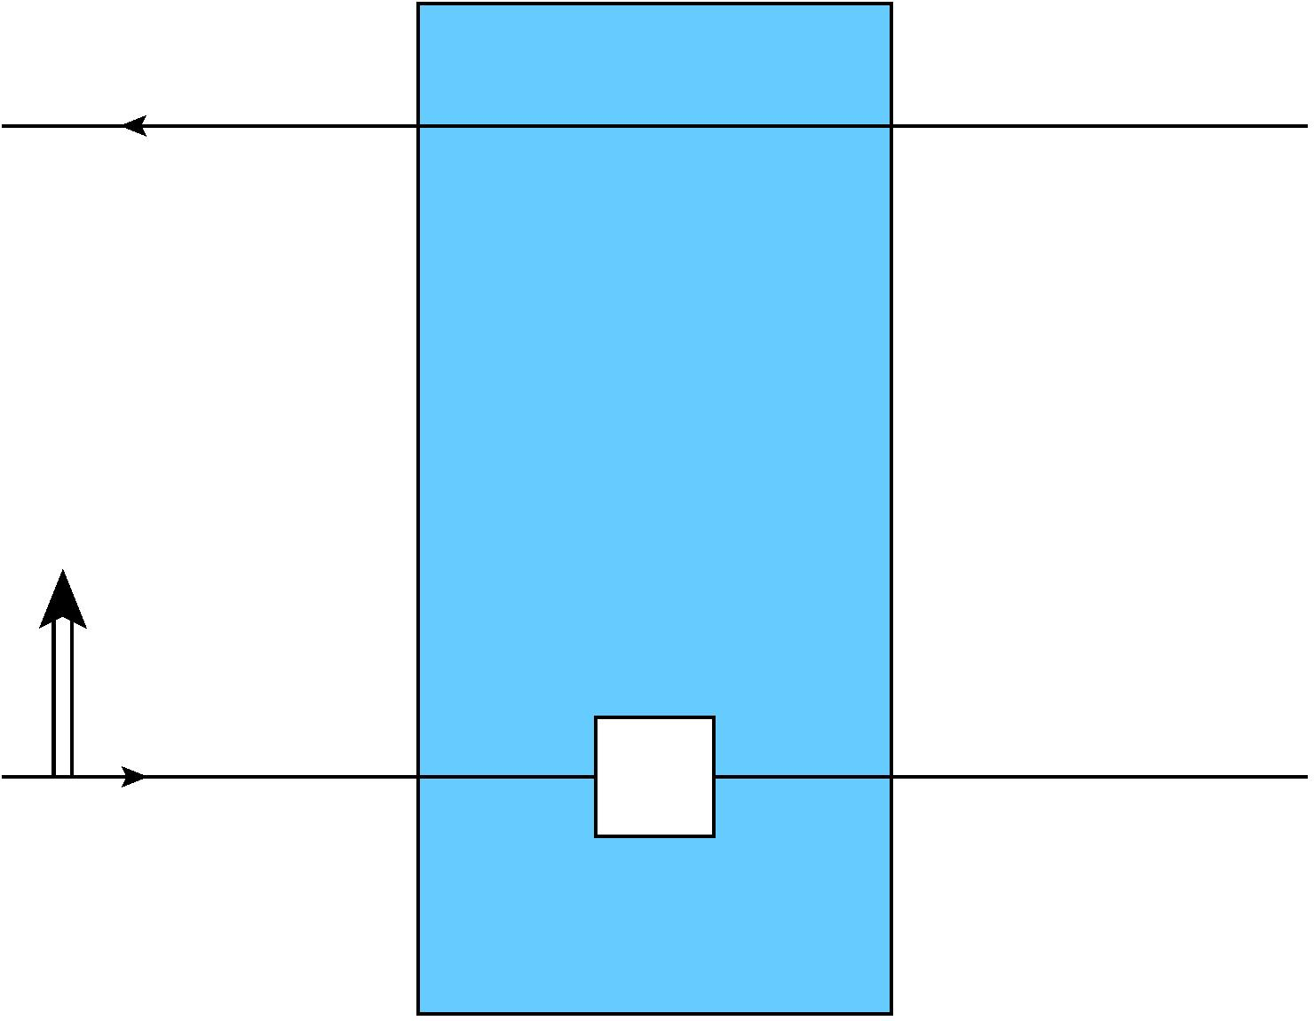
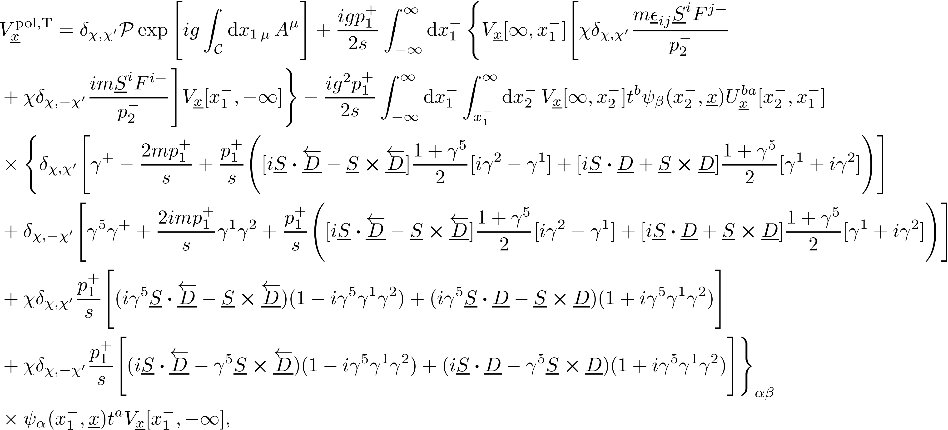



Transverse polarized Wilson line
Full sub-sub-eikonal polarized fundamental Wilson line for TMDs which depend on the proton’s transverse spin
$$χ,$$
$$S$$
$$χ′$$

Slide 10
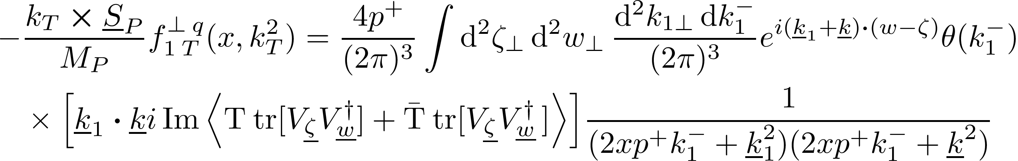

Small-$x$ Sivers function
Apply the formalism to rewrite the Sivers function in terms of polarized transverse Wilson lines
Discarding light quark masses, the quark-quark correlator which yields the Sivers function is
Only an eikonal Wilson line correlator remains!

Slide 11
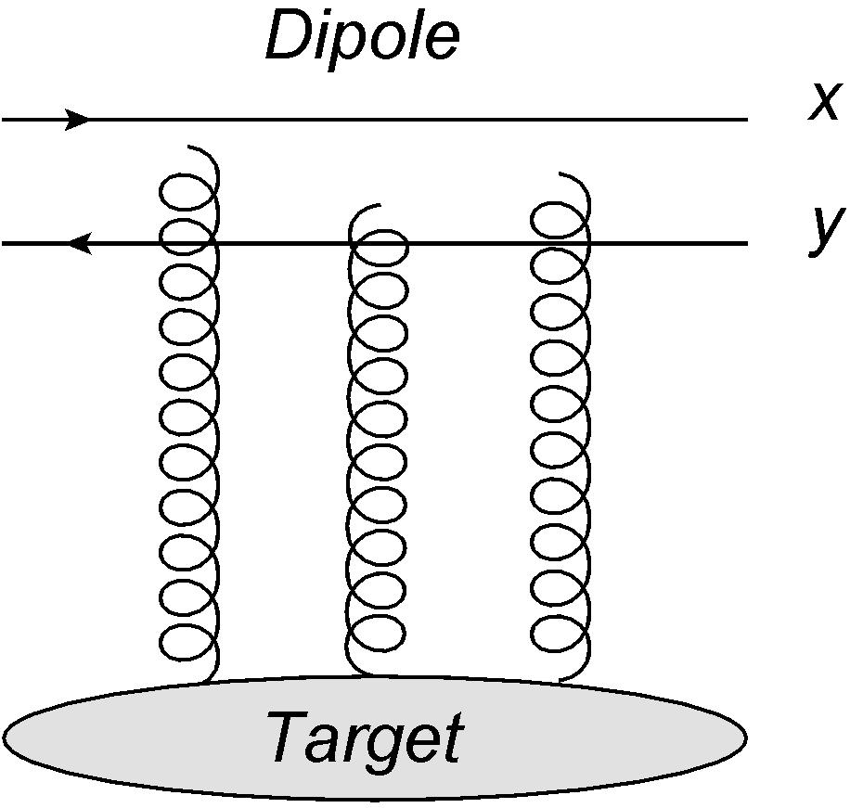
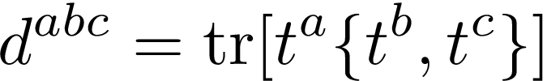

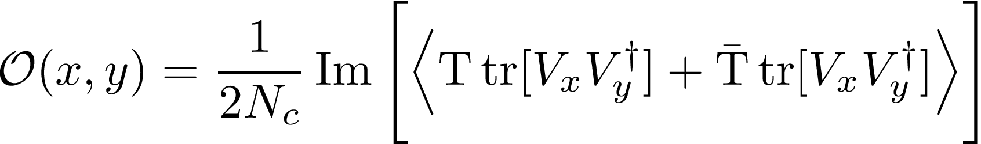
Dipole Odderon
In the color dipole picture, it is the antisymmetric, imaginary piece of a dipole correlator

Slide 12
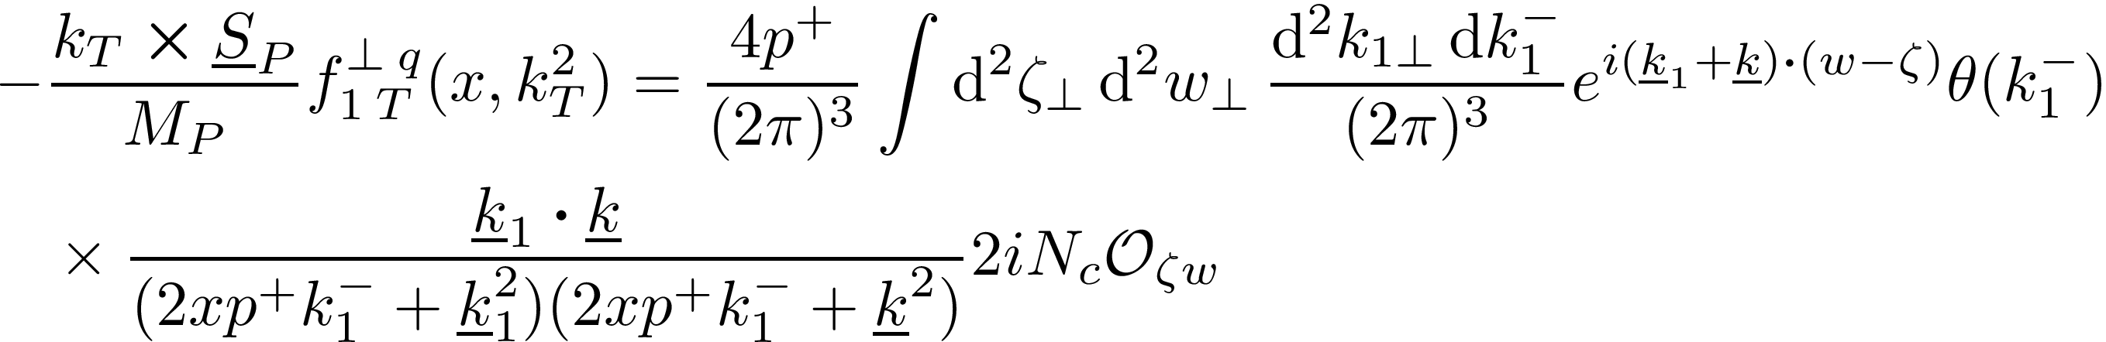
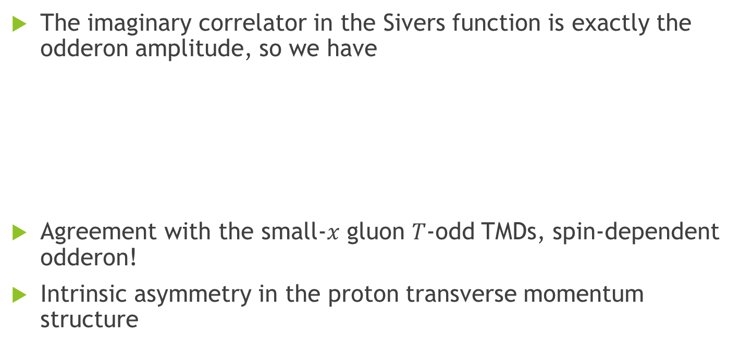

Small-$x$ Sivers = Spin-dependent Odderon!
The imaginary correlator in the Sivers function is exactly the odderon amplitude, so we have
Agreement with the small-$x$ gluon $T$-odd TMDs, spin-dependent odderon!
Intrinsic asymmetry in the proton transverse momentum structure

Slide 13
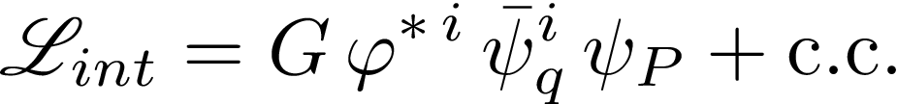
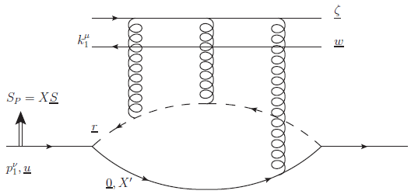
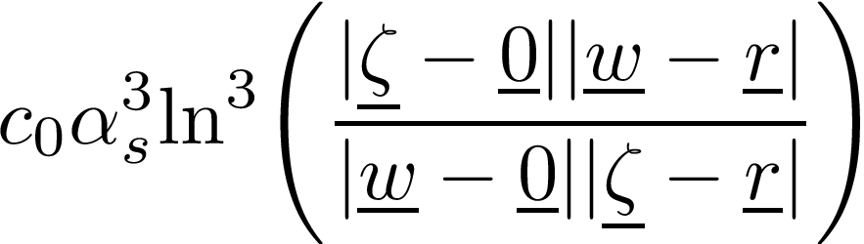

Diquark model calculation
We can estimate the small-$x$ Sivers function in the diquark model, where the interaction between the point-particle proton $ψ_{P}$, the quark field $ψ$, and the scalar diquark $φ$ is

Slide 14
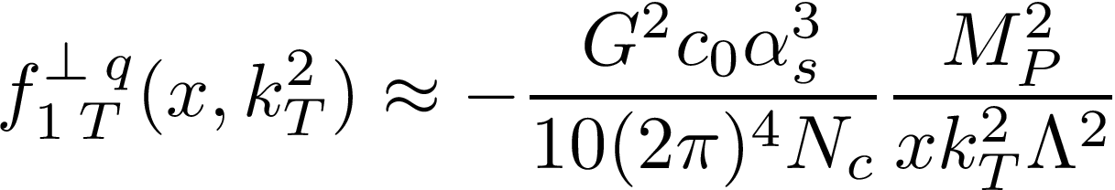

Diquark model calculation
Plugging the diquark model odderon into our Sivers function result gives
Nonzero spin-dependent odderon!
Interesting behavior as , Sivers function does not vanish

Slide 15
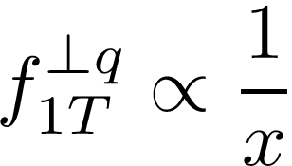

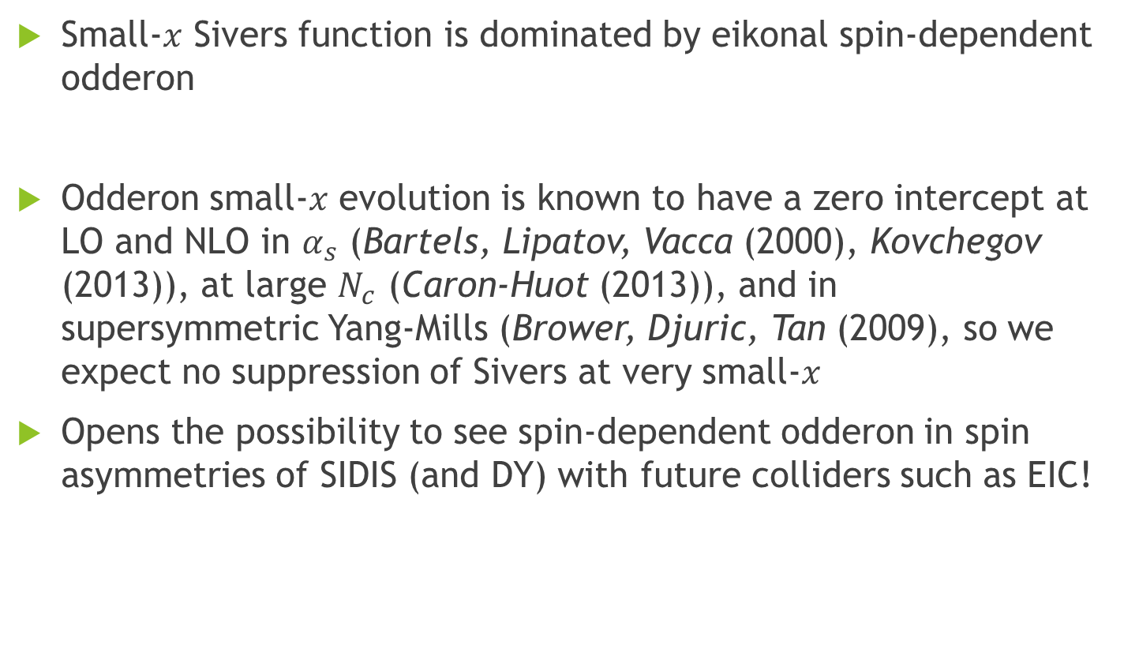
Outlook
Small-$x$ Sivers function is dominated by eikonal spin-dependent odderon
Odderon small-$x$ evolution is known to have a zero intercept at LO and NLO in $α_{s}$ (Bartels, Lipatov, Vacca (2000), Kovchegov (2013)), at large $N_{c}$ (Caron-Huot (2013)), and in supersymmetric Yang-Mills (Brower, Djuric, Tan (2009), so we expect no suppression of Sivers at very small-$x$
Opens the possibility to see spin-dependent odderon in spin asymmetries of SIDIS (and DY) with future colliders such as EIC!

Slide 16
References
D. Boer, M. G. Echevarria, P. Mulders, and J. Zhou, Phys. Rev. Lett. 116, 122001 (2016), arXiv:1511.03485 [hep-ph].
L. Szymanowski and J. Zhou, Phys. Lett. B760, 249 (2016), arXiv:1604.03207 [hep-ph].
Y. V. Kovchegov and M. D. Sievert, Phys. Rev. D99, 054032 (2019), arXiv:1808.09010 [hep-ph].
Y. V. Kovchegov and M. D. Sievert, Phys. Rev. D99, 054033 (2019), arXiv:1808.10354 [hep-ph].
V. M. Abazov et al. (D0, TOTEM), (2020), arXiv:2012.03981 [hep-ex].
J. Bartels, L. Lipatov, and G. Vacca, Phys.Lett. B477, 178 (2000), arXiv:hep-ph/9912423 [hep-ph].
Y. V. Kovchegov, AIP Conf. Proc. 1523, 335 (2013), arXiv:1212.2113 [hep-ph].
S. Caron-Huot, JHEP 05 (2015), arXiv:1309.6521 [hep-th].
R. C. Brower, M. Djuric, and C.-I. Tan, JHEP 0907, 063 (2009), arXiv:0812.0354 [hep-th].

Slide 17
Thank You

