Slide 1
Single spin asymmetry at two-loops
Yoshitaka Hatta
BNL/RIKEN BNL
Sanjin Benic, YH, Hsiang-nan Li, Dong-jing Yang, Phys. Rev. D100 (2019), 094027
Benic, YH, Li, work in progress

Slide 2
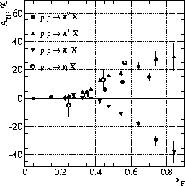
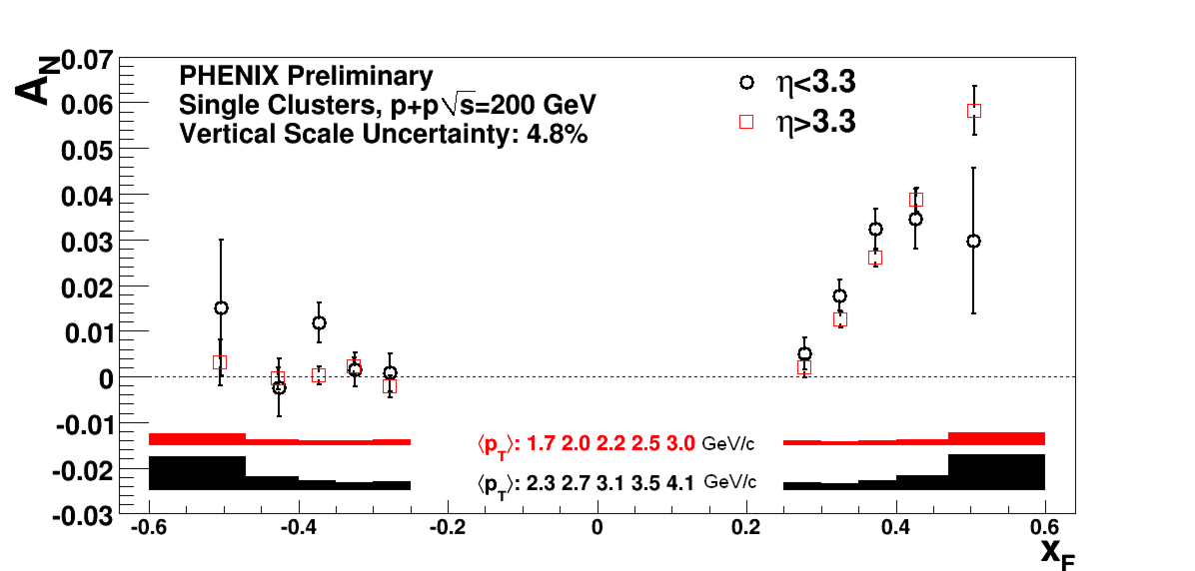
Transverse Single Spin Asymmetry (SSA)
Production of hadrons are left-right asymmetric

Slide 3
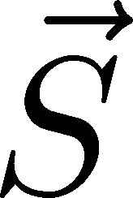
Quest for a phase
Find part of the cross section linear in spin → interference terms
Naively purely imaginary, vanish after adding the complex-conjugate part
An extra factor of is needed.

Slide 4
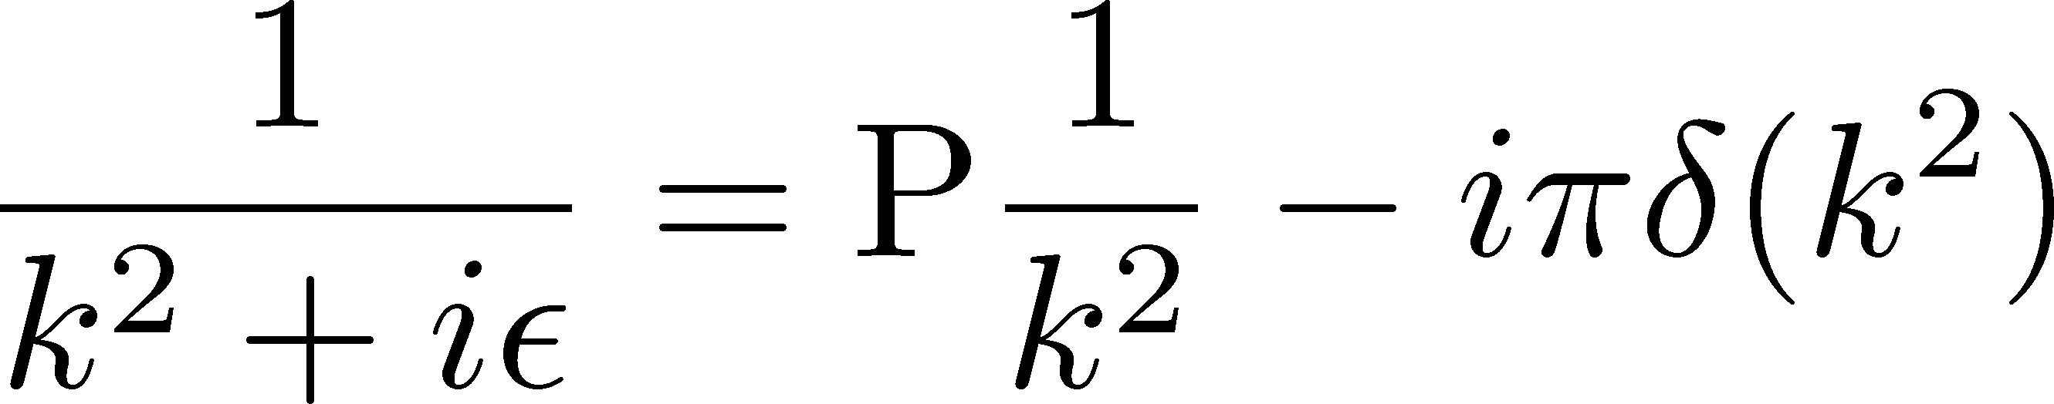
Phase from the propagator pole
Efremov, Teryaev (1985)
Qiu, Sterman (1999)
Soft fermionic pole
Soft gluonic pole
ETQS functions
`genuine twist-three’

Slide 5
Origins of SSA (collinear framework)
Soft fermionic pole
Soft gluonic pole
Hard pole
Twist-three fragmentation functions
Three-gluon correlator
….
All these mechanisms require introducing nonperturbative
higher-twist functions that need to be parameterized and fitted.

Slide 6
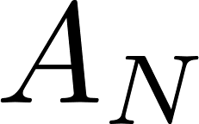
Towards spin asymmetries at NLO
No all-order proof of factorization for SSAs in collinear twist-3 framework.
Phenomenology based on leading order formulas.
Check of factorization at NLO very hard, so far only for very limited observables.
Pt-weighted in Drell-Yan and SIDIS Not yet for Pt-differential
Polarized hyperon production in e+e-
Vogelsang, Yuan;
Chen, Ma, Zhang;
Kang, Vitev, Xing;
Yoshida
Gamberg, Kang, Pitonyak, Schlegel, Yoshida

Slide 7
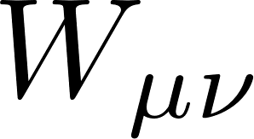

New origin of SSA
Benic, YH, Li, Yang (2019)
Start from the general expression of the hadronic tensor in DIS
Hard part: collinear expansion

Slide 8
Soft part:
Usually people just keep this
(transversity)
Eguchi, Koike, Tanaka (2006)
No phase at the Born level. But at higher orders, there is.
Our new contribution will be proportional to the structure function

Slide 9
All-order result
Benic, YH, Li, Yang (2019)
See also, Ratcliffe (1985)
QED gauge invariance OK
QCD gauge invariance OK

Slide 10


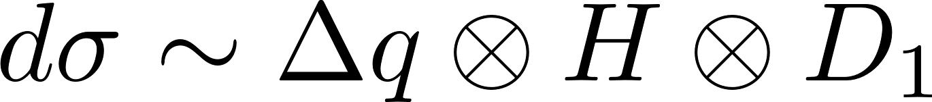
Wandzura-Wilczek approximation
polarized quark PDF
SSA solely from collinear twist-two PDFs and twist-two FFs.
No higher-twist distributions involved.
Not proportional to the current quark mass.
unpolarized FF

Slide 11
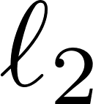
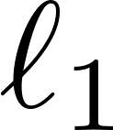
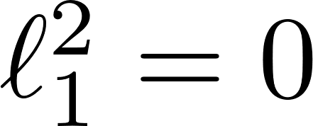
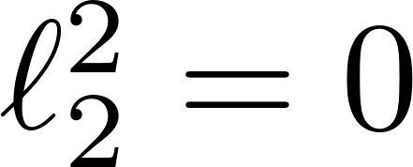
Hard part: Box diagram
No phase at the Born and 1-loop diagrams.
Phase starts to show up first at 2-loops.
An example of 2-loop diagrams that contribute to SSA
cut
cut
Check if the on-shell conditions have a solution → imaginary phase
→ 2 roots
→ 2 roots
One root collinear to the incoming quark,
the other is not.

Slide 12
Hard part:
An example of 2-loop diagrams that do not contribute to SSA
Real-virtual cancellation
Consider all diagrams, all possible cuts.

Slide 13
Hard part (there are 12 diagrams in total)
+ mirror images
Imaginary piece alone respects the QED, QCD gauge invariance.

Slide 14
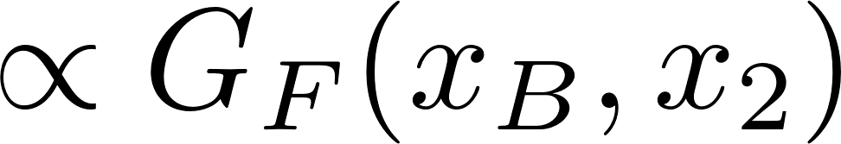
Factorization
The diagrams contain collinear divergence
Discard the known contributions in the literature.
Fierz
Re-factorize. This is called
`hard pole’ in SSA literature
Bjorken-x
Divergence when this gluon is collinear
and has a transverse polarization index.

Slide 15
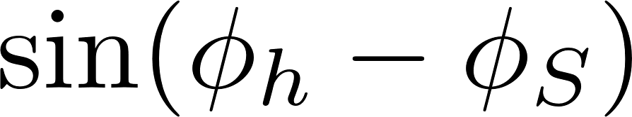
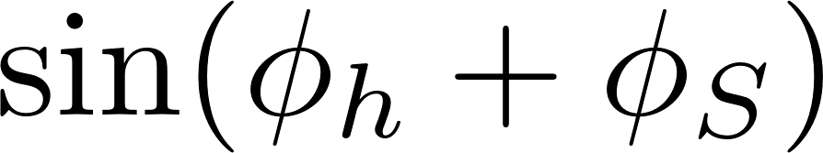
New origin of SSA
When this gluon is not collinear (the other root),
the diagram is finite and has an imaginary phase.
In fact, we can also include the collinear root.
The divergence is canceled between the two terms.
Fierz
Contributes to both Sivers and
Collins asymmetries in SIDIS

Slide 16
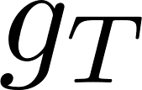
TMD case (up to 2-loops, twist-3)
Sivers
TMD version
of
Collins
Notations of TMD/FF from
Bacchetta et al. (2007)
In general, these new twist-3 terms contribute to ``Sivers”
and ``Collins” asymmetries in SIDIS

Slide 17




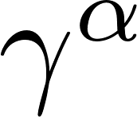
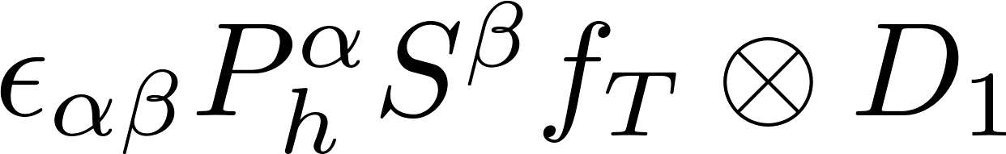
Example
T-odd twist-3 TMD
``Sivers asymmetry” not from the Sivers function

Slide 18

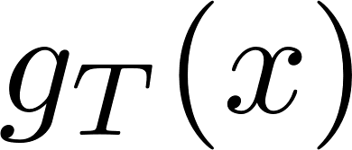
Gluon channel
gluon Sivers (a.k.a. spin-dependent odderon)
gluon initiated SSA
three-gluon correlator
New source of SSA from the gluonic analog of
Ji (1992)
YH, Tanaka, Yoshida (2013)
genuine twist-3
gluon helicity PDF

Slide 19

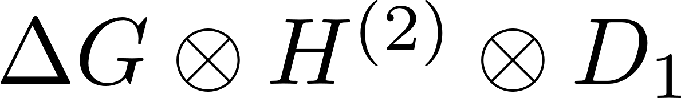
Two-loop SSA, gluonic channel
Benic, YH, Li, work in progress
or in the WW approximation,
New contribution to SSA of open charm, etc.

Slide 20

Conclusions
New source of SSA proportional to in SIDIS.
Subleading in , but involves only twist-2 PDFs (FFs) after WW approx.
Similar new contributions expected in pp, DY, etc.
A plethora of new twist-3 contributions in TMD framework that can affect Sivers and Collins asymmetries
Numerical evaluation underway (hard!)

