Slide 1
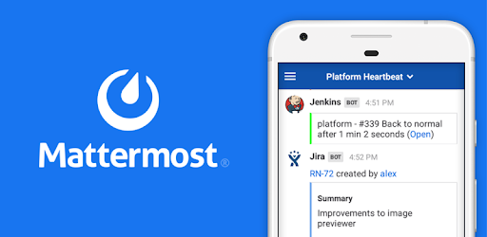
Mattermost
Open source, self hosted Slack alternative

Slide 2
Multiple levels of hierarchy.
Teams - Private/Public
Channels - Private/Public
Direct Messages - one on one
2. Supports encryption in transit and encryption at rest – Security and Privacy.
3. Free version of mattermost, paid versions could get very expensive.
3 Fully searchable unlimited message history
4. Custom Emojis and rich markdown
5. Voice, Video and Screen sharing.
6. File, image and public link sharing.
7. Custom desktop, email and mobile notifications
8. Do not disturb mode.
9. Keyword mention alerts.
10. Various themes available including custom themes.
Currently only SDCC accounts and guest accounts are allowed. Will add support for Federated access in the future.

Slide 3
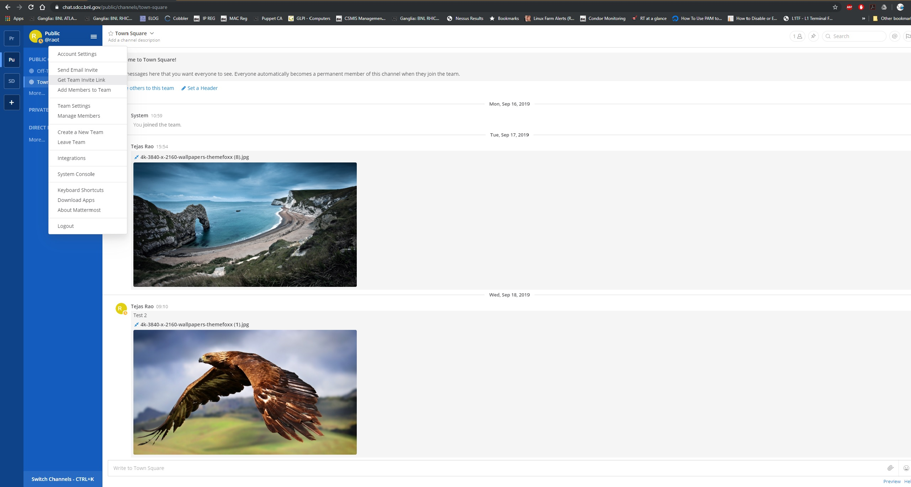

Slide 4
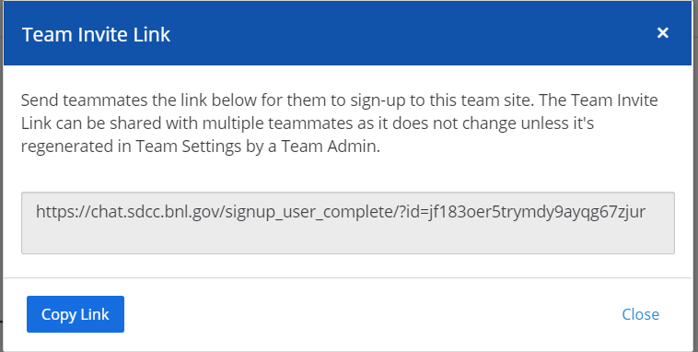
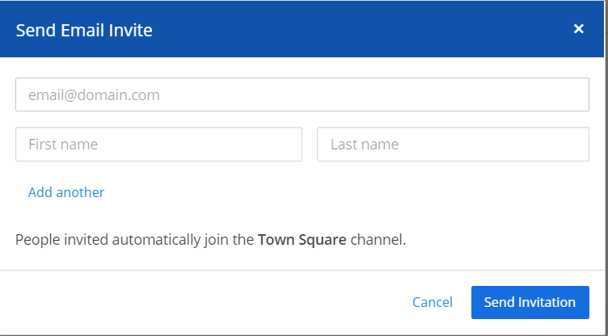
Inviting SDCC or non-SDCC users to join private Teams.

Slide 5
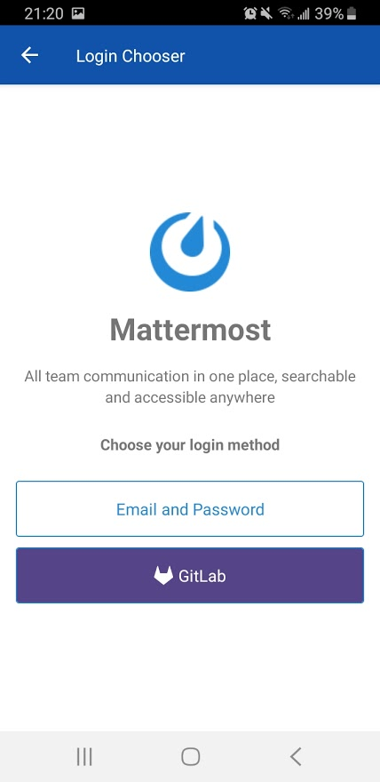
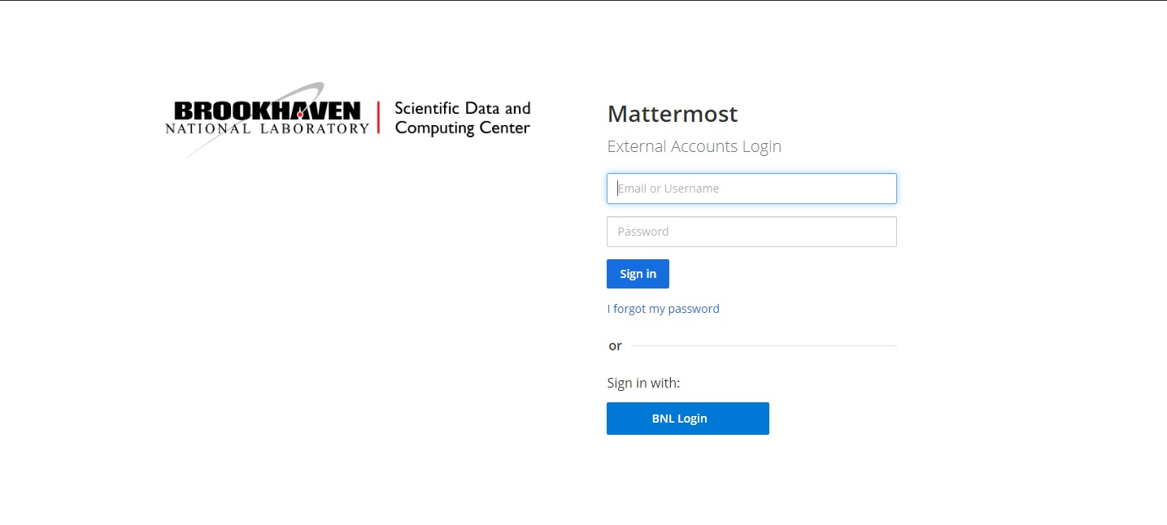

Slide 6
https://chat.sdcc.bnl.gov
Documentation
https://www.racf.bnl.gov/docs/services/Mattermost

