Slide 1

KATRIN
and the
Neutrino
Mass
Scale
Image from Symmetry Magazine
Diana Parno – Carnegie Mellon University
Physics Colloquium, Brookhaven National Lab, October 22, 2019

Slide 2
The Plan
Neutrinos and neutrino mass: A quick review
Molecular physics of T₂
KATRIN: How to weigh a neutrino
Background considerations
KATRIN’s new results
What’s next?

Slide 3
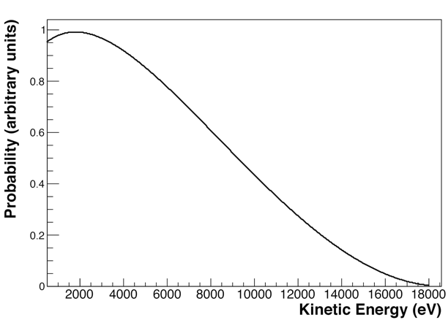
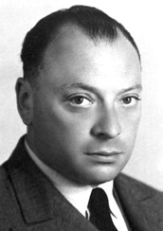
The Neutrino: A “Desperate Remedy”
1930: Proposed by Pauli to save energy conservation
ν_{e}
Beta spectrum for T decay
e⁻
³H
³He
Additional, unseen particle needed to explain beta spectrum
I have done a terrible thing. I have postulated a particle that cannot be detected.
-- Wolfgang Pauli

Slide 4
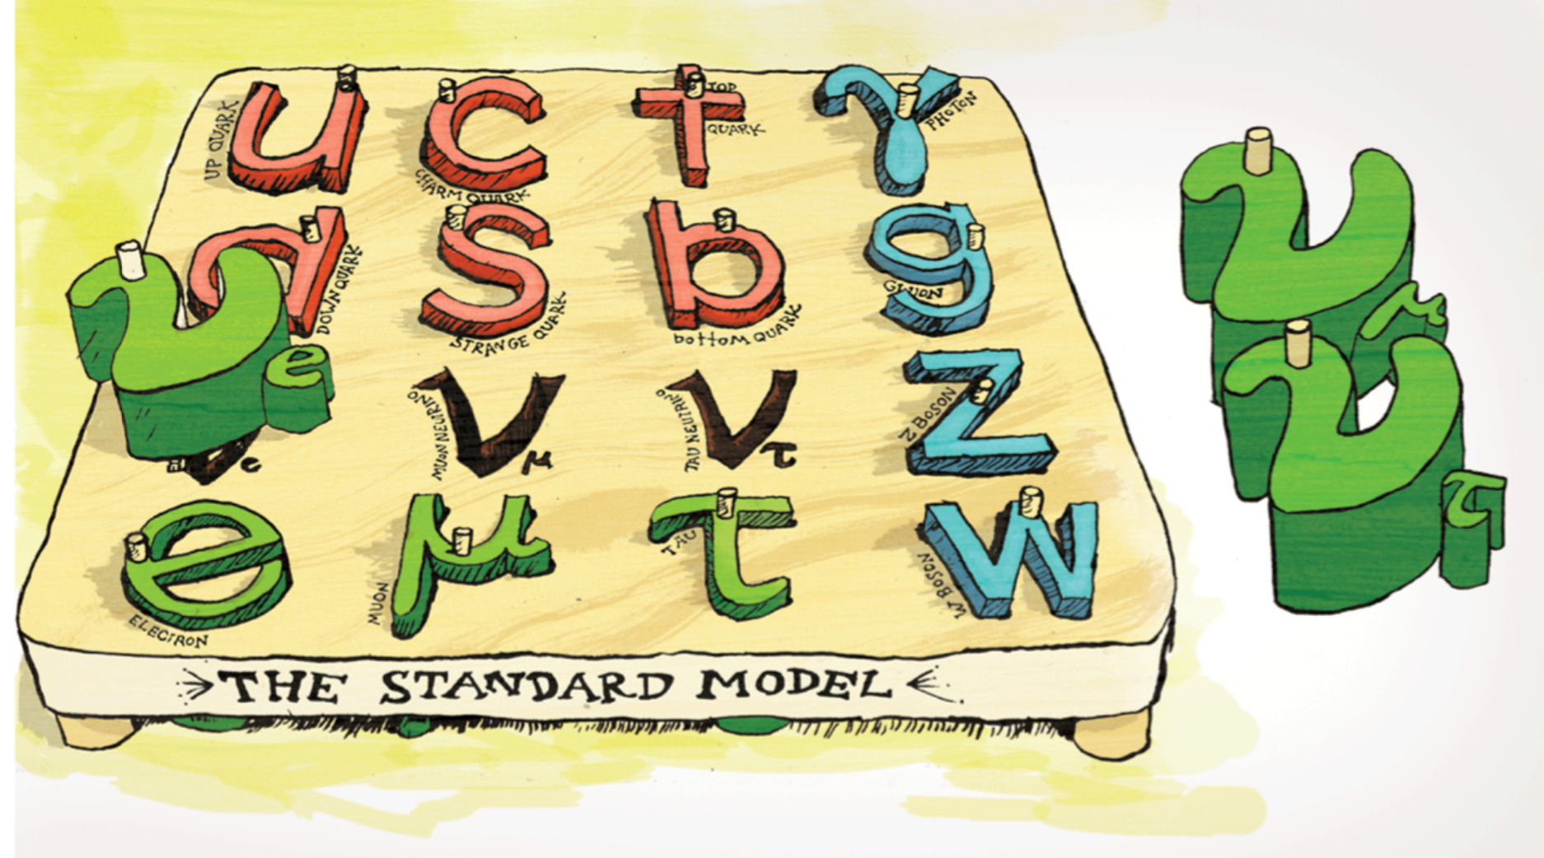
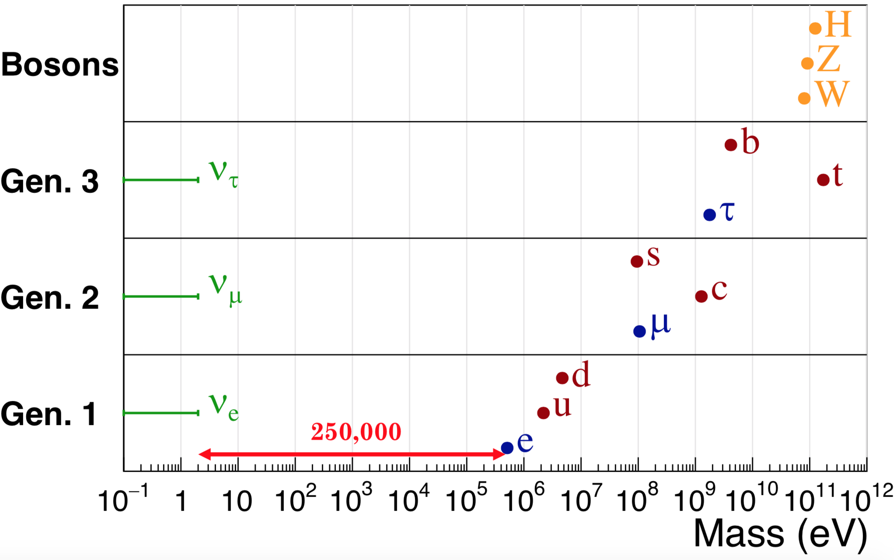
A Gap in the Standard Model
Neutrino mass doesn’t quite fit in the original Standard Model – how does it arise?
Image from Symmetry Magazine
Why are neutrinos so light compared to all other fundamental particles?
Plot from Luke Kippenbrock

Slide 5
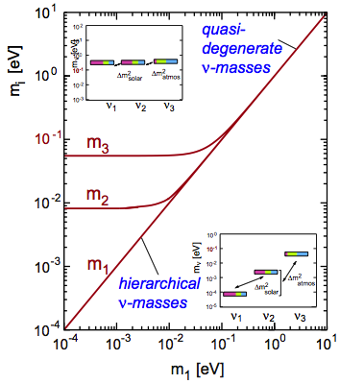
Neutrino Mass Scale
Normal hierarchy
Oscillation experiments give a lower limit on the two heavier neutrino-mass states
What can we say about the offset of the lightest mass from zero?
Neutrino mass m_{i} (eV)
Lightest neutrino mass m₁ (eV)

Slide 6
Neutrino Mass and Cosmology
Most abundant matter particle in universe
  Neutrino mass affects structure formation, CMB
CDM density
ν density
Σm_{i}=0.6 eV
ν density
Σm_{i}=0.3 eV
J. Brandbyge et al., J. Cosm. Astropart. Phys. 2008 (2008) 020
You can try to measure neutrino mass with cosmic microwave background
Or ... you can test cosmology in the lab!
Notes:
Neutrino free-streaming inhibits the growth of perturbations (i.e. suppress the matter power spectrum)
Degeneracy is enhanced at lower neutrino masses
Increasing mnu decreases the amplitude of power spectrum of matter perturbations in universe
Tension with Planck Sunyaev-Zel’dovich cluster abundances. That pushes m_nu higher, but that in turn worsens the discrepancy with local H0 measurements

Slide 7
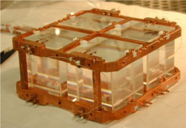
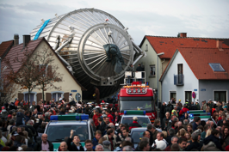
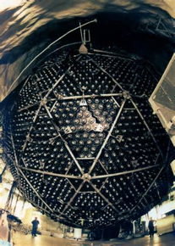
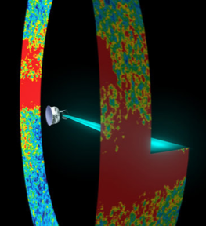
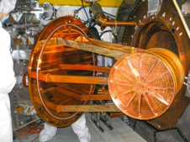
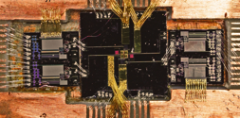
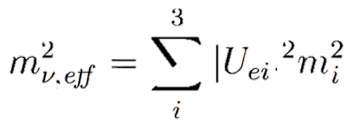
Probes of Neutrino Mass
 | ν oscillation | 0νββ | Cosmology | Decay kinematics
Observable
Present knowledge |  | m_{ββ} < (0.06-0.4) eV |  | m_{ν,eff} < 2 eV
Next gen. / near future |  | 0.01 – 0.05 eV | 0.01 – 0.05 eV | 0.2 eV
Model dependence of mass extraction | No mass-scale information | δ₁, δ₂ phases Nuclear matrix elements Requires LNV | ΛCDM Many parameters | Energy conservation

Slide 8
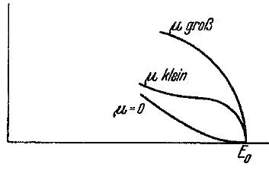
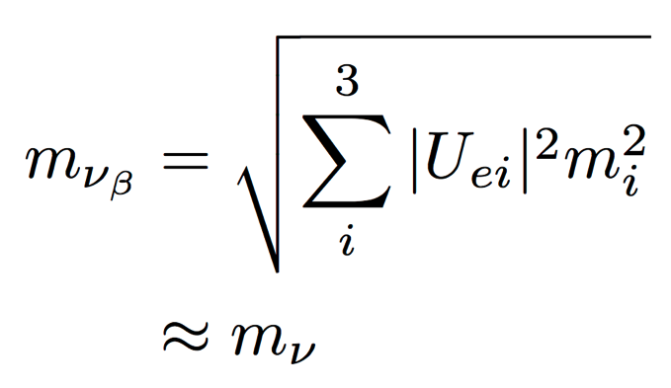
Direct m_{ν} from β⁻ Decay
ν_{e}
Fermi, Zeitschrift für Physik, 88 (1934) 161
e⁻
³H
³He
m_{νβ} from kinematics
  Almost model-independent
m_{νβ} = 0 eV
m_{νβ} = 1 eV
Extract m_{νβ} from spectral shape near endpoint
³H (tritium)
Q = 18.6 keV
t_{½} = 12.3 years
Super-allowed
(quasidegenerate regime)

Slide 9
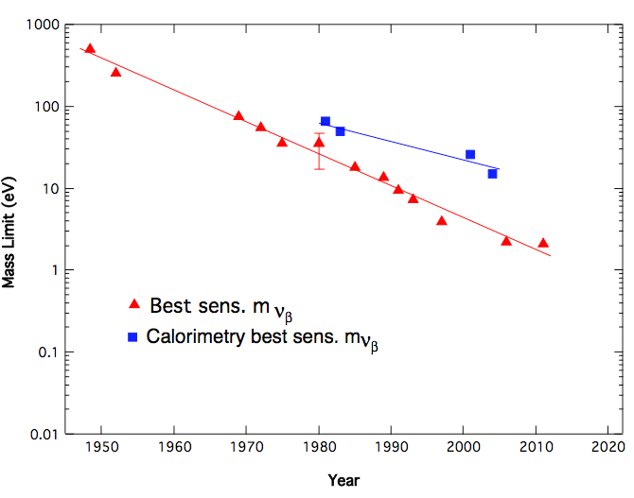
The State of the Art (Until Now)
100x more until oscillation limit
No longer quasi-degenerate below 0.1 eV
Mainz/Troitsk limit: m_{νβ} < 2 eV (90% CL)
SuperK oscillation result
SNO oscillation result
MIBETA
Mass Limit (eV)
Neutrinos discovered
Troitsk
Mainz
Year
Figure from J. Wilkerson, Neutrino 2012

Slide 10
The Plan
Neutrinos and neutrino mass: A quick review
Molecular physics of T₂
KATRIN: How to weigh a neutrino
Background considerations
KATRIN’s new results
What’s next?

Slide 11
Molecular Final-State Distribution
Electronic excitations in T atoms
Excitations in T₂ gas
  Electronic: 20 eV
  Vibrational: ~0.1 eV
  Rotational: ~0.01 eV
Beta spectrum depends on excitation energies V_{k} and probabilities P_{k}

Slide 12

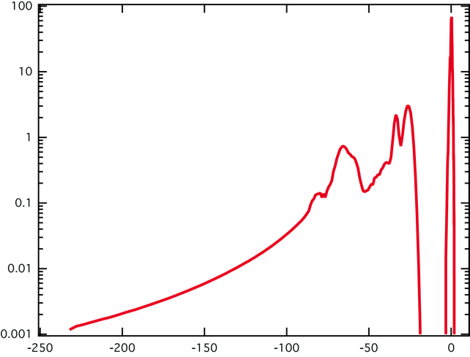
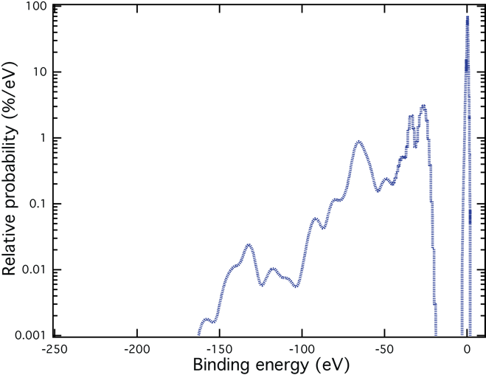
LANL, LLNL and the FSD
Any mistake in the FSD variance will shift the mass observable:
Robertson and Knapp, Annu. Rev. Nucl. Part. Sci 38, 185 (1988)
Older calc. (Fackler et al. 1985)
Modern calc. (Saenz et al. 2000)
Bodine, DSP, Robertson, Phys. Rev. C 91, 035505 (2015)

Slide 13
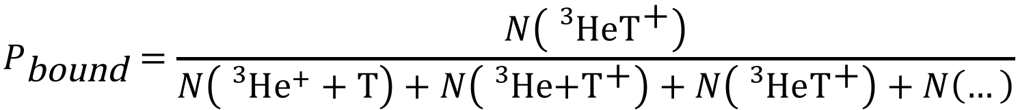
The Odd Observable Out
How often does ³HeT⁺ stay bound after beta decay?
$$P_{\text{bound}}=\frac{N\left({}_{}^{3}{\text{He}{\text{T}}^{\text{+}}}\right)}{N\left({}_{}^{3}{\text{H}{\text{e}}^{+}+\text{T}}\right)+N\left({}_{}^{3}{\text{H}\text{e}\text{+}{\text{T}}^{\text{+}}}\right)+N\left({}_{}^{3}{\text{He}{\text{T}}^{\text{+}}}\right)+N\left(…\right)}$$
 | Theory | Snell Experiment* | Wexler Experiment*
HT | 0.55 – 0.57 | 0.932 ± 0.019 | 0.895 ± 0.011
T₂ | 0.39 – 0.57 |  | 0.945 ± 0.006
Jonsell, Saenz, Froelich, PRC 60, 034601 (1999)
Snell, Pleasanton, Leming, J. Inorg. Nucl. Chem. 5, 112 (1957)
Wexler, J. Inorg. Nucl. Chem. 10, 8 (1958)
* = Not really comparable ...

Slide 14
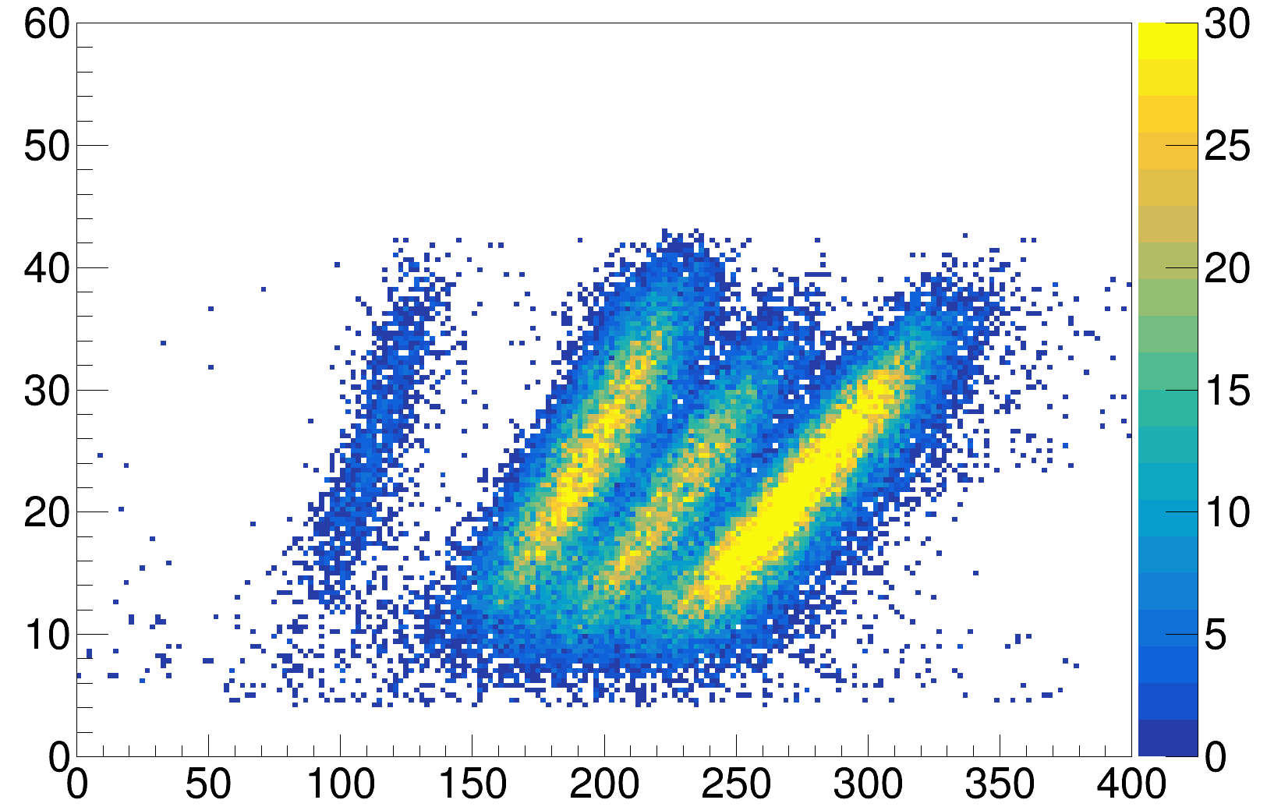

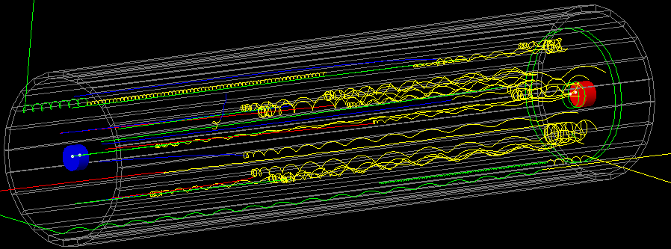
Tritium Recoil-Ion Mass Spectrometer
A few plausible experimental explanations for discrepancy
TRIMS (at University of Washington) aims to resolve the issue with a modern time-of-flight mass spectrometer
30 minutes with HT – T₂ gas mix
Preliminary
H⁺
³He⁺, T⁺
³HeT⁺
³HeH⁺
Ion Energy (keV)
Ion Timing – Beta Timing (ns)

Slide 15
The Plan
Neutrinos and neutrino mass: A quick review
Molecular physics of T₂
KATRIN: How to weigh a neutrino
Background considerations
KATRIN’s new results
What’s next?

Slide 16
The First Challenge
~10⁻¹³ of decays
m_{νβ} = 0 eV
m_{νβ} = 1 eV
Take a huge number of decays
Precisely measure energy, rate near endpoint
Somehow ignore all the low-energy decays with no useful information

Slide 17
MAC-E Filter
Measure integral spectrum with moving threshold
Magnetic Adiabatic Collimation + Electrostatic filter
Electrodes
T₂ source
Detector
Analyzing plane
p_{e} (without E field)
Detailed application to KATRIN: Kleesiek et al., EPJC 79 204 (2019)

Slide 18



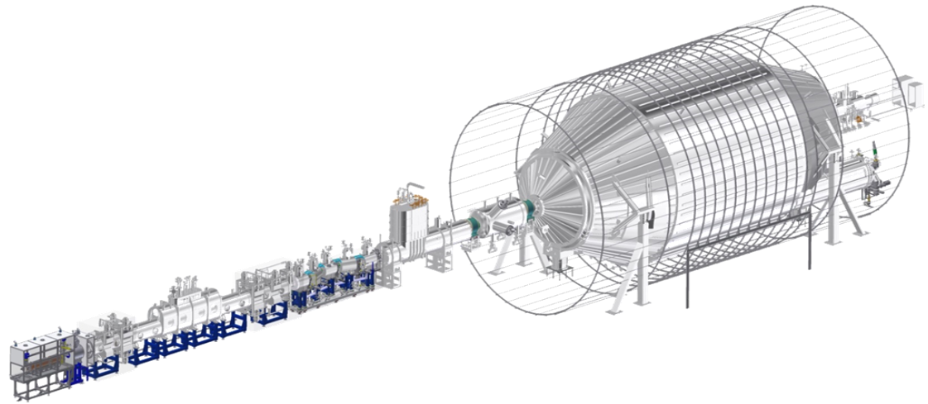

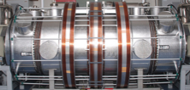
KATRIN Experiment
1 e⁻/sec
³H
³He
ν_{e}
10³ e⁻/sec
Detector
e⁻
10¹¹ e⁻/sec
Spectrometers
(integrating high-pass filters)
Gaseous T₂ source
Transport section
Voltage monitoring
V

Slide 19

KATRIN by the Numbers
Expected m_{ν} sensitivity in 5 calendar years:
0.2 eV at 90% confidence
Magnetic field range 3 G – 60,000 G
Source activity: 10¹¹ decays every second
95% tritium purity
Main spectrometer volume: 1240 m³

Slide 20
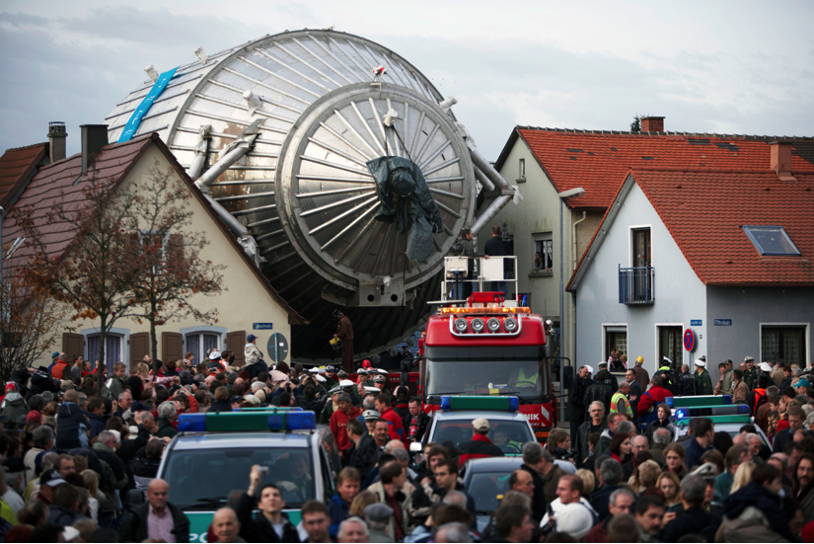
1240 m³ in Real Life
Leopoldshafen, Germany
November 2006
Photo: KIT

Slide 21
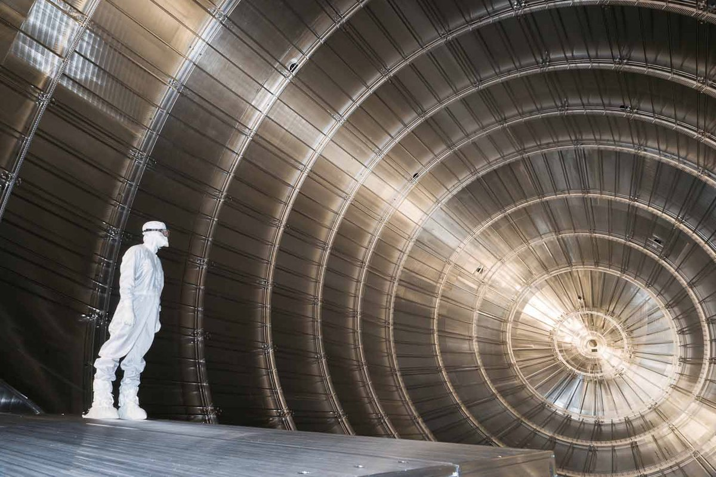
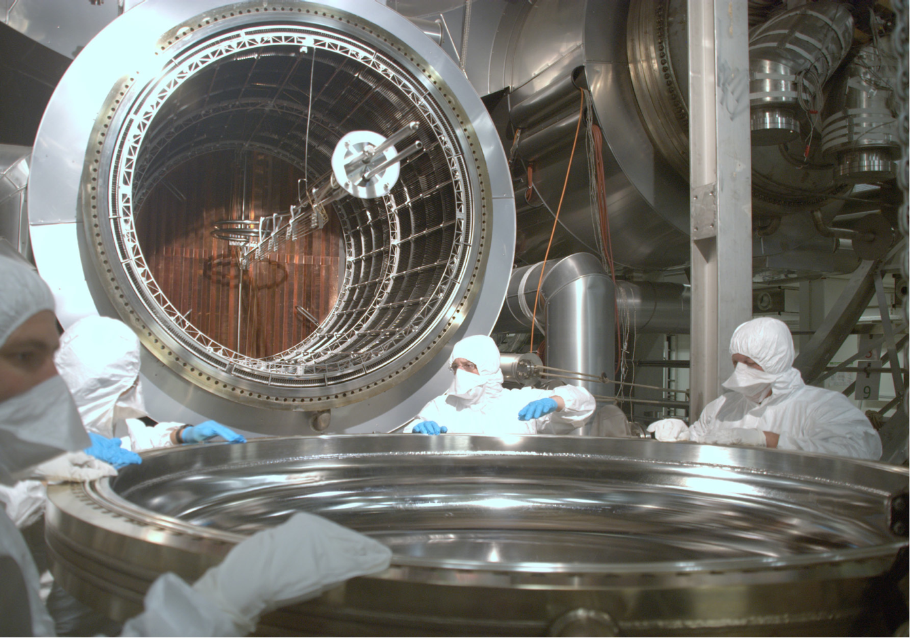
1240 m³: Practical Challenges
2007-2012
Photo: KIT
Spring 2013
Arenz et al., JINST 11 P04011 (2016)

Slide 22
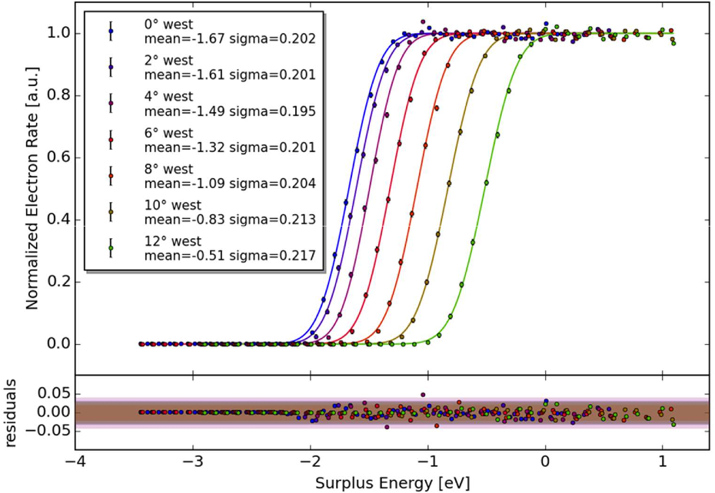
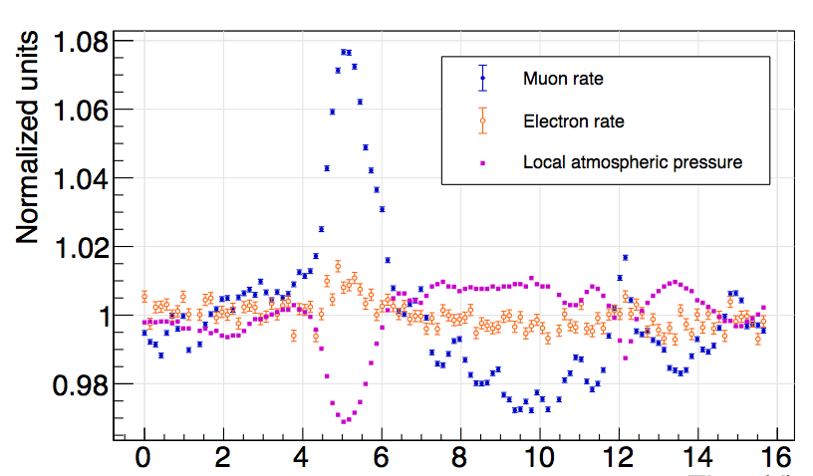
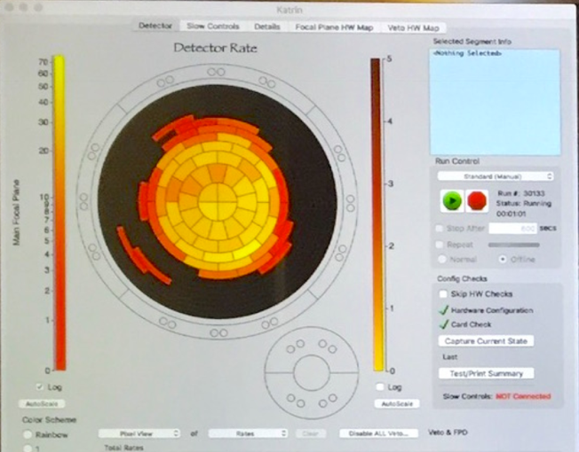
Putting It Together
Transmission function
Backgrounds
Normalized Electron Rate (arb. u.)
Time (days)
Astropart. Phys. 108 40 (2019)
Surplus energy (eV)
First electrons transmitted down entire beamline (October 2016)

Slide 23
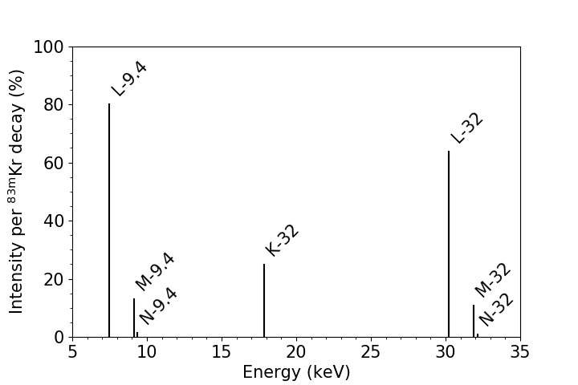
Can KATRIN Measure Decay Spectra?
Quasi-monoenergetic electron source: ^{83m}Kr
Conversion electron lines with linewidths ~ few eV
⁸³Rb
5/2–
^{83m}Kr
T_{1/2} = 86.2 d; 75 %
1/2–
T_{1/2} = 1.83 h
α = 1947
ΔE = 32.1516 keV
K–N electrons
7/2⁺
T_{1/2} = 155 ns
α = 16
ΔE = 9.4057 keV
L–N electrons
9/2⁺
Slide credit: Martin Slezák, TUM/MPPG

Slide 24
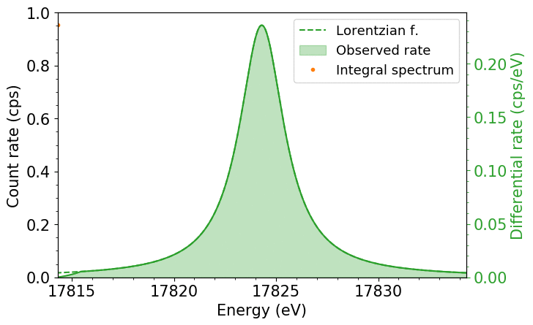

Scanning a Conversion-Electron Line
Set retarding potential and record rate of electrons at the detector
Map out the spectrum by stepping the potential
sharp high-pass filter
Transmission
ΔE
Energy
Slide credit: Martin Slezák, TUM/MPPG

Slide 25
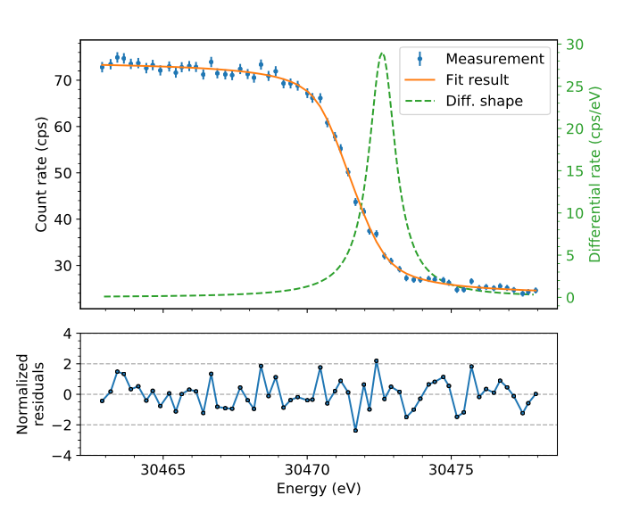
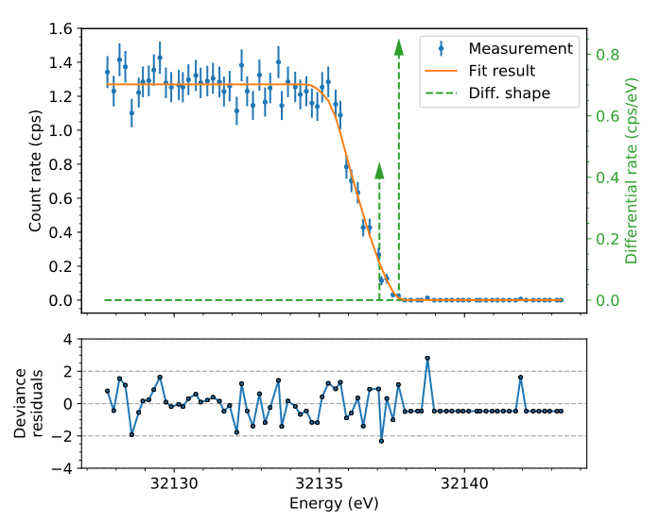
^{83m}Kr Spectroscopy at KATRIN
arXiv:1903.06452 [physics.ins-det]
K-32 and L₃-32 linewidth uncertainties improved by 10x
L₃-32
30472.60 ± 0.02 eV
Γ=1.15 ± 0.02 eV
N_{2,3}-32
32137.098 ± 0.05 eV
32137.758 ± 0.05 eV
Sub-eV energy resolution

Slide 26
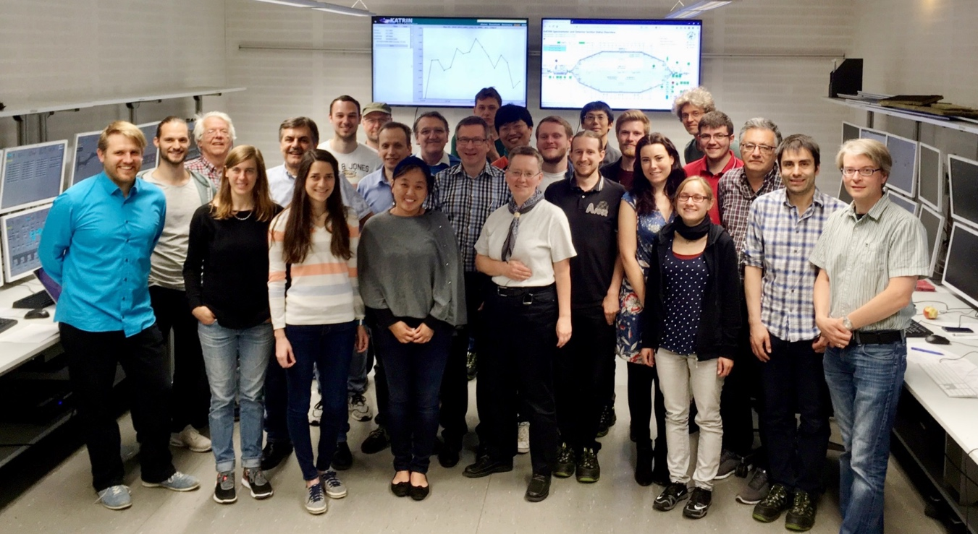
Can KATRIN Handle Tritium?
First tritium tests in May-June of 2018
0.5% T atoms circulating in D₂ gas
Tested everything except loops
Preliminary
Day 1 Fit,
Stats Only
First tritium injection:
Friday 18 May
7:48 am UTC

Slide 27

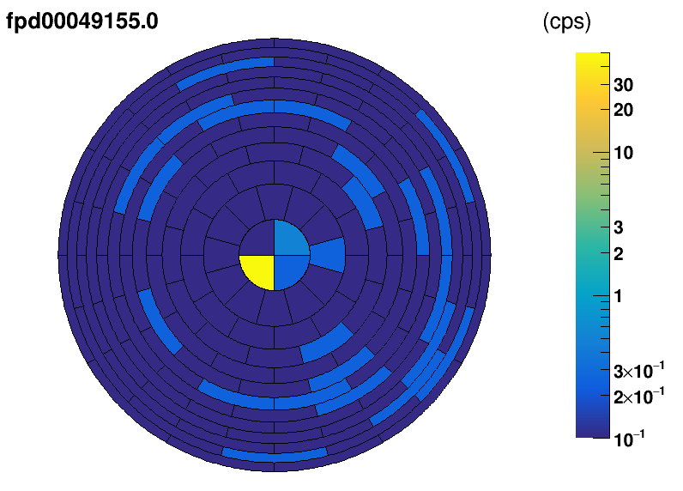
Spring 2019: KATRIN Takes Off
A few glitches remained

Slide 28
The Plan
Neutrinos and neutrino mass: A quick review
Molecular physics of T₂
KATRIN: How to weigh a neutrino
Background considerations
KATRIN’s new results
What’s next?

Slide 29
Backgrounds
Backgrounds 30x higher than design goal!
Two weird sources: Rydberg atoms and Rn decay
But, rates were stable and we have some countermeasures

Slide 30
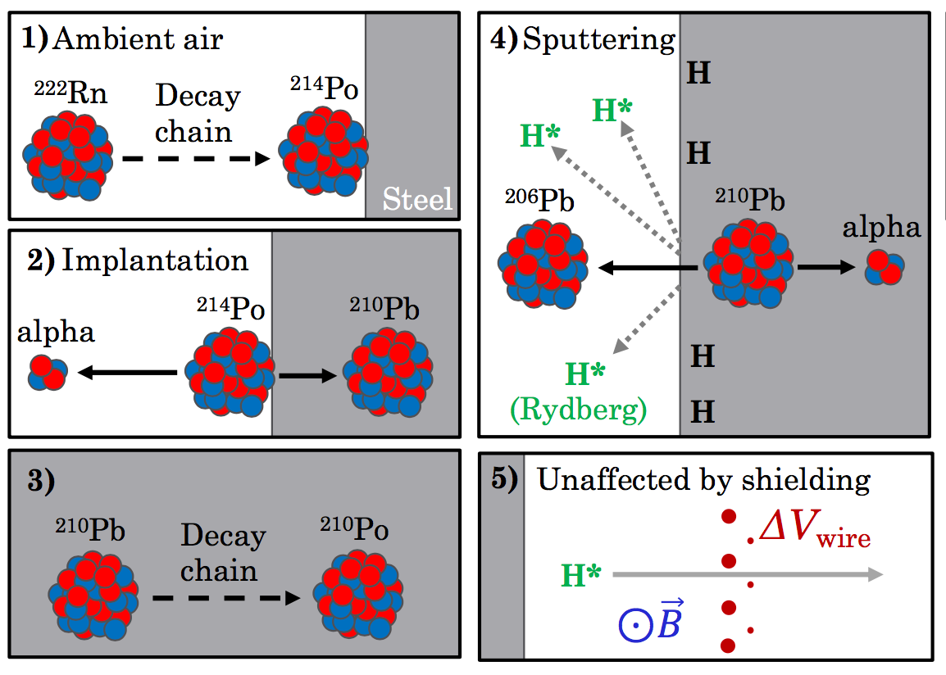
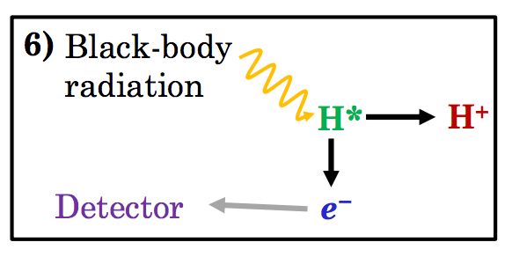
The Rydberg Background
²¹⁰Po
Dominant background
Tested with ²²⁰Rn source
  All daughters are short-lived
Slide credit: Luke Kippenbrock, UW

Slide 31
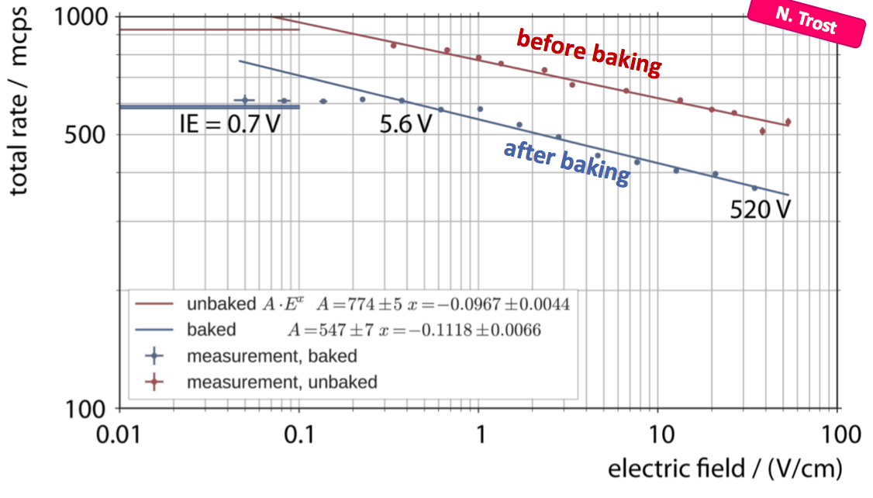
Does This Really Make Sense?
Dominant background is homogeneously distributed in the volume
Background electrons are created with very low energy (< 1 eV)
Rate dependence on temperature, inner-electrode offset, bakeout

Slide 32
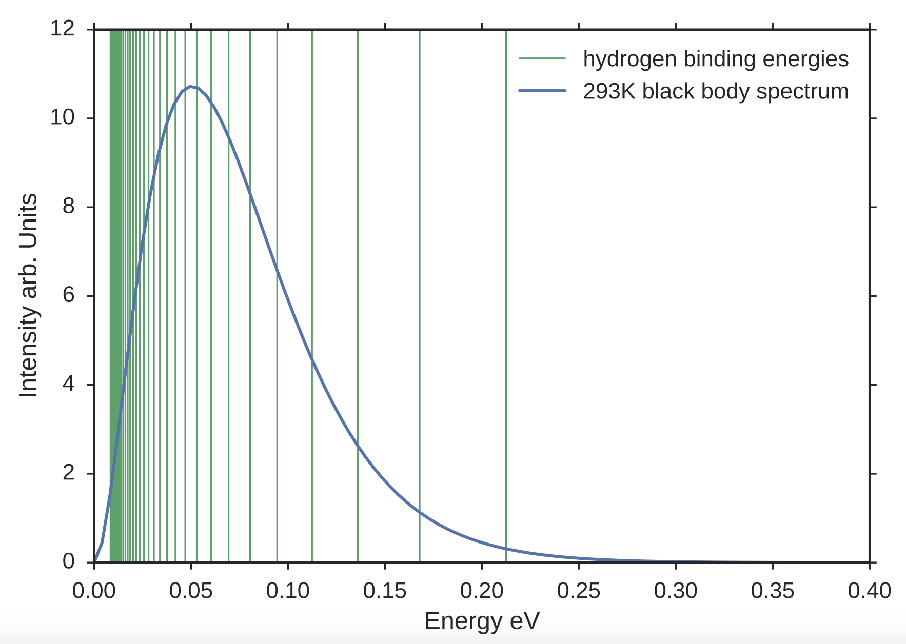
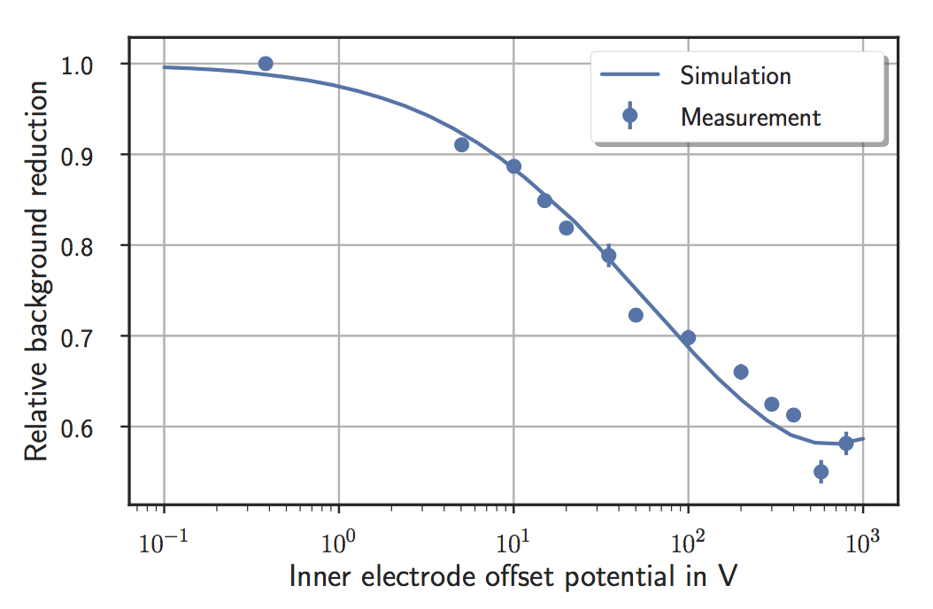
Rydberg Backgrounds: I Want to Believe
Blackbody radiation really can ionize these atoms
Simulations reproduce measured rate, dependences
Hydrogen binding energies, 8 ≤ n ≤ 40
Intensity (arb. u.)
Relative background reduction
BBR spectrum, 293 K
Energy (eV)
Inner electrode offset potential (V)
PhD thesis, Nikolaus Trost (KIT)

Slide 33
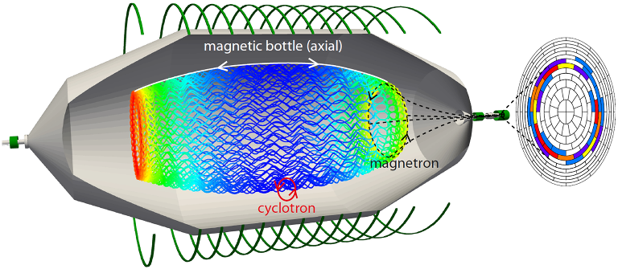
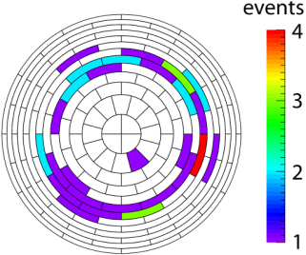
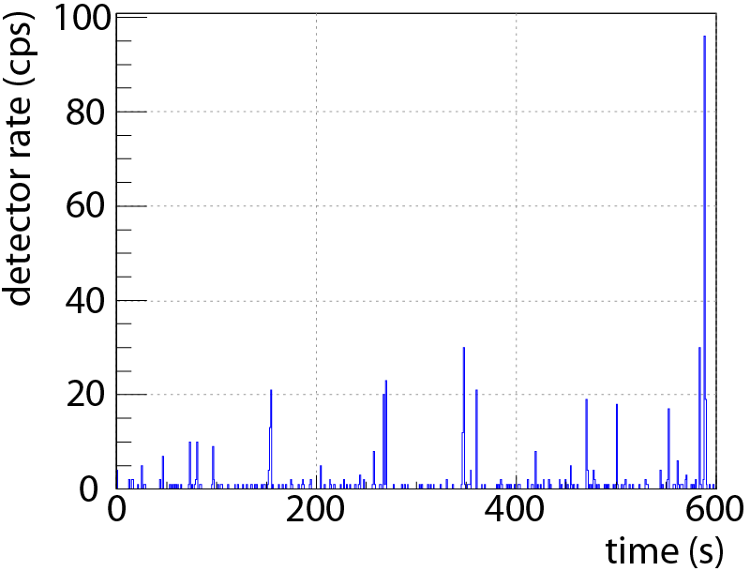

Radon-Induced Backgrounds
simulation
measurement
clustered events
“single” events
²¹⁹Rn emanates from NEG pumps
Shakeoff electrons are magnetically trapped and ionize residual gas molecules
Detected electrons show motion pattern of progenitors
Slide credit: Florian Fränkle, KIT

Slide 34
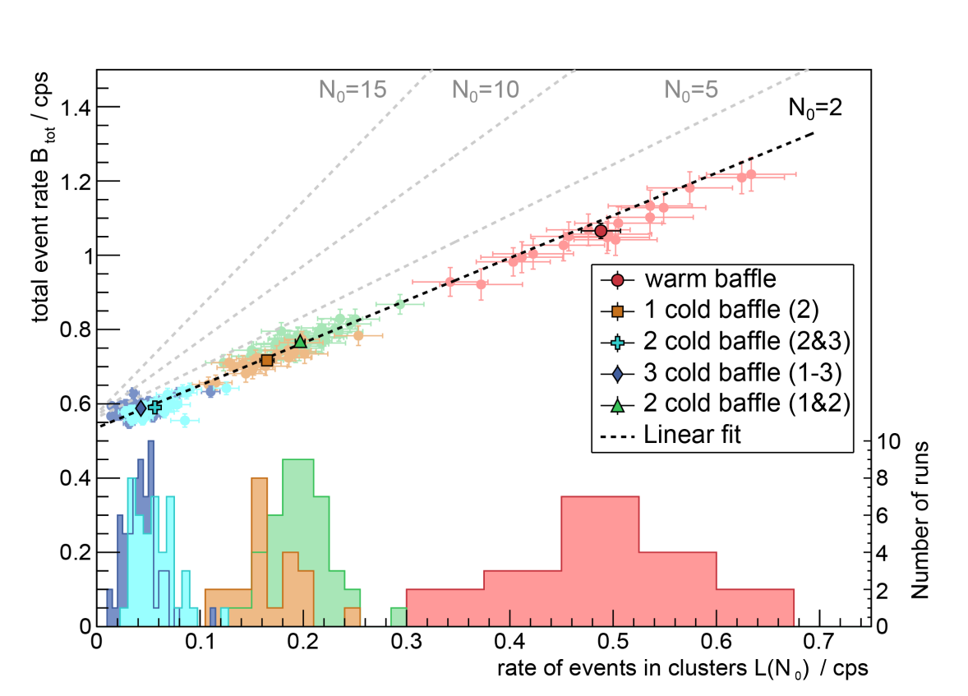
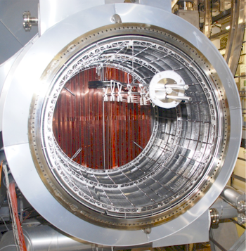
Suppression: Radon-Induced Background
LN-cooled baffle at each pump port
~97% suppression with all three baffles cold
Testing optimal regeneration strategy
Total background rate (cps)
Rate of events in clusters (cps)
PhD thesis, Fabian Harms (KIT)

Slide 35
The Plan
Neutrinos and neutrino mass: A quick review
Molecular physics of T₂
KATRIN: How to weigh a neutrino
Background considerations
KATRIN’s new results
What’s next?

Slide 36
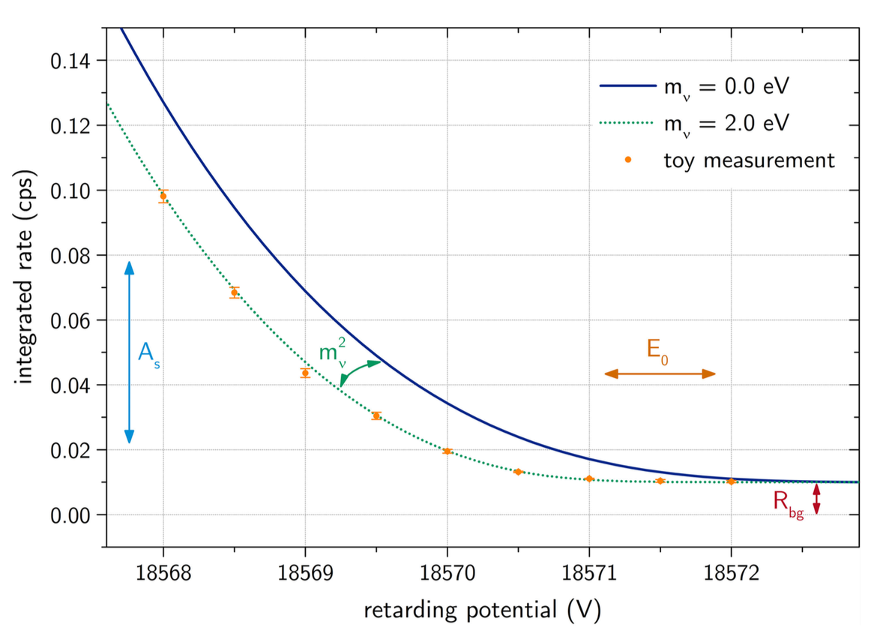
Fitting the Data (in Principle)
A KATRIN spectral fit ideally has four parameters:
  Amplitude / intensity
  Background rate
  Endpoint energy
  m_{ν}²
PhD thesis, Marco Kleesiek (KIT)

Slide 37
Fitting the Data (in Practice)
Fit of modeled to measured spectrum over all data
  Treat detector as one uniform pixel
  “Stack” similar high-voltage settings
  4 fit parameters: intensity, background, endpoint, neutrino mass

Slide 38
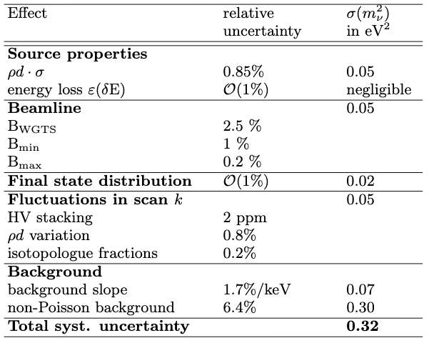
Systematics
Column density
Magnetic fields
Molecular physics
Drifts
Backgrounds
Statistical 0.97

Slide 39
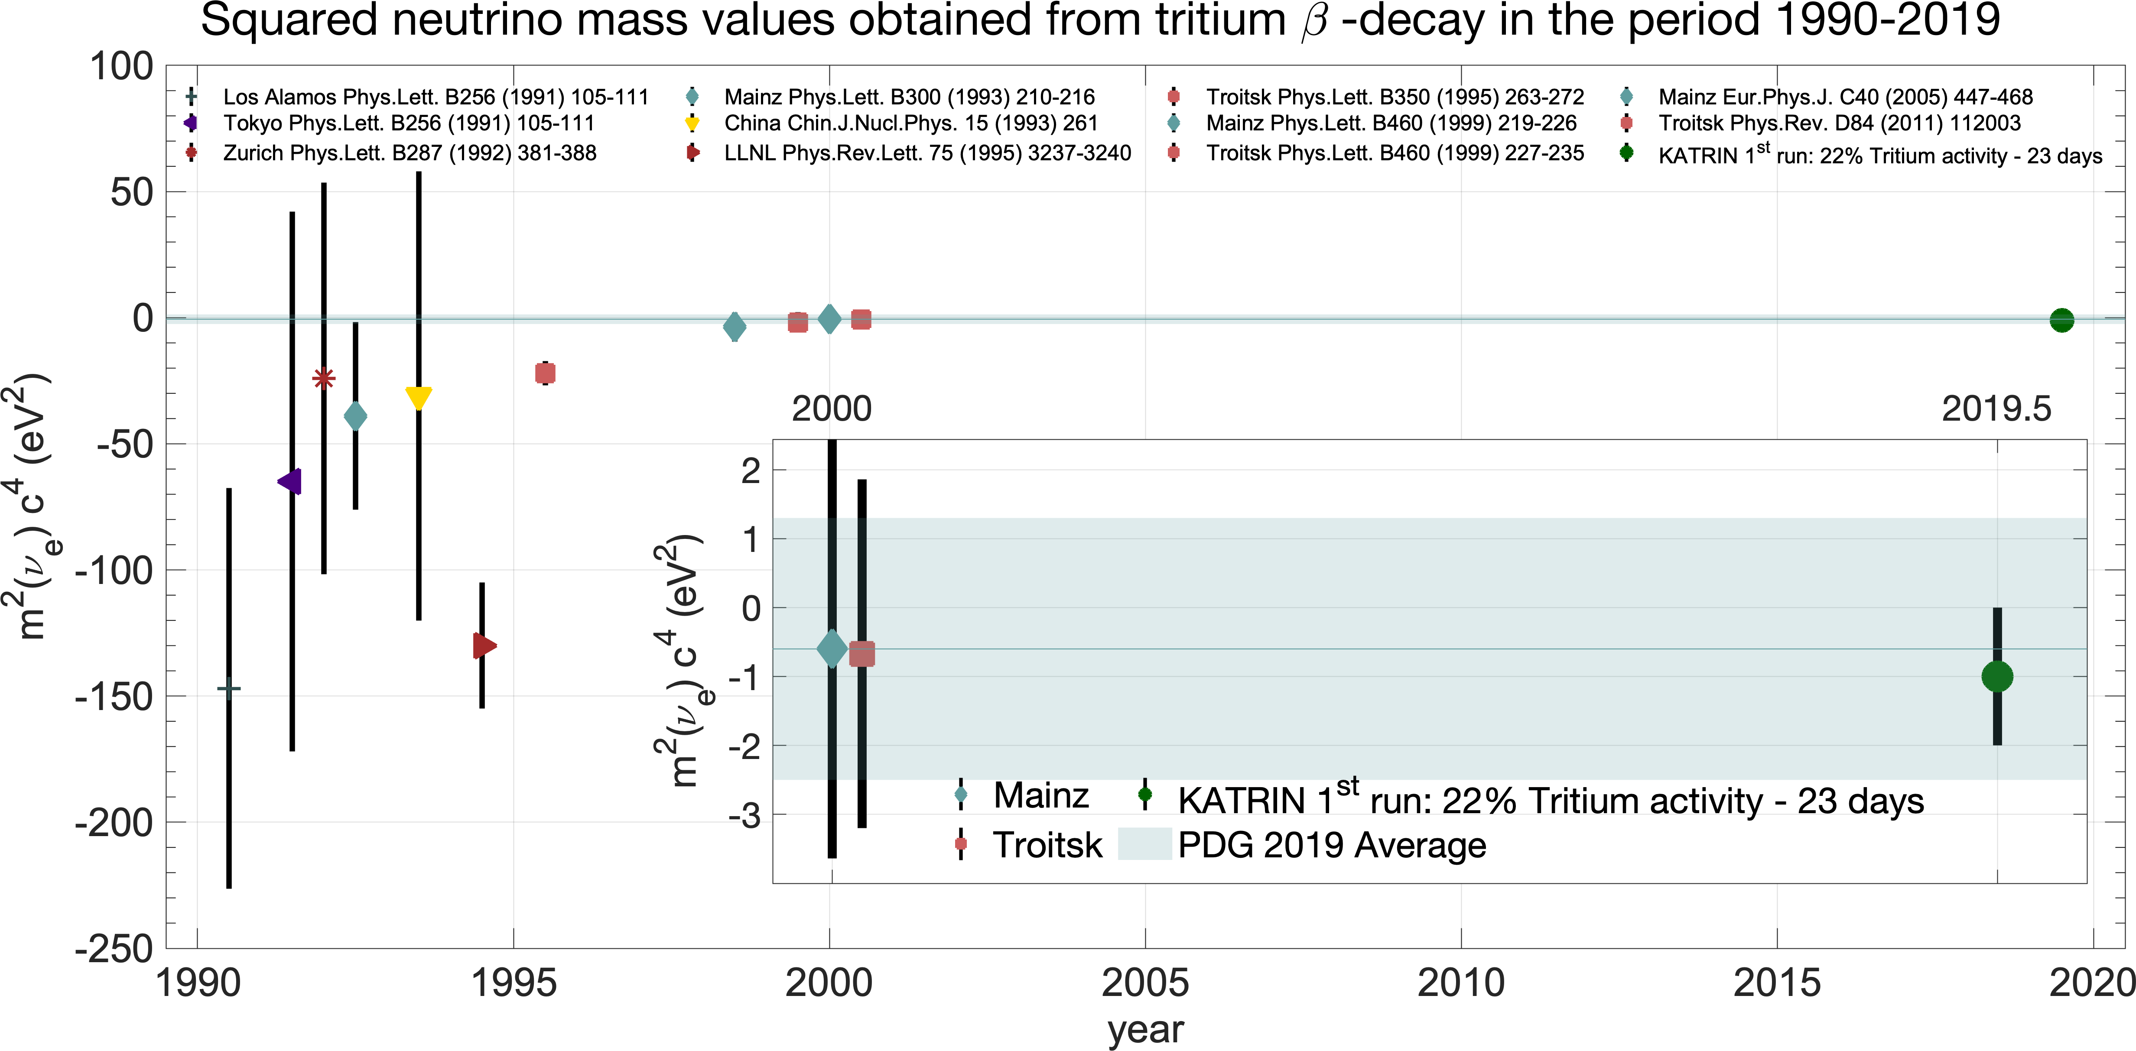

The Results
Best-fit value:$m_{ν}^{2}=\left({−1.0}_{−1.1}^{+0.9}\right) {\text{eV}}^{2}$
Find upper limit based on sensitivity:
    ${ m}_{ν}<1.1 \text{eV}\text{ (90\% }\text{C}\text{.}\text{L}\text{.)}$
arXiv:1909.06048 [hep-ex]

Slide 40
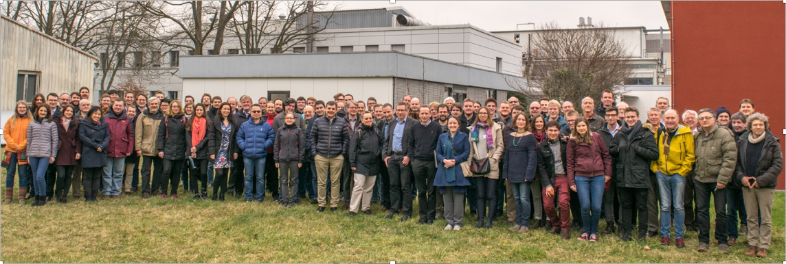
Acknowledgments
Funding and support from: Helmholtz Association (HGF), Ministry for Education and Research BMBF (05A17PM3, 05A17PX3, 05A17VK2, and 05A17WO3), Helmholtz Alliance for Astroparticle Physics (HAP), and Helmholtz Young Investigator Group (VH-NG-1055) in Germany; Ministry of Education, Youth and Sport (CANAM-LM2011019), cooperation with the JINR Dubna (3+3 grants) 2017–2019 in the Czech Republic; and the Department of Energy through grants DE-FG02-97ER41020, DE-FG02-94ER40818, DE-SC0004036, DE-FG02-97ER41033, DE-FG02-97ER41041, DE-AC02-05CH11231, DE-SC0011091, and DE-SC0019304 in the United States.

Slide 41
Conclusion
Neutrino mass is an exciting field!
  Gap in Standard Model
  Cosmological data from the lab
KATRIN is taking data and taking names
  More neutrino-mass runs – at 4x the column density – started last month!
Thank you!
m_{ν} limit (eV, 90% CL)
Discovery potential (σ)
Full beam time (months)
Full beam time (yrs)
G. Drexlin et al., Adv. High Energy Phys. 2013 (2013) 293986

Slide 42
Backup

Slide 43
Beyond Neutrino Mass?
With an incredibly precise measurement of the tritium β spectrum, we can probe:
  Lorentz-invariance violation
    Endpoint oscillation during sidereal day
  Sterile neutrinos
  Relic neutrinos
  Right-handed weak currents
  New, light bosons
Díaz et al., Phys. Rev. D 88 (2013) 071902(R)
Formaggio and Barrett, Phys. Lett. B 706 (2011) 68;
Mertens et al., JCAP 02 (2015) 020
Faessler et al., EPJ Web Conf. 71 (2014) 00044
Bonn et al., Phys. Lett. B 703 (2011) 310
Arcadi et al., JHEP 2019 (2019) 206

Slide 44
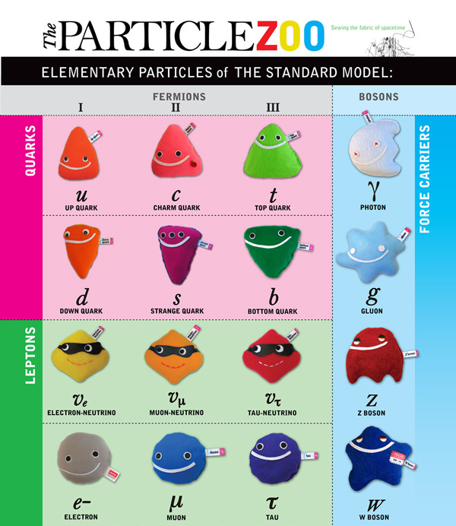
Three Neutrino Flavors
Electron neutrino ν_{e}:
  Nuclear reactions (fission, fusion)
  Beta decays
Muon neutrino ν_{μ}:
  Cosmic-ray interactions in atmosphere
Tau neutrino ν_{τ}:
  Accelerators
  Last fundamental particle discovered before Higgs
http://www.particlezoo.net

Slide 45





Neutrino Oscillation
SuperKamiokande, Japan
SNO, Canada
Source
ν_{e}
L
ν_{e}
ν_{e}
ν_{e}
ν_{e}
v_{e}
ν_{e}
ν_{τ}
Detector
v_{μ}
ν_{μ}
Probability of detecting ν_{α}
ν_{τ}
ν_{e}
v_{τ}
ν_{μ}
ν_{e}
L/E (km/GeV)
Credit: Wikipedia

Slide 46




Neutrinos Have Mass!
Neutrino oscillation means mixing between flavor and mass states:
$$\left|ν_{e}\right\rangle =a\left|ν_{1}\right\rangle +b\left|ν_{2}\right\rangle +c|ν_{3}⟩$$
$$\left|ν_{μ}\right\rangle =A\left|ν_{1}\right\rangle +B\left|ν_{2}\right\rangle +C|ν_{3}⟩$$
$$\left|ν_{τ}\right\rangle =α\left|ν_{1}\right\rangle +β\left|ν_{2}\right\rangle +γ|ν_{3}⟩$$
The masses are different, so the coefficients change as the neutrino travels
Measurement collapses the wave function and gives a chance of observing a different flavor
(simplified two-neutrino case)
Notes:
The mass eigenstates propagate with different frequencies.

Slide 47




m_{νi} from Supernovae
Supernova 1987a in light
Supernova 1987a in neutrinos
G. G. Raffelt, Annu. Rev. Nucl. Part. Sci. 49 (1999), 163
Time delay goes as m_{νi}²/E_{ν}²
From absence of dispersion, m_{νi} < 5.8 eV

Slide 48

Neutrino Mass and 0νββ
If neutrinos are Majorana instead of Dirac, then:
  Lepton number violation
  Possible baryogenesis explanation
  Neutrinoless double beta decay 0νββ
{
Kellie Jaeger, Discover Magazine
Better m_{νβ} from lab: access phases α_{i}

Slide 49
Column Density
Tritium-decay β energy means radiochemistry
Tritiated methane forms in source and freezes in capillary
Ran at 20% nominal column density to control blockage
Cold trap installed this summer

