Slide 1
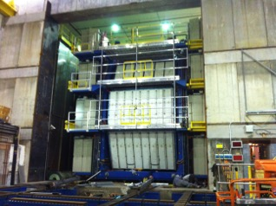
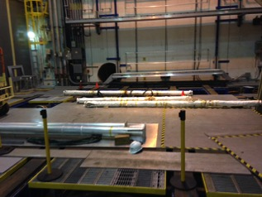
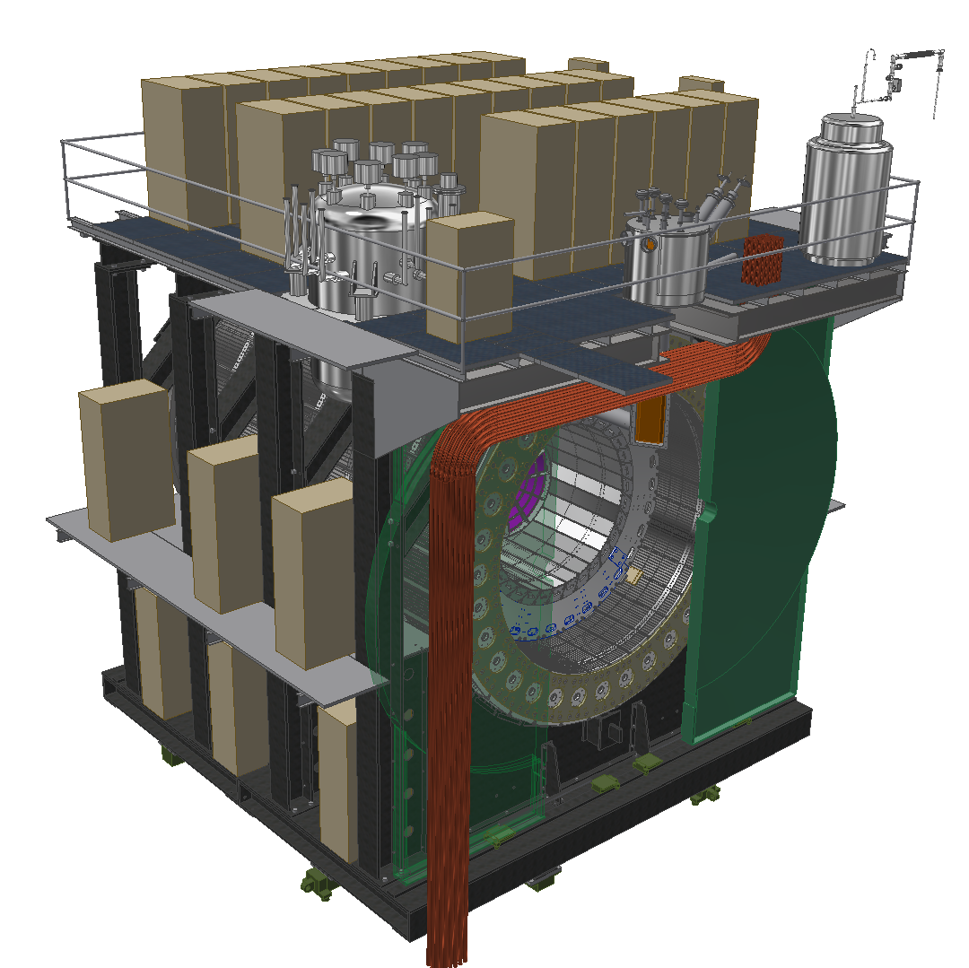
sPHENIX Planning
Weekly Planning Meeting: 9/26/2019

Slide 2
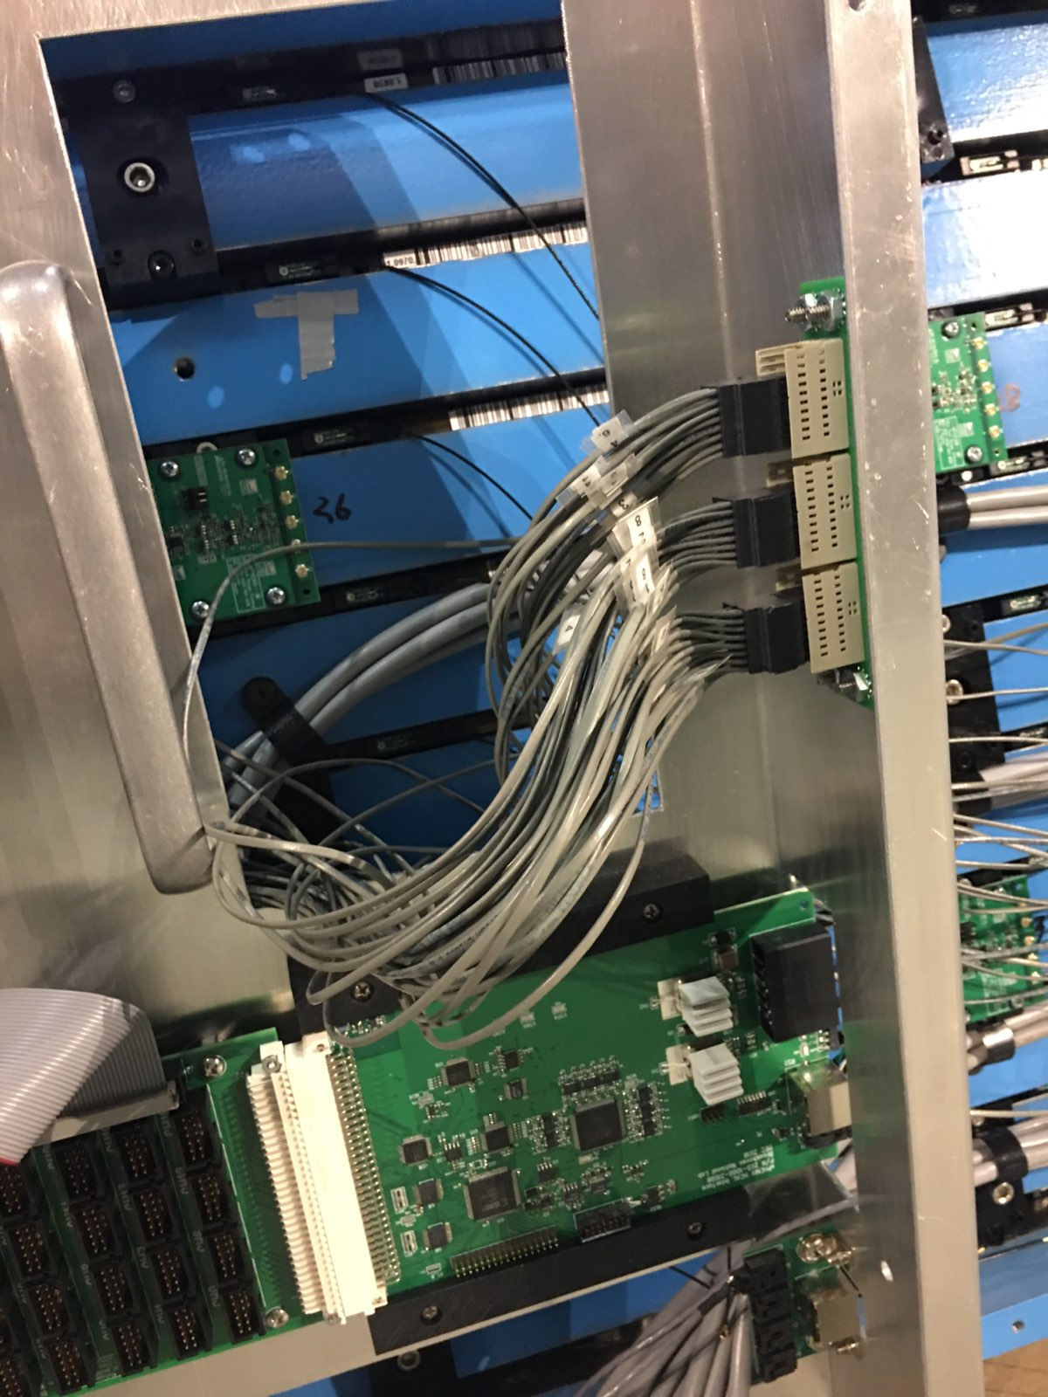
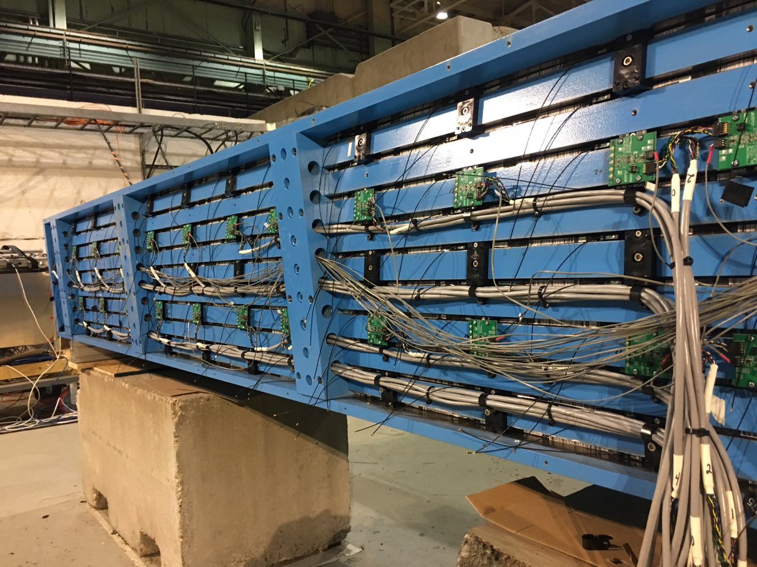
HCAL
TASK | STATUS | NOTES
Continue to Support O-Hcal Factory in 912 | ONGOING
O-Hcal sector inspection (Go/No Go Gauge) | ONGOING | 3 left
HCAL Electronics box | ONGOING
Preproduction Skins | ONGOING
OHCAL Cables, pre-amps, fibers, etc | ONGOING | Progress
SiPM Arrival | ONGOING
Starting to cable 1st sector | ONGOING | Signal Cables Installed
Super clamp for rigging | ONGOING | Shipping 9/7

Slide 3
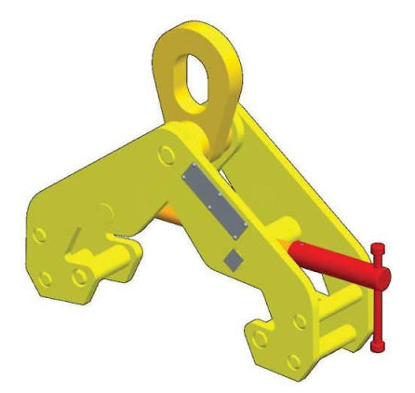
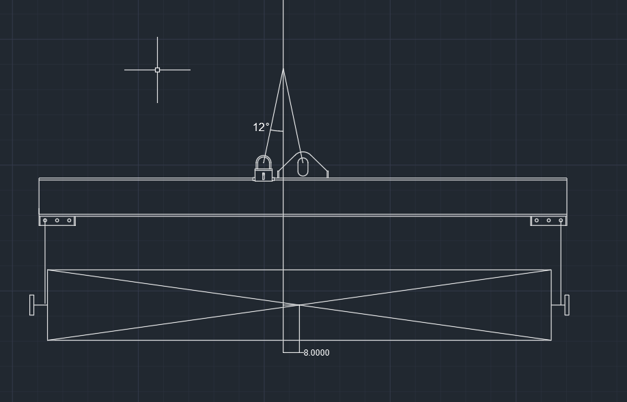

Manufacturer will ship 9/27 (Friday)

Slide 4
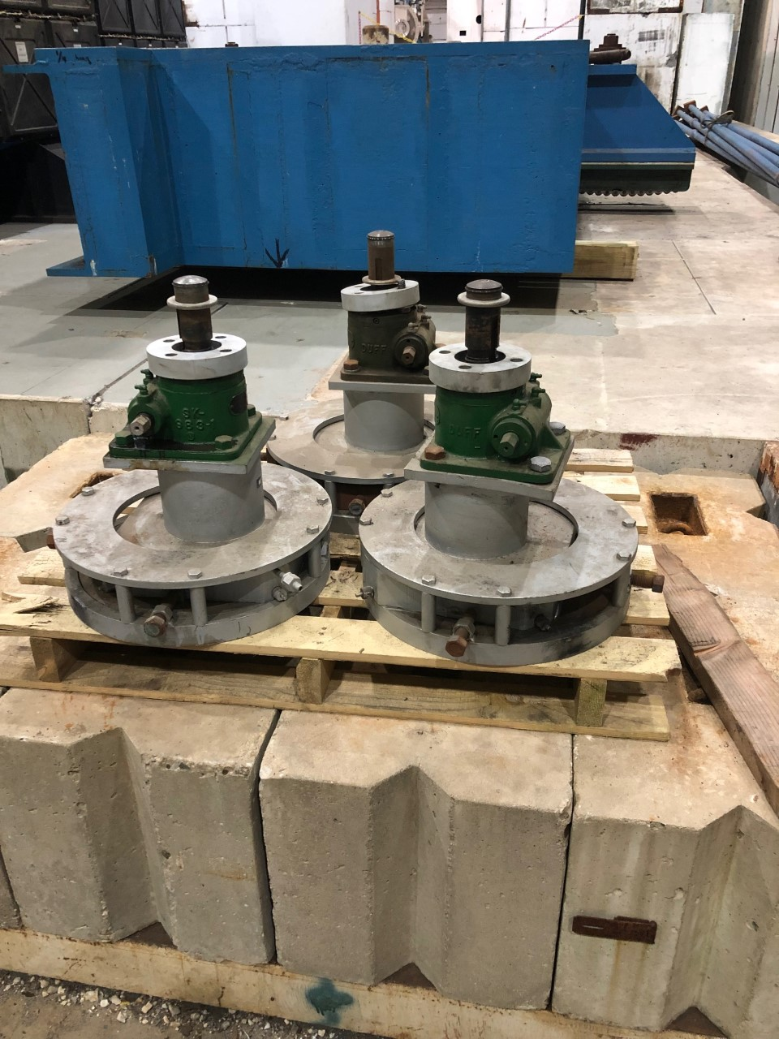
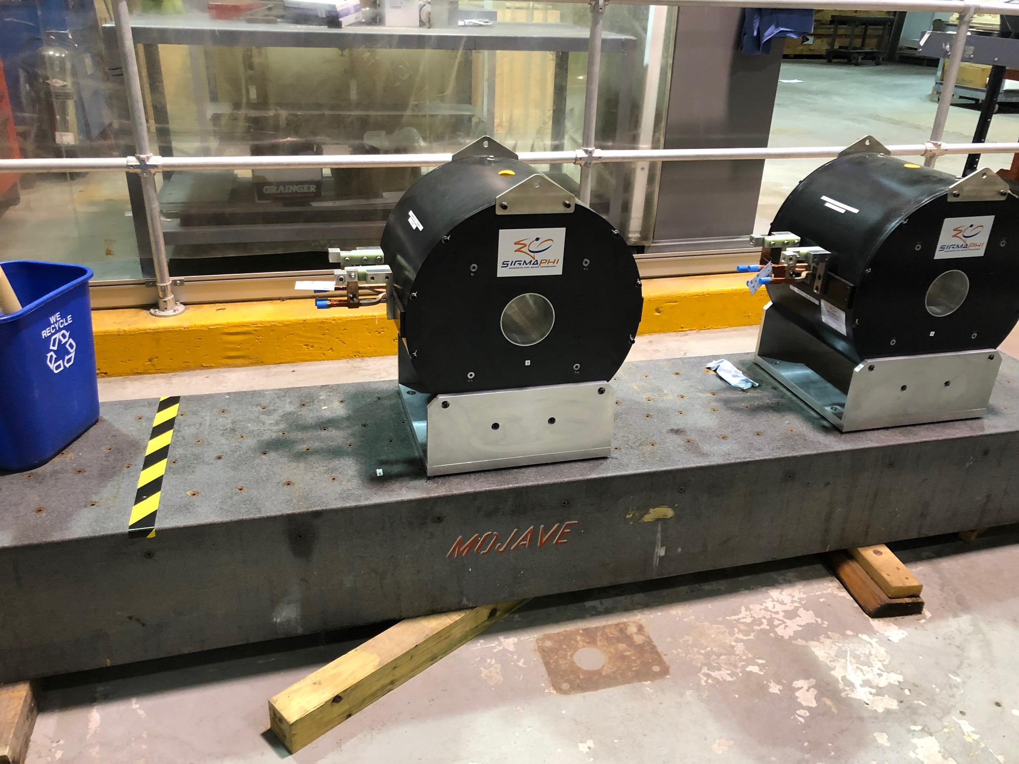
EMCAL
TASK | STATUS | NOTES
EMCal Cooling Work | ONGOING | Almost done, Pisani running test, may change Sipm cooling loop
Preamp cooling pem nuts | ONGOING | Cooling plates to mount to cooling loop
SiPM Cooling Insulation | ONGOING | Addressed after cooling loop situation
"Bump" test | Done
Mechanical parts 1-12 Order | Done
Electronic parts 1-12 Order | ONGOING | Steve is waiting on some parts
Granite Table |  | Waiting for riggers
Build a second assembly rail | Waiting

Slide 5
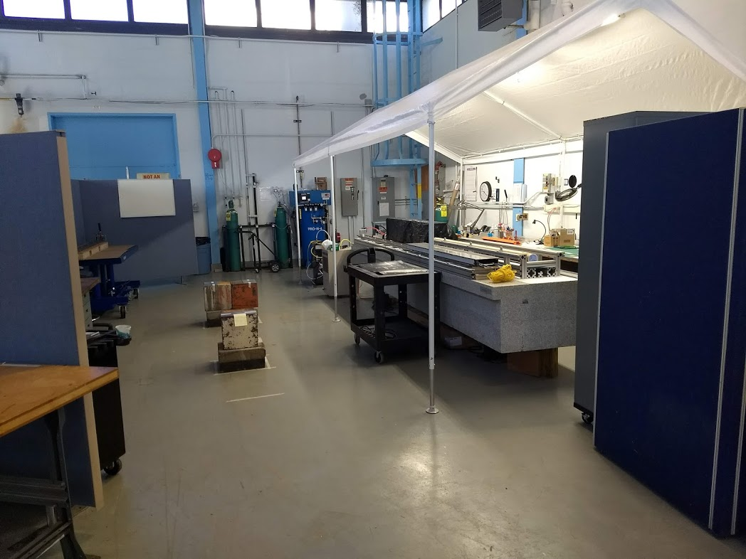
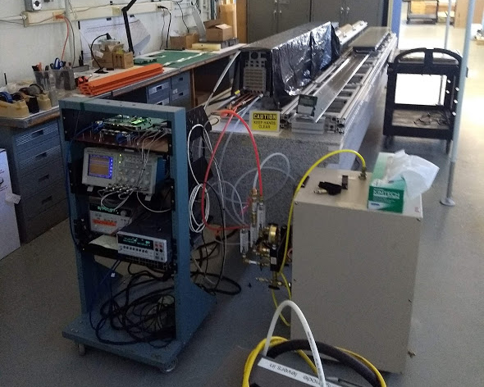
510 Assembly area
All channels in Sector Zero have been tested
Waiting for new rack to power the sector as a whole.
New slab coming in to double the assembly area.

Slide 6
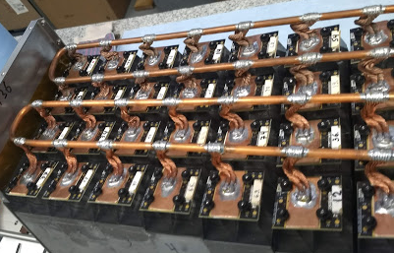
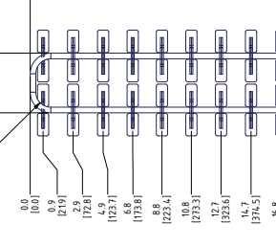
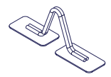
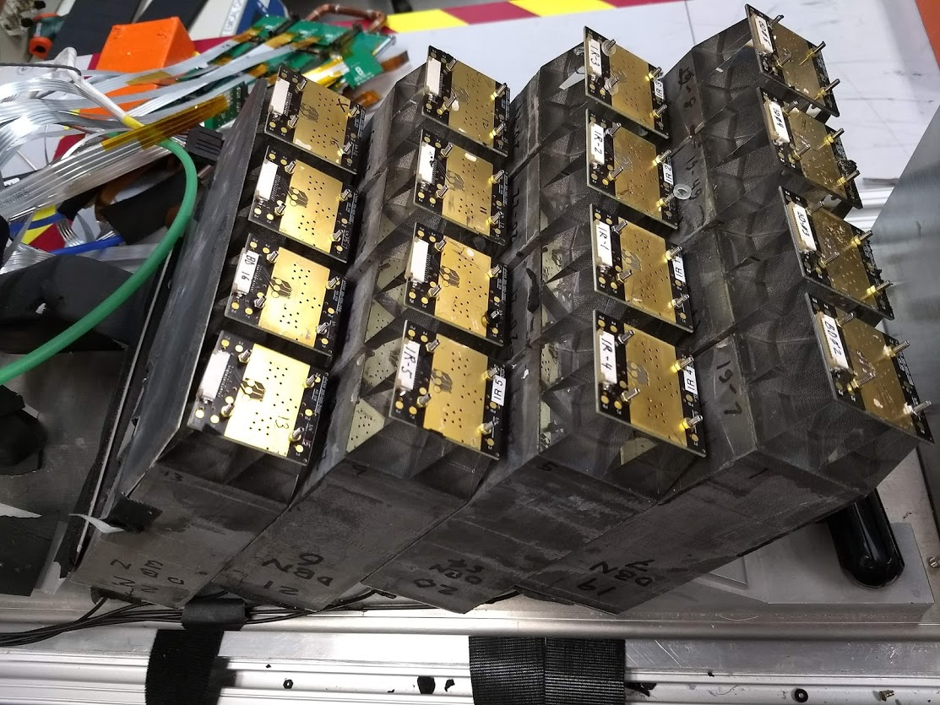
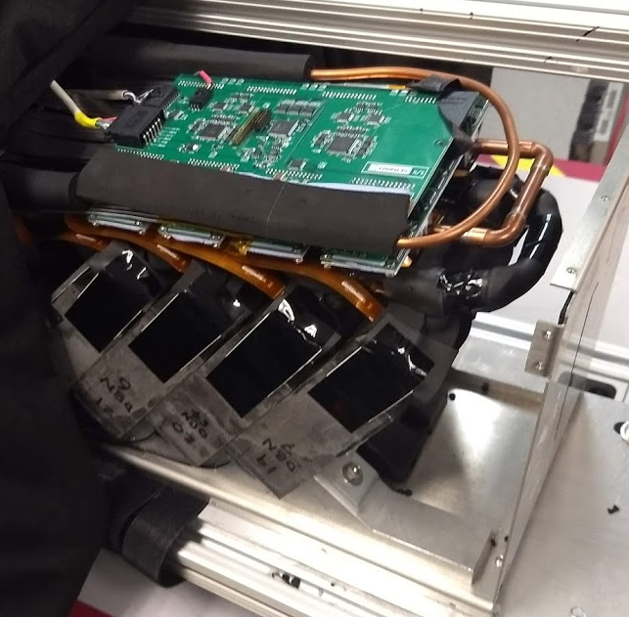
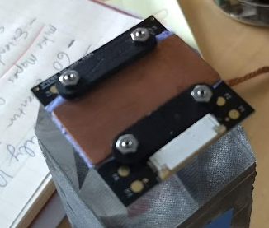
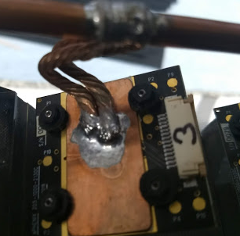
V2.2 modified
Old– two ¼” loops
New 3/8” cooling loop installed on SiPM’s –Single loop, optimized for easier installation, has same thermal characteristics.
New Pre-Amp with modified charge injection cap installed.
Using new removal gap pad between Sipm and cold plate
Used new clips to hold down cold plate.
Sipm’s are insulated
System is back on and being tested
New– One 3/8” loops
New
OLD

Slide 7
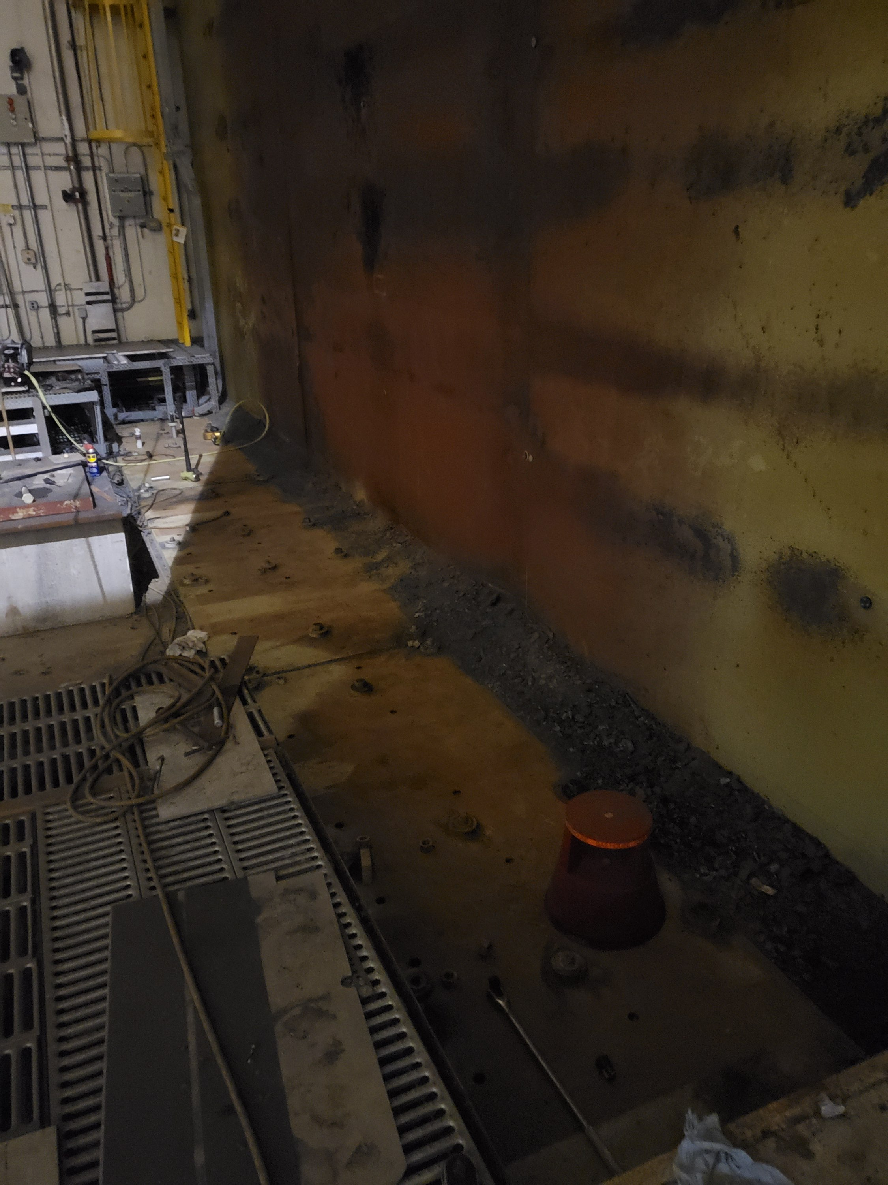
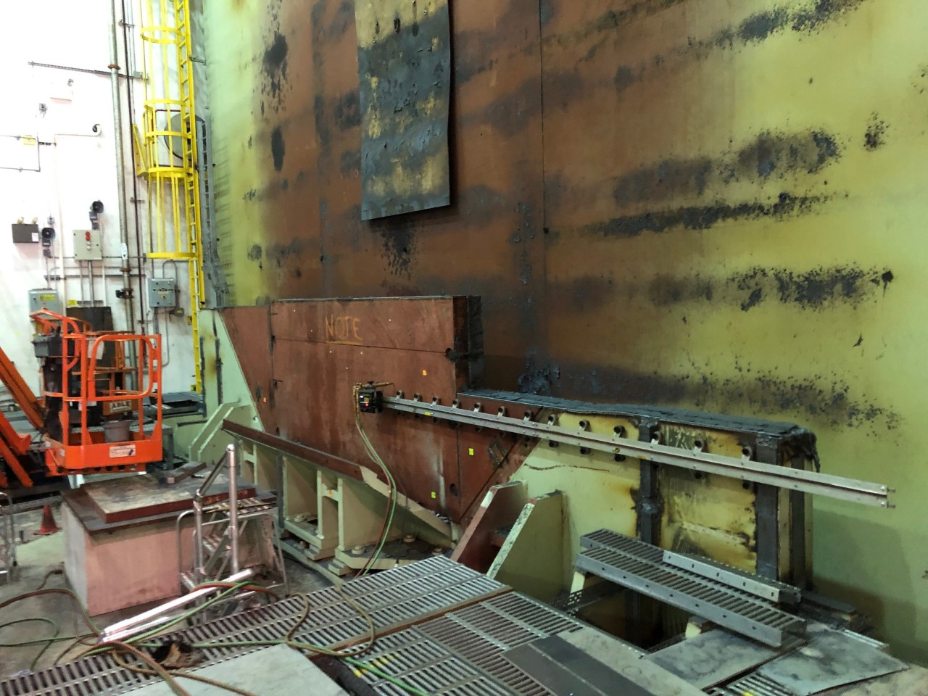
Infrastructure/1008
TASK | DATES | STATUS | NOTES
Cutting of North Magnet Steel |  | DONE | Cuts Complete
Clean up |  | ONGOING
Put Beam Pipe back up | 11/4-11/15 |  | 1-2 weeks for the job
Shield Wall | 11/18-11/22
RHIC Run | 12/1?

Slide 8

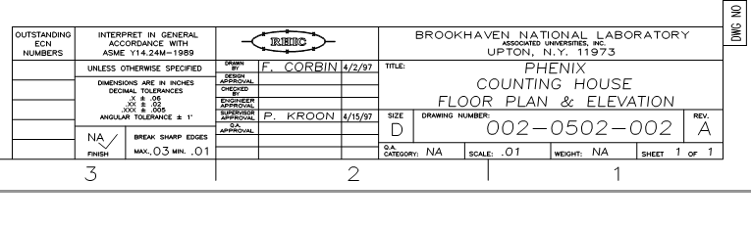
Cabinets
Cabinets
Shelving
SPHENIX
SPHENIX
Preliminary Sketch
Not to scale
Cabinets

Slide 9
New Faces Coming to sPHENIX
Joel Vasquez --> Paul Giannotti replacement EE. Working on sPHENIX infrastructure engineering, mainly electrical
Peter Tamblem --> designer starting Monday 9/30. Support Joel Vasquez and Rob Pisani on infrastructure design work
Rich Faussete --> NSLS-II mechanical designer, starting Monday 9/30. Working 2-days a week for us Monday and Tuesday. Will work with Dan and I on EMCAL and iHCAL install an build design work
Andy Desantis --> NSLS-II mechanical designer, starting Wednesday 10/2. Working 2-days a week for us Wednesday and Thursday. Will work with Jim on 1008 track modifications and other 1008 mechanical design

Slide 10
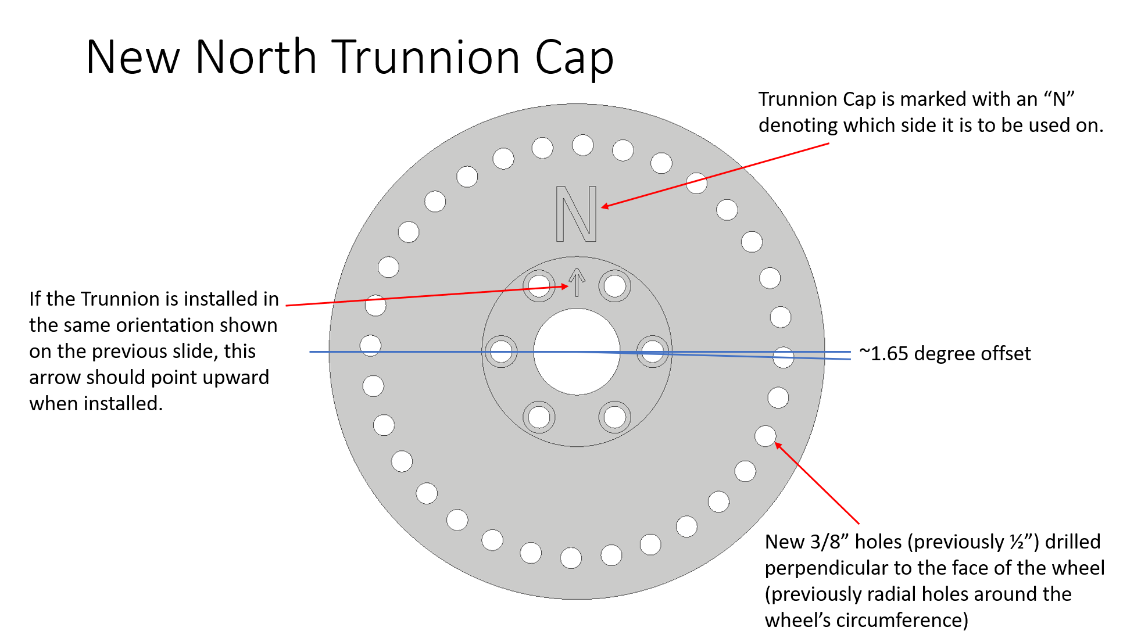
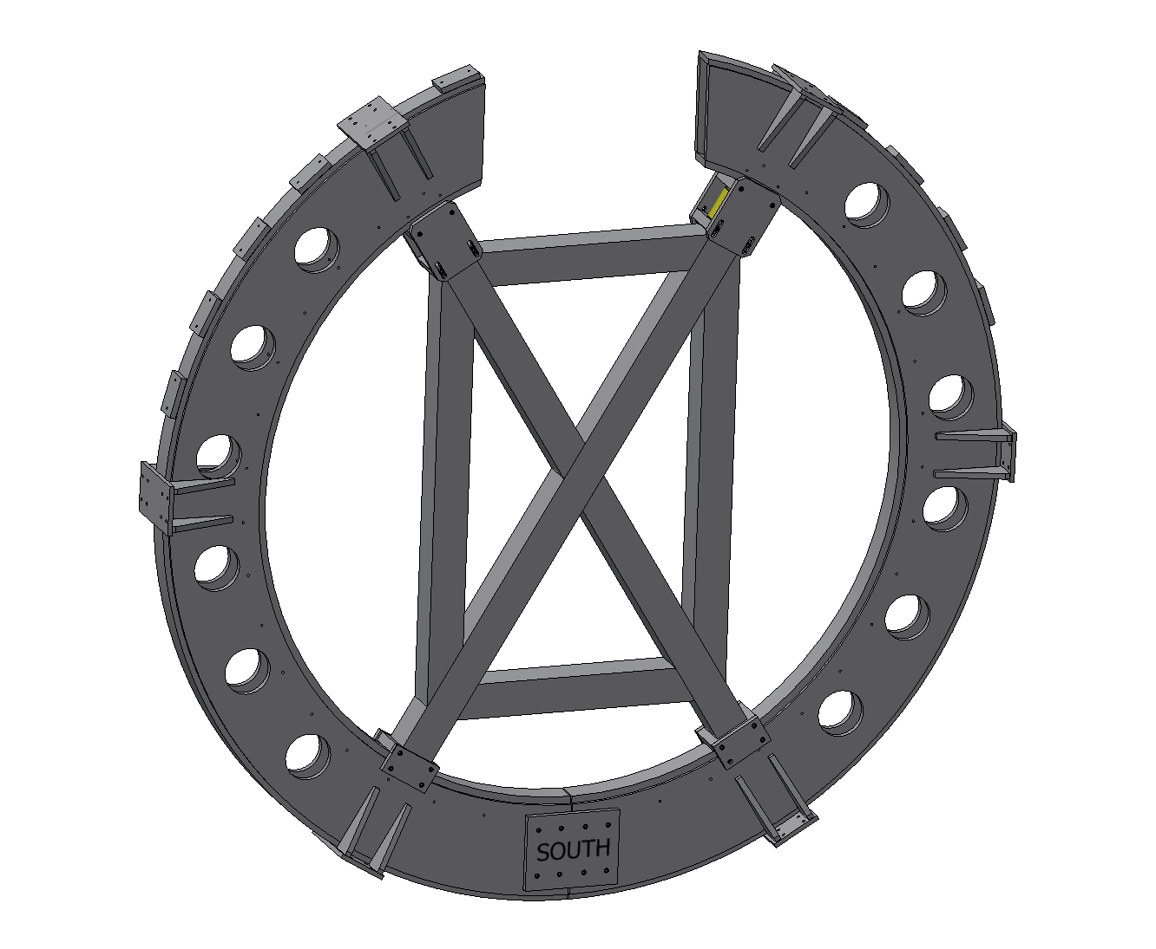
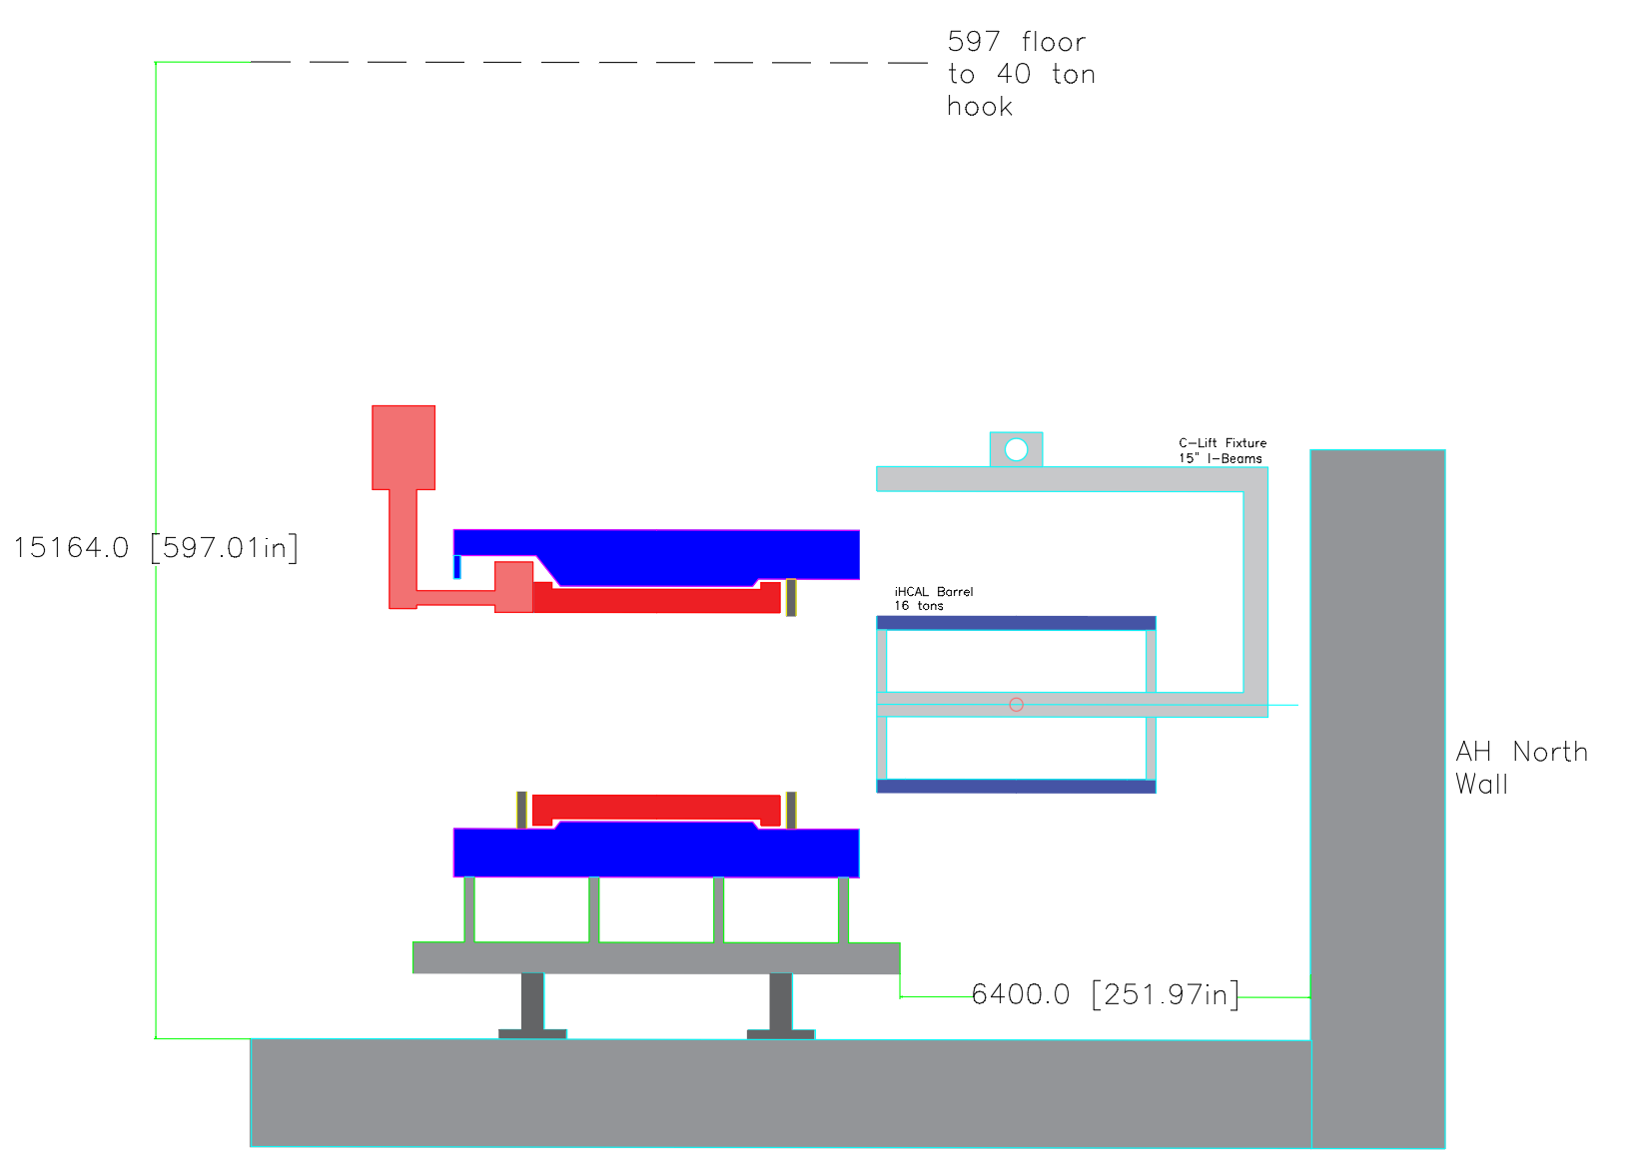
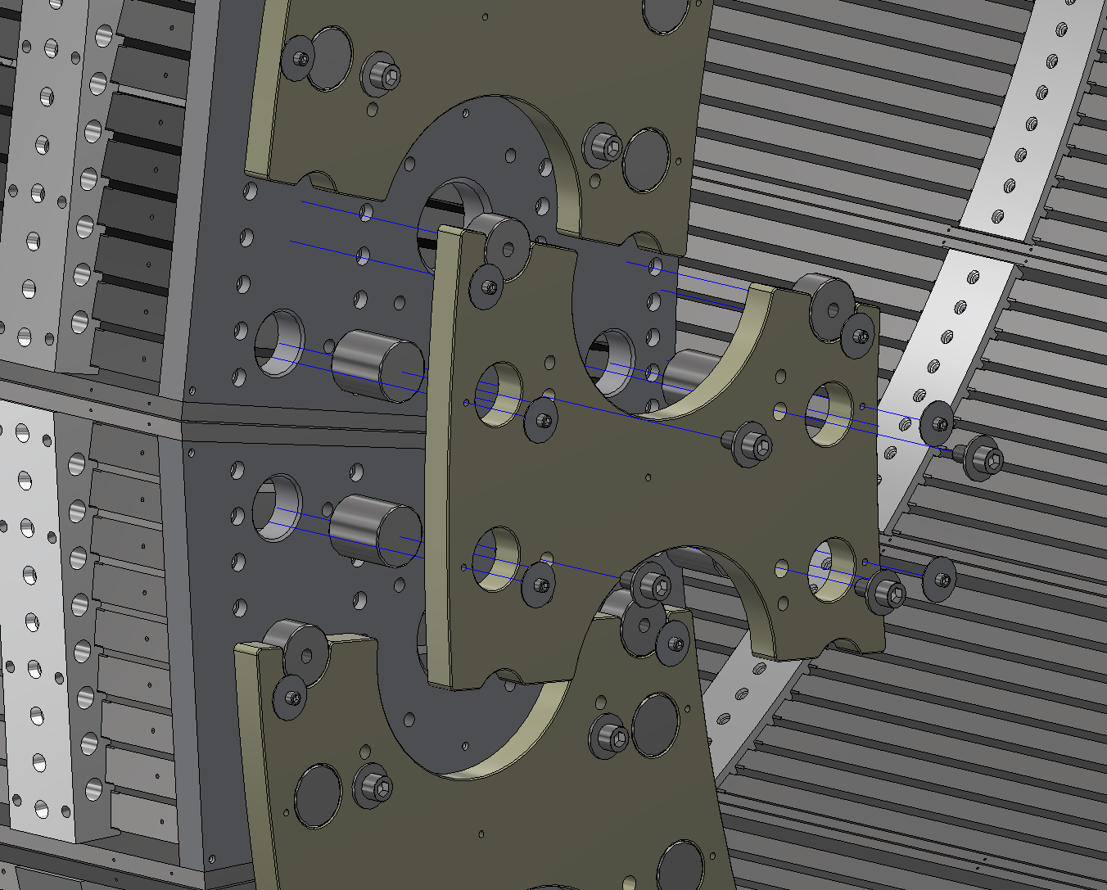
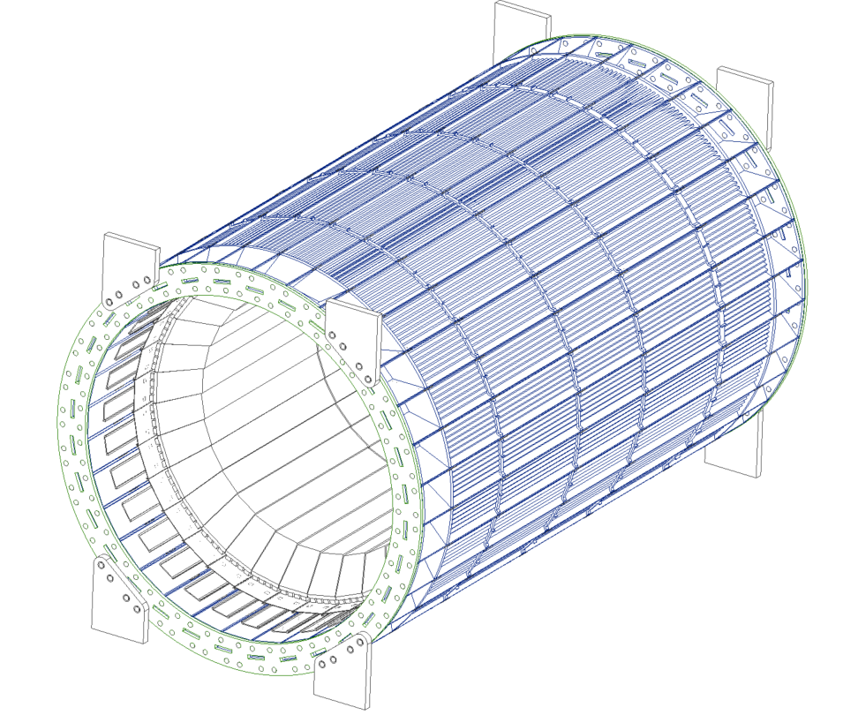
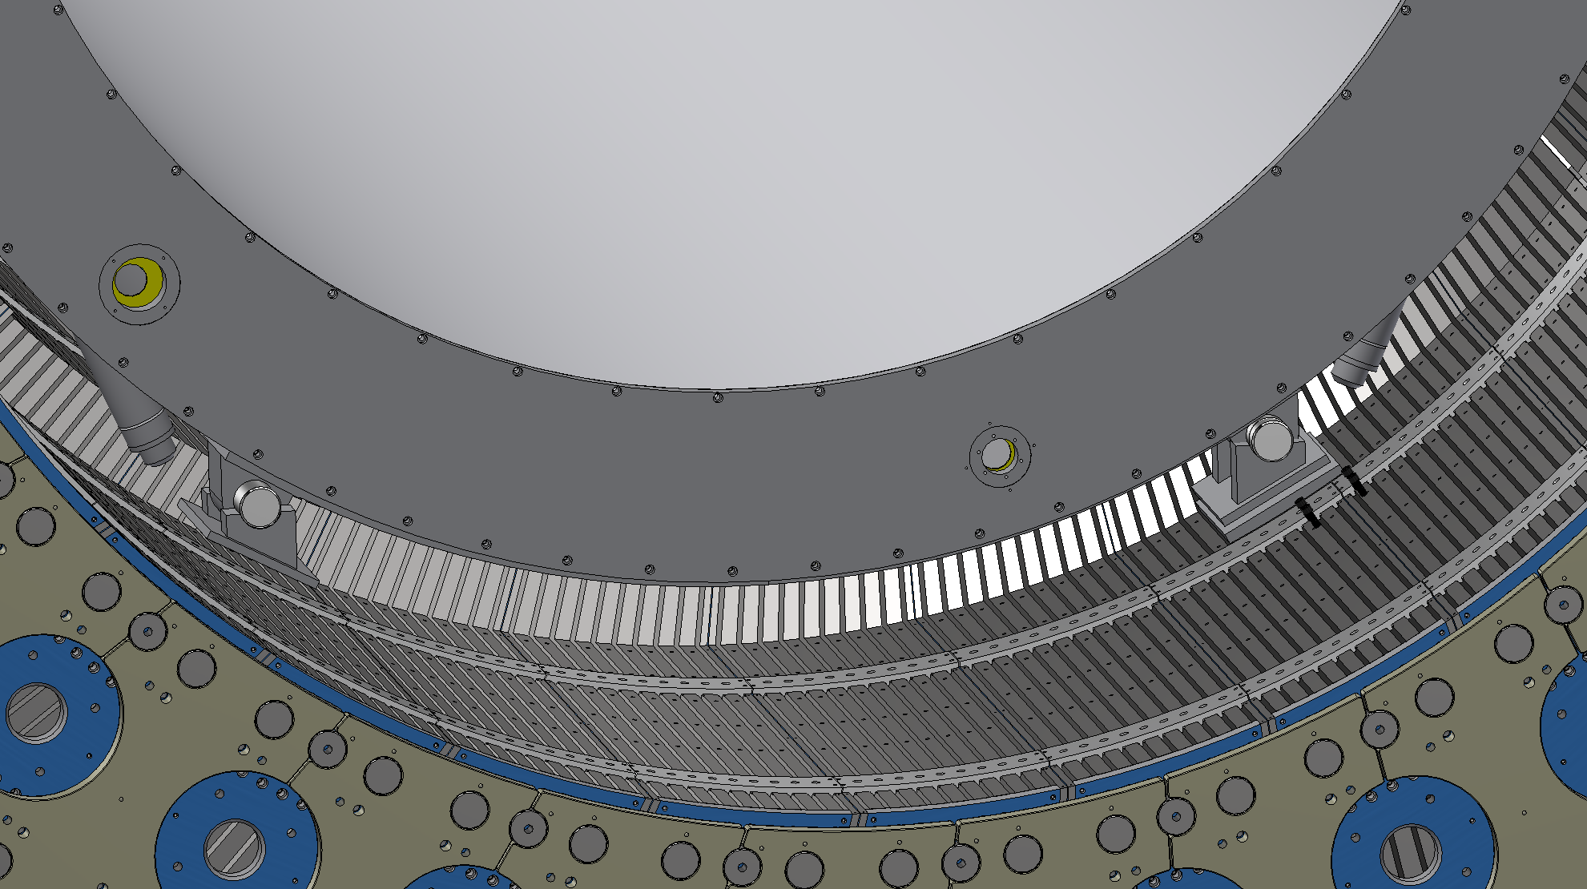
Other sPHENIX Work
Design work continues to be able to “open up” the ring, such that we can make space for last sector installation
FDR Complete/Moving on to Procurement Review after 2X review
Work has begun on a new installation fixture for the inner hcal sectors
Met with CA/Magnet engineers
Updating inner hcal design

Slide 11
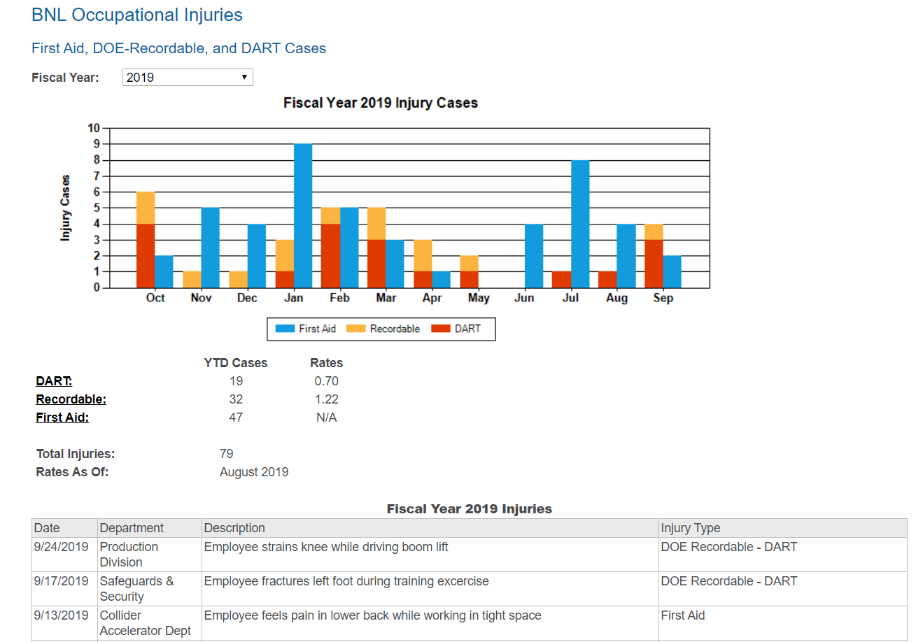
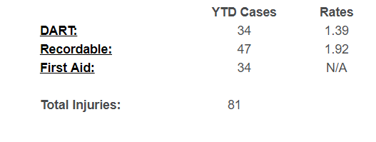
Safety
2018

