Slide 1
Compact CW FFAGs for High-intensity Applications
Dr. C. Johnstone
FFAG14
22rd Workshop on Fixed Field Alternating Gradient Accelerators
Brookhaven National Lab
Sept 21-26 2014
Upton, NY

Slide 2
Outline
Motivation and Background
    Next generation high-energy fixed field accelerators
    Medical, security, energy applications
    CW FFAGs ; i.e. strong-focusing cyclotrons
      Relativistic energies: ~200 MeV – 1 GeV
      Compact versions
      Constant machine tunes (optimized gradients)
      High mA currents (low losses)
These machines require high gradient acceleration; and SCRF for high currents
    Compactness
    Low extraction losses
  Large horizontal aperture of the FFAG, like the cyclotron, is a challenging problem for SCRF design

Slide 3
Cyclotrons: general comments
Cyclotrons are the highest current, most compact solution, but only up ~200 MeV for protons
As the energy becomes relativistic, orbit separation becomes smaller and smaller for CW operation
Higher energies require separated sectors (like the 590-MeV PSI or 500-MeV TRIUMF machines) – in order to insert strong accelerating (RF) systems.
  Stronger acceleration is required to minimize beam losses and radioactivity particularly during beam extraction
  Fewer acceleration turns and larger between different acceleration orbits facilitate efficient extraction.
However, once space is inserted between the magnetic sectors of the cyclotron, the footprint grows rapidly.
At relativistic energies, above 200 MeV, cyclotrons do not scale. Field profile must be nonlinear at relativistic energies for CW operation

Slide 4
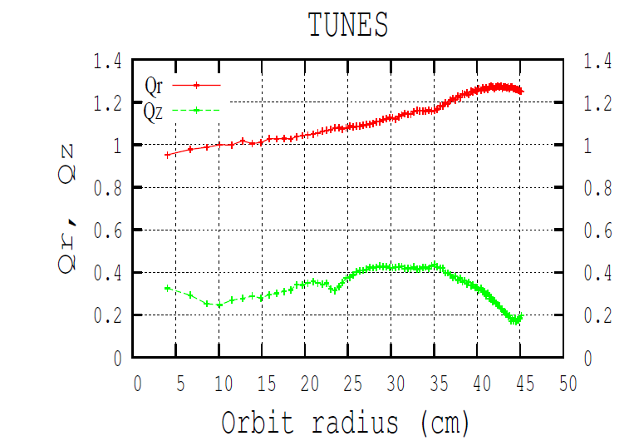
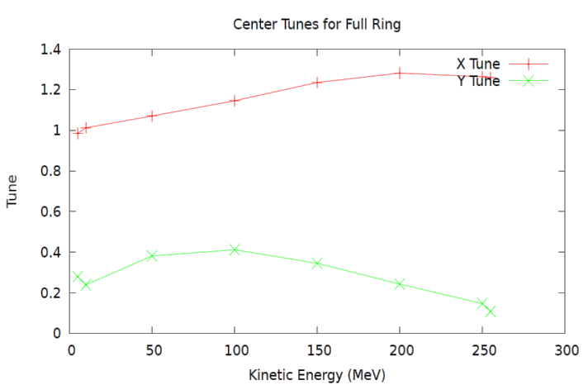
Tunes in a relativistic ultracompact cyclotron
One of the most important indicators of stability is called machine tune; the no. of oscillations a particle makes about the energy-specific reference orbit in one translation around the ring
The tune in a cyclotron must vary as it enters relativistic energies.
A gradient must be imposed to keep the beam CW
Predicted tune from an ultracompact medical cyclotron(left) and ZGOUBI (middle) and COSY (right).. Predicted problems are marked with red arrows

Slide 5
So what is a FFAG?
Next generation cyclotron
A Fixed Field Alternating Gradient Accelerator is a ~ a cyclotron with strong synchrotron-like focusing
The ns-FFAG combines all forms of transverse beam (envelope) confinement in an arbitrary, optimized magnet field:
  For the horizontal, the three terms are
The power of the FFAG is that the confinement terms can be varied independently to optimize machine parameters such as footprint, aperture, and tune in a FFAG AND DC beam can be supported to very high energies
synchrotron
cyclotron

Slide 6
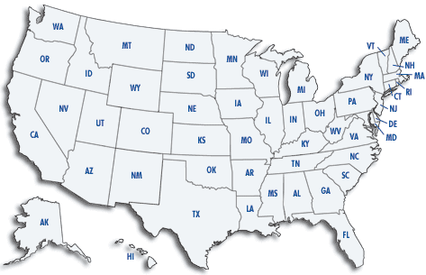




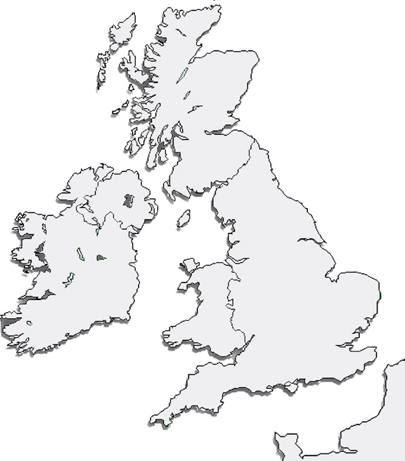














The international FFAG collaboration
Accelerator Science and Technology Centre

Slide 7
Quick Guide to Fixed-Fielding Alternating Gradient FFAGs
Simplest Dynamical Definition:
  FFAG is ~ a cyclotron with a gradient; beam confinement is via:
    Strong alternating-gradient (AG) focusing, both planes: radial sector FFAG
      normal/reversed gradients alternate (like a synchrotron)
    Gradient focusing in horizontal, edge focusing in vertical: spiral sector FFAG
      vertical envelope control is through edge focusing (like a cyclotron)
      the normal gradient increases edge focusing with radius /momentum (unlike a cyclotron)
  A cyclotron can be considered the lowest-order FFAG
Types of FFAGs:
  Scaling:
    B field follows a scaling law as a function of radius - r^{k} (k a constant;) present-day scaling FFAGs: Y. Mori, Kyoto University Research Reactor Institute
  Nonscaling:
    Linear (quadrupole) gradient; beam parameters generally vary with energy (EMMA FFAG, Daresbury Laboratory, first nonscaling FFAG)
    Nonlinear-gradient; beam parameters such as machine tune can be fixed (as in a synchrotron)

Slide 8
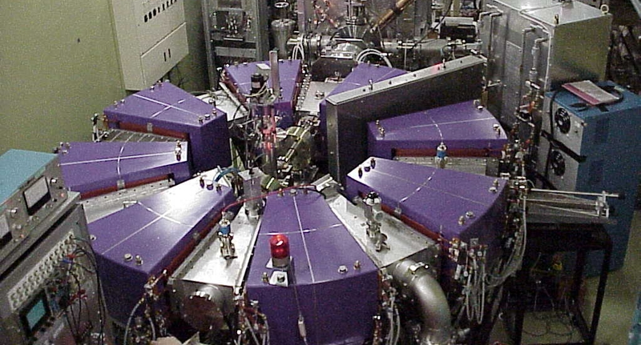
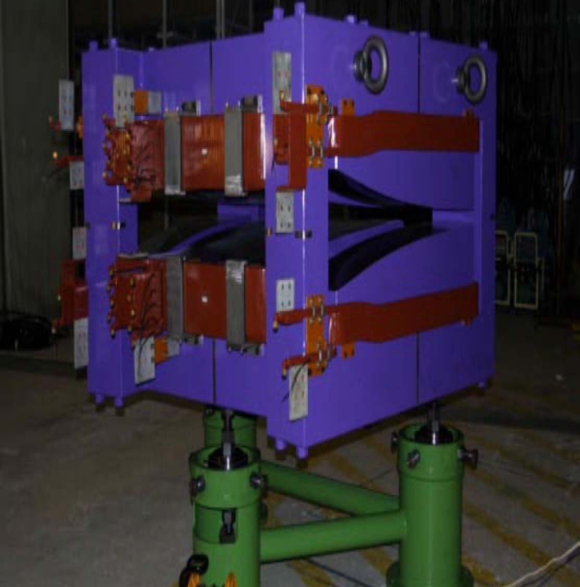

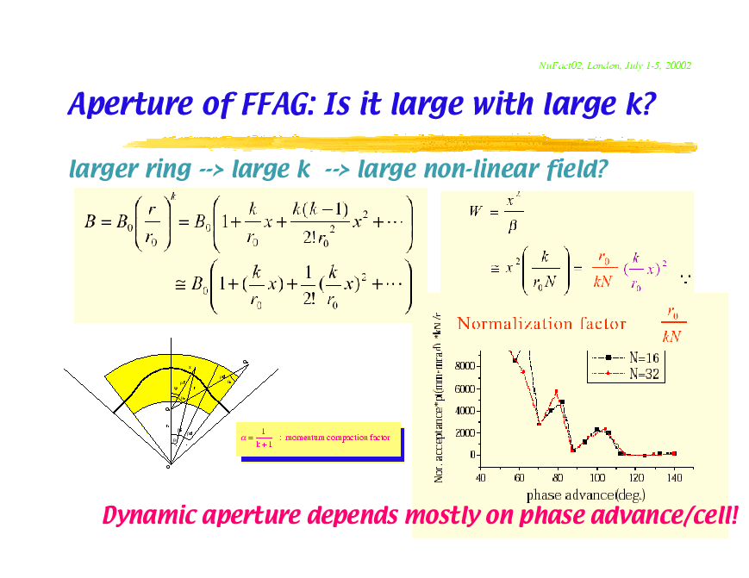
FFAGs and their Variations
Scaling FFAGs (spiral or radial-sector) are characterized by geometrically similar orbits of increasing radius, imposing a constant tune (field and derivative gradient scale identically with r). Magnetic field follows the law B ∝ r^{k}, with r as the radius, and k as the constant field index.
Spiral Sector: example: more compact; positive bend field only. Vertical focusing controlled by edge crossing angle.
Field expansion: k determines multipole order;
Comments: the lower the k value, the more slowly field increases with r and the larger the horizontal aperture, but the more linear the field composition and dynamics.
Radial Sector: example: This is a triplet DFD cell; there are also FDF, FODO and doublets. In a radial sector the D is the negative of the F field profile, but shorter.
F
D
D

Slide 9
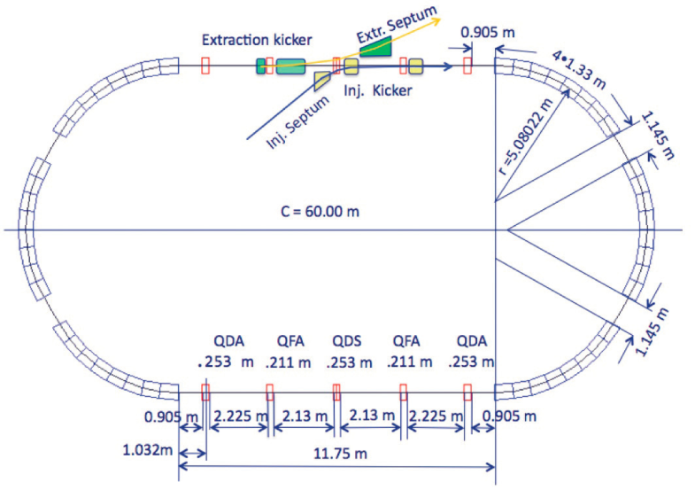
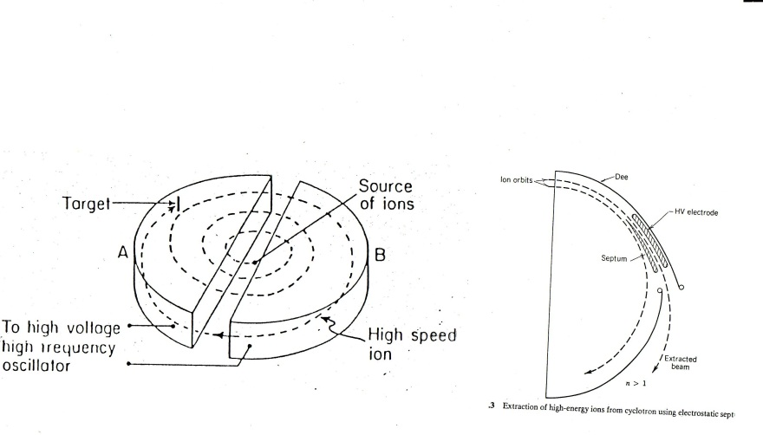
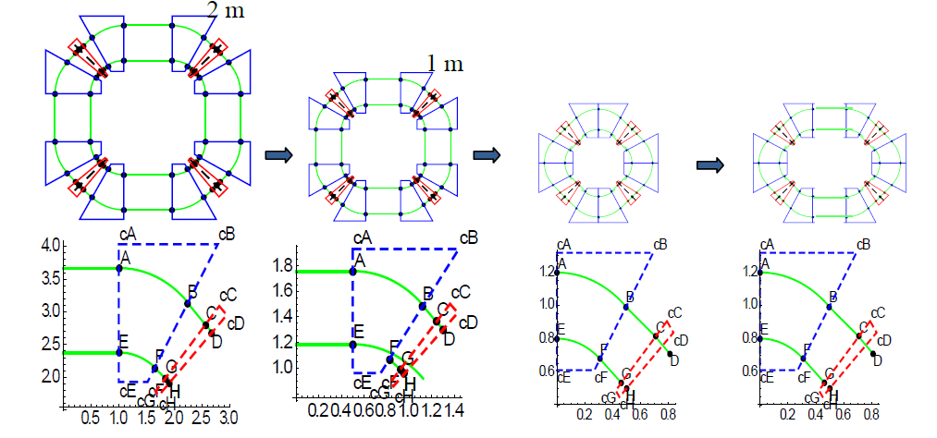
Understanding a ns-FFAG
Apply a “synchrotron” strong-focusing field profile to each “cyclotron” orbit
Strong-focusing allows
  Long injection/extraction or synchrotron-like straights
  Strong RF acceleration modules
  Low –loss profile of the synchrotron
  DC beam to high energies in compact structure
    400 MeV/nucleon: charge to mass of ½ (carbon)
    1.2 GeV protons
  Avoidance of unstable beam regions
    constant machine tune
straight =
CONSTANT MACHINE
TUNES AT NEAR AND FAR RELATIVISTIC ENERGIES
UNLIKE A CYCLOTRON

Slide 10
Relativistic CW (DC-beam) ns-FFAGs
NS FFAG can maintain isochronous orbits at relativistic energies
  Pathlength of isochronous orbits are proportional to velocity
  Orbits as a function of momentum follow, therefore the B field must scale with velocity
  At relativistic energies, momentum is an increasingly nonlinear function of velocity; therefore B field transitions from a linear slope to nonlinear, non-relativistic to relativistic as an approximate function of radius.
  THIS HAS BEEN ACHIEVED IN RECENT NONLINEAR NS FFAG DESIGNS
  Nonlinear field expansion + edge angle can constrain the tune
  Nonlinear gradient provides very strong focusing at high energy in both planes relative to the cyclotron
FFAG limit
≥2 GeV protons
Cyclotron limit
~ 1 GeV protons
P (MeV/c)
<Br> ∝ p/β for isochronous orbits
β or normalized path length

Slide 11
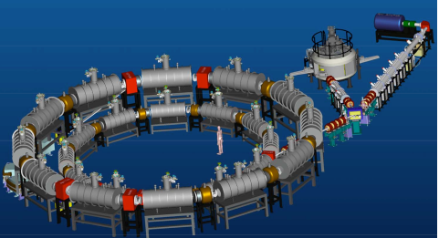
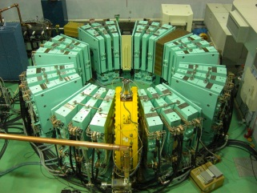
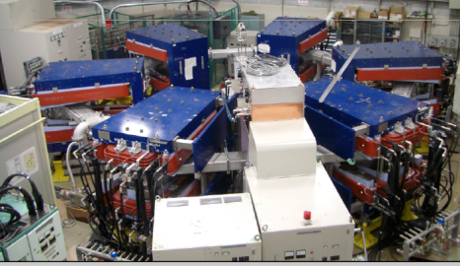
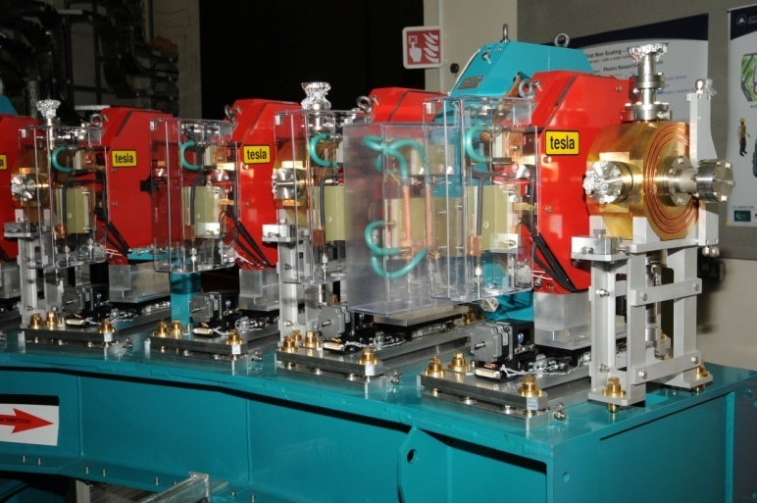
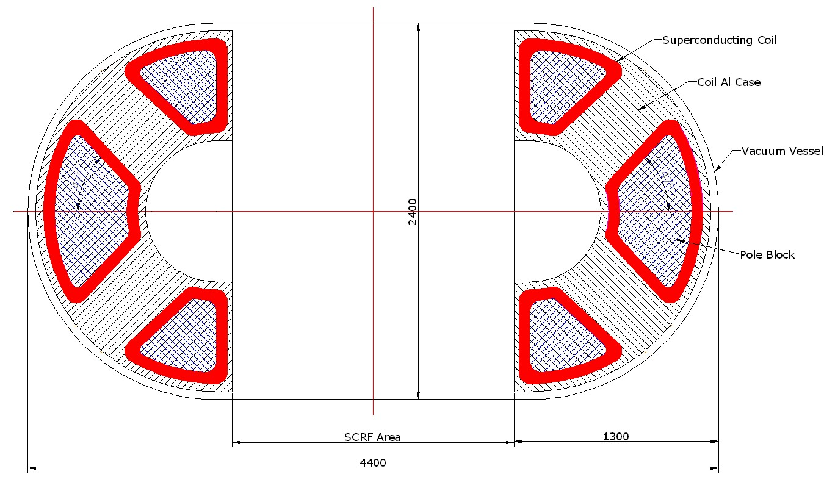
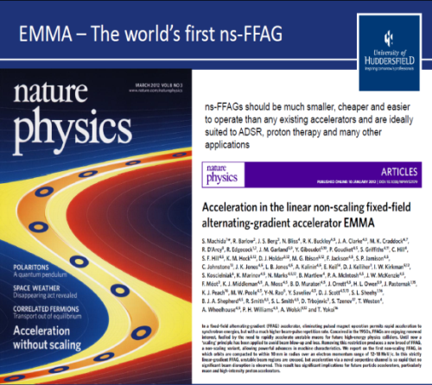
INTERNATIONAL DEVELOPMENT OF FFAGS
PAMELA: hadrontherapy design
Oxford, U.K.
RACCAM: proton therapy LPSC Grenoble, France
ERIT: neutron source
KURRI, Japan
PRISM: intense muon beam
Lepton flavor violation exp.
Osaka, Japan
0.2 -1 GeV intense proton FFAG (ADS)
Compact Racetrack
~ 4 m
Injection
extraction
EMMA: POP muon acc demo
Daresbury Laboratory, U.K.
KURRI: ADS test
Kyoto U. Research Reactor
Institute, Japan
RF
~6 m
Compact CW ns-FFAG racetrack design capable of variable energy and various applications
POP, 1st p FFAG, KEK, Japan

Slide 12
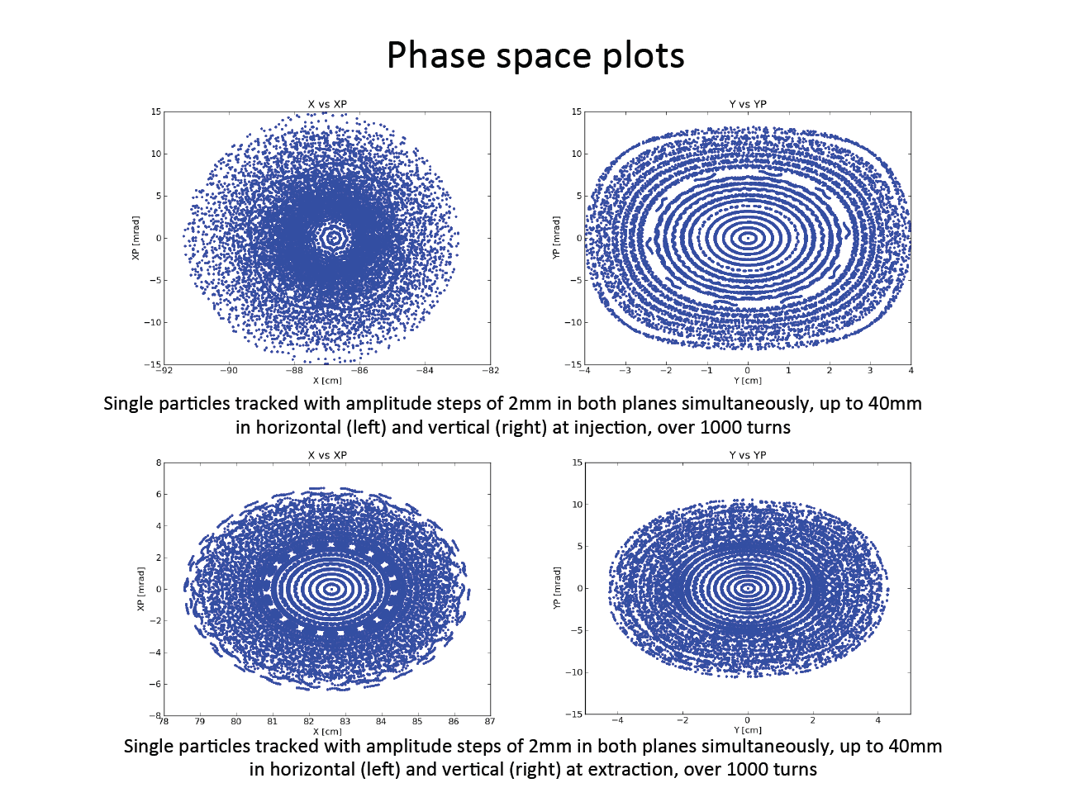
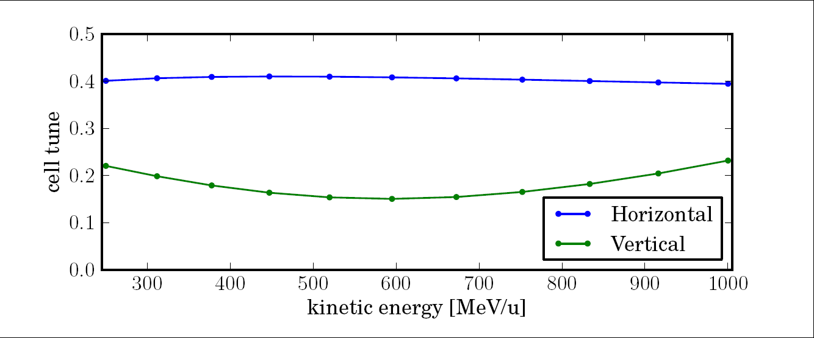
Advanced design and simulation of an
Isochronous 0.25-1GeV Nonscaling FFAG
2m
General Parameters of an initial 0. 250 – 1 GeV non-scaling, near-isochronous FFAG lattice design
Parameter | 250 MeV | 585 MeV | 1000 MeV
Avg. Radius (m) | 3.419 | 4.307 | 5.030
Cell ν _{x} / ν_{y} (2π rad) Ring. | 0.380/0.237 1.520/0.948 | 0.400/0.149 1.600/0.596 | 0.383/0.242 1.532/0.968
Field F/D (T) | 1.62/-0.14 | 2.06/-0.31 | 2.35/-0.42
Magnet Size F/D Inj | 1.17/0.38 | 1.59/0.79 | 1.94/1.14
ENORMOUS DYNAMIC APERTURE WITH THESE MACHINES
constant strong-focusing machine tune – NO RESONANCES ARE CROSSED

Slide 13
Advanced design and simulation of an
Isochronous 0.25-1GeV Nonscaling FFAG
2m
General Parameters of an initial 0. 250 – 1 GeV non-scaling, near-isochronous FFAG lattice design (±~3% TOF variation)
Parameter | 250 MeV | 585 MeV | 1000 MeV
Avg. Radius (m) | 3.419 | 4.307 | 5.030
Cell ν _{x} / ν_{y} (2π rad) Ring. | 0.380/0.237 1.520/0.948 | 0.400/0.149 1.600/0.596 | 0.383/0.242 1.532/0.968
Field F/D (T) | 1.62/-0.14 | 2.06/-0.31 | 2.35/-0.42
Magnet Size F/D Inj | 1.17/0.38 | 1.59/0.79 | 1.94/1.14
ENORMOUS DYNAMIC APERTURE WITH THESE MACHINES
constant strong-focusing machine tune – NO RESONANCES ARE CROSSED

Slide 14
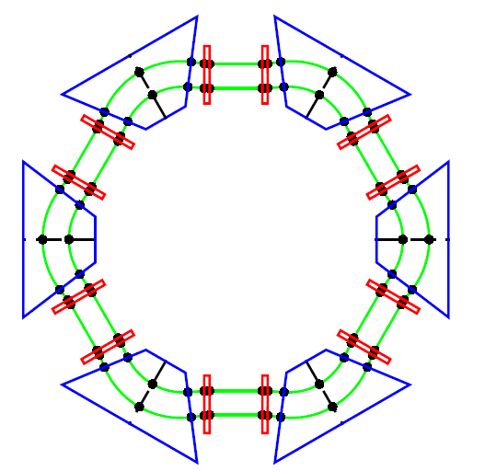
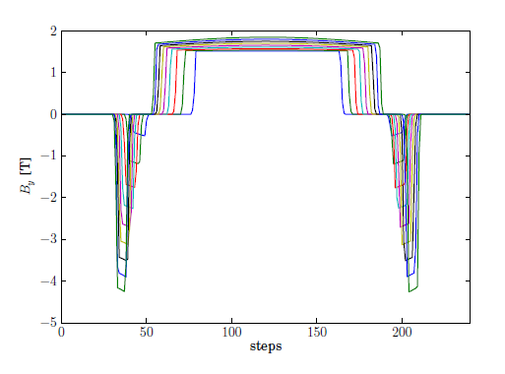
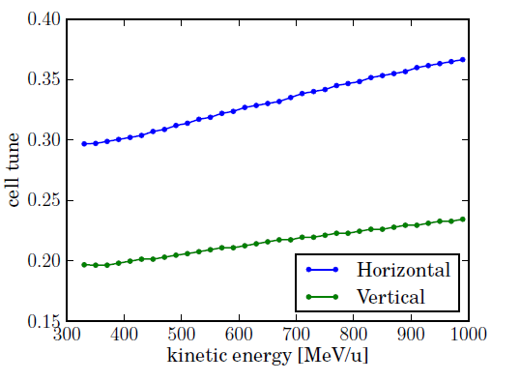
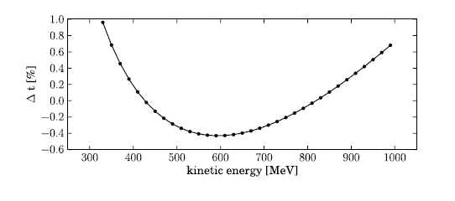
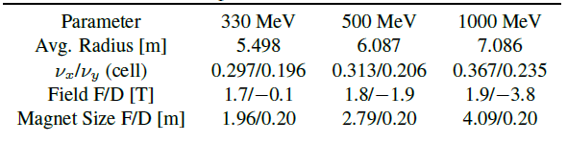
Design of an Isochronous 0.3-1GeV DFD
FFAG with space charge
2m
Vertical magnetic field from 0.33-1 GeV in 80 MeV steps and variation of cell tunes using OPAL in 20 MeV steps
General Parameters of an initial 0. 3 – 1 GeV isochronous FFAG lattice design (±0.5% TOF variation)
Variation cell tunes / OPAL in 20 MeV steps
Preliminary Design – a resonance is crossed at 617 MeV which needs to be addressed

Slide 15
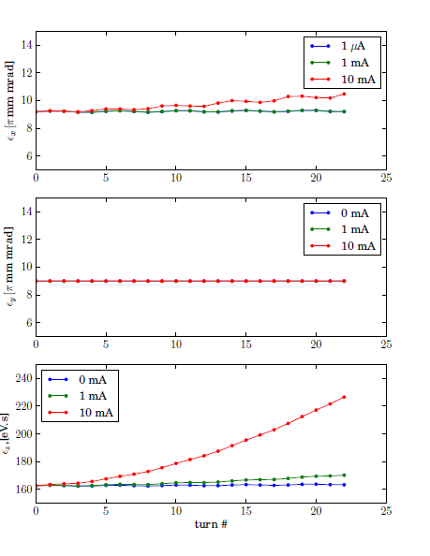
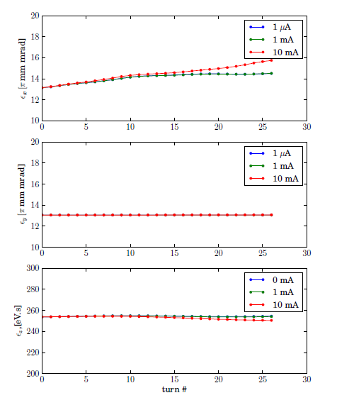
Simulation of an Isochronous 0.3-1GeV DFD
FFAG with space charge
S. Sheehy/A. Adelmann
Emittance variation at 330 MeV (left) and 610 MeV (right) for fixed energy tracking (no acceleration) with space charge for 0 – 10 mA and a 100mm long single bunch
With no longitudinal focusing the bunch expands in length but space charge has little impact on transverse emittance due to strong focusing

Slide 16
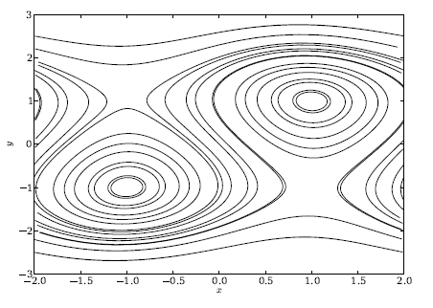
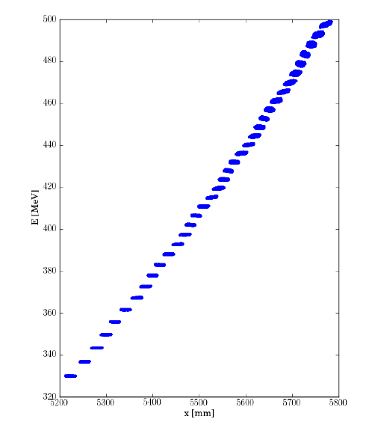
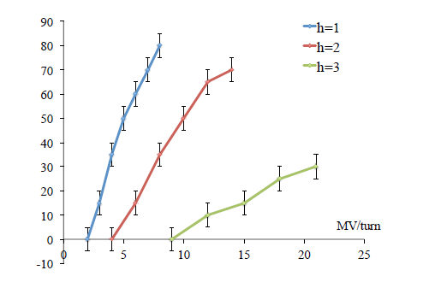
Simulation of an Isochronous 0.3-1GeV DFD
FFAG with space charge
S. Sheehy/A. Adelmann
Serpentine channel for = 4=3 contours plotted for regularly spaced values of x=y.
Maximum serpentine acceptance in degrees for varying voltage per turn and harmonic number.
Turn-by-turn radial position vs energy for a low intensity beam in the serpentine channel accelerated to 500MeV.

Slide 17
Compacting the FFAG
The footprint of CW/DC FFAG accelerators is decreasing rapidly
Light NbSn/NbTi self-shielding SC magnets are under design
A conceptual design for a SC RF pillbox cavity design (50 cm x 5 cm) has been completed and achieves 10 MV/m
Stable – no resonance crossing machine tunes
Strong-focusing tunes:
ν_{r} = 1.3
ν_{x}=0.7
RLA FFAG
is stable !

Slide 18
FFAG Tracking summary:
3.7 m radius, 4-cell; 4x2m straights
Stable beam area @injection (200 MeV)
Tracked: 24 cm x 240 mr
ε = 57,600π mm-mr
ε_{norm} = 39,460π mm-mr
Stable beam area
@500 MeV
Tracked: 36 cm x 225 mr
ε = 81000π mm-mr
ε_{norm} = 94,132π mm-mr
Stable beam area
@1000 MeV
Tracked: 39 cm x 150 mr
ε = 58,500π mm-mr
ε_{norm} = 105,824π mm-mr
300 mr
520 mm
Stable horizontal Beam size vs. Energy, tracked in 3cm steps
Stable beam area @injection (200 MeV)
Tracked: 30 mm x 8 mr
ε = 240π mm-mr
ε_{norm} =165π mm-mr
Stable beam area
@500 MeV
Tracked: 33 mm x 6 mr
ε = 198π mm-mr
ε_{norm} =229π mm-mr
Stable beam area
@1000 MeV
Tracked: 30 mm x 4 mr
ε = 120π mm-mr
ε_{norm} =216π mm-mr
100 mr
10 mr
40 mm
Stable Vertical Beam size vs. Energy: tracking ends at ±1cm, vertical magnet gap, tracked in 3mm steps

Slide 19
FFAG Tracking summary:
1.2 m ext. radius, racetrack
Stable beam area @injection (200 MeV)
Tracked: 8 cm x 293 mr
ε = 23440π mm-mr
ε_{norm} = 16,059π mm-mr
Stable beam area
@500 MeV
Tracked: 12 cm x 220 mr
ε = 26400π mm-mr
ε_{norm} = 30680π mm-mr
Stable beam area
@1000 MeV
Tracked: 13 cm x 165 mr
ε = 21450π mm-mr
ε_{norm} = 38802π mm-mr
330 mr
180 mm
Stable horizontal Beam size vs. Energy
Stable beam area @injection (200 MeV)
Tracked: 10 mm x 9 mr
ε = 90π mm-mr
ε_{norm} =62π mm-mr
Stable beam area
@500 MeV
Tracked: 11 mm x 7 mr
ε = 77π mm-mr
ε_{norm} =89π mm-mr
Stable beam area
@1000 MeV
Tracked: 10 mm x 5 mr
ε = 50π mm-mr
ε_{norm} =90π mm-mr
100 mr
10 mr
15 mm
Stable Vertical Beam size vs. Energy: tracking ends at ±1cm, vertical magnet gap

Slide 20
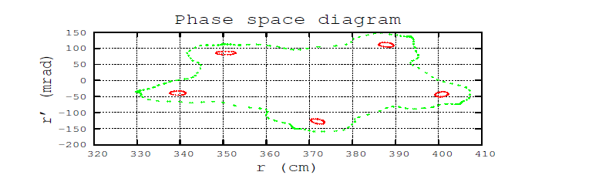
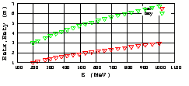
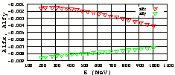
ZGOUBI simulations of the circular FFAG
Haj-Tahar Malek
Periodic betatron functions vs energy at azimuthal angle =0. – analytical model
.

Slide 21
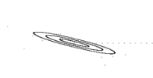
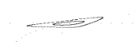
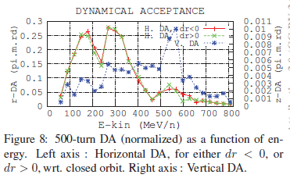
Comparing fixed-field Dynamic Apertures
FFAG Stable beam area @200 MeV vs DA of ultracompact 250 MeV cyclotron
cyclotron
cyclotron
80 mm x 293 mr
ε_{H} = 23,440π mm-mr
ε_{norm} = 16,059π mm-mr
10 mm x 9 mr
ε_{V} = 90π mm-mr
ε_{norm} =62π mm-mr
FFAG: Horizontal – 1 cm steps
FFAG: Vertical – 1 mm steps
FFAG Stable beam area @1000 MeV vs. DA of 800 MeV Daeδalus cyclotron*:
factor of 4 larger for ~ a factor of 4 smaller footprint
Tracked: 130 mm x 165 mr
ε = 21450π mm-mr
ε_{norm} = 38820π mm-mr
Tracked: 10 mm x 5 mr
ε = 50π mm-mr
ε_{norm} =90π mm-mr
*FFAG vert. stable area at aperture limits.
*F. Meot, et. al., Proc. IPAC2012

Slide 22
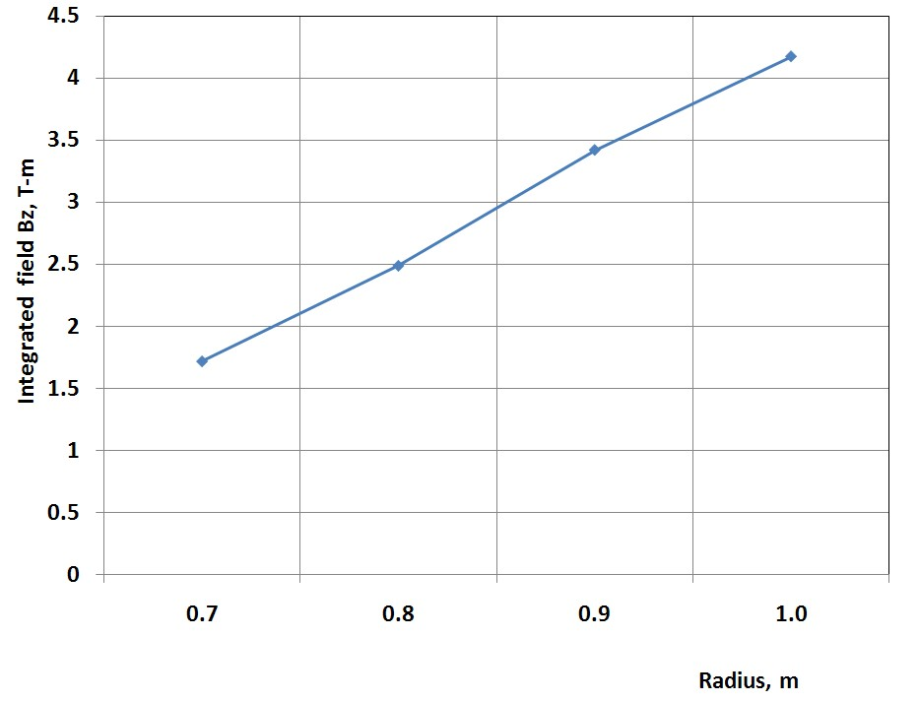
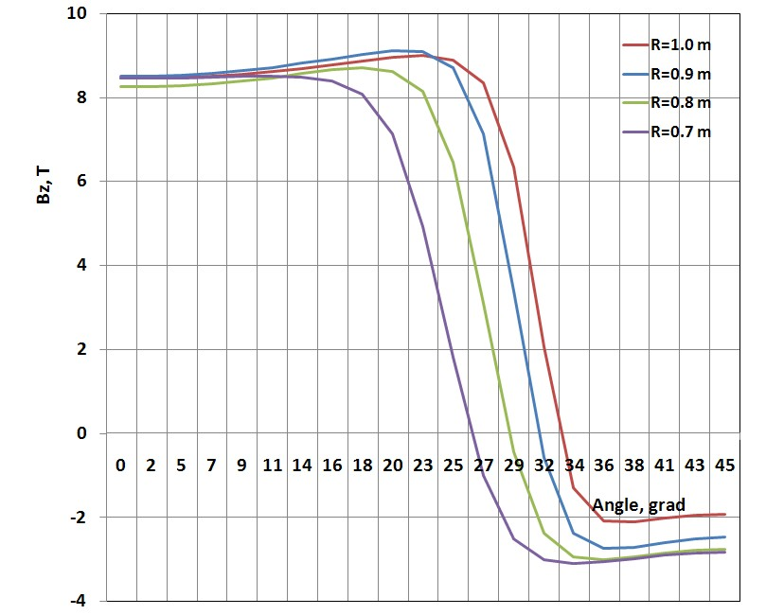
MAGNETS and modeling
Parameter | Units | Value
Number of magnets |  | 6
Number of SC coils |  | 12
Peak magnetic field on coils | T | 7
Magnet Beam Pipe gap | mm | 50
Superconductor type |  | NbTi
Operating Temperature | K | 4.0
Superconducting cable |  | Rutherford
Coil ampere-turns | MA | 3.0
Magnet system height | M | ~1
Total Weight | tons | ~10
< 3 m
< 5 m
One straight section occupied by RF cavities
and injection/extraction in the other
The magnetic field is relatively flat under the F-pole but the angular field length strongly depends on the radius providing the needed range from injection to extraction. The return flux provides the D or reverse gradient but needs careful optimization

Slide 23
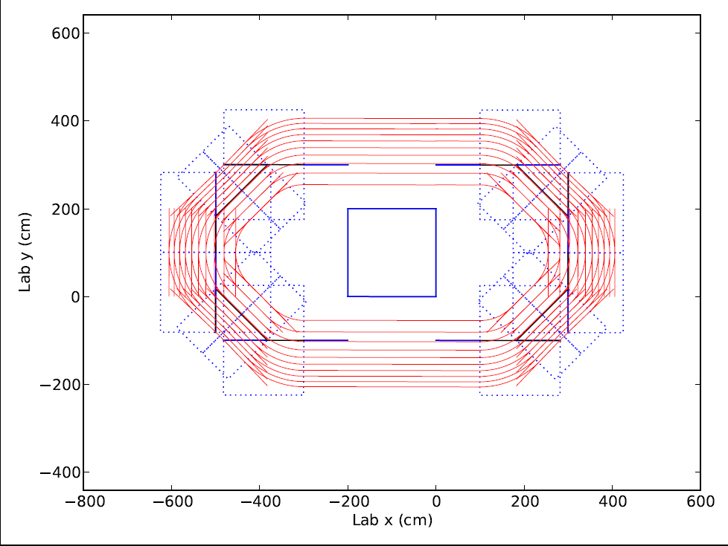
Racetrack layout
Start with the 2m straight, 3.7 m radius, ~2T fields
Remove 2 m straights from sides and add to two opposing straights
12m
.
8m
.
4m
.
Layout of racetrack FFAG for simulations and half arc layout
.
PyZoubi tracks
.

Slide 24
Circular vs Racetrack simulations using PyZgoubi/ R. Appleby
Machine tunes for the 2m ring (left) and the mini-racetrack FFAGs (right) as a function of beam energy.
.
Dynamic aperture | Horizontal π.mm.mrad | Vertical π.mm.mrad
200 MeV 40 turns | 74700 | 107
200 MeV 200 turns | 72600 | 91
800 MeV 40 turns | 156300 | 364
800 MeV 200 turns | 155100 | 356
Dynamic aperture | Horizontal π.mm.mrad | Vertical π.mm.mrad
200 MeV 40 turns | 25000 | 46
200 MeV 200 turns | 23700 | 43
800 MeV 40 turns | 63000 | 277
800 MeV 200 turns | 63000 | 223
Very preliminary unnormalized DA for circular (left) and racetrack (right) computed with PyZoubi

Slide 25
Error Analysis: Circular vs Racetrack - R. Appleby
Racetrack is showing similar stability to misalignments and errors
The relative drop in dynamic aperture as a function of misalignment for the circular 2m straights FFAG (left and the 4m straights racetrack (right) computed with PyZgoubi.
.

Slide 26
Observations
DA of a FFAG ≥ cyclotron for medium energies (~100-200 MeV) and equivalent footprint
DA aperture for these new constant-tune isochronous FFAGs are large – tens of thousands of π mm-mr (normalized)
DA scales almost completely geometrically with size of the machine – ultracompact FFAGs show identical dynamical stability

Slide 27
Design specifications
Large horizontal beam aperture of 50 cm
Cavity should operate at 150 or 200 MHz (harmonic of the revolution frequency)
Should provide at least 5 MV for proton beam with energies 200 – 900 MeV
Peak magnetic field should be no more than 160 mT (preferably, 120 mT or less)
Peak electric field should be minimized
Cavity dimensions should be minimized

Slide 28
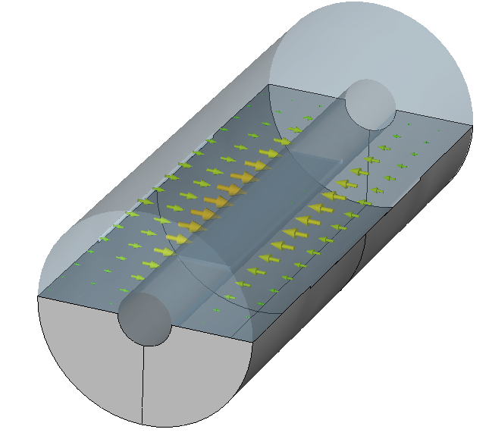
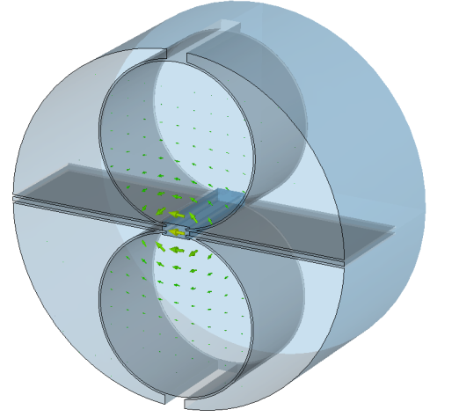
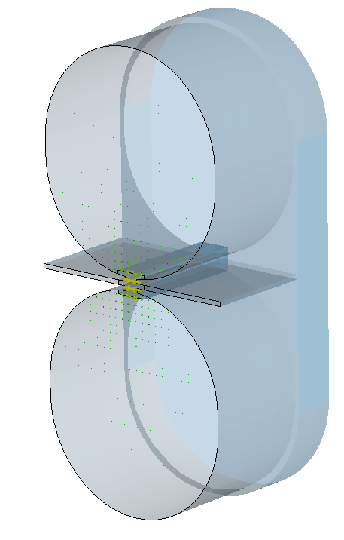
Cavity options
Beam
trajectories
Half-wave resonator H-Resonators
HWR is very dependent on particle velocity
Can’t be used efficiently for such a wide range
of particle energies
Dimensions are very large as is peak magnetic field on the electrode edge

Slide 29
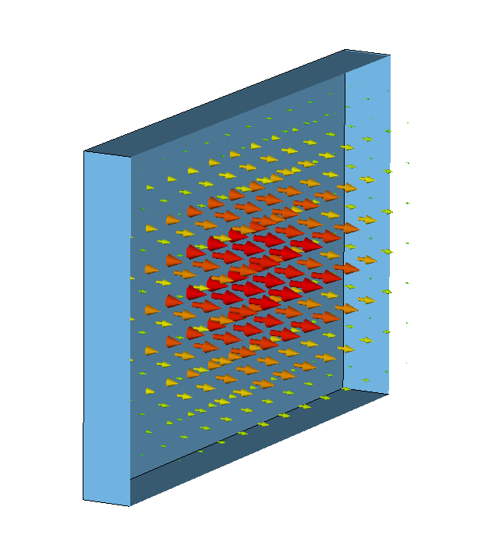
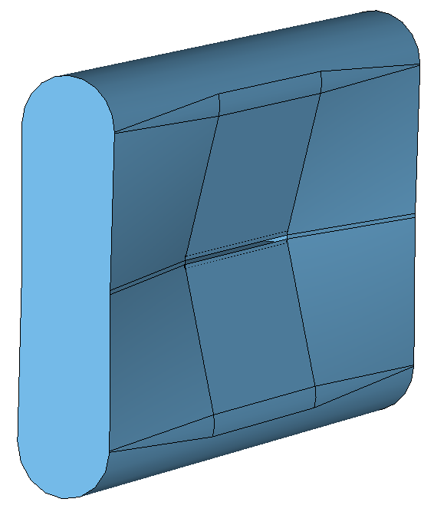
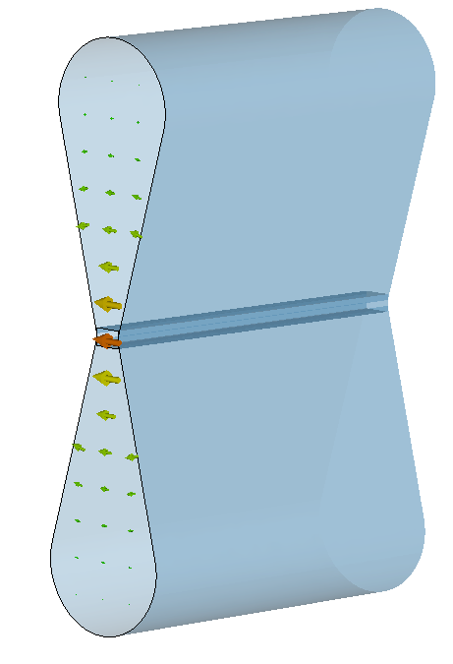
Rectangular Cavity
Rectangular cavity operating at H101 mode has electric field concentrated in the center of the wall
To concentrate electric field at beam aperture, we introduced tapers
To reduce peak magnetic field the blending was introduced
W
Beam
direction
H
L

Slide 30
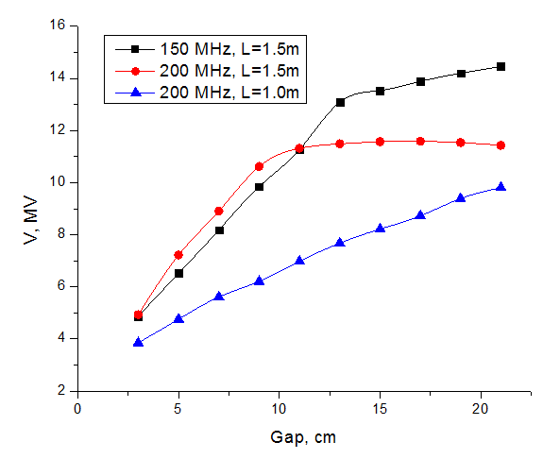
Gap and Frequency Optimization
The voltage at 160 mT maximum field dependence on gap length was calculated for cavities with different frequencies and lengths
Beam Energy = 200 MeV
Voltage in the center of the aperture
Peak magnetic field = 160 mT
150 MHz 1.5 m structure has a potentially higher possible voltage or lower peak magnetic field at 5 MV
200 MHz structure is more compact

Slide 31
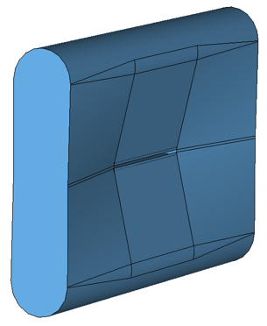
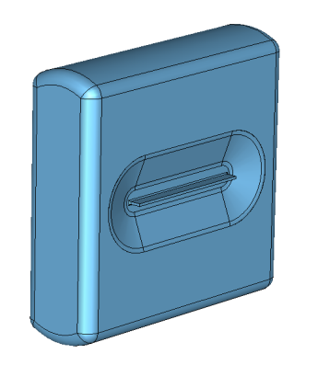
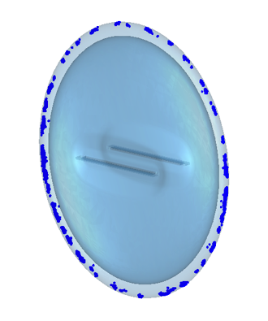
Cavity shape optimization
A taper was introduced to distribute the magnetic field over a larger volume keeping the electric field concentrated around the beam aperture
Such a cavity design has smaller dimensions for the same volume
All edges were rounded and improved reentrant nose shape reduced the peak magnetic field by more than 15% and the transverse dimensions by more than 10 cm
Final study was an elliptical cell shape where the magnetic field varies along the cavity wall such that there are no stable electron trajectories and multipacting is inhibited

Slide 32
Comparison of different cavity geometries
Parameters of the different cavity designs.
Rectangular cavity is better than elliptical by all parameters except multipactor resistivity
Parameter | Rectangular top | Rectangular middle | Elliptical bottom
Frequency, MHz | 200 | 200 | 200
Length, cm | 100 | 100 | 120
Height, cm | 104.5 | 92.9 | 142
Voltage (β=0.56, edge), MV | 4.67 | 4.66 | 4.68
Voltage (β=0.78, center) , MV | 6.72 | 6.71 | 6.89
Voltage (β=0.86, edge) , MV | 5.00 | 5.00 | 5.00
R/Q (β=0.86, edge), Ohms | 82.8 | 89.7 | 75.0
G, Ohms | 147.9 | 150.2 | 134.2
Peak magnetic field, mT | 92.1 | 72.7 | 77.2
Peak electric field, MV/m | 55.2 | 47.0 | 48.1
The RF performance degrades at higher frequencies.

Slide 33
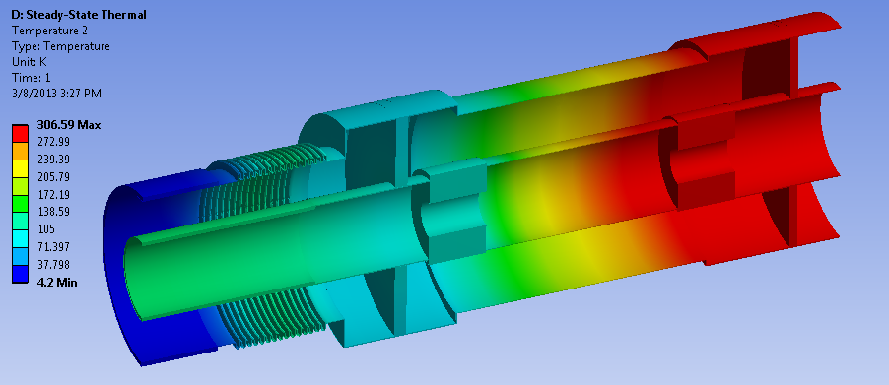
RF input coupler design
As 1 mA beam is accelerated by 4 cavities from 200 to 900 MeV, each cavity requires about 175 kW of power
One of the options is to attach 2 100kW couplers to the cavity
80K
126K
4K
Heat Flows:
To 4K = 9.8W
To 60K = 92.0W
From 300K = 18.8W
300K
133K
ANSYS estimations show no significant overheating

Slide 34
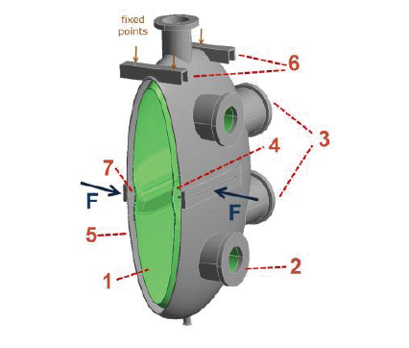
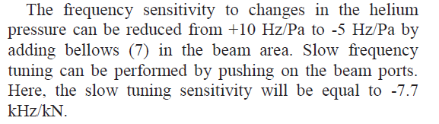
Magnetic power coupling and mechanical design
External Q-factor should be ~ 1.9*10⁶
Preliminary results predict ~1.1mm Nb and ~0.6mm SS deformation at magnetic field area
The complete mechanical design:
1 – niobium shell, 2 – RF ports, 3- extra ports, 4 – frequency tuning, 5 – steel jacket, 6 – rails

Slide 35






SCRF design: 10 MV/m; 50 cm x 5 cm (WxH)
RF input coupler
Mechanical design: port layout
Nb shell and He jacket
Parameter | Rectangular (Fig.1.3c) left | Rectangular (Fig.1.6) middle | Elliptical right
Frequency, MHz | 200 | 200 | 200
Length, cm | 100 | 100 | 120
Height, cm | 104.5 | 92.9 | 142
Voltage (β=0.56, edge), MV | 4.67 | 4.66 | 4.68
Voltage (β=0.78, center) , MV | 6.72 | 6.71 | 6.89
Voltage (β=0.86, edge) , MV | 5.00 | 5.00 | 5.00
R/Q (β=0.86, edge), Ohms | 82.8 | 89.7 | 75.0
G, Ohms | 147.9 | 150.2 | 134.2
Peak magnetic field, mT | 92.1 | 72.7 | 77.2
Peak electric field, MV/m | 55.2 | 47.0 | 48.1
First and final optimized rectangular cavity shape (left, middle left) and surface magnetic field profile (middle right) and elliptical cavity (right).

Slide 36
Summary
The nsFFAG has evolved to an isochronous, high energy, high current application
With constant strong-focusing machine tunes and optics that are independent of energy
  No resonance crossing
  The DA aperture is 10,000 – 100,000π mm-mr depending on size and tunes
In the relativistic regime, the FFAG becomes more compact than the separated sector cyclotron and more stable if designed properly
  The racetrack is the most compact
Large aperture high-gradient cavities including SCRF have been designed
Ironless, self-supported coil SC magnets are also being developed

