Slide 1
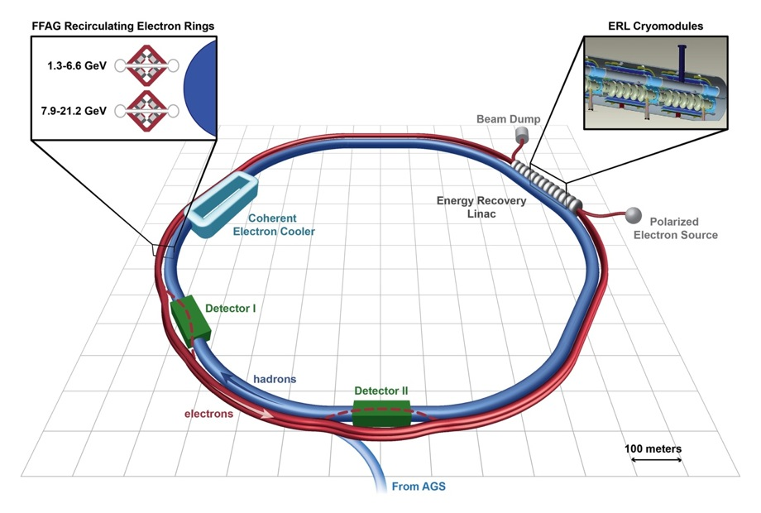

eRHIC Accelerator Design
V. Ptitsyn for the eRHIC design team

Slide 2
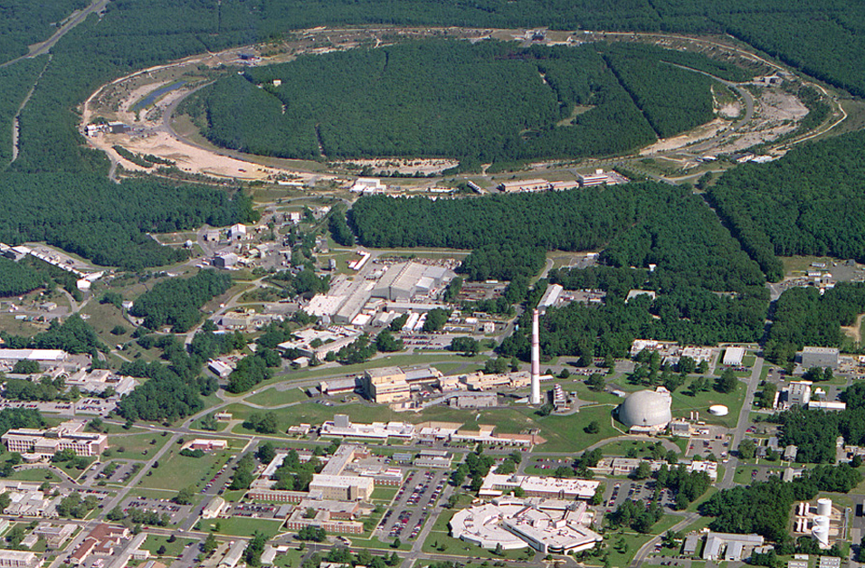
RHIC – a High Luminosity (Polarized) Hadron Collider
Polarized Jet Target
12:00 o’clock
Electron lenses
10:00 o’clock
RHIC
(Electron cooling)
2:00 o’clock
PHENIX
8:00 o’clock
RF
4:00 o’clock
STAR
6:00 o’clock
LINAC
NSRL
EBIS
Booster
BLIP
AGS
Operated modes (beam energies):
Au – Au 3.8/4.6/5.8/10/14/32/65/100 GeV/n
U – U 96.4 GeV/n
Cu – Cu 11/31/100 GeV/n
p↑ – p↑ 11/31/100/205/250/255 GeV
d – Au* 100 GeV/n
Cu – Au* 100 GeV/n
Planned or possible future modes:
Au – Au 2.5 GeV/n
p↑ – A* 100 GeV/n (A = Au, Cu, Al)
³He – A* 100 GeV/n (A = Au, Cu, Al)
p↑ – ³He↑* 166 GeV/n (*asymmetric rigidity)
Tandems
Achieved peak luminosities:
Au – Au (100 GeV/n) 195 × 10³⁰ cm⁻² s ⁻¹
p↑ – p↑ (255 GeV) 245 × 10³⁰ cm⁻² s ⁻¹
Other large hadron colliders (scaled to 255 GeV):
Tevatron (p – pbar) 110 × 10³⁰ cm⁻² s ⁻¹
LHC (p – p) 493 × 10³⁰ cm⁻² s ⁻¹

Slide 3
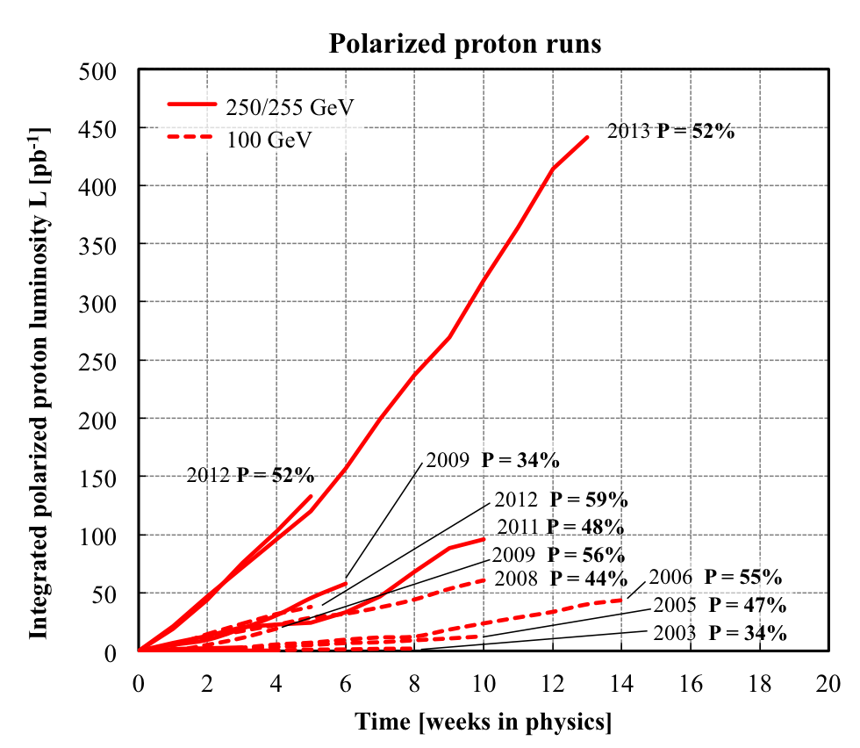

Slide 4
eRHIC: QCD Facility at BNL
Add an electron accelerator to the existing $2.5B RHIC including existing RHIC tunnel and cryo facility
p
70% polarized protons
25 - 250 (275*) GeV
80% polarized electrons:
6.6 – 21.2 GeV
Light ions (d, Si, Cu)
Heavy ions (Au, U)
10 - 100 (110*) GeV/u
e⁻
Pol. light ions (He-3)
17 - 167 (184*) GeV/u
Center-of-mass energy range: 30 – 145 GeV
Any polarization direction in electron-hadron collisions
protons
electrons
* It is possible to increase RHIC ring energy by 10%

Slide 5
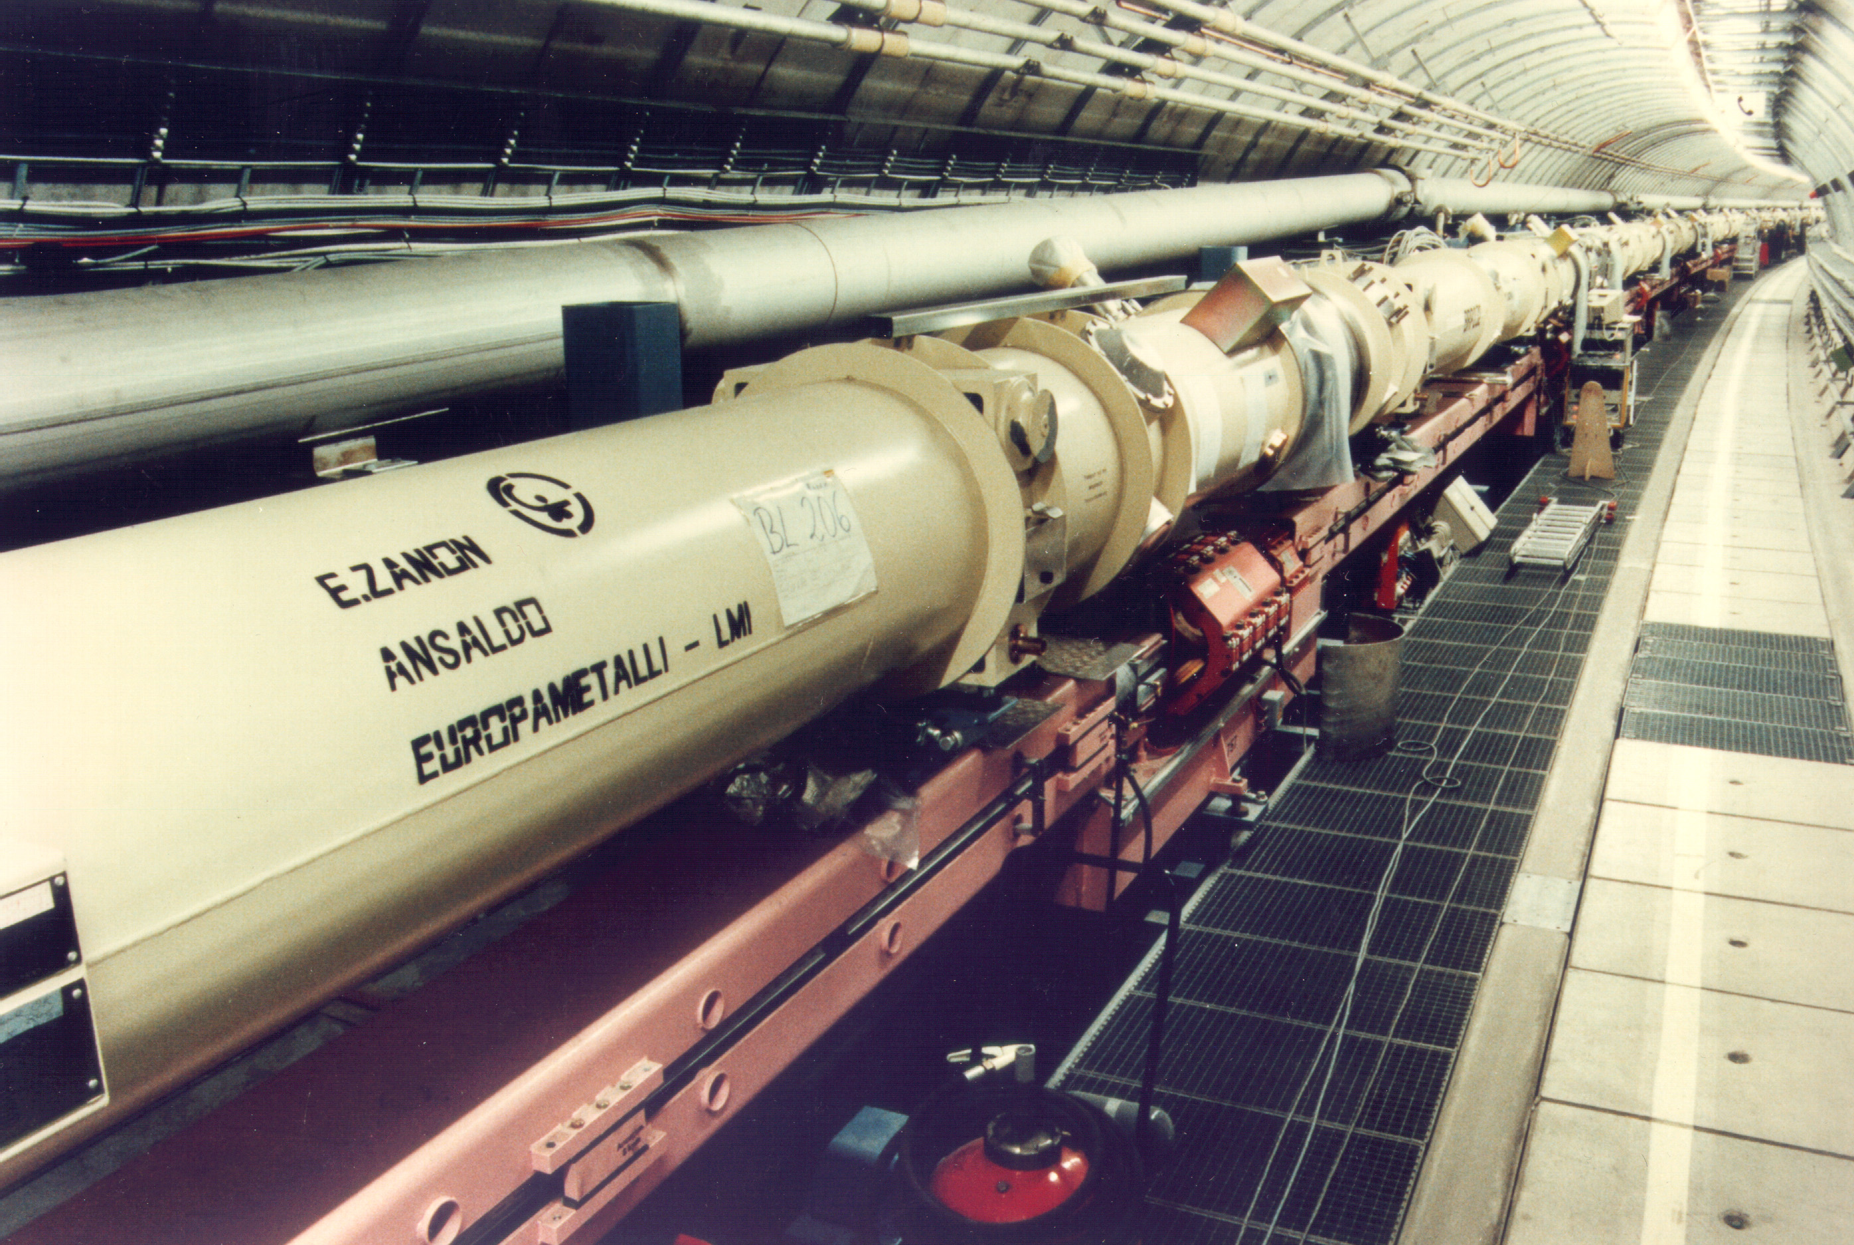
Lepton-nucleon scattering
Deep Inelastic Scattering (DIS) of electron, muon and neutrino beams on nucleons (fixed targets) has been a vital scientific exploration tool for several decades.
Experiments at SLAC (late 60s) led to the quark-parton model of nucleons, and ultimately to establishing QCD theory.
Numerous DIS experiments in 70-80s uncovered the momentum and spin distribution of quark constituents of proton and neutron
HERA (1991-2007): first electron-proton collider
Higher CME -> reach to the momentum distribution of quark and gluons at very low momentum fraction (x)
Selection of physics results:
precise data on details of the proton structure
the discovery of very high density of sea quarks and gluons present in the proton at low-x
detailed data on electro-weak electron-quark interactions
precision tests of QCD (α_{s} measurements)
Notes:
In the process of DIS, a lepton particle penetrates into a nucleon and interacts in electroweak way with the constituents of the nucleon. Scattering of electron, muon and neutrino beams on fix targets has been a vital tool …
Then in 1991 the first electron-proton collider HERA started its operation. It brought DIS experiments to the area of very high CME which allowed to study with high resolution the momentum distribution of quark and gluons down to very low momentum fraction (x). Here is shown the selection of HERA physics results demonstrating…
HERA program was very successful, but as it often happens in science the results and discoveries made at HERA and in fixed target experiments opened new puzzles and put new questions.
Presently several designs of the future electron-hadron colliders (they are also often called electron-ion colliders) are developed in Europe and United States laboratories to address those questions.

Slide 6
From HERA to future EICs
Future colliders
HERA
Much higher luminosity:
10³³-10³⁴ cm⁻² s⁻¹
Polarized protons and light ions
(in addition to polarized electrons)
e⁻
p
e⁺
Heavy ion beams
Polarized e⁻,e⁺ (27.5 GeV)
Unpolarized protons (920 GeV)
Peak luminosity: 5⋅10³¹ cm⁻² s⁻¹
Different (and variable) Center-of-Mass Energy range
Notes:
Having mentioned the physics goals for future electron-ion colliders let’s see what the features of those colliders that should help to realize the goal. What the differences compared with HERA?

Slide 7
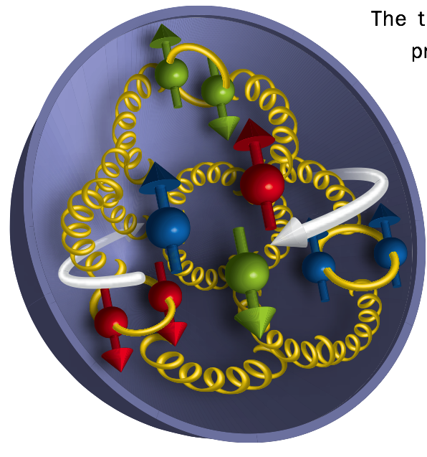
Major physics objectives of eRHIC
Mapping the gluon content of ions and protons;
High-density gluon state
3-dimensional imaging of the nucleons
eRHIC
In vacuum
Parton distributions and interaction in nuclei
Probing the nucleon’s spin structure
Inside the nucleus
Notes:
So, let’s look at the major objectives of future electron-ion colliders.
While, from previous experiments, we have rich information on the momentum structure functions of nucleon constituents, a high-luminosity EIC will be able to get data also on spatial distribution of the nucleon constituents, thus doing the imaging of the nucleons.
The proton spin puzzle needs to be fully answered. With EIC’s using polarized proton and electron beams the contribution from gluons to the proton spin can be measured in the region of low momentum fraction not accessible by RHIC polarized proton experiments. The contribution to proton spin from the orbital momentum of quark and gluons also can be measured.
One of the important (and somewhat surprising) results from HERA was the discovery of increasing gluon density at low x values. Mapping the gluon content of the ions and protons, verification whether it is saturated at some level and understanding the properties of this high-density gluon state is important task for future EICs. More efficiently the high-density gluon studies can be done with heavy ion beams. Because of that the use of the heavy ion beams is important feature of future EICs.
The physics objectives shown her mainly characterize the EIC’s as big microscopes (or femtoscopes) for study of nucleon structure
But with very high luminosity or with very high CME (on TeV scale) one can also effectively search and get better understanding of new physics:…

Slide 8
eRHIC History Line
I. Ben-Zvi, J. Kewisch, J. Murphy, S.Peggs, “Accelerator Physics Issues in eRHIC”, Nuclear Instrumentations and Methods in Physics Research A 463 (2001), p.94.
eRHIC ZDR (the ring-ring design with L~10³² cm⁻² s⁻¹; ERL linac-ring as backup) (2004).
ERL-based eRHIC with separated re-circulating passes
  L~10³⁴ cm⁻² s⁻, high hadron beam intensity, upgrades in hadron ring, Space Charge Compensation
  Energy staging. First stage eRHIC: 4-5 GeV electron machine.
2012-2013: Work on cost optimized machine design.
Bottom-up cost estimate and optimization: minimal cost first stage (5 GeV) eRHIC with separated re-circulating passes: $530 mln. (detector(s) not included).
FFAG re-circulating passes + permanent magnets
  construction and operational cost savings
  No energy staging. Using FFAG passes widens the energy reach at moderate cost.
10 GeV FFAG design has been evaluated by Machine Advisory Committee (Nov. 2013) :
  ”The MAC congratulates the eRHIC design team for its ingenious and novel use of the FFAG concept.”
The “eRHIC Design Study” report includes the Accelerator Design Chapter presenting main features of eRHIC FFAG design.

Slide 9
FFAG eRHIC Design
Up to 21.2 GeV electron beam accelerated with Energy Recovery Linac (ERL) inside existing RHIC tunnel collides with existing 250 GeV polarized protons and 100 GeV/n HI RHIC beams
Single collision of each electron bunch allows for large disruption, giving high luminosity and full electron polarization transparency
Use 2 FFAG magnet strings in RHIC tunnel to transport up to 16 beams
Considered permanent magnet design for FFAG lattice magnets
Cool hadron beam 10-fold in all directions using coherent electron cooling (CeC) at reduced intensity of hadron beam
IR design with β*= 5 cm using SC magnet technology and crab-crossing scheme
Average polarized electron current of 50 mA
1.32 GeV

Slide 10
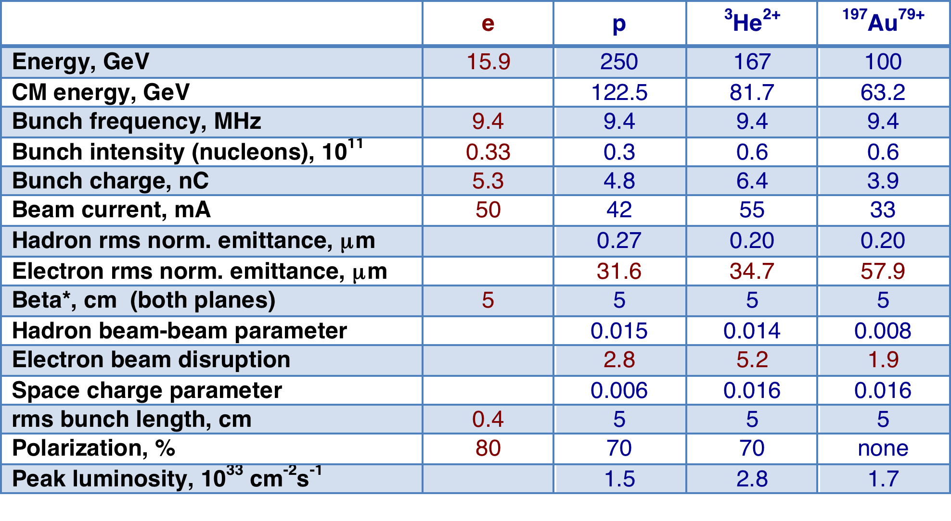
eRHIC beam parameters and luminosities
  Future luminosity upgrade
  The proton beam intensity is only at ~15% of present level.
  Open path to the moderate cost luminosity upgrade the future by increasing the hadron beam intensity (by an order of magnitude) and related hadron ring improvements:
  copper coating of beam pipe, beam diagnostics upgrade, RF system upgrade
  Luminosity above 10³⁴ cm⁻² s⁻¹ can be reached

Slide 11
Luminosity vs CEM
© T. Roser
Factors defining eRHIC luminosity:
Electron source current
Electron synchrotron radiation
Hadron beam-beam limit
Hadron space charge limit
Detector energy asymmetry requirements

Slide 12


Why FFAG eRHIC?
5.50 GeV
10.4 GeV
15.3 GeV
Until 2013 the high luminosity ERL-based eRHIC has been designed with individual recirculation passes.
20.2 GeV
25.1 GeV
30.0 GeV
Main arguments for using FFAG for beam recirculation:
Construction cost saving: 2 FFAG beam lines instead of numerous separate recirculation passes .
Other view: Possibility to reach higher electron beam energy at the same cost.
Operation cost saving: potential of using permanent magnet technology for FFAG beam lines.
Dejan Trbojevic
Campaining for NS-FFAG eRHIC approach for many years.

Slide 13
Demonstrating feasibility of NS-FFAG lattice design approach
Optimization of FFAG cell design to minimize synchrotron radiation, orbit spread, path length spread, …
Development of the lattice solutions for detector bypasses, straight sections, arc-to-straight matching sections, a technique for extraction into the IR beamline from the FFAG beamline.
Beam orbit measurements and corrections in the FFAG beam lines
Theoretical analysis methods and simulation tools have been developed to resolve the listed tasks.

Slide 14
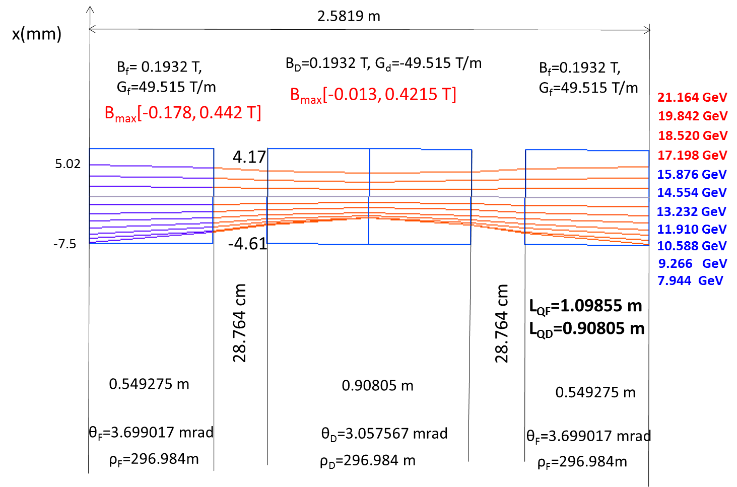
NS-FFAG approach for eRHIC
Non-Scaling Fixed Field Alternating Gradient (NS-FFAG) approach is used for eRHIC recirculation passes. It can transport large energy range.
eRHIC FFAG cell is comprised of two quadrupoles (F & D) whose magnetic axes are shifted horizontally with respect to each other by an offset Δ .
It can be considered as strongly focusing, bent FODO cell
  Small quadrupole offsets bend the beams adiabatically if bend radius is much larger than cell length
Orbit and optics dependence on the energy can be accurately found in paraxial approximation
© V. Litvinenko
© D.Trbojevic
High energy FFAG cell

Slide 15
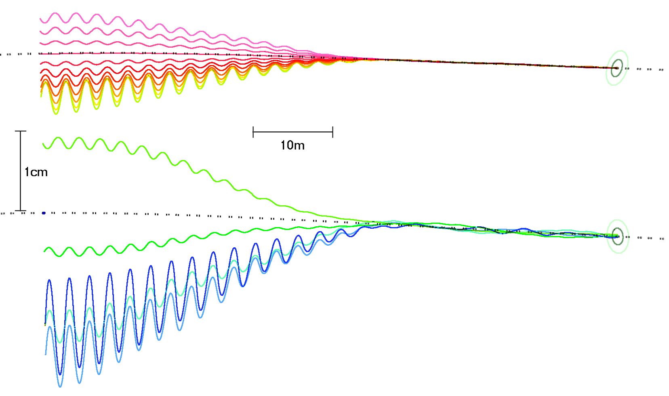
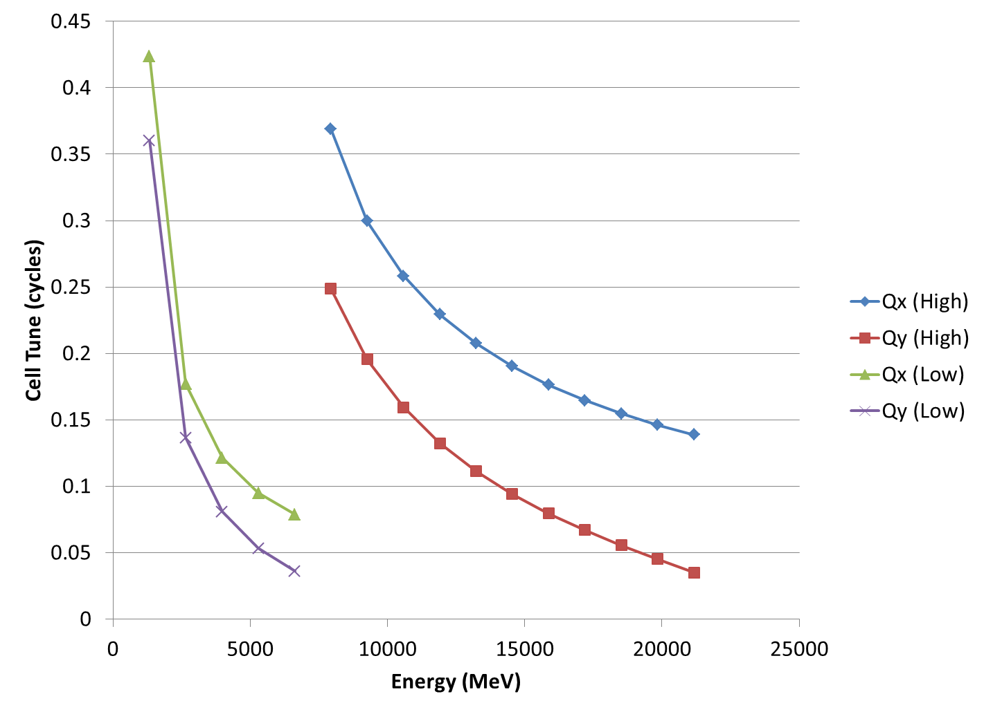
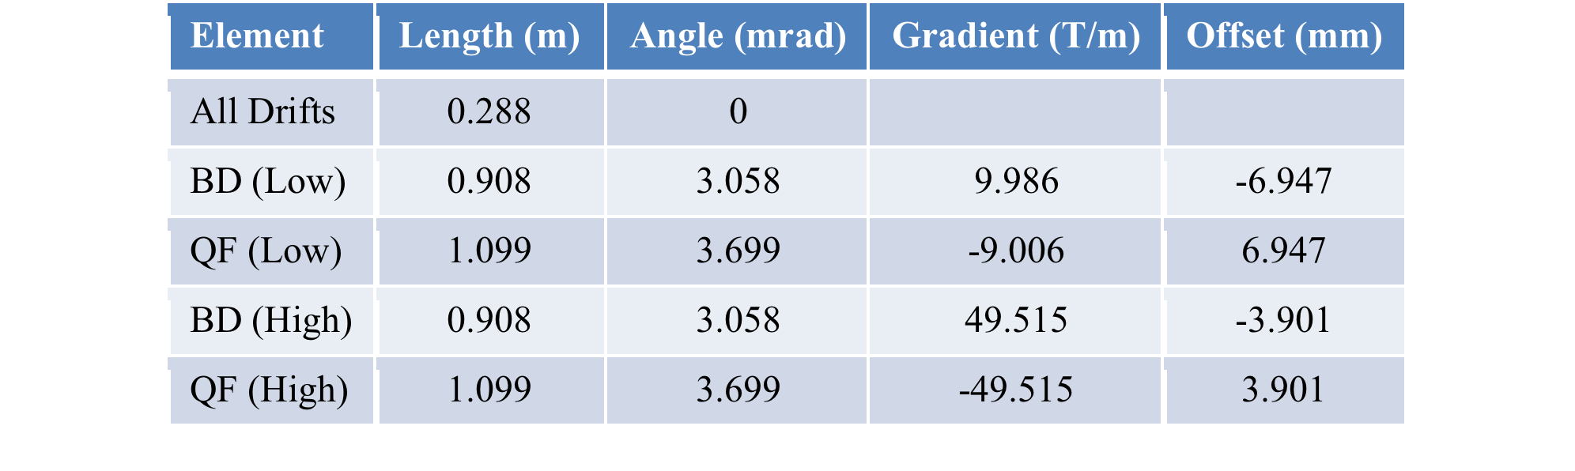
FFAG Recirculation Passes
FFAG lattice was thoroughly optimized on several factors:
  energy acceptance
  orbit spread
  time-of-flight spread
  synchrotron radiation power
Cell parameters for both FFAGs
© D.Trbojevic, S. Brooks
Transition from arc section to straight section is done by
gradual reduction of quadrupole offsets

Slide 16
Synchrotron Radiation Effects
SR power loss per recirculation pass
Accumulated energy spread
I_{e}=50 mA
I_{e}=18 mA
© S. Brooks, F. Meot, V. Ptitsyn, O. Tchoubar
Total SR power 12 MW:
operation at 15.9 GeV top energy -> 50 mA
operation at 21.2 GeV top energy -> 18 mA
Transverse emittance growth
Energy loss compensation schemes :
  2nd harmonic (844 MHz) cavities; or
  main linac RF phase offset + high harmonic cavities

Slide 17
Permanent Magnet Design
FFAG lattice can be realized with permanent magnets
Expected construction and operational cost savings
Expected field quality < 10⁻²
SmCo: acceptable B_{r}, good temperature stability, exceptional radation resistance
low-carbon magnetic steel
© W. Meng
Hybrid magnet
Sm₂Co₁₇
Different designs of 50 T/m permanent magnet
have been under consideration.
Including 1% dipole and quadrupole
correction coils.
© N. Tsoupas
Halbach magnet

Slide 18
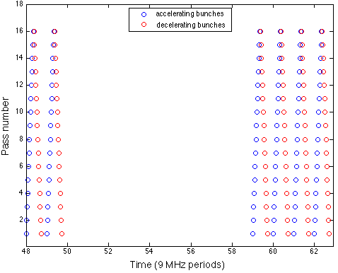
e-Beam Bunch Pattern
The bunch pattern is defined by the length of electron circumference.
Presently one RF bucket shift between the bunches.
Half-bucket shift at the top energy pass.
~ 900 ns gap to eliminate ion accumulation
For orbit measurements of individual passes: bunches in the gap are introduced.
Every 16 RHIC revolution periods inject one bunch into the gap.
BPM bunches
Bunch pattern
in the Linac

Slide 19
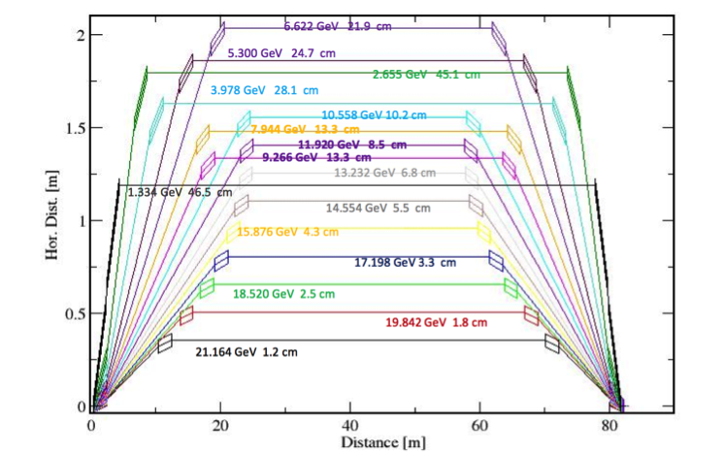
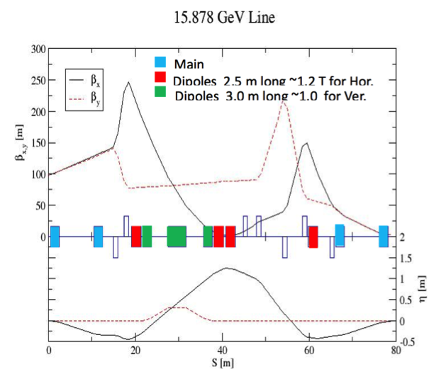
Beam Spreader and Combiner
© N. Tsoupas
Placed on either side of the linac to separate/combine the 16 beams with different energies between FFAG arcs and CW Linac
Match optical function from the arc to the linac
Ensure isochronous one turn transport:
path length and R₅₆ corrections
Betatron phase advance adjusters
Linac
Arcs
15 cm horizontal separation between individual lines
Some of the lines are folded into the vertical plane to reduce path length difference
Vertical magnet chicanes are used for pathlength correction

Slide 20



Electron Polarization in eRHIC
ϕ
90% longitudinally polarized e-beam from DC gun with super-lattice GaAs-photocathode with polarization sign reversal by changing helicity of laser photons.
Only longitudinal polarization is needed in the IPs.
eRHIC avoids lengthy spin rotator insertions. Cost saving.
Integer number of 180-degrees spin rotations between the gun and IPs
With the linac energy of 1.322 GeV the polarization is longitudinal at both experimental IPs
To achieve 80% polarization up to 21.2 GeV harmonic cavities are used for the energy spread reduction
_{stays in horizontal plane}
_{and rotates in arcs around}
_{vertical direction}
Polarized
e-gun
ϕ_{0,} γ₀
ϕ_{d,} γ_{d}
with energy spread compensation
protons
without energy spread compensation
electrons
Dashed – 21.2 GeV
Solid – 15.9 GeV

Slide 21
Hadron-Electron Synchronization
Main synchronization condition:
the electron and hadron bunch repetition frequencies at the collision points have to be the same:
f_{be} = f_{bh}
The hadron bunch frequency (at the fixed circumference) depends on the hadron energy
Presently solution:
Hadron delay
Radial orbit offset in hadron ring:
Up to 16 cm path lengthening ability.
The RF harmonic switching method;
Used to operate with the hadron energies <50 GeV/n
Hadron circumference lengthening

Slide 22
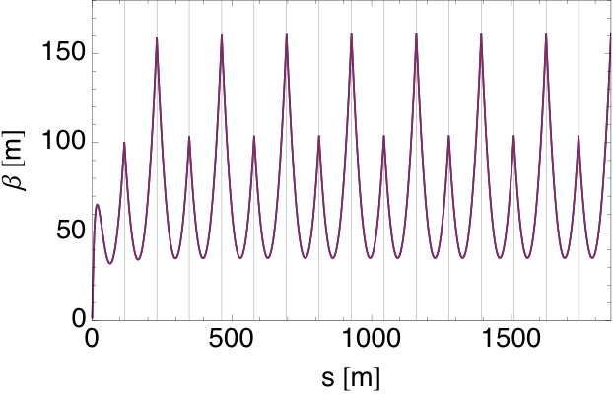

SRF Linac
Energy Recovery Linac:
422 MHz SRF cavities
120 m cold length
no quadrupoles
Multipass beam-breakup thresholds
for 16 pass operation (simulation results)
© Y. Hao
HOM frequency spread
Additional SRF systems:
Energy loss compensation
(2nd harmonic)
Energy spread reduction
(3rd or 5th harmonic)
The beta function in the linac for 16 passes.
The horizontal and vertical optics are identical.
The grid lines separates the optics of each pass.

Slide 23
Beam Dynamics
Beam-beam
e-beam disruption (emittance increase by ~30%)
Luminosity enhancement by e-beam pinching: 33%
Kink instability of hadron beam:
the feedback system (50-300 MHz) damps the instability
Hadron beam heating by electron parameter noise
Multi-pass BBU
Single bunch BBU
Electron-ion interactions
  Gap is introduced to prevent ion accumulation
  Fast ion instability simulations
Energy spread due to impedances: ~18 MeV
Compensation schemes are under studies
Kink instability threshold
© Y. Hao
eRHIC parameter area
Circulant matrix method
Two particle model
© G. Wang
e-ion instability

Slide 24
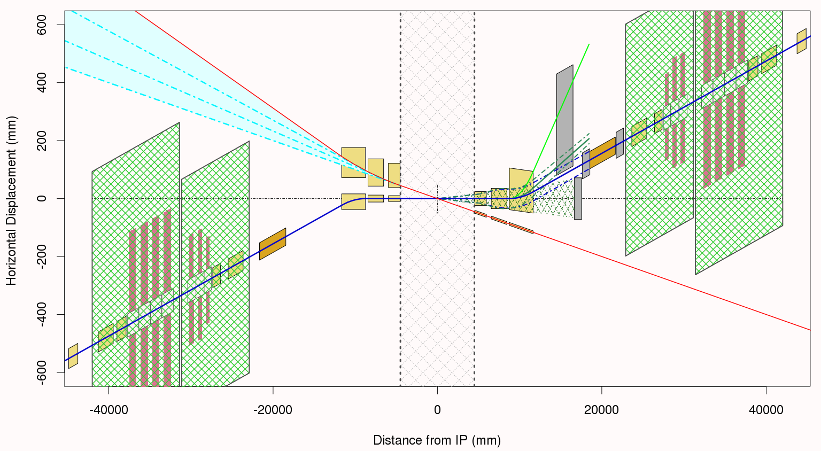

Interaction Region with β* = 5 cm
© B. Parker
Forward detector components
10 mrad crossing angle with crab-crossing
Large enough aperture IR SC magnets for forward collision products and with field-free passage for electron beam
Recent IR design improvements on the magnet design with electron passage and integration of
detector components
90 degree lattice and beta-beat in adjacent arcs (ATS) to reach β* of 5 cm and provide effective chromatic corrections
Crab-cavities
p
e
Electron passage is arranged between SC coils of hadron magnet

Slide 25
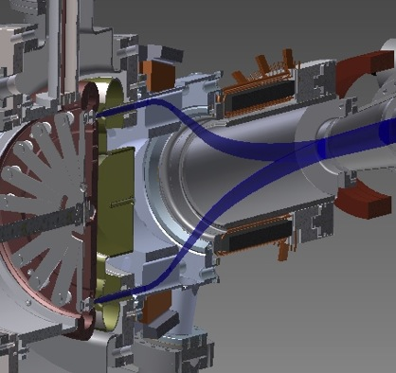
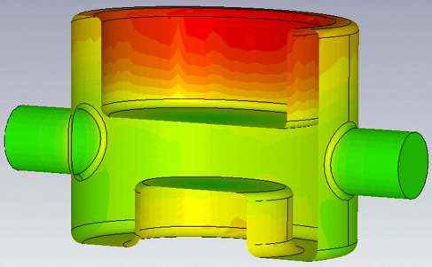
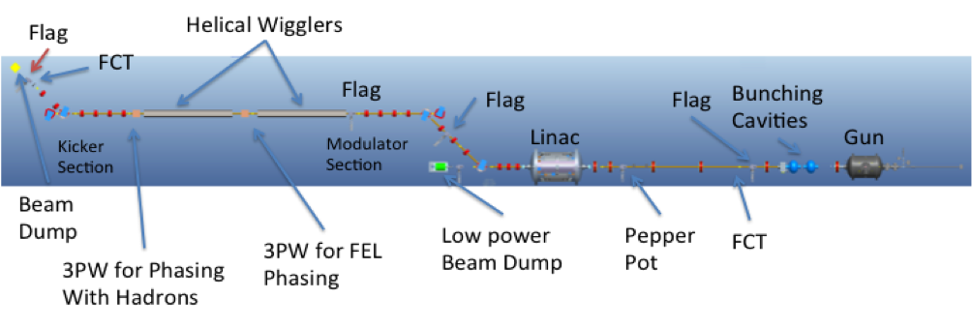
eRHIC R&D
  Prototyping of Gatling Gun polarized electron source
  Coherent electron Cooling PoP using 40 GeV/n Au beams in RHIC
  High average current ERL to support operation with high current e-beam
  Prototype eRHIC ERL with FFAG arcs (@ Cornell ?)
  Development of high gradient crab cavities within LARP
  Development of polarized He-3 (underway in collaboration with MIT)
QWR crab-cavity design (BNL)
Gatling gun
CeC PoP

Slide 26
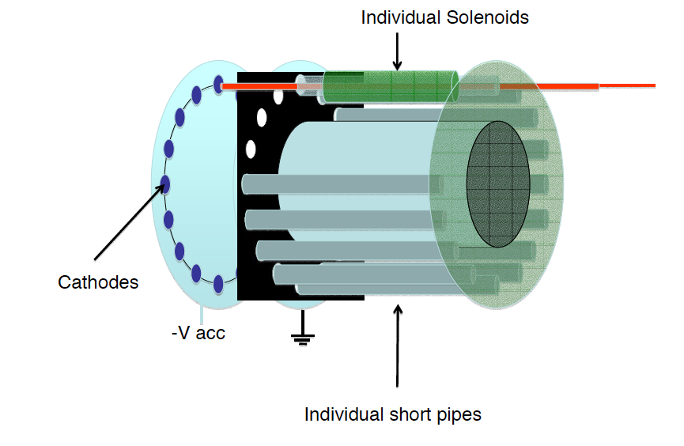
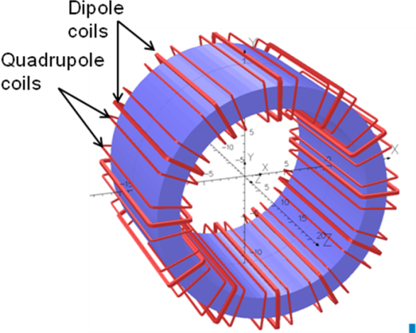
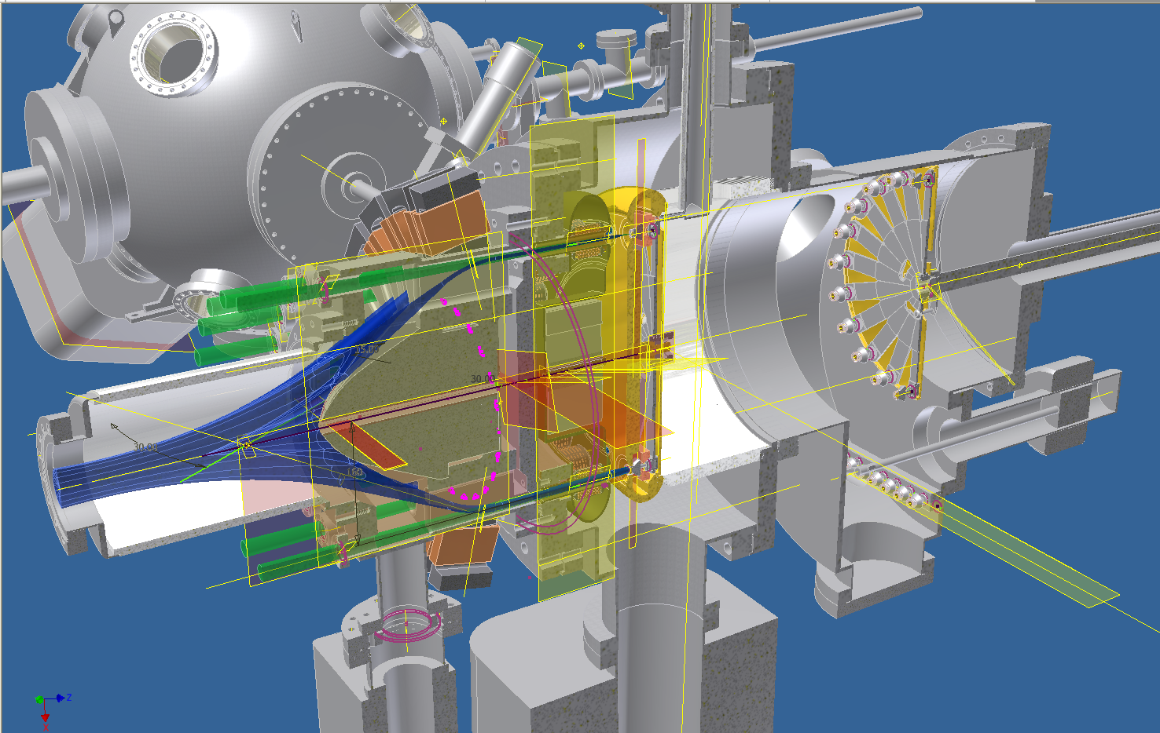
50 mA polarized electron source R&D
BNL Gatling Gun:
the current from multiple cathodes is merged
I. Ben-Zvi
V. Litvinenko
J. Skaritka
Prototype with 20 potential cathodes has been built
Photo current from two cathodes during first test at Stangenes Industries (CA)
End of 2014: test with two cathodes in Stony Brook

Slide 27
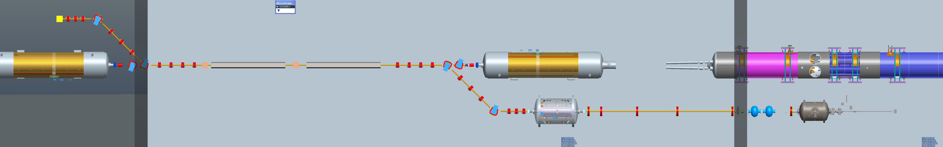
Proof-of-principle CeC Experiment in RHIC IP2
Accelerator
Section
Beam Dump
Helical Wiggler
Buncher
Cavities
Kicker Section
Gun
© V.N. Litvinenko, I. Pinayev, G. Wang …
Modulator Section
Coherent Electron Cooling:
Idea proposed by Y. Derbenev in 1980, novel scheme with full evaluation developed by V. Litvinenko.
Fast cooling of high energy hadron beams is necessary for eRHIC luminosity
Made possible by high brightness electron beams and FEL technology
@ A. Fedotov
Proof-of-principle demonstration planned with
40 GeV/n Au beam in RHIC (2016)
Aim : to demonstrate longitudinal cooling of 40 GeV/u Au ion bunch in RHIC

Slide 28
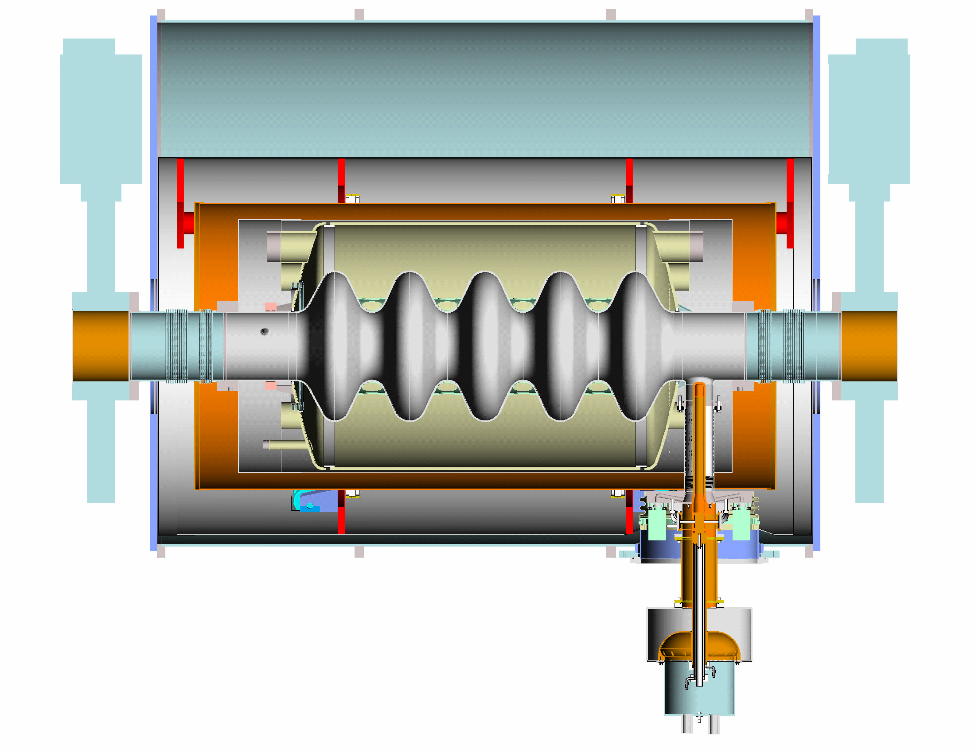
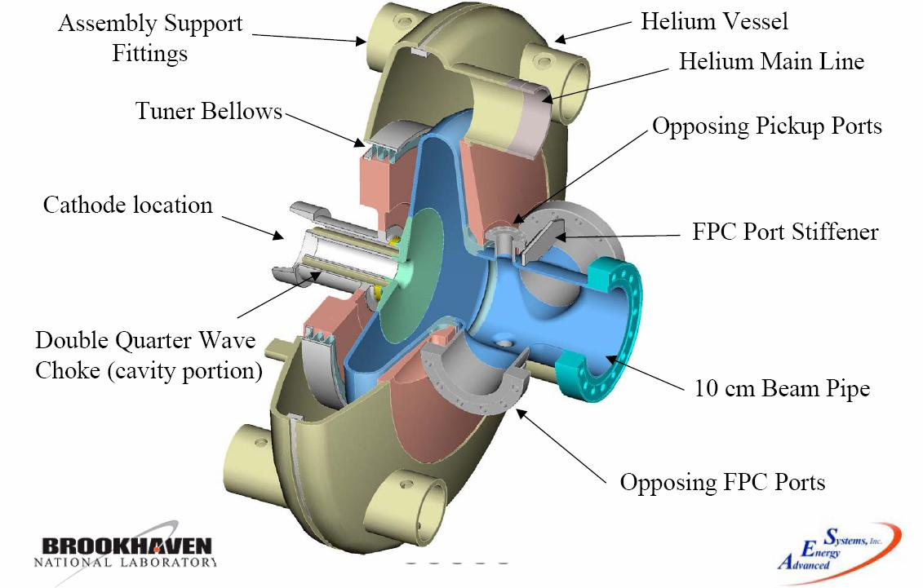
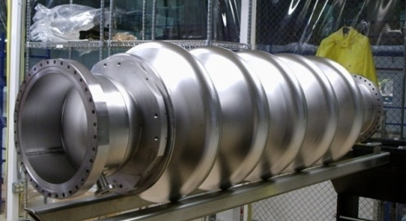
Energy Recovery Linac Test Facility
ERL test facility at BNL.
E=20 MeV
Test of high current, high brightness ERL operation
SC RF gun was tested at 2MV
The beam from the gun expected by the end of 2014
Recirculation: 2015/16
Controls &
Diagnostics
e⁻ 15 – 20 MeV
Magnets, vacuum
Cryo-module
SC RF Gun
e⁻ 2.5MeV
e⁻
2.5 MeV
Beam dump
1 MW
700 MHz
Klystron
Laser
50 kW 700 MHz
transmitter

Slide 29
eRHIC Schedule

Slide 30
Summary
The present cost-effective design of ERL-based eRHIC relies on FFAG lattice of recirculation passes and reaches high luminosity (> 10³³ cm⁻² s⁻¹) up to 125 GeV CM energy and 145 GeV CM energy for somewhat lower luminosity.
Studies of design issues specific for the FFAG lattice approach have not revealed showstoppers. Solutions have been found for the optimal FFAG lattice, spreader/combiner, orbit measurement and correction, ion gap formation … .
R&D is under way on high current polarized electron source (Gatling Gun), strong hadron cooling (Coherent electron Cooling) and high current ERL with key results coming in next two years.

Slide 31
Acknowledgements
for their contributions to the FFAG eRHIC Accelerator design:
E.C. Aschenauer, S. Belomestnykh, I. Ben-Zvi, S. Berg, M. Blaskiewicz, S. Brooks, C. Brutus, T. Burton, A. Fedotov, D. Gassner, Y. Hao, Y. Jing, D. Kayran, V. N. Litvinenko, C. Liu, G. Mahler, G. McIntyre, W. Meng, F. Meot, T. Miller, M. Minty, B.Parker, I. Pinayev, V.Ptitsyn, T. Roser, J. Skaritka, O. Tchoubar, P. Thieberger, D. Trbojevic, N. Tsoupas, J. Tuozzolo, E. Wang, G. Wang, Q. Wu, W. Xu

Slide 32
Luminosity versus Beam Energy
Luminosity versus hadron beam energy
  For 15.9 GeV electron energy or less
  Limited by hadron beam-beam parameter above 100 GeV and space charge below 100 GeV
Luminosity versus electron beam energy
  Limited by maximum SR power of 12 MW above 15.9 GeV

Slide 33
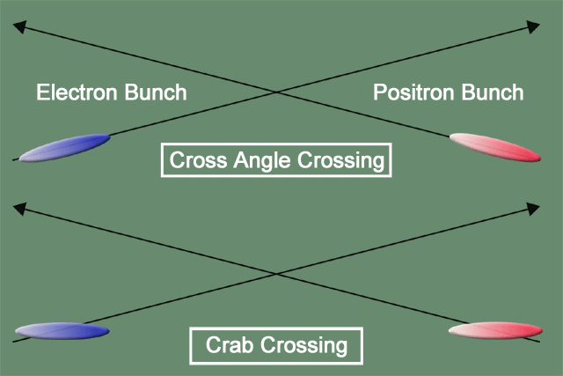
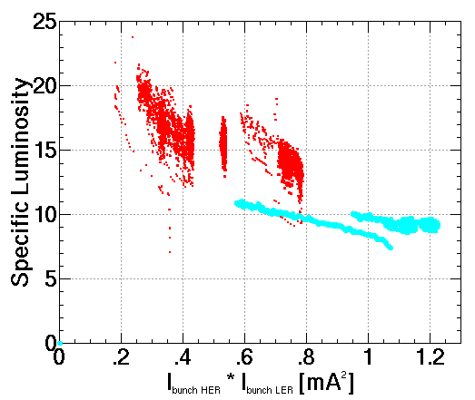
Crab-crossing
Idea Introduced by R. B. Palmer SLAC PUB 4832
Used at KEK B-factory
Fundamental +3rd + 5th ,
f_{fund}= 183 MHz, V_{fund} = 24 MV, V_{3rd}=1.3 MV, V_{5th} =0.09 MV
OR
Fundamental +2nd + 3rd
f_{fund}= 244 MHz, V_{fund} = 22 MV, V_{2nd}=4.4 MV, V_{3th} =0.5 MV
Crab-cavity design on the basis of the quarter wave SRF cavities has been developed
@ V. Litvinenko, I. Ben-Zvi,
S. Belomestnykh, Q. Wu
QWR crab-cavity design (BNL)

