Slide 1
NS-FFAG GANTRY DESIGN
Dejan Trbojevic
Brookhaven National Laboratory

Slide 2
INTRODUCTION
Future gantries for the ion cancer therapy need to have large momentum acceptance - longitudinal scanning - conclusions from the ion cancer workshop organized in January 2013, by NIH (US National Institute of Health), NCI (US-National Cancer Institute), DOE (US Department Of Energy) and DOD (US-Department of Defense).
Efforts should be put on: reducing the gantry cost, size, and complexity of operation.
Work on markers to be used for in city during the real time of treatment to provide information on ion-tumor interaction but also on the very low intensity beam measurements: precise dose, beam position, profile, and energy. There are some simple ideas at BNL of using the vacuum windows for determining the beam position, beam transverse profile and even the intensity (dose) (Peter Thieberger).
For the reduction of size in both carbon or proton gantries the superconducting magnets are clearly needed. The larger the field the smaller the size.
S.A.D without large magnets (Except the second scanner magent still large 20 (30) cm aperture.

Slide 3
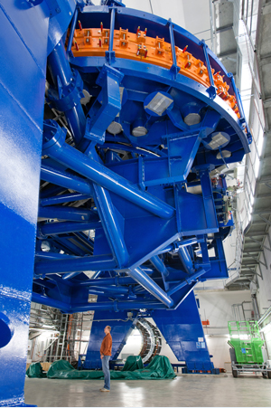
What is the OBJECTIVE?
- Reduce the size of an accelerator
- Improve its performance
- Reduce the cost
- Allow large energy range
The NEW carbon ion gantry replaces the 135 ton magnets of the Heidelberg gantry with 2 ton small BNL superconducting magnets.

Slide 4
Lawrence equation
υ=ds/dt
ρ
E_{oC}=0.93149 GeV/u
E_{op}= 0.938272 GeV
E=E_{k} + E_{o}
p/c=√ E ² – E_{o}²
p_{proton 250 MeV} =0.729 GeV/c
p_{carbon 400 MeV/u}=0.95142 GeV/c/u
Bρ _{proton 250 MeV} [Tm] = 2.432 Tm
Bρ _{carbon 400 MeV/u} [Tm] = 6.348 Tm

Slide 5
Scanning above the patient
Proton
CARBON IONS Minimum
0.48 m
0.38 m
θ= 1.2∗0.38/6.34=0.071
θ= 1.2∗0.35/6.34=0.066
2m
H=2.5-3 m
θ= 0.1/1.4=0.0713
θ= 0.1/1.5=0.0667
Proton
1.2*0.3/2.43 →H1= 0.67m
H1=1.4 m
H1=2.175 m
H ∼1.7 m
0.38 m
0.1 m
0.5 m
0.1 m
0.154

Slide 6
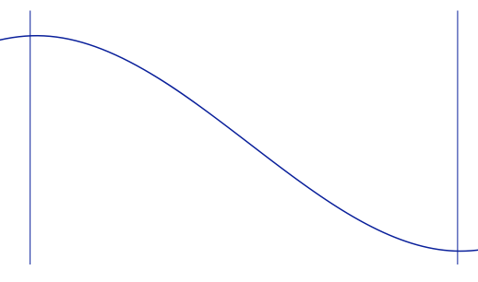
Spill extraction
τ≈10 ms
20,000 turns/62/2
323/2 turns each spill
E₁ ~ 24 cm
tumor
E₂~ 20 cm
E₁
~4 cm/ 3 mm=13.3
E₂
~13 layers
t₁
t₂
33.3 ms
τ ≈0.298 μs → time of one turn around circumference of 64 m at 400 MeV/u
τ ~ 1.63 μs @ 8 MeV/u

Slide 7
Construction of the gantry
Proton Gantry – E_{k}=250 MeV → E=250 + 938.27 MeV → p=√E ² - E_{o}²
Bρ= p/c = 2.432 Tm θ = Bl/Bρ if B ∼ 5T → then r = 0.486 m
B_{avrg}=Bρ/r = 1.344 T → If we raise the field to the superconducting
r=1.809 m
h=2.5 m
Φ=72º
1m
l = 2π r =11.37 m

Slide 8
The state of the art proton gantry at PSI
3.2 m
3.2 m

Slide 9
The state of the art proton gantry at PSI

Slide 10
SAD – SOURCE-TO-AXIS-DISTANCE Scanning system: applied for patent by BNL
The maximum dose to the patient surface relative to the dose in the SOBP
increases as the effective source-to-axis distance (SAD) decreases. For a fixed,
horizontal beam, large SAD's are easy to achieve; but not for gantry beam lines. A smaller gantry with a physical outer diameter of less than 2 meters may have important cost implications. Such a gantry would require magnetic optics to ensure that the effective source-to-axis distance is large enough to provide adequate skin sparing.
S
S
S
S
Axis
Axis
Axis
Axis

Slide 11
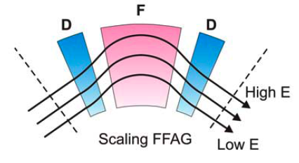
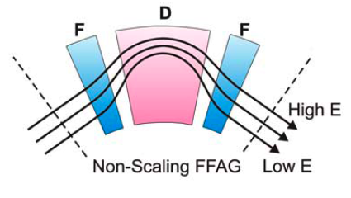
SCALING VS. NON-SCALING FFAG
Linear magnetic field:
B = B_{o}+ r G_{o}
0.03 meters
3 cm
0.9 meters
Orbit offsets are proportional to the dispersion function:
- To reduce the orbit offsets to ±4 cm range, for momentum range of δp/p ~ ± 50 % the dispersion function D_{x} has to be of the order of:
D_{x} ~ 4 cm / 0.5 = 8 cm
Δx = D_{x} ∗ δp/p

Slide 12
Range of momentum = range kinetic energy
ΔE_{k carbon}=400-195.4 MeV/u [27.3-8.2 cm]
ΔE_{k carbon}=195.4-91.5 MeV/u [8.2–2.2 cm]
ΔE_{k proton}=250-118.81 MeV [37.8-10.4 cm]
ΔE_{k proton}=118.81-54.6 MeV [10.4-2.6 cm]

Slide 13
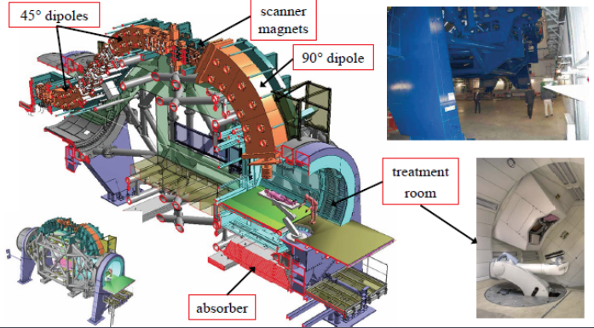
State of the art C-gantry at Heidelberg
Weight of the transport components – 135 tons
Total weight = 630 tons - 19 m long. WEIGHT and SIZE

Slide 14
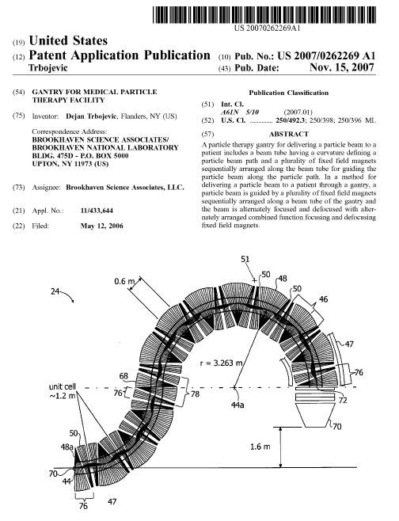

Slide 15
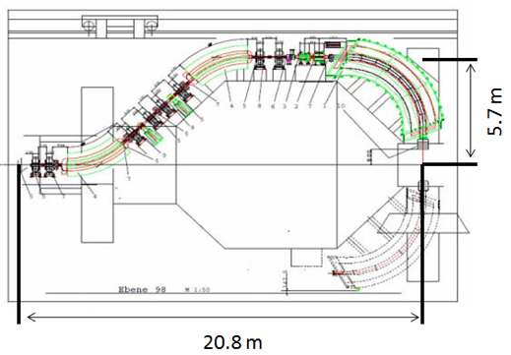
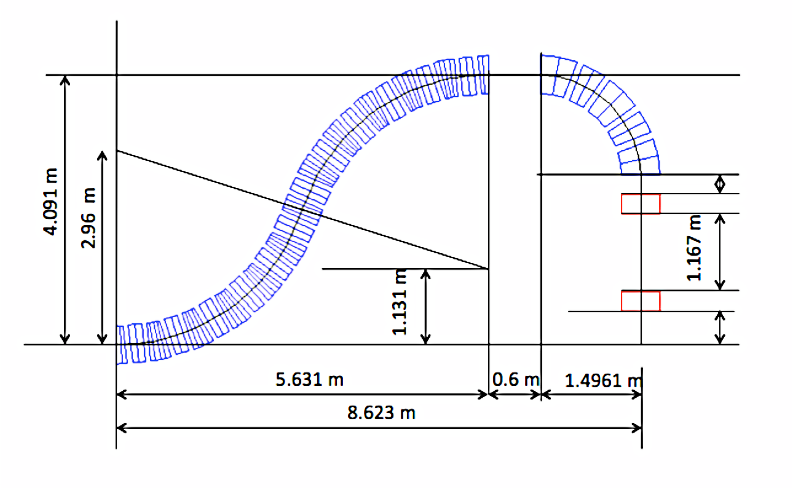
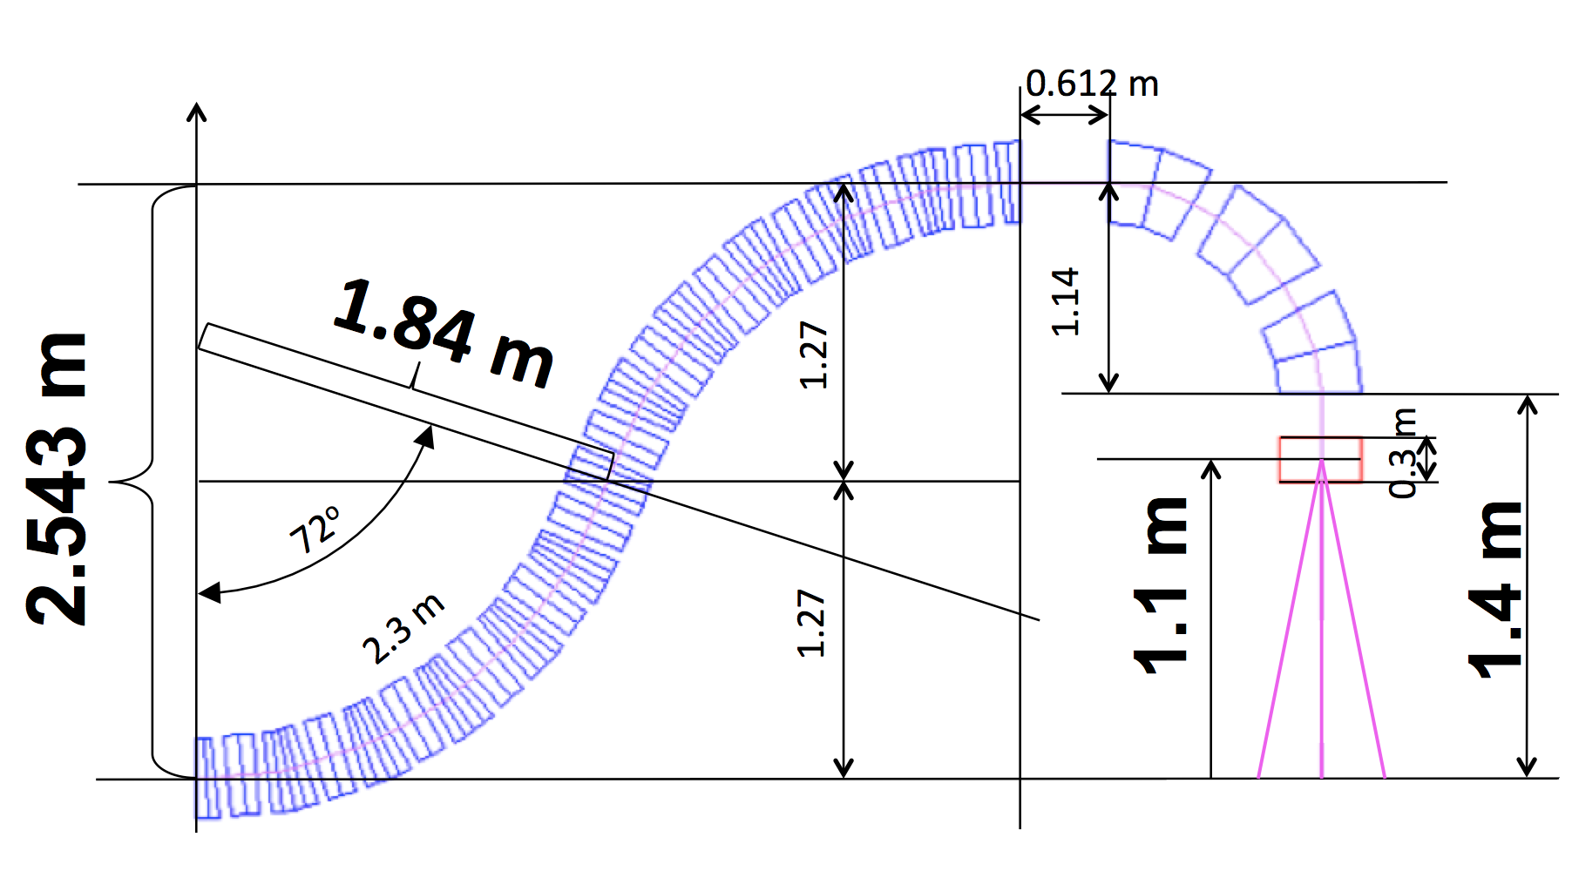
Carbon E_{k}=400 MeV/u → Bρ = 6.35 Tm ( θ= Bl/Bρ )
Warm iron magnets: B=1.6 T then ρ ~ 4.0 m Superconducting magnets B=3.2 T then ρ ~ 2.0 m
DIMENSIONS of the CARBON GANTRY
4.1 m
2.54 m
8.6 m
20.8

Slide 16
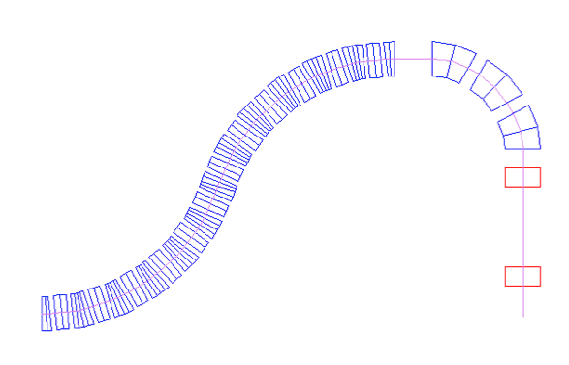
Reducing the size and weight of the carbon gantry(135 tons→ 2 tons) with fixed field
0.612 m
1.84 m
1.14
1.27
2.543 m
0.3 m
72º
1.1 m
1.4 m
2.3 m
1.27

Slide 17
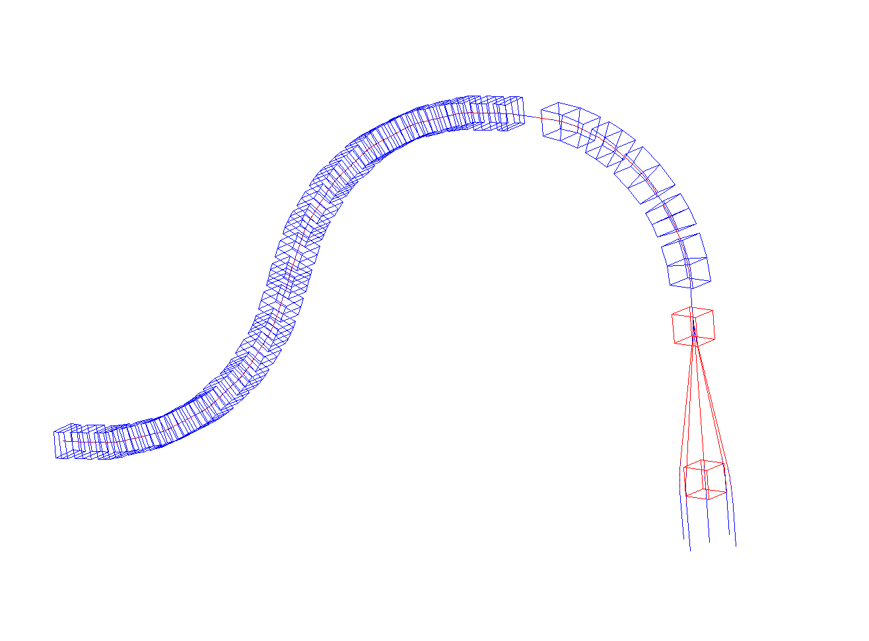
Three Dimensional picture

Slide 18
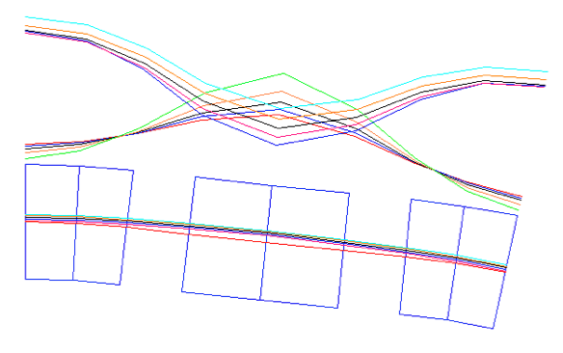
Amplitude functions in the carbon gantry
√β_{x}, √β_{y} (m^{1/2}), D_{x} (m)
1.45 (2.1 m)
√β_{y}
√β_{x}
D_{x}
D_{max}<8 cm

Slide 19
Magnetic field required in the pipe and estimated maximum field in the coils
4.54 mm
3.80 T
Dipole, quad coils
B_{D max} = B_{d} + G_{D} x = 4.27 - 102 ∗
B_{F max} = B_{f} + G_{F} x = -0.52+ 141.8 ∗
insulation
-2.90 mm
4.6 T
r
7.5 mm
0.54 T
Beam
Quadrupole Coil
140 T/m * 2 cm = 2.8 T
-6.64 mm
-1.46 T
6 cm
Beam size : σ_{T}=√σ² + (D dp/p)²
R=1.5 cm
R=1 cm

Slide 20
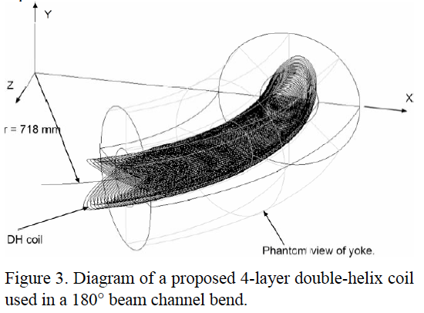
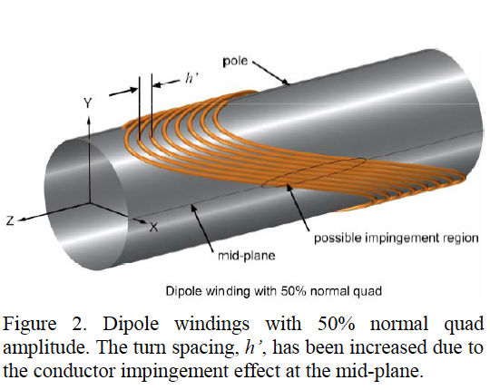
AML combined function magnet design

Slide 21
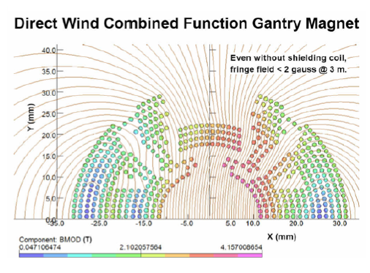
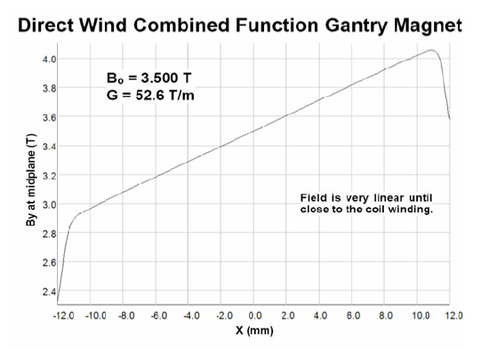
BNL- combined function magnet design

Slide 22
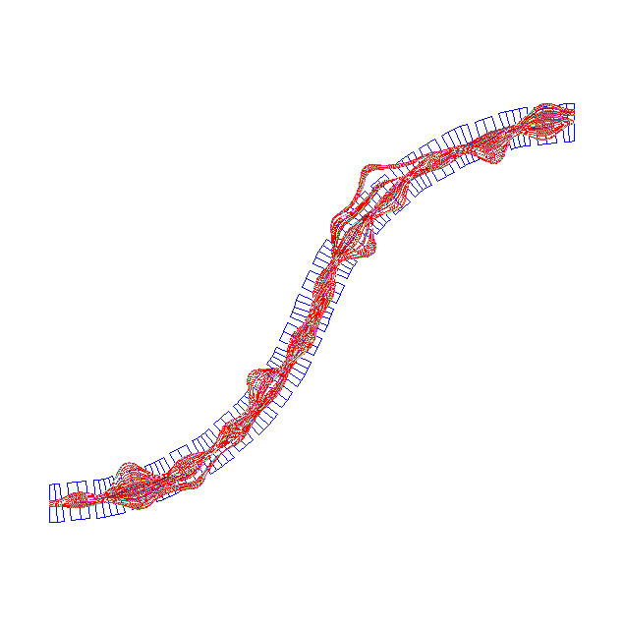
Tracking particles in the carbon gantry for the energy range of 210-400 MeV/u

Slide 23
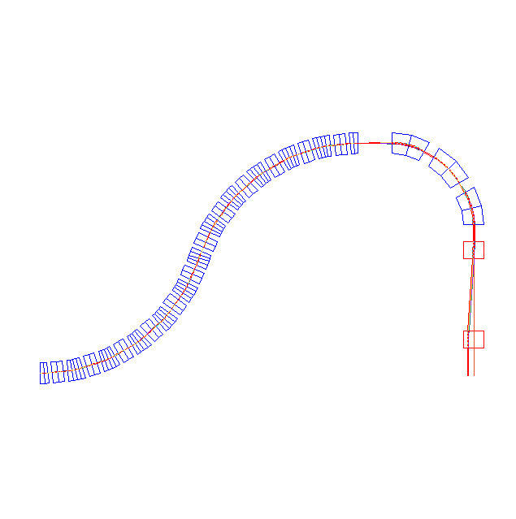
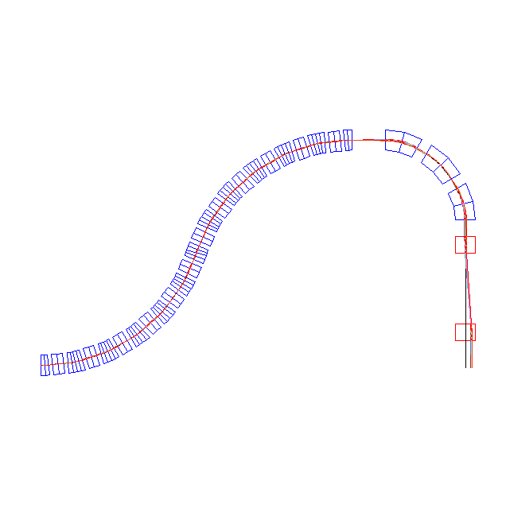
CARBON GANTRY h=4.091m without magnification
θ=Bl/6.347=0.1/1.586=0.063
l=0.3m → B_{max}=1.33 T

Slide 24
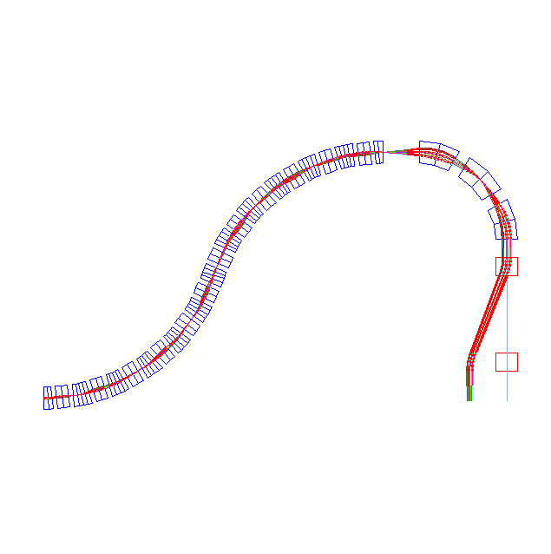
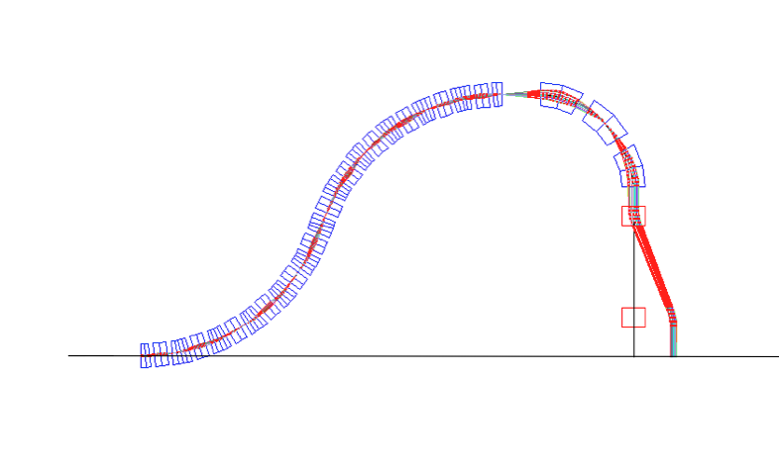
CARBON GANTRY height 4.091m 5X magnification, scanning ±10 cm

Slide 25
Concepts

Slide 26
Replacing the large magnet

Slide 27
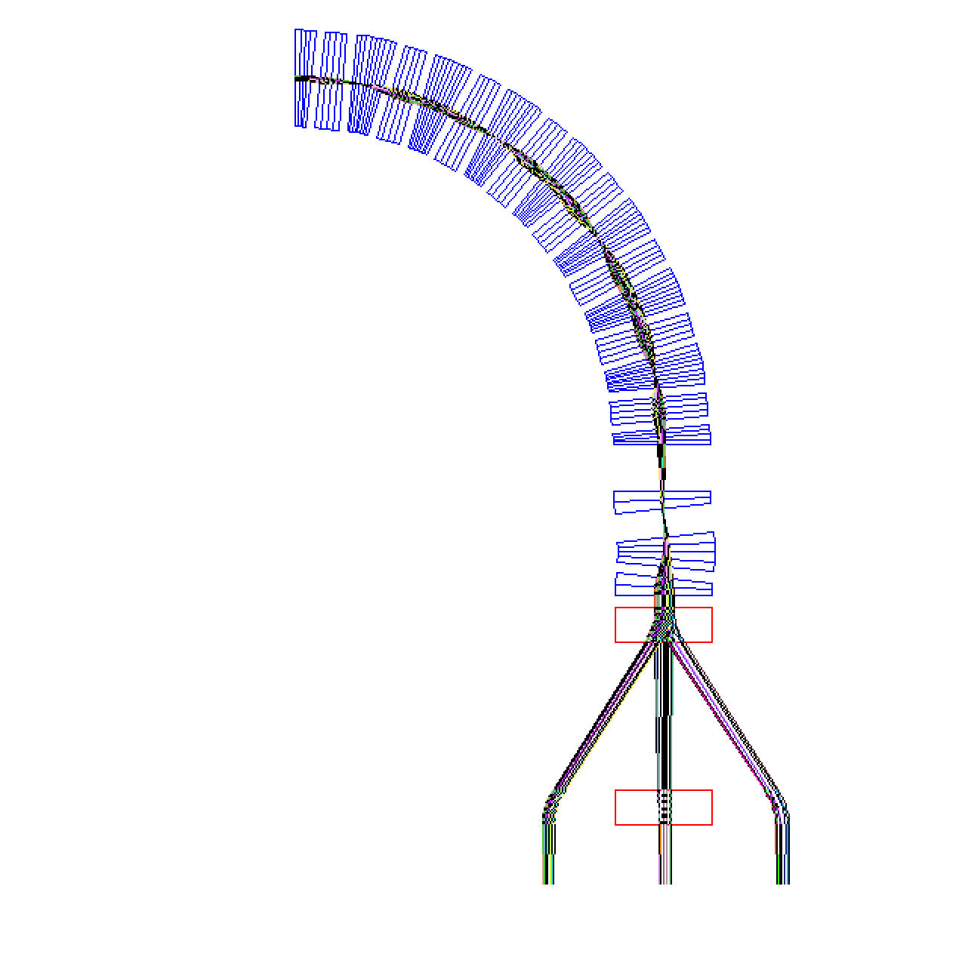
3.0503 m
6.84166 m
3.7913 m
2.7607 m
0.5 m
Magnified x10 =±10cm

Slide 28
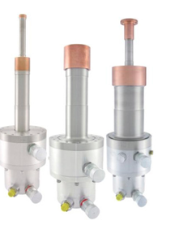
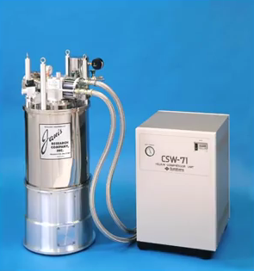
CRYO-COOLERS: reliable, maintenance free, easy to operate

Slide 29
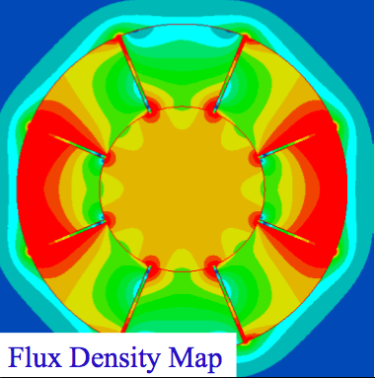
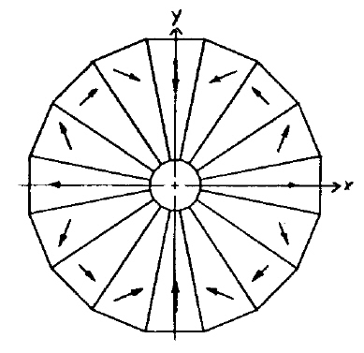
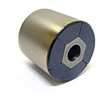
NS-FFAG gantry with permanent magnets
7.375 cm

Slide 30
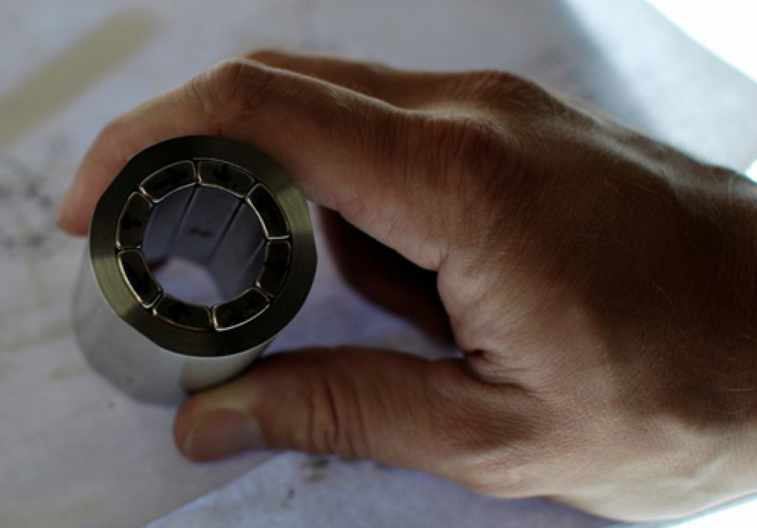
Halbach Permanent Magnets
In reality it would be limited by:
The realistic size
The demagnetization effect

Slide 31
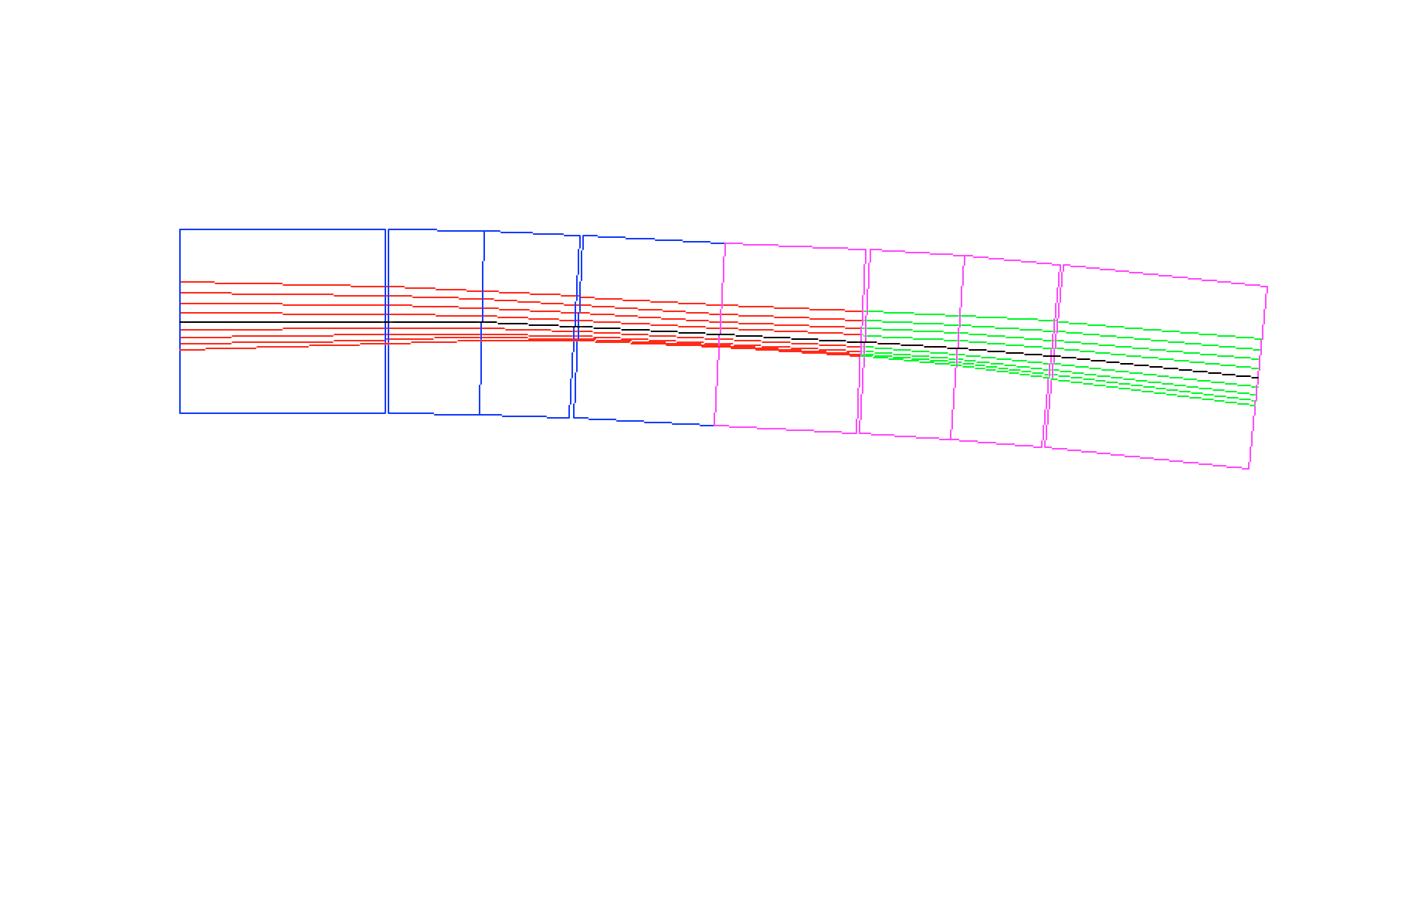
What is innovative? The extreme focusing
L _{QF/2}=6 cm
L_{QF/2}=6.05 cm
L _{QD}=9.2 cm
L_{QD}=9.2 cm
16 mm
250 MeV
-10 mm
31 MeV
QF/2
B
QD
B
QF/2
L_{B}=3.8 cm
L_{B}=3.8 cm
29.7 cm

Slide 32
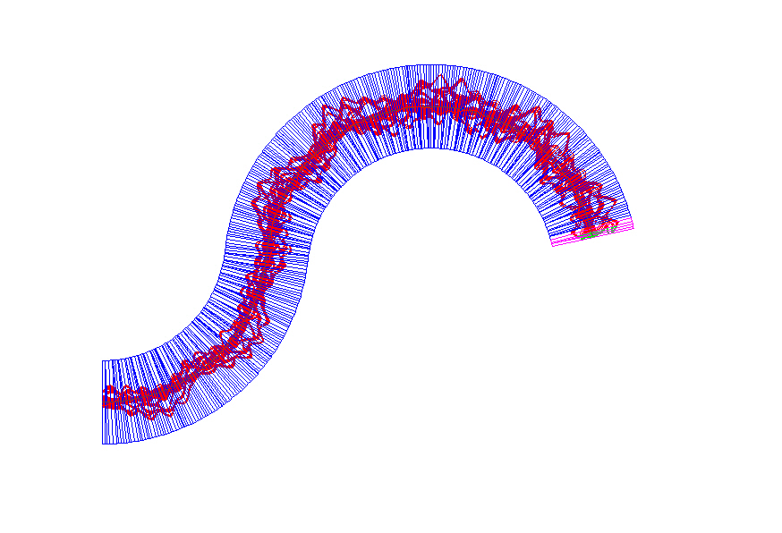
Permanent Halbach Magnet NS-FFAG Proton Gantry
14 cells-27 cells
ORBITS MAGNIFIED
-10<Δx<16 mm
r=2.71 m
162º
84º
h₂=3.172 m
h₁=2.61 m
Proton kinetic energy range
30 – 250 MeV

Slide 33
SUMMARY:
NS-FFAG gantries provide transfer of carbon ions with Δp/p=± 20% (200-400 MeV – or - 100-200 MeV) allowing longitudinal scanning as fast as the front accelerator can change the energy of the beam because the magnetic field is fixed for the required energy range
Weight is reduced for one or two orders of magnitude
Size of NS-FFAG the carbon gantry is of PSI proton one
Operation is simplified as the magnetic field is fixed
Scanning system is with SAD=∞
Beam size is adjustable with the triplet magnets
Triplet magnets do not need to be superconducting

