Slide 1
Radiation Belts & Plasmapause
svs.gsfc.nasa.gov

Slide 2
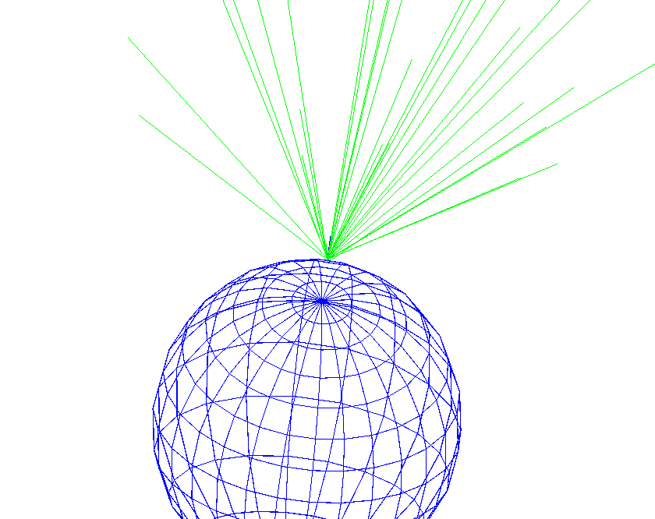
Cosmic Ray Shower Simulation at a Global Scale and Associate Applications
Olesya Sarajlic
INAUGURAL WORKSHOP ON APPLICATIONS OF COSMIC RAY MEASUREMENTS
October 5th, 2019

Slide 3
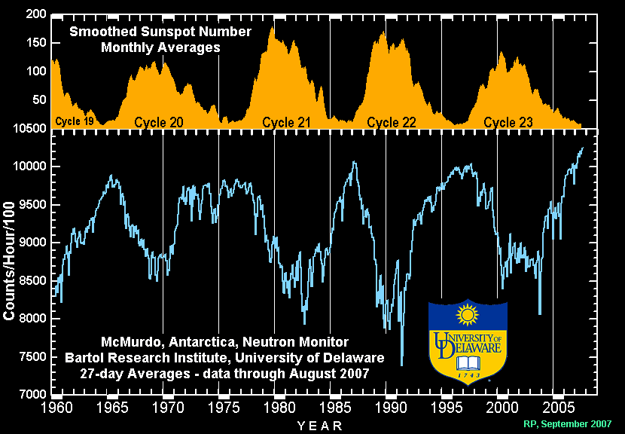
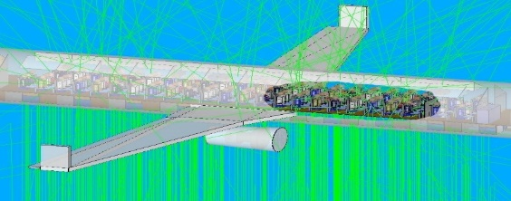
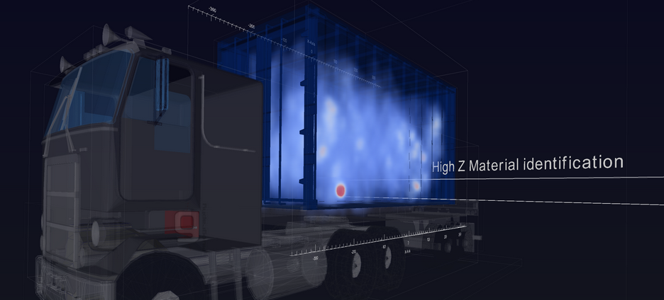
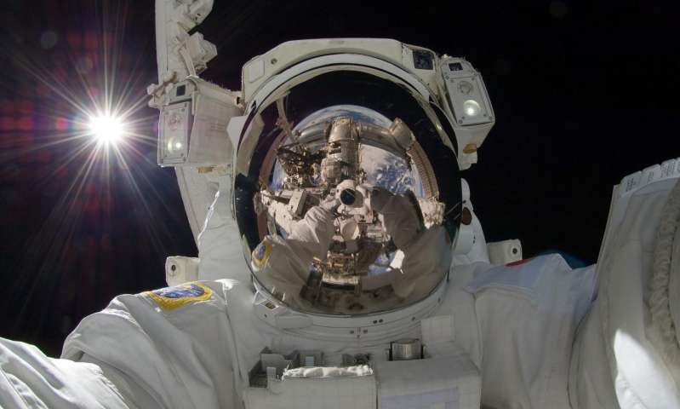
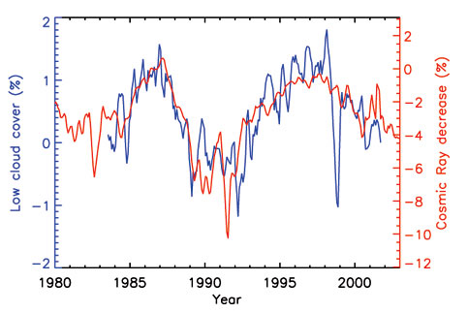
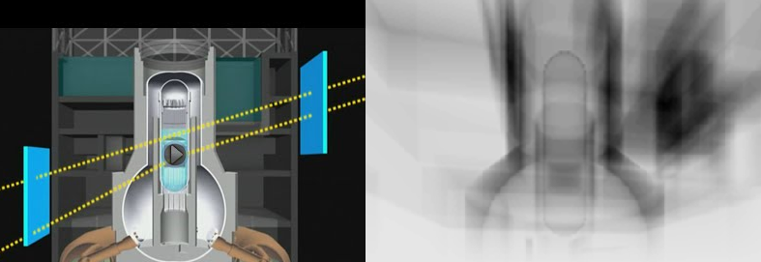
Some Interesting Applications
of Cosmic Ray Measurements
Muon tomography
Homeland Security
Monitoring volcanic activities
Nuclear reactor core
Health-related studies
Space/air travel
Cancer formation
http://mutomweb.pd.infn.it:5210/
Space/earth weather studies
Cloud formation
Lighting
Atmospheric monitoring
http://www.fukuleaks.org/web/?p=14602
https://phys.org/news/2017-06-collateral-cosmic-rays-cancer-mars.html
N. Marsh and H. Svensmark, J. of Geophys. Res., 108(D6), 6 (2003)

Slide 4
Motivation
Focusing on cosmic ray applications
Cosmic ray muon tomography
Global weather correlation study
Perform an extensive ECRS simulation study while varying geomagnetic field, air composition, diurnal and solar specifications on a global scale

Slide 5
Outline
Introduction to Cosmic Rays
Worldwide Cosmic Ray Experiments
Earth Cosmic Ray Shower Simulation
Computing Resources and Challenges
Particle Distribution on a Global Scale
Earth’s Geomagnetic Field Effect
Lateral Distribution
Weight Function
Summary and Future Work

Slide 6
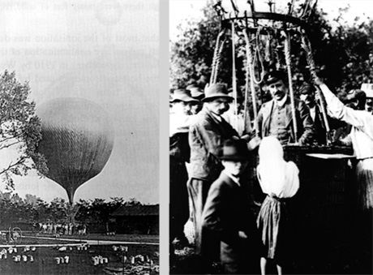
Discovery of Cosmic Rays
Cosmic rays were discovered in 1912 by Victor Hess
In 1936, Hess received the Nobel Prize in physics for his discovery

Slide 7
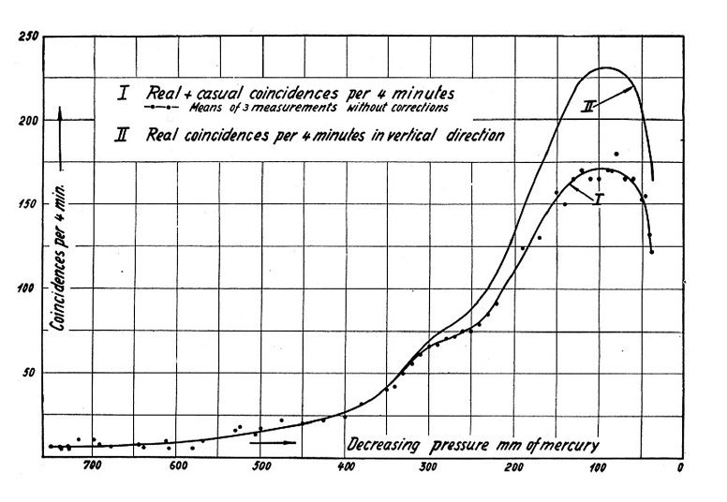
The maximum in ionization of the atmosphere
maximum between ~100 - 200 hPa
In 1935, Erich Regener and Georg Pfotzer measured the vertical intensity of the atmosphere up to 28 km in altitude
The position in the atmosphere at which the rate of production of ionization becomes a maximum is termed Photzer Maximum or Regener-Pfotzer Maximum
1000 900 800 700 600 500 400 300 200 100 1
Air Pressure (hPa)

Slide 8
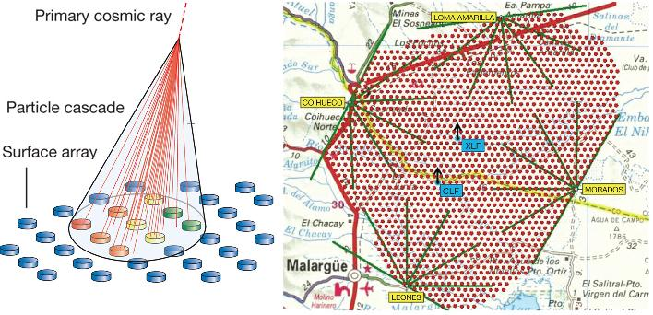
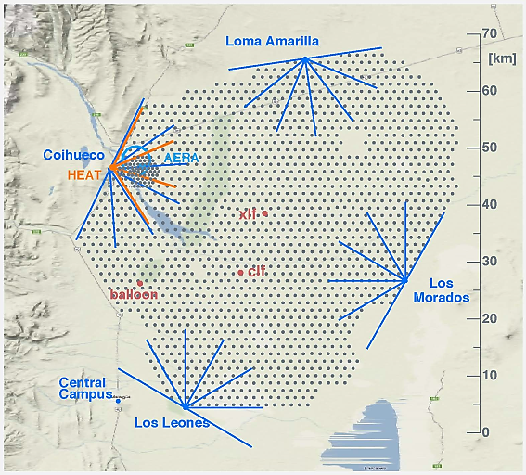
High energy cosmic rays
In 1939, Pierre Auger and his co-workers have estimated the energy of extensive cosmic ray shower to be above 10¹² eV
Discovery of astronomical events that accelerate the primary cosmic ray particles at energies of 10²⁰ eV was first detected in 1962 by John Linsley in the Volcano Ranch array in New Mexico, USA
In 1995, Pierre Auger Project begun, named in honor of the discoverer of extensive air showers with a purpose of tracing high-energy cosmic rays to their unknown source that will advance the understanding of the origin and evolution of the universe

Slide 9
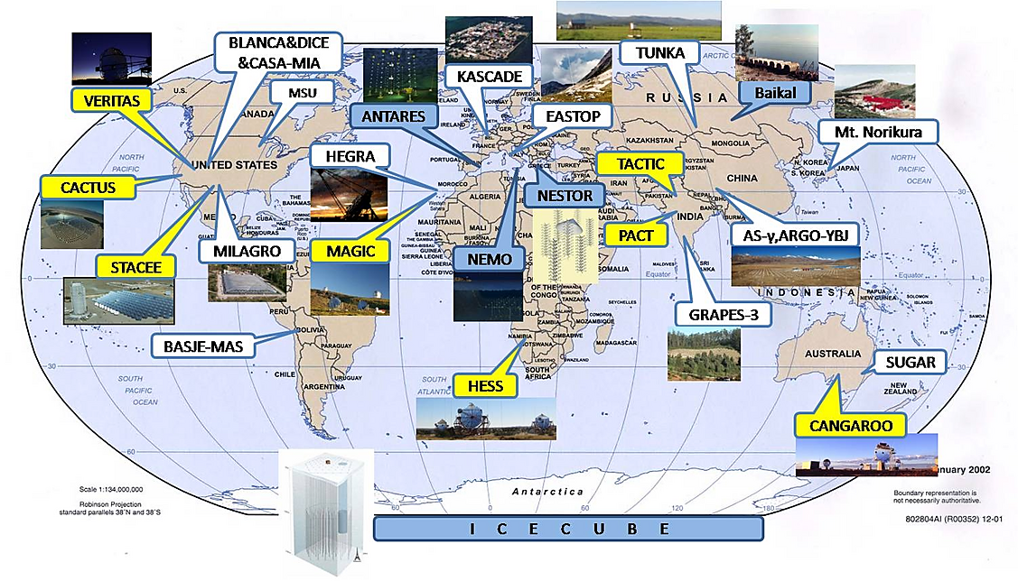
World-wide distribution of EAS experiments
H. Hu. arXiv:0911.3034 (2009)
The study of the most energetic showers is very active research field

Slide 10
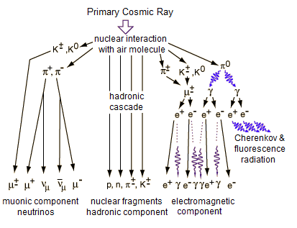
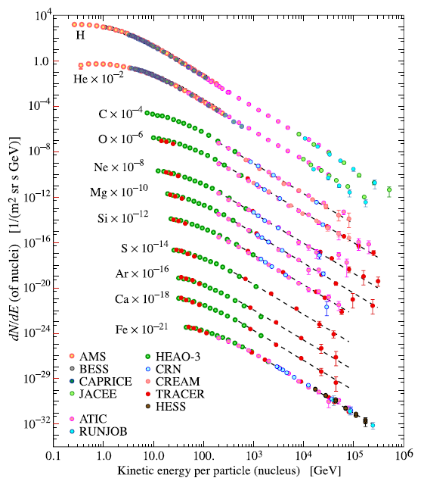
Cosmic ray composition
K.A. Olive et al. (PDG), Chin. Phys. C, 38, 090001 (2014)
~ 79% of primary nucleons are protons
~ 70% of the rest are helium

Slide 11
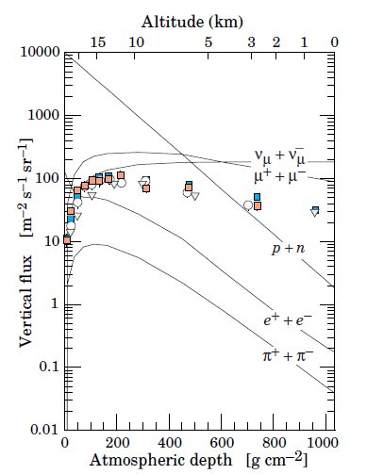
Vertical muon distribution
Muons are the most numerous charged particles at sea level
Muons produced high in the atmosphere, at around 15 km in altitude
Lose about 2 GeV to ionization before reaching the ground
Integral intensity of vertical muons above 1 GeV/c at sea level is about 1 cm⁻² min⁻¹ for horizontal detectors
SEA LEVEL
K.A. Olive et al. (PDG), Chin. Phys. C, 38, 090001 (2014)

Slide 12
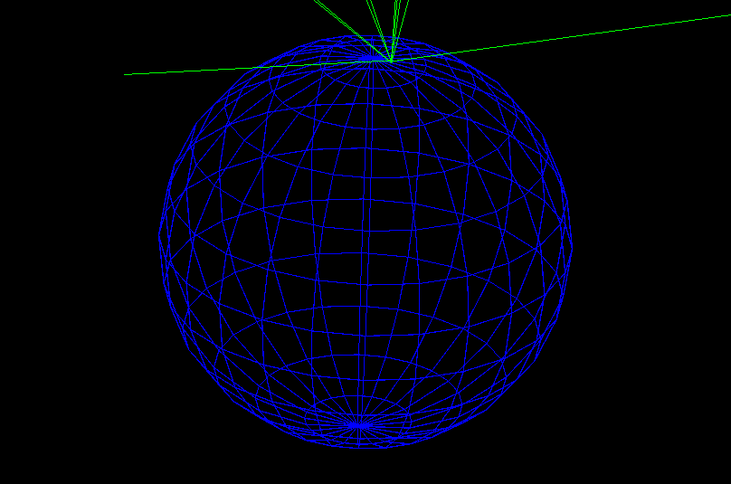
Earth Cosmic Ray Shower Simulation

Slide 13
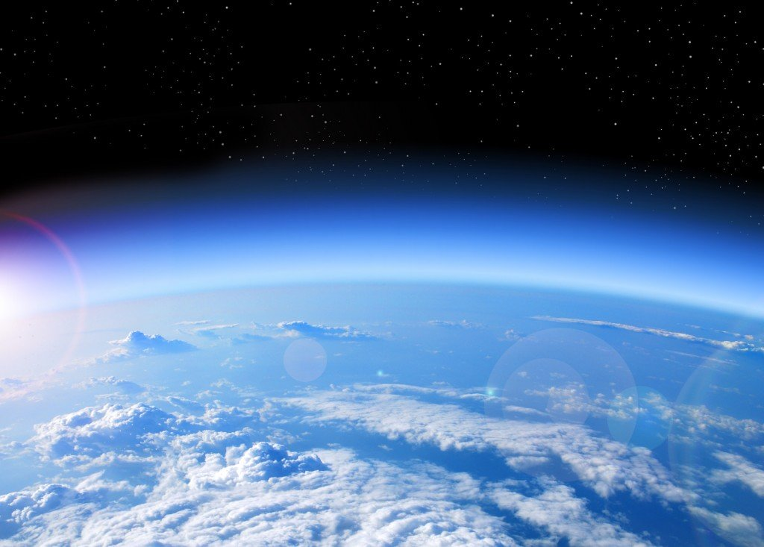
Features of the GEANT4-based Shower Simulation
Geant4-based simulation program, Earth Cosmic Ray Showers (ECRS), has been developed to study cosmic ray particle showers in the full range of Earth's atmosphere
The earth atmosphere is modeled by varying the density and chemical composition according to NASA’s atmospheric model (grc.nasa.gov)
Geomagnetic field (internal and external field) is implemented according to NOAA’s IGRF model (ngdc.noaa.gov)

Slide 14
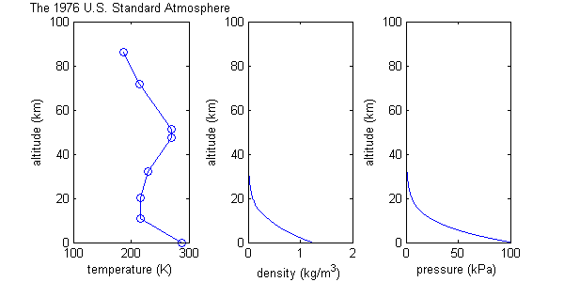
Geant4 simulation - atmospheric configuration
Model of the earth atmosphere with 100 atmospheric layers (1 km thickness)
ECRS program allows to vary density and chemical composition of the air that are parameterized according to the U.S. standard atmospheric model. In the simulation, the air density profile is static.

Slide 15
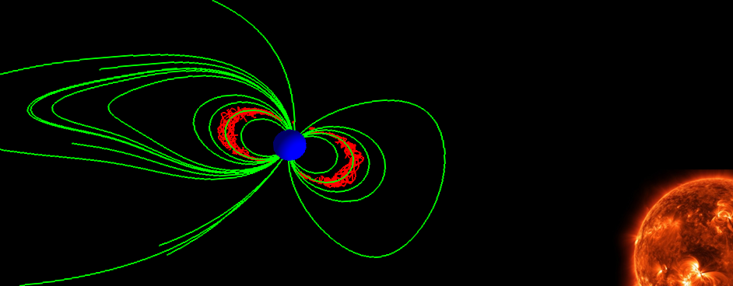
Magnetic Field Implementation
External magnetic field
Implemented based on Tsyganenko model
Very asymmetric because of solar wind
Internal magnetic field
The internal geomagnetic field is given by IGRF model
Symmetric along longitudinal direction

Slide 16
How valid is our simulation?

Slide 17
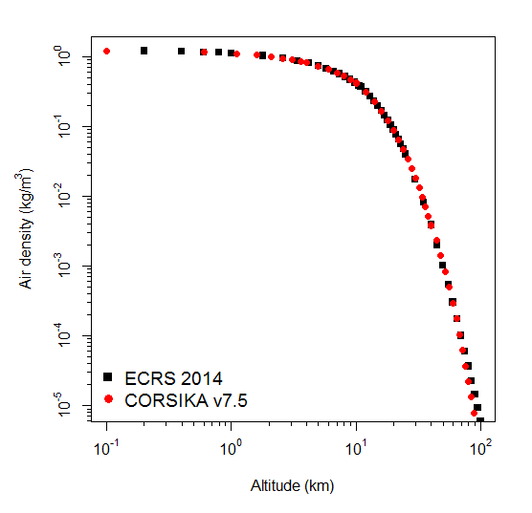
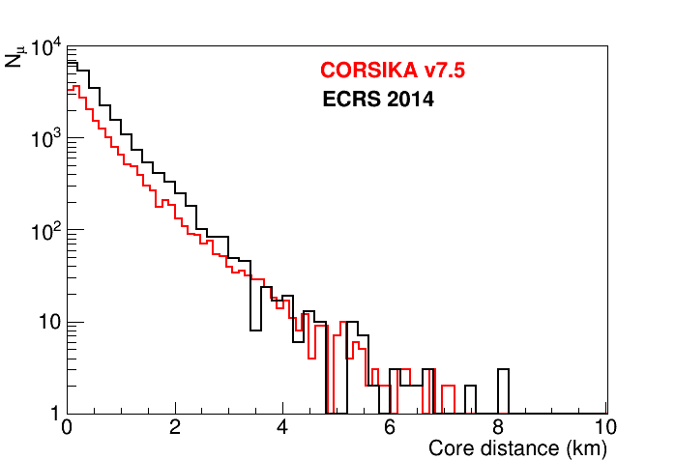
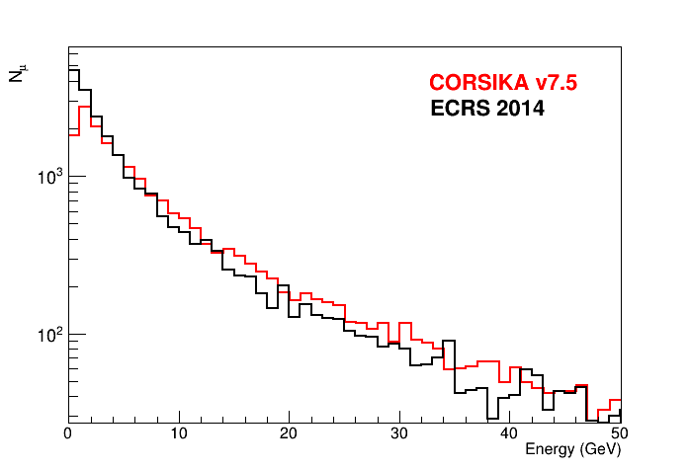
Comparing ECRS with CORSIKA
CORSIKA is a widely used simulation, especially for high energy experiments
1 TeV primary protons toward Atlanta, GA
1 TeV primary protons toward Atlanta, GA

Slide 18
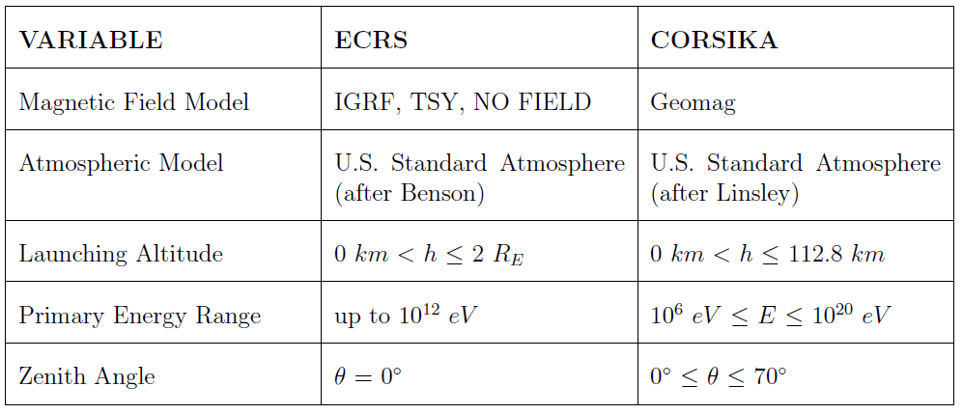
Comparing ECRS with CORSIKA
Some advantages of using ECRS vs CORSIKA:
Global scale analysis, magnetic field effect,
and variation in launching altitude

Slide 19
Single particle shower development
1 TeV primary proton launched toward Atlanta, GA with full magnetic field implemented

Slide 20
Simulated Event Display
100 GeV primary proton launched toward Atlanta, GA from 1.2 Re in altitude with full magnetic field implementation
20 km
Stratosphere
10 km
Tropopause
Negatively charged particles
Positively
charged particles
Neutral particles
Troposphere
0 km
Sea level

Slide 21
Focus points
Perform an extensive ECRS simulation study of
geomagnetic field effect
diurnal variations
solar effect
on cosmic ray showers in the atmosphere and at sea level on a global scale
ECRS simulation results are also critically important for determining the temperature coefficients in every pressure layer in the atmosphere to calculate the temperature variations from cosmic ray data

Slide 22
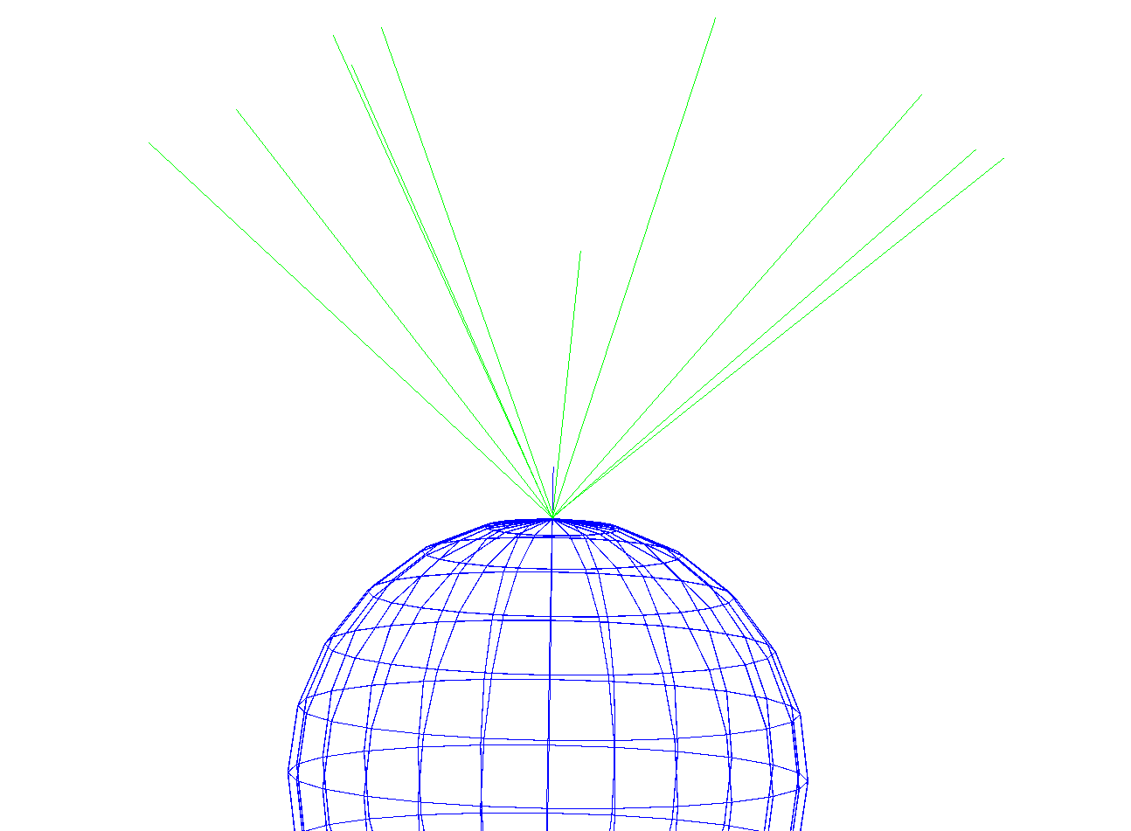
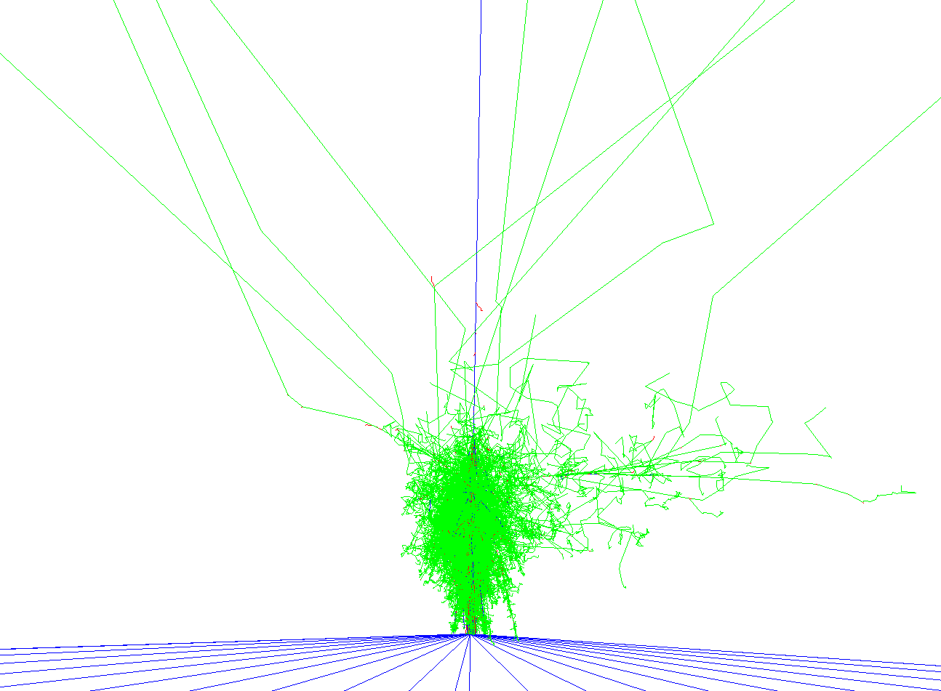
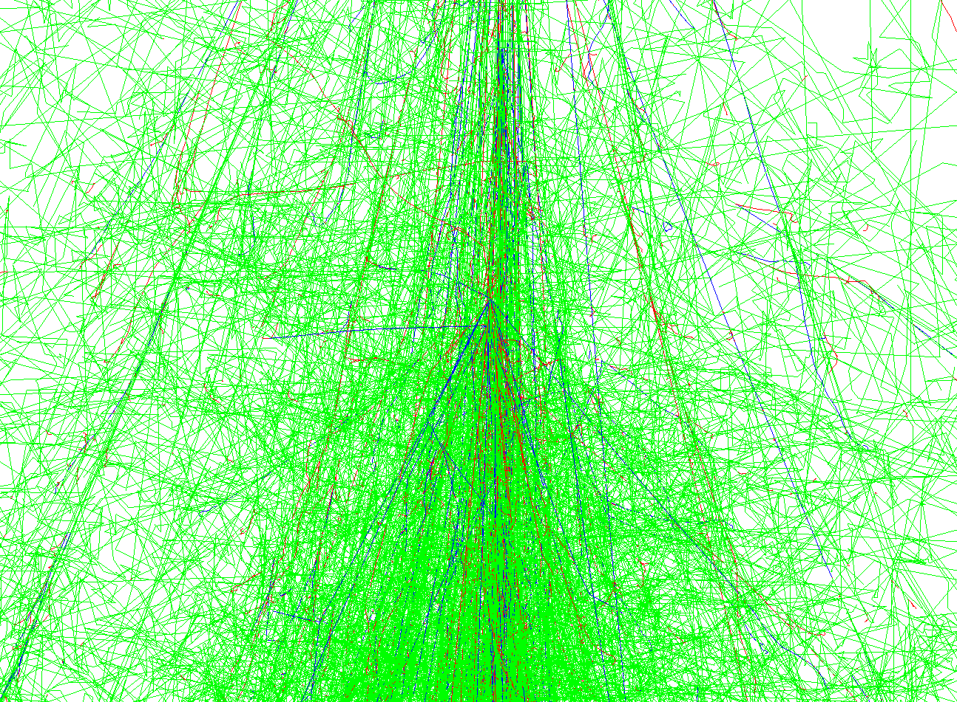
Cosmic ray characteristics without geomagnetic field
One of the design features of the ECRS simulation is the flexibility of switching on and off the geomagnetic field
At the same time, one can take the advantages of the Geant4 visualization to display cosmic ray shower events according to user’s input parameters

Slide 23
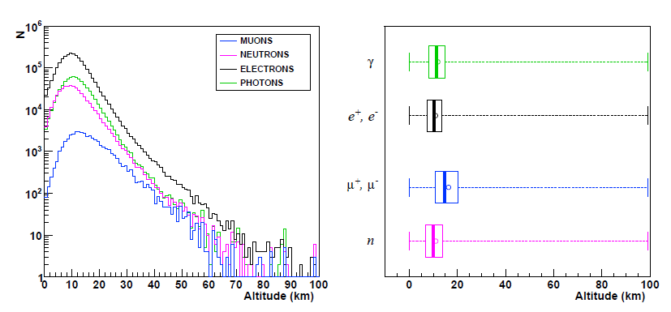
Cosmic ray characteristics without geomagnetic field
The altitude of particle production
Magnetic field configuration during Jan. 1, 2010 for cosmic rays launched from 1.2 Re toward Atlanta, GA
Muons are produced at higher altitude than other particles

Slide 24
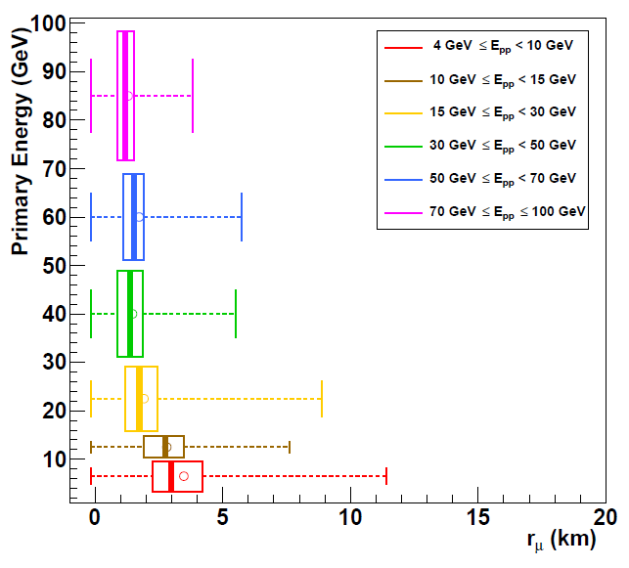
Cosmic ray characteristics without geomagnetic field
Lateral distribution of muons at different ranges of primary energy
Magnetic field configuration during Jan. 1, 2010
for cosmic rays launched from 1.2 Re toward Atlanta, GA
Muon core distance decreases with greater primary energy

Slide 25
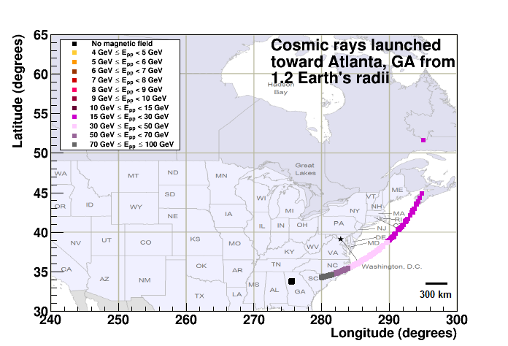
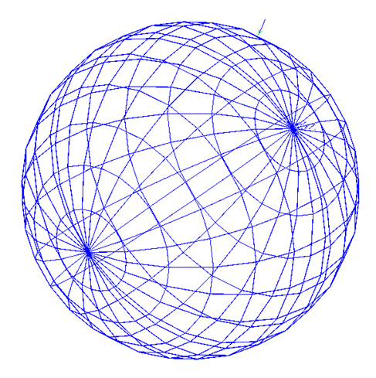
Magnetic field effect
Incoming
Cosmic
rays
FULL FIELD
NO FIELD

Slide 26
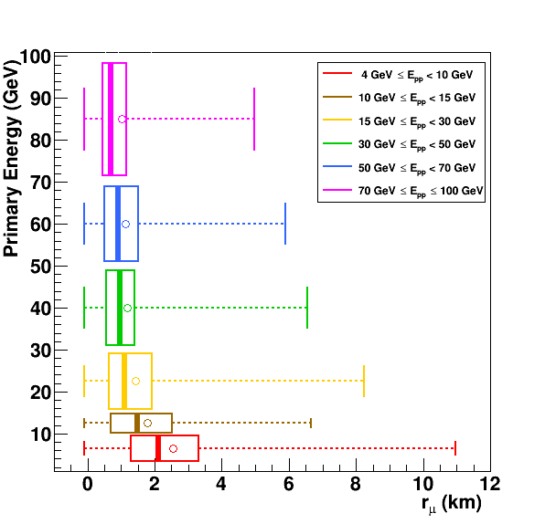
Lateral distribution of muons
with magnetic field implementation
Magnetic field configuration during Jan. 1, 2010
for cosmic rays launched from 1.2 Re toward Atlanta, GA
100 km altitude:
The muons are mainly 5 km from the shower core with most muons concentrated around 1km

Slide 27
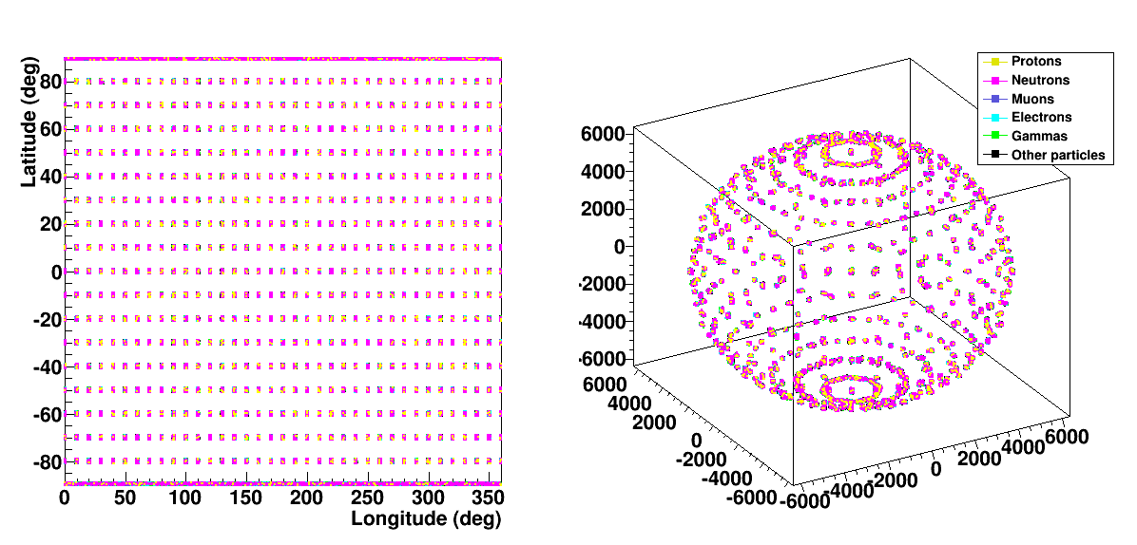
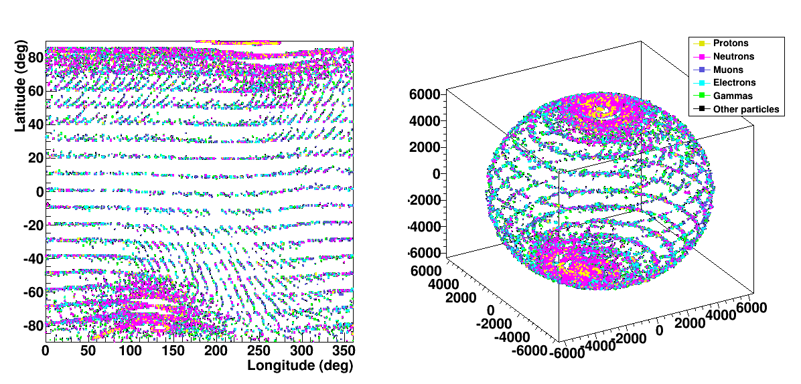
Lateral distribution of particles at a global scale
Epoch, 2000
NO FIELD
FULL FIELD

Slide 28
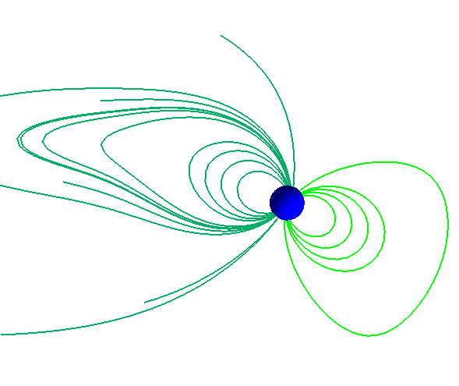
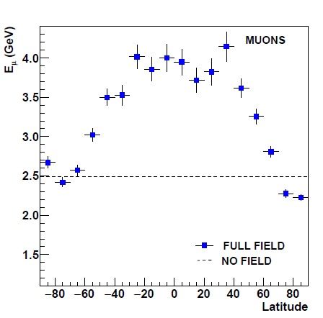
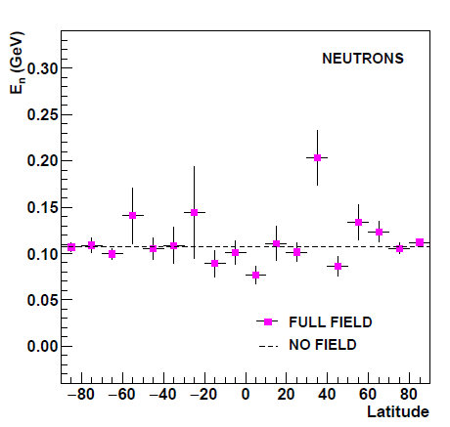
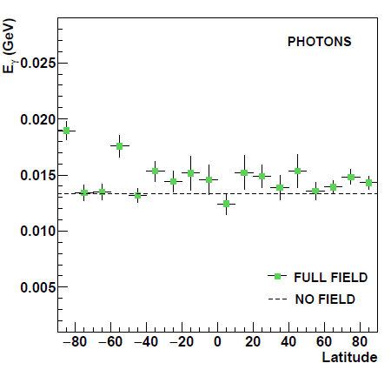
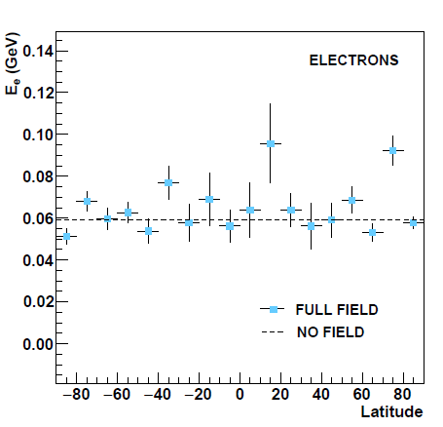
Latitudinal Energy Distributions
Magnetic field configuration during Jan. 1, 2010
Global energy distribution of muons, neutrons, photons, and electrons at sea level
Dashed line is the mean energy on a global scale without magnetic field. Solid characters reflect the global particle energy distributions with geomagnetic field
Average muon energy varies between 2 GeV to 4 GeV from polar regions to equator

Slide 29
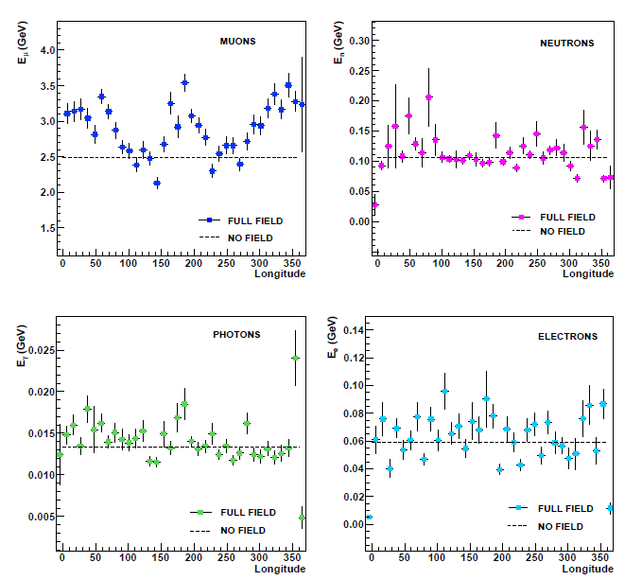
Longitudinal Energy Distributions
Magnetic field configuration during Jan. 1, 2010
Global energy distribution of muons, neutrons, photons, and electrons at sea level
Average muon energy at the surface displays sinusoidal pattern over longitude with the muon energies varying from around 2 GeV to 4 GeV suggesting diurnal variations

Slide 30
ECRS simulation capabilities
Perform an extensive ECRS simulation study of
geomagnetic field effect
diurnal variations
solar effect
on cosmic ray showers in the atmosphere and at sea level on a global scale
Aid the effective temperature calculations in atmosphere with ECRS simulation
Geo-position dependent weight function

Slide 31
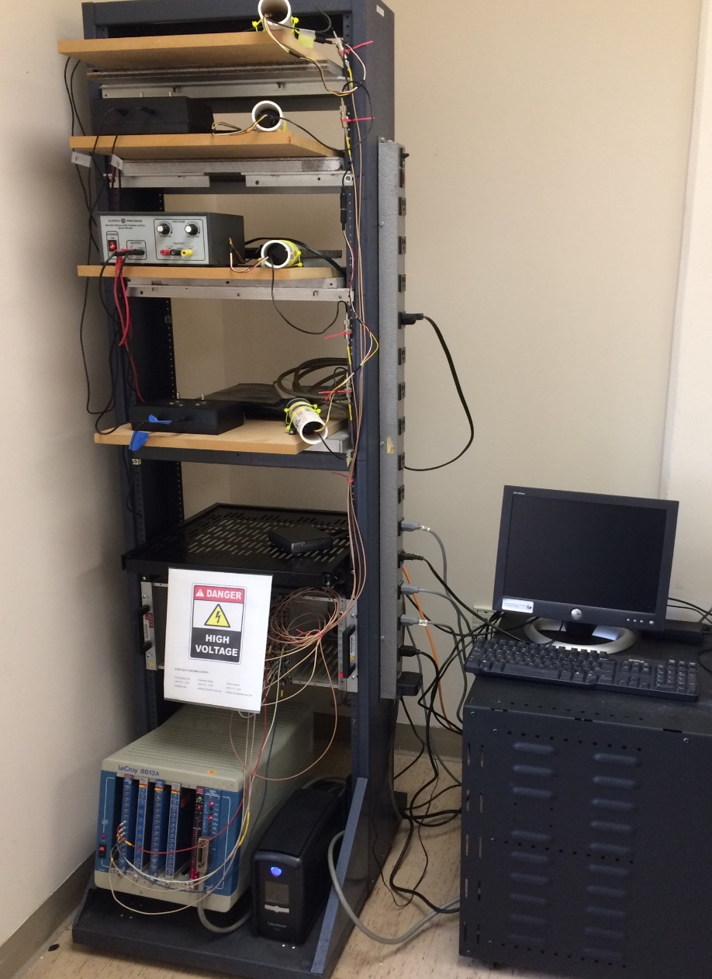
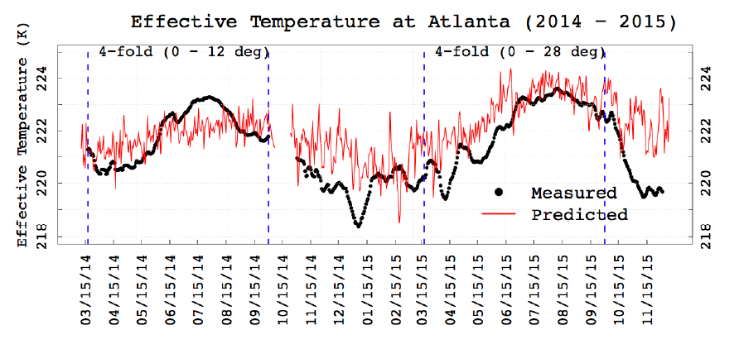
Studying the effective temperature variations with cosmic ray muon and neutron measurements
Cosmic ray four-paddle detector built at GSU
Zhang, Xiaohang, "Statistical Modeling Of Effective Temperature
With Cosmic Ray Flux." Thesis, Georgia State University, 2016.

Slide 32
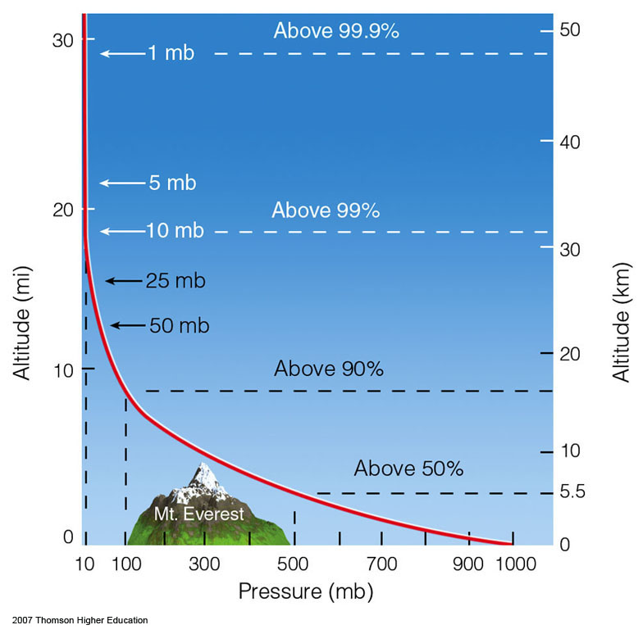
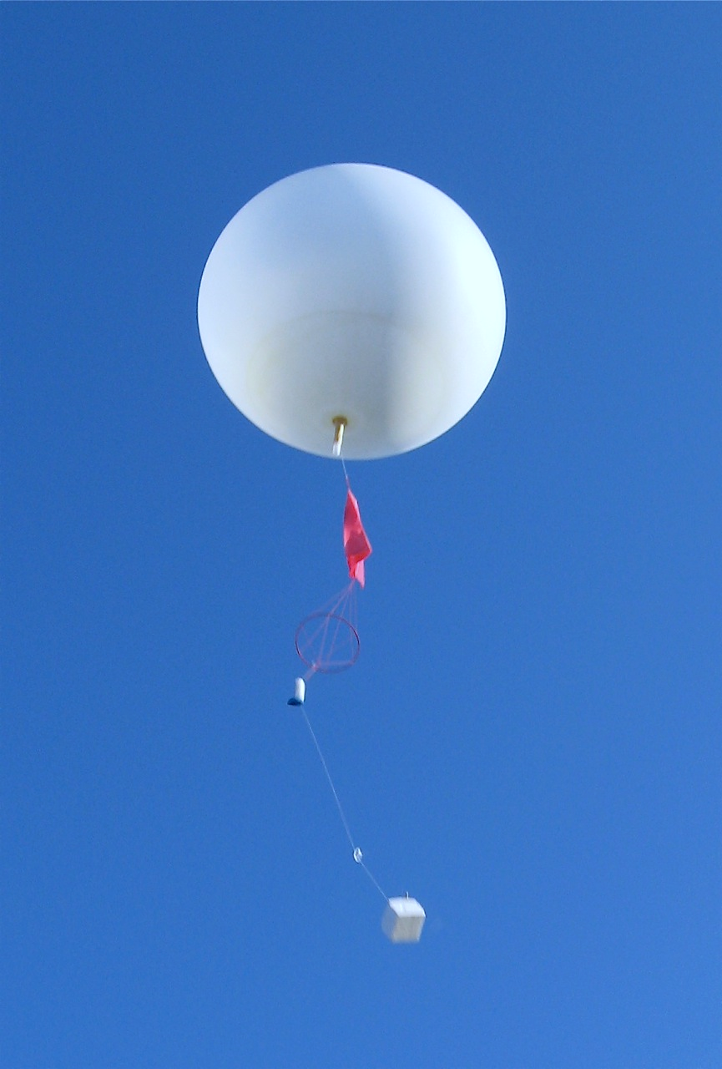
Effective temperature calculation
Effective temperature, T_{eff} , is the weighted average of atmospheric temperature from level of observation to the generation level of muons
where
is the weight in i^{th} pressure layer of the atmosphere, W_{i}
Pµ is given by the ECRS simulation

Slide 33
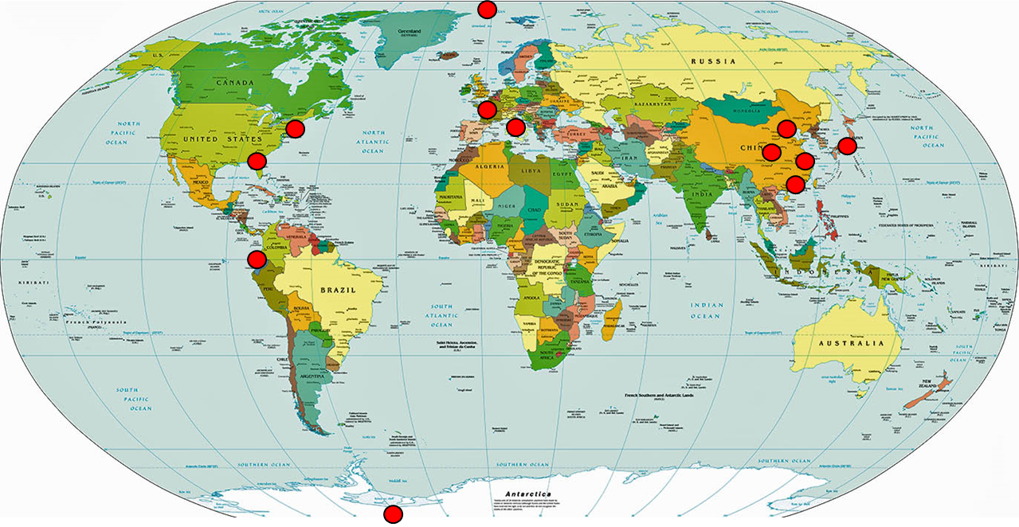
Single particle weight function
Despite the limitations in computing resource, the calculations of a single particle weight function have been done at selected latitudes
Dependence of weight function on geo-position is demonstrated

Slide 34
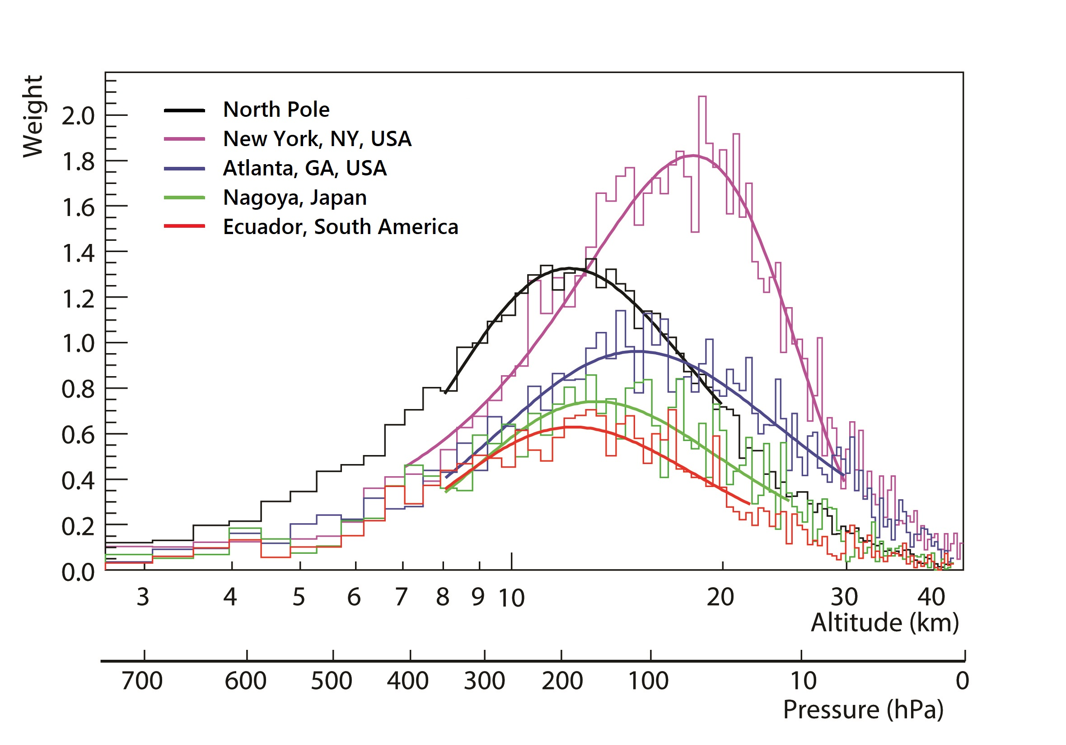
Single particle weight function
around different latitudes
Geomagnetic field configuration during Jan. 1, 2010

Slide 35
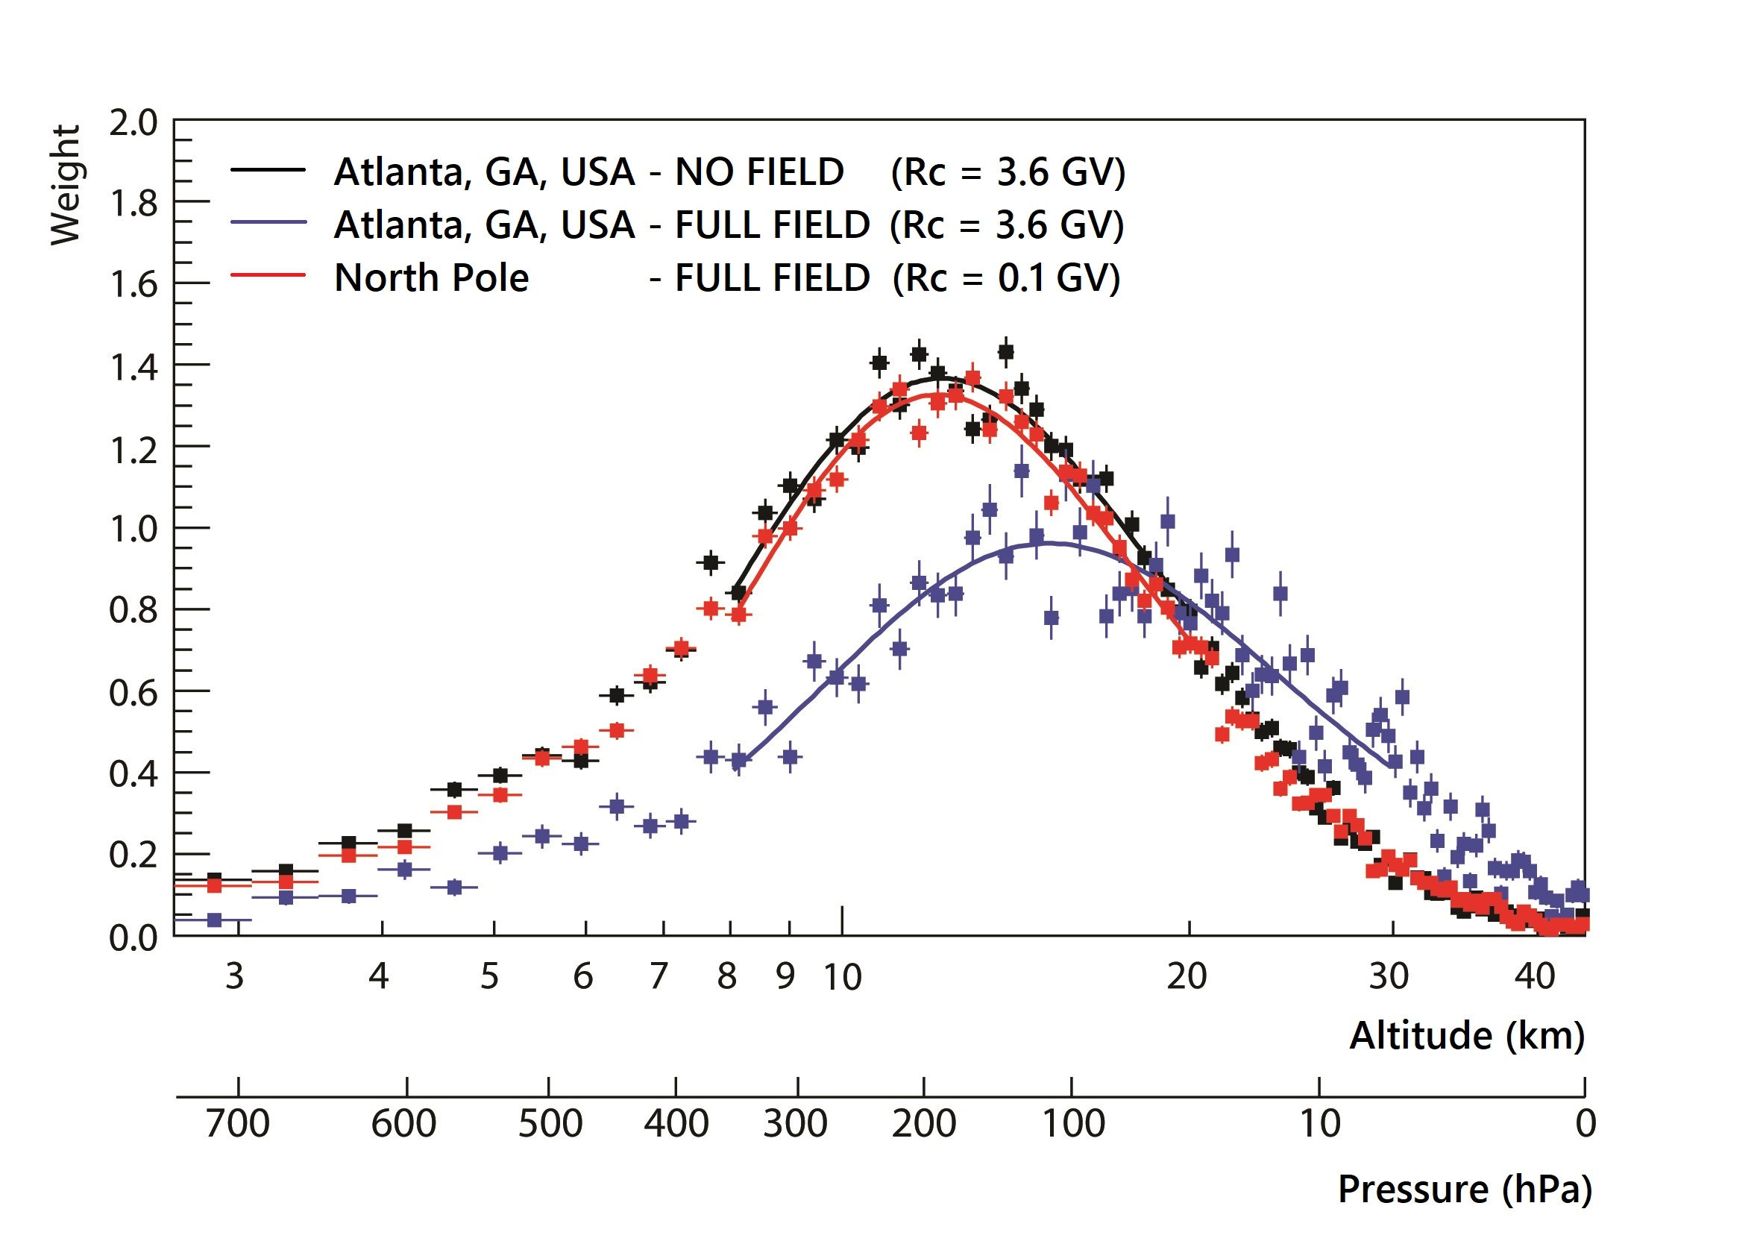
Single particle weight function
magnetic field effect
Geomagnetic field configuration during Jan. 1, 2010

Slide 36
Studying the effective temperature variations with cosmic ray muon and neutron measurements
Cosmic ray muon telescopes are being developed to build a world-wide network for measuring muon and neutron flux variations in order to monitor the dynamic weather changes around the globe
Tracing the temporal variations of effective temperature in Earth's upper atmosphere with cosmic ray measurements
by Meena Beena at 2:00pm, Saturday Oct. 5, 2019

Slide 37
Summary and Future Work
Extensive cosmic ray shower simulations have been carried out using the computing resources at GSU, Brookhaven National Lab, and XSEDE
The importance of the work includes, but not limited to:
providing systematic understanding of the cosmic ray shower particle distributions in the atmosphere and at the surface of the Earth at different geo-positions
providing a framework for studying diurnal, solar, and atmospheric effects on cosmic ray shower development
Future work
High statistics simulation to quantify cosmic ray flux variation with higher accuracy under different solar activities and atmospheric conditions
The results may be crucially important for studying the space/earth weather system change using the measurements of cosmic ray flux variation at a global scale

Slide 38
Acknowledgements
This work used the Extreme Science and Engineering Discovery Environment, which is supported by National Science Foundation grant number ACI-1053575.

Slide 39
Thank you!

