Slide 1


Cosmic rays muon flux studies at Belgrade shallow underground laboratory
Nikola Veselinović, Mihailo Savić, Aleksandar Dragić, Dimitrije Maletić, Dejan Joković, Radomir Banjanac, Vladimir Udovičić and David Knežević
Inaugural workshop “Cosmic Ray Flux Measurement at Global Scale and the Associated Applications”, Friday, 4 October 2019, Atlanta

Slide 2

Overview
Cosmic rays
Transport through heliosphere
Transport through geomagnetic field
Interaction with atmosphere
Detection of cosmic rays
The Belgrade group
Low-background laboratory
Past activities
Cosmic rays physics at Low-background lab
Measurement of solar activity
  Comparison between ground detectors
  Comparison with satellite
Muons and temperature of the atmosphere
Cloudiness and CR
Small arduino detector
Plans for future
Conclusion

Slide 3
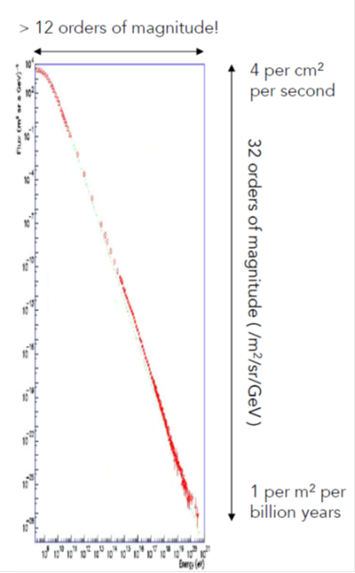
Cosmic rays
Major phenomenon in our galaxy
  Energy density ~ star light, thermal, B field
  Regulate the equilibrium between the different phases of the interstellar medium
  Control ionisation, heating
  Regulate star formation
  Control astrochemistry
  Generate turbulent magnetic field
  Produce Li, Be and B
  Major unknown
  Sources are not well known (Galactic and Extragal.)
  Acceleration processes are uncertain

Slide 4
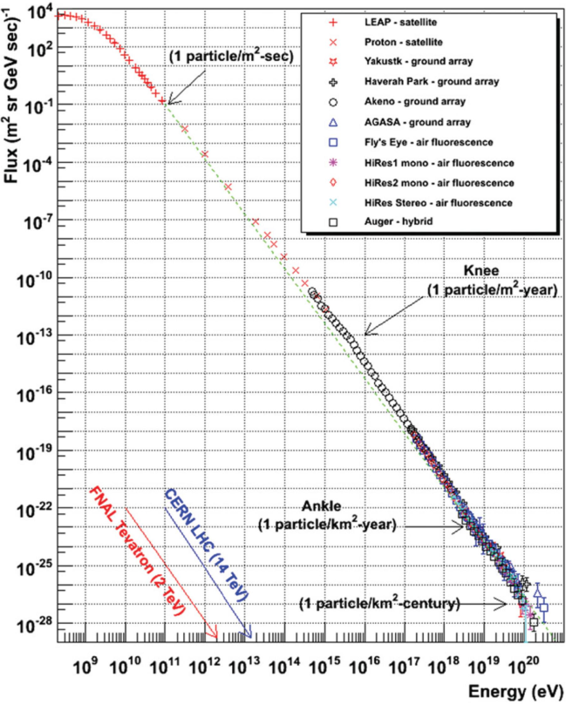
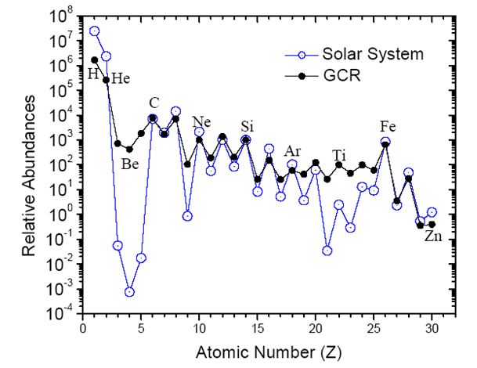

Cosmic rays
Primary cosmic rays spectrum
  Power law
γ ~ 2.7
Cosmic rays composition
  Depends on CR energy
  ~80% protons, ~12% helium nuclei rest are electrons and nuclei of hevier elements
$ј(Е)=\frac{dN}{dE}∝E^{−γ}$

Slide 5
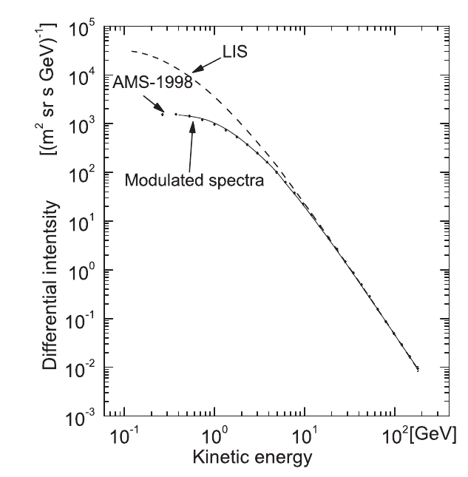
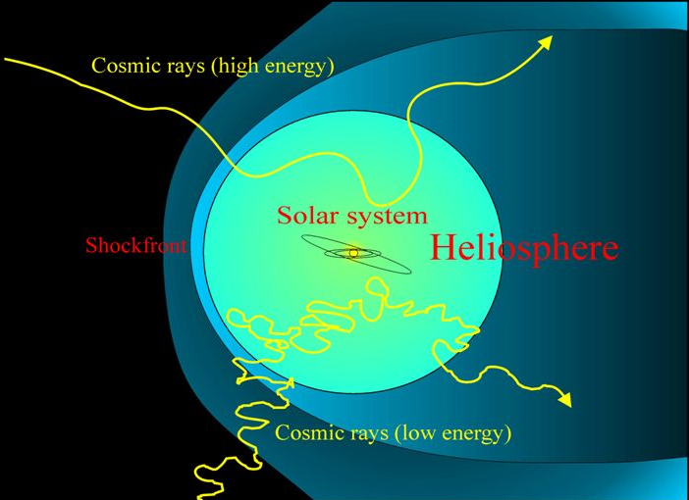
Transport through heliosphere
Solar wind
  stream of charged particles released from the upper atmosphere of the Sun
CR interact with helioshere - modulation of CR
Magnetic field and solar wind depend on activity of the Sun (space weather)
CR modulation increases with higher solar and decreases when activity is lower.
Solar modulation depends on energy of the CR
Magnetic rigidity
  R ≡ pc / Ze.

Slide 6
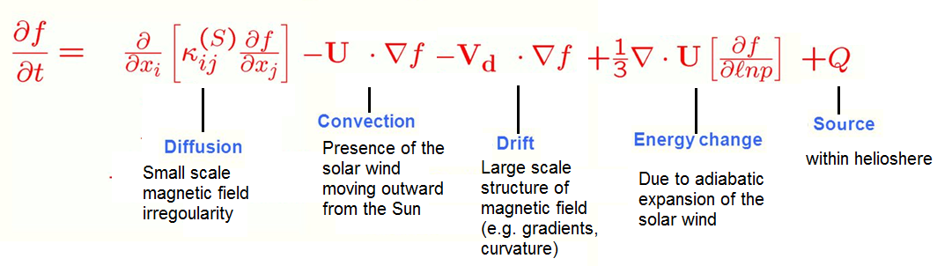
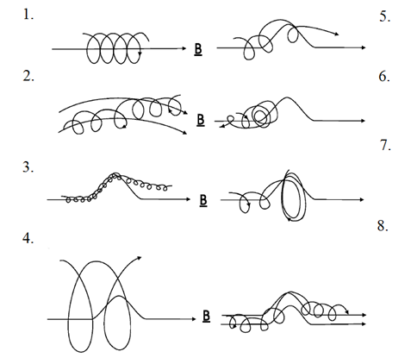
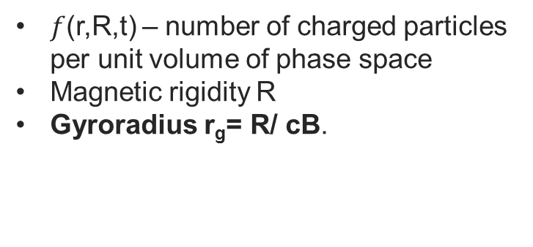
Transport through heliosphere equation
Propagation in the heliosphere was described by Parker (1965) equation
$f$(r,R,t) – number of charged particles per unit volume of phase space
Magnetic rigidity R
Gyroradius r_{g}= R/ cB.

Slide 7



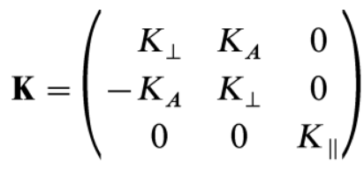
Transport through heliosphere
Equation
  Scattering of cosmic rays by turbulence is described by the cosmic-ray diffusion tensor
  the diagonal elements describe diffusion of particles parallel ( ) and perpendicular ( ) to the mean magnetic field,
  off-diagonal, antisymmetric terms (K_{A}) describe effects of gradient and curvature drift

Slide 8
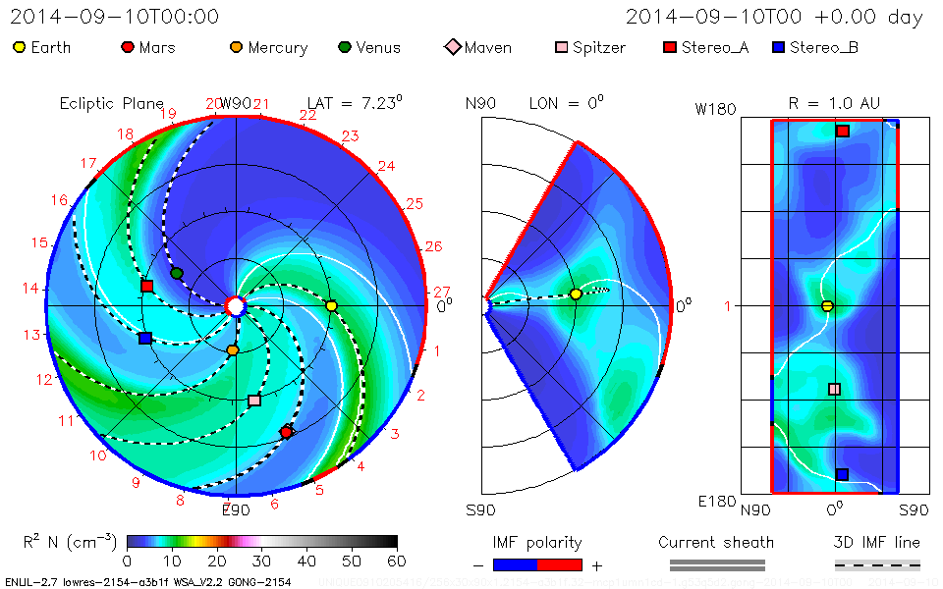
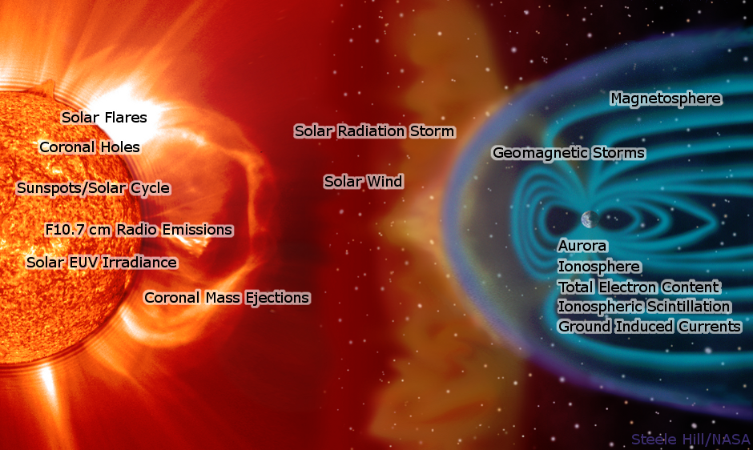
Solar activity
Sporadic events
Violent processes at the Sun produces disturbance of the heliosphere.
This disturbance interact with geomagnetic field.
This interaction have disruptive potential on our civilization.

Slide 9
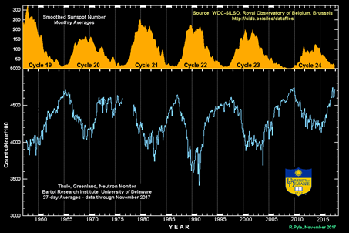
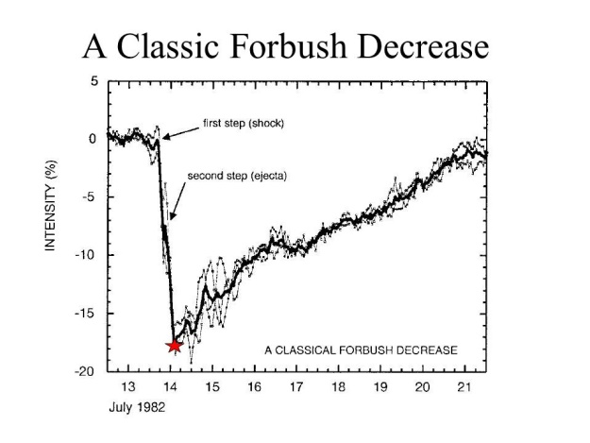
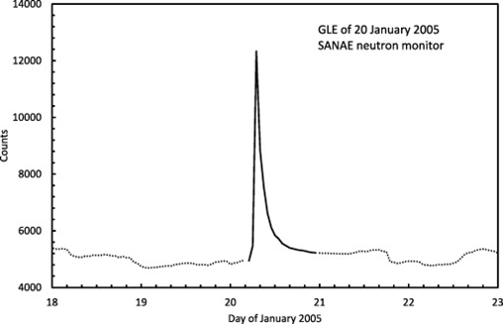
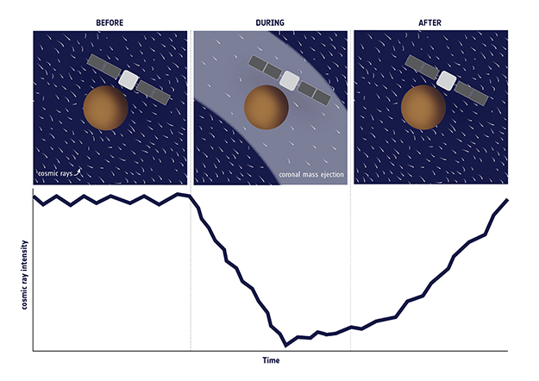
Solar activity
Type | Amplitude | origin
Periodic variations
11-years and 22-years | Up to 30% | Solar cycles (change of sunspot number)
27-days | < 2% | due to Sun’s rotation
daily | 0,5 % | flux anisotropy due to Earth’s movement through heliosphere
Sporadic variation
GLE | Up to 300% | additional flux of charged particles from CME
Forbush decrease | ~10% | decrease due to reflection of low energy CR from the shockwave in heliosphere

Slide 10
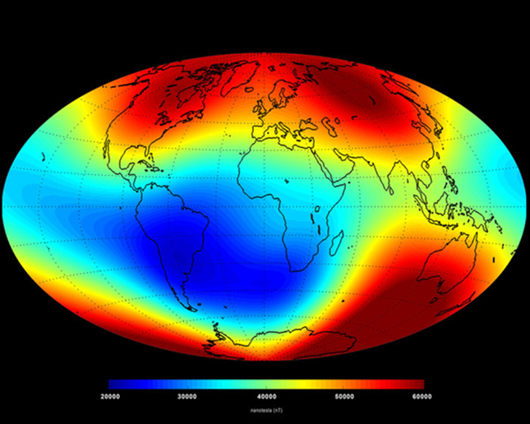
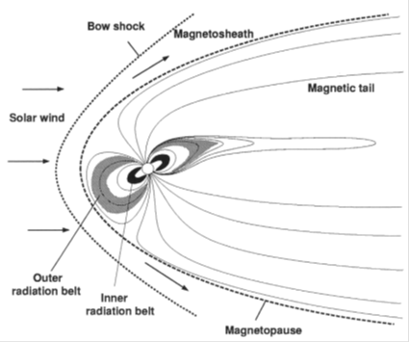
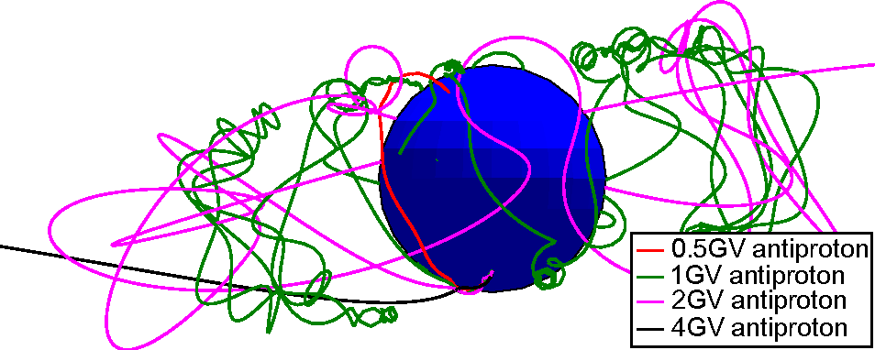

Transport through geomagnetic field
  Geomagnetic field also affect CR
  Dipole aproximation
  R_{s} (geomagnetic cutoff rigidity)
    Smallest rigidity for charged particle to reach surface
$R_{c}=\frac{M \cos{{}_{ }^{4}λ}}{4 r^{2}}$

Slide 11
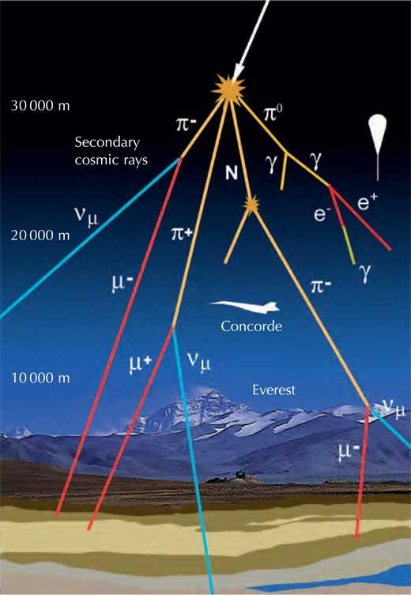
Interaction with atmosphere
Secondary CR
Primary CR interact with nuclei from atmosphere
Secondary CR shower
  Particles that are created from the interaction
Electromagnetic cascade
  π⁰→2γ
  γ*→ е⁻ + е⁺ pair production
  е→ е + γ bremsstrahlung
Hadronic and mesonic cascade
  p + p → p + Δ⁺ →p + n + π⁺
  π⁺→ μ⁺ + ν_{μ}
  π⁻→ μ⁻ + ν_{μ}
Shower spread with every new generation of particles
Must be corrected with atmospheric parameters in mind

Slide 12

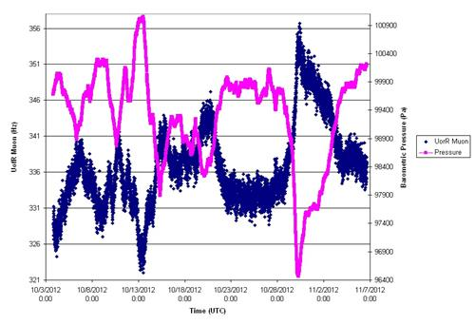
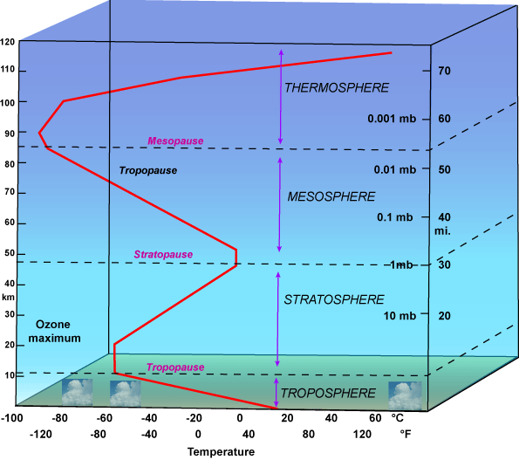
Interaction with atmosphere
Correction
Correction on pressure
  β barometric coefficient
Correction on temperature
  Muons are more affected
  Negative temp. effect
  Positive temp. effect

Slide 13
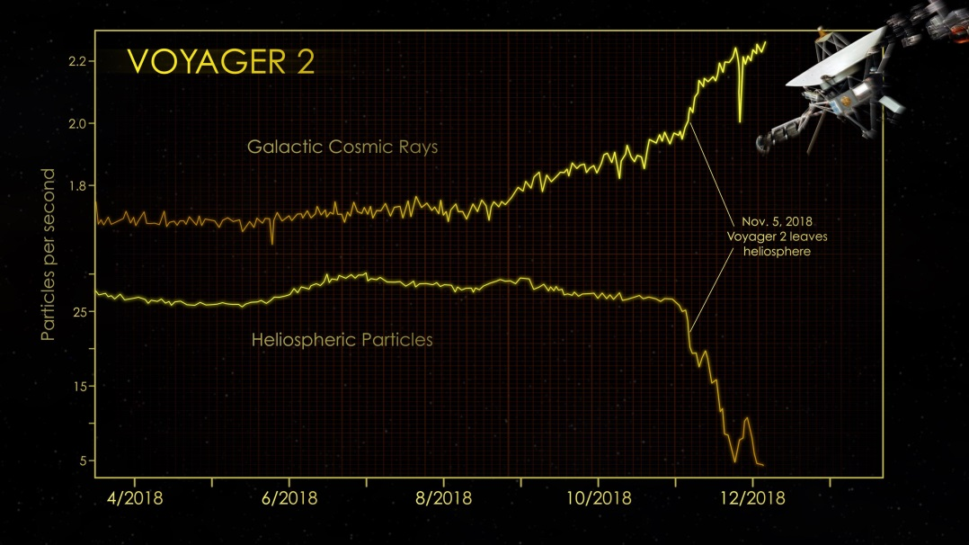
Detection of CR
Can be:
  Outside the heliosphere ( Voyager )
  Above the atmosphere ( various satellites)
  High in the atmosphere ( high altitude balloons)
  On ground ( secondary CR)
  Underground ( secondary muons, neutrinos…)

Slide 14
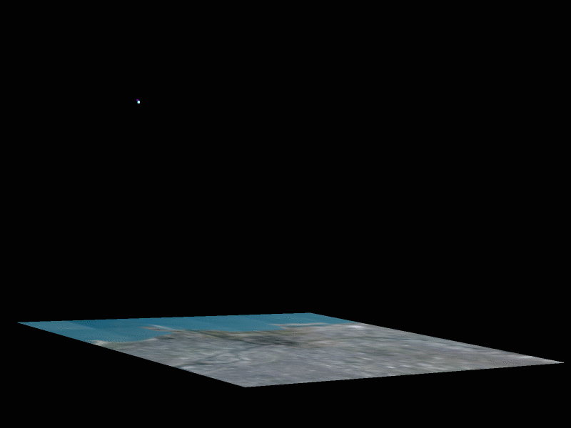
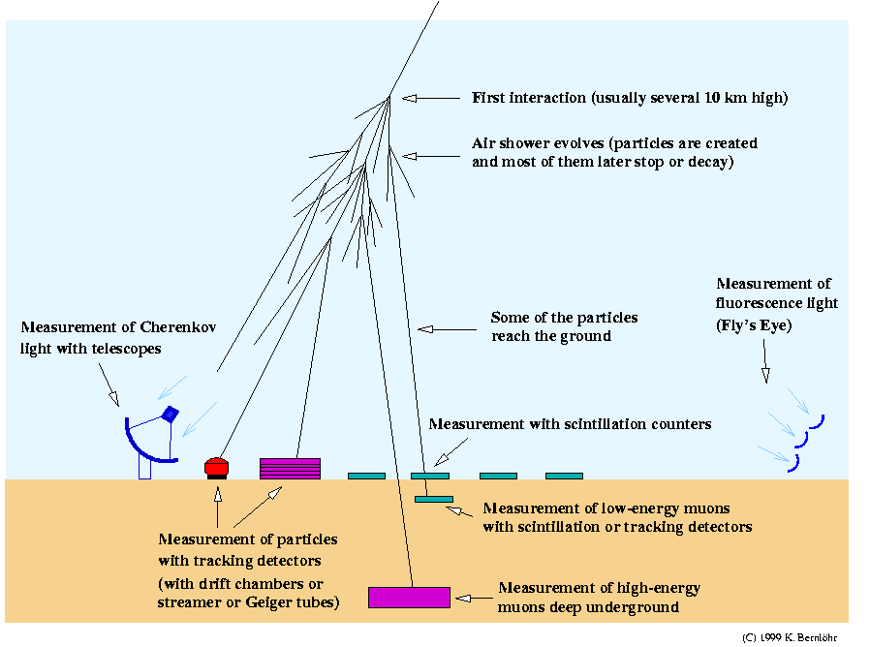
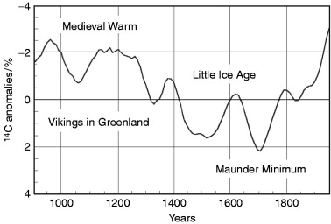
Ground systems
Various methods are used to detect CR
Some indirect methods includes measurement of concentration of cosmogenic radioisothopes ¹⁰Ве and ¹⁴С in a sample
Neutron monitors are standard detectors for ground measurements

Slide 15
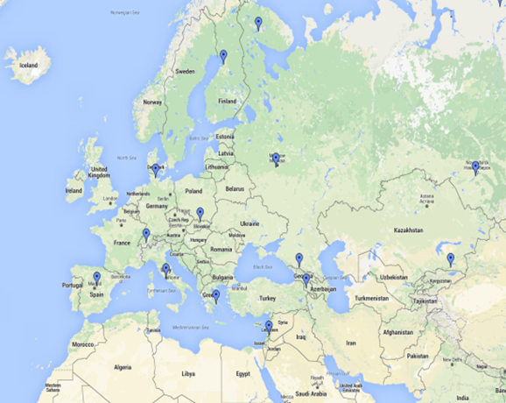
Ground systems
Modulation effects have been studied extensively by the neutron monitors sensitive up to several tens of GeV, depending on their geomagnetic location and atmospheric depth.
Muon detectors at ground level are sensitive to primary particles of higher energies than NMs.
Underground muon detectors correspond to even higher energy primaries. For this reason muon observations complement NM observations in studies of long-term CR variations, CR anisotropy and gradients or rigidity spectrum of Forbush decreases

Slide 16
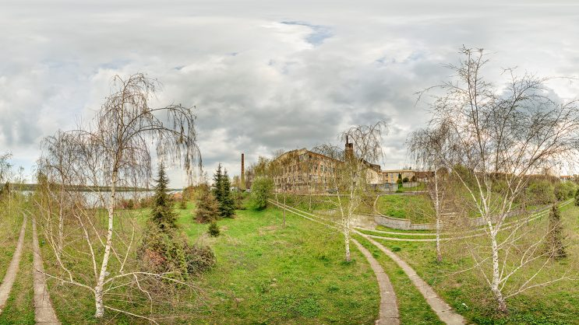
The Belgrade group
The Institute of Physics Belgrade (IPB) is the reference institution for research in physics in Serbia. IPB currently employs 120 senior researchers and 80 PhD students and post-doctoral researchers.
IPB researchers make up 1% of Serbia’s research sector, producing roughly 10% of the country’s scientific output.
IPB leads Serbian participation in international projects and collaborations. The majority of the international collaborations are within the European Research Area (ERA) or with key international research centres such as CERN.
Particle and nuclear physics research at IPB is conducted through two research groups:
  High energy physics group – ATLAS collaboration
  Nuclear physics group – cosmic-ray muon measurements, MICE collaboration
IPB‘s Scientific computing laboratory is a part of the GRID international infrastructure.
IPB also has a well established cooperation with JINR in Dubna.

Slide 17
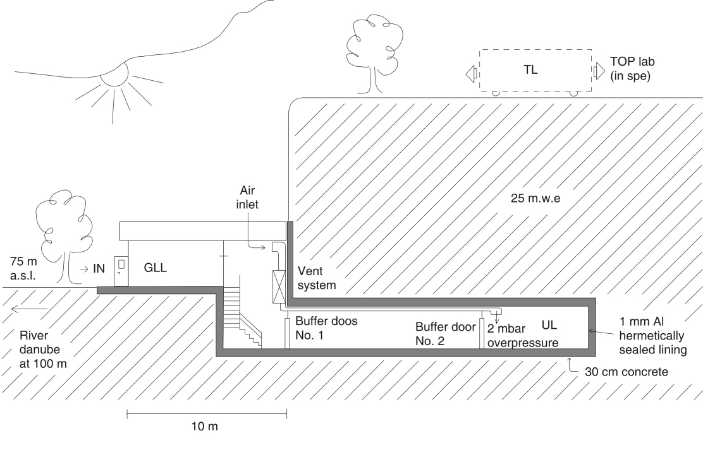
Low-background laboratory for nuclear physics
Institute of physics, Belgrade, Serbia
78 m a.s.l., Geographic coordinates 44º 51’ N, 20º 23’ E
Minimal vertical rigidity 5.3 GV.
Consist of two parts:
  Ground level (GLL)
  Underground (UL) level, dug in 12m of loess .
Scientific research activities in the LBLNP are in the fields of nuclear and high energy physics. They are related in particular to cosmic-ray physics, nuclear spectroscopy, radon and environmental radiation measurements

Slide 18

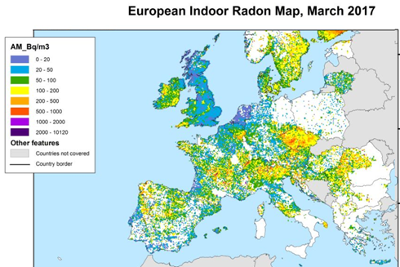
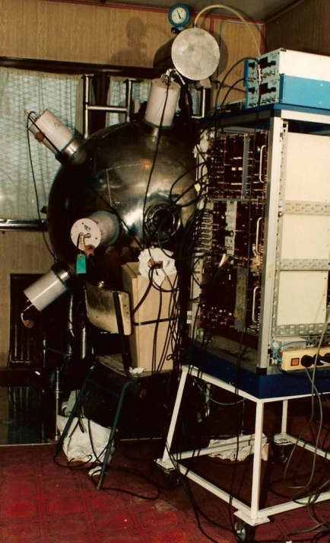
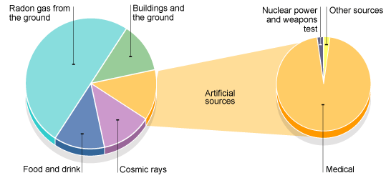
Low-background laboratory for nuclear physics
Past activities
For the last 25 years we participated in the realization of LOREX ( lorandite experiment), the only geochemical experiment to determine the average solar neutrino flux over the last 5 million years, via the neutrino capture by Thallium-205.
Studying rare nuclear and particle processes
Comprehensive studies of all components of background in high sensitivity experiments
Cosmic ray muon induced signatures in low-energy detectors
Continuous monitoring of cosmic ray muon intensity ( from 2002)
Radon and enviromental radiation studies
Neutron induced nuclear reaction
  Backgroundless search for element Z-113 (eka-thallium) in nature: (conc<e-11g/g at 90%CL)
  Plasma focus-fusion machine
etc...

Slide 19
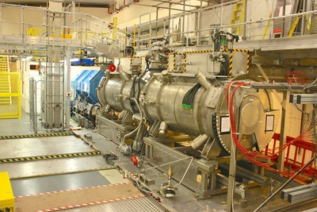
Low-background laboratory for nuclear physics
Recent collaborations
  MICE experiment. EU, EUCARD2 (2014-2017).
  Bilateral project with Belorussia
  IAEA RER9136: Reducing Public Exposure to Radon by Supporting the Implementation and Further Development of National Strategies
  Belgium. CHANDA (solving CHAllenges in Nuclear Data) project. FP7-EURATOM-FISSION program.
  EUFRAT (European Facilities for Nuclear Reaction and Decay Data Measurements) program. JRC-European Commission:
  1.Prompt-fission gamma ray characteristics from the reactions 235U(n,f) in the resolved neutron-resonance region
  2. Set up and commissioning of a CeBr3 array as part of the GLADIS hybrid gamma-ray spectrometer.

Slide 20
Low-background laboratory for nuclear physics
Experience in high energy physics
CMS experiment at CERN, 2003-2010
NA61/SHINE experiment at CERN, 2011-2015
MICE experiment at RAL, since 2015
  software development, MC simulations (Geant4)
  data processing and calibration, data transfers in grid environment
  analyses (also utilizing the artificial neural network approach or multivariate analysis)
  operations: NA61 ToF detectors M&O, CMS Ecal Safety System M&O

Slide 21
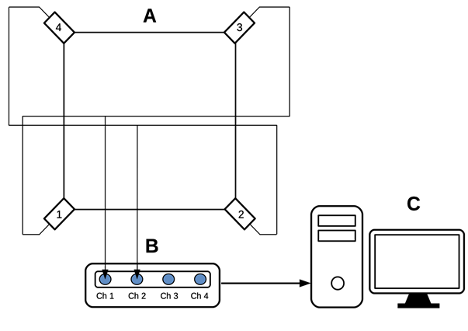
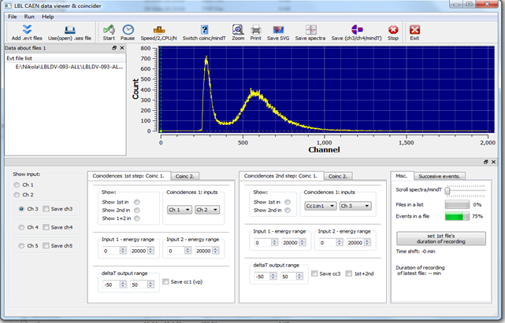
Low-background laboratory for nuclear physics
Cosmic rays physics
The experimental setup consists of two identical sets of detectors and read out electronics, one situated in the GLL and the other in the UL. Each setup utilizes a plastic scintillation detector with dimensions 100cm × 100cm × 5cm equipped with 4 PMTs optically attached to beveled corners of a detector.
Preamplifier output of two diagonally opposing PMTs are summed and fed to a digitizer input (CAEN FADC, type N1728B). FADC operates at 100MHz frequency with 14 bit resolution.
They are capable of operating in the list mode, when every analyzed event is fully recorded by the time of its occurrence and its amplitude. This enables correlation of the events, both prompt and arbitrarily delayed, at all four inputs with the time resolution of 10 ns. Single and coincident data can be organized into time series within any integrationn period from 10 ns up. The two N1728B units are synchronized, enabling coincidence/correlation of the events recorded in both of them. The flexible soft ware encompassing all above said off-line analyses is user-friendly and entirely homemade.

Slide 22
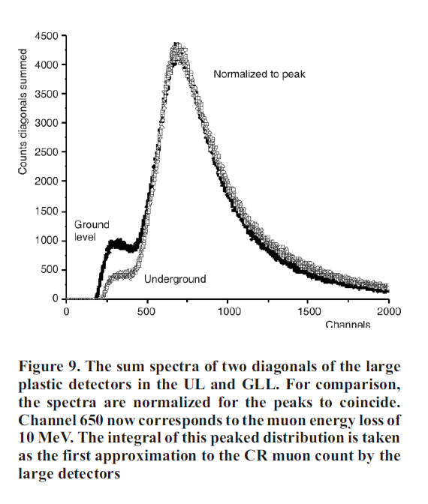
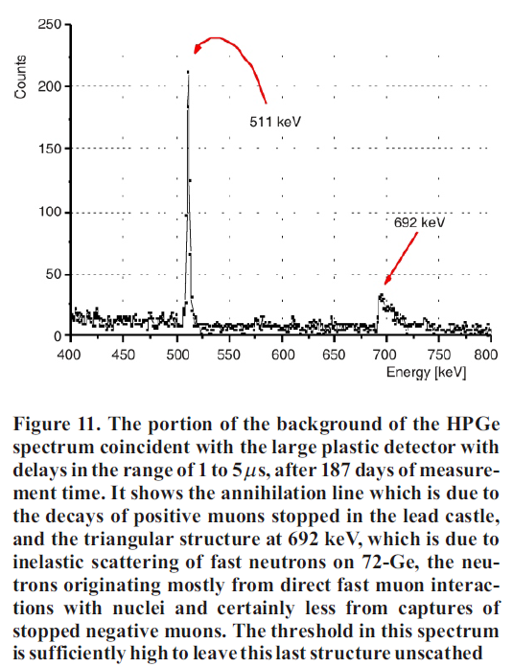
Low-background laboratory for nuclear physics
Cosmic rays physics
The events generating enough scintillation light to produce simultaneous signals in both inputs, exceeding the given threshold, are identified as muon events.
To account for the contribution from other particles to the experimental spectrum, not all the events in the spectrum are counted when muon time series are constructed.
Muon events are defined by setting the threshold corresponding to muon fraction of recorded spectrum. Threshold is set in terms of ”constant fraction” of the spectrum maximum, which also reduces count rate fluctuations due to inevitable shifts of the spectrum during long-term measurements.

Slide 23
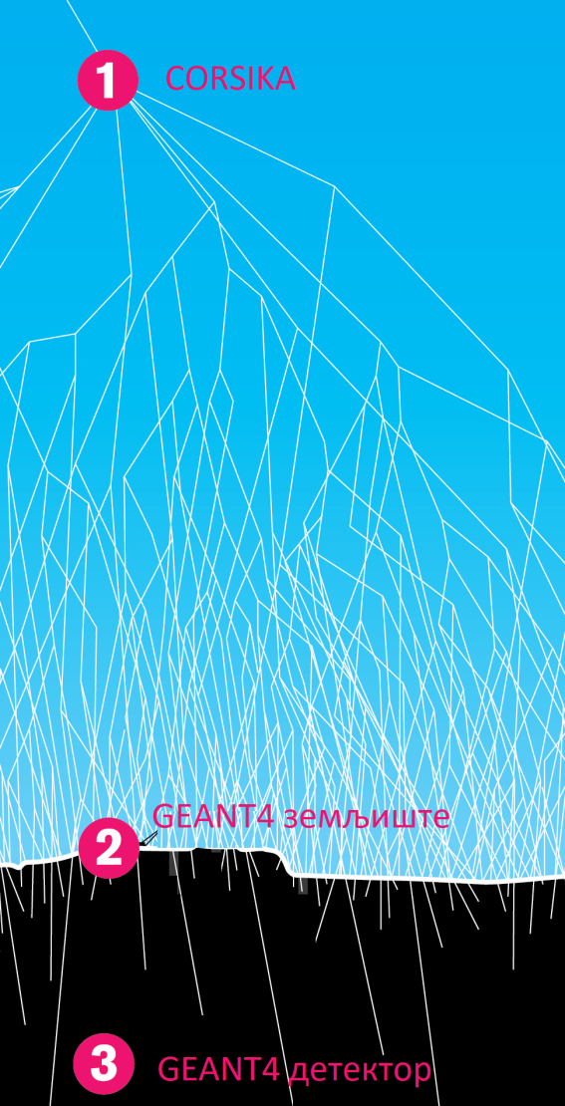
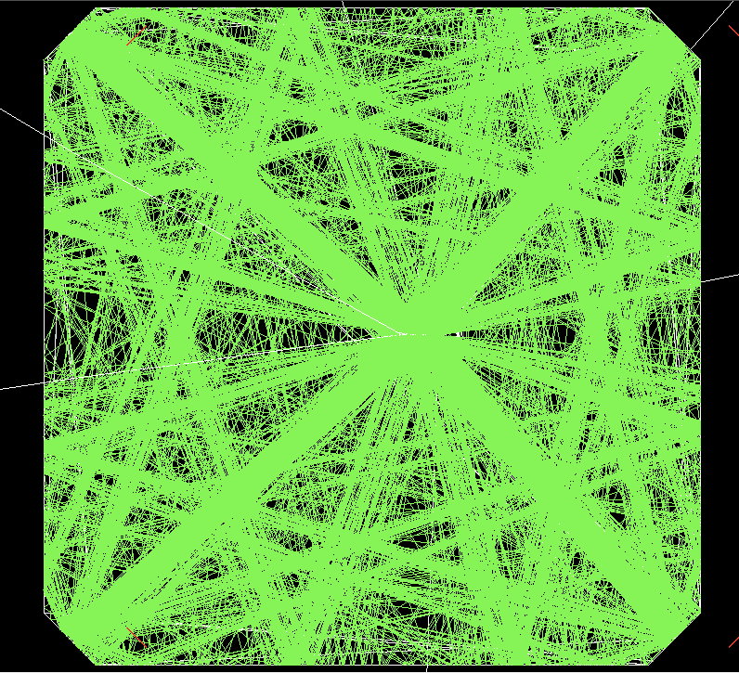
Low-background laboratory for nuclear physics
Simulation packages
For the simulation of cosmic radiation the CORSIKA software package developed for the experiment KASCADE was used.
Geant4 software package has been developed for particle physics and simulates the interaction of particles with matter.It is a very good tool to simulate the response of detectors used in the experiment.
Cosmic rays can be simulated from primary cosmic radiation that is entering in the atmosphere and follow the creation of the cascade through the atmosphere, and finally detects using plastic scintillators at the Earth's surface or in the underground laboratory.

Slide 24
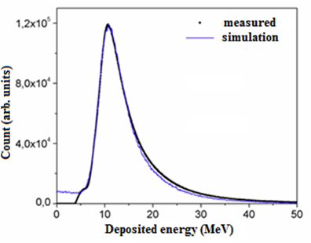
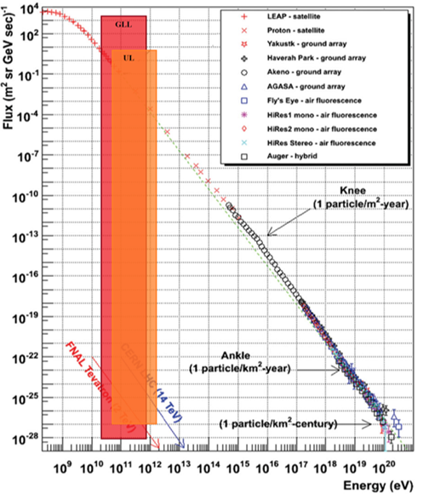
Low-background laboratory for nuclear physics
Simulation packages
Response of the detectors are calculated from simulation
Range of energy for the primary CR found

Slide 25
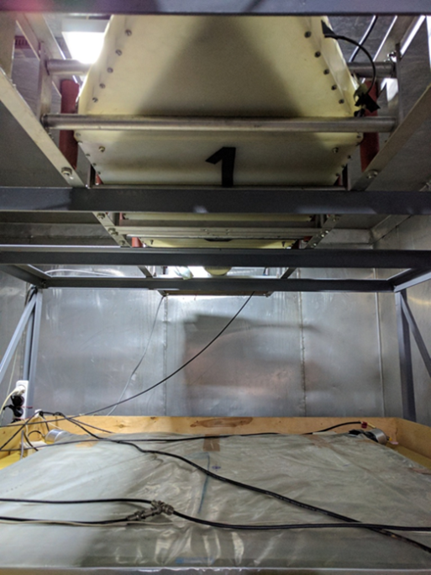
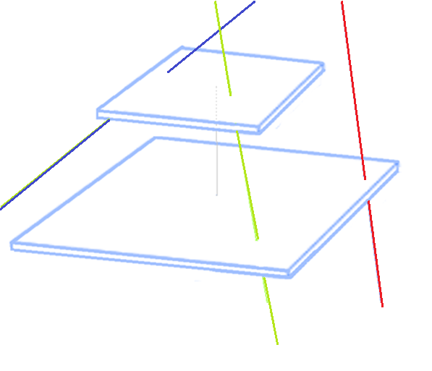
Low-background laboratory for nuclear physics
“Asymut“ set-up
Asymmetric muon telescope separates muons with respect to zenith angle. Asymmetric muon telescope is an inexpensive detector, constructed from the components already available in the laboratory.
It consists of two plastic scintillators of unequal dimensions. Detectors are separated by 78 cm, to have roughly the same count rate in the coincident and anticoincident mode. Lower detector in single mode operates in the same manner as the one in the GLL, with wide angular acceptance. The coincident mode constitute the events registered in both upper and lower detector, while the anticoincident mode is made from the muons passing through the upper but not the lower detector and therefore favors inclined muon paths.

Slide 26
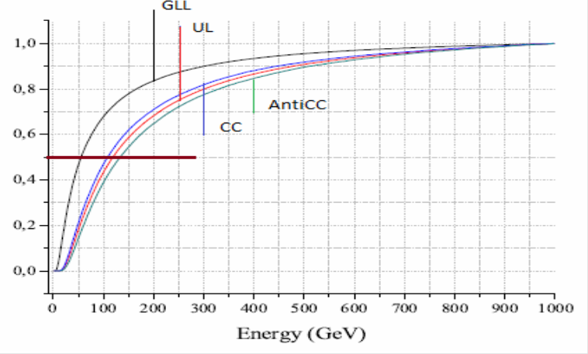
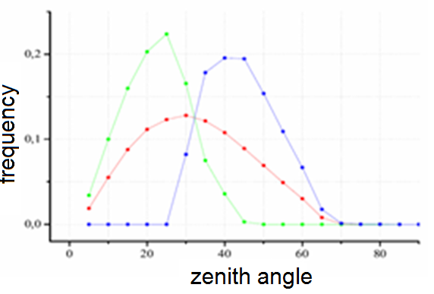

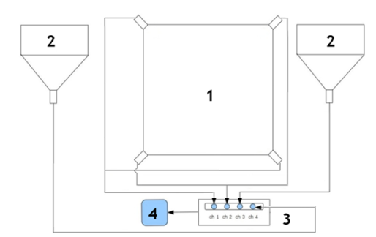
Low-background laboratory for nuclear physics
“Asymut“ set-up
Different angular distribution means different path length of muons registered in three modes of ASYMUT and also different energy distribution of parental primary particles
Other experimental arrangement is also discussed –Planar configuration
Cumulative response function to galactic cosmic rays of different muon detectors in the lab. 0.5 level corresponds to median energy.
Detectors | Е_{0.05} ( GeV ) | E_{median} (GeV) | E_{0,95} ( GeV )
CC | 27 | 121 | 1585
ANTI | 35 | 157 | 2031
UL | 31 | 137 | 1811

Slide 27
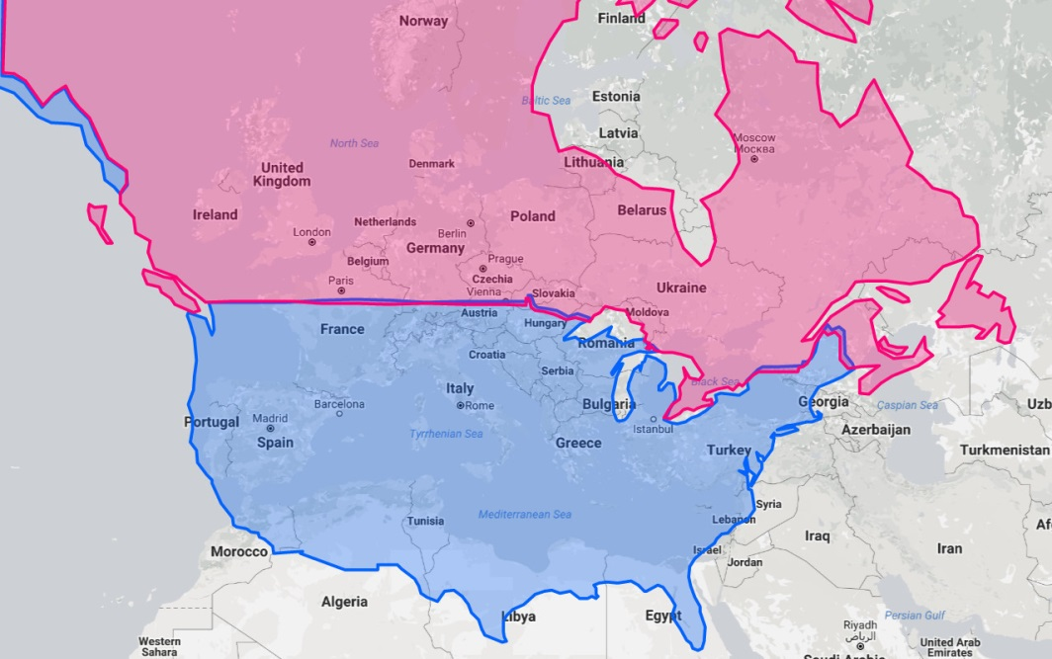
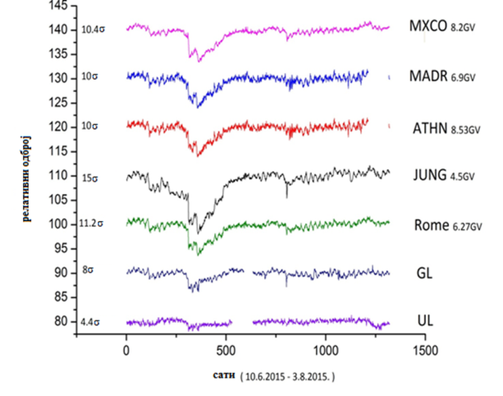
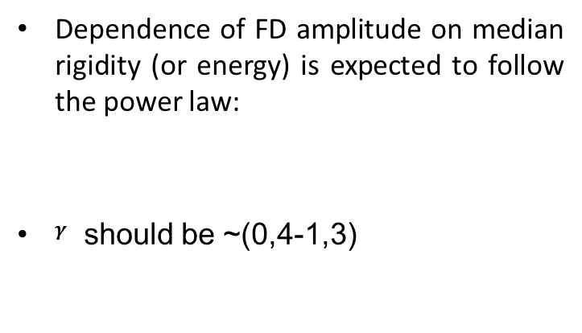
Solar activity
Ground measurements
Comparison with nearby NM
  The amplitude of a Forbush decrease is one of its main characteristics.
Dependence of FD amplitude on median rigidity (or energy) is expected to follow the power law:
$γ$ should be ~(0,4-1,3)

Slide 28
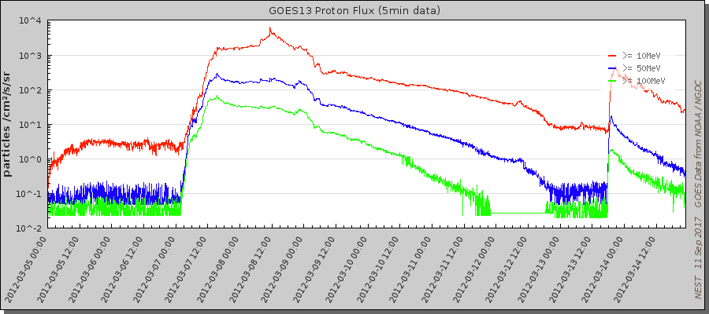
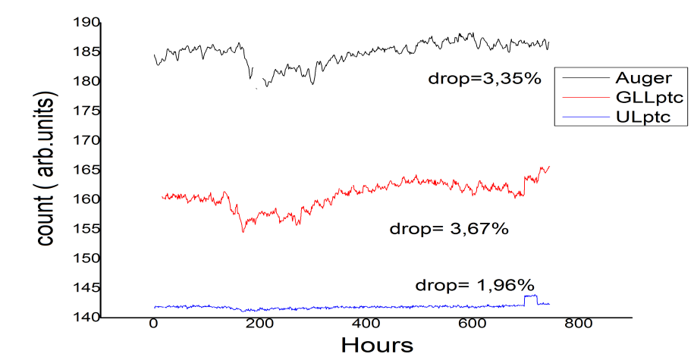

Solar activity ground measurements Forbush decrease
As the solar activity was approaching its maximum during solar cycle 24, an X-ray flare (X5.4 class) occurred in NOAA AR 11429 at 00:02 UT on 2012 March 7 (flare onset time), associated with an intense halo CME with a peak speed of about 2684 km s−1, and followed by a smaller flare (X1.3 class) about 1.5 hr later. After that, a series of M-class flares and large CMEs occurred within the same region.
Strong FD detected after this aperiodical solar event.

Slide 29





Solar activity ground measurements Forbush decrease

Slide 30

Solar activity ground measurements Forbush decrease
Found dependence of FD amplitude on median rigidity o illustrates applicability of our setup for studies of consequences of CR solar modulation process in the energy region exceeding sensitivity of neutron monitors.
Amplitude of Forbush decrease is inverse proportional to component of the diffusion tensor parallel to magnetic field which depends on CR rigidity
Higher power indices can be due to more complex variation of GCR. This more complex variation is a result of series of CMEs during this event that leads to large compound ICME structure with multiple shocks and transient flow
γ | NM | NM+Belgrade
March 2012. Sept. 2014. June 2015. Sept. 2017. | 0,82±0,08 0,79±0,16 0,57±0,05 1,27±0,16 | 0,78±0,03 0,67±0,06 0,58±0,02 0,86±0,07

Slide 31




Comparison with satellite data
STEREO (Solar Terrestrial Relations Observatory)
  Two nearly identical spacecraft were launched in 2006 into orbits around the Sun
  Communication with STEREO B stopped 2014.
FD March 2012

Slide 32



Comparison of ground and satellite data
Correlation matrix of linear correlation coefficient ( in % ) for Belgrade cosmic ray station with its temperature and pressure corrected underground and ground level detectors (UL_tpc, GL_tpc), only pressure corrected ( UL_pc, GLL_pc ),raw data ( UL_raw, GLL_raw ) and Rome, Oulu, Jungfraujoch (JUNG) and Athens NMs for March 2012.

Slide 33



Muons and temperature of the atmosphere
Common empirical models use temperature of the muon creation level in the atmosphere for temperature corrections but muons are created throughout the atmosphere
Our empirical model is based on using temperature on several levels in the atmosphere.
Use Principal component analysis to untangle these correlated parameters by switching to new set of (orthogonal) linearly independent parameters created from linear combination of original parameters.

Slide 34


Muons and temperature of the atmosphere
Also this procedure is reducing dimensionality of the problem by choosing only statistically meaningful.
Method is more efficient then others but our alternative method which use machine learning is even more efficient.

Slide 35


Muons and temperature of the atmosphere
The effect of atmospheric parameters in secondary cosmic ray muon component is well known. There are several theoretical and empirical models that describe these effects well. Usually this knowledge is used to correct for secondary cosmic ray variations due to atmospheric effects.
Alternatively, once model parameters are established, sensitivity of cosmic ray muon detectors to variations od atmospheric origin can be used to estimate temperatures for different layers of the atmosphere.
We demonstrate this procedure using cosmic ray data measured in our lab, combined with parameters of our empirical model for meteorological effects based on principal component analysis.

Slide 36

Muons and temperature of the atmosphere
Time series of measured (red) and estimated temperature (green and dark green) for isobaric levels 30, 150, 350 i 975 mbar. Preliminary data!

Slide 37



Cloudiness and cosmic rays
The physical mechanism proposed to explain CR contribution to cloud formation is named ion-induced nucleation
Diurnal temperature range (DTR) is the difference between daily temperature maximum and minimum DTR = Tmax − Tmin .It is a useful quantity since it is anticorrelated with cloudiness is used as a proxy for cloudiness.
An index of DTR deviations is defined combining temperature data from multitude of north hemisphere meteorological stations. This is the excursion od DTR from the expected value, and this difference, normalized to standard deviation.
DTR deviation index time series are studied, searching for variations correlated with CR variations, with the aim of testing the hypothesis of CR influence on cloud cover
Superposed epoch analysis on the set of Forbush decreases above certain amplitude cut has been performed.
When the cut is raised to 7%, the DTR deviations start to differ significantly from zero in the days following FD.

Slide 38




Arduino detector
Based on MIT project for hendheld muon detector-Cosmic watch
With collaboration with one highschool ( for gifted children)
Telescope arrangement of two plastic scintilators with MPPS/SiPM
Need improvement!

Slide 39

Plans for future
Exploring correlation of the CR with enviromental parameters measured at the site ( atmospheric parameters, soil composition, particles in air, cloudiness,...)
CR induced radiation ( cosmogenic radionuclides) in the enviroment ( past and present) and in the detectors ( active shielding, understanding background noise)
New CR detectors and outreach
Organizing an international workshop on radiation and enviroment next year

Slide 40

Conclusion
Muon detectors at Low level laboratory are used to find rigidity dependence of Forbush decrease. These data for transient solar modulation of GCR are obtained over much higher range of rigidities than region sensitive to NM thus allowing more extensive studies of cosmic-ray solar modulation processes.
Comparison of ground data with satellite data outside geomagnetic field shows different correlation depending on energy recorded particles thus allowing better understanding of correlation between Forbush decreases and CME that can lead to hazardous event on Earth.
Dependence of FD amplitude on median rigidity can lead to better models of propagation of CR through heliosphere thus giving condition of the heliosphere.
Small detectors can be used to monitor not just solar weather but also some CR induced effects in enviroment

Slide 41

Thank you for your attention!
http://cosmic.ipb.ac.rs/

Slide 42
Backside slides

Slide 43

Detektorski sistemi
Funkcija odziva ( Response function)
Odbroj detektora se može prikazati sa:
$N_{d}= \sum_{i}{\int_{E_{th}}^{∞}{Y_{i}}}\left( E,h\right)∙J_{i}\left(E,t\right)dE=\int_{E_{th}}^{∞}{W_{t} \left( E,h,t\right)dE}$
Funkcija $J_{i}\left(E,t\right)$ je spektar energija primarnog kosmičkog zračenja
$Y_{i}( E,h)$ je funkcija prinosa za datu energiju i visinu.
$Y_{i}\left(E,h\right)=\int_{E_{th}}^{∞}{\int{S_{i}}}\left(θ,φ\right)∙Φ_{i,μ}\left(E_{i},h,E,θ,φ\right)dEdΩ$
$S_{i}\left(θ,φ\right)$ efektivna površina detektora
$Φ_{i,μ}\left(E_{i},h,E,θ,φ\right)$ je diferencijalni fluks miona po primarnoj čestici i tipa sa energijom $E_{i}$.
$W_{t} \left( E,h,t\right)$ je diferencijalna funkcija odziva
Metod parametrizacije, teorijski metod ili uz pomoć simulacije se određuje

Slide 44


Low-background laboratory for nuclear physics
Past activities
  Plasma focus device
    The plasma focus experiment in Belgrade, Serbia started in the late eighties of the last century. Belgrade plasma focus device (BPFD) is a fusion machine intended to operate as optimized neutron source or hard X-ray source and can be used for neutron activation or production of short-living radioisotopes. These radioisotopes will have very low activity which can be analyzed in the underground Low-Background Laboratory for Nuclear Physics. Also, we compared the obtained experimental data (neutron yield, total current waveform, working gas pressure) with the numerical simulation code (The Lee model code) to test our plasma focus machine. Comparison between neutron yield from our experimental data and neutron scaling laws and neutron yields derived from computation using the Lee Model code shows good matching, but for better verification of the code, more experimental data are needed.

Slide 45


Експерименталнe поставкe
First one was to extend the sensitivity to 94 higher energies with detection of multi-muon events underground. An array of horizontally oriented muon detectors ought to be placed in the UL. Simultaneous triggering of more than one detector is an indication of a multi-muon event.
The idea was exploited in the EMMA underground array located at the deeper underground laboratory in Pyhasalmi mine, Finland, with the intention to reach energies in the so called knee region.
For a shallow underground laboratory, exceeding the energy region of solar modulation would open the possibility to study CR flux variations originating outside of the heliosphere.
На основу симулације број мултимионских догађаја је сувише мали да би се само уз помоћ садашње опреме могле пратити промене флукса услед соларних модулација која је реда неколико процената дневно. Да би се детектовале промене флукса реда 1% са 3$σ$ извесношћу (3√N/N), потребно је проширити детекторски систем да би добили потребан интензитет флукса. Уколико се систем за детекцију миона прошири на целу површину подземног дела Нискофонске лабораторије (слика 5.24). Из симулације се добија ∼2600 коинциденција по дану, детектованих у по два детектора (површине 1m²), на различитим могућим растојањима на целој површини. Овај број омогућава, са потребном статистичком сигурношћу, посматрање варијација већих од 5,8% које потичу од соларне модулације. Овакве варијације флукса се ретко јављају ( нпр. веома велико Форбушово смањење) па је ова поставка неодговарајућа за континуално посматрање флукса на различитим енергијама примарног космичког зрачења
Важно је и да се узимају у обзир само коинциденције настале од миона а не и од електромагнетне компоненте. Електромагнетна компонента ( δ електрони, фотони и слично) настаје у интеракцији миона са земљиштем изнад детектора. Овакав „мини пљусак“ је локализован око миона, а те честице се могу детектовати у детектору и погрешно идентификовати као миони. Да би се избегла оваква лажна коинциденција потребно је коинцидирати догађаје са већих растојања. Уколико се узимају само коинциденције на растојањима преко четири метара, избегавају се овакве лажне коинциденције. Ово растојање је одређено коришћењем резултате GEANT4 симулације као сигурно растојање на којим нема електрона насталих од миона у интеракцији са земљиштем.
број вишеструких коинциденција је за ред величина мањи од броја двоструких коинциденција.
Стога овакав систем није од користи за посматрање дневне промене флукса троструких коинциденција и виших енергија примарног космичког зрачења у оквиру Нискофонске лабораторије.

Slide 46

https://soho.nascom.nasa.gov/classroom/nordlys_english.mov

Slide 47
Симулациони пакети CORSIKA и GEANT4
RUNNR | 20907 | Број симулације
EVTNR | 1 | Редни број прве честице
NSHOW | 1000000 | Укупан број примарних честица
PRMPAR | 14 | Тип примарне честице, у овом примеру протон
ESLOPE | -2.7 | Експоненцијални коефицијент енергије
ERANGE | 1 2.E7 | Интервал енергија примарних честица у GeV-а
THETAP | 0. 70. | Распон зенитних углова упадне примарне честице у степенима
PHIP | -180. 180. | Распон азимутних углова упадне примарне честице у степенима
SEED | 814 0 0 | seed за прву секвенцу случајних бројева
SEED | 1114 0 0 | seed за другу секвенцу случајних бројева
OBSLEV | 7.80E+03 | Опсервациони ниво (у cm)
FIXCHI | 0 | Почетна висина (g/cm²)
MAGNET | 22.7 42.1 | Геомагнетно поље за Београд
ATMOD | 4 | Атмосферски профил дат са 5 нивоа. Овде профил ATM511 изнад Штудгарта измереног маја 1993. године
QGSJET | T 0 | Укључена QGSJET01c рутина за симулацију високоенергетских хадрон-нуклеус и нуклеус-нуклеус судара
ECUTS | 0.15 0.15 0.0015 0.0015 | Доњи праг енергија (у GeV) за честице које се прате и то за хадроне, мионе, електроне и фотоне
MUADDI | T | Додатни подаци о месту и начину креације миона се такође прате
Коришћено 10⁹ примарних протона и алфа честица приликом симулирања атмосферске каскаде

Slide 48

Простирање космичког зрачења кроз земљиште
Миони при проласку кроз земљиште производе терцијалне каскадe
Мион губи енергију при кретању двојако, континуално и дискретно.
  Континуално губи енергију кроз јонизацију
  Дискретни губици енергије продукцију електрон-позитрон парова, закочно зрачење и електромагнетна интеракција са језгром.

Slide 49




Измерени подаци – флукс миона
Увођење нове опреме у лабораторију се поклапа са почетком 24. Соларног циклуса
Флукс миона за подземни део
Декохеренција
Φ=46,53 m⁻²s⁻¹
$$Φ=\frac{N}{S∙ε·t}$$
Φ_{cc}=24.89 m⁻²s⁻¹ и Φ_{anti}=21.64 m⁻²s⁻¹ .

Slide 50


Detektorski sistemi
Poređenja
Poređenje sa bliskim Neutronskim detektorima
Utvrđen je stepen linearne korelacije

