Slide 1
The GSU Neutron Detector
Carola Butler
Georgia State University

Slide 2
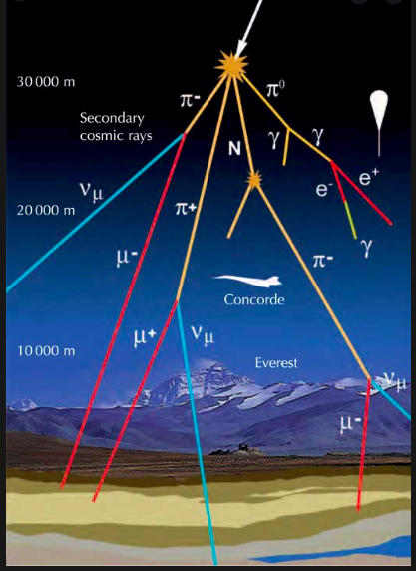
Introduction
It has long been known that the number of cosmic ray muons and neutrons reaching the surface of the earth depends on many conditions. We know this depends on:
Location on earth (geomagnetic rigidity)
Time of day
Season of the year
Solar conditions
Solar wind
Interplanetary magnetic field magnitude and polarity
Sunspot cycle
Temperature
Barometric pressure

Slide 3
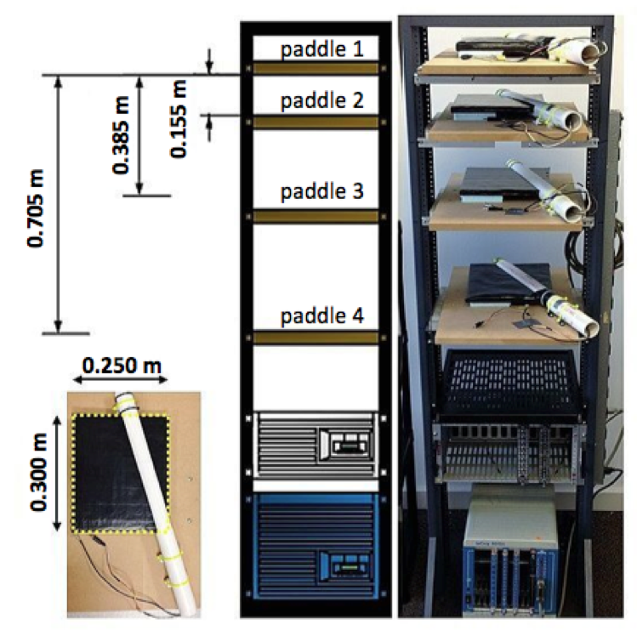
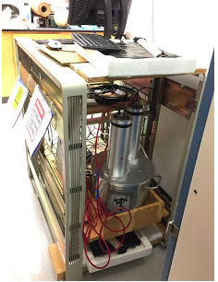
At Georgia State we have a long history of building cosmic ray detectors for different studies
The ‘Pot Detector’ was originally built to measure muon lifetime. Built from scrap material and a cooking pot, it cost less than $150. It was later converted to a cosmic ray counter. It has been running for 17 years
The four paddle detector is used to study cosmic rays counts using different acceptance angles,

Slide 4
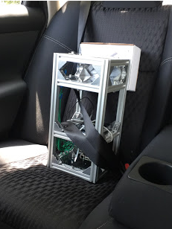
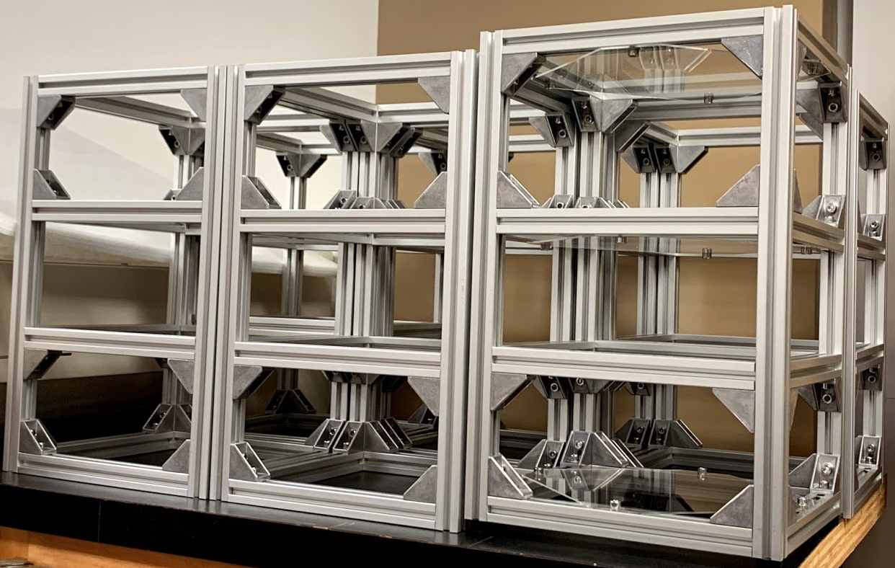
The Muon Telescope
Our latest project is to build muon telescopes that will use SiPm technology and will be portable and relatively inexpensive. The frame will hold plastic scintillator tiles and the acceptance angle can be varied.
When we started building our muon telescopes we wanted a neutron detector that would fit on the frame. The scintillator tiles could be used to help differentiate between charged particles and neutrons. The neutron detector had to be compact, reasonably light and use SiPM’s rather than PM tubes.

Slide 5
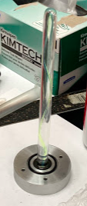
When we started building the muon telescopes we used the designs used by sPHENIX– plastic scintillator plates with embedded wavelength shifting fibers coupled to SiPM’s.
The only practical way to detect neutrons is to use containers full of liquid scintillator.
The problem was then to find a way to couple the SiPM to a tank full of scintillation liquid.
Some people have tried immersing the fibers in liquid scintillator, but this has two problems. Some liquids are very chemically aggressive and the fibers are not rigid and would drift around in the tank.
Putting the fibers into glass tubes was the solution.
For optical coupling the tube is filled with optical grease.

Slide 6
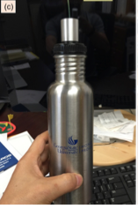
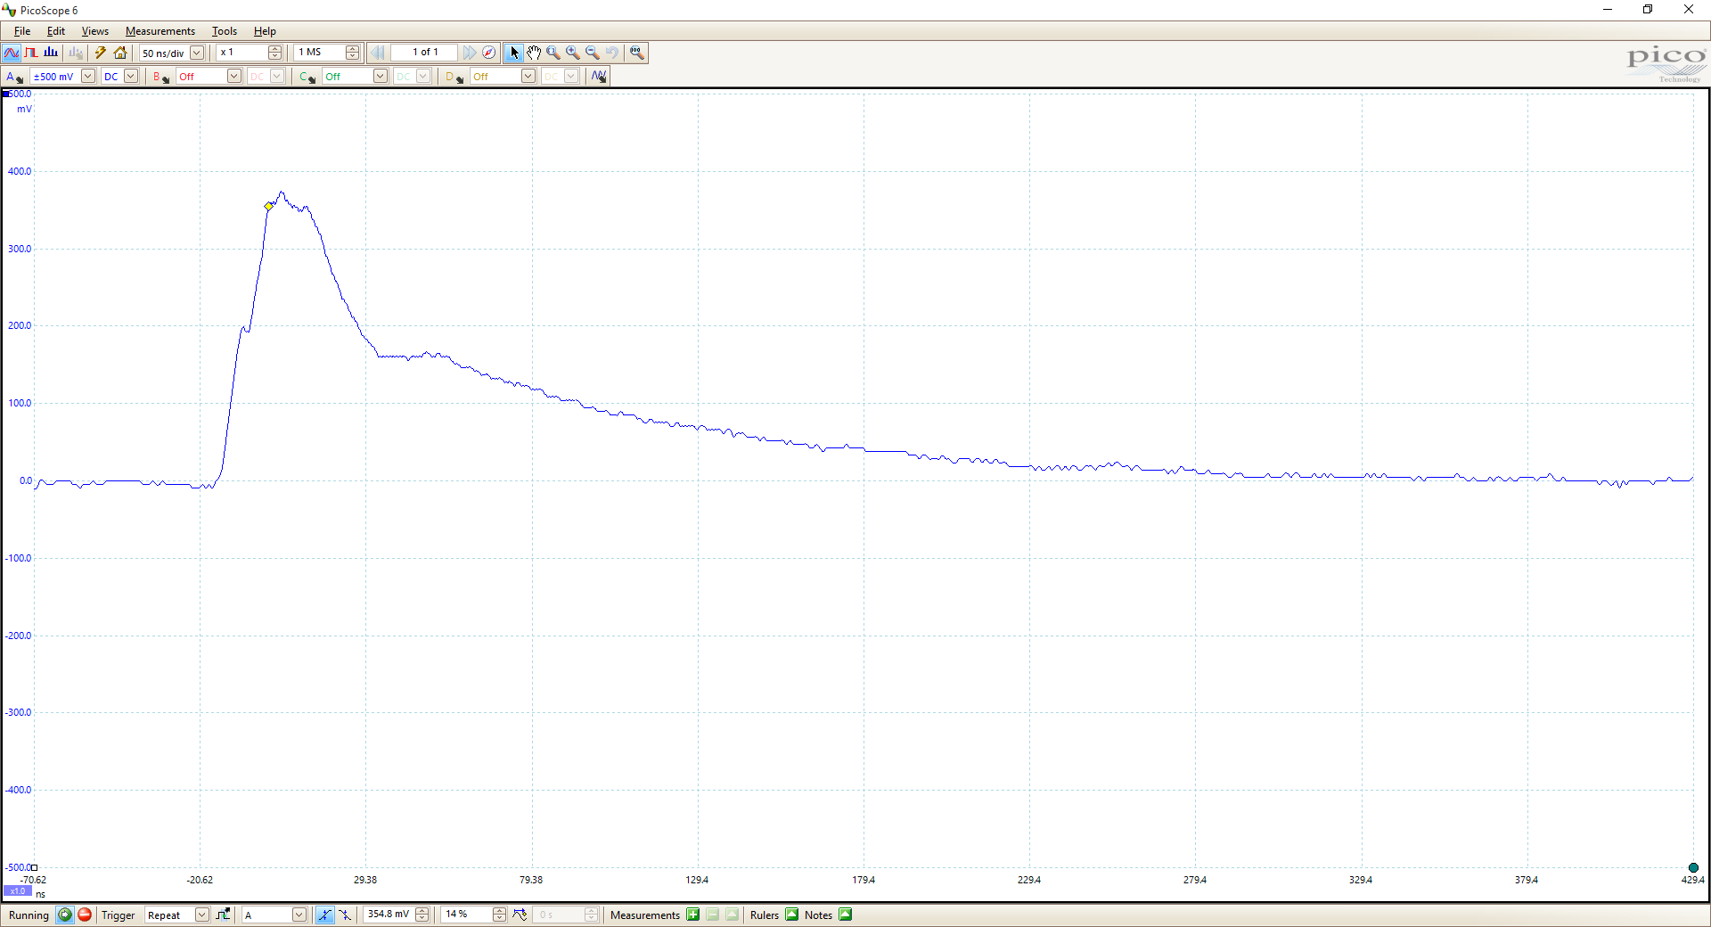
The Prototype
The prototype was made from a water bottle a student left in the lab and never came back for. When it was connected to an SiPM it gave a beautiful signal.

Slide 7
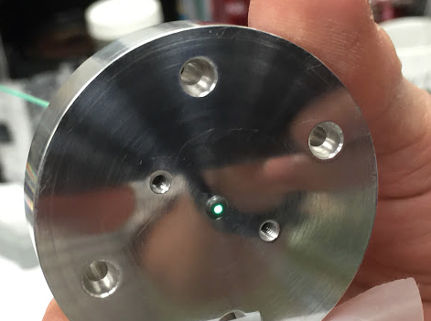
The Light Collection Tube
Bicron 505 n = 1.505
Optical grease, n=1.465
Fiber, n=1.59 Cladding, n=1.49
Borosilicate glass, n=1.517
The differences in refractive indices is fairly small.

Slide 8
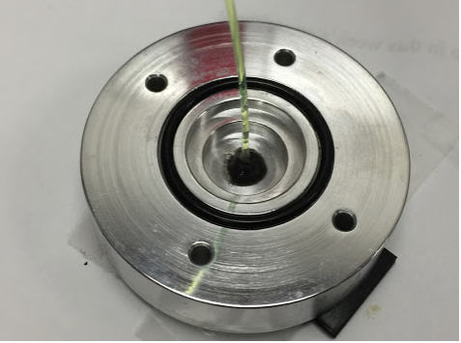
The End Cap
The most important part of the assembly is the end cap. It has to both hold the fiber and the grease tube, prevent the tank from leaking and provide a place to securely attach the SiPM holder.

Slide 9
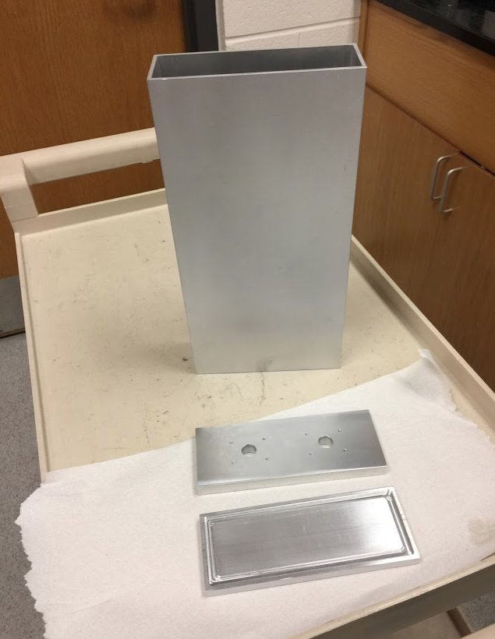
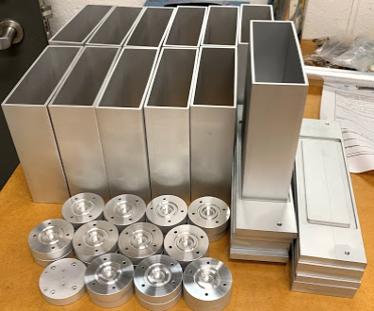
The Mark II-Mark V
In principle any container would work. Our detectors are made from 6061 aluminum which is inexpensive, comes in many sizes,and is easy to machine. This is 6” x 2” standard tubing. We cement the parts together using Araldite 2014 epoxy which is very strong, not electrically conductive and chemical resistant.

Slide 10
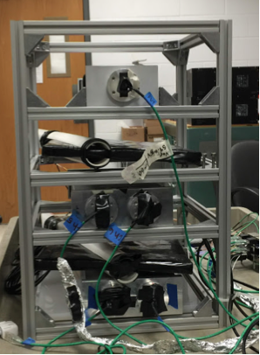
The Mark II model had only one tube and SiPM. However, SiPM’s are very noisy (about 300,000 dark counts/second) so all our subsequent models have two SiPM’s and rely on coincidence to declare a hit.
Mark II
Mark III
Mark IV

Slide 11
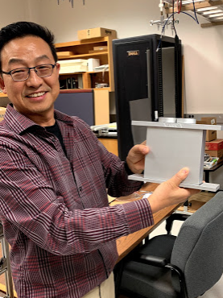
Current design
The Mark V is six by six by two inches and has two end caps. The flanges on the side let us bolt it securely to the muon telescope frame.

Slide 12
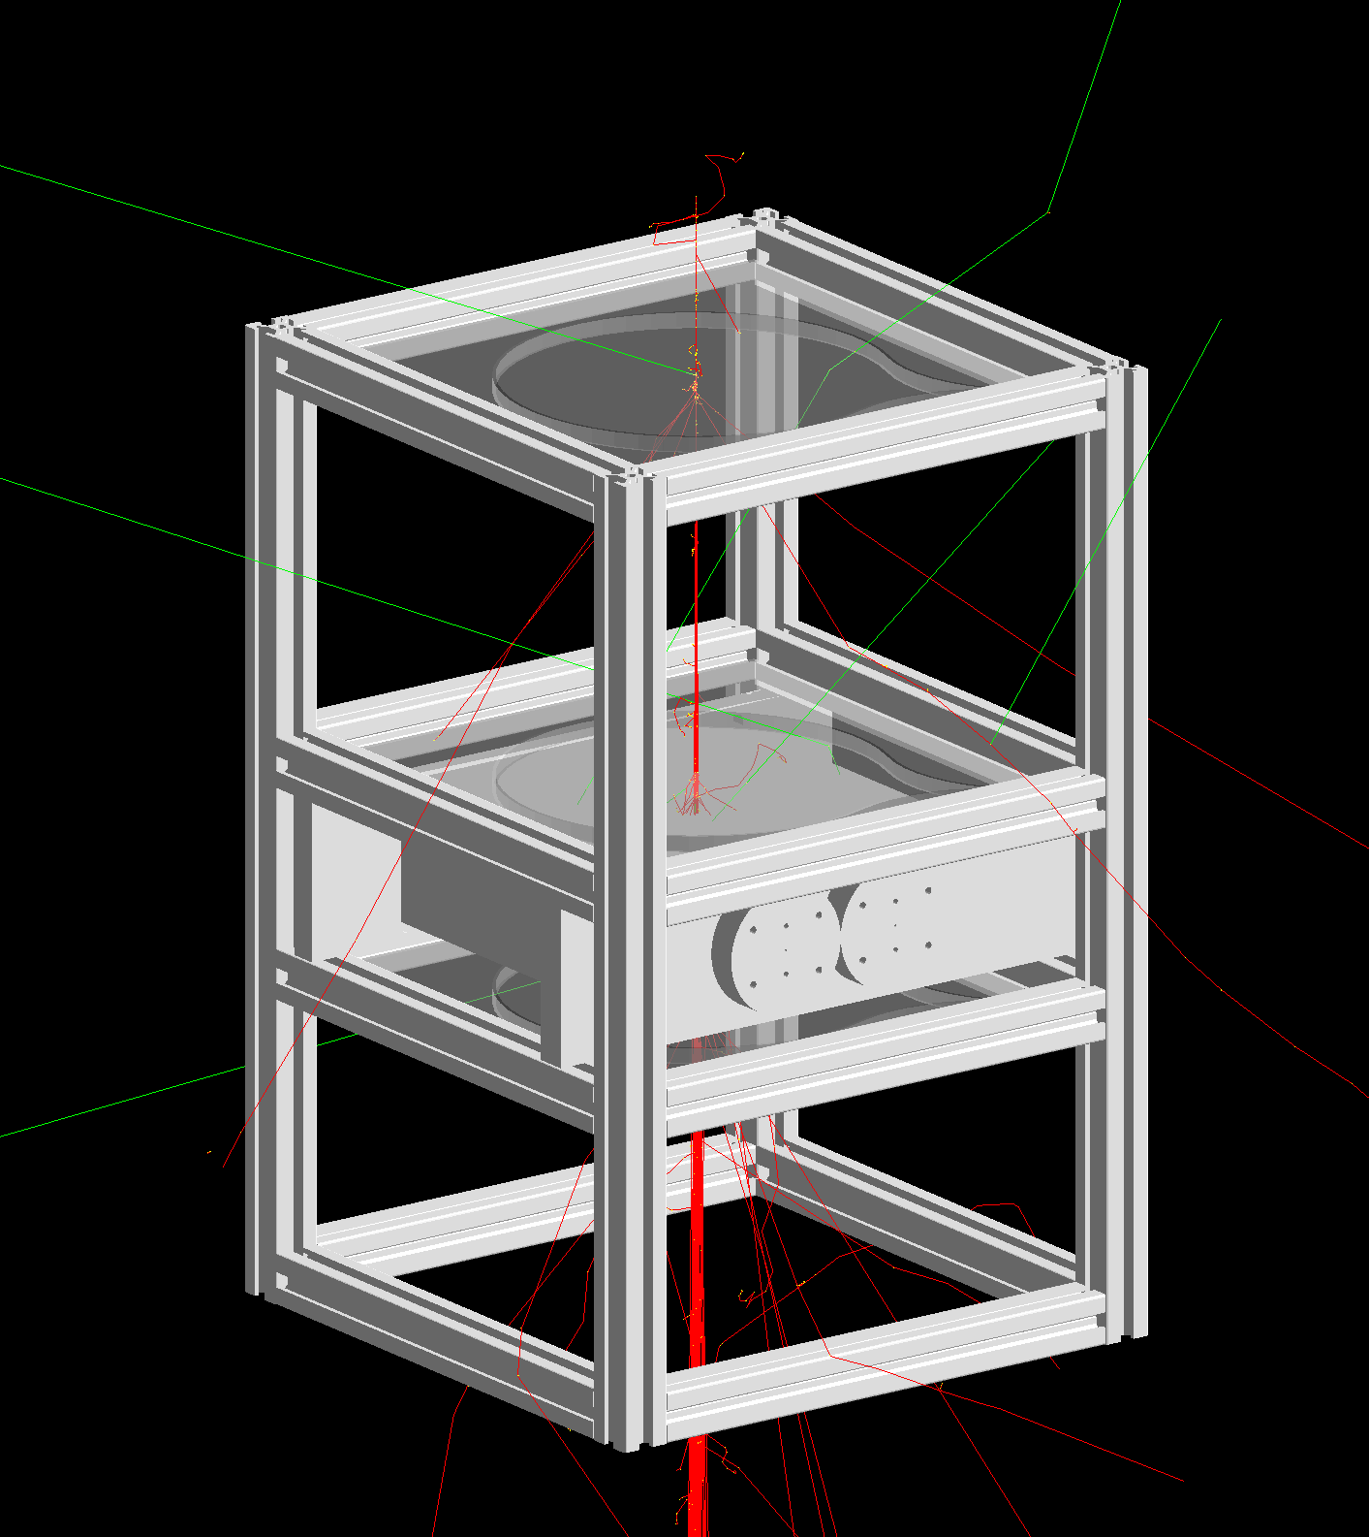
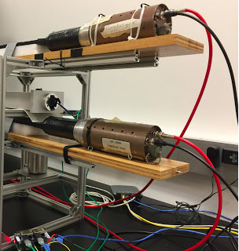
Performance
Test set up by Montgomery Steele

Slide 13
Slide courtesy of Montgomery Steele

Slide 14
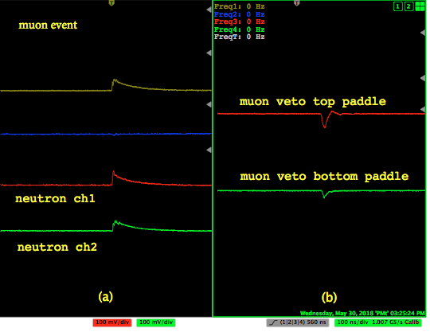
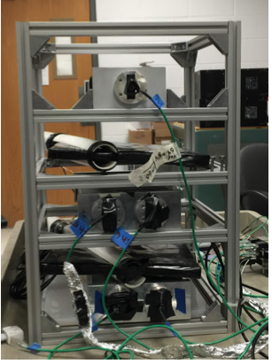
Muon Signals

Slide 15
Neutron Signal

Slide 16
Slide courtesy of Montgomery Steele

Slide 17
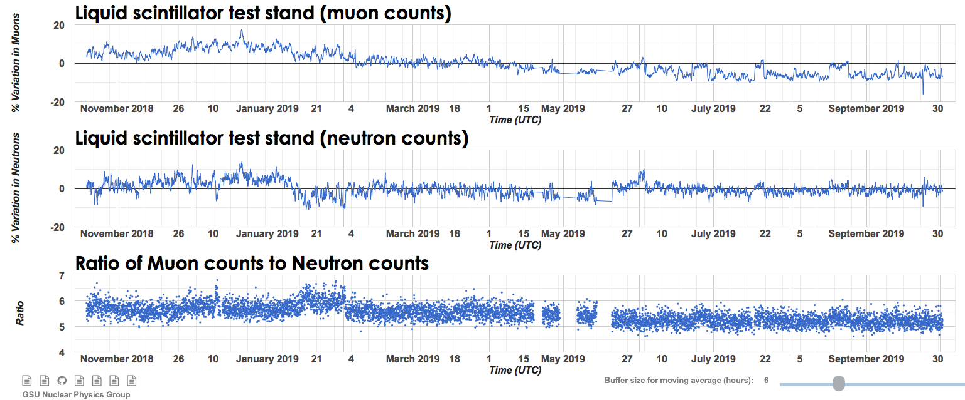
Online monitoring

Slide 18
Comparison with Other Detectors
http://phynp6.phy-astr.gsu.edu/~cosmic/dynamicDisplay

Slide 19
Future work
Improve signal by adding more fibers to the grease tube
Calibrate ADC using known neutron energies
Build more detectors

Slide 20
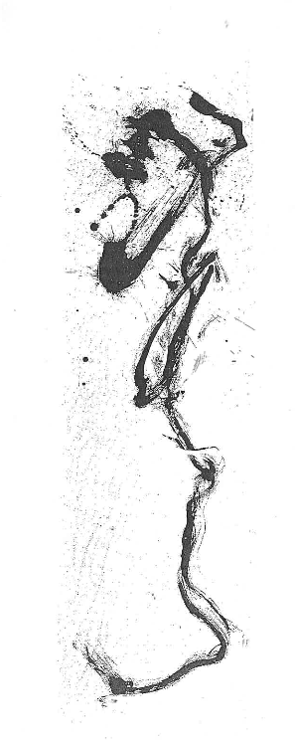
Deep bows of Gratitude
The entire Nuclear and Particle Physics Group –Past and Present Members
Dr. Xiaochun He
Dr. Murad Sarsour
Dr. Megan Connors
For letting me play with their group
Peter Walker
Dwayne Torres
Sam Mayberry
Our instrument shop people for their endless patience and help
Jonathan He
For help with drawings
Montgomery Steele
For testing and data analysis
Sawaiz Syed
For electronics and rendering help

Slide 21
And Thank You for Your Attention

