Slide 1
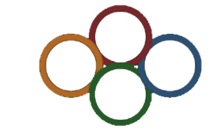

Engaging the next generation through a network of radiation and environmental sensors
Institute for Resilient Communities
Enabling resilience through science, technology, education and outreach
Ali Hanks
Cosmic Ray Workshop @ GSU
Oct. 6th, 2019

Slide 2
How RadWatch began
Response to local (west coast) fears following the Fukushima Dai’ichi Nuclear Power Plant accident

Slide 3
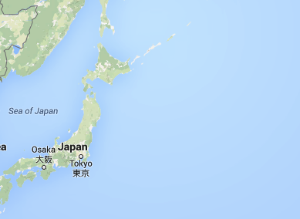
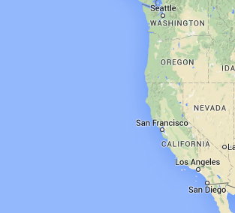
Radiation transport and fear
Challenges: local event with global impact
  Air/ocean transport
  Public response and social media
Air transport: ~60 hours
Fukushima
Berkeley
Ocean currents: 3-4 years
A lot of public concern and confusion exposed need for clear and transparent data and communication from experts

Slide 4
West coast concerns
Understandable concerns after Fukushima accident
  Should I stay inside? Should I stay out of the rain?
  Can children play outside?
  Do we need to leave California?
  Should we stop drinking milk? Tap water? Do we need filters?
  Do we need to take iodine pills (sold out in CA)?
  Can we use a Geiger counter?
  What do the numbers and units mean: cpm vs dose - rem vs Sievert - and dose rate - rem/hour vs. (milli or micro) Sievert/hour, etc.
  …
Government
  Why isn’t the government doing more? Is it censoring data?
  Can we trust what we are being told?

Slide 5
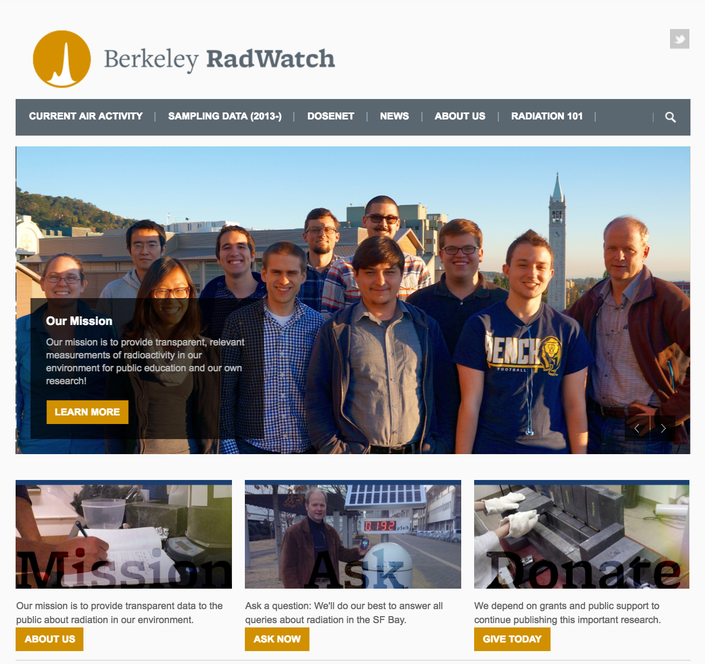
Berkeley RadWatch
Mission: provide transparent, relevant measurements of radiation for public education

Slide 6
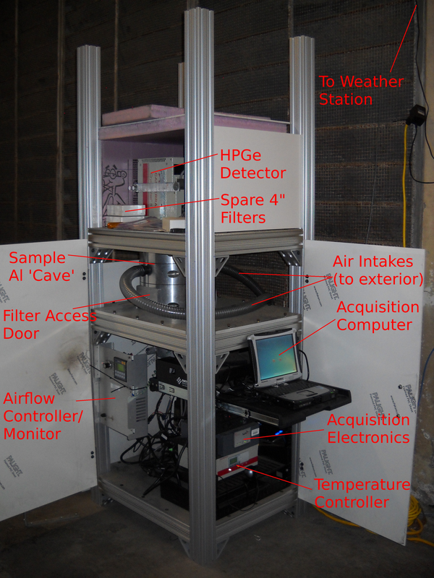
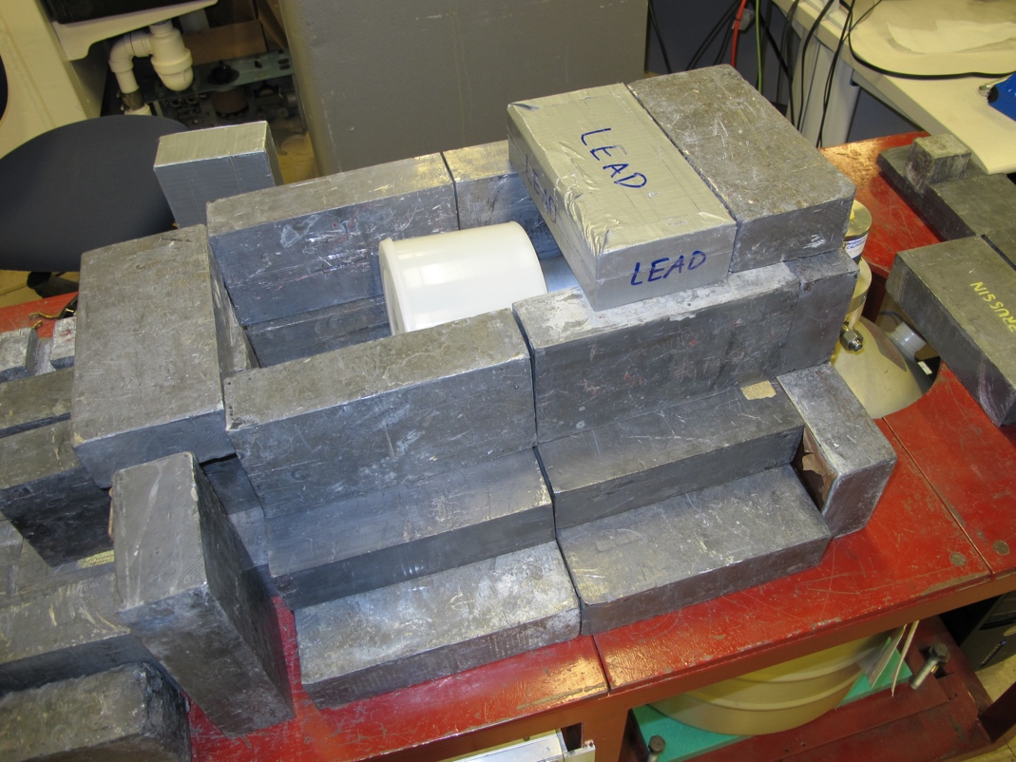
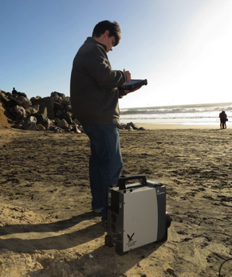
Berkeley Radwatch
Independent measurements at Berkeley
  Make use of sophisticated instruments available through our lab
  High-purity germanium detectors for sample and air measurements
Measurements taken at Surfers Beach in Half Moon Bay to address public concern
Controlled measurements of biological samples collected from around the Bay Area
On-going air particulate sampling to demonstrate variation in air-born radiation

Slide 7
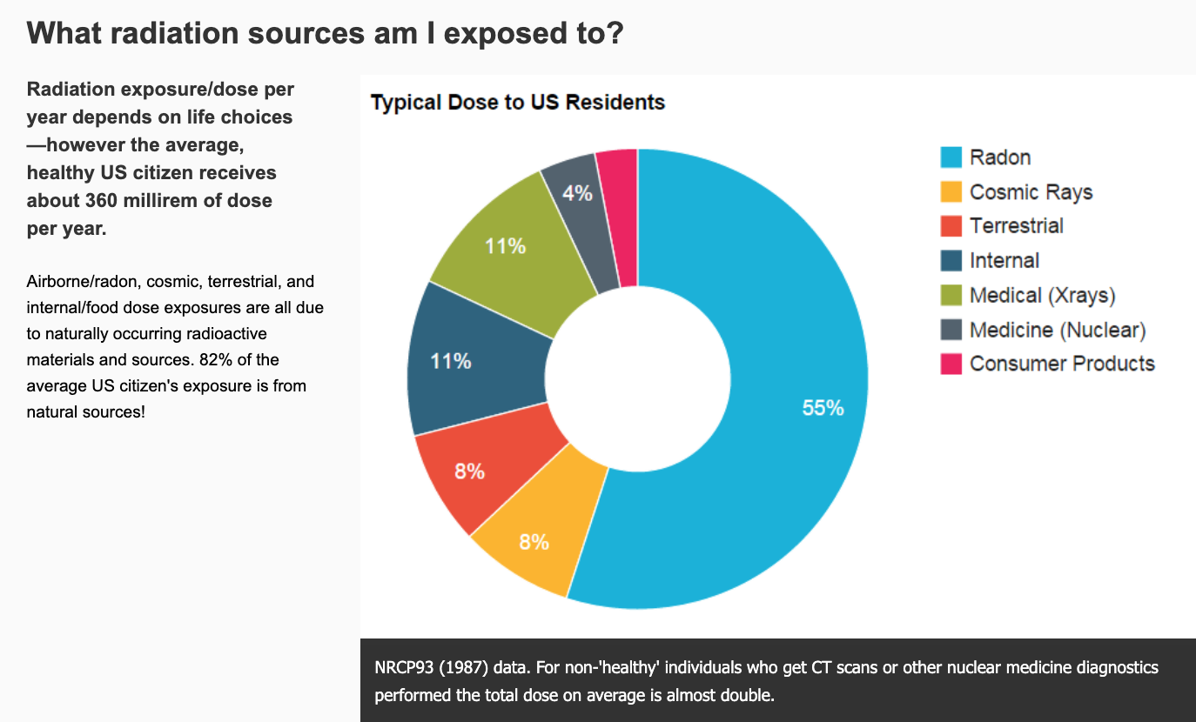
Radiation exposure

Slide 8
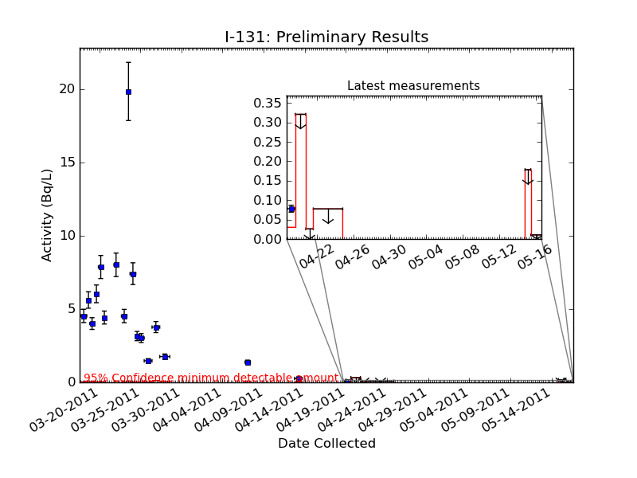
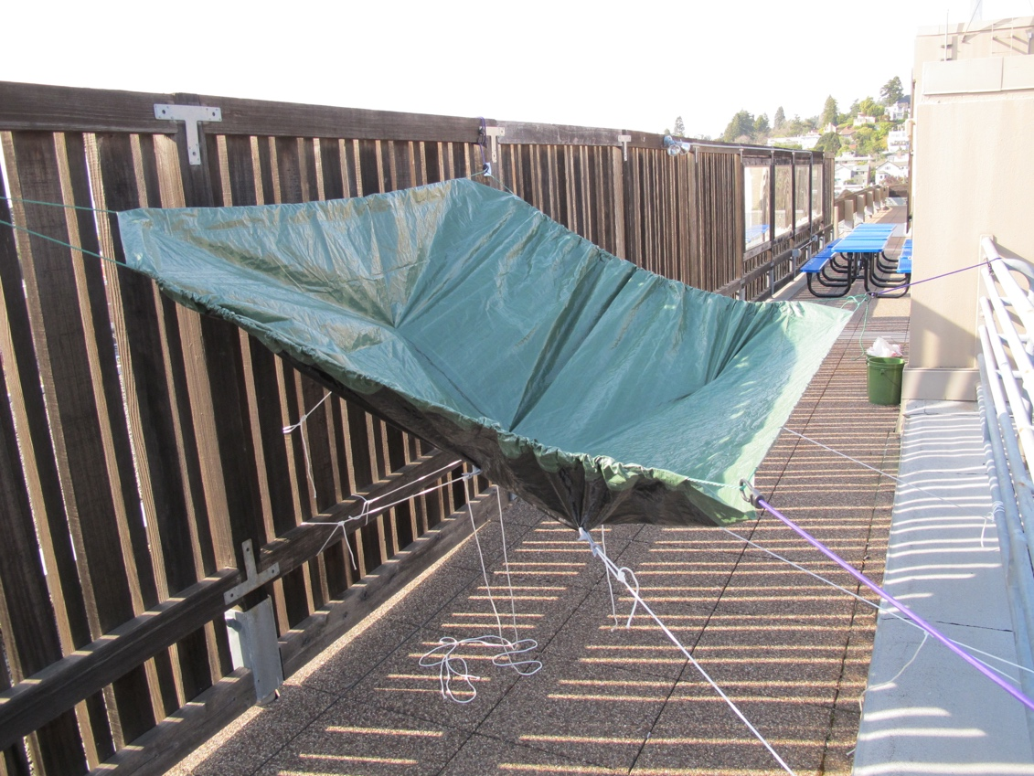
Putting data in context
Compare with natural and elective radiation levels
Effect observed? Yes
Effective dose?
Flight from SFO to Tokyo ⇒ drinking ~ 140 liters
I-131 in rain water

Slide 9
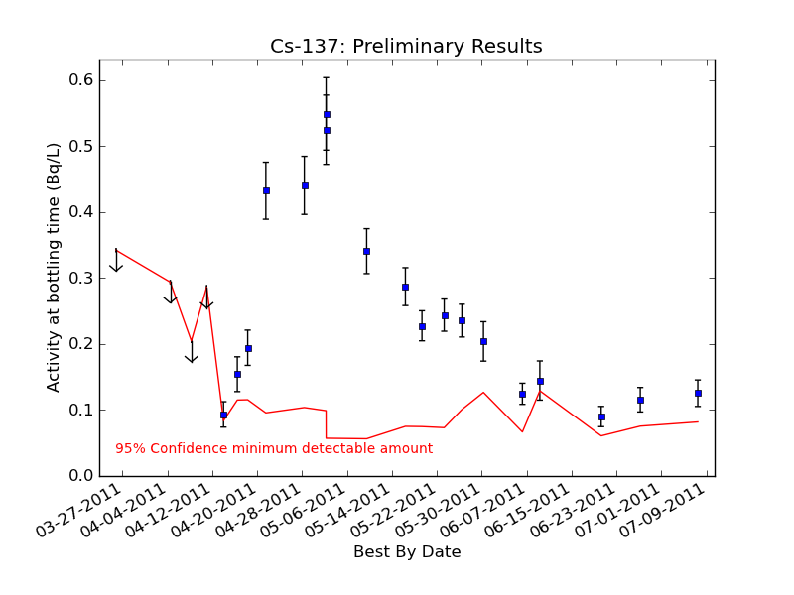
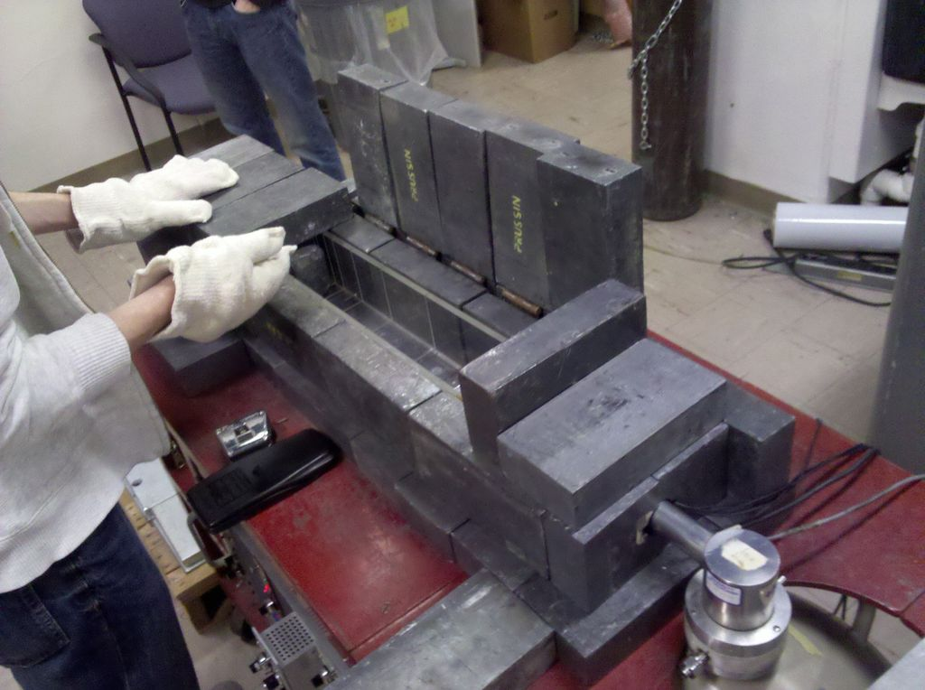
Putting data in context
Compare with natural and elective radiation levels
As compared to 50 Bq/L of K-40 in milk, naturally
Cs-137 in local milk

Slide 10
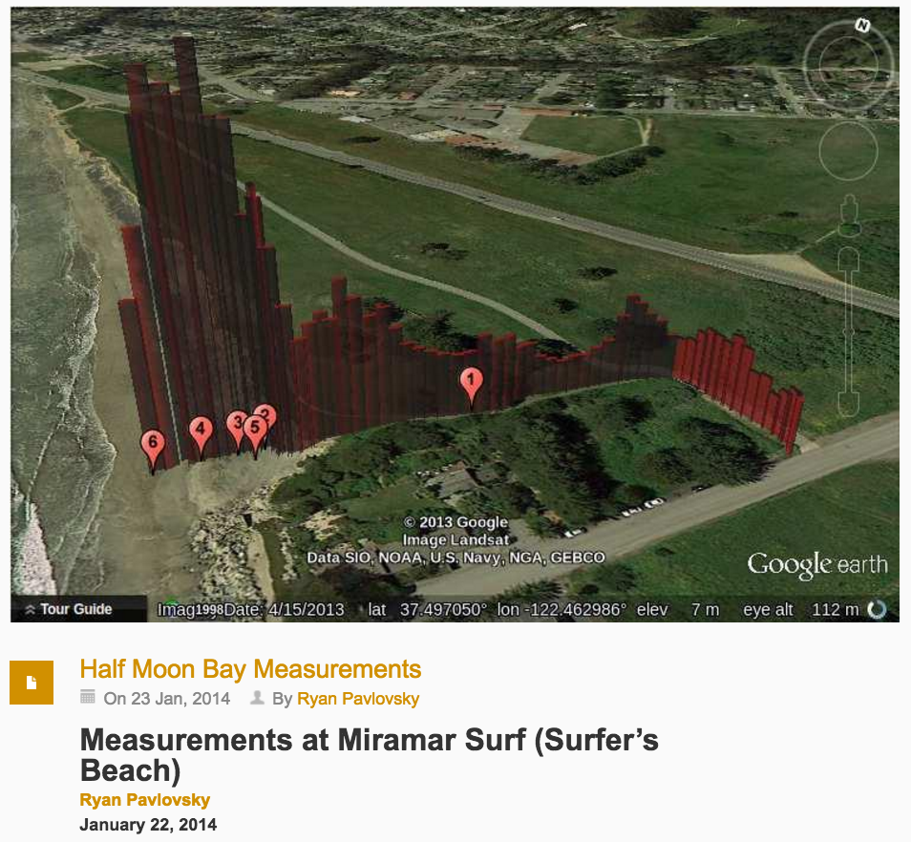
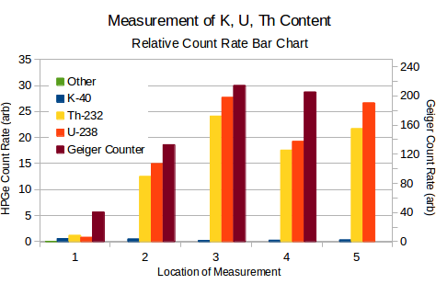
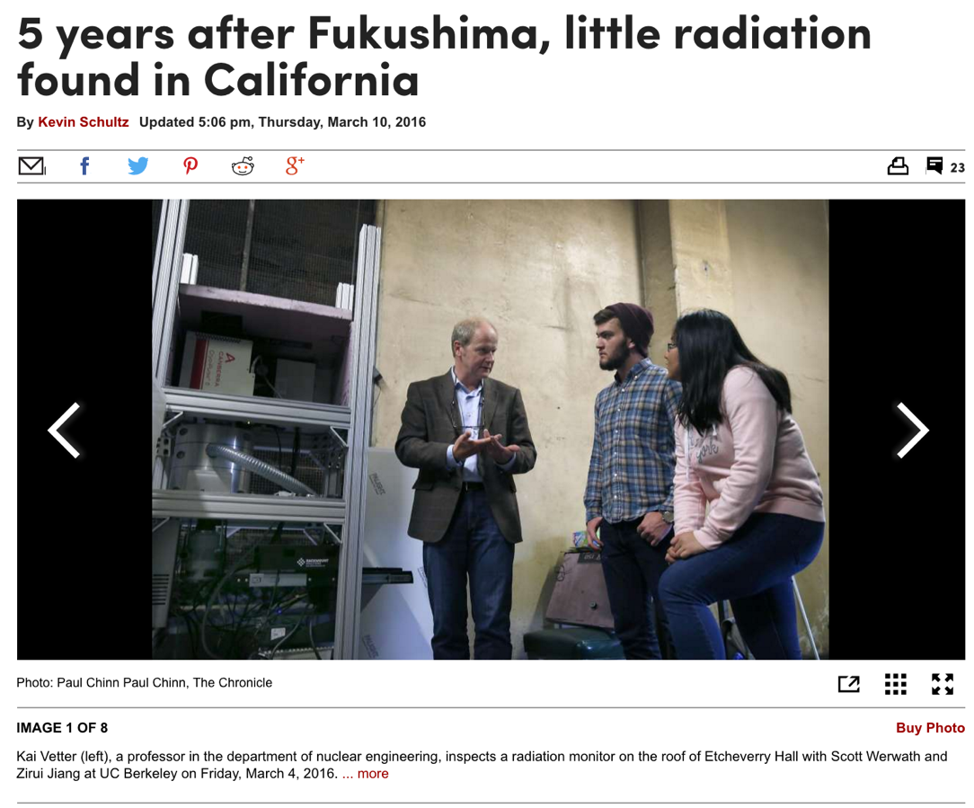
Engaging the public
Open a dialogue addressing issues in the media and building trust

Slide 11
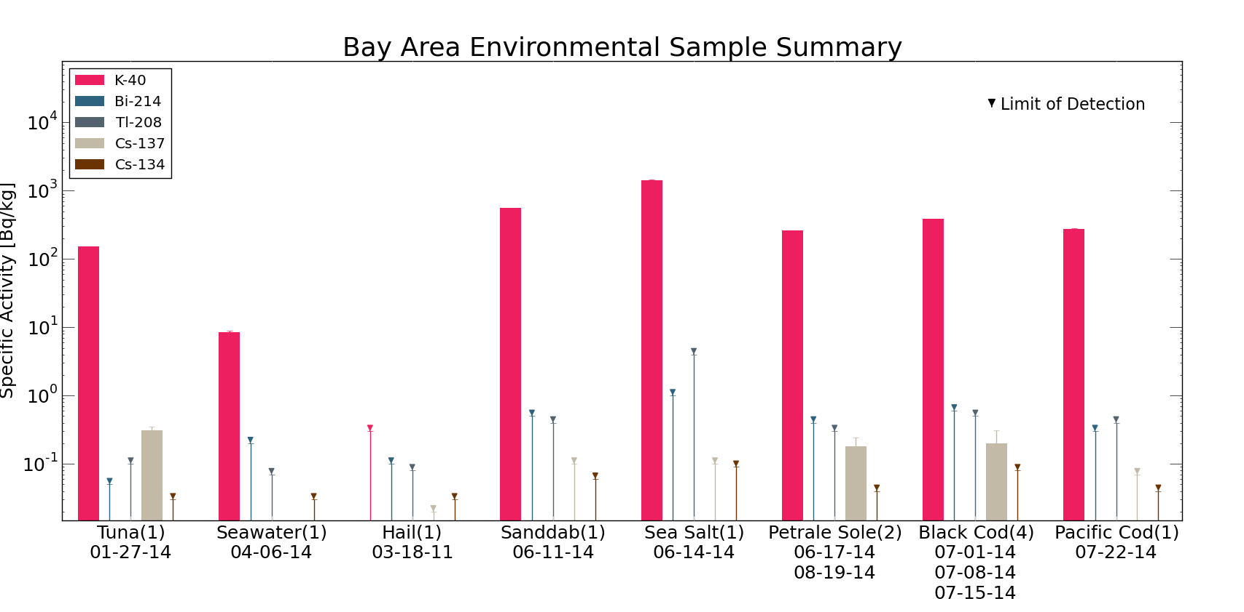
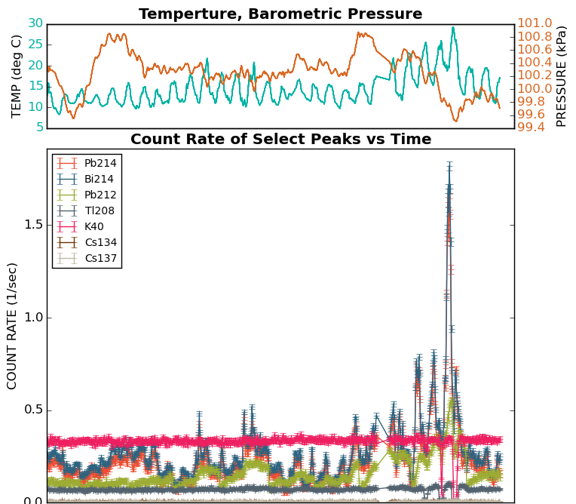
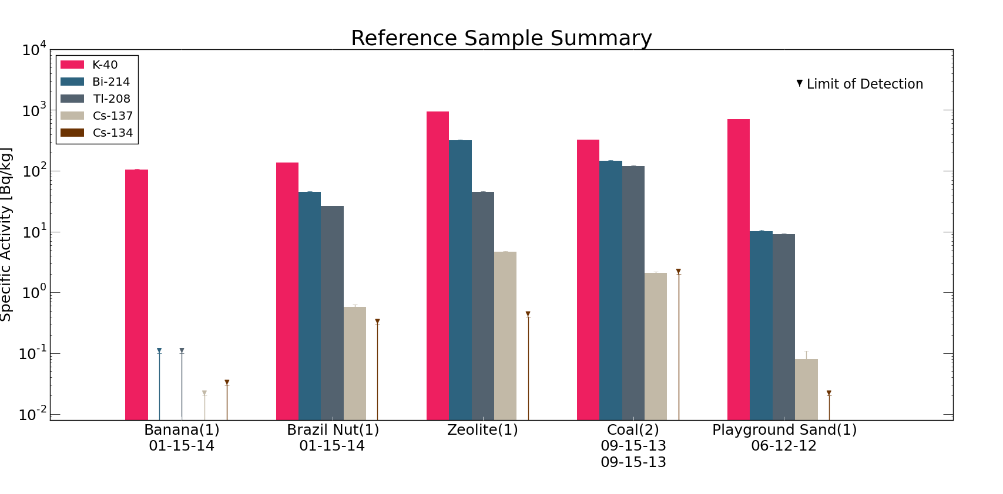
Ongoing monitoring
Air particulate and biological sample measurements

Slide 12
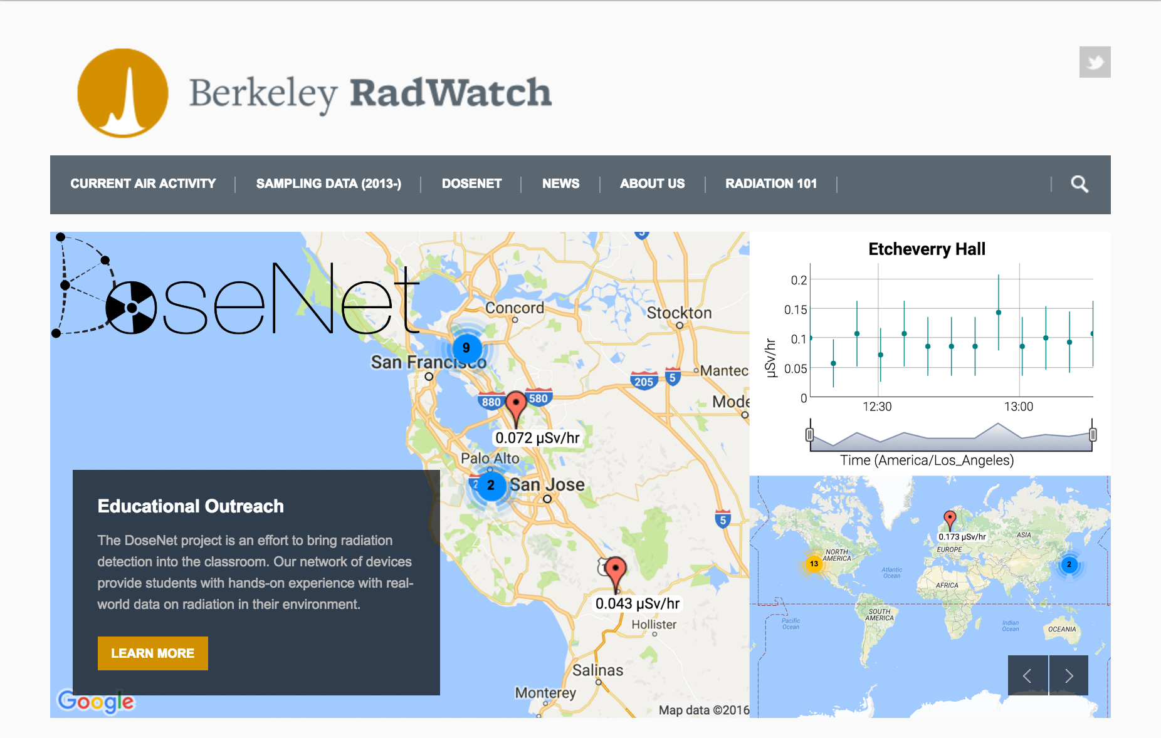
Reaching the next generation
Expanding RadWatch to engage students directly and encourage critical thinking about radioactivity in the world around us.

Slide 13
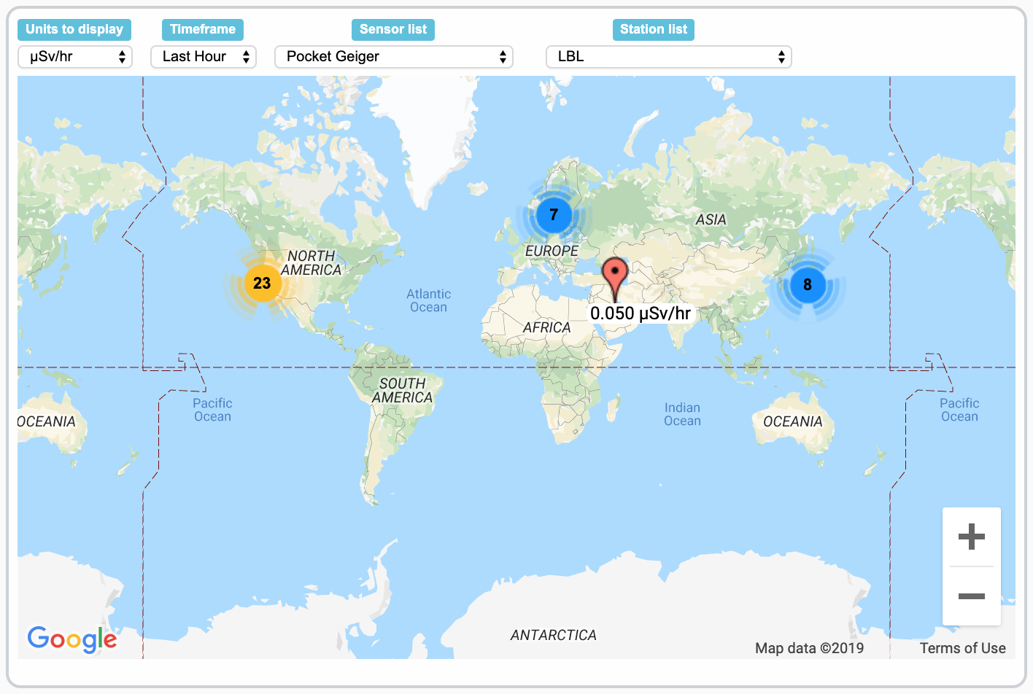
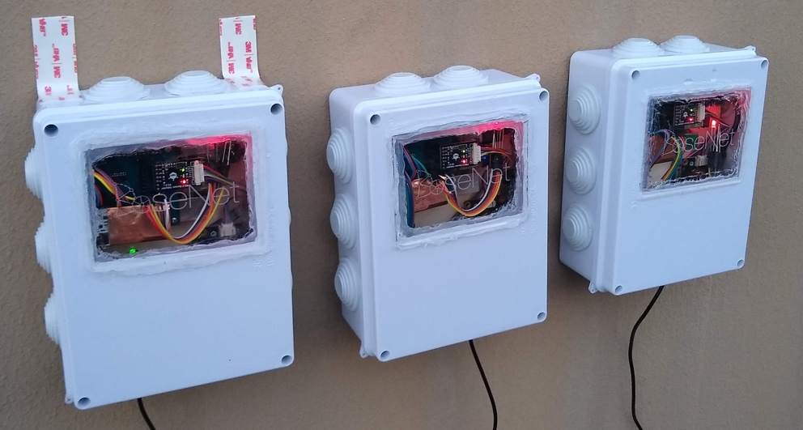
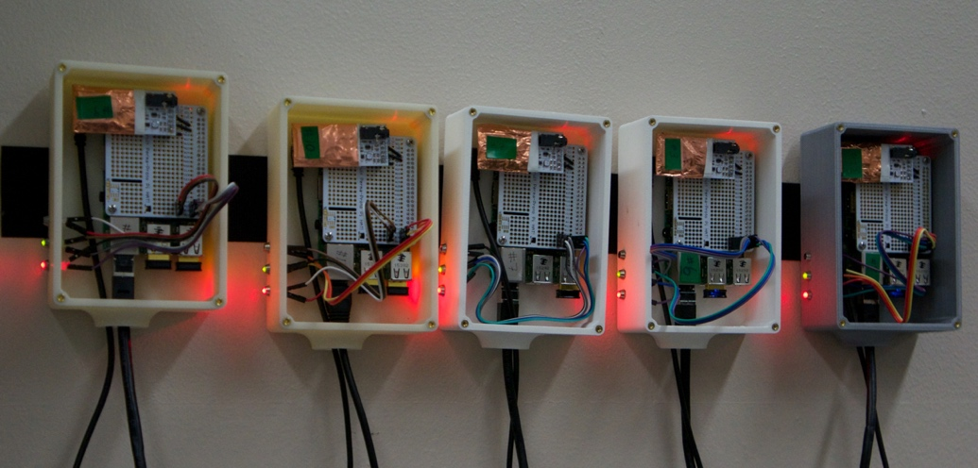
The DoseNet project
Establish a network of reliable and affordable radiation and environmental sensors providing clear and accessible measurements.

Slide 14
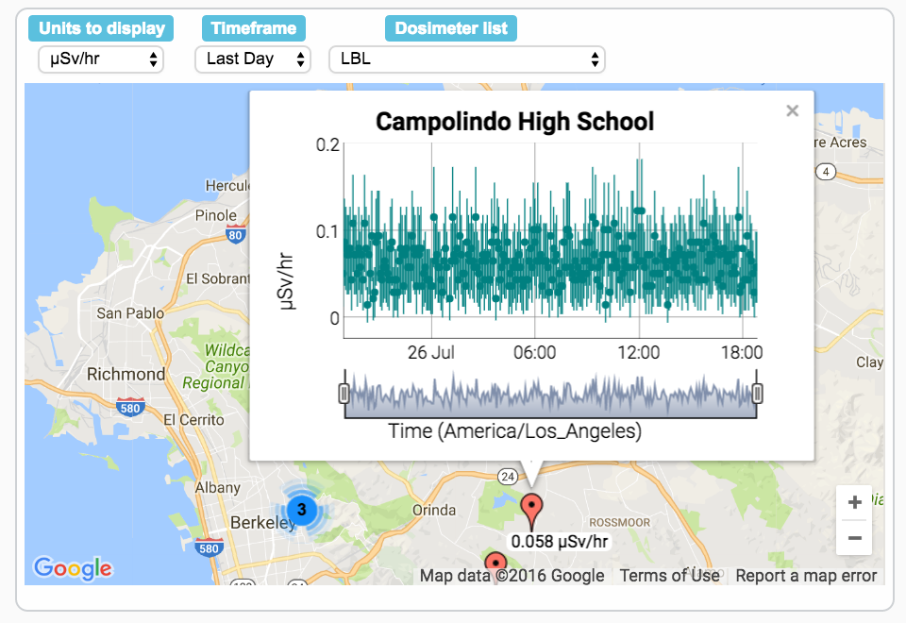
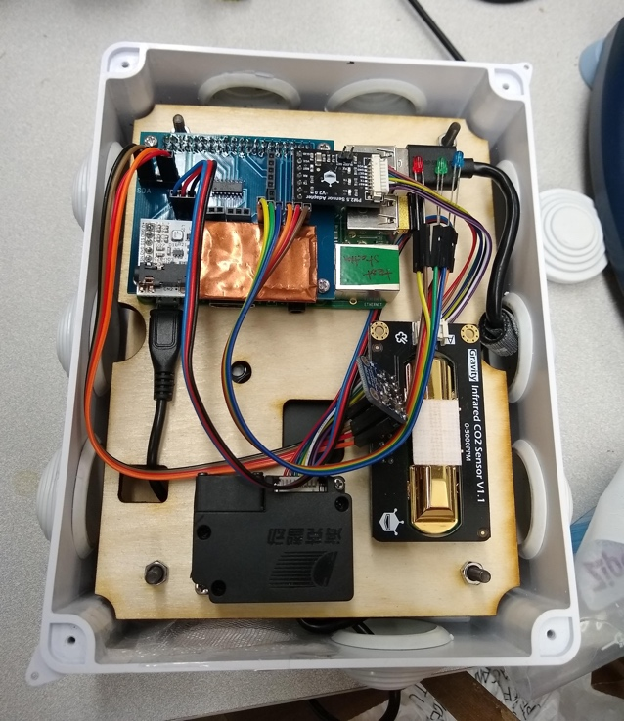
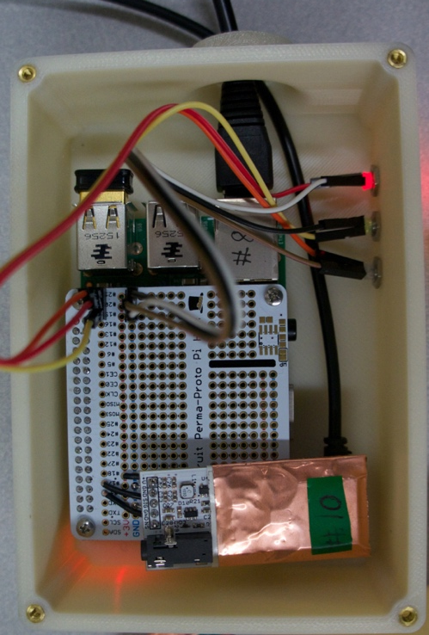
How does it work
Data server
(UCB/LBNL)
Currently using MySQL
RadWatch Web Server
(https://radwatch.berkeley.edu/)
Data linked through RadWatch:
  open to public
  interactive map
Raw data stored on our server and uploaded to the web server
RadiationWatch sensor (radiationwatch.org)
+ Raspberrypi
+ environmental sensors
All related software is open-source and available through GitHub

Slide 15
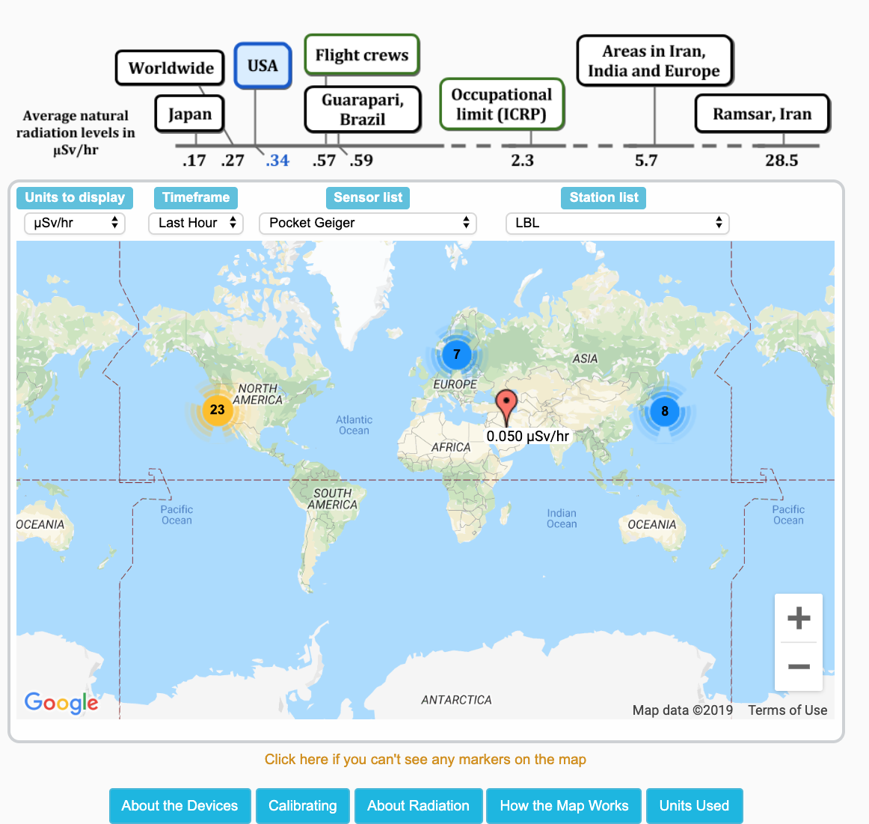
Website interface
Time Series Dose Data
history of data from each location
Range of Units:
dose rate: μSv/hr, mrem/hr
raw counts: CPM
examples of exposure: X-rays, flight time and cigarettes
Description of the unit or source with references for more info
Making sense of Dose:
Key examples of dose-rates and how they very provide context for rates seen at each location
Details of background rates and locations shown
Careful calibration of our detectors
Full description of the calibration procedure

Slide 16
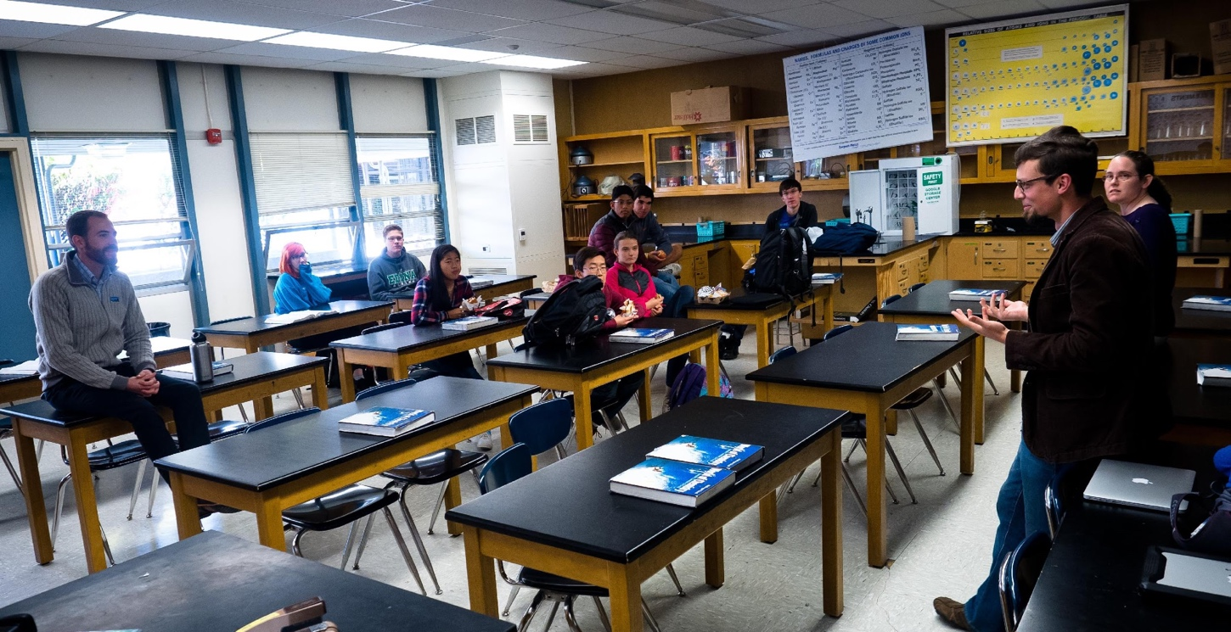
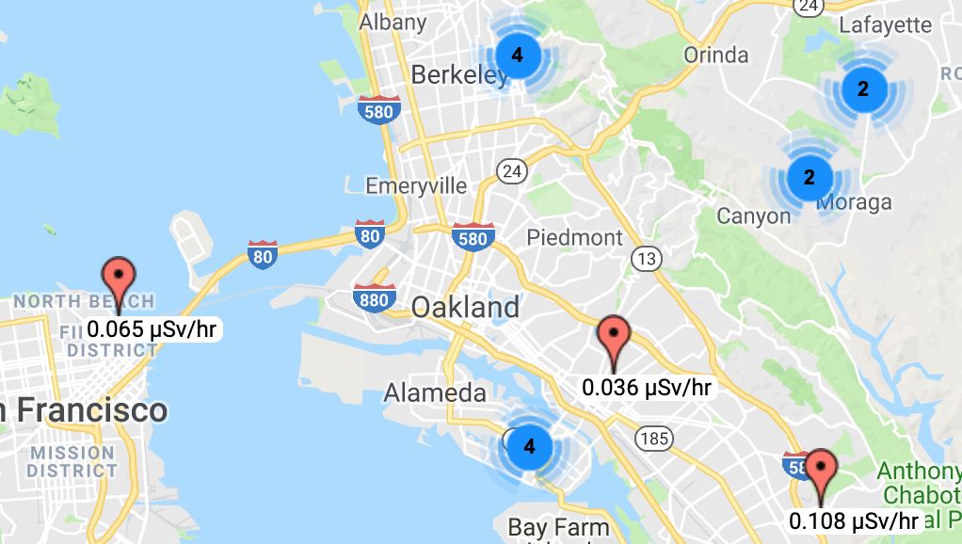
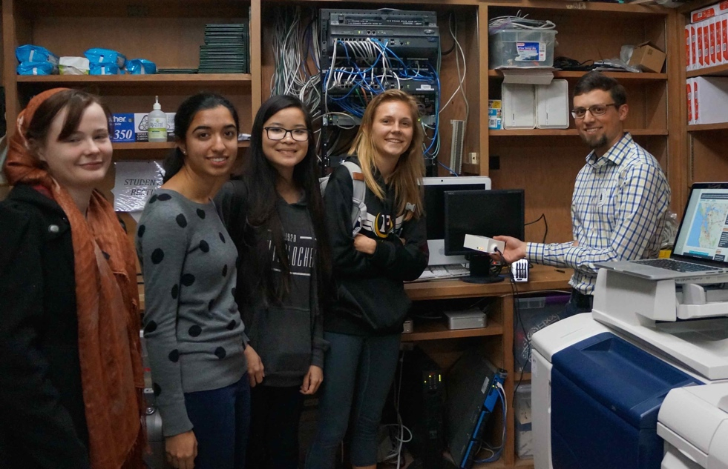
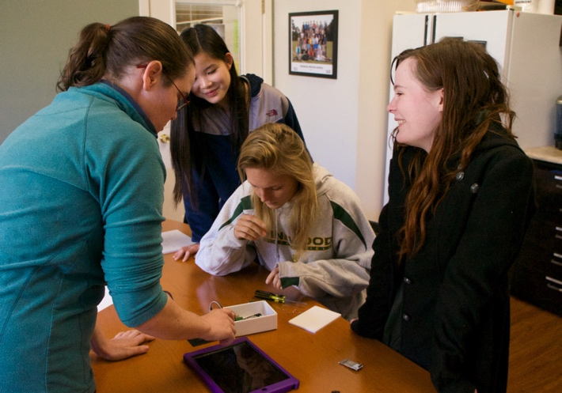
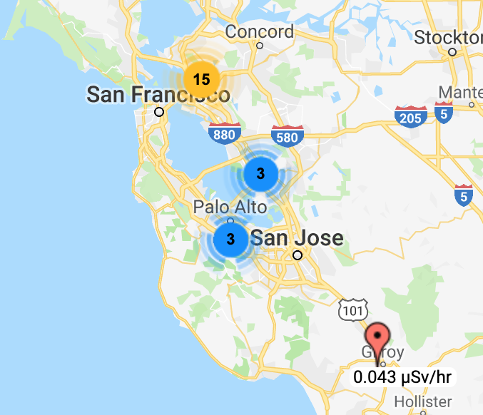
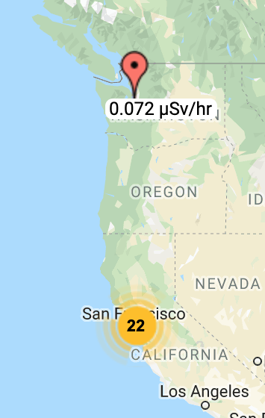
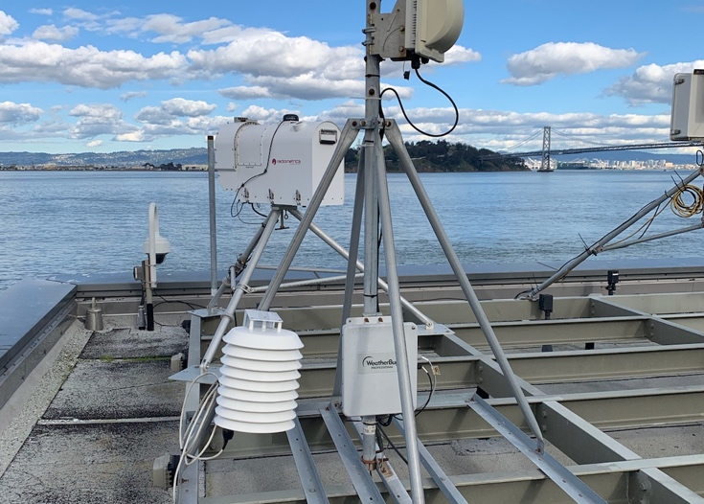

Building a community
Establish an international social network fostering collaborations of students, educators, and researchers
10+ Bay Area schools connected to UC Berkeley and LBNL

Slide 17
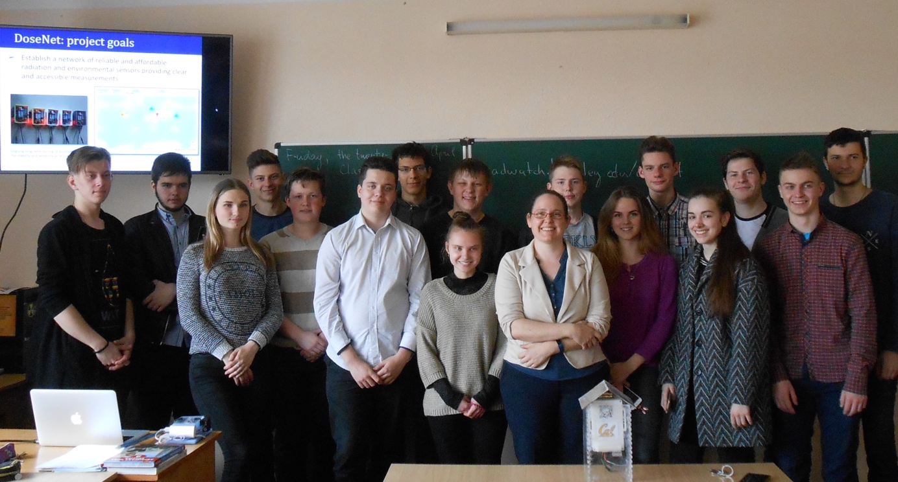
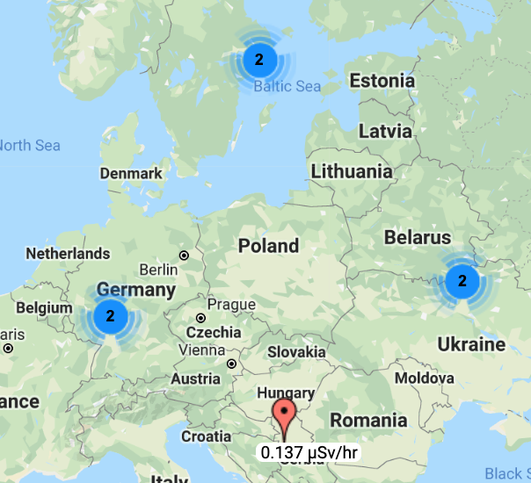
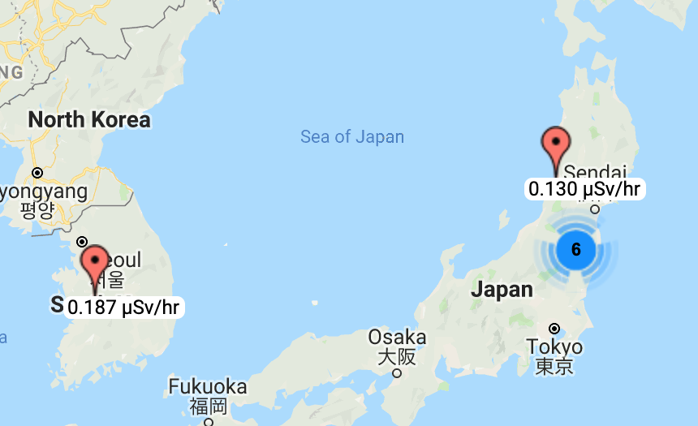
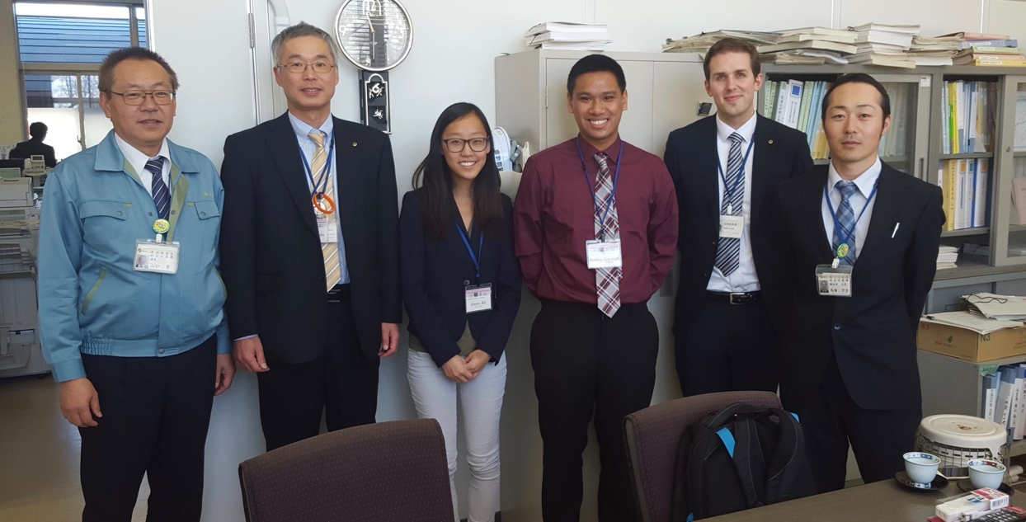
Building a community
Establish an international social network fostering collaborations of students, educators, and researchers
KTH in Stockholm connected with nearby high school
Ukraine Universities in Chernigov and Slavutych building connections with technical colleges (last two years of high school)
Have connections with JAEA, Koriyama City, and 4 Fukushima Prefecture high schools

Slide 18
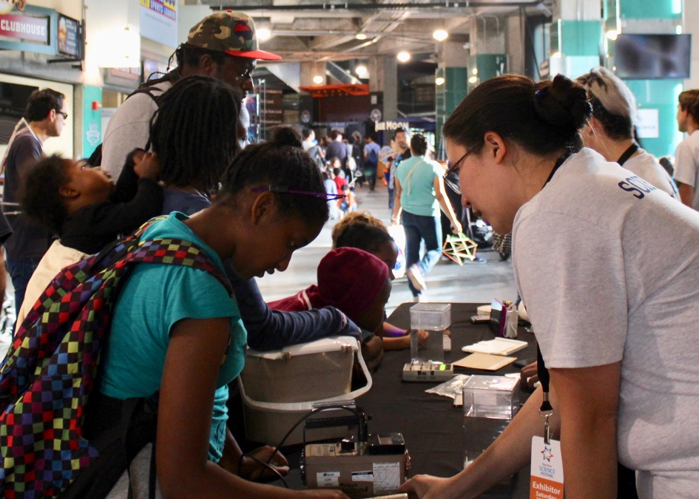
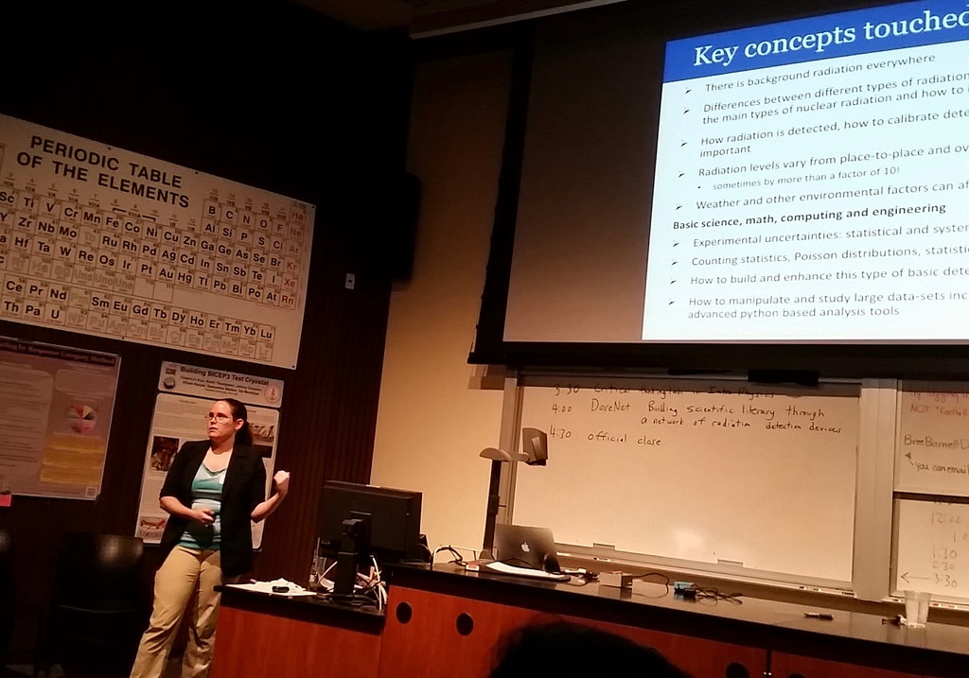
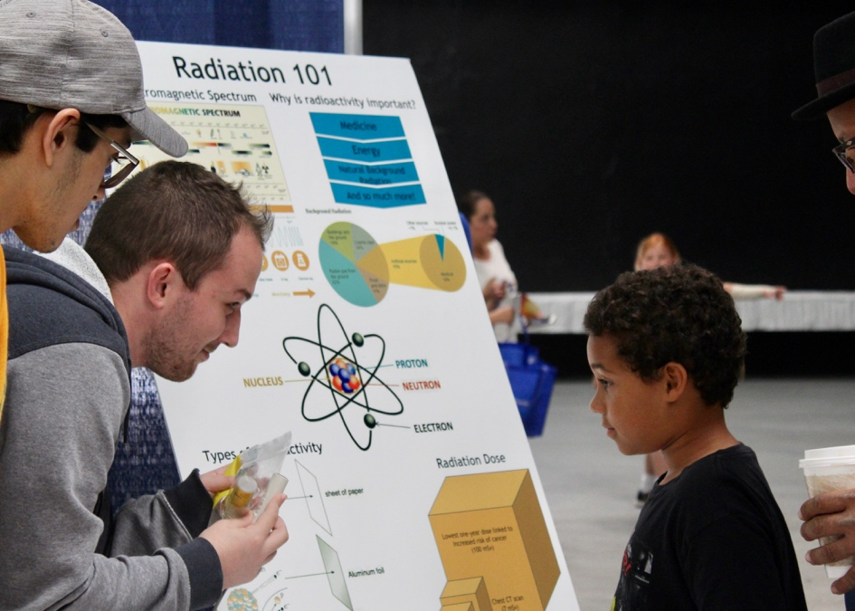
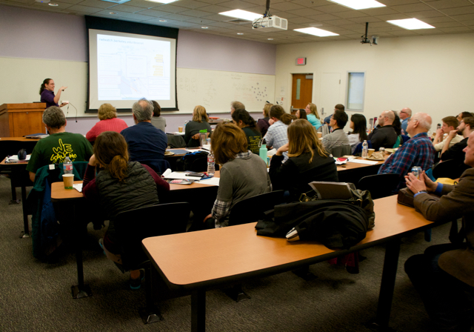
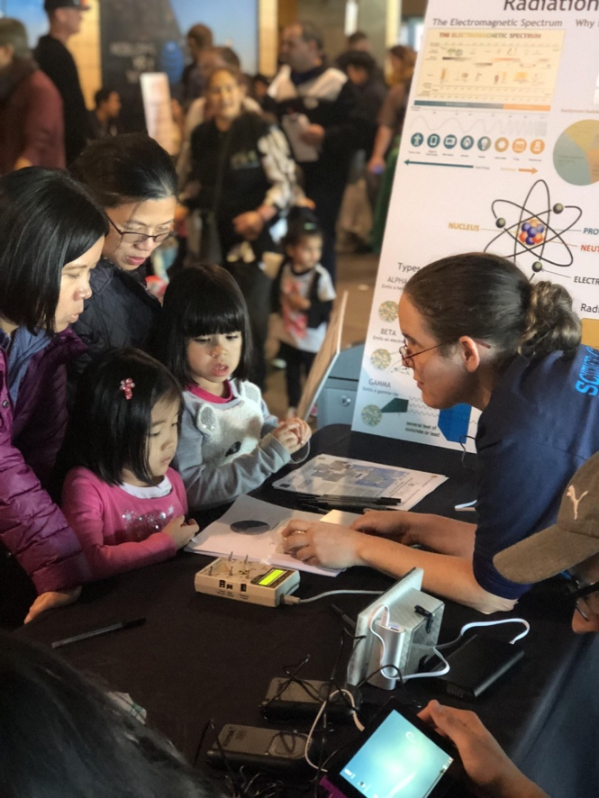
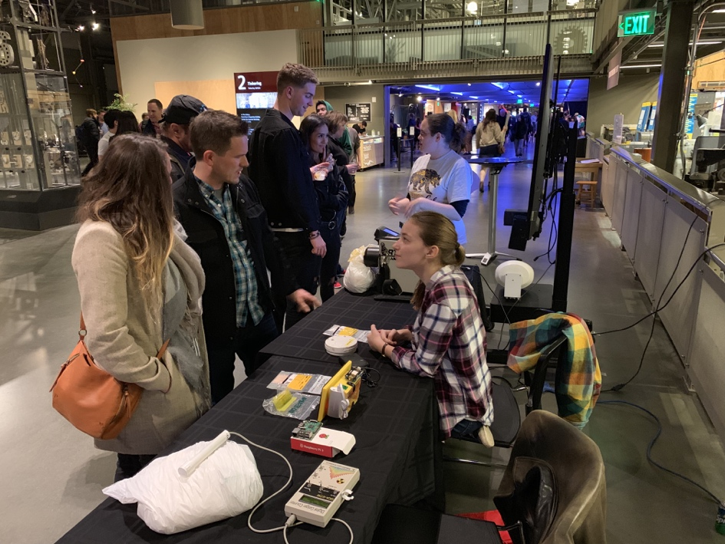
Building a community
Raise awareness with teachers and communities through workshops and science festivals

Slide 19
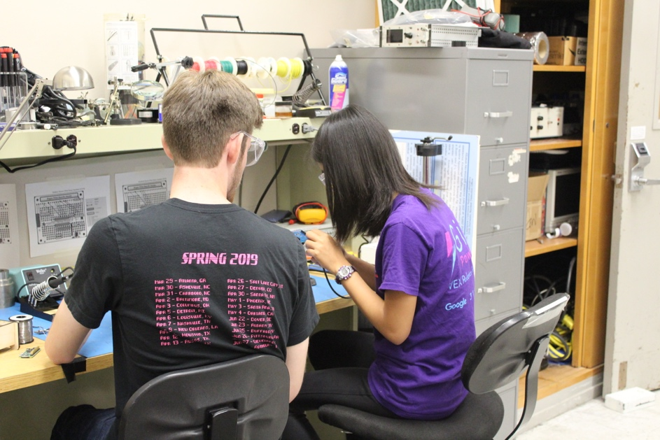
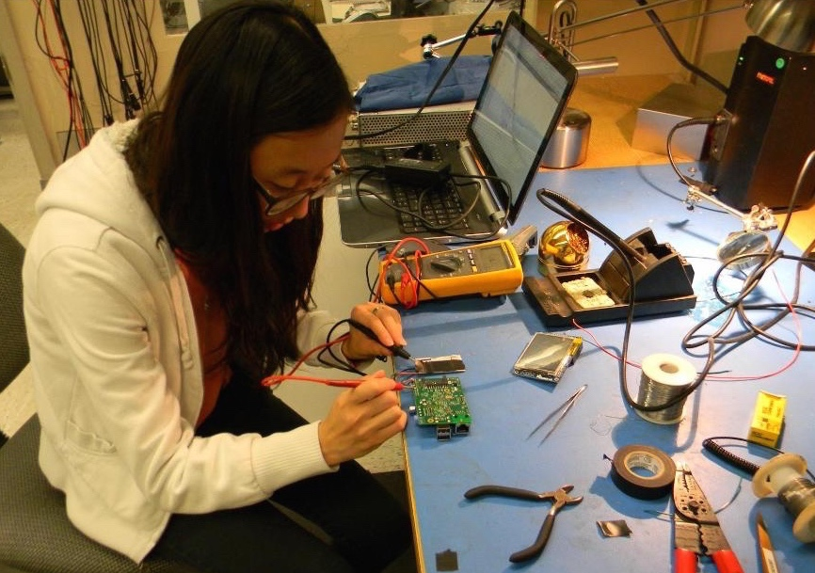
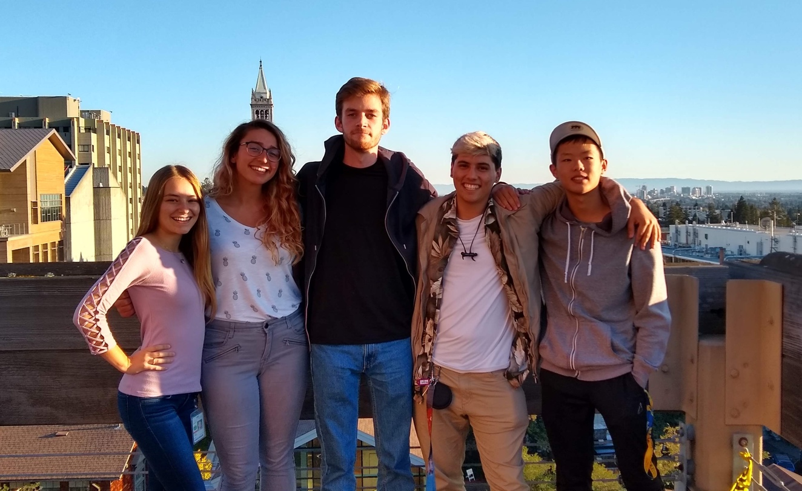
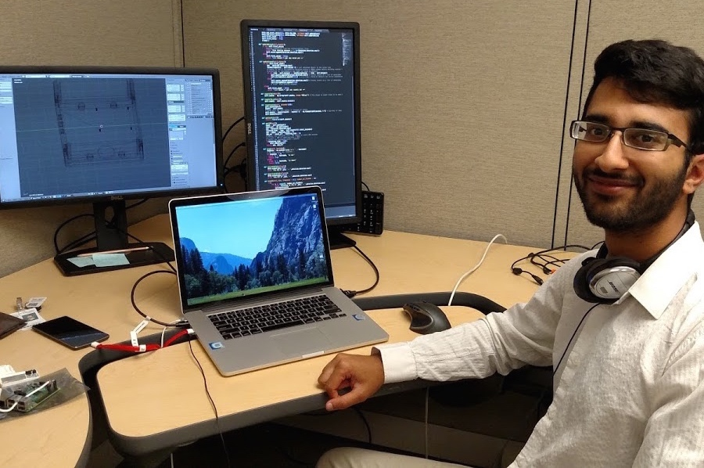
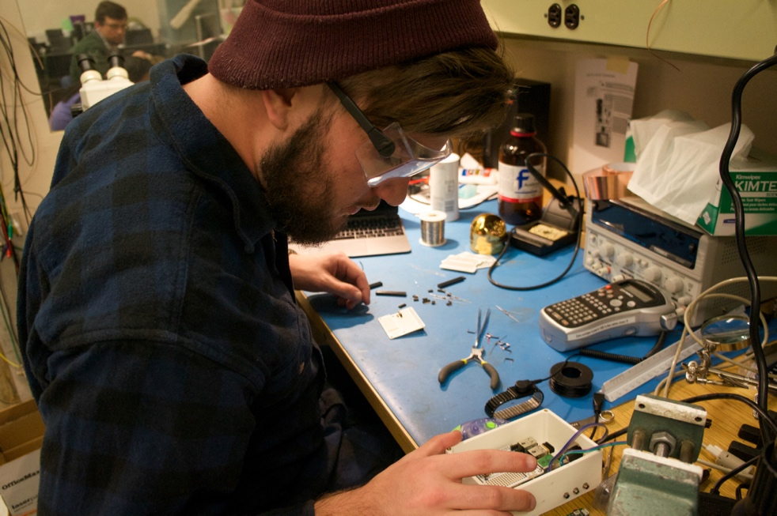
Engaging students
Undergraduates drive the project at all levels

Slide 20
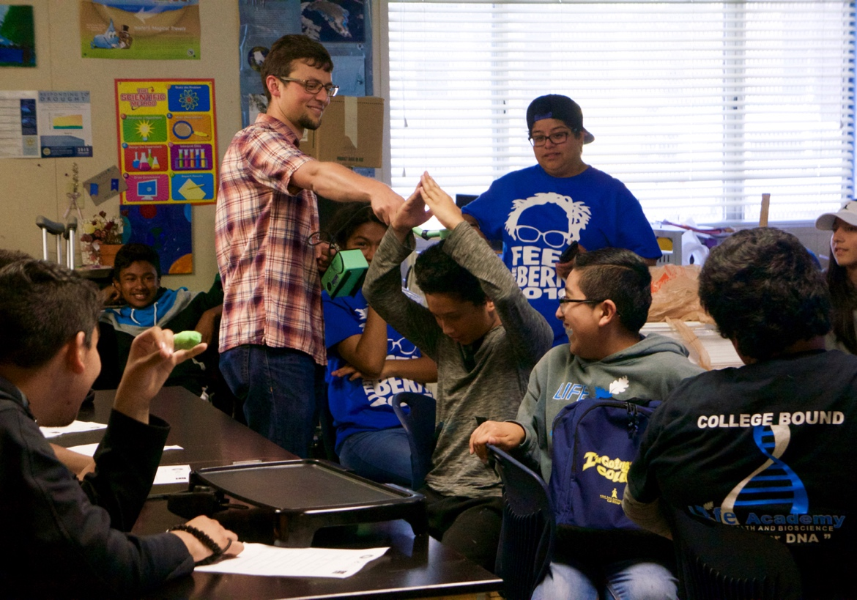
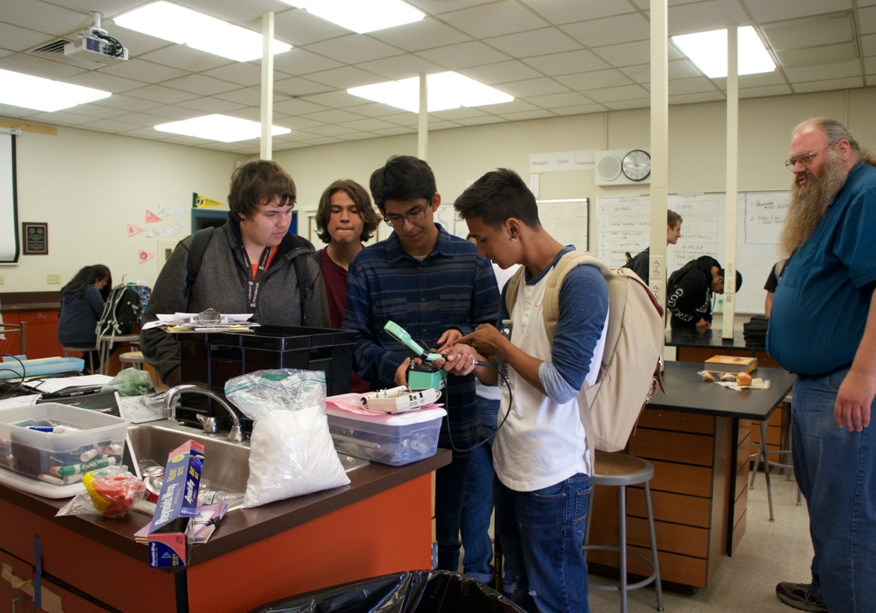



Engaging students
Demonstrations of what is and isn’t radioactive in our environment

Slide 21




Engaging students
Hands on classroom activities

Slide 22






Engaging students
High school students contribute directly to the expansion of sensors used, detector design, and data analysis tools during summer internships

Slide 23

Student Discoveries

Slide 24





Student Discoveries
Students observed and quantified differences even in our local area
Learning opportunity to demonstrate identification of different sources to explain and quantify different levels

Slide 25


Expanding network data
Learn about environmental effects
Put radiation in context
Weather Stations:
Establish model for setting up/using personal weather station at each location
Provide tools for comparing weather and radiation data
Additional sensors:
Temp, pressure, humidity
Air quality: CO₂, particulate matter (PM 2.5)

Slide 26


Expanding network data
See the “COLORS” of the gamma rays
  Demonstrate identification of isotopes contributing to measured background levels
  Address energy dependence of effective dose-rate
More advanced detector: CsI
  Energy sensitivity
  Improved statistical accuracy

Slide 27


Summer Internship – year 1
Added environmental sensor data and made our systems portable
Silicon counter
CsI spectrometers
Air quality
CO₂

Slide 28





Summer Internship – year 1
Compare sensors to understand systematic effects
CO₂
T/P/H
Explore basic linear and non-linear correlations

Slide 29









Integrated sensor system
CO₂
CsI
2.5 PM
Si counter
T/P/H

Slide 30




Summer internship – 2nd year
What can we “discover”?
- Should see major temporal effects from Radon daughters
CsI
Si counter
Unique features of Bay Area may require additional information – weather station data

Slide 31





Summer internship – 2nd year
Are we sensitive to impact on Radon from rain/wind?

Slide 32




Summer internship – 3rd year
pi-zero
GPS
+
GPS integration
Improved portability

Slide 33

Next steps
big data in the classroom
Use our existing tools and understanding of data quality to build interactive learning modules
Give students introduction to real scientific exploration of large data sets and the corresponding data science tools
Cross-cutting curriculum integrating physics, environmental science, statistics, and computer programming
Open source, interactive data science and scientific computing across over 40 programming languages.
multiuser version designed for centralized deployments

Slide 34
Next steps
International internships
Collaborations with high schools in Japan, Sweden, S. Korea, and more recently with France and South Africa, that we hope to turn into opportunities for students to work together across our network

Slide 35
Next steps
Introductory undergraduate course
Give 1st and 2nd year science and engineering students hands-on experience
  building an environmental sensor system
  interfacing using microcontroller components – providing exposure to basics in electronics and signal processing
  Proposing and performing research – developing the statistical analysis and programming skills needed to collect and analyze real data

Slide 36
Thank you!

