Slide 1
From Physical Principles to Prediction of Water and Energy Fluxes over the Earth Surface
Jingfeng Wang
School of Civil and Environmental Engineering
Georgia Institute of Technology
Workshop on Applications of Cosmic Ray Measurements
Georgia State University
October 05, 2019

Slide 2
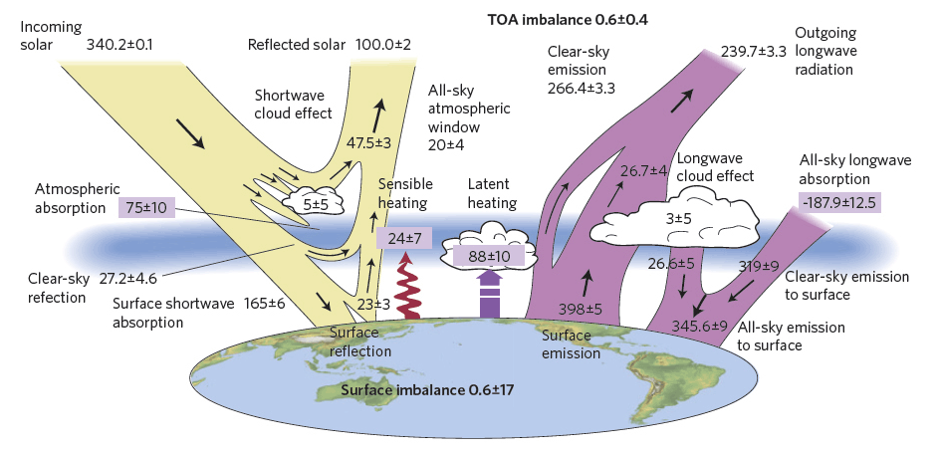
H
E
all fluxes in W m⁻²
Stephens et al., An update on Earth's energy balance in light of the latest global observations, Nature Geoscience, 5, 691–696 (2012).

Slide 3
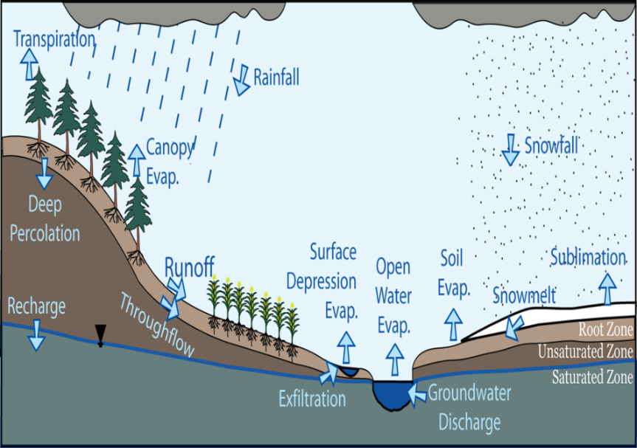
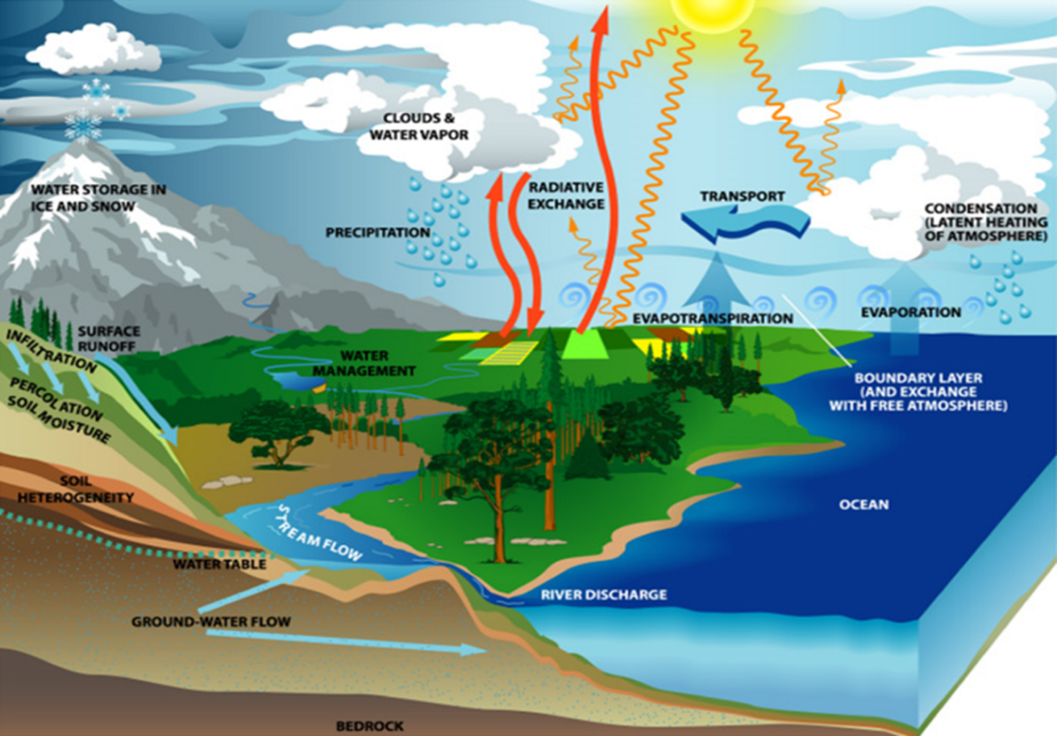
Watershed Scale
Global Scale
Notes:
Hydrology has been transformed in the past decades from watershed scale to global scale. This trend brings both challenges and opportunities. Classical Models of hydrological processes, especially water-energy and carbon fluxes, at watershed scale have difficulties in monitoring and modeling these processes at global scale. Data collect at ground stations are rarely available at remote areas and almost non-existence over oceans. Hydrologists must use remote sensing observations to monitor surface fluxes of water, heat and mass such as CO2.

Slide 4
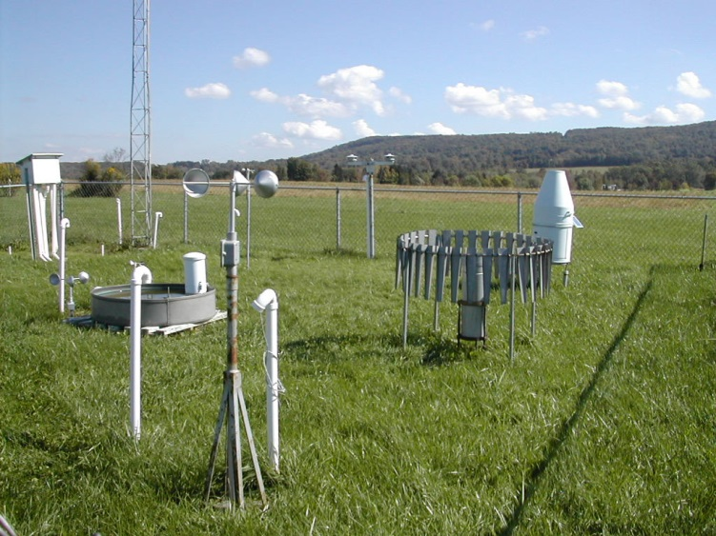
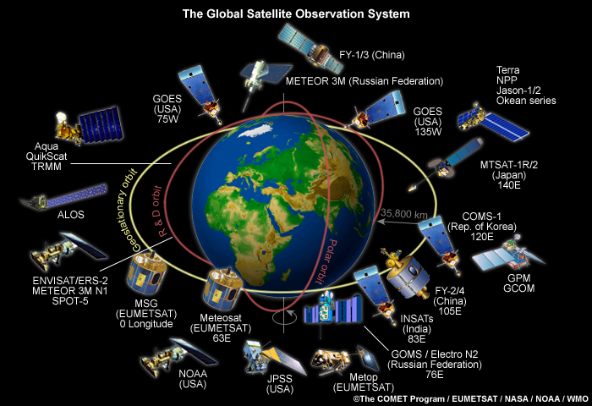
Ground Station
Satellites
Notes:
Remote sensing observations cover large regions, but have limitation on variables that can be measured and their space-time resolution.

Slide 5
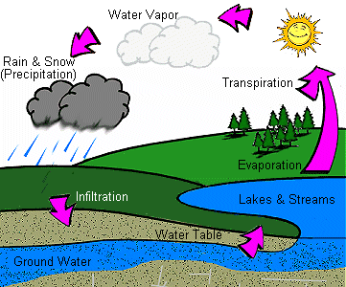
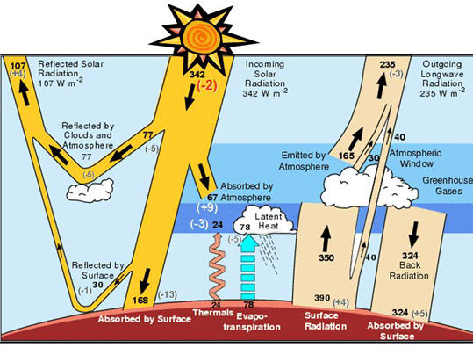
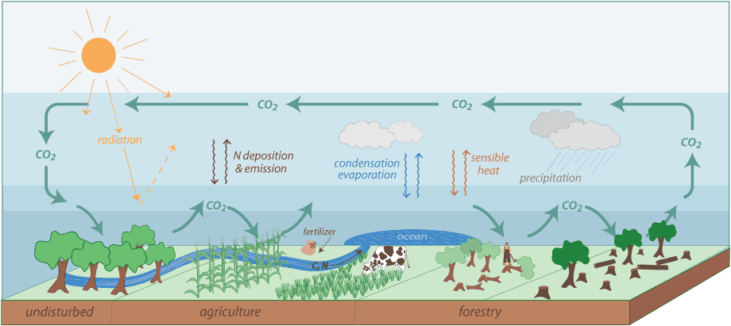
water cycle
energy cycle
Evapotranspiration (ET)
carbon cycle
photosynthesis-transpiration

Slide 6
Maximum Principle of Evapotranspiration (MaxET)
Land-atmosphere interactive processes lead to such thermal and water states of the land surface that evapotranspiration is maximized in a given meteorological environment.
(Wang et al., WRR, 2004; Wang et al., JGR, 2007)
Notes:
Among all hydrological processes, ET stands out as the unique one – it is at the cross-road of water, energy and carbon cycle. It is arguably the most challenging to monitor and model. I was very surprised and disappointed, when I started my doctoral study a quarter century ago, that the most advanced theory Penman model is nothing more than a combination of conservation of energy with an empirical water vapor flux-water vapor gradient equation.

Slide 7
Stationary Principle of Heat Fluxes (dry soils)
Land-atmosphere interactive processes lead to such thermal states of dry land surface that partition of net radiation into sensible and ground heat flux at a saddle-point in a given meteorological environment.
(Wang and Bras, WRR, 2009)
Notes:
Among all hydrological processes, ET stands out as the unique one – it is at the cross-road of water, energy and carbon cycle. It is arguably the most challenging to monitor and model. I was very surprised and disappointed, when I started my doctoral study a quarter century ago, that the most advanced theory Penman model is nothing more than a combination of conservation of energy with an empirical water vapor flux-water vapor gradient equation.

Slide 8
Minimum Principle of Turbulence
At a given height within an atmospheric surface layer, momentum flux reaches such values that minimize (negative) heat flux and wind shear under stable condition; while minimize (positive) heat flux and temperature gradient under unstable condition.

Slide 9
The new physical principles,
Maximum Principle of ET
Stationary Principle of Heat Fluxes
Minimum Principle of Turbulence
open new opportunities to modeling ET and heat fluxes.
Notes:
Use of the physical principles:
Diagnostic analysis of other Et and fluxes models: satisfying the stationary conditions.
Advantages: tests of the hypotheses do not require specification of ET and heat fluxes models, principles are general,
Disadvantages: they cannot predict he fluxes (not ET and heat fluxes models)

Slide 10
Physical Processes of ET
Solar and longwave radiation,
Dynamics of soil moisture,
Turbulent transport of water vapor and heat,
Thermodynamics of water phase change,
Plant physiology,

Slide 11
The Project for Intercomparison of Land-surface Parameterisation Schemes (PILPS)
“… no single land surface model is capable of capturing all features of the surface energy balance under all conditions …”
(Desborough et al., 1996; Henderson-Sellers et al., 2003)

Slide 12
Physically-based Methods
Bulk transfer

Slide 13
Bulk Transfer Models
H, E surface turbulent latent and sensible heat flux,
T_{s}, T_{a} surface, air and soil temperature,
q_{s}, q_{a} surface and air humidity,
C_{H}, C_{E} transfer coefficients

Slide 14
Physically-based Methods
Bulk transfer
Penman

Slide 15
Penman Model
γ: psychomatric constant
Δ: slope of saturated vapor pressure

Slide 16
Bulk Transfer Model
Lack of conservation of energy,
Measurement errors of bulk gradients,
Uncertainties of (wind speed and roughness lengths dependent) transfer coefficients,
Modeling errors of bulk transfer formulae (semi-empirical 1st order closure of Reynolds decomposition of turbulent flow).

Slide 17
Penman Model
Valid only for saturated soils,
Uncertainties of (wind speed and roughness lengths dependent) transfer coefficients,
Modeling errors of bulk transfer formulae (semi-empirical 1st order closure of Reynolds decomposition of turbulent flow).

Slide 18
Maximum Entropy Production (MEP) Model
Bayesian probability theory (calculus of inductive logic),
Information theory (Shannon information entropy - quantitative measure of missing information),
Atmospheric Boundary Layer Turbulence Theory (Monin-Obukhov similarity theory),
Maximum Entropy (MaxEnt) Principle (method of assigning probability distributions),
Maximum Entropy Production (MEP) Principle (application of MaxEnt to non-equilibrium thermodynamic systems).

Slide 19
Information Entropy
(Shannon, 1948)
the probability of a “random variable” x
in i^{th} state, .
Notes:
Major drawbacks of bulk transfer method include … The problem is especially severe for E, an energy driven process with four basic elements (supply of energy, supply of water, fugacity and transfer mechanisms).

Slide 20
Maximum Entropy (MaxEnt) Principle (Jaynes, 1957): Out of all the possible probability distributions which agree with the given constraint information, select the one that is maximally non-committal with regard to missing information.
$\vec{λ}$ Lagrange Multipliers; $\vec{F}$ constaints
Notes:
Major drawbacks of bulk transfer method include … The problem is especially severe for E, an energy driven process with four basic elements (supply of energy, supply of water, fugacity and transfer mechanisms).

Slide 21
MaxEnt to Equilibrium Thermodynamics
(Tribus, 1961)
1st law of thermodynamics
Notes:
Major drawbacks of bulk transfer method include … The problem is especially severe for E, an energy driven process with four basic elements (supply of energy, supply of water, fugacity and transfer mechanisms).

Slide 22
MaxEnt to Non-equilibrium Thermodynamics
- Maximum Entropy Production Principle
(MEP/MaxEP) (Dewar, 2003, 2005, 2014)
Notes:
Major drawbacks of bulk transfer method include … The problem is especially severe for E, an energy driven process with four basic elements (supply of energy, supply of water, fugacity and transfer mechanisms).

Slide 23
“MaxEnt is equivalent to an extremal selection criterion of (macroscopic fluxes), i.e. MEP”
C: macroscopic physical constraints on $\vec{F}$
Notes:
Major drawbacks of bulk transfer method include … The problem is especially severe for E, an energy driven process with four basic elements (supply of energy, supply of water, fugacity and transfer mechanisms).

Slide 24
$I(\vec{F})$ is equivalent to
physical variables thermodynamic entropy production and mechanical energy dissipation (Dewar and Maritan, 2014) and MEP as a physical principle;
Notes:
Major drawbacks of bulk transfer method include … The problem is especially severe for E, an energy driven process with four basic elements (supply of energy, supply of water, fugacity and transfer mechanisms).

Slide 25
$I(\vec{F})$ is equivalent to
physical variables thermodynamic entropy production and mechanical energy dissipation (Dewar and Maritan, 2014) and “MEP” viewed as a physical principle;
non-physical variables (Wang and Bras, 2011) and “MEP” treated as an inference algorithm.
Notes:
Major drawbacks of bulk transfer method include … The problem is especially severe for E, an energy driven process with four basic elements (supply of energy, supply of water, fugacity and transfer mechanisms).

Slide 26
thermal
inertia
(Wang and Bras, 2009; 2011)

Slide 28
Monin-Obukhov similarity equations for the atmospheric boundary layer turbulence (Wang and Bras, 2010),

Slide 29
surface specific humidity
surface temperature
α,β,γ₂ : universal empirical constants in the M-O similarity equations [Businger et al, 1971].

Slide 30
C:
Max: maximal irreversibility or farthest to equilibrium
Min: minimal irreversibility or closest to equilibrium
Notes:
Major drawbacks of bulk transfer method include … The problem is especially severe for E, an energy driven process with four basic elements (supply of energy, supply of water, fugacity and transfer mechanisms).

Slide 31
Surface Energy Budgets
Land
Water
Notes:
Gradient variables have large measurement errors, especially those derived from remote sensing observations.

Slide 32
MEP Model for land Surface
(Wang and Bras, 2011)

Slide 33
MEP Model of Transpiration

Slide 34
MEP Model for Water-Snow-Ice Surface
(Wang et al, 2014)

Slide 35
 | Surface Energy Budget | Input data | Model Parameters | Modeling Error
Penman Method | Balanced | Air temperature, humidity, ground heat flux | Wind speed, roughness lengths, etc. | Semi-empirical (first order closure)
Bulk Method | Not balanced | Temperature & moisture gradient | Wind speed, roughness lengths, etc. | Semi-empirical (first order closure)
MEP Method | Balanced | Not used | Not used | First-principles (MaxEnt, MEP, MOST) constrained by radiation data

Slide 36
Physical Processes of ET
Solar and longwave radiation: energy balance equation
Dynamics of soil moisture: thermal inertia I_{s}, surface specific humidity q_{s}
Boundary-layer turbulence: thermal inertia I₀
Phase-change thermodynamics of water: $σ(Ts,qs)$
Plant physiology: q_{s}

Slide 37
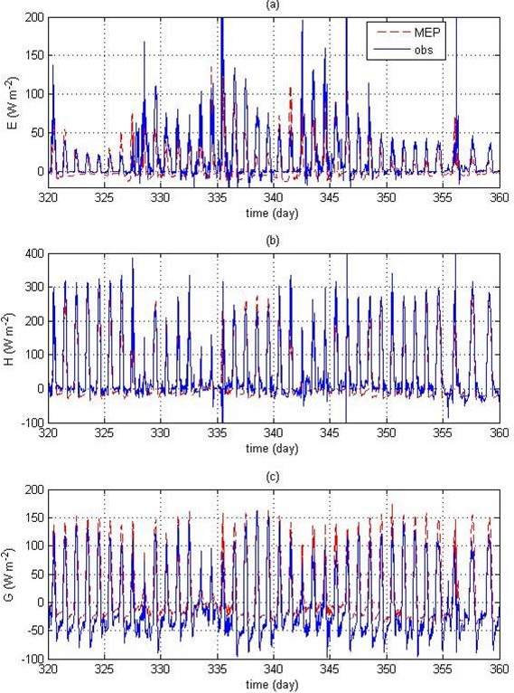
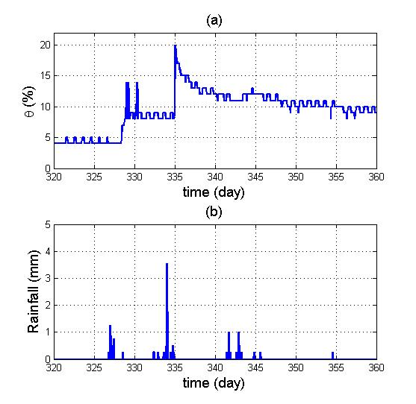
Bare Soil
Lucky Hills site of the Walnut Gulch Experimental Watershed during 11/16 – 12/26, 2007.

Slide 38
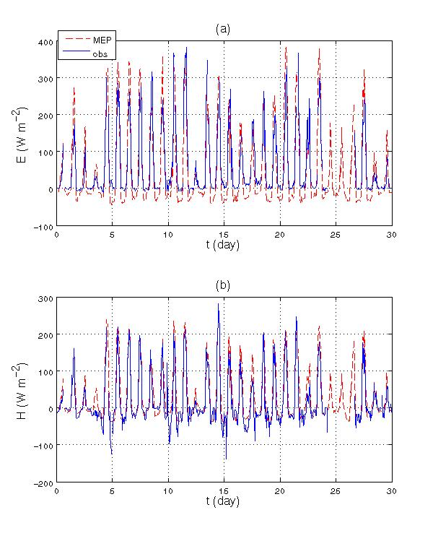
Canopy
Harvard Forest site during 19 August - 18 September 1994.

Slide 39
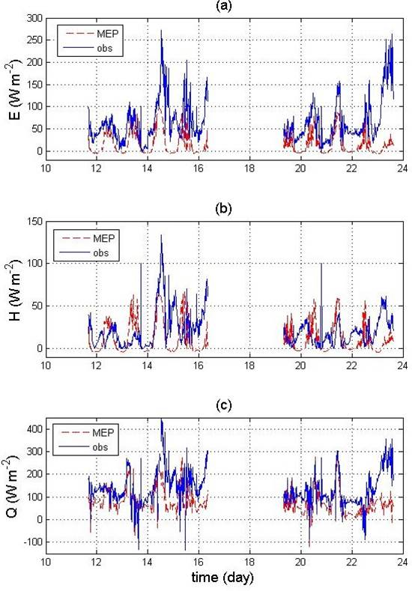
Water
NOrthern hemisphere climate Processes field Experiment (NOPEX) that made eddy-covariance measurements turbulent fluxes over Lake Raksjo (1.5 km² in surface area and 4m in depth) during June and July of 1994.
(Data courtesy of Sven Halldin).

Slide 40
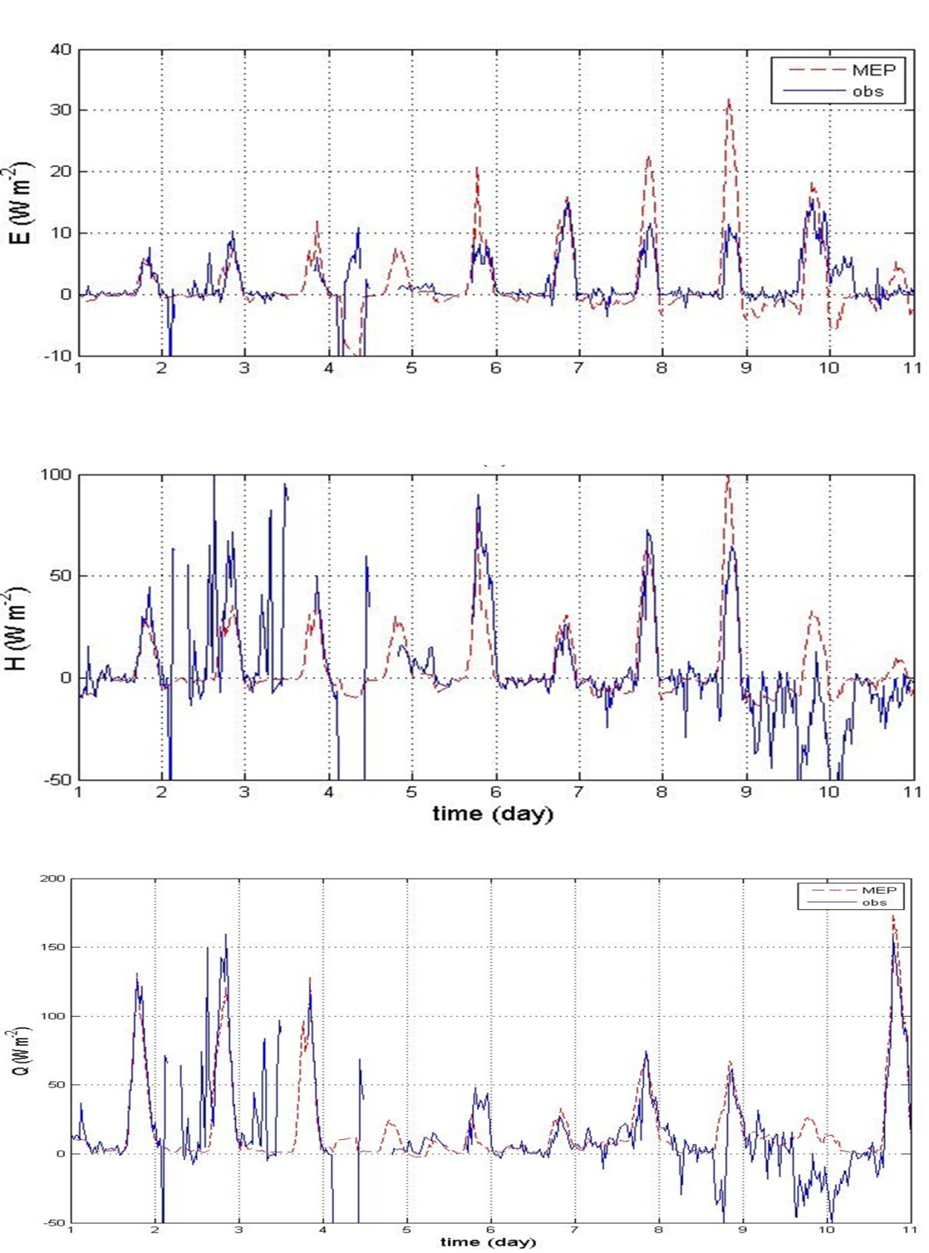
Snow
FLUXNET eddy-covariance data of surface fluxes and meteorological variables collected at a snow covered grassland site in Lethbridge, Alberta, Canada (AB-GRL) during 1 - 10 December 2007. Courtesy of Charmaine Hrynkiw, Betsy Sheffield, and Mary J. Saddington.

Slide 41
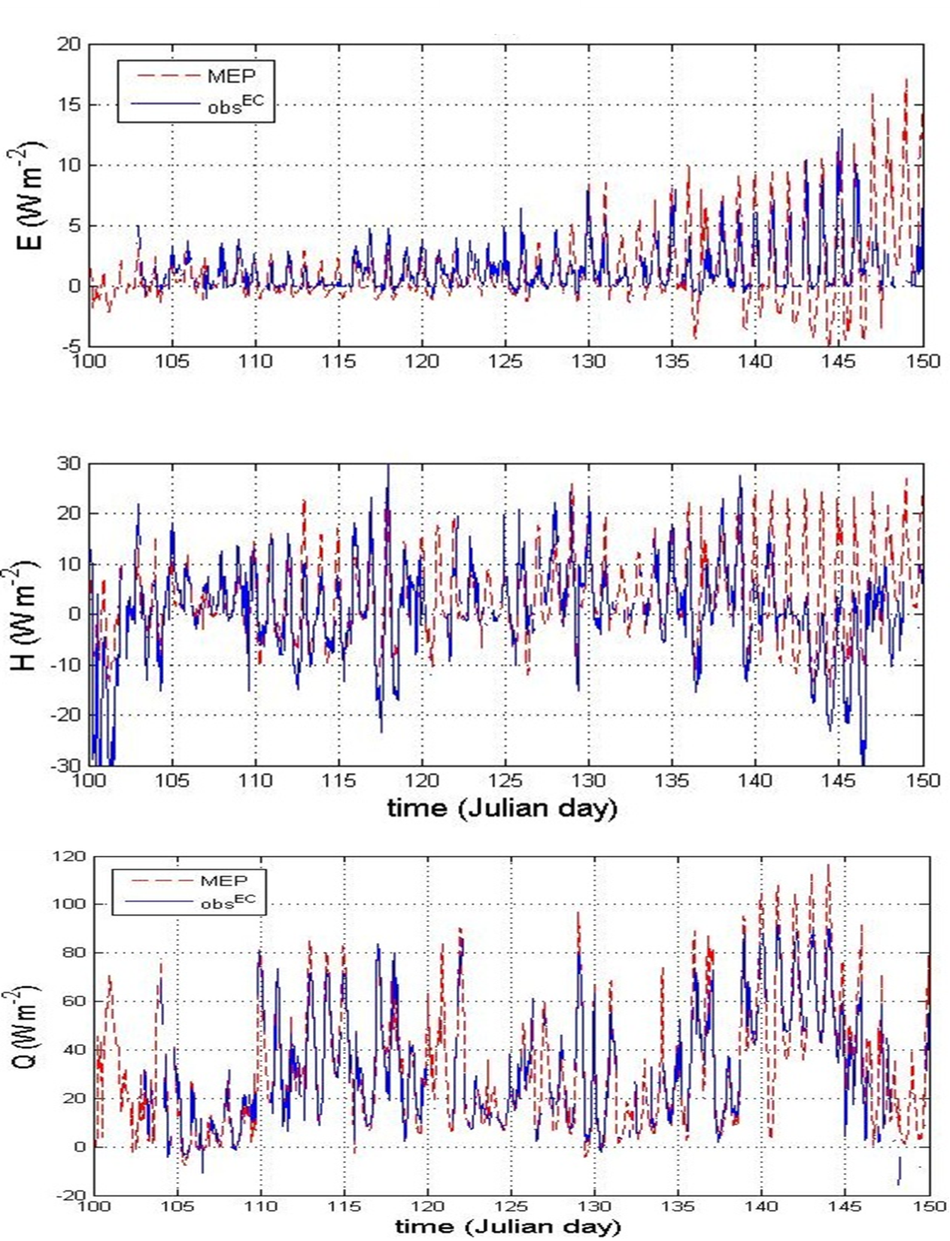
Sea Ice
Phase II eddy-covariance measurements of turbulent fluxes and meteorological variables from the Surface Heat Budget of the Arctic Ocean (SHEBA) experiment at a ice pack of the Arctic Ocean during 10 April - 30 May 1998. Courtesy of Judith A. Curry and Carol Anne Clayson.

Slide 42
Conclusions
The Bayesian method is a powerful tool to translate new knowledge into new models,
The MEP model parameterizes more ET related physical processes and uses less input data than commonly used models,
More applications of the Bayesian method in hydrologic modeling are yet to be explored.

Slide 43
References
Businger, J. A., J. C. Wyngaard, Y. Izumi, and E. F. Bradle (1971), Flux-profile relationships in the atmosphere surface layer, J. Atmos. Sci., 28, 181-189.
Dewar, R. C. (2003), Information theory explanation of the fluctuation theorem, maximum entropy production and self-organized criticality in non-equilibrium stationary states. J. Phys. A: Math. Gen. 36, 631–641 (2003)
Dewar, R. C. (2005), Maximum entropy production and fluctuation theorem, J. Phys. A: Math Gen., 36, L371-L381.
Dewar, R. C., and A. Maritan (2014), A Theoretical Basis for Maximum Entropy Production, in Beyond th Second Law - Entropy Production and Non-equilibrium Systems, 49-71, Springer-Verlag, Berlin Heidelberg.
Desborough, C. E., A. J. Pitman, and P. Irannejad (1996), Analysis of the relationship between bare soil evaporation and soil moisture simulated by 13 land surface schemes for a simple non-vegetated site, Global Planet. Change, 13, 47– 56.
Henderson-Sellers, A., P. Irannejad, K. McGuffie, and A. J. Pitman (2003), Predicting land-surface climates—Better skill or moving targets?, Geophys. Res. Lett., 30(14), 1777.
Huang, S.-Y., Y. Deng, and J. Wang (2016), A New Look at the Global Surface Energy Budget Using the Maximum-Entropy-Production Model, Clim., Dyn., in revision.
Jung M, Reichstein M, Ciais P, Seneviratne S, Sheffield J, Goulden M, Bonan G, Cescatti A, Chen J, de Jeu R, Dolman A, Eugster W, Gerten D, Gianelle D, Gobron N, Heinke J, Kimball J, Law B, Montagnani L, Mu Q, Mueller B, Oleson K, Papale D, Richardson A, Roupsard O, Running S, Tomelleri E, Viovy N, Weber U, Williams C, Wood E, Zaehle S, Zhang K (2010) Recent decline in the global land evapotranspiration trend due to limited moisture supply. Nature, 467:951-954.
Tribus, M. (1961), Thermostatics and Thermodynamics, D. van Nostrand Company, Inc., New York, 649pp.
Wang, J., and R. L. Bras (2010), An extremum solution of the Monin-Obukhov similarity equations, J. Atmos. Sci. 67(2), 485-499.
Wang, J., and R. L. Bras (2011), A model of evapotranspiration based on the theory of maximum entropy production, Water. Resour. Res., 47, W03521.
Wang,. J., R. L. Bras, V. Nieves, and Y. Deng (2014), A model of energy budgets over water, snow and ice surfaces, J. Geophys. Res. Atmos., 119 (10), 6034-6051.

