Slide 1
Universal system
of long range radio communication
for mobile detectors
Katarzyna Smelcerz
Cracow University of Technology, Poland

Slide 2
Agenda
Introduction
CREDO
Smaprtphones
Mobile Scintillator Based Detectors
Data acquisition problem
Carrier
System
Features
Topology
Protocol
Time Synchronization
History of the versions
Tests results
Obstacle Avoiding
Summary

Slide 3
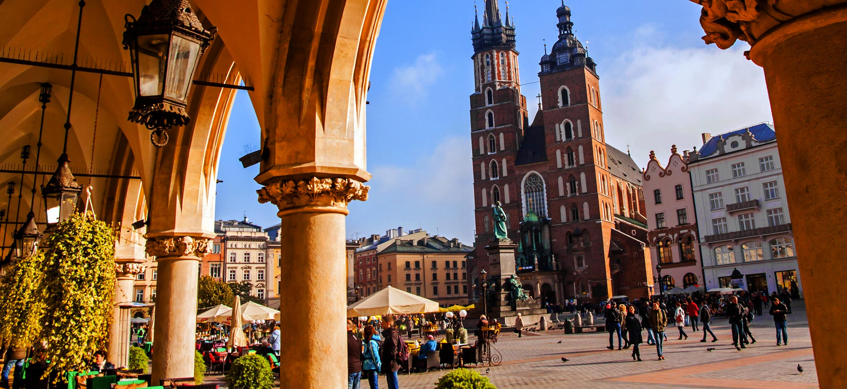
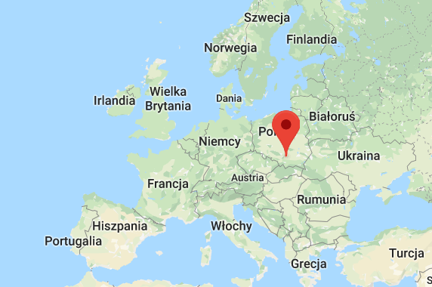
Introduction
Graduated Cracow University of Technology, Computer Science, master program in 2012
PhD student, Faculty of Computer Science and Telecommunications

Slide 4
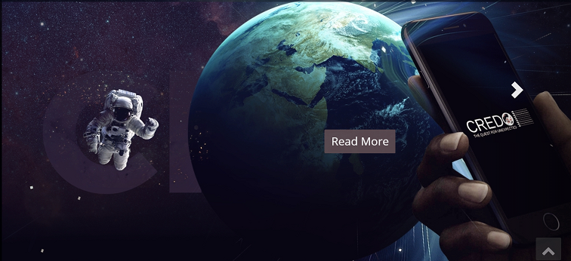
Back to the beginning
CREDO Collaboration (march 2017 - June 2019)
https://credo.science/

Slide 5
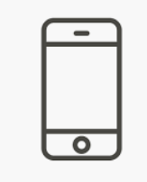
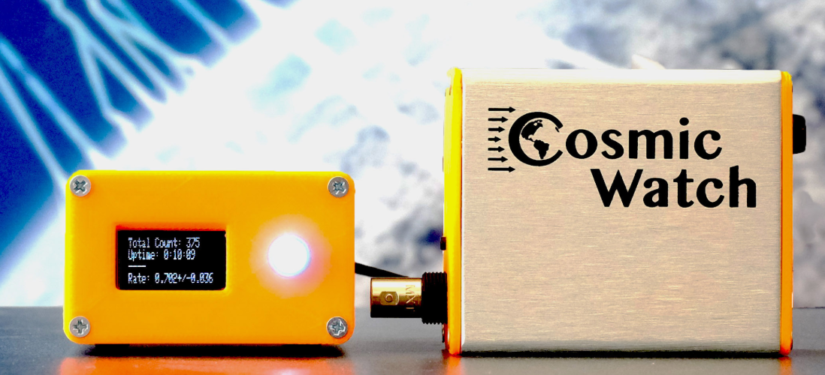
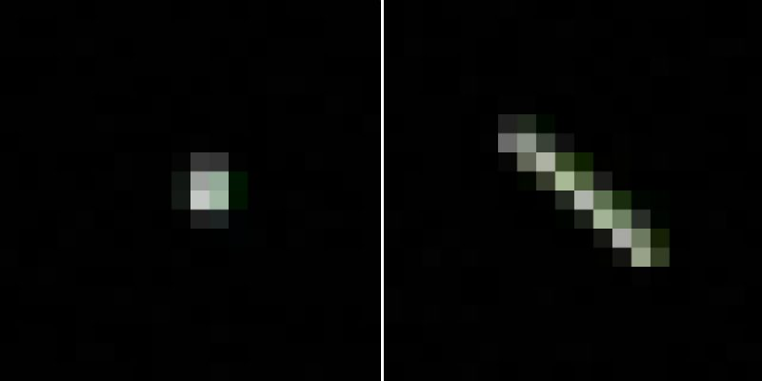
CREDO project
The study of Cosmic-Ray Ensembles (CRE) in large areas and the correlation between specific events:
Requires a large and widely dispersed research infrastructure
Not only specialized detectors
Citizen science - detectors that could be used by people who are not necessarily scientists (cheap, easy to use and available)
Smartphones & Mobile Cheap Scintillator Based Detector (similar to Cosmic Watch)
Source: http://www.cosmicwatch.lns.mit.edu/

Slide 6
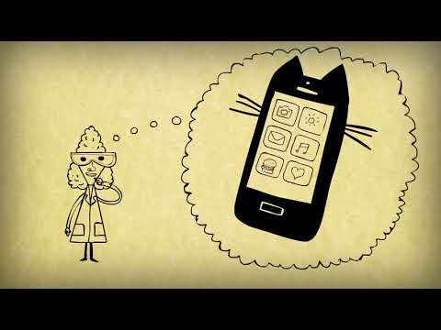

Slide 7
CREDO: Scintillator Based Detectors
Network of mobile detectors
How to collect data?
🤷🏻‍♀️

Slide 8
Scenarios

Slide 9
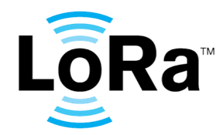
Currently available carriers
Maybe we could use something that already exists?
Internet
LoRa
SigFox
GSM
FSK

Slide 10
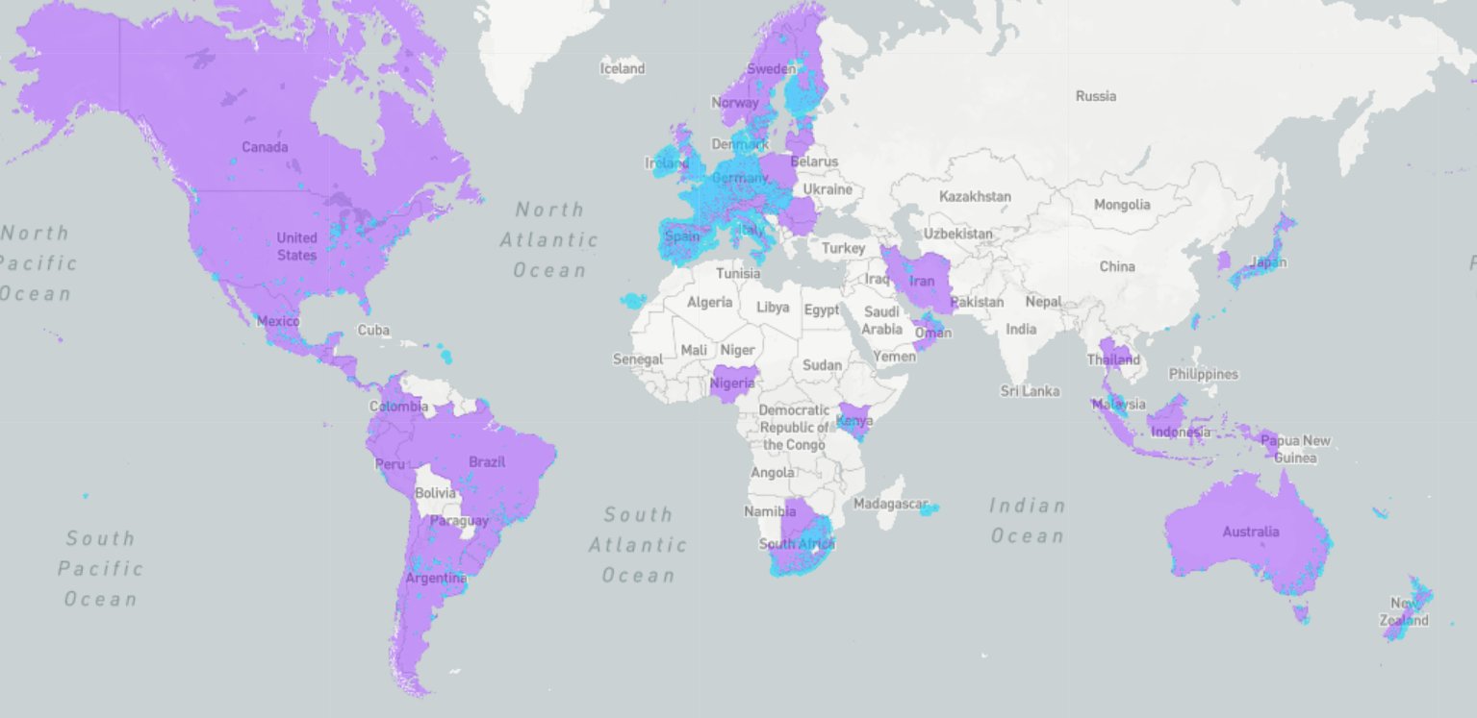
Currently available carriers
SigFox coverage
Source: https://www.sigfox.com/en/coverage
Maybe we could use something that already exists?
Internet - not available everywhere
LoRa - it processes the signal. Offers a receiving (mobile) station, but only at 868 433MHz. No access to the software of the receiving station, however it can decode simultaneously many transmissions on many bands.
SigFox - has good results, but receiving station is something ready to go solution, it cannot be modified or customized, and requires significant power supply. This is not mobile solution.
GSM - same as the Internet, not available on the desserts for example
FSK - short range, about 3 times less than LoRa.
Notes:
After demodulation it is sampled by the ADC, then they use filters in the software. As the result, even if the signal is weaker 100 times than noise, it can still be decoded - which is not the case with classic FSK transceivers.

Slide 11
Currently available carriers
Maybe we could use something that already exists?
Internet
LoRa
SigFox
GSM
FSK

Slide 12
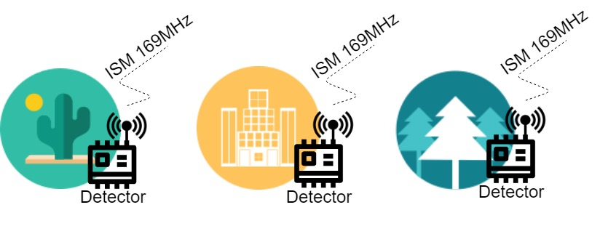
Different scenarios - universal carrier

Slide 13
System features
Carrier: ISM 169MHz radio frequency
Star topology
Unidirectional transmission (from sensors to sink) in specific time slots. requires time synchronisation for all the sensors.
Small packet size - at the moment: 8 bytes
Low energy consumption, battery operation; ~2 years on battery in a scenario where the data is sent once per hour from a detector, and the frame transmission time is 2.2 s.
Sink: 5V, ~0.5A
Sender: 3.4V

Slide 14
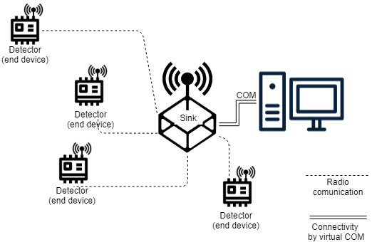
System topology

Slide 15
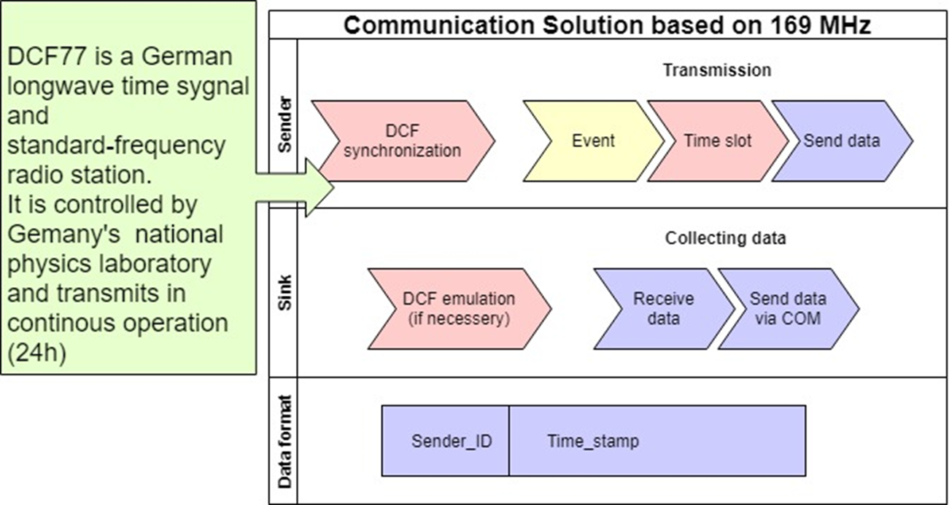
Protocol

Slide 16
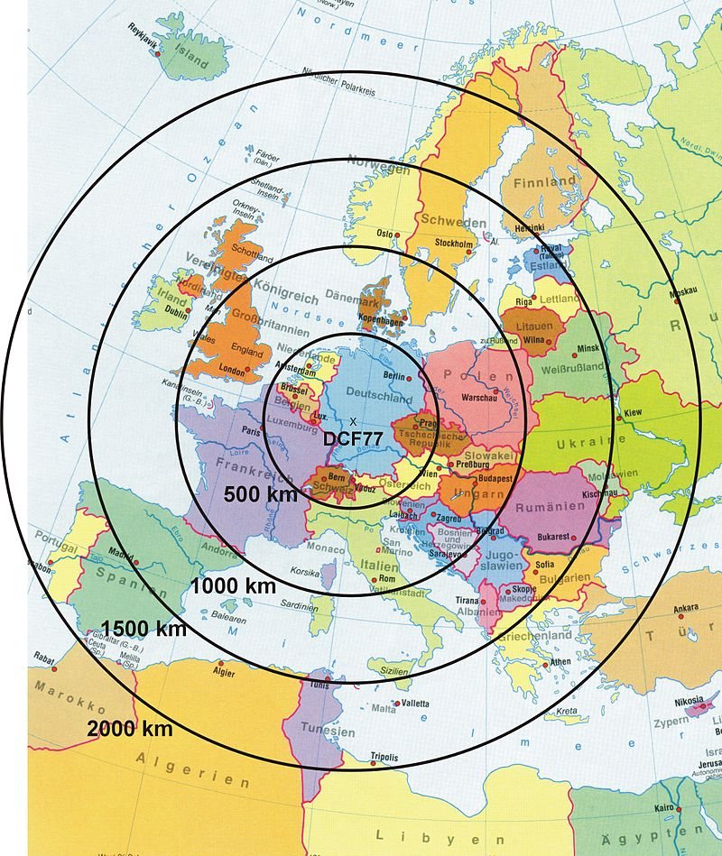
Time synchronization
DCF: Broadcast time and date information is repeated every minute with a marker at the end of each minute. The accuracy of the end of minute marker is ±2 millisecond. Frequency: 77.5 kHz, Power: 50 kW
WhiteRabit: Synchronous Ethernet (SyncE) to achieve syntonization and IEEE 1588 (1588) Precision Time Protocol (PTP). Sub-nanosecond accuracy
GPS: 10ns jitter https://cdn-shop.adafruit.com/datasheets/GlobalTop-FGPMMOPA6H-Datasheet-V0A.pdf

Slide 17
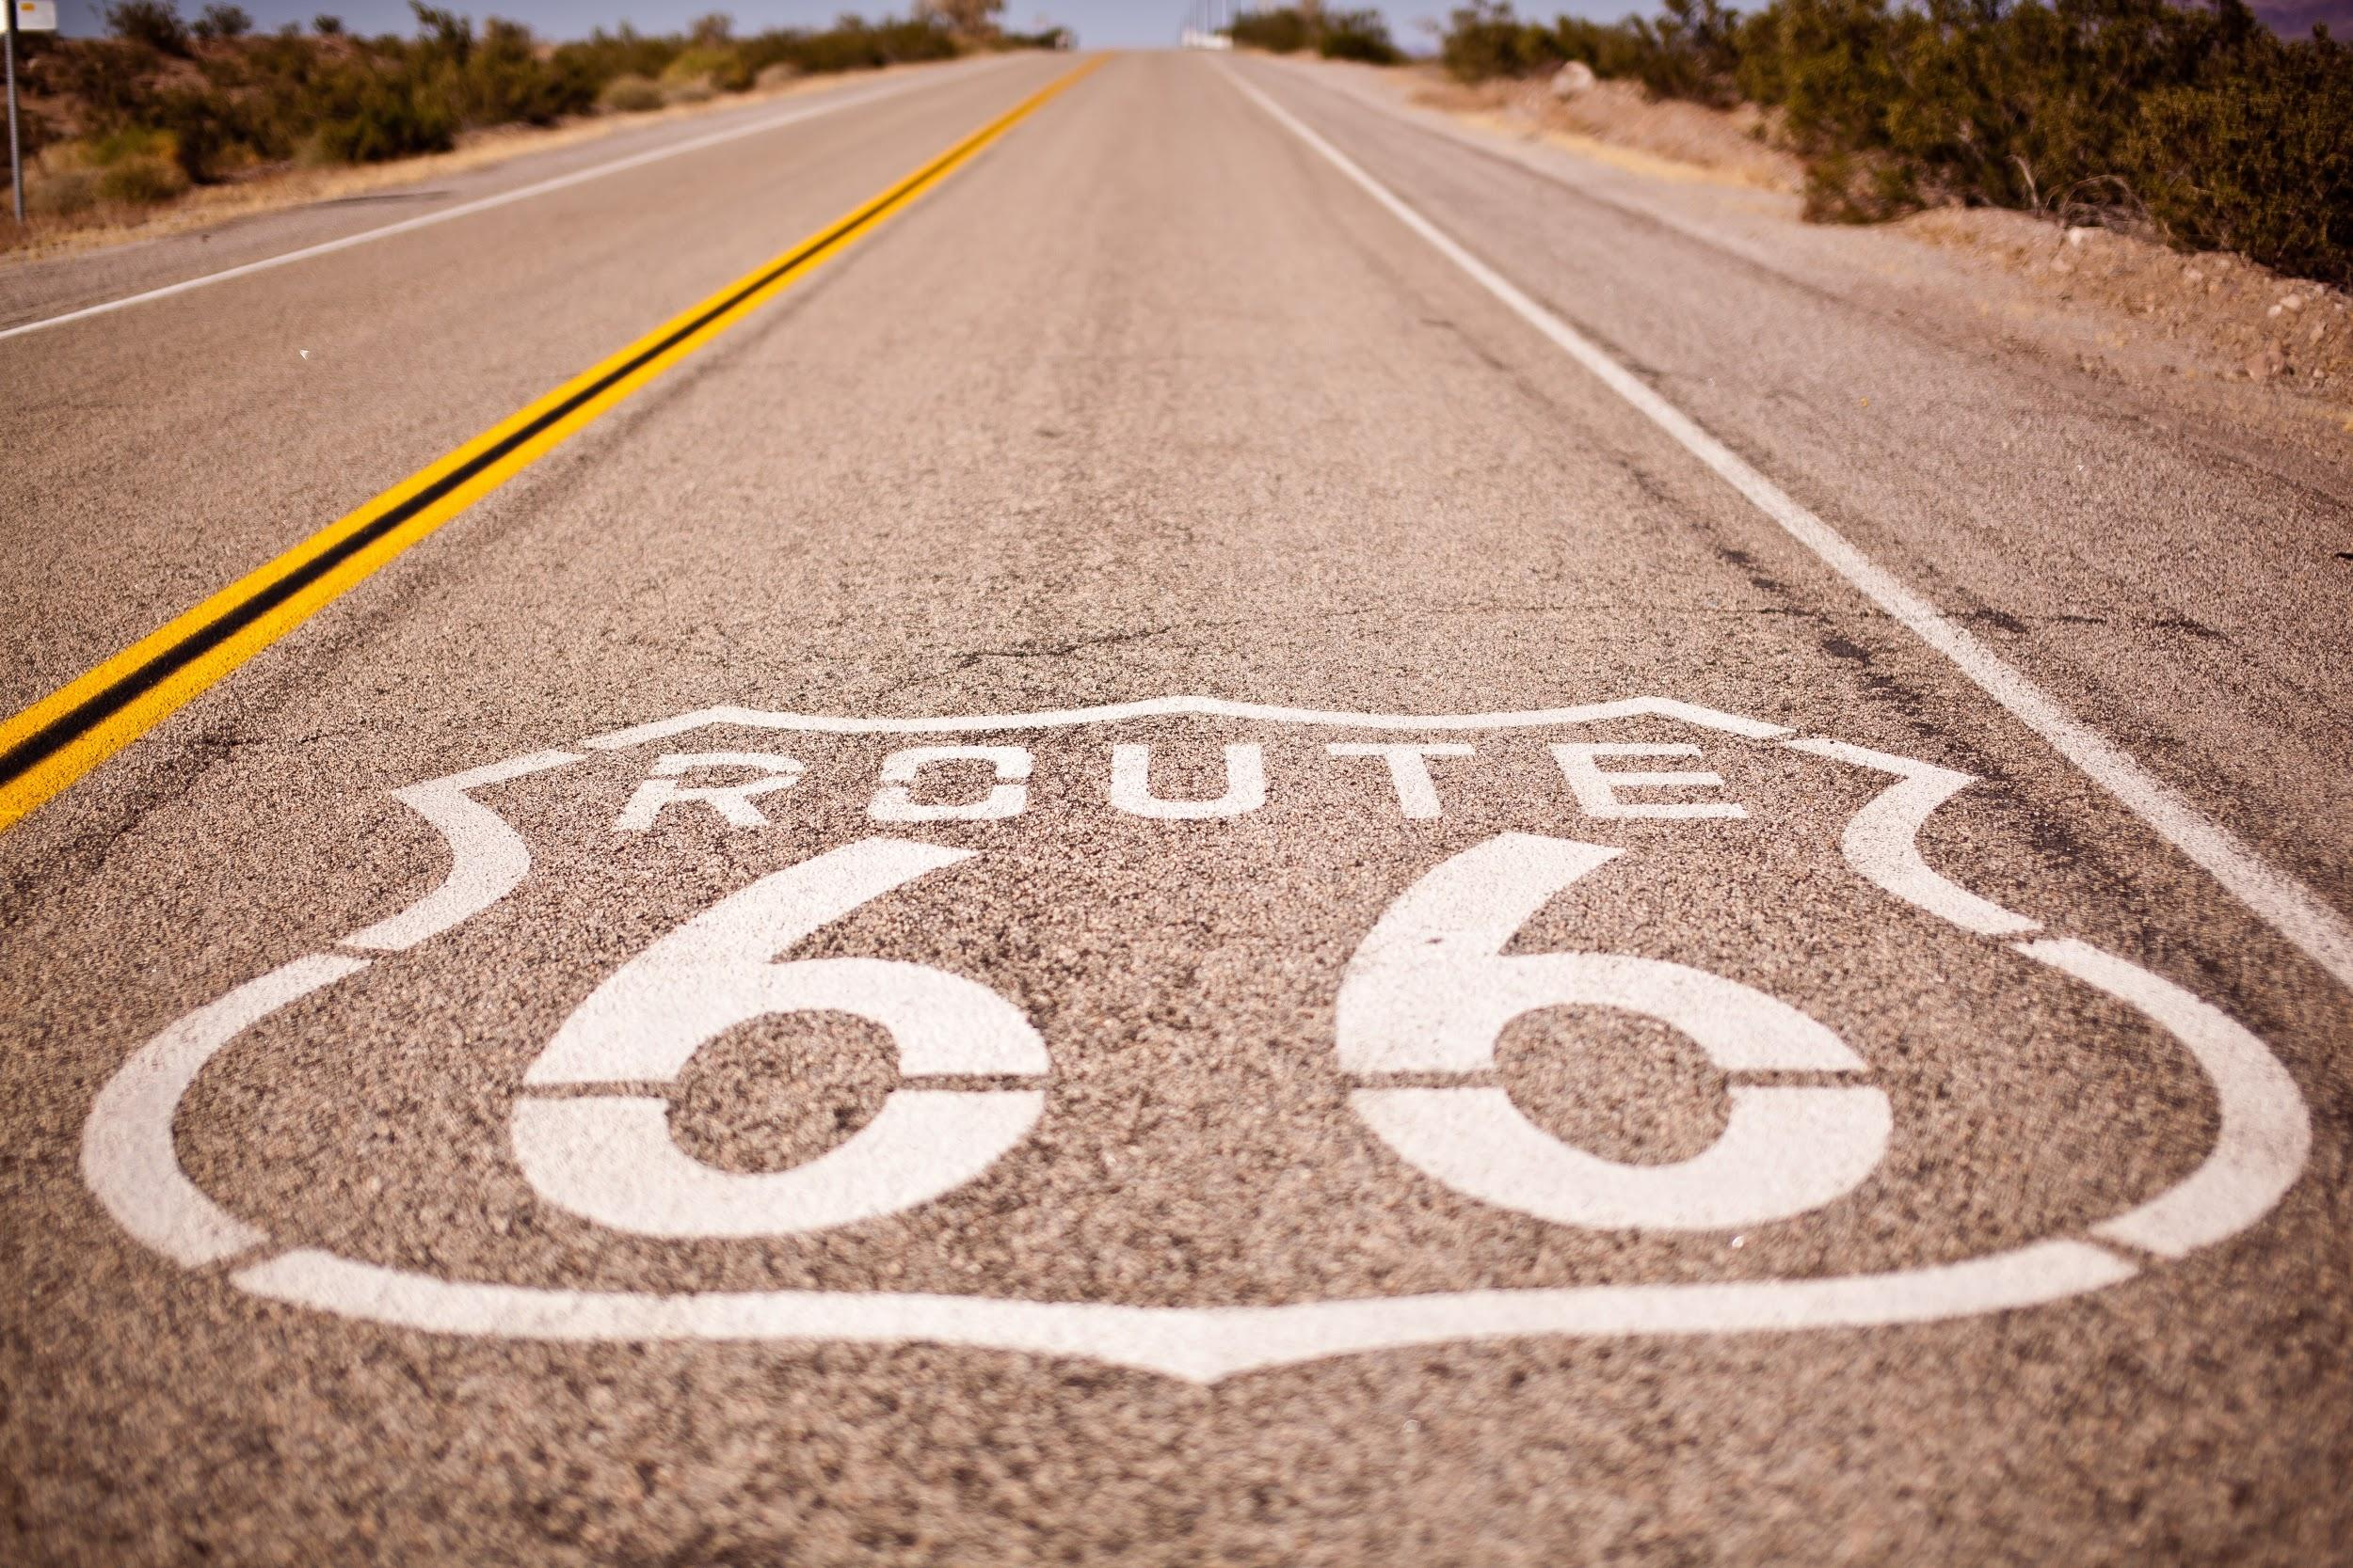
It was a long, long way...
It started on the Spirit1 FSK chip and it turned out that even on the evaluation kit the range is 100-150m.
Over a year of struggling with Spirit1, STM. Starter-kits worked better than the own designed system, although theoretically the same elements were used. The system was tested on bands 169, 433 and 868 MHz with similar range, which was inconsistent with the theory (lower frequency should have higher range).
Discovery SX1276 (Semtech) - had better range than Spirit1.
At the starter-kit from Semtech, range about 300m on the same route as Spirit1, but nothing more.
Tests on a changed modulation parameters - no significant progress...

Slide 18
Long, long way...
The idea 💡
To build a preamplifier (low-noise amplifier) ​​that catches the signal from the antenna, amplifies it and passes it on to the system (time> 2 years). At first, the amplifiers behaved like oscillators instead like amplifiers, than this problem had been fixed (it was a bad PCB layout). The next version had too high noise, so there was no change in range (still 300m).
The 7th version of the amplifier had range of about 1.5 km at the beginning of 2019
At the same time, the antennas were constantly improved better and better), the concept of the receiving station was also changed, which at first was assembled as a cover mounted on a nucleo plate, but later it was switched to a larger plate, which is having uC itself.
Work continued on reducing the amplifier's own noise, cutting off the processor noise and improving the signal from the antenna.
The recently built amplifier works stable, does not excite and allows establishing communication in built-up area for about 4km, as long as there is no obstacle such as hill

Slide 19
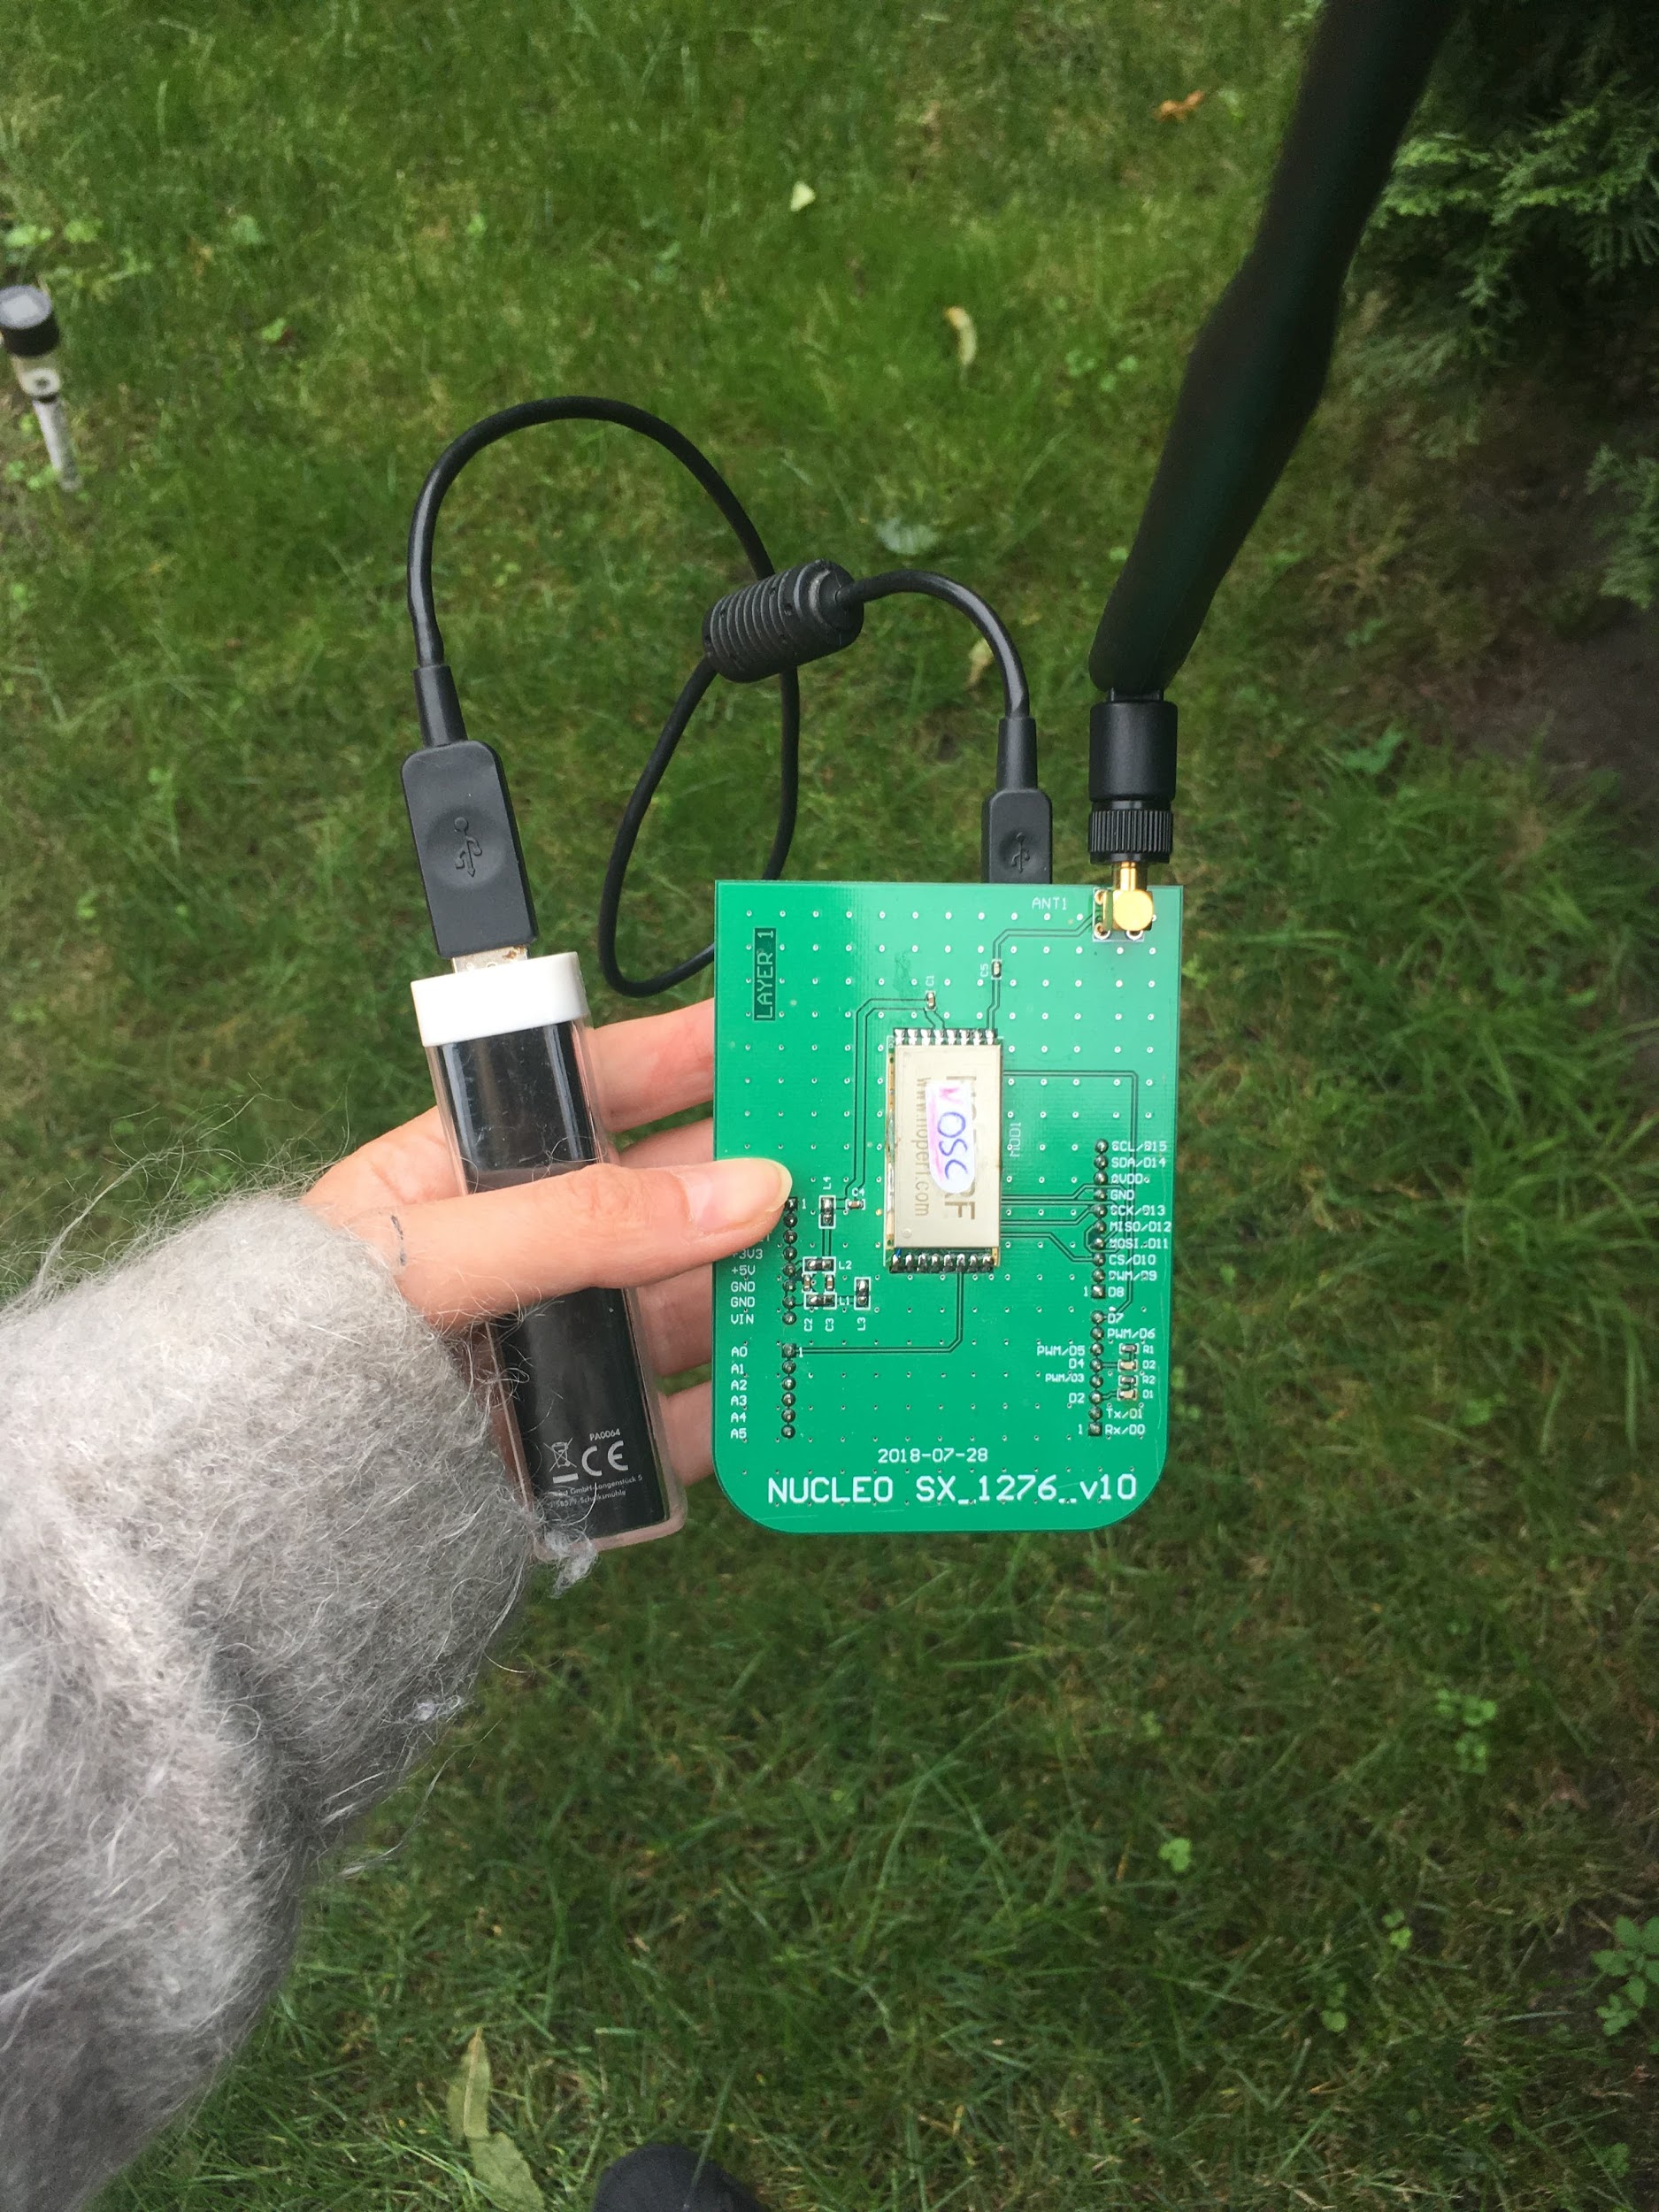
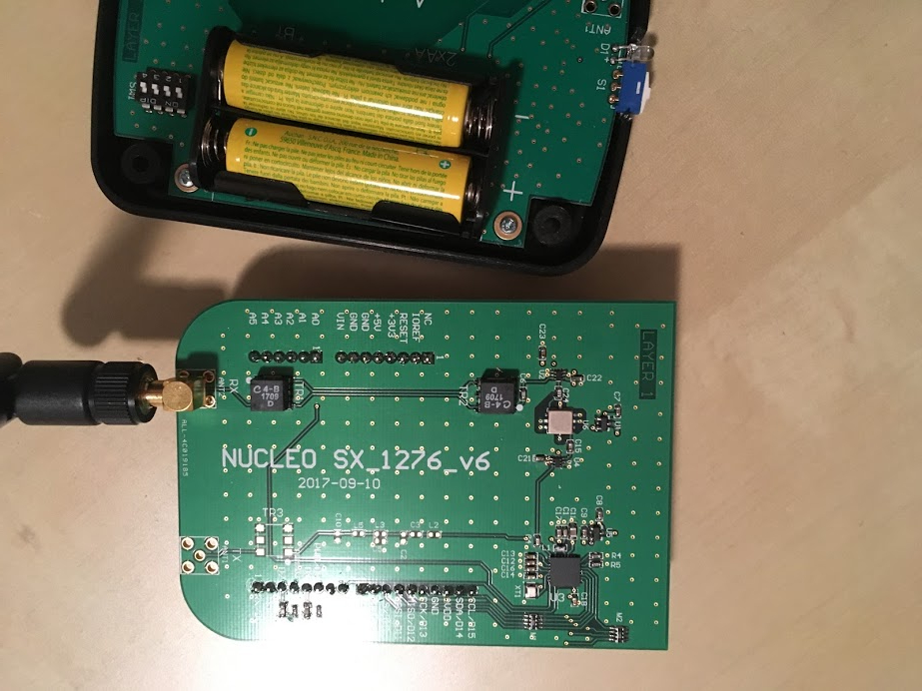
Versions over last 2 years > 15

Slide 20
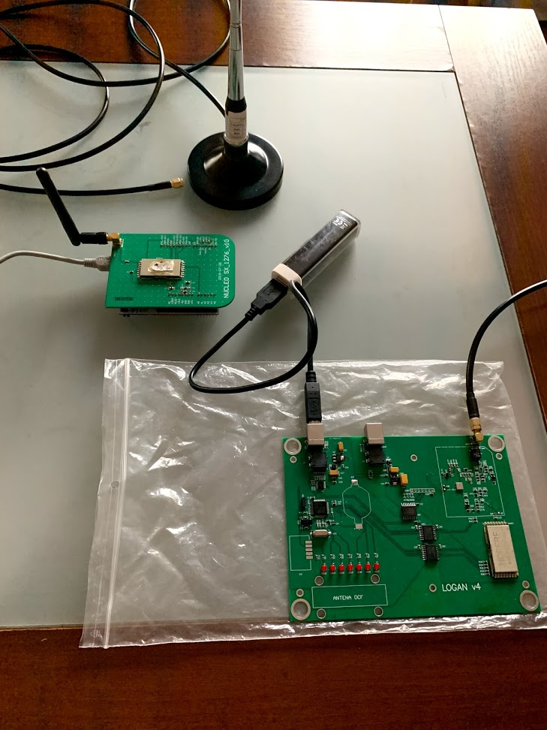
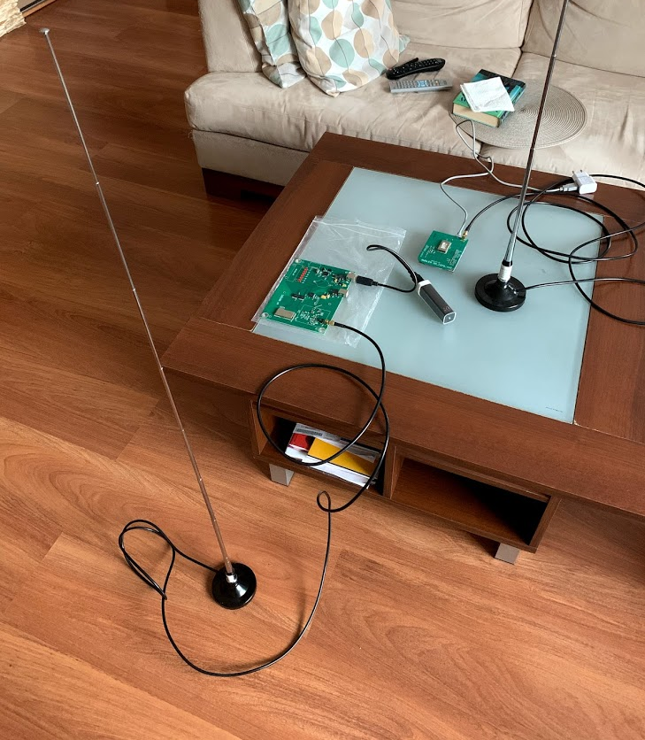
Current System: Sender and Sink
Sender cost: ~50$
Sink cost: ~200$
Sink zdjęcie

Slide 21
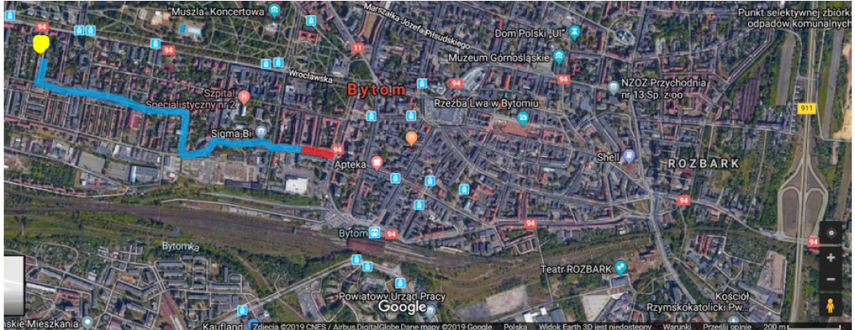
Tests results in the city
February 2019, ~1.5km

Slide 22
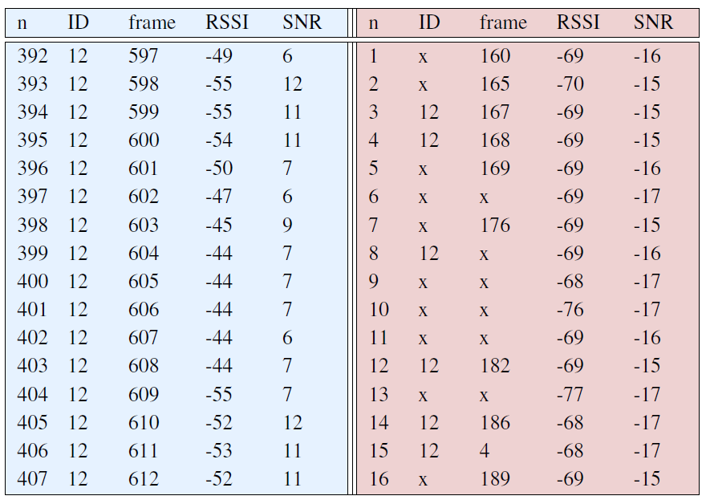
Transmission parameters
Transmission parameters from the range limit area (red) compared with transmission parameters for the very good range area (blue)
SNR (Signal Noise to Radio)
RSSI (Received Signal Strength Indication), that is the value of the signal measured in decibels (dB) from 0 to -120. The closer to 0, the stronger the signal is.

Slide 23
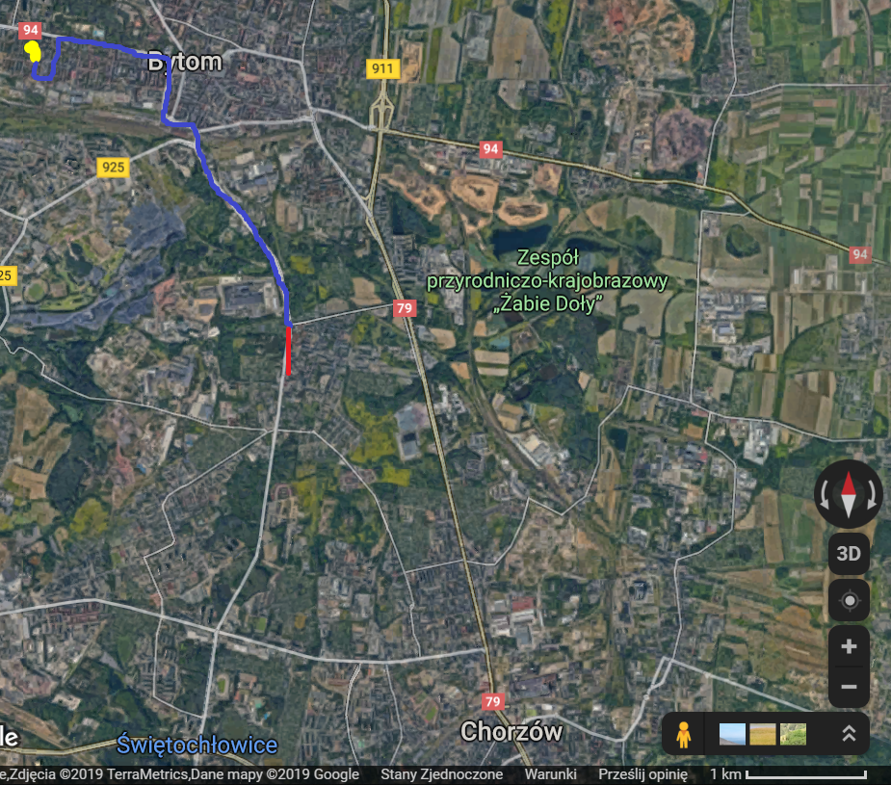
September 2019: ~4km

Slide 24
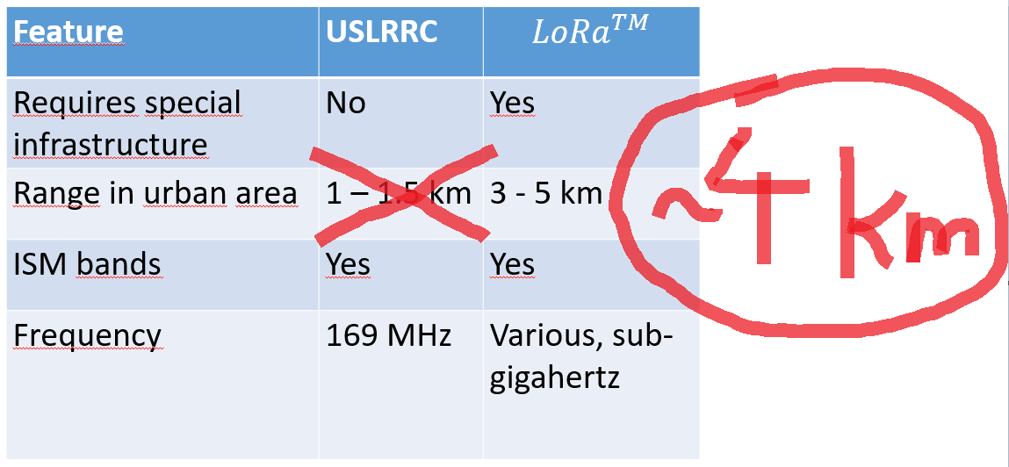
Comparison of Universal System of Long Range Radio Communication vs. LoRa

Slide 25
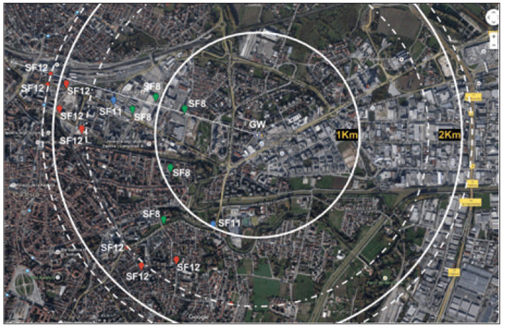
LoRa tests in urban area
LoRa system single-cell coverage in Padova, Italy.
Connectivity was achieved at approx. 2 km.
For more details see:
Marco Centenaro, Lorenzo Vangelista, Andrea Zanella, and Michele Zorzi, Long-Range Communications in Unlicensed Bands: The Rising Stars in the IoT and Smart City Scenarios, IEEE Wireless Communications ( Volume: 23 , Issue: 5 , October 2016 )

Slide 26
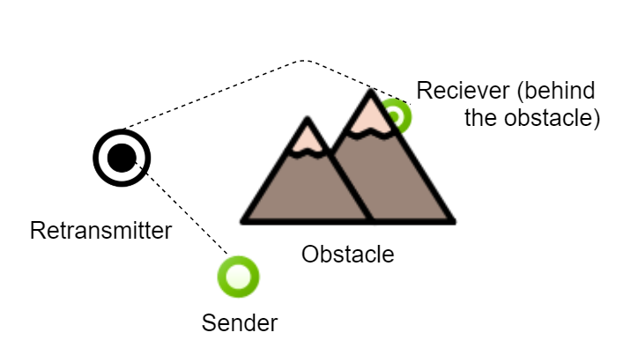
Avoiding obstacles
Basic problem in long range wireless communication is how to avoid obstacles. Nowadays it is done by the following ways :
using mesh topology, that bypasses by the obstacle

Slide 27
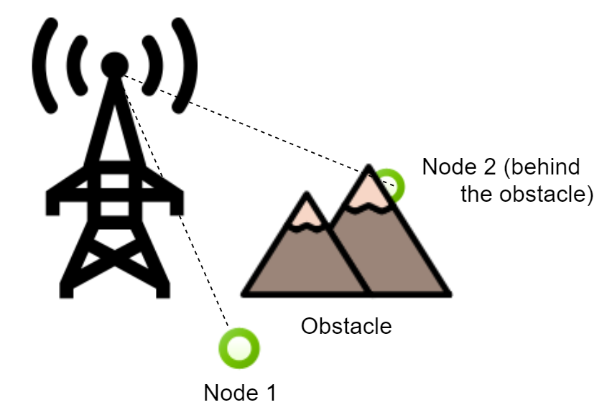
Avoiding obstacles
using for receiver station high placed antenna on some hill or pole, which is above the obstacles

Slide 28
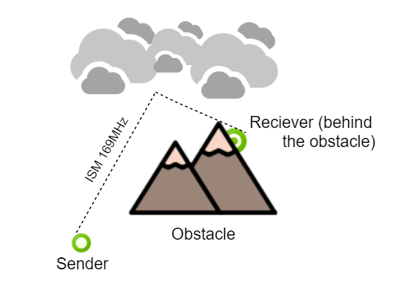
Skywave reflection
In this application, nether mesh topology nor antennas placed high on poles can be used.
💡Reflection signal from the air.
If this works, communication is possible above obstacles if only transmitter and sink can see the sky. At this stage of the project, reflection from the clouds was seen with good signal quality. Now the challenge is communication on the cloudless sky.

Slide 29
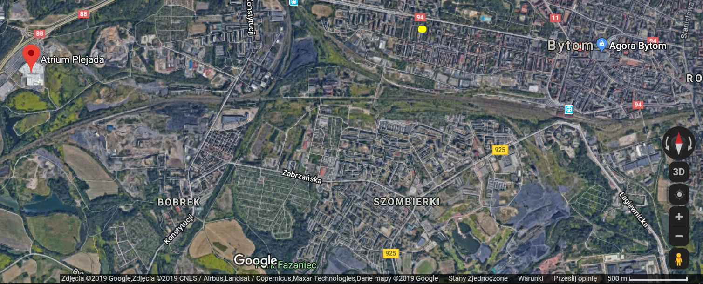
Problematic place

Slide 30
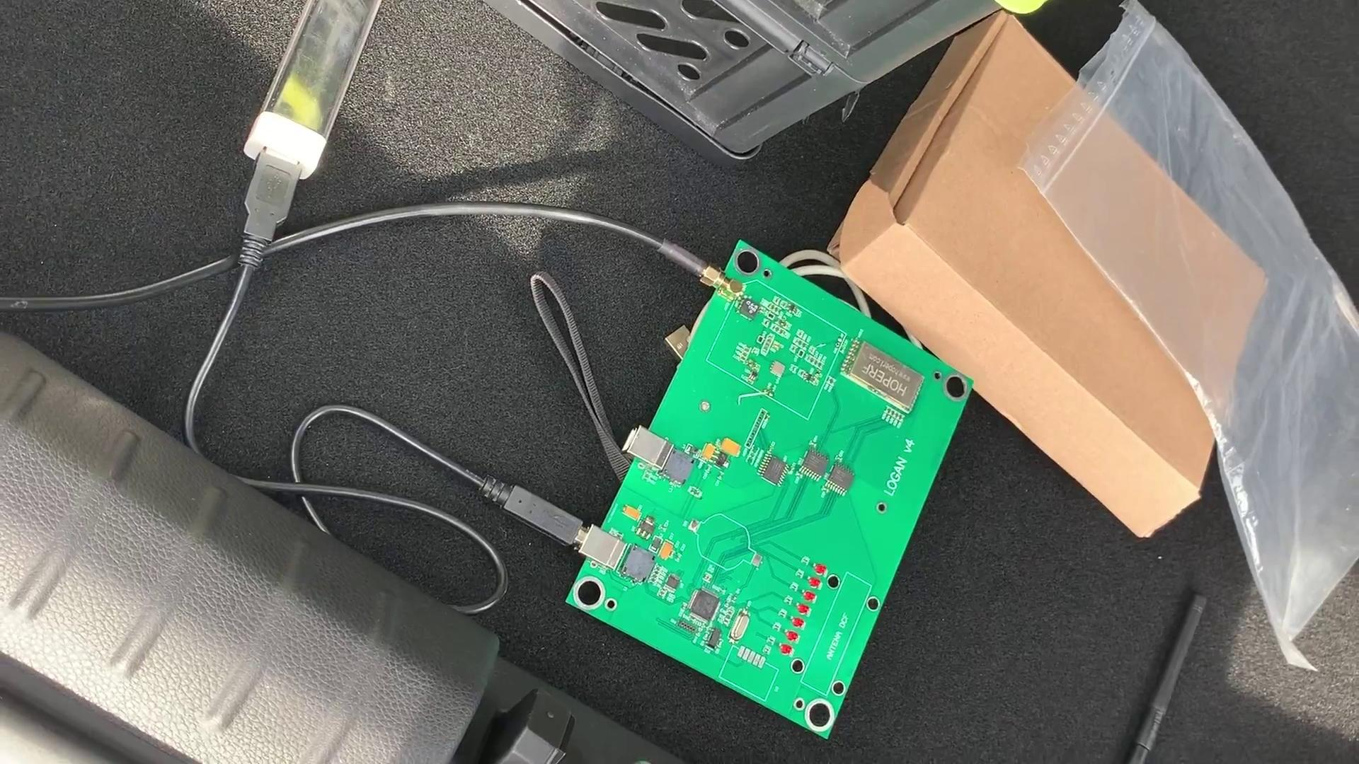

Slide 32
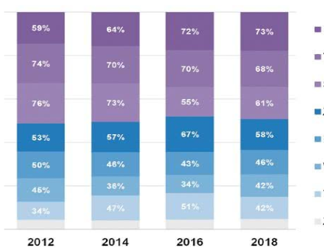
Why is the system interesting?
Monitoring and diagnostics
Telemetry
Alarm and security system
Remote control of systems operation
Energetics
Sewage
Transportation
Custom and trade
Source: https://automatykab2b.pl/raporty/49178-sieci-bezprzewodowe-przemyslowe-raport-rynek

Slide 33
Future work
Publishing a paper
Improvement of the range
Improvement of the protocol and tests over it - including simulations
Optimization of power consumption

Slide 34
Thank you
for your attention

