Slide 1

Outreach Efforts at GSU with Cosmic Ray Detection
Xiaochun He, Murad Sarsour and Megan Connors
Nuclear Physics Group

Slide 2
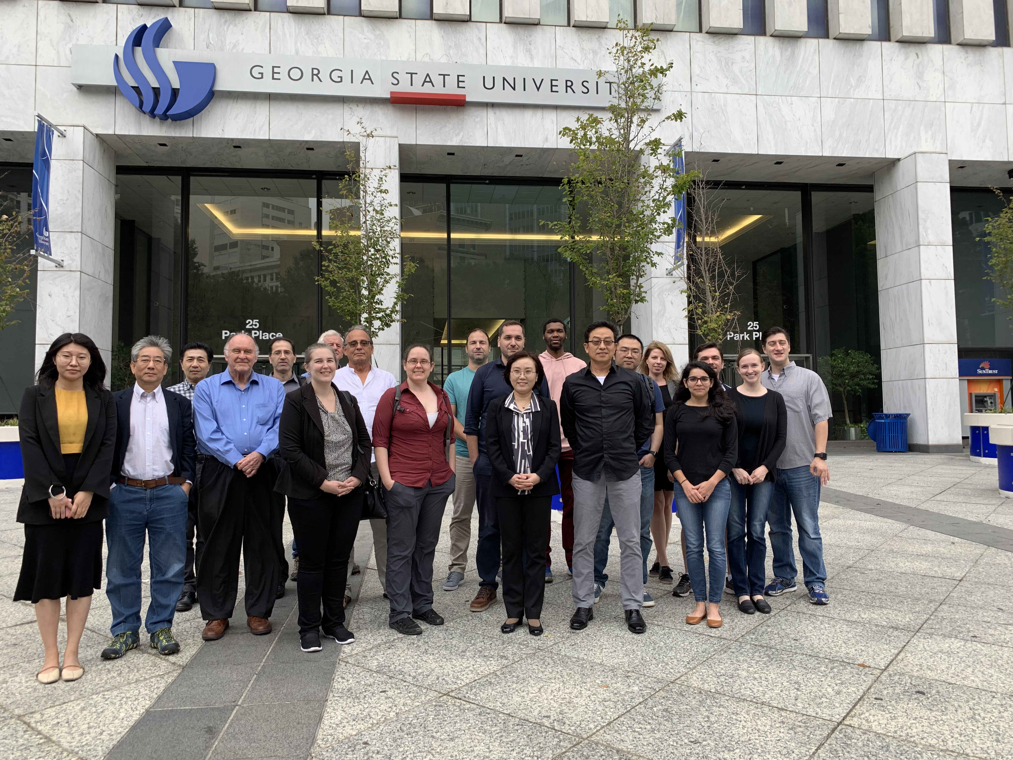
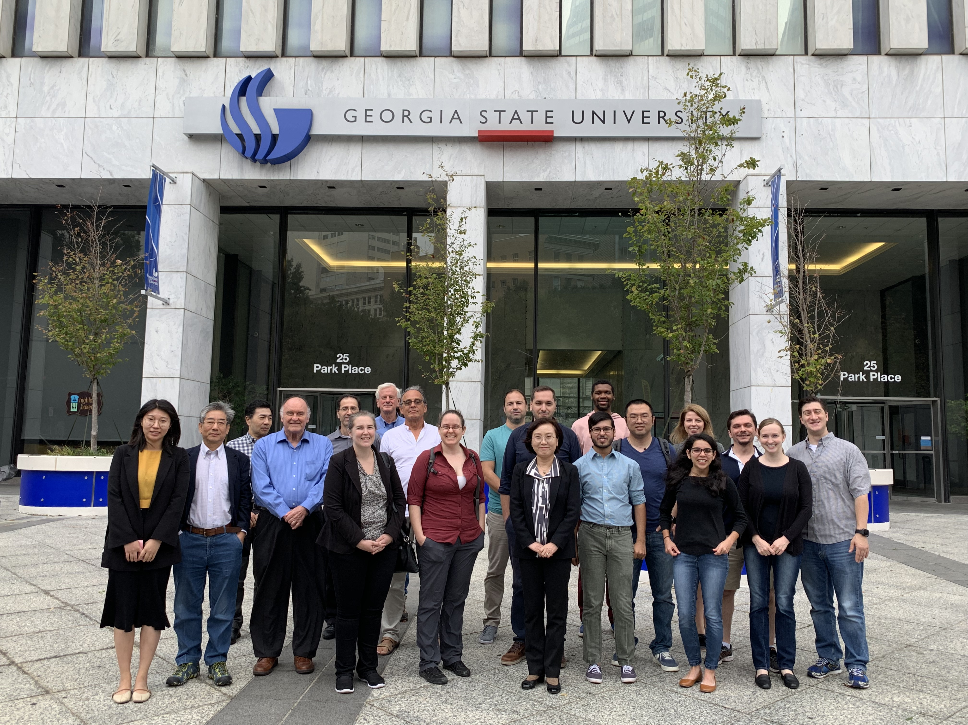
Workshop Photos
Selected photos will be post on the workshop website. Please send photos to me if you like to share

Slide 3
Fun and Inspirational
Working with youngsters

Slide 4
A List of Outreach Presentations at Local Schools
2009
“Cosmic Ray Measurement”, Memorial Middle School, Conyers, Georgia, October 27, 2009.
“Fun Physics Camp”, co-organizer with Unil Perera, Mark Geil and Cherilynn Morrow, June 22-26, 2009
“Catching Cosmic Ray Particles”, Professional Development Day for Clayton Teachers, Clayton County, Georgia, January 27, 2009.
“Catching Cosmic Ray Particles with Scientists at Georgia State University”, Southern Atlantic Coast Section Meeting, American Association of Physics Teachers, Kennesaw State University, October 25, 2008.
“Catching Cosmic Ray Particles with Scientists at Georgia State University”, Conyers Middle School, May 2, 2008.
“Training Science Teachers to Perform Cosmic Ray Muon Observations: An Immersion into Scientific Inquiry”, J. Wilson and X. He, ASTE 2008, St. Louis, MO, January 10-12, 2007.
“COSMIC RAY Muon Measurement”, J. Wilson and X. He, South Atlanta School of Law and Social Justice, Atlanta, Georgia, November 7, 2007.
“Collaborations Between Scientists and Educators”, J. Wilson, X. He and L. Martin-Hansen, SASTE 2007, Valdosta, Georgia, October 27, 2007.
“RESEARCH AND EDUCATION – THE INSEPARABLE DUAL”, X. He, SASTE Conference at the University of Georgia, Athens, Georgia, October 15, 2005.
“COSMIC RAY MUON PROJECT IN GEORGIA”, X. He, Georgia State University, September 7, 2005.
“COSMIC RAY Muon PROJECT IN GEORGIA”, X. He, Cross Keys High School, Georgia, January 20, 2005.
“COSMIC RAY EXPERIMENT AT GRIFFIN MIDDLE SCHOOL”, X. He, Griffin Middle School, Smyrna, Georgia, November 17, 2004.
“COSMIC RAY MUON PROJECT IN GEORGIA”, X. He, Kennesaw State University, September 20, 2004.
“COSMIC RAY MUON PROJECT”, X. He, PRISM Conference at Georgia Tech, June 24, 2004.
“COSMIC RAY EXPERIMENT AT CAMBELL HIGH SCHOOL”, X. He, Cambell High School, Smyrna, Georgia, November 17, 2003.
“COSMIC RAY EXPERIMENT”, X. He and Carola Butler, Holly Innocence Christian School, Atlanta, Georgia, April 9, 2003.
“COSMIC RAY EXPERIMENT”, X. He, North Springs High School, Atlanta, Georgia, March 5, 2003.
“COSMIC RAY EXPERIMENT”, X. He, Fayette County High School, Fayetteville, Georgia, February 5, 2003.
“COSMIC RAY EXPERIMENT”, X. He, Chapel Hill High School, Douglasville, Georgia, November 15, 2002.
“COSMIC RAY EXPERIMENT AT GRIFFIN MIDDLE SCHOOL”, X. He, Griffin Middle School, Smyrna, Georgia, October 16, 2002.
2002

Slide 5

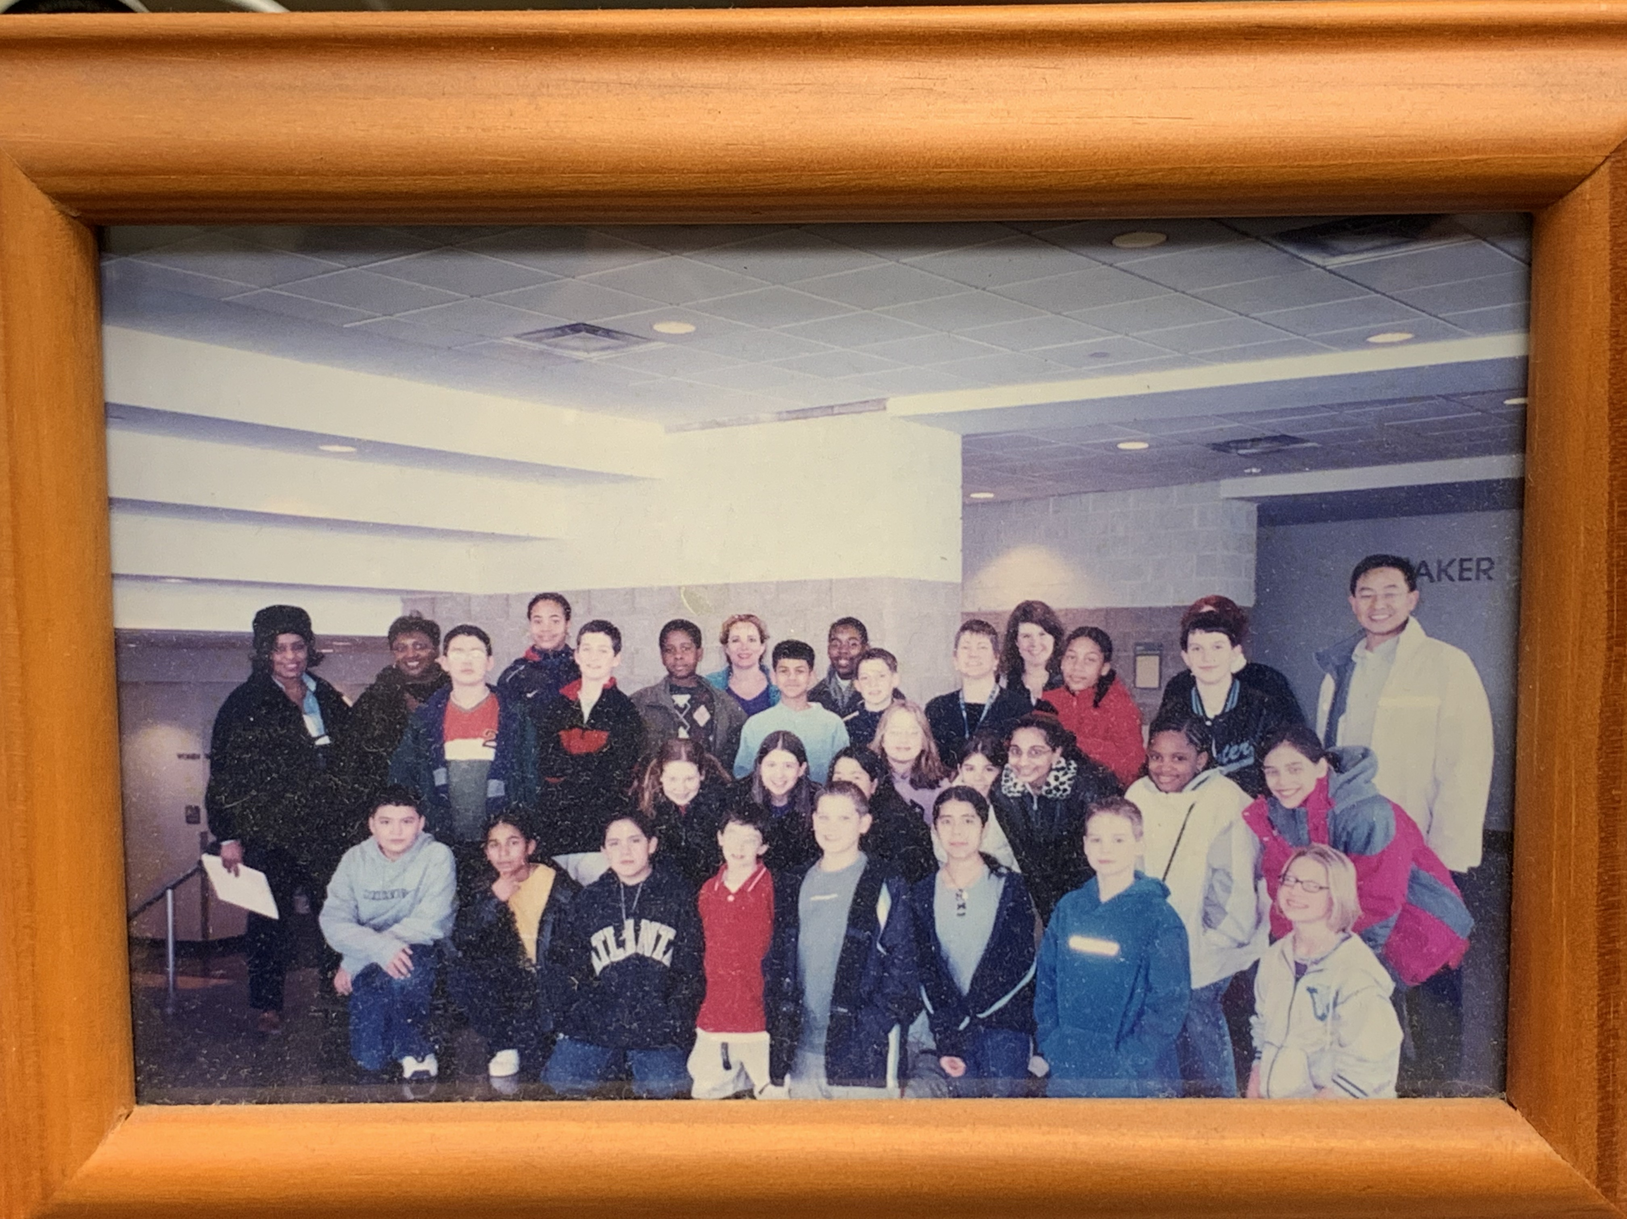
Griffin
Middle
School
~2002

Slide 6
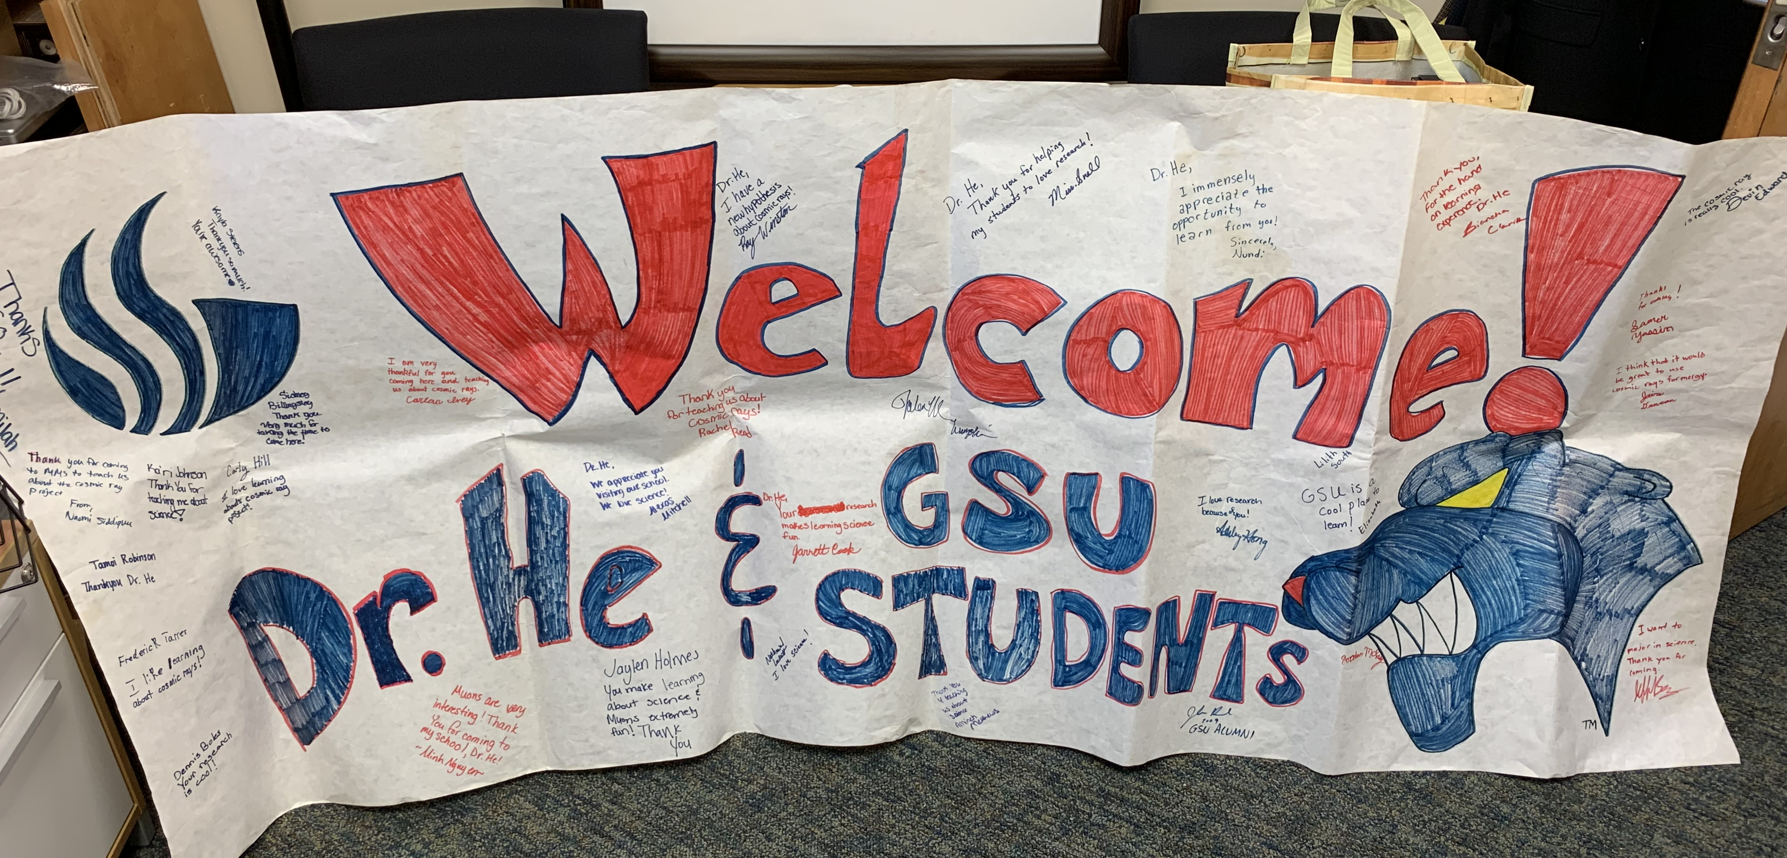
2008

Slide 7
Summer 2019

Slide 8
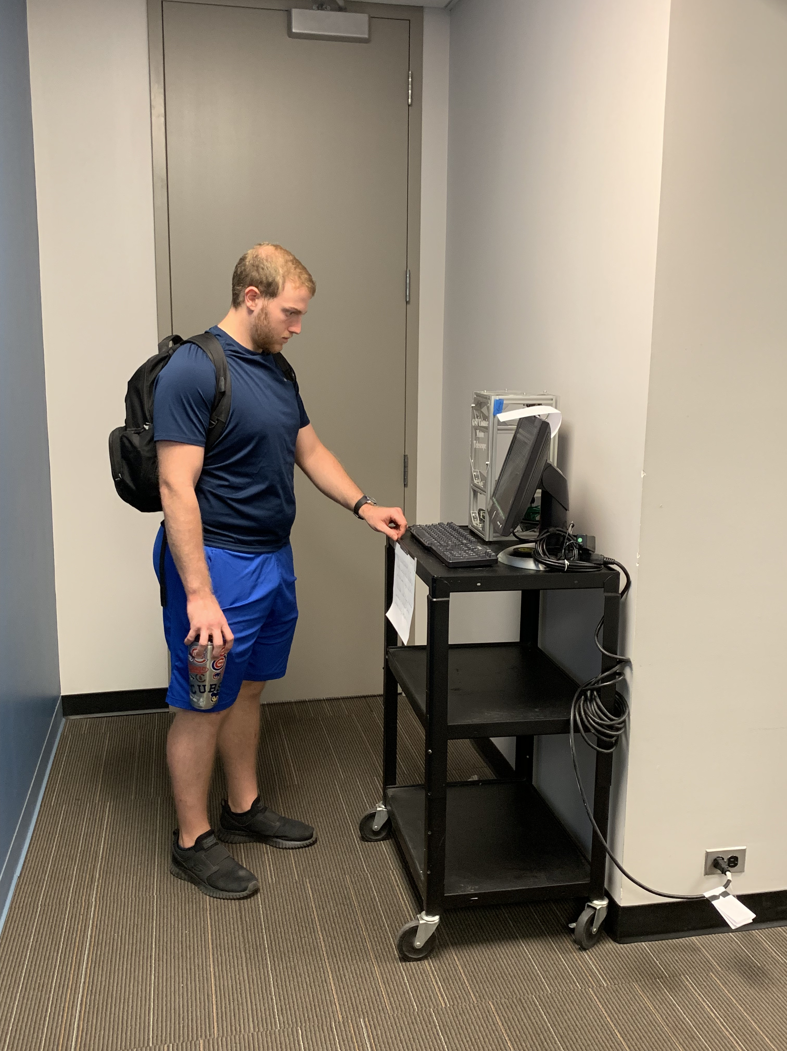
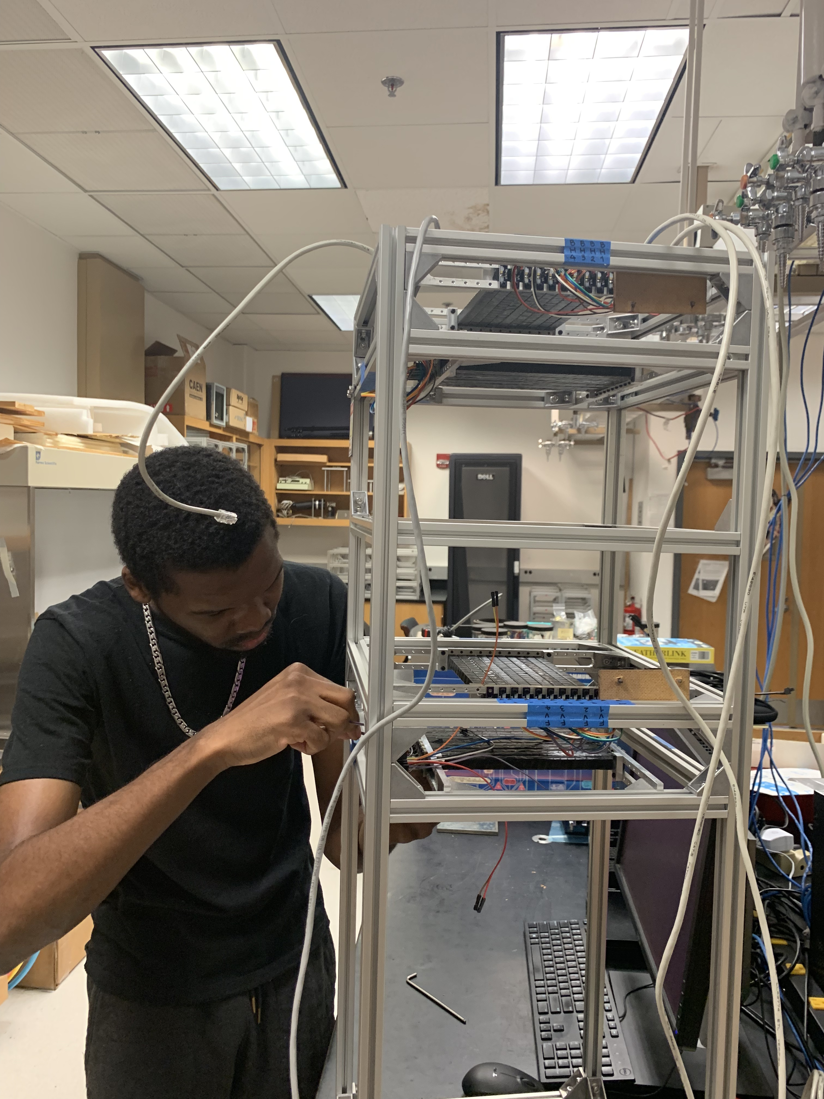
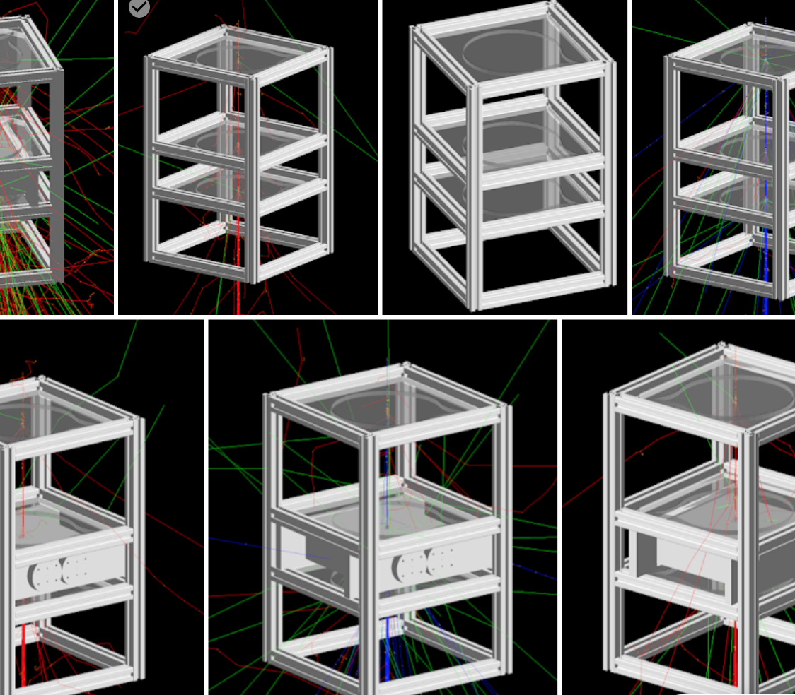
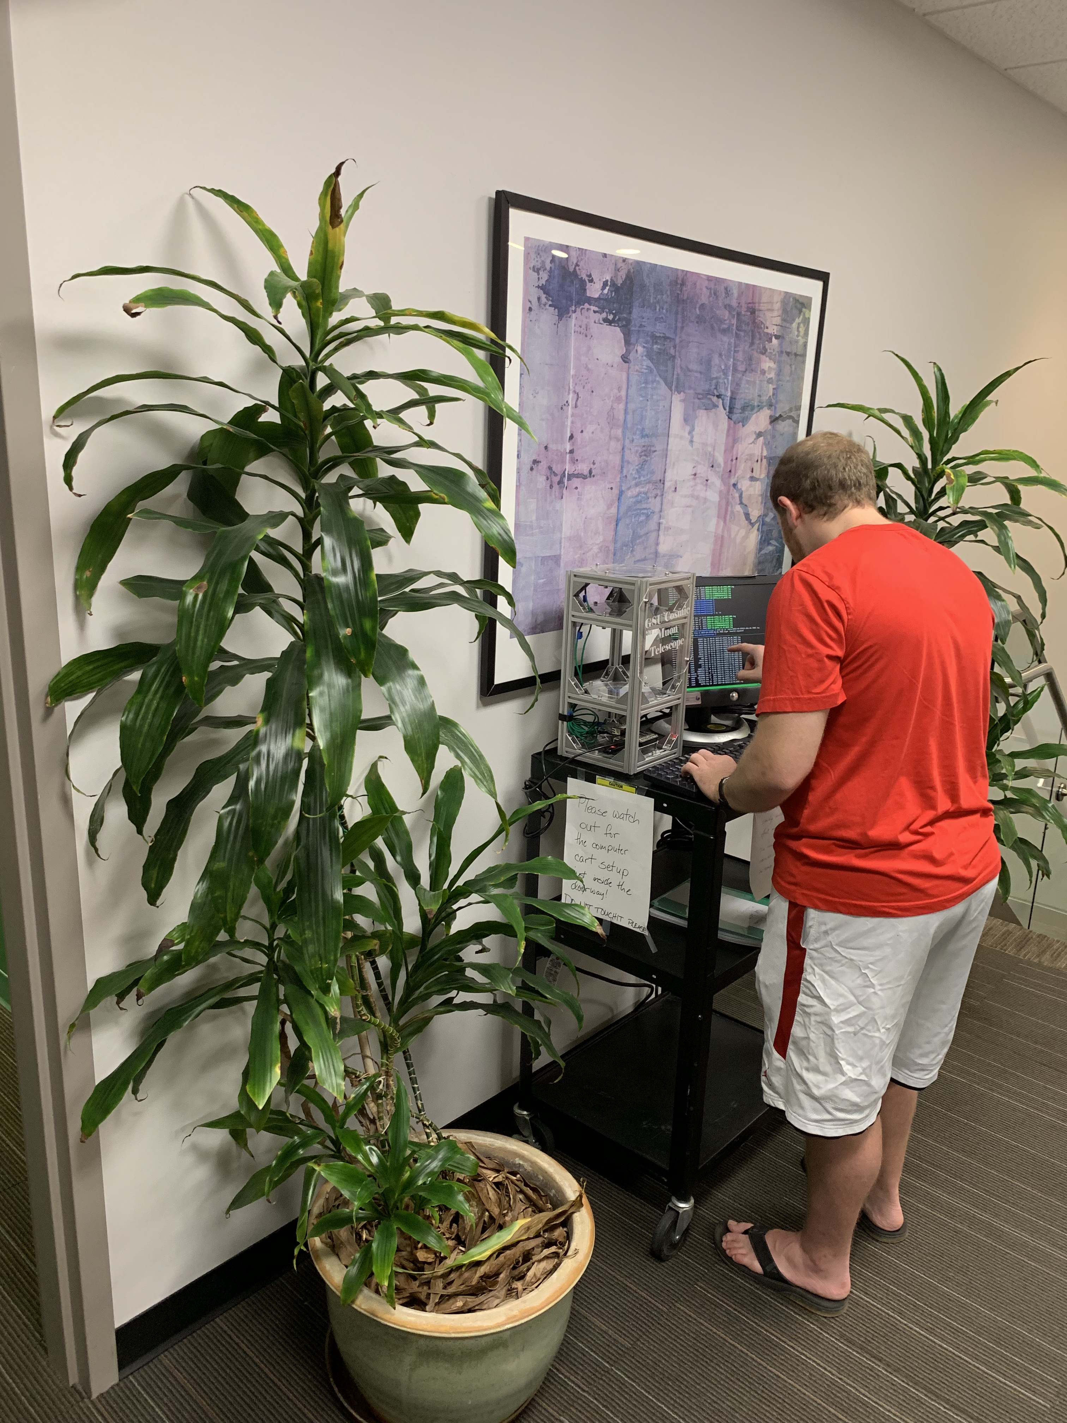
Student Activities

Slide 9
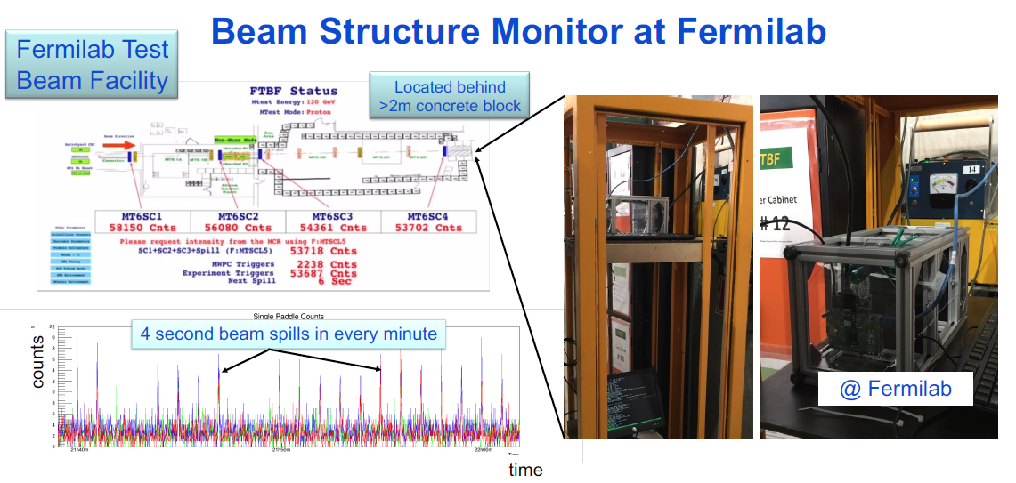
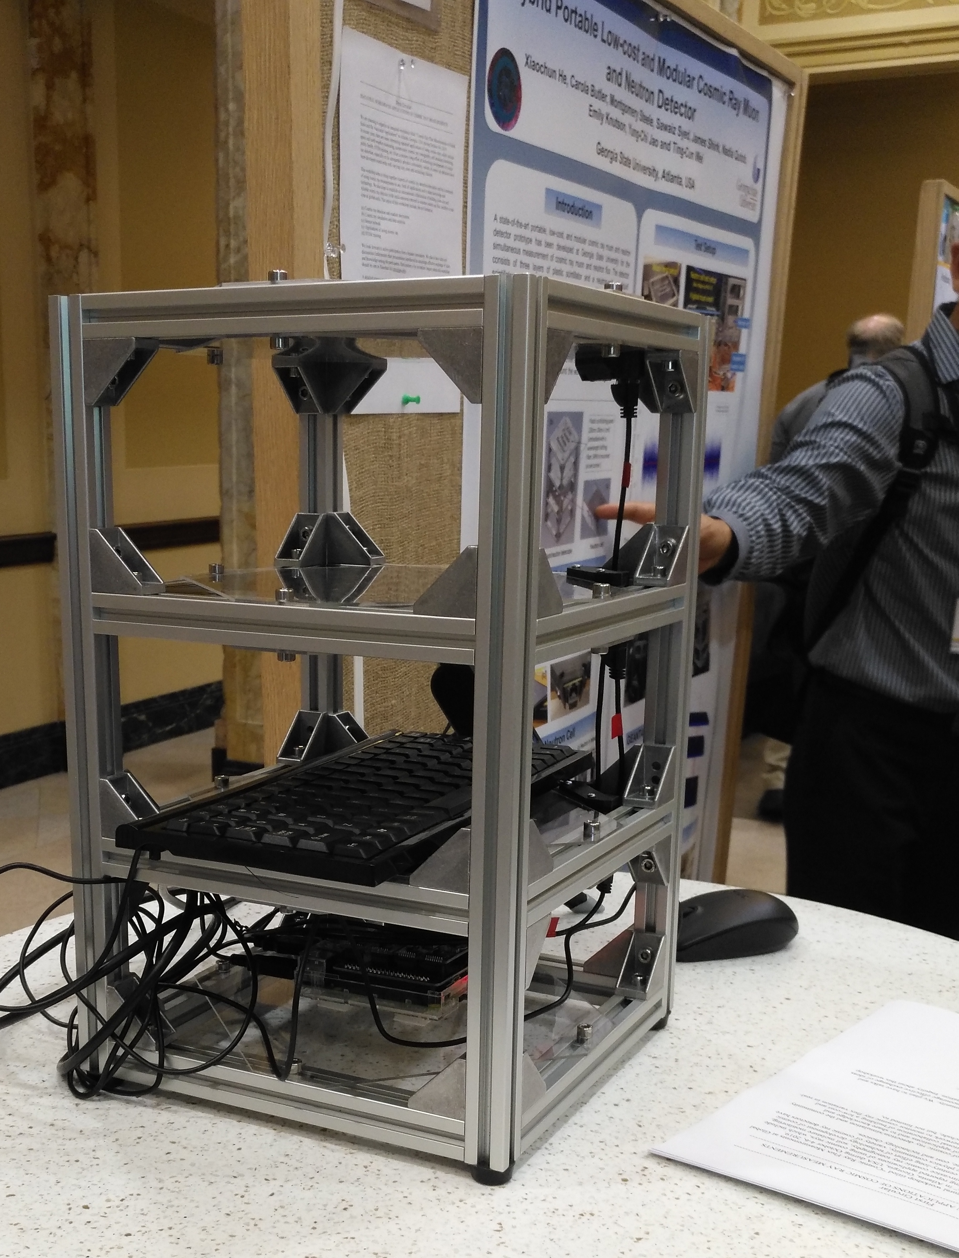
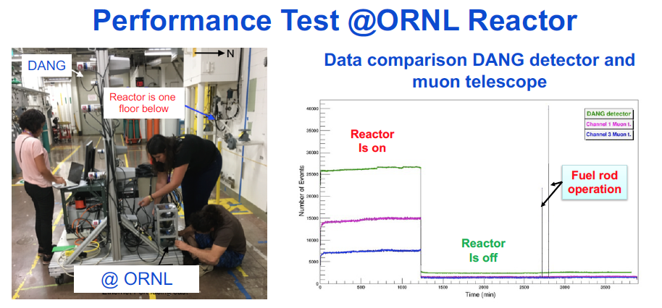
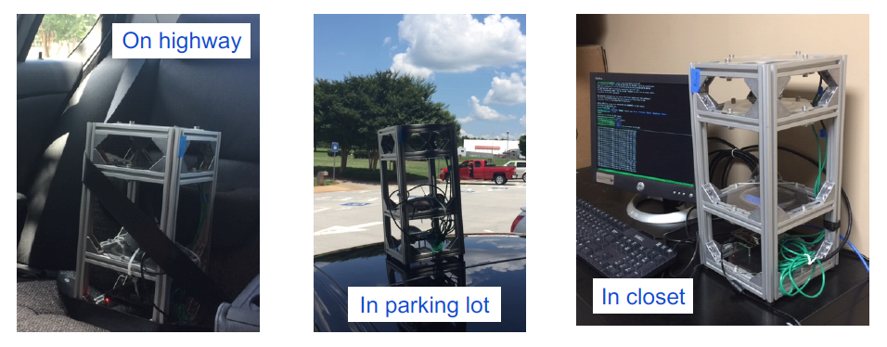
Reached out to the community
Live Demonstration at ICRC 2019 at Mandison, WI.
During a trip to Jefferson Lab

Slide 10
Challenges and Opportunity

Slide 12

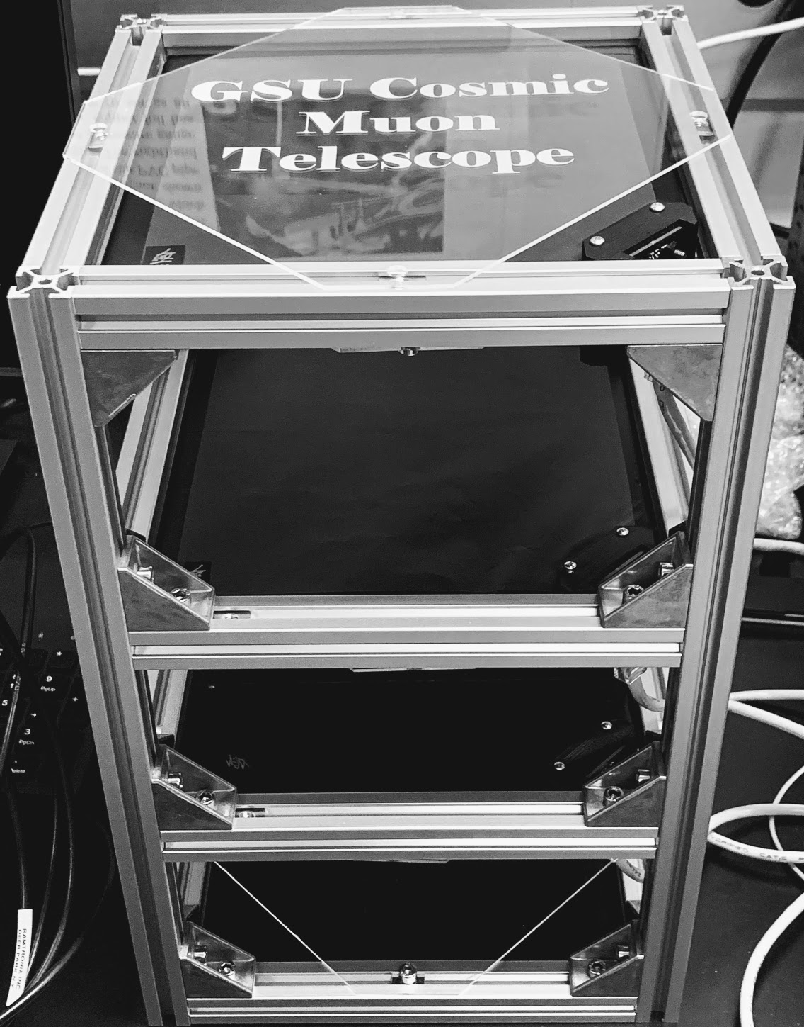
Go Global
If we build it, people will come
The community is large! How to reach out to them and start collecting data
This could be the largest experiment on the planet with small detectors!

