Slide 1
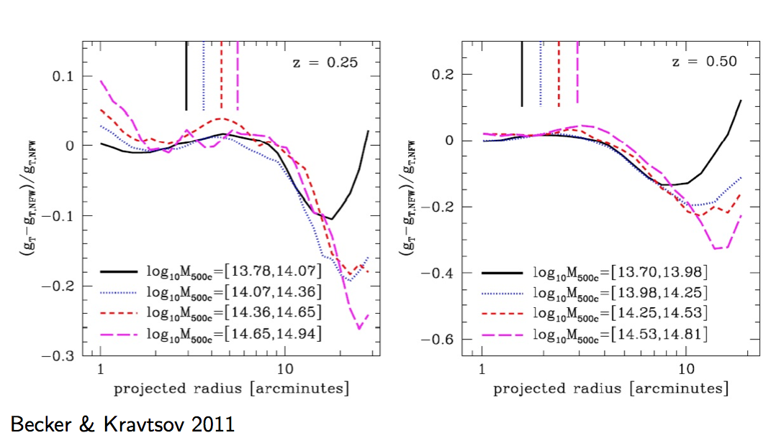
DESC Clusters group report
Very productive meeting– thank you to Pitt/CMU and all the local organizers!
There really is no substitute for in-person meetings.

Slide 2
Significant progress within group
EXAMPLES:
Defined a new set of simulations for the March 2014 highlight release, isolating measurements of lensing signal at fixed distortion level. (Will help improve accuracy of current cluster shear measurements.)
Determined priorities for the next round of cluster shear simulations.
Made important advances towards understanding how best to model cluster shear profiles and robustly measure cluster masses.
Can expect the above to have an important near-term impact on cluster cosmology constraints!

Slide 3
… and just as important
Cross-group discussions lead to progress:
With simulations group, for example:
Process for obtaining and analyzing required ray-traced cosmological simulations (thanks to Becker, Wechsler et al.)
Process for provision of improved mass functions, spanning required mass/redshift/cosmology range (thanks to Heitmann, Habib et al.)
Also productive discussions with weak lensing, strong lensing, and photo-z groups.
High bar for the next meeting!

