Slide 1
Theory/Joint Probes WG Activities mainly H1 & H2
Investigating modified gravity theories
Testing gravity and dynamical dark energy with various probes and their combinations including those with spectroscopic surveys
Mitigating systematics through cross-correlation clustering and lensing data, CMB lensing and weak lensing
Studying impact of approximate likelihoods
Modeling baryonic effects in large scale structure clustering

Slide 2
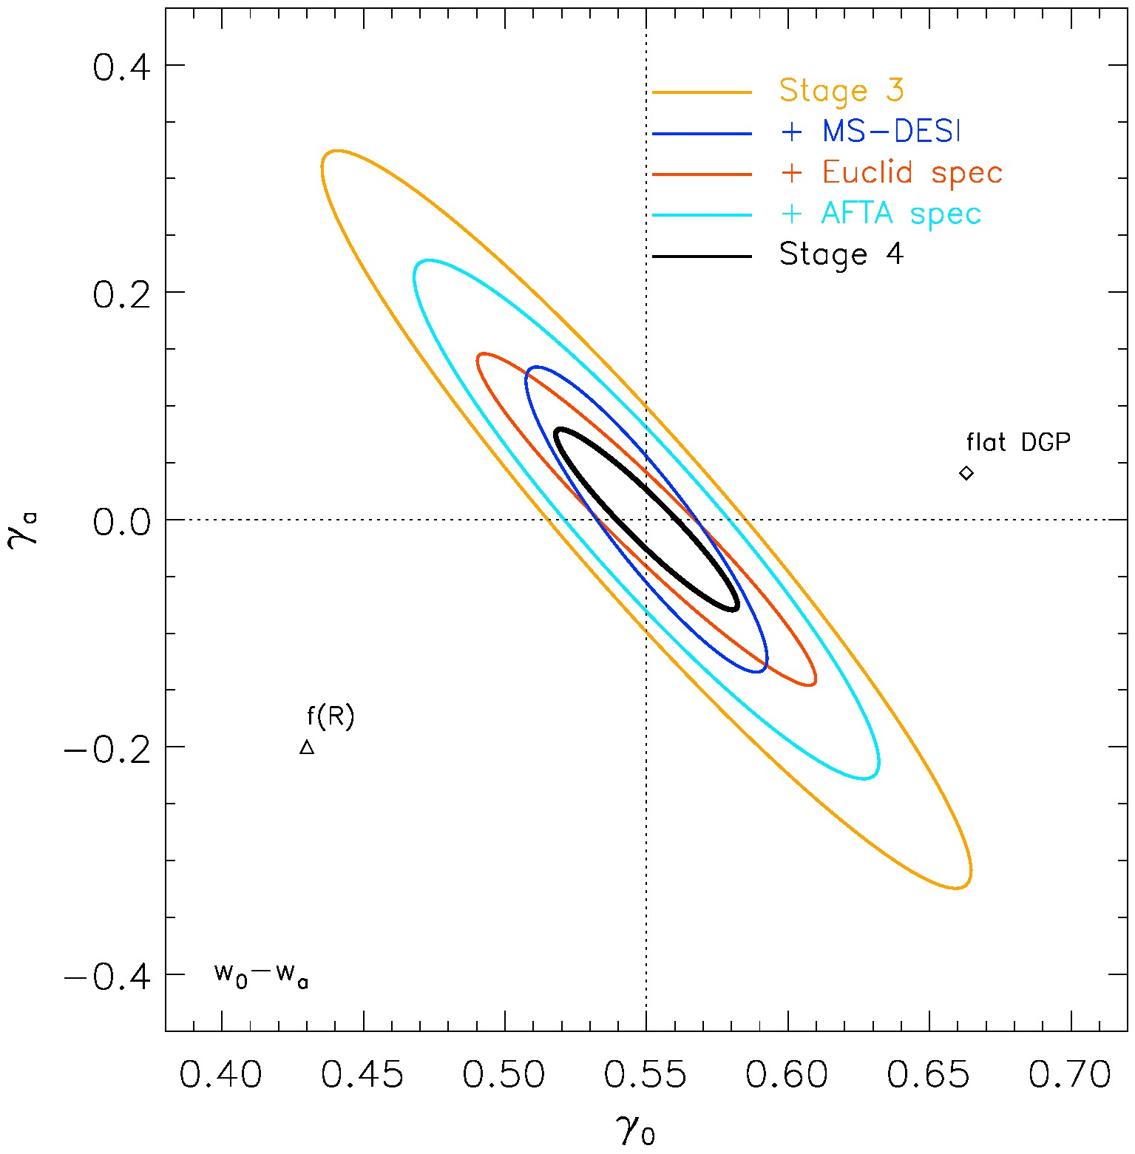
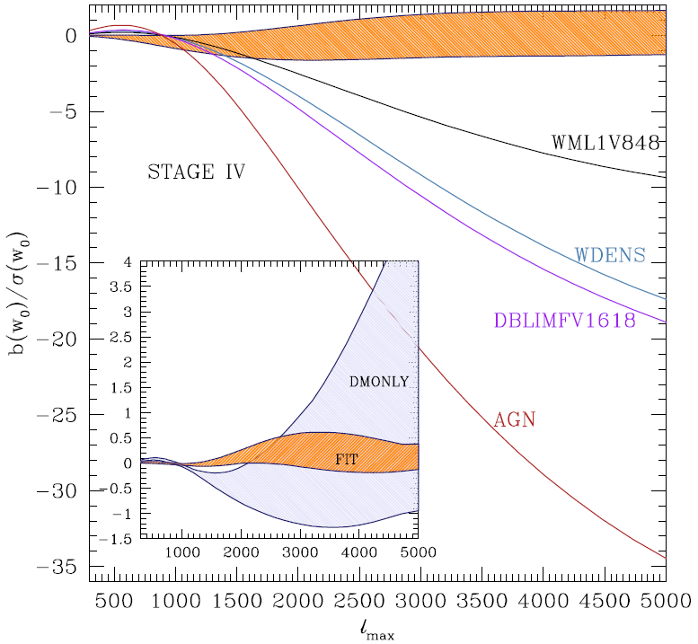
Theory/Joint Probes WG Activities
Forecast on γ & γ_{a} for various surveys
Mueller & Bean, in progress
Bias in w₀ due to baryons
Zentner et al., PRD, 2013

Slide 3
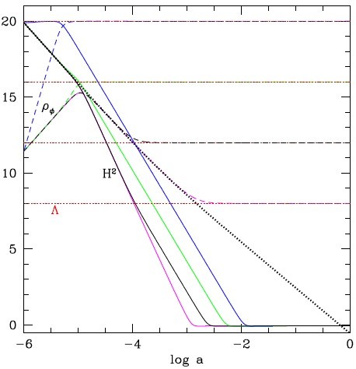
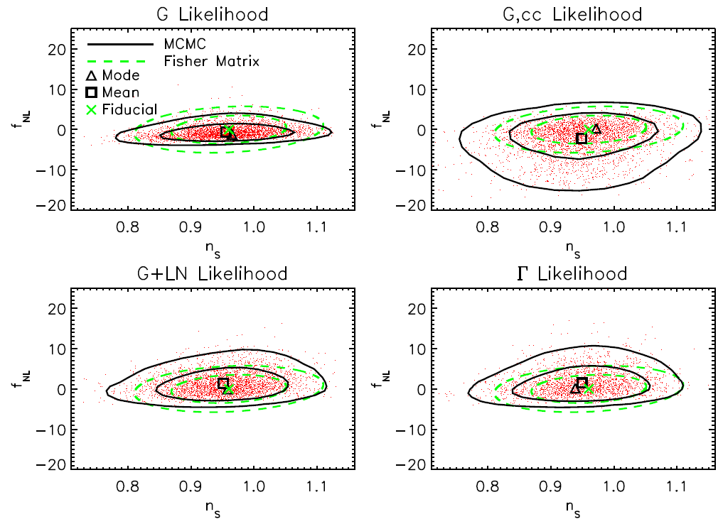
Theory/Joint Probes WG Activities
Fab 5 grav cancels all components.
Linder, 1310.7597
Impact of Gaussian approx. on f_{NL} estimation
Sun, Wang & Zhan, ApJ, 2013

