Slide 1
Update on PanDA Integration with the SLAC Pipeline for LSST DESC Use
Torre Wenaus, BNL
DESC Collaboration Meeting
University of Pittsburgh
December 5, 2013

Slide 2
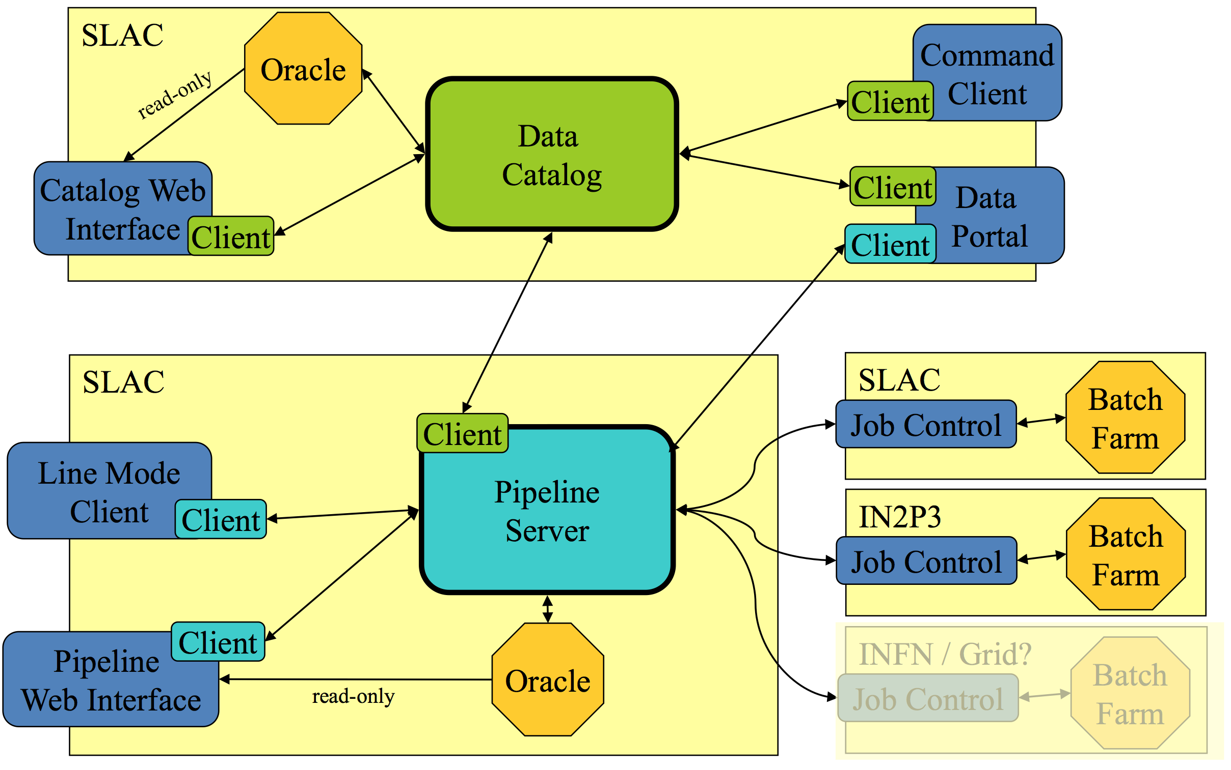
SLAC Workflow Pipeline and PanDA Prototype
PanDA as distributed job manager and gateway to grid, cloud, HPC resources

Slide 3
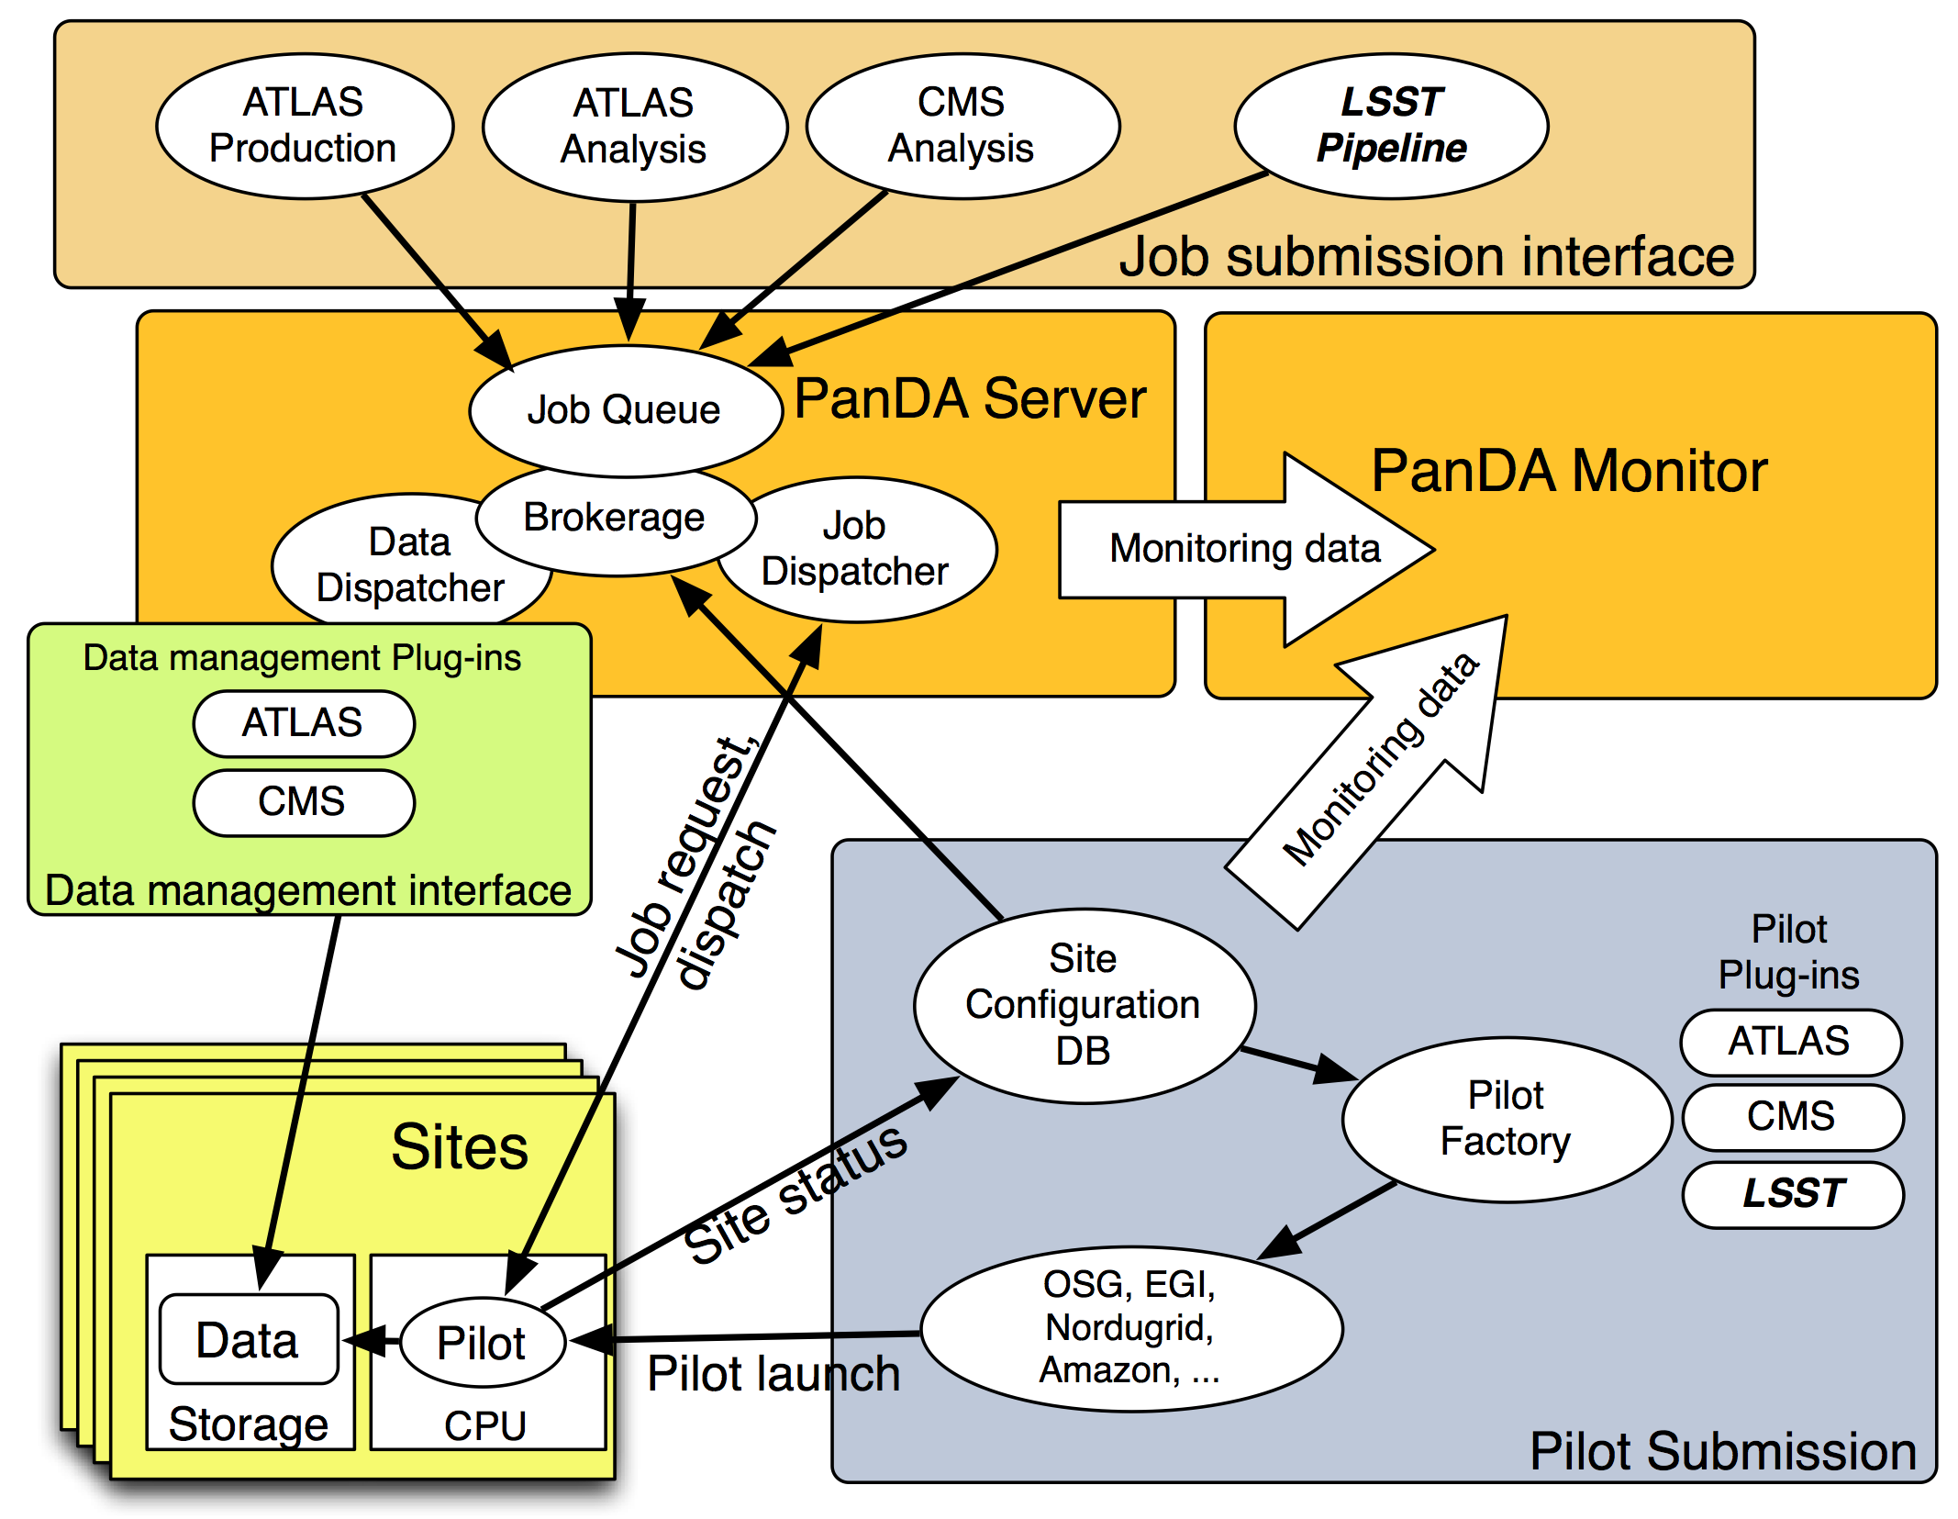
PanDA System Overview

Slide 4
PanDA and LSST
Pipeline => PanDA submission implemented and tested with HelloPanda and a standard DESC simulation workflow (phosim, DM stack) last June
PanDA implementation of Tony’s Java interface to pipeline
Initial tests used ATLAS PanDA queue at BNL and CERN based PanDA pilot submission
Presented at June DESC computing meeting, FNAL
Next step to use it seriously: move it to non-ATLAS infrastructure and resources

Slide 5
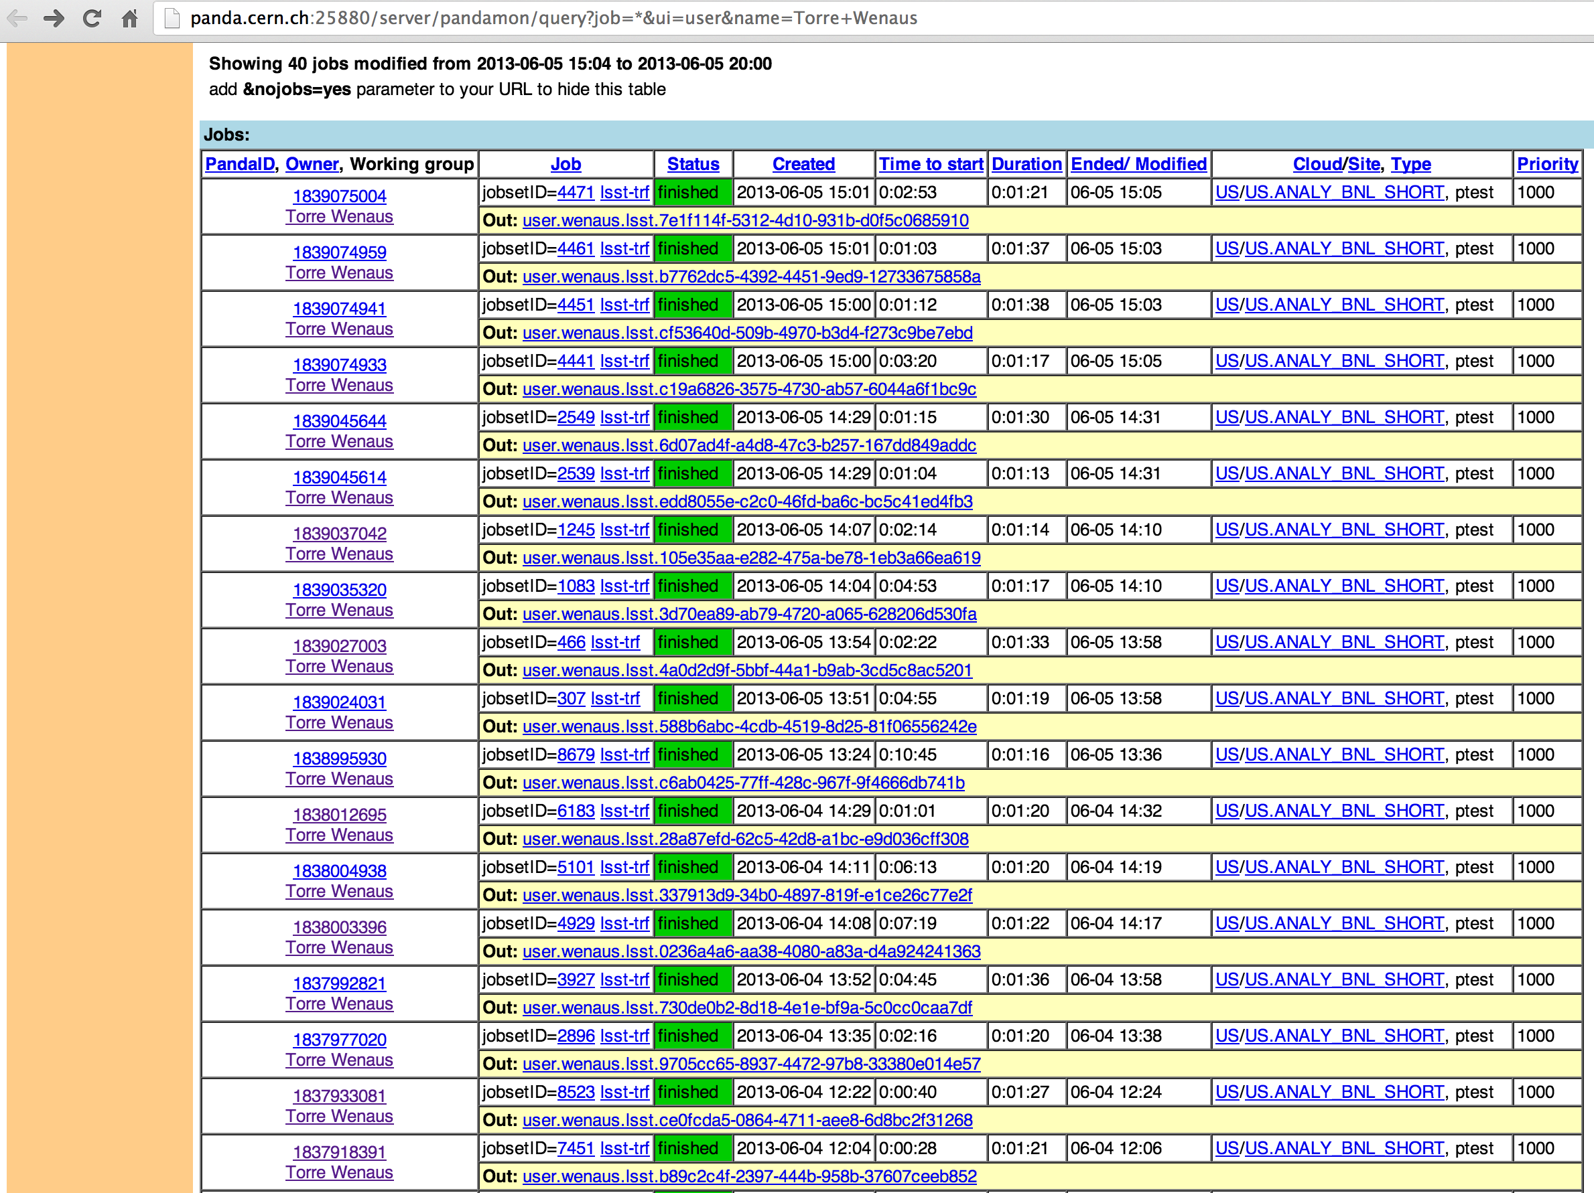
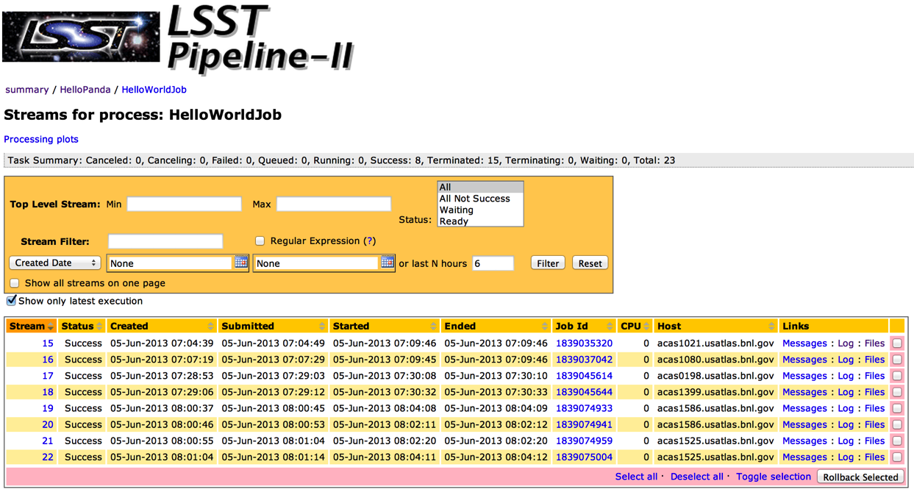
LSST PanDA jobs in pipeline and PanDA monitors (June)

Slide 6
Activities Since June
Work program established with Open Science Grid (OSG) to move PanDA towards becoming an OSG service
US PanDA instance supporting OSG VOs
Leverages “BigPanDA” project work on generalizing PanDA for non-ATLAS use: modularity, packaging, documentation, no Oracle requirement
Much progress since June by Jarka Schovancova (BNL) on the BigPanDA team
Implemented MySQL based PanDA server as a tandem (with Oracle) back end for non-ATLAS use
Amazon EC2 based MySQL PanDA service set up for OSG PanDA
VO-neutral PanDA monitor operating against the EC2 PanDA service for non-ATLAS PanDA monitoring (in progress)
LSST DESC is the first target for trying it all out
LSST DESC specific submission and monitoring

Slide 7
Current Activities
With the infrastructure in place for OSG VO support, working on LSST VO based pipeline-driven PanDA submission using non-ATLAS infrastructure
PanDA-pipeline daemon (Tony’s pipeline interface) moved to the PanDA OSG EC2 server
Pipeline-triggered PanDA job submission being set up there
Readying the associated job monitoring
PanDA site BNL-LSST serving the LSST VO created for LSST DESC jobs
Submission to the BNL-LSST site being set up

Slide 8
Next Steps
Slow progress, too often bumped by firefighting higher priorities
Solution – make this a higher priority by identifying real customers if we can
Would like to enlist and work with users to get their workloads up and running
Get DESC user input to tailor functionality, monitoring
Then extend to support opportunistic OSG (or non-OSG, e.g. HPC) sites – ie sites that don’t necessarily have a local LSST person helping out
Issues are software and data availability
For software, try out OSG’s Oasis service for CVMFS based distribution
For data access, xrootd a good candidate
Down the road, integrate the SLAC data catalog
Reported at CHEP to be a few months away from the new VO-neutral REST interface being ready

