Slide 1
DESC Pittsburgh Meeting
Bhuvnesh Jain
University of Pennsylvania
December 5, 2013

Slide 2
News and Updates
This week!
Final Design Review, Tucson
  Feedback by Friday
P5 panel, SLAC
  Presentations by LSST, DESI and CMB-S4 on Tuesday.
  Recommendations in a few months.

Slide 3
This session
Governance: Pat Burchat’s talk
  Friday vote
Highlight projects
  Analysis and Computing

Slide 4
High priority tasks and ``highlight projects”
We’d like to
Interact with our peers in the global cosmology community
Have an impact on ongoing surveys
Learn from cosmologists outside LSST
  An example of the above is the tree-ring structure in chips found by the LSST and DES teams!
Proposal
Every six months we release products that are advertised outside DESC
  First Release: March 2014; Second Release: November 2014
What qualifies – up to us to decide! A rough guide is:
  Of interest beyond LSST
  A product that we know _some_ people will use
  Can be done by an existing DESC group in a reasonable timeframe
These can include
  Simulation challenges in the spirit of the GREAT weak lensing challenge
  Software products
  Simulations runs
  Analysis or compilations of current data

Slide 5
Your ideas here!

Slide 6
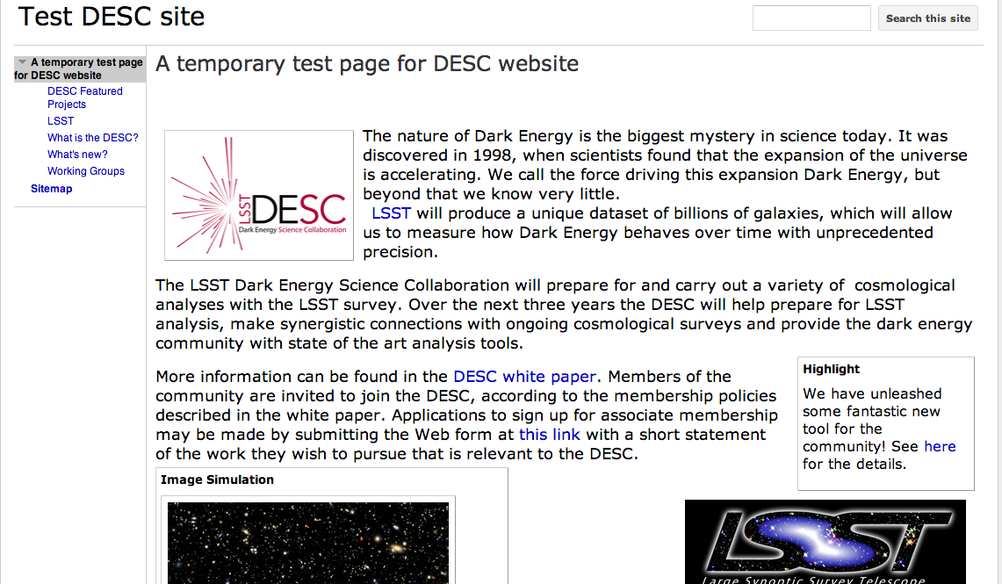
High priority tasks and ``highlight projects”
We have made a start on the DESC website. A lot more content and all of the design is to be done….
Thanks to Debbie Bard!

Slide 7
so we were looking at recent examples of website that have gone public…

Slide 8
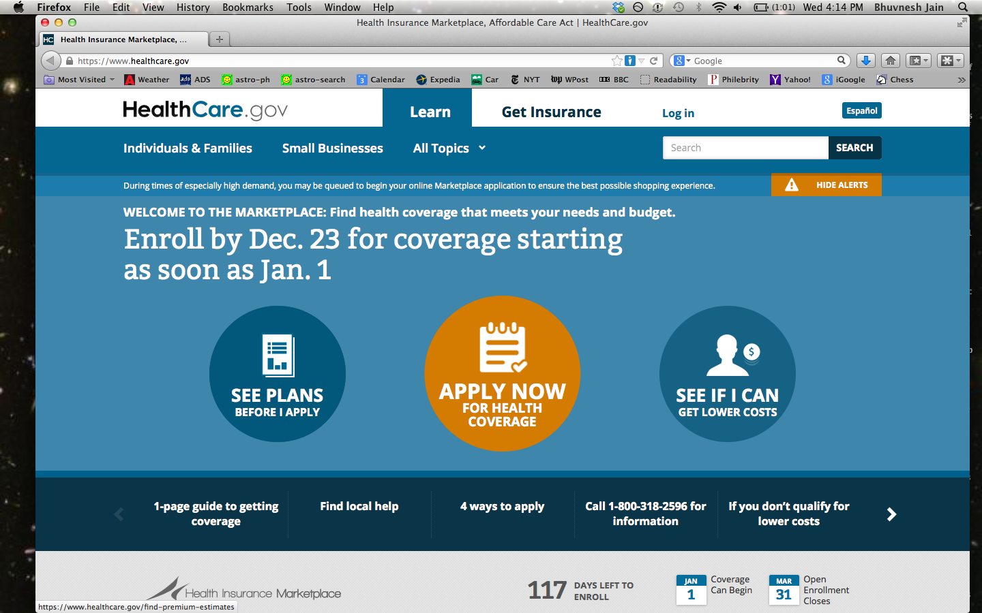
HealthCare.gov

Slide 9
How we stack up
HealthCare.gov | desc.org
Goal: to support 50,000 simultaneous users | Goal: 5 simultaneous users
Subsidizes your health care | Mitigates your systematic errors
200 million people consider it a disaster | 20 cosmologists will find it useful
In November 2013 the White House ordered a tech surge (America’s finest talents) to rescue it | In January 2014 Debbie Bard would like one volunteer (DESC’s finest) to help get it done

