Slide 1
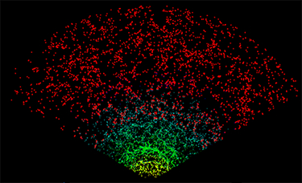
Gravity on Cosmic Scales and LSST
Eric Linder
5 December 2013
Berkeley Center for Cosmological Physics

Slide 2
Test Gravity
Test gravity in model independent way.
Gravity and growth: Gravity and acceleration:
Are φ and ψ the same? (yes, in GR)
Tie to observations via modified Poisson equations:
G_{light} tests how light responds to gravity: central to lensing and integrated Sachs-Wolfe.
G_{matter} tests how matter responds to gravity: central to growth and velocities (γ is closely related).
cf Bertschinger & Zukin 2008

Slide 3
Model (In)dependence
Single field scalar-tensor models (Horndeski) have fixed scale dependence: k⁰, k².
This isn’t a “miracle”. Denominators must be the same since both are defined in terms of δ. Cannot have k^{>2} because 2nd order OOM. Cannot have k¹ because FRW symmetry.

Slide 4
Scalar-Tensor
Don’t slip!
Using gravitational slip γ=φ/ψ as a variable obscures the origin of the physics and gives strong covariance in observational constraints.
How useful is this Horndeski form?
Only valid for linear perturbations
Only valid for single scalar fields
Corrections from matter anisotropic stress
Simple time dependence is invalid and even so poorly constrained

Slide 5
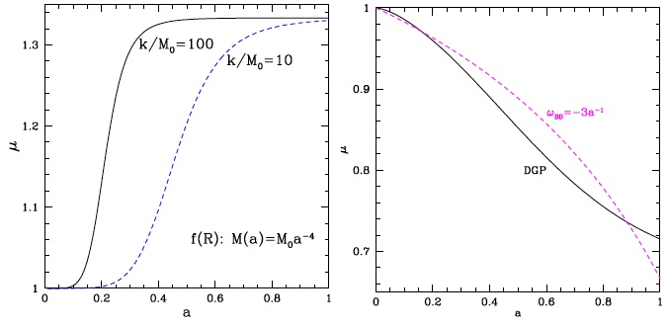
Power Law in Time?
G_{matter}
G_{matter}
Even simple (1-2 parameter) gravity models do not have a power law time dependence.
Incorrect dependence will preferentially weight certain epochs and bias results.

Slide 6
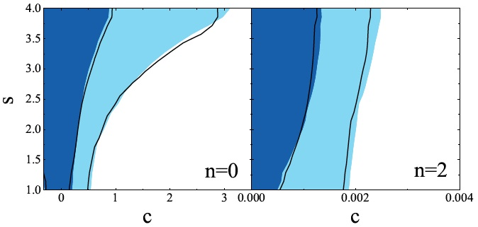
Power Law in Time
Even for power law time dependence, we get poor constraints.
p₃(a) ~ ca^{s} ~ p₅(a)
k⁰ (DGP)
k² (S-T)
Zhao+ 1109.1846

Slide 7
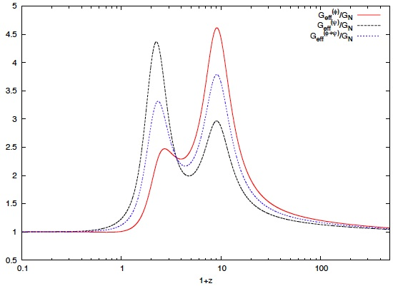
Not Power Law in Time!
Multiparameter models, e.g. Galileons, are emphatically non-power law!
Appleby & Linder 1112.1981

Slide 8
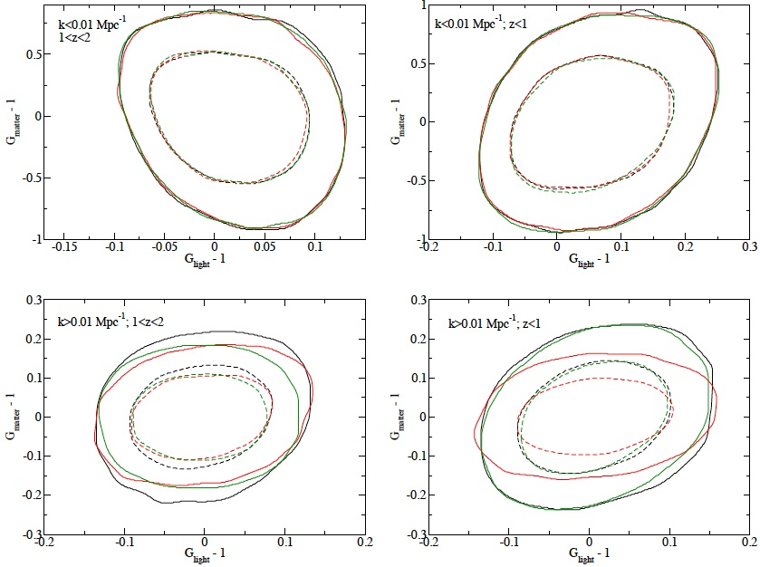
Testing Gravity
Model independent tests of gravity: two functions, at high/low z, high/low k (8 tests). Simultaneous fit for gravity, expansion (w₀, w_{a}), galaxy bias (27 bins).
Galaxy P_{k}+Planck
Fit all Fix to Λ Fix to b~1/D
Daniel & Linder 2013

Slide 9
Extending Gravity
Interesting recent theories extending gravity for cosmic acceleration often have shift symmetries (ϕ → ϕ+c) and higher order kinetic terms (ϕ_{μ}ϕ^{μ}), related to higher dimensions or massive gravity).
From Horndeski general scalar-tensor theory, Charmousis+ 2011 found “Fab 4” unique self tuning terms. Appleby, De Felice, Linder 2012 promote to nonlinear, mixed function.
Fab 5 gravity
Nonlinear function can act like 2nd scalar field, so breaks Horndeski (cf. Padilla & Sivanesan 2013)

Slide 10
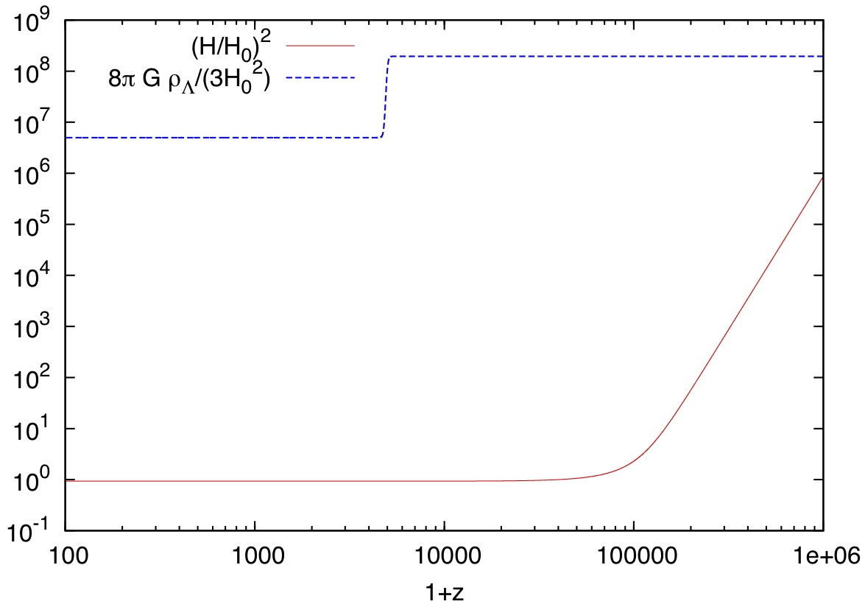
Fab 5 Gravity
Fab 5 accelerates, has tracker, de Sitter attractor, no extra dof! – and self tuning.
It makes Λ invisible!
ρ_{Λ}
H²
Appleby, De Felice, Linder 2012

Slide 11
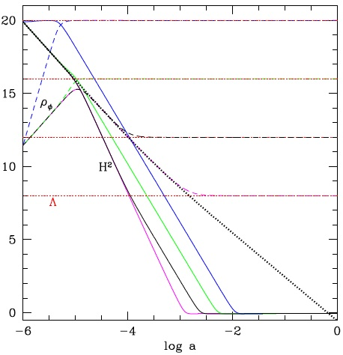
Too Fabulous
It makes Λ invisible! And everything else too...
It is not clear how to make self-tuning apply only to Λ.
This may kill John, and Horndeski G₅.
Linder 1310.7597

Slide 12
Summary
We have good phenomenological parametrizations of modified gravity – in a sense we’ve done the hard part of how to connect to LSST – but are unsure how to treat the time- and space-dependent functions.
Horndeski is limited. Power law is unrealistic and biasing.
Self-tuning from gravity coupling is a powerful new solution to cosmological constant problem – too powerful!
Model (in)dependence: damned if you do, damned if you don’t.
Need more work on model independence. Need better models (massive gravity? Arbitrary 2nd metric?).

