Slide 1
The GREAT3 challenge: what can the DESC get from it?
Rachel Mandelbaum
Dec. 4, 2013

Slide 2
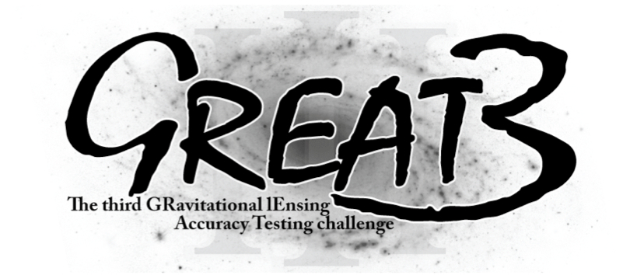
http://great3challenge.info
Supported in part by:
NASA via the Strategic University Research Partnership (SURP) Program of the Jet Propulsion Laboratory
The IST Programme of the European Community, under the PASCAL2 Network of Excellence, IST-2007-216886

Slide 3
GREAT3 executive committee: Some familiar names
Bosch, Chang, Courbin, Gill, Jarvis, Mandelbaum, Miyatake, Nakajima, Rhodes, Rowe, Simet, Zuntz

Slide 4
What questions do we want to answer?

Slide 5
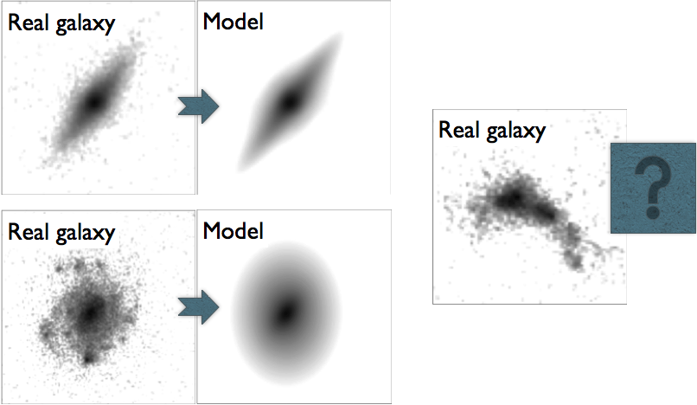
Galaxies are messy. We need to quantify the effect of this messiness on WL shear inference in a general context.

Slide 6
Realistic PSFs, spatial variation
Atmospheric PSFs based on imSim
Optical PSFs based on older DECam model (ground), WFIRST-AFTA (space)

Slide 7
Two-point functions

Slide 8
Combination of multiple exposures (6)
Two regimes:
Ground, Nyquist-sampled: test of implementation details
Space, undersampled: true algorithmic issue
Realistic variation of PSFs between exposures: a straightforward stack might not be optimal
Note: does not include some complications like unknown offsets between exposures

Slide 9
How does the challenge design enable us to make these tests?
Increased complexity / sophistication
Gradual introduction of effects

Slide 10
5 experiments / 20 branches

Slide 11
Timeline
August 2013: Initial “alpha release” of a fraction of the data
Oct 2013: Beta release of 60% of the data, initiating 6-month challenge period
Nov 2013 (end): end of beta status
~this week: release of the other 40% of the data
April 30, 2014: end of challenge
Week of May 19, 2014: end of challenge meeting (at CMU, in Pittsburgh, PA)

Slide 12
How is this helpful for DESC? (the narrow view)
Realistic galaxy morphology: are the algorithms we are considering using affected by morphology at the few % level, 1%, <1%? → possible strategy changes?
Realistic PSF variation: lessons about PSF interpolation algorithms for a non-trivially complex atmospheric + optical PSF model
Multiepoch: possibly less interesting considering the number of exposures being simulated and reduced complexity

Slide 13
How is this helpful for DESC? (a broader view)
GREAT3 drove many helpful GalSim improvements, which can facilitate some of the tests we need done:
Highly accurate shearing of realistic galaxy images
Config / catalog-handling / large batches of images
Simulation scripts will become public, and are easily modifiable to carry out other tests of interest to the DESC.

Slide 14
What can you do now?
Participate!! (Please?)

