Slide 1

Wavefront information for weak lensing
Michael D. Schneider
LLNL / UC Davis
December 4, 2013

Slide 2
Motivation
Knowledge of the wavefront phase perturbations in the pupil can help us:
  Predict and fit the PSF
  Validate the AO control (real-time and in post-processing)
  Constrain the PSF interpolation, particularly in regions of low stellar density.
We can learn about the wavefront in the pupil by:
  Wavefront sensors (WFS), at 4 field locations, ideally through forward modeling
  Putting the telescope out of focus periodically (strategy in DES)
  Fitting a model to the science PSFs (limited by seeing contributions)
We are primarily concerned with the optics PSF, but all considerations apply to the atmosphere turbulence as well in principle.

Slide 3
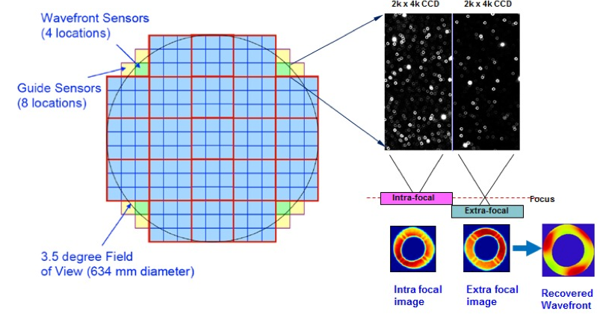
Active Optics control will improve image quality, but also introduce dynamic optics residuals in the PSF
What metrics for image correction will validate WL-driven requirements?
Can residuals / degeneracies ever be a concern for ellipticity correlations?
Is there extra information that can help with PSF fitting & interpolation?
Design sufficient given:
- 4 sensors at corners of image
Faint, sparse stars
Manuel et al. (2008)
Claver, Liang (2012/13):
r.m.s. of wavefront mode amplitudes can be controlled to Project tolerances (0.01) given expected noise, star density

Slide 4
Some potential concerns for AO control that might affect the PSF correlations for WL
Degeneracies in wavefront perturbations between optical surfaces.
Accurate and physical basis expansion of wavefront perturbations and mirror figure errors.
Aliasing with atmospheric turbulence.
Non-common path errors (e.g. chip height variations).
Vignetting changes in the shape of the out-of-focus star images.
Blind modes.
Star selection (crowding & scarcity)
Thanks: M. Ammons, C. Claver, B. Macintosh, L. Poyneer, A. Roodman

Slide 5
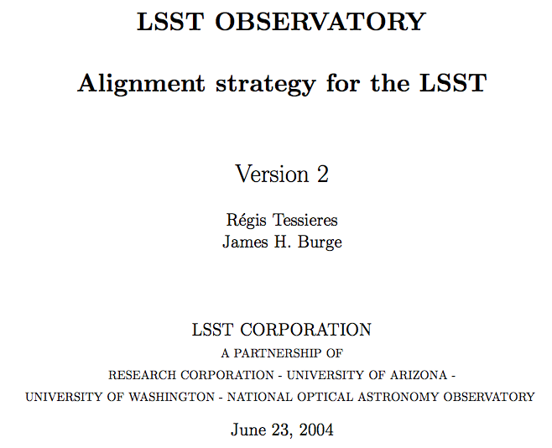
A similar model was constructed early in the LSST project design
https://docushare.lsstcorp.org/docushare/dsweb/Get/Document-14667/LSST_Alignment%20(Tessieres).pdf

Slide 6
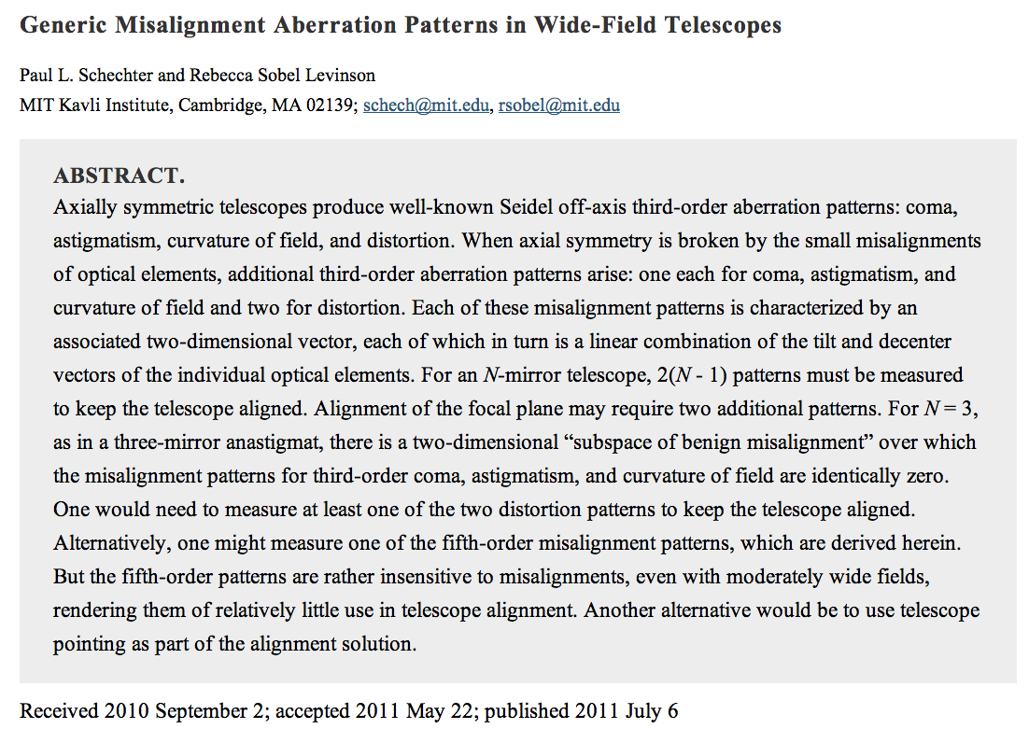
Same model recently used to assess LSST WFS plan
http://www.jstor.org/stable/10.1086/661111

Slide 7
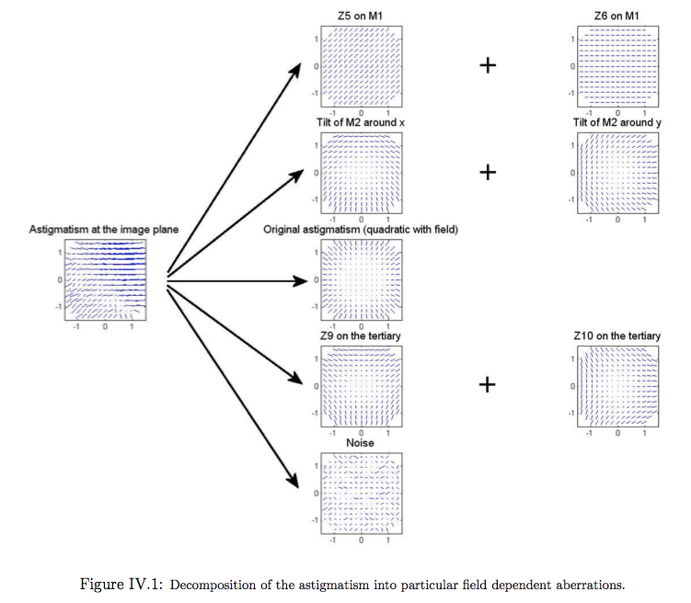

Slide 8
Modeling misalignments of optics
The wavefront can be series expanded in powers of the pupil coordinate, rho, and field coordinate, H:
For a perturbed system, the field coordinates get remapped:
  Work out cross terms and reorganize -> new lower order terms produced.

Slide 9
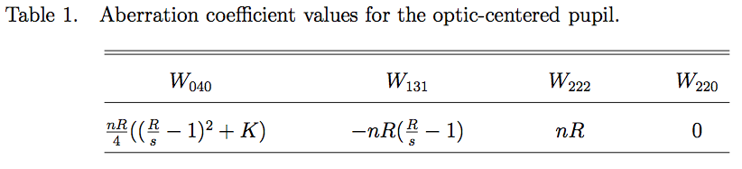
Telescope parameters for deriving wavefront perturbations from misalignments
Field
curvature
Spherical aberration
Coma
Astigmatism
For each mirror:
R: curvature
K: conic constant
m: magnification
s: position
n: index of refraction
Schechter & Levinson (2011)

Slide 10
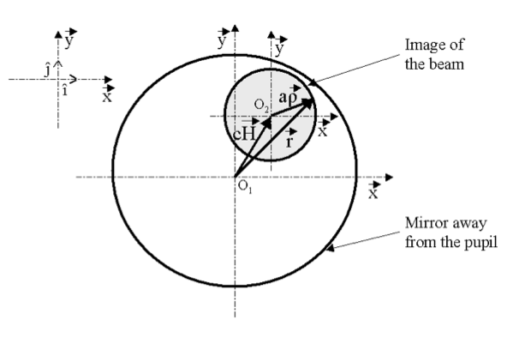
Geometry for mapping bending modes on mirrors to basis functions in the exit pupil

Slide 11
“Subspace of benign misalignment”
Schechter & Levinson (2011) identify that for a “three mirror anastigmat” there is a subspace of benign misalignments where 3rd order perturbations cancel.
  No need for AO to correct beyond 3rd order?
  What do 5th order (and higher) residuals impart to the ellipticity correlations?
  “… a small relative error in a measurement of a third-order aberration pattern will produce a large relative error in the corresponding fifth-order aberration pattern.”

Slide 12
Implementation with GalSim
Code at: https://github.com/DarkEnergyScienceCollaboration/psf_model
Define parameters: Zernike coefficients on each mirror and tilts/decenters mapped to image plane displacements.
Map to Zernike coefficients in pupil with the previously described coordinate transforms.
GalSim: Construct pupil wavefront from Zernike coefficients
Sum the pupil wavefronts from each mirror
  This is not strictly correct because the LSST mirrors are not conjugate.
  Can do an FFT to propagate each wavefront instead.
GalSim: FFT the combined pupil wavefront to get the PSF in the image plane.
GalSim: Measure the PSF moments.
Go to step 2 and repeat for each position in the image plane.

Slide 13
Model parameters
8 Zernike terms on each of M1/M3 and M2 for a total of 16 bending mode parameters
  Defocus, astigmatism (1,2), coma (1,2), trefoil (1,2), spherical aberration
2 image plane displacements (x, y) mapped from tilts and decenters of:
  Secondary, tertiary, L1, L2, L3
  10 parameters total
Combined: 26 optics perturbation parameters
Merit function for AO control:
r.m.s. of the Zernike aberration coefficients for the pupil wavefront as measured at the 4 field locations of the WFS

Slide 14
Tilts & decenters of M2
Consider a perturbation of M2 along the x-axis.
Astigmatism dominates – What is the expected field dependence of the ellipticity?
For small perturbations (sigma) the red term dominates.
-> Astigmatism amplitude linear in field position.
For larger sigma, the blue term dominates.
-> Astigmatism amplitude constant over the field.
Small perturbation
Large perturbation

Slide 15
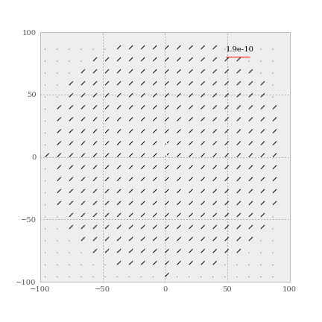
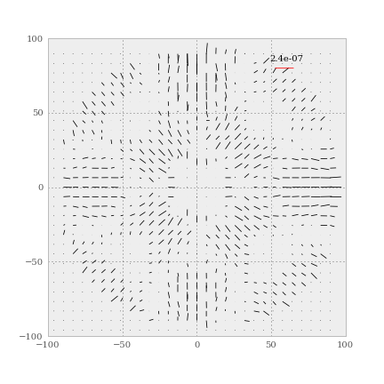
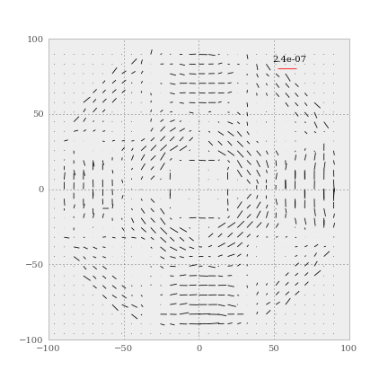
Bending modes
Z5, Z6 – Astigmatism component on each mirror with same amplitudes
M1
M2

Slide 16
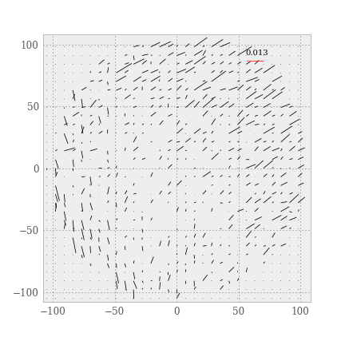
Astigmatism added to all surfaces

Slide 17
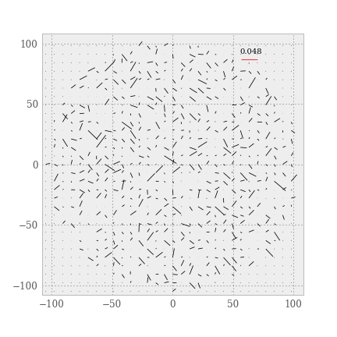
Random perturbation coefficients for all modes

Slide 18
Sensitivity analysis
With Ammons, Bard, Bauman, Macintosh, Roodman, Tyson
and DESC SF Bay Area working group

Slide 19
Sensitivity analysis plan
Compute the PSF at a grid of field locations for different combinations of optics perturbation parameters.
  25 points selected in the 26 dimensional parameter space using an ‘Orthogonal Array Latin Hypercube’
  Constant seeing kernel at 0.6”
  Width of input parameter space selected to yield merit functions ~ 0.01 (but not strictly in this bound as we will see)
Summary statistics (e.g. merit function, ellipticity) can be modeled as Gaussian Processes for interpolation over the input parameter space.
  Same statistical framework as used by ANL group for matter power spectrum
  Study allowed input parameter volume given WL-driven requirements on the outputs.

Slide 20
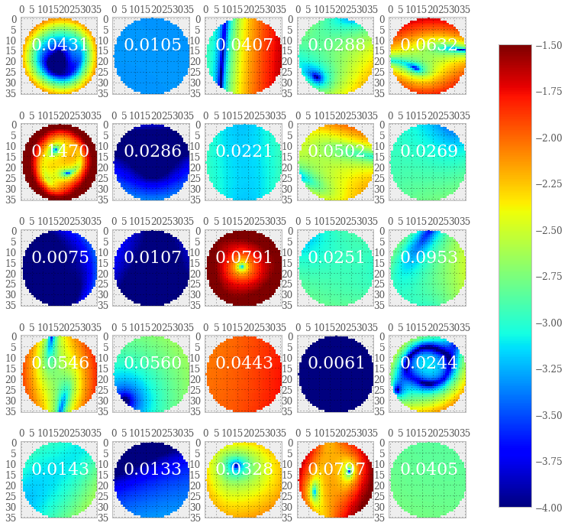
Ellipticity magnitude distribution at each design point
26 parameters for optics perturbations
Color:
Base 10 log of
ellipticity magnitude
Numbers in each panel are the merit function for AO control.
Nominal tolerance: 0.01

Slide 21
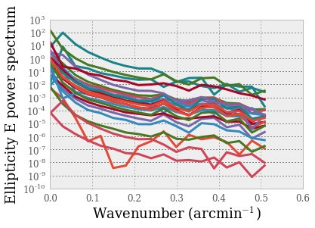
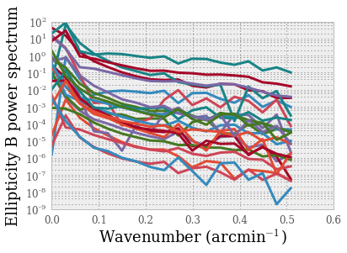
Ellipticity power spectrum at each design point
The power spectrum of the ellipticity distribution sometimes has non-negligible power at small separations.
This could be helpful in interpolating PSFs in sparse regions.
Note: only 3rd order perturbations!

Slide 22
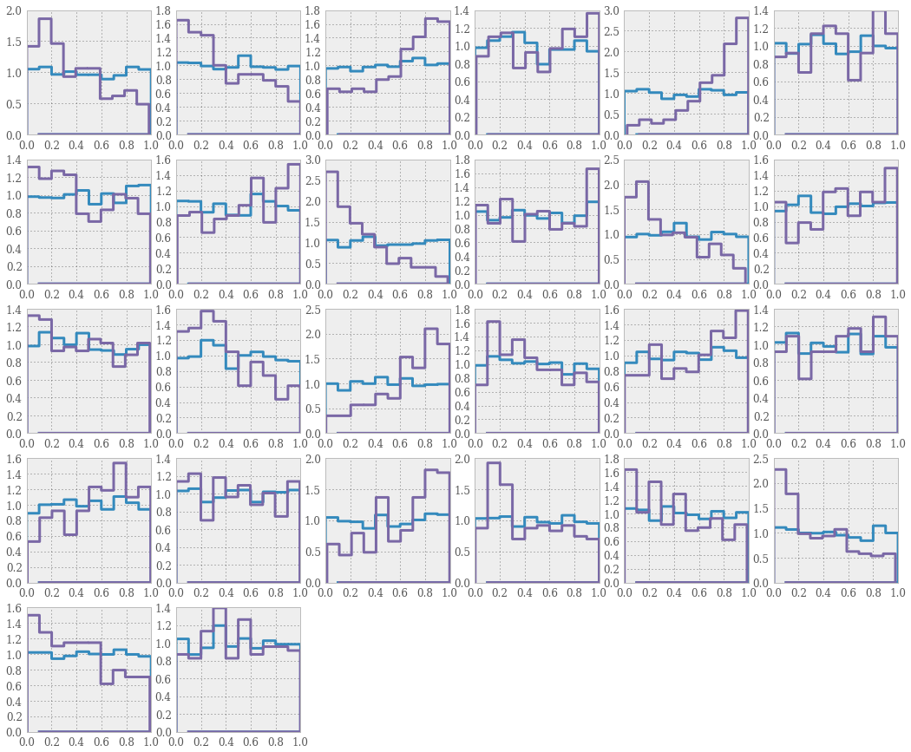
Parameter volume with bounded merit function
M1/M3
defocus
M1/M3
Astig 1
M1/M3
Astig 2
M1/M3
Coma 2
26 optics perturbation parameters
Blue: no bound on merit function
Purple: merit function < 0.01
M1/M3
Coma 1
M1/M3
Trefoil 1
M2
defocus
M2
Astig 2
M1/M3
Trefoil 2
M1/M3
Sph. aberr.
M2
Astig 1
M2
Coma 1
M2
Trefoil 2
M2
Coma 2
M2
Trefoil 1
M2
Sph. Aberr.
M2
Sigma_x
M2
Sigma_y
L1
Sigma_x
L1
Sigma_y
L2
Sigma_y
M3
Sigma_x
M3
Sigma_y
L2
Sigma_x
L3
Sigma_x
L3
Sigma_y

Slide 23
Forecasts: aligning the telescope with the star
PSFs in the science images

Slide 24
Fisher matrix forecasts on M2 misalignments
How much information about optics misalignments is in the star PSFs in the science images?
  Pro: Many field positions (not just edges like WFS)
  Con: profile dominated by seeing
Approach: calculate numerical derivatives of PSF moments with respect to misalignment parameters.
Fisher matrix uses derivatives to forecast parameter constraints.
Example:
  M2 misalignment (dx, dy)
  1000 stars with max S/N ~ 250
  Use only ellipticities.
  Offsets mapped to image plane constrained to 0.07 arcminutes if the fiducial model is a misaligned telescope.

Slide 25
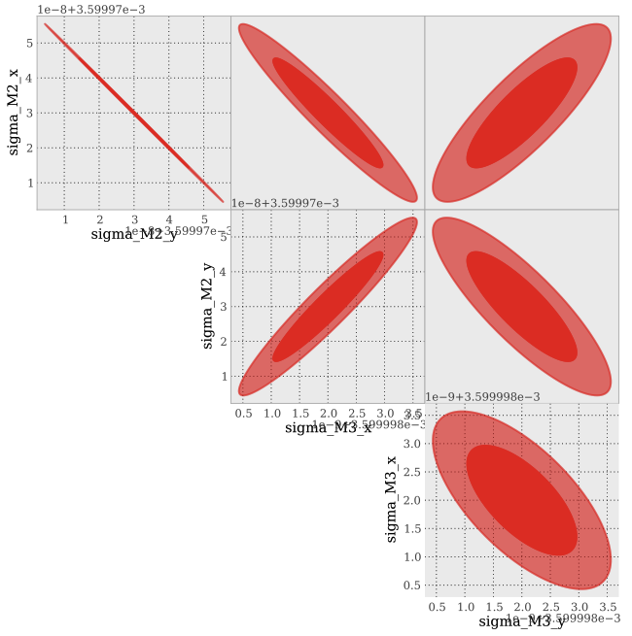
Constraints on tilts/decenters of both mirrors
Units: arcseconds

Slide 26
LSST Geometry for tomography from wavefront sensors
S. M. Ammons (LLNL)

Slide 27
Summary
We have a reasonably fast model to predict the optics PSF over the image plane.
  Code in the DESC github repository
Exploring WL-driven requirements on AO control.
  Working towards a forward model for the AO control as done by Roodman for DES.
Combined information from the WFS and the science PSFs can help us constrain the contributions to the PSF.
  Physical model / prior for PSF fitting and interpolation

Slide 28
PSF Simulation
With Lisa Poyneer & Bruce Macintosh

Slide 29
PSF simulation - motivation
What PSF features do we care about for shape estimation?
  Need detailed simulation to assess validity of approximations.
How do we model the atmosphere correctly?
How do we fit and interpolate a measured PSF?
  When and at what level are chromatic features important?
Simulation code credit: Lisa Poyneer

Slide 30
PSF simulation parameters
3 layer atmosphere with arbitrary r_0, wind velocity
  No outer scale (!)
Fresnel & Fraunhofer propagation
  Using JPL Proper code
Simple telescope model
  Spiders included
Layer 1: 50 m altitude, 18 cm r0, 5 m/s wind speed at 0 deg
Layer 2: 1000 m alt, 40 cm r0, 10 m/s wind at -73 deg
Layer 3: 5000 m alt, 23 cm r0, 8 m/s wind at 135 deg
Total r0: 12 cm

Slide 31
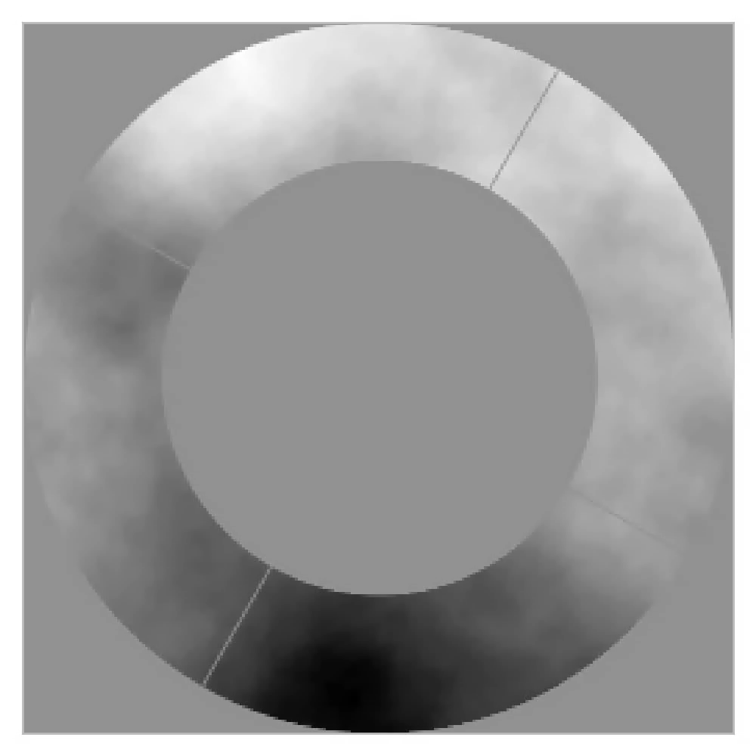
Phase evolution in on-axis pupil

Slide 32
Speckle intensity vs time

Slide 33
Speckle intensity vs time – no tilt

Slide 34
Speckle decorrelation time
Conclusion: time steps should be < 1 second

Slide 35
FWHM vs exposure time
Solid: 20 msec timesteps
Dashed: 1 sec timesteps

Slide 36
Ellipticity vs exposure time
Solid: 20 msec timesteps
Dashed: 1 sec timesteps

Slide 37
Fresnel vs Fraunhofer propagation – 3 sec exposures

Slide 38
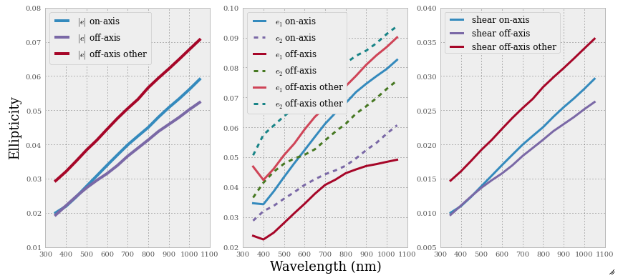
Wavelength dependence, ellipticity correlation, and wind direction

