Slide 1

Atmosphere model exploration
Michael D. Schneider
LLNL / UC Davis
December 5, 2013

Slide 2
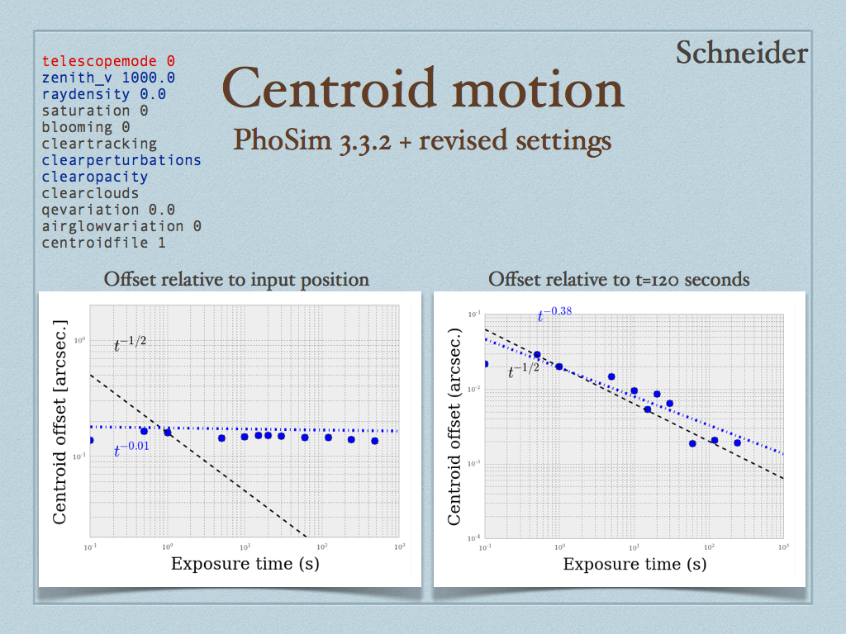
How can users better understand the choice of settings?

Slide 3
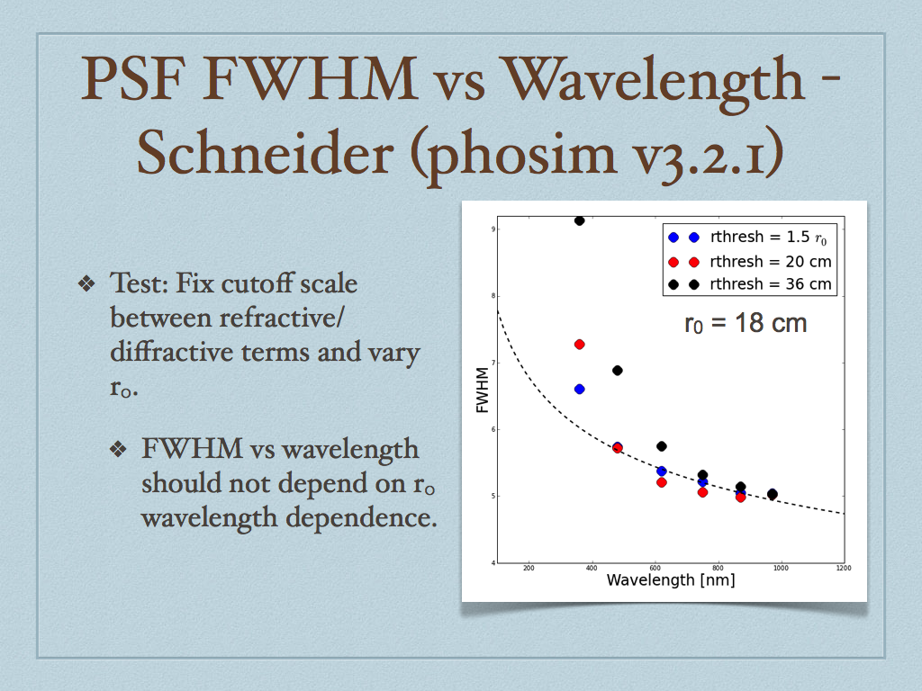
Josh Meyers tests informative for this issue – when do we want finer binning in wavelength?

Slide 4
PhoSim phase screen construction
3 screens of different resolutions combined together to achieve wide dynamic range with minimal memory footprint.

Slide 5
New approach for atmosphere modeling
Nearly all atmosphere simulation methods to-date assume the “frozen flow” approximation – generate static screen and ‘blow’ across aperture to model wind.
Time variations in the Fried parameter and outer scale could be non-negligible for the LSST wide field.
Also, generating a big phase screen for the full meta-pupil is memory intensive and unwieldy.
Alternative:
  Conditional phase screen generation in configuration space
  Requires Kolmogorov correlation function and Cholesky decomposition – expensive!
  There are some neat mathematical algorithms to potentially make this a feasible and competitive approach.

Slide 6
Algorithm for phase screen generation in configuration space
Compute Kolmogorov covariance matrix (Npix x Npix)
Compute Cholesky decomposition of covariance
Generate a vector of iid uniform random variates of dimension equal to the size of the next phase screen increment
Multiply uniform vector by Cholesky factor

Slide 7
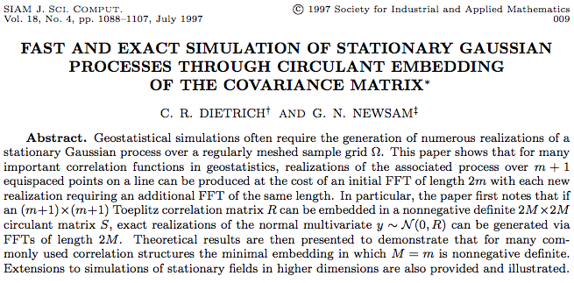

Slide 8
PSF simulation parameters
3 layer atmosphere with arbitrary r_0, wind velocity
  No outer scale (!)
Fresnel & Fraunhofer propagation
  Using JPL Proper code
Simple telescope model
  Spiders included
Layer 1: 50 m altitude, 18 cm r0, 5 m/s wind speed at 0 deg
Layer 2: 1000 m alt, 40 cm r0, 10 m/s wind at -73 deg
Layer 3: 5000 m alt, 23 cm r0, 8 m/s wind at 135 deg
Total r0: 12 cm

Slide 9
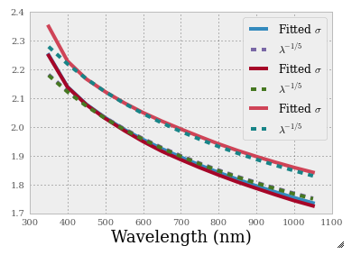
Wavelength dependence: 3 sec exposures
Wavelength dependence is a prediction, not an input.
Can test different scenarios that might impact chromaticity.
FWHM

Slide 10
Fresnel vs Fraunhofer propagation – 3 sec exposures

Slide 11
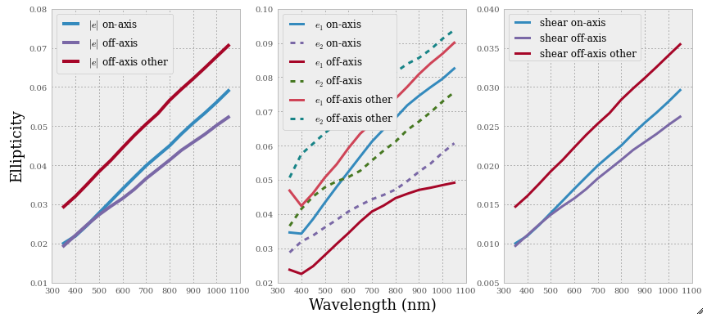
Wavelength dependence, ellipticity correlation, and wind direction
Why different slopes?

Slide 12
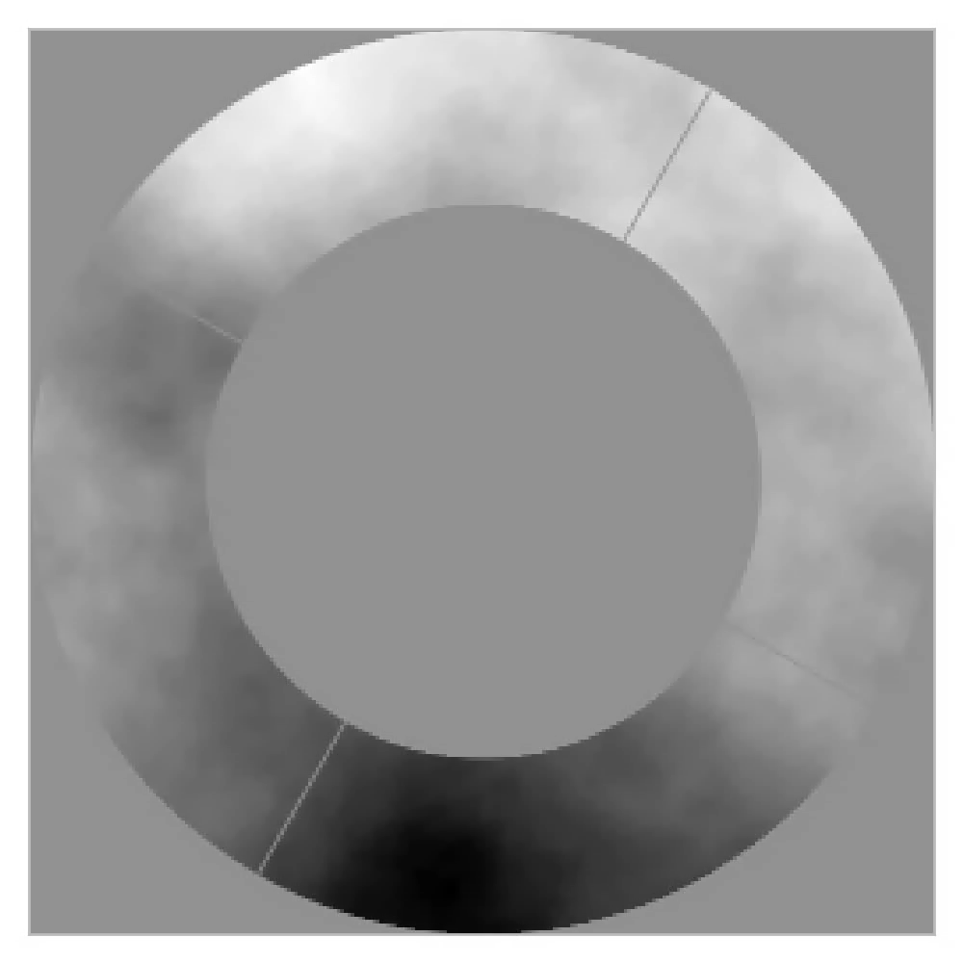
Phase evolution in on-axis pupil

Slide 13
Speckle intensity vs time

Slide 14
Speckle intensity vs time – no tilt

