Slide 1
DESC Computing Resources and Model
Richard Dubois
richard@slac.stanford.edu
5 Dec 2013
DESC Collaboration meeting
Pittsburgh, PA

Slide 2
Outline
Short term resources available: NERSC and SLAC
Scenario for needs at First Light
Potential “High Profile” project: “Imsim on Demand”
What we still need from you

Slide 3
Short term resources: NERSC
The 2013 NERSC MPI allocation is winding down
2.5 M CPU-hrs allocated
1M used so far; allocation has been reduced to 1.5M
30k hrs used investigating running ImSim
Rest in collaborator use
Peter Nugent led the charge to renew the allocation for 2014: 5M CPU-hrs requested
2M for collaboration cosmo sims
2M for ImSim
1M for individual collaborators
300 TB storage
Awaiting the outcome of the request

Slide 4
Using NERSC
Fill out account forms
Process is straightforward and there is help
Do you need HPC, I/O intensive, GPU?
Notify me or Peter Nugent to be added to DESC project
Tips on setting up:
http://www.nersc.gov/users/accounts/user-accounts/
https://confluence.slac.stanford.edu/display/LSSTDESC/NERSC+usage+tips

Slide 5
Mid-range Resources: SLAC
SLAC is accustomed to providing mid-range computing resources to collaborations
Follow procedure for getting a unix account at SLAC
Gives access to our batch farm
Recently upgraded to have 3k cores connected by infiniband
Have ImSim builds installed and are writing cookbooks for usage
Will need some idea of resource needs for us to supply storage and batch allocation

Slide 6
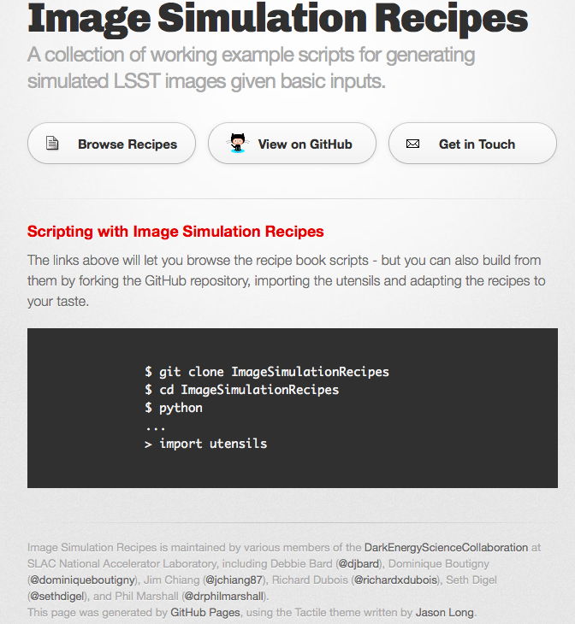
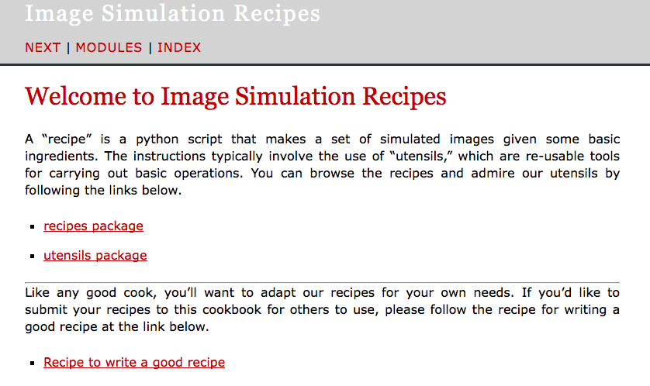
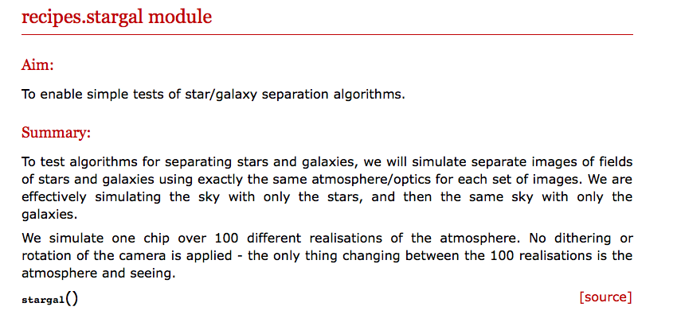
ImSim Recipes: work in progress
Example scripts to get started with
http://darkenergysciencecollaboration.github.io/ImageSimulationRecipes/

Slide 7
Projecting Needs up to First Light
Example from the WL group:
Several observables that we estimate for each galaxy require exquisite accuracy, such that there is no currently known algorithm that produces the required estimates without systematic errors at the level that LSST requires. One notable example is the shear estimate to be used for weak lensing. The current state of the art algorithms are known to have biases at a level that will be unacceptable for LSST science.
Therefore, we expect that there will need to be considerable development of better algorithms for LSST beyond those that will be used for the upcoming Stage III surveys (e.g. DES, HSC, Kids). Testing these algorithms will require them to be run on a significant fraction of the data volume that LSST is expected to observe.
There are some tricks we can do in the testing procedure such that we won't need to test on simulations equal to the full data volume, but probably 10% of the volume will be required. Furthermore, it is likely that we will need to make several runs on this data to find such an algorithm and convince ourselves that it is acceptable.
Therefore a reasonable estimate of the data processing needs for simulations would be to run 1% of the data volume of order 50 times. And then run 10% of the data volume of order 5 times.
https://confluence.slac.stanford.edu/display/LSSTDESC/DESC+Reprocessing+Needs+Projection

Slide 8
Projecting Needs up to First Light
Planning on “worst case” scenario:
Provide cycles and storage for DESC to reprocess first year’s data from pixels
Could also be multiple reprocessings of a subset of year 1 to optimise Level 3 software or Level 2 software to be included in the DM pipeline
Updated budget envelope projection
DM has taken a fresh look at reprocessing resource needs for FDR
~35k then-cores & 1 PB storage for 1 year’s data
Plan on ramp up in 3 years ahead of commissioning data
CC-IN2P3 has been engaged in a design study to supply half the Project reprocessing needs
Well-developed costing model already exists for predicting CPU and storage prices ($2/3M, $1M, $2M: ’17, ‘18, ‘19)
https://confluence.slac.stanford.edu/display/LSSTDESC/DESC+Reprocessing+Needs+Projection

Slide 9
Working Group Resource Needs – Still need input!
To fund this level of compute resources we need a well defined set of analysis use cases and this needs significant input from the working groups
We’re hoping the NERSC allocation will cover needs while this happens
Our model for resource needs currently is:
MPI/non-MPI cycles at NERSC for direct WG needs
Efficient running of ImSim for different scales of simulations
Large scale to support multiple groups
Smaller scale for individual group or individual person
Aiming for “ImSim on Demand” system as Highlight Project
Web interface to notionally take catalogue as input and then take care of running the jobs

Slide 10
ImSim on Demand
PhoSim is easy to set up and run on a small system
Much harder to manage production on thousands of cores and worse on big MPI machines
Work towards a simple web interface for running ImSim on demand, supplying a catalogue and PhoSim parameters
Fire off jobs into the ether and notify the user when done (or if action is needed to rerun any failed jobs)
Make use of existing workflow tools
Workflow engine to run graph of jobs
data catalogue to record where the data went
Interfaces to GRID, HPC, clouds etc to find the cycles

Slide 11
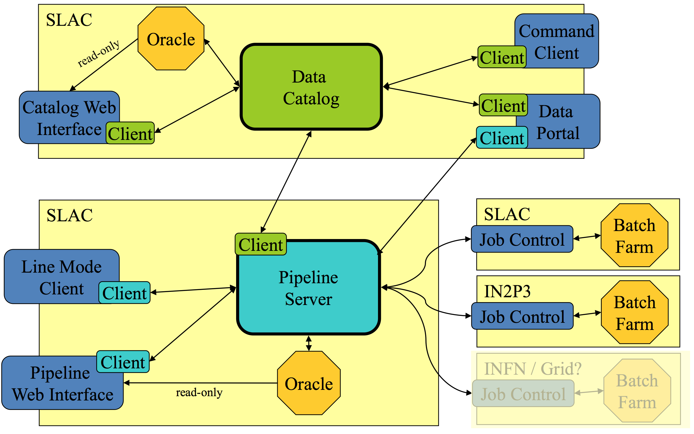
ImSim on Demand
PanDA as distributed job manager and gateway to grid, cloud, HPC resources
Tony Johnson, Torre Wenaus

Slide 12
What do we need from you?
Probe interest in the “ImSim on Demand” service
Need beta tester(s) to keep the pressure on us
Improve resource needs model
Interest in mid-range cycles/storage at SLAC
Significant WG simulations needed?
Significant campaigns with precursor surveys?
Will there be any DESC-wide data challenges mid-decade?

