Slide 1
DESC Software Framework
Scott Dodelson (Theoretical Astrophysics Group)
Marc Paterno (Software Systems Development Group)
Fermilab

Slide 2
DESC Software Framework
Workshop in June with reps from all science WG’s
Follow-up telecons with 5 science WG’s
Where are we going? (first draft of use case doc released today; framework released in 12-18 months) How will we get there?

Slide 3
Empower scientists to use LSST tools and resources without knowing a lot about computers

Slide 4
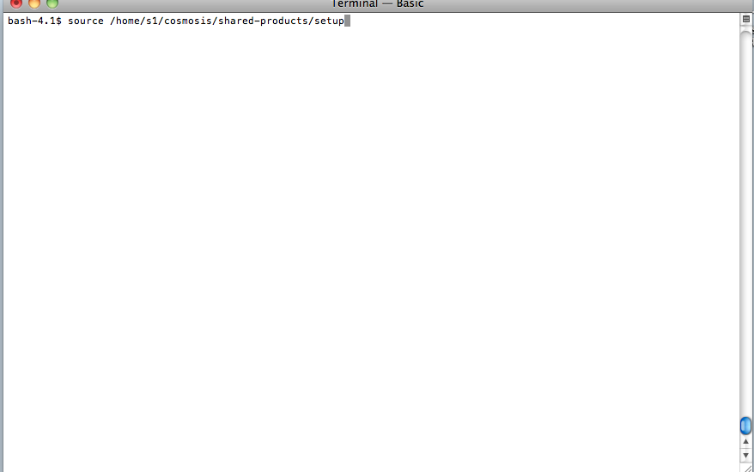
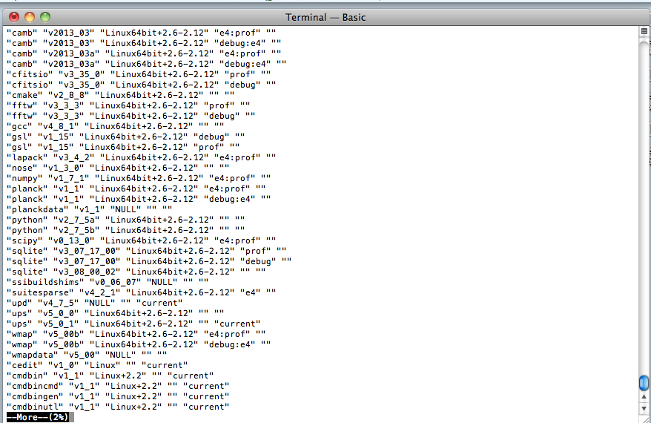
Packaging: install the relevant software without worrying about versions, dependencies, compatibilities, etc.

Slide 5
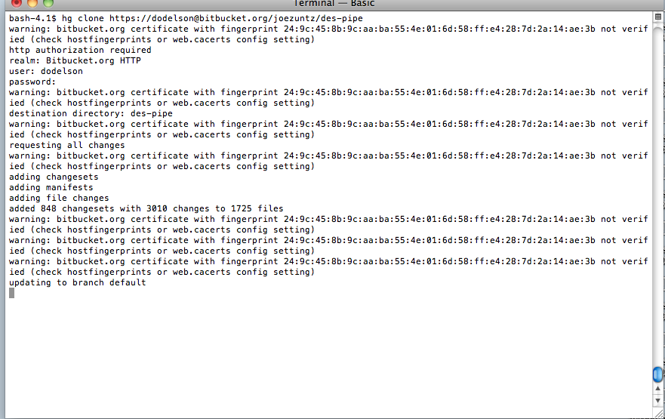
Repos: Collaboration members push/pull their modules for the benefit of all

Slide 6
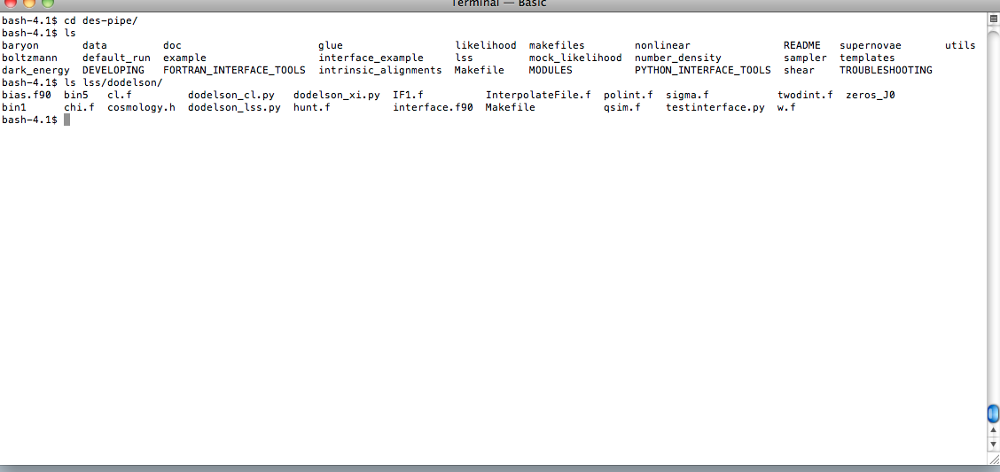
Repos: Collaboration members push/pull their modules for the benefit of all

Slide 7
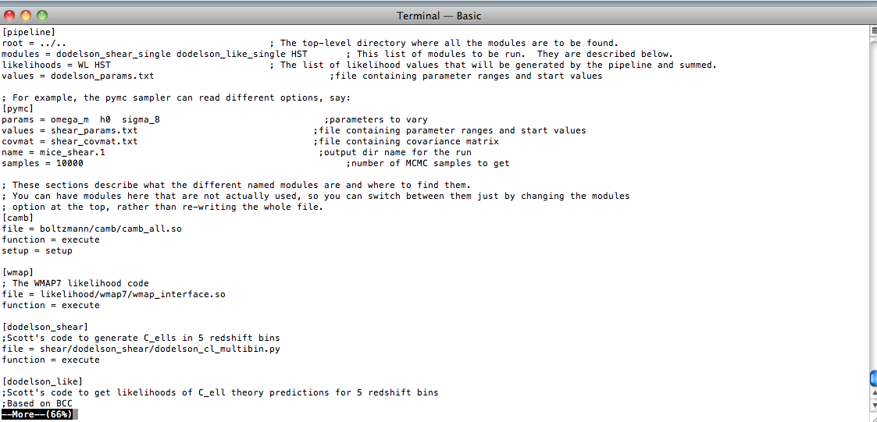
Development: Can now edit any of the files and add your code; run by simply putting a list of modules to include in a config file

Slide 8
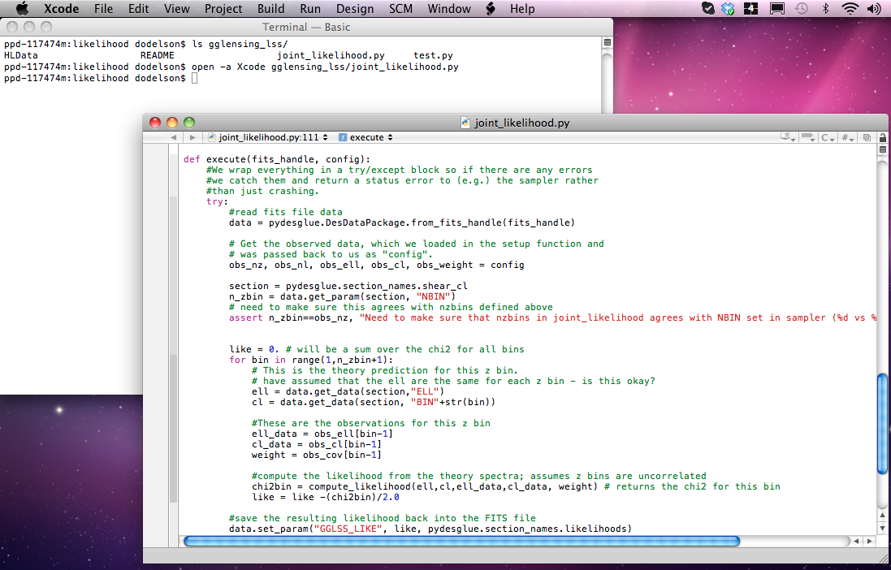
Interfaces: Need to be able to pass inputs/outputs easily from one module/user to another

Slide 9
All of this will be much harder for LSST
Not simply a parameter estimation toolkit: we need to understand what the Science WGs want to do and how they do them
Incorporate project simulation tools
Incorporate aspects of DM
Leverage data handling tools developed for other experiments
Use Compute resources (Grid, NERSC) in least painful way

Slide 10
DESC Software Framework in context
DESC scientists must interact with:
  software and data products from DM
  simulation tools
  data handling tools
  various computing resources
DESC scientists will
  study and improve existing algorithms
  develop, implement and work with new algorithms
  analyze “high level” data products specific to their work
  share their efforts with others in their WG, and with other WGs
The goal of the DESC software framework is to enable scientists to do these tasks as smoothly as possible.

Slide 11
Purpose and organization of the
Use Case document
The purpose of the document is to help determine the requirements for the DESC software framework.
We are doing this early enough in the project to help guide making the right choices among many possible options.
We will use these to determine the nature and scope of the DESC software framework:
  identify common data types and interfaces,
  discover where there are “holes”, where new tools are needed,
  discover in what contexts are the different tools used,
  identify what underlying libraries are used and what dependencies are present.
We do this by cataloging two types of things:
  functional elements and
  use cases.
The document is not yet complete; the current draft is available at https://cdcvs.fnal.gov/redmine/projects/l3-framework-usecases.

Slide 12
Functional Elements
A functional element is a piece of software that could be run “by the framework”, e.g.
  A tool to apply a given shear to an image of a galaxy
  A tool to measure the PSF at the location of stars in an image
  GalSim, configured for task X as used by WG Y.
It is not a generic “task” to be implemented many different ways.
We are collecting descriptions of currently-used tools, and of those that are needed, to help identify commonalities that allow sharing.

Slide 13
Information we need for each functional element
A (high-level) description of what the tool does.
A list of input types used by the tool. This may be the most important item, because we will rely on these to identify shareable data formats.
A description of how inputs are obtained, which helps us understand the context in which a tool runs (e.g. does is require a supercomputer, or a connection to a specific database?)
A description of output types, to help identify shareable data formats.
Optionally, common follow-up uses and estimates of time and size, both of which help put the tool into the context of its use.

Slide 14
Use Cases
A use case is a sequence of steps that an actor performs within a system to achieve a specific goal.
  An actor is usually a person, but it could be another system.
  The system for our use cases is the DESC software framework.
  The goals we are interested in developing use cases for are scientific goals (not peripheral goals).
We are collecting use cases in order to identify:
  commonalities among tools used in the steps,
  commonalities among types of data used by different groups,
  tools that are needed but are missing.

Slide 15
Information we need for each use case
A high-level description of the immediate scientific goal, which is the “task” described by the use case.
Any preconditions necessary for the execution of the use case (e.g. required data, or special computing facility requirements).
The steps that are carried out to perform the use case. Ideally, each step involves the execution of a single functional element, which would be described in the previous section of the document.
Optionally, whatever important postconditions will be true, e.g. where output data should go.
Optionally, any important failure paths, describing what should be done if one or more steps fail.

Slide 16
We need your input
Document contents:
  introduction/motivation
  catalog of functional elements: a section for each science working group
  catalog of use cases: a section for each science working group
  glossary of terms
  description of common data types
The current draft is available in PDF format from https://cdcvs.fnal.gov/redmine/projects/l3-framework-usecases.
We are asking for your input
  for whatever science working group(s) you participate in
  for improving existing functional element and use case descriptions
  for adding new items.
We need to understand the relation between DESC software and LSST project software, e.g. afw.
The collection of requirements is just the precursor to actually producing the software framework: timescale 6 months to complete requirements gathering, then 12-18 months to deliver the framework.

