Slide 1
Simulated Catalogs and Data Management Update Simon Krughoff for DM and the Simulations Team Dec. 4, 2013
DESC TEAM MEETING
December 4 - 6 , 2013

Slide 2
Update on Simulated Catalogs: Recent
Simulations Review
Universal model reviewed and passed relative to Simulations Requirements
Validation
Validation work ongoing in response to review
Updates to catalogs framework
Simplified adding pre-existing databases to the framework
Added ability to add catalogs from text files

Slide 3
Update on Simulated Catalogs: Future
Validation
Validation document exists in git but is in flux until the validation efforts converge.
Expect new tagged catalogs and corresponding tagged validation document by Jan 1
Updates to catalogs framework
Code to produce all validation figures will be versioned with the framework code.
Expand documentation and examples.
Catalogs enhancements
Library of galaxy images to provide more realistic morphology
Implement a model for large scale astrophysical background (e.g. galactic dust emission, zodiacal light)

Slide 4
Update on Data Management: Recent
SDSS coadds
Stripe 82 coadds for all 5 bands
Non-PSF matched, background matched
De-blended detection on all 5 coadds
Forced photometry on the union of 5 band detections with model mags
Image differencing
Showed that, in simplified scenarios (but with realistic PSF), current algorithms can get to the limit predicted by fluctuations in random Gaussian fields.
Interaction with users
Exploring new ways for DM team to interact with users
http://hsca.ipmu.jp:8080/account/signin/
DESC users contributing greatly to the body of documentation
http://ls.st/ieo -- Chris Walter’s iPython Notebooks
http://ls.st/jdo -- Debbie Bards’s PhoSim recipes

Slide 5
Update on Data Management: Future
Multifit
Shape measurement is a primary focus of the DM efforts in the immediate future
This includes algorithms for refinement of relative astrometry on stacks of images
Image difference
Extension of previous analysis to spatial PSF modeling in the presence of chromatic effects
Camera geometry
Re-design of camera descriptions to make them more flexible and easier to implement.

Slide 6
Update on PhoSim
John R. Peterson (Purdue) &
the PhoSim Group
December 2013 DESC Meeting

Slide 7
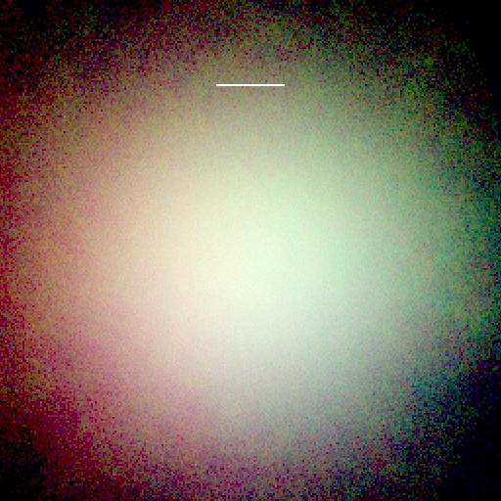
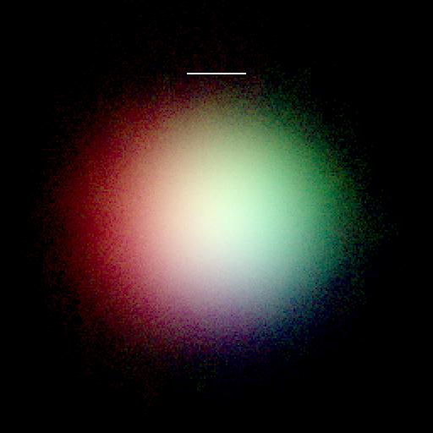
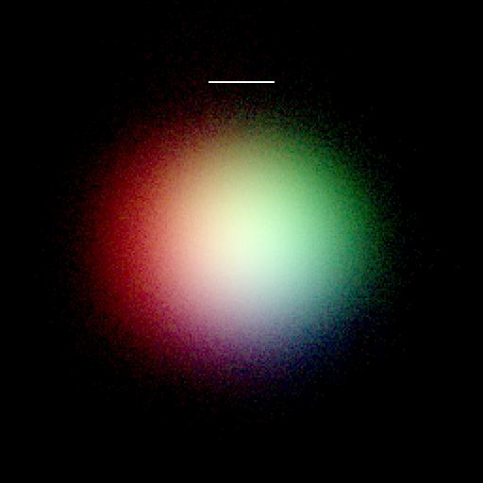
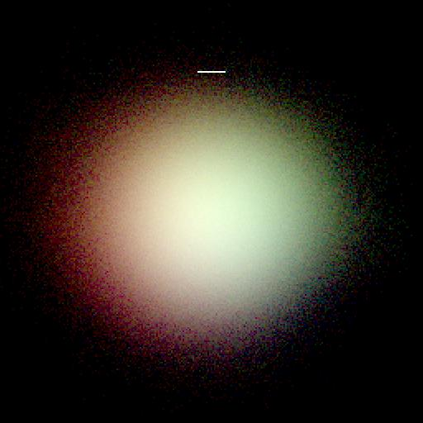
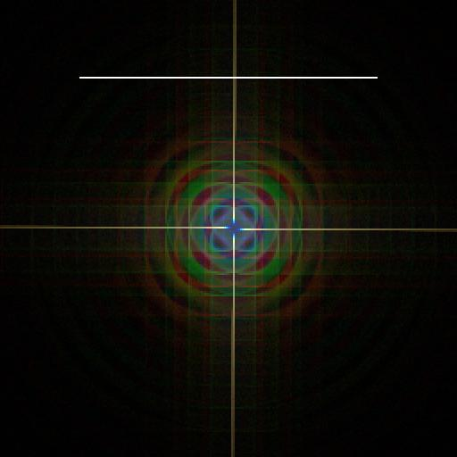
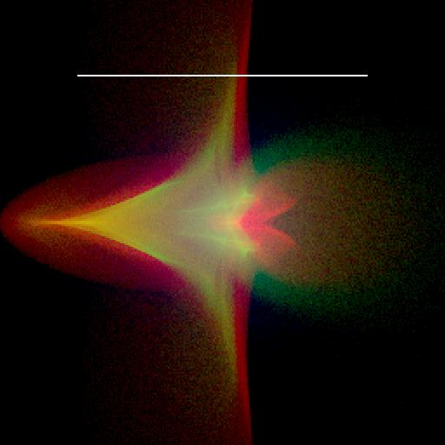
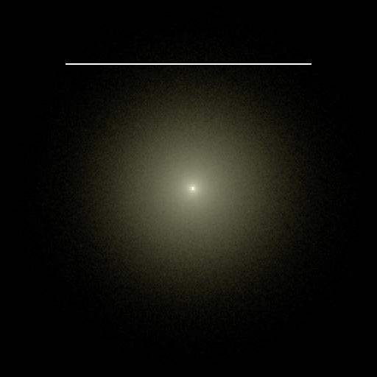
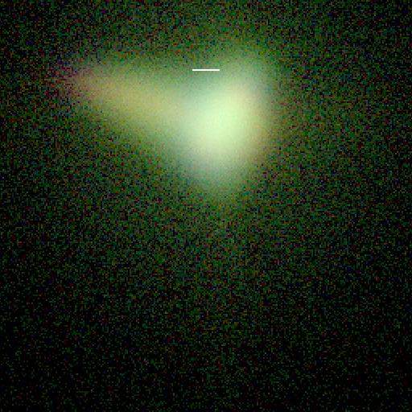
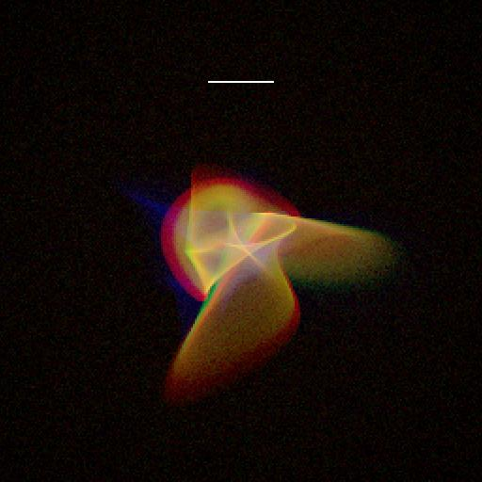
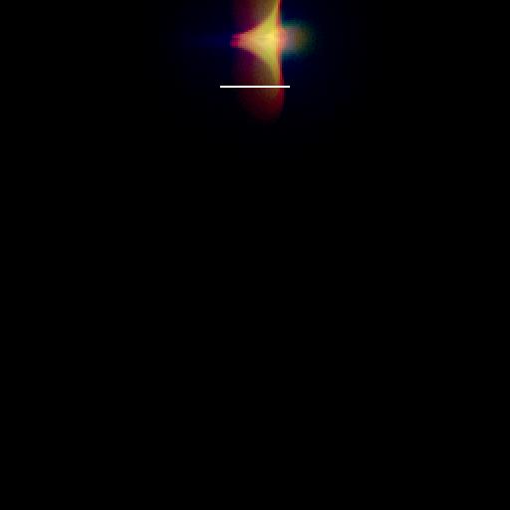
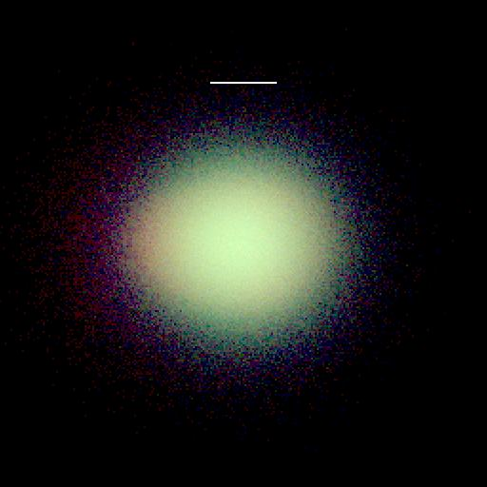
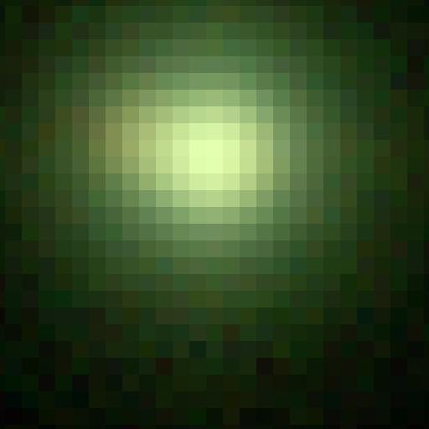
PhoSim (Photon Simulator) google “phosim git” and “phosim documentation”
Code to bridge detailed physical understanding of atmosphere, telescopes, & cameras ⬄ precision astronomical science using optical images
Open Source, C++, Grid-enabled code that uses literal photon Monte Carlo approach w/ detailed physics (not toy models)
Written for LSST, but instrument & design characteristics are separated so it can be used for other telescopes (or even lab setups)
Astronomical Images Simulating Every Photon
Chromatic PSFs w/ Different Physics on/off

Slide 8
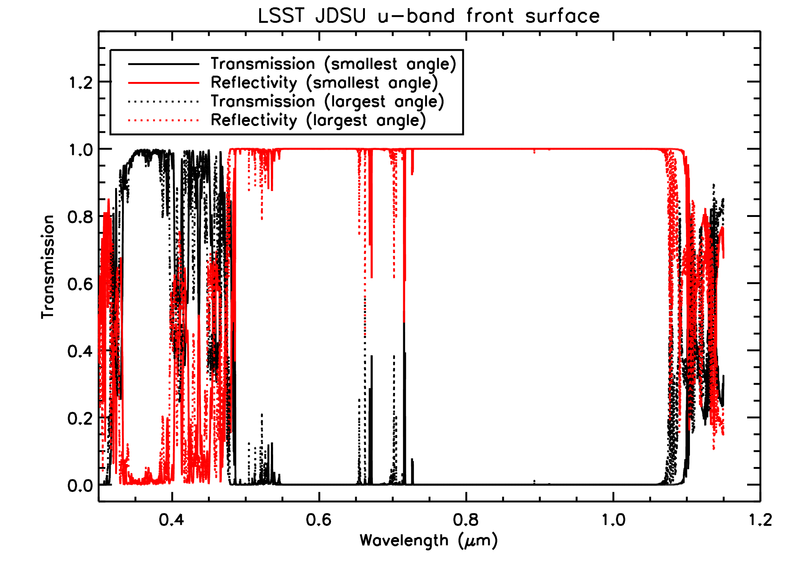
PhoSim v3.3 (Released July 2013)
Fringing
New features:
Fringing
Anisotropic diffusion in Silicon
Lithographic pixel boundary errors
Charge sharing near saturation
Silicon dead layer due to laser annealing
Silicon impurity variation
Larger turbulence screens (& more scales) for greater numerical accuracy
Wind vector variation during exposure
Charge Diffusion Validation vs. Voltage
Structure function validation for airglow, clouds, and turbulence screens
Photometry validation
Cloud structure based on physical scale
Differential Chromatic Refraction Validation
Three sets of new filter options
Monochromatic Flat validation
Various atmosphere validation with CFHT measurements
New Comprehensive phosim documentation
Checkpointing ability on grid systems
Unified phosim script for desktop, condor, or other grid system
Various usability improvements including installation,
multi-user capability, consistency of commands
Various class & architecture reorganization
Various c++ standardization/software standards
New clouds
New filters

Slide 9
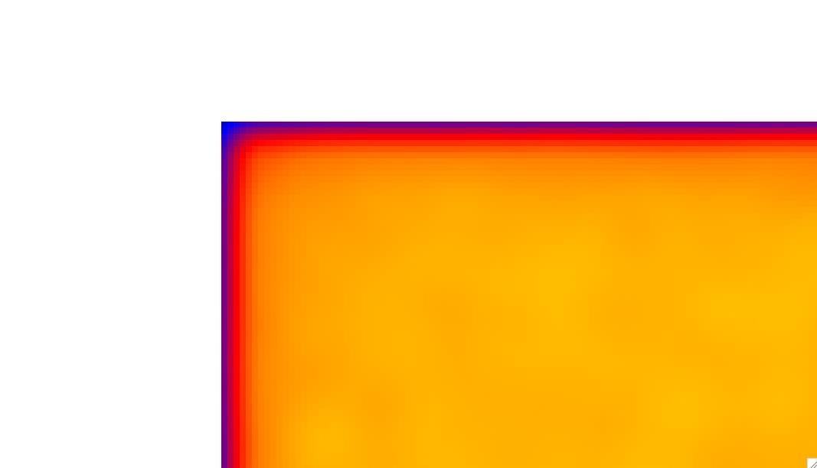
PhoSim v3.4 (being tested now, coming early next year)
New features:
Surface Perturbation interface to FEA camera/telescope models
Lateral fields tied to impurity variation (tree rings)
Lateral fields tied to edge surface charge (anti-glowing edge)
Exposed more design parameters to user
No approximation in airmass calculations
Crosstalk in amplifiers
Height of outerscale simplified
Dust and condensation framework
Various reorganization of classes
More accurate and faster background
Greater consistency in atmospheric wavelength-dependencies
Better description of index of refraction for LSST lenses/filters
Validation of signal vs. variance sub-linearity
Charge diffusion validation expanded to study wavelength
temperature, and voltage dependencies
Surface deformation from physical
FEA simulations
Edge
effects
Tree
rings

Slide 10
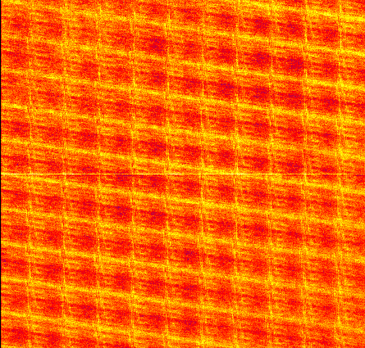
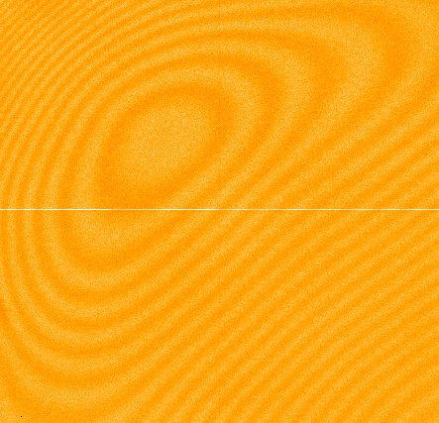
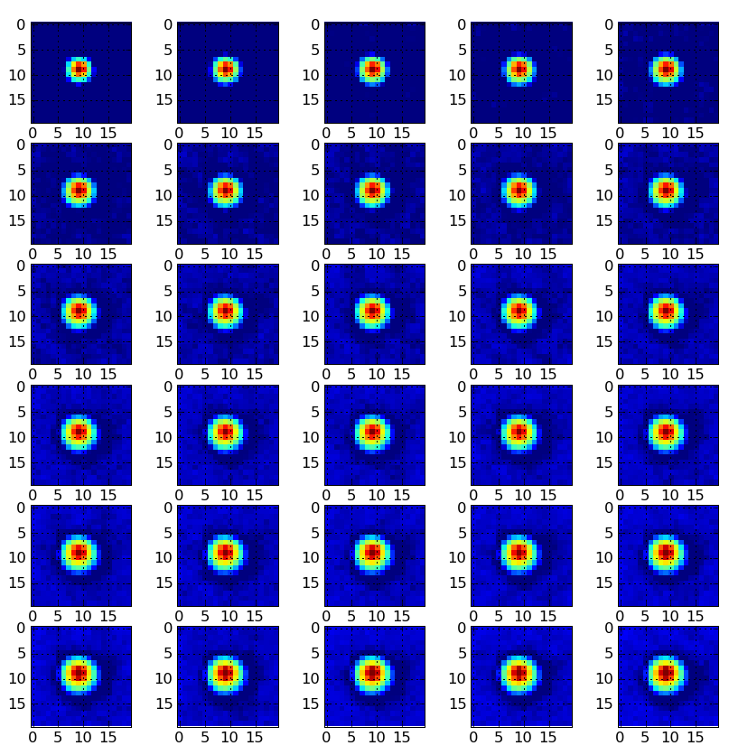
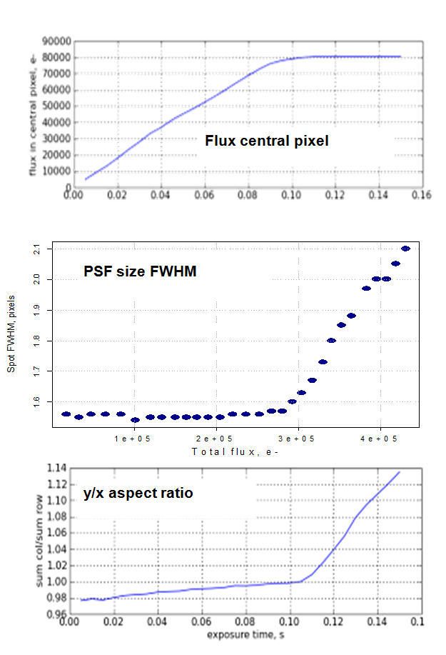
PhoSim Validation
Most of the future work for PhoSim is in validating with real data
Requires simulating exact conditions of setup to make proper apples-to-apples comparison since we are increasingly worried about subtle effects
Current example of this is simulating LSST Prototype Sensor Tests in Labs
Have data from:
1) BNL sensor test stand
2) the UC Davis LSST Beam Setup
Groups at BNL, Purdue, UC Davis, Duke, SLAC working to do these detailed simulations
Real
Data from
O’Connor
(BNL):
Short Wavelength Flats
Long Wavelength Flats
Spot Measurements
Figure 8 Spot intensity scan

Slide 11
PhoSim Power User Session (Thursday 3:30-5:00)
Presentations by:
Wei Cui
Josh Myers
James Jee
Michael Schneider
Debbie Bard
Andrei Nomerotski
Novel uses of PhoSim involving everything from:
Simulation of the Calibration Telescope
Verification of Sensor Physics involving Laboratory Simulations
Study of PhoSim Chromatic Effects
Use of PhoSim for Weak Lensing Systematics
Star/Galaxy Separation & Shear Peak Detection

