Slide 1

Cosmology-dependent covariances
Michael D. Schneider
LLNL / UC Davis
December 6, 2013

Slide 2
DLS cosmic shear:
The parameter dependence of the covariance is important!
Jee et al. (2013)

Slide 3
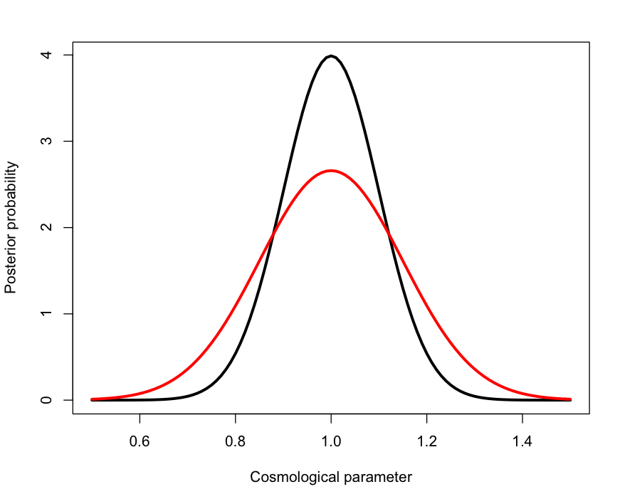
Sample covariance error increases cosmological parameter errors
(Fixed cosmology)
Dodelson & Schneider (2013)

Slide 4
How many simulations needed?
300 ‘bins’ = 15 angular bins in the shear correlation x 2 correlation functions x 10 tomographic redshift bins
Require > 2e4 simulations to keep FoM degradation below 10% at fixed cosmology.
We have ignored all the other (cross-)correlations -> These projections are only for the cosmic shear analysis.

Slide 5
Mode-resampling yields cov. estimates with 10x fewer simulations
MDS, Cole, Frenk, Szapudi (2011)

Slide 6
How many simulations needed?
Previous: Require > 2e4 simulations to keep FoM degradation below 10% at fixed cosmology.
Now: > 2e3 simulations at fixed cosmology when mode resampling may be used.
What about cosmology dependence?
  Naively: 2e3 simulations x 1e5 MCMC steps !
  Can we interpolate?

Slide 7

Simulation emulator (UQ)
Use statistical model to interpolate outputs of select simulation runs.
  Simulation design
  Emulator
Simultaneously learn the error distribution for the data.

Slide 8
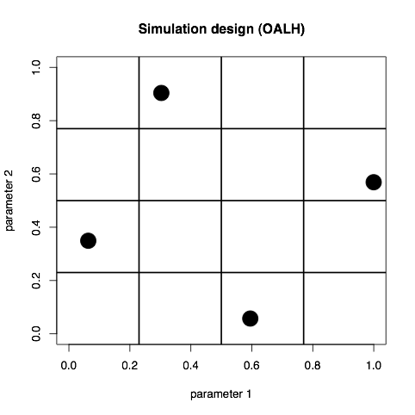
Choosing which simulations to run
Orthogonal Array Latin Hypercube
    Specify hypercube parameter bounds (rescaled to unit interval)
    Latin square: one point per row and column
    Orthogonal array: each quadrant has a sample
    Optimize with distance criterion

Slide 9


Covariance matrix parameterization
Generalized Cholesky decomposition (Pouramahdi et. al 2007)
Components of T are unconstrained:
Impose prior structure on covariance with a ( independent) conjugate Gaussian prior on (allows “shrinking” to constant T)
Prior mean can be set from sample covariance of design runs
Model , “variance”, and mean all as Gaussian Processes
Estimate covariance at each design point simultaneously - fewer realizations needed
MDS, Knox, Habib, Heitmann et al. (2008)

Slide 10
Parameter reduction and interpolation
Use PCA to decompose the components of the covariance:
Model each mode amplitude as an independent Gaussian Process:
Morrison, MDS (2013)
MDS, Knox, Habib, Heitmann et al. (2008)

Slide 11
Parameter reduction
32 design points
5 cosmological parameters
Morrison, MDS (2013)

Slide 12
What parameter directions are most important to sample?
Morrison, MDS (2013)

Slide 13
How many simulations does the covariance emulator need?
Prior
Emulator
Sample cov.
Almost 1 order of magnitude gain
Morrison, MDS (2013)

Slide 14
Summary
Previous: Require > 2e3 simulations to keep FoM degradation below 10% at fixed cosmology (incl. mode resampling).
Now: Still require > 1e3 simulations, but can include the cosmology-dependence with the same number of cosmological simulations.

