Slide 1
PMG Agenda Items
Present the revised cost of the MVTX, plans on how the cost/schedule will monitored, and dates to start reporting to DOE
Present plans on how the TPC (Time Projection Chamber) will be reviewed by the sPHENIX appointed TPC committee
Analyze the impact of EIC and sPHENIX need for resources
Plans to develop a succession plan
Feedback from the OHCAL review
Open recommendations: • Discuss with the magnet division the possibility to perform the field map of the sPHENIX magnet • Finalize the MoA with C-AD
AoB (eg. communication flow)

Slide 2
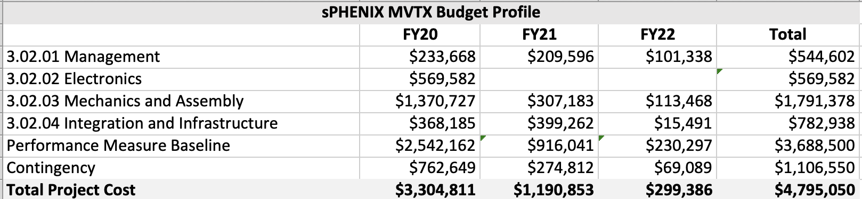
MVTX Management
The MVTX will be managed as a Level-2 subsystem of sPHENIX.
The MVTX has been fully integrated into the sPHENIX P6 file
There is a draft PMP that the sPHENIX Management team is in the process of revising that will get submitted to BNL Physics, NPP for approval and DOE-NP for concurrence.
The plan is to have MVTX quarterly reports and phone meetings with DOE-NP similar to the STAR iTPC.

Slide 3
MAPS Vertex Detector (MVTX)
TPC | Project Director L2 Manager | Status | % Complete
$4.75M AY | Edward O’Brien Ming Liu | BNL Capital Project: Approval pending addressing C&S review recommendations | Just started
Scope
Three layers of Monolithic Active Pixel Silicon Sensors modeled on the ALICE Inner Tracking System, mechanical support system, electronics, assembly, integration and services.
Updated RLS for the MVTX as of July 2019
MVTX Management and RLS are integrated with sPHENIX MIE and I&F Upgrade
Schedule
Expect approval Oct 2019
sPHENIX Upgrade Early Completion date March 2022
First RHIC run of sPHENIX Feb 2023
Project Close Out Dec 2023
Cost
$4.75 M AY Total Project Cost including 28.6% contingency on ETC

Slide 4
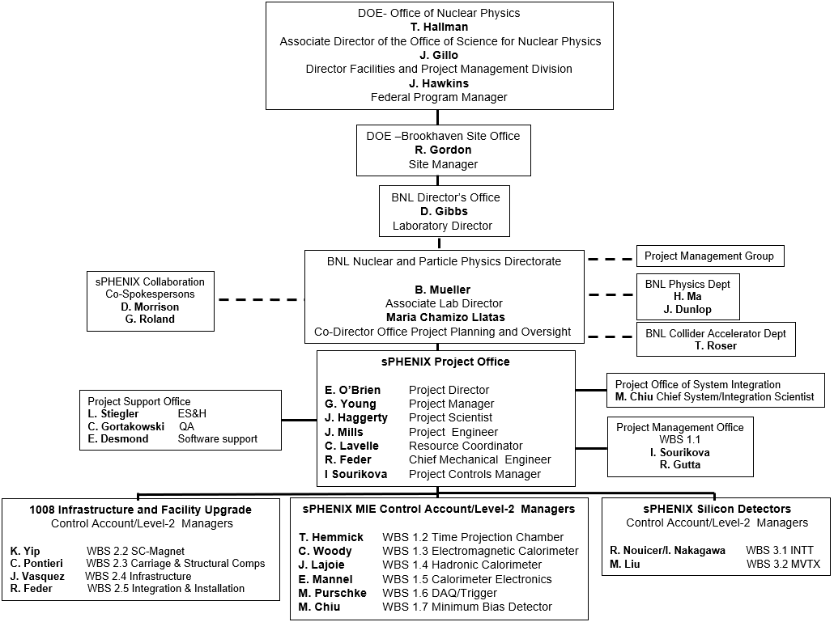
sPHENIX MIE + Infrastructure & Facility + Silicon Detectors
The same management team with an expanded organizational structure manages the sPHENIX MIE, the 1008 Infrastructure and Facility Upgrade and the Silicon Detector Upgrades

Slide 5
TPC Advisory Team
Present plans on how the TPC (Time Projection Chamber) will be reviewed by the sPHENIX TPC advisory committee
The sPHENIX TPC advisory team will be:
Dick Majka Yale/ALICE/STAR
Harry Appelschauser CERN/ALICE
Ties Behnke DESY/ILD
In the future whenever we hold TPC PDRs, FDRs, PRRs, safety reviews we will ask that they participate a panel members. Dick Majka from Yale already participates in sPHENIX TPC performance meetings as does Nikolai Smirnov from Yale.

Slide 6
Analyze the impact of EIC and sPHENIX need for resources
One of the objectives of the CAD Staffing Plan tool developed in P6 was to capture all of the tasks that needed to be done in CAD including labor assignments to sPHENIX. Once the EIC effort at BNL is defined, most likely at CD-1, and included in the staffing plan we will be able to determine if there are any conflicts. However if a general reorganization of the lab were to take place prior to CD-1, the sPHENIX project would have to reevaluate our immediate needs.
However I do not foresee a significant interference between EIC resources and sPHENIX construction. I do anticipate a drain of sPHENIX resources (Cryo, PS, infrastructure, crafts, 1008 access) as CAD prepares for Run-22.

Slide 7
How Do We Do Succession Planning?
We have deputies or back-ups throughout the organization
The PHENIX group led by Dave Morrison has a succession plan
We use most of the arrows within the BNL HR quiver to fill departures
Use of talent pools as in the PMC/IO
Effort temporarily transferred in from other department/divisions: CAD, SMD, NSLS-II
New hires, especially at or near entry level
Expertise from outside collaborators: Universities, DOE Labs, International Institutions
BNL Emeritus program
We have gotten pretty good at utilizing the BNL HR system for new hires.
HR has been very helpful in all aspects of hiring by sPHENIX

Slide 8
Feedback from the OHCAL review
The HCal Outer Mechanics Final Design Review was held at BNL Sept 17
Russ Feder will discuss the outcome of the review

Slide 9
SMD Mapping of sPHENIX SC- Magnet
Discuss with the magnet division the possibility to perform the field map of the sPHENIX magnet.
John held a second meeting with Piyush Joshi this week. SMD will develop a cost estimate for mapping the SC-Magnet and provide it to sPHENIX Management. We have budgeted $100k for the mapping which is consistent with the ATLAS cost estimate for mapping.
This large-bore magnet mapping is a very custom procedure requiring the construction of specialized equipment that might not be re-used. The STAR and PHENIX magnets were mapped over 20 years ago and no large bore magnets have been mapped at BNL since then.

Slide 10
Status of the Final MoA with CAD
The one incomplete MoA with CAD includes:
Fab of new conventional beam pipes built to drawings provided by sPHENIX
Modification of central Be beam pipe based on drawings provided by sPHENIX
Management of Craft and Surveyors for 1008 Installation and Infrastructure
Mechanical support system for cryo installation
1008 HVAC
Electronics cooling water
Support for any mods to the AC power system including Arc flash calculations
Building safety systems and assist with detector safety systems
Any necessary 1008 building modification
Glenn Young and Jim Mills have provided Charlie Folz and Bill Christie with a detailed spreadsheet and P6 file plus a Requirements document written by the sPHENIX Project team.
As far as I am concerned it contains all of the updated information that we current have on these tasks. I am ready to sign for the sPHENIX Project.

Slide 11
Communication
Two related issues:
I meet with DOE 2-3 times/month, the PMG 1-2 times/month, the POB month to discuss sPHENIX status (avg 1.5 times/week). A combination of the NPP ALD and the Director of OPPO attends most if not all of those meetings.
In order to get a WebReq/Change Order of any significant size approved I need to get 8-9 signatures from PO/NPP and 3-4 signatures from PPM. I estimate this adds 3-4 weeks of delay to every order. sPHENIX needs to order ~$9M worth of equipment/material in FY20.
In the spirit of reducing BNL bureaucracy can we reduce the rate of meetings and required signatures? Both are set by internal policy not SMBS or DOE order.

