Slide 1
Jets and JETSCAPE for an EIC
Kolja Kauder
Joined June 2018
Supervisor: Thomas Ullrich

Slide 2
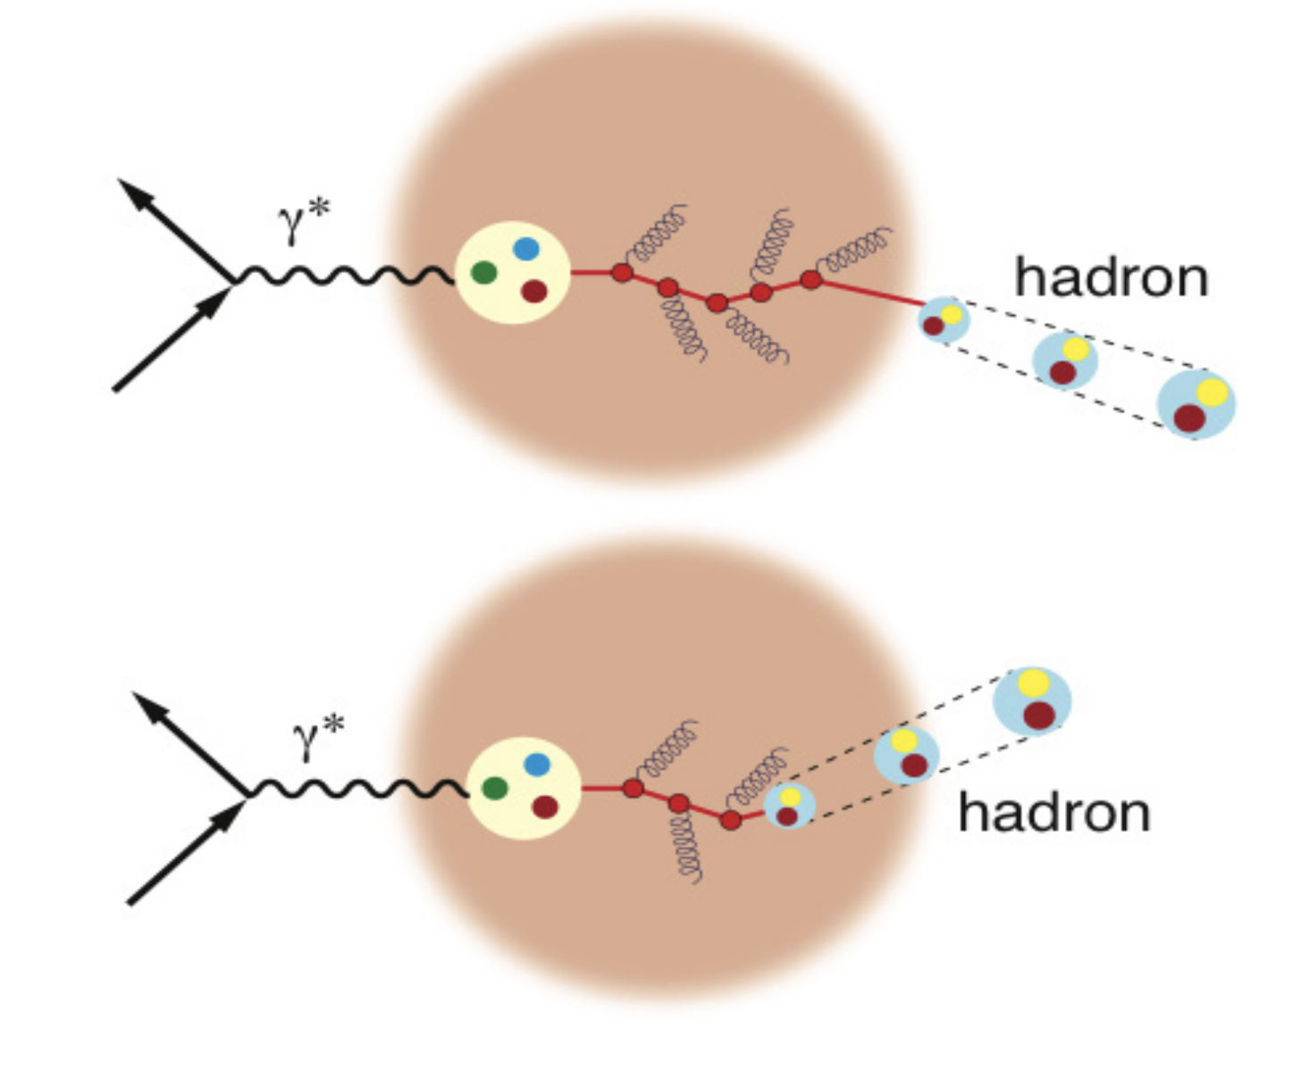
LDRD Goals
Identify novel jet studies particularly suited to eP, eA
Theoretically robust observables
Feasibility studies for EIC measurements
Develop a state-of-the-art Monte-Carlo (MC) Event Generator for in-medium jet fragmentation

Slide 3
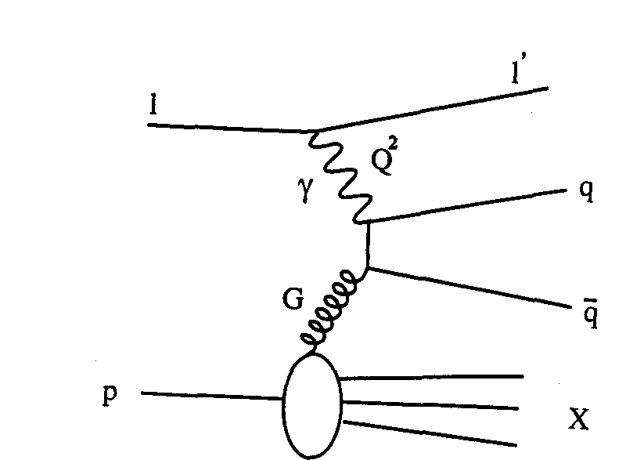
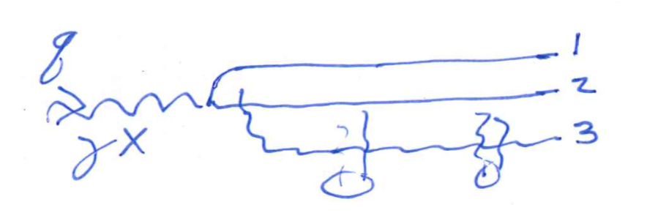
Jets as Parton Proxy
E.g., cross sections, dijet invariant mass, asymmetries
Focus is on jet ~ parton
What belongs to the jet?
How many jets are in the event?
Novel: Winner-Take-All and/or Groomed axes: Potential for probing soft wide-angle radiation and for substantial background reduction in existing measurements
Started work with B. Page, F. Ringer
see arXiv 1911.06840
see recent talks from Ignazio Scimemi
Novel: Dipole size from 3-jet events. Use N-Jettiness to disentangle soft, broad, overlapping jets?
Started work with B. Page, T. Ullrich
see talk by Al Mueller at EICUG Meeting 2019

Slide 4
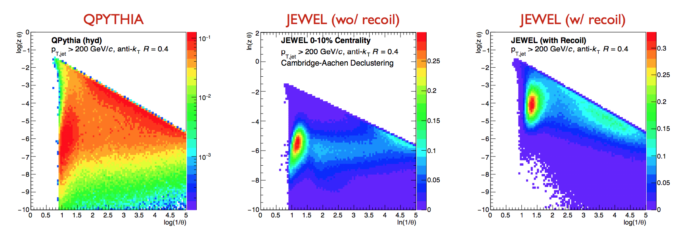
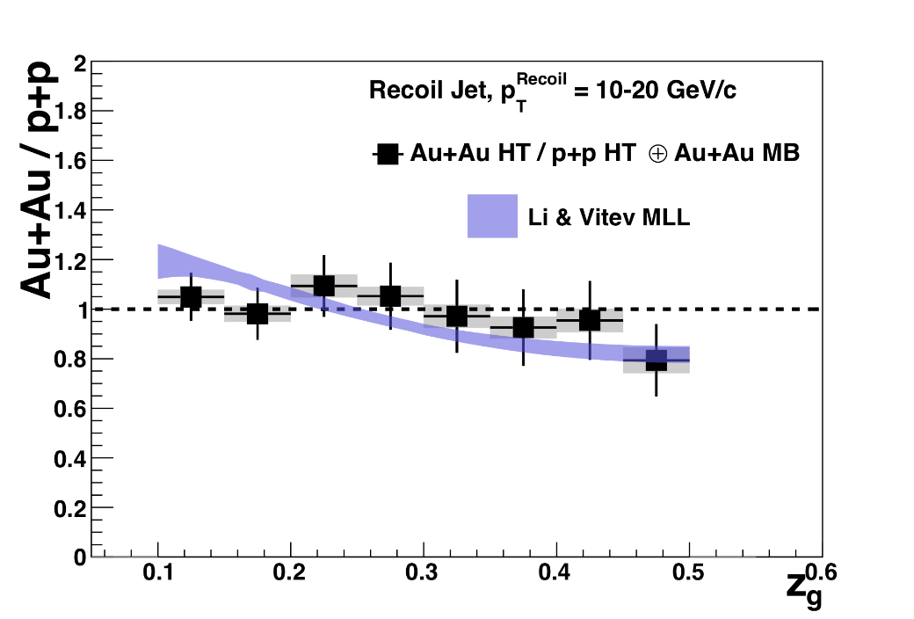
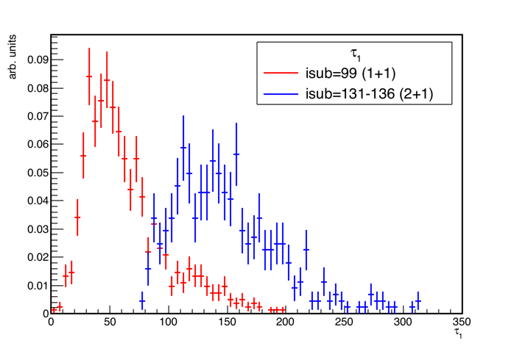
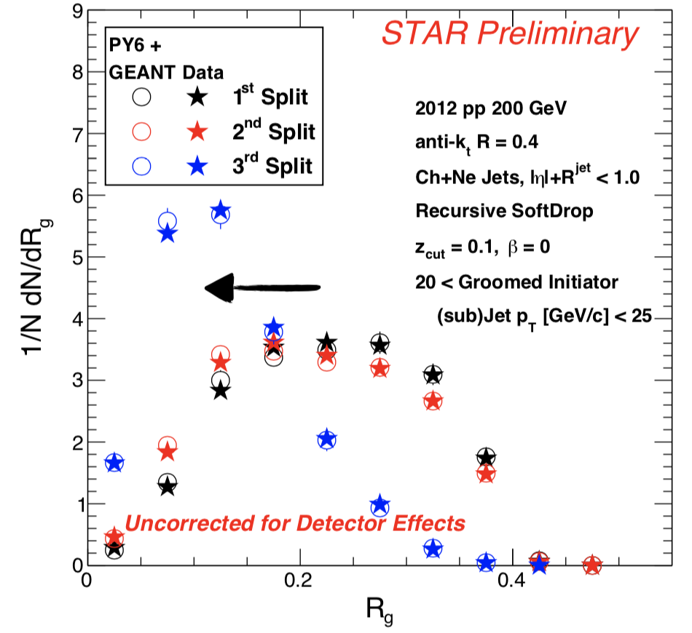
Jets beyond σ
De-clustered (groomed) observables
Angularity family
Fundamental QCD
flavor separation
Explore signatures of jet sub-structure modification in eA
N-(Sub)jettiness

Slide 5
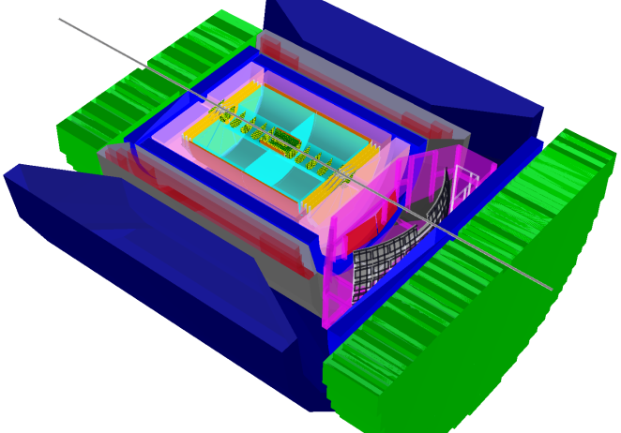
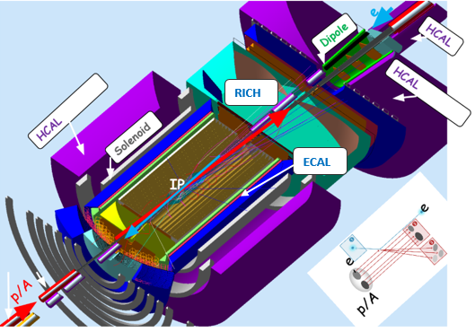
Expanding the Toolbox
Feasibility studies rely crucially on
MC Generators, especially for e+A
Detector simulations, fast and slow

Slide 6
General Purpose EIC MC’s
Electron-Proton:
Tremendous development in recent years
Thriving community beyond the Big Three
Electron-Ion:
BeAGLE.
(Pythia+Angantyr?)
JETSCAPE is an ideal, orthogonal, candidate to double this number
… especially toward modularity and jet physics
Slide from Simon Plätzer

Slide 7
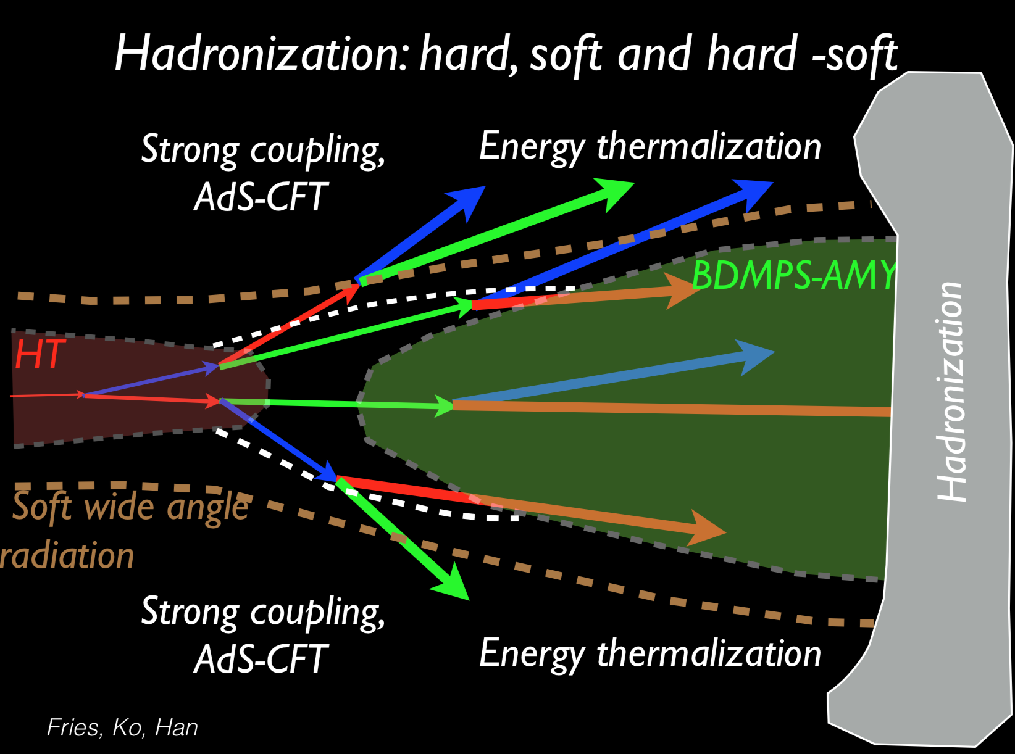
free stream
Strings, Cooper-Frye, …
Glauber, IPGlasma, …
Pythia, …
Hydro (MUSIC, …) Energy loss, ...
Rescattering, SMASH, …
Experts at every stage
Multi-Stage Energy Loss
… no one group can do it all
→ Unify in
A. Majumder, Hard Probes ‘15

Slide 8
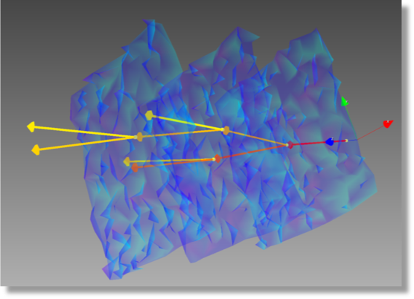
JETSCAPE Strengths
Modular Framework
Focus on a single aspect – framework provides the rest
Easily extensible – testing a new model may require a single class and few lines of code
Modern technology: Tasks, Signals/Slots, C++11, Graphs…
Large, versatile collaboration
Expertise in exp. and th. physics, computer science, statistical science, …
Substantial manpower and resources

Slide 9
JETSCAPE for EIC
Hard Scattering
Medium-modified
Parton Shower
Selected by Q, E, p_{T}?
…
Jet Hadronization
Module 1
Module 2
Initial Geometry
Nuclear Medium
Nuclear Breakup
Remnant Hadronization

Slide 10
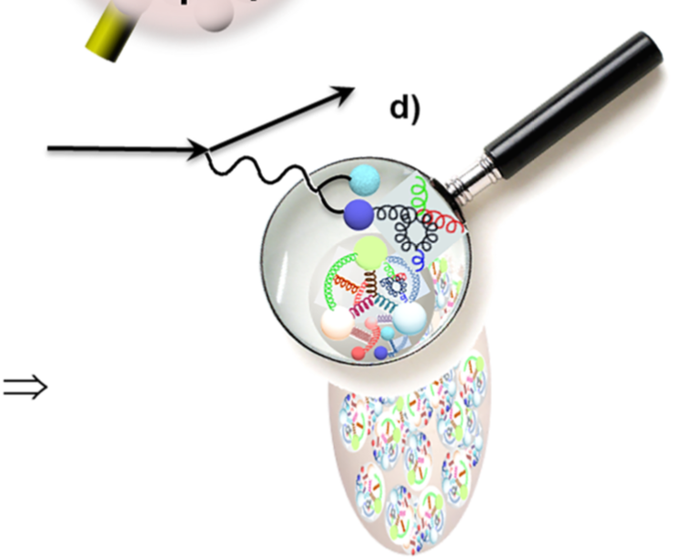
Hard Process
Currently: hard scattering from tuned Pythia6
Can select PDF in generator
Full MB mix accepted
Radiative correction available (but currently cannot be parsed)
Future:
Herwig, Sherpa, …
Separate radiative correction module?

Slide 11
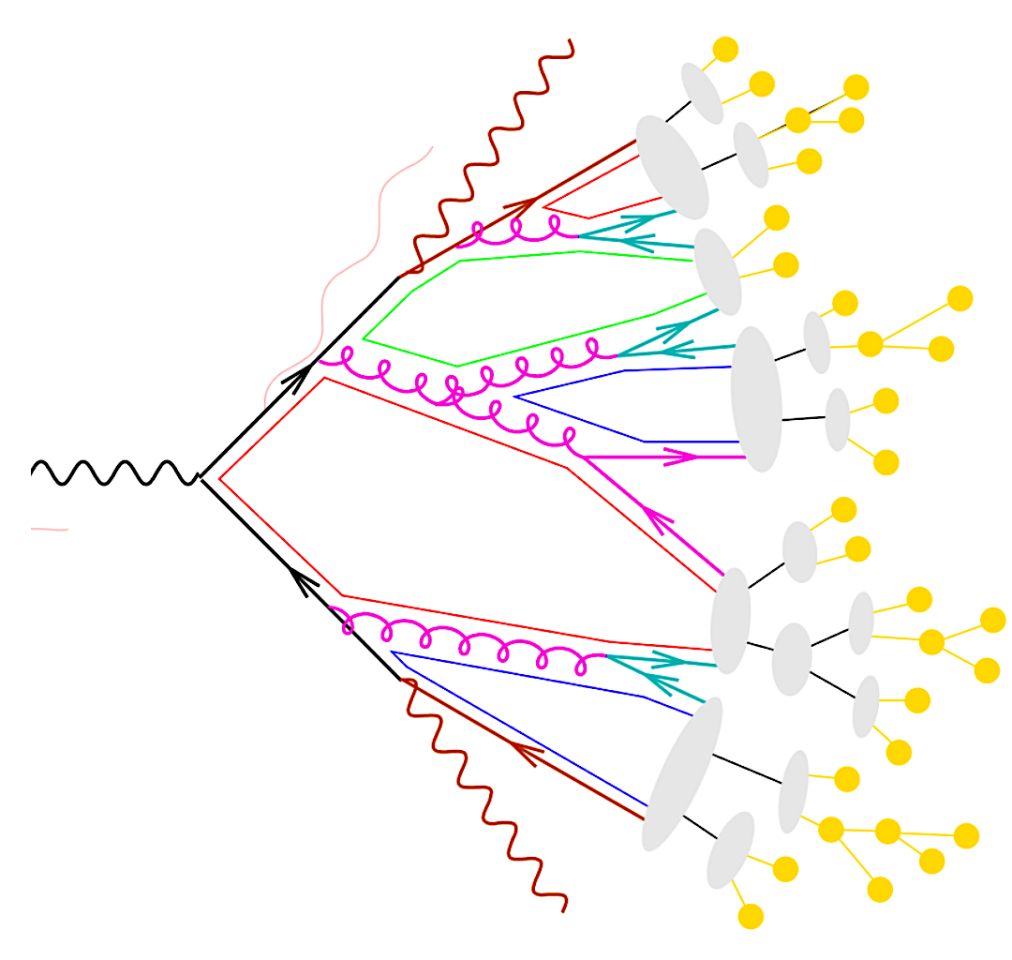
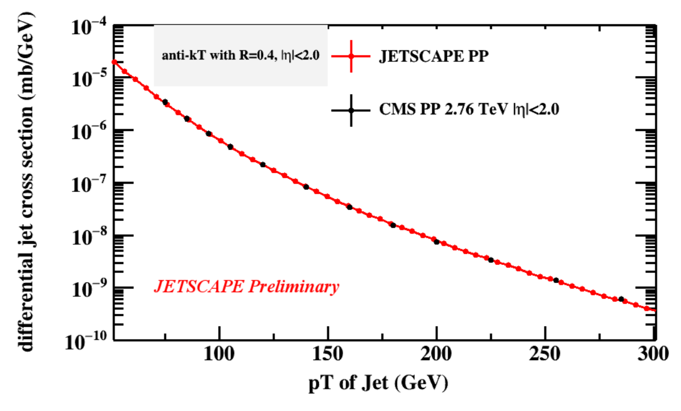
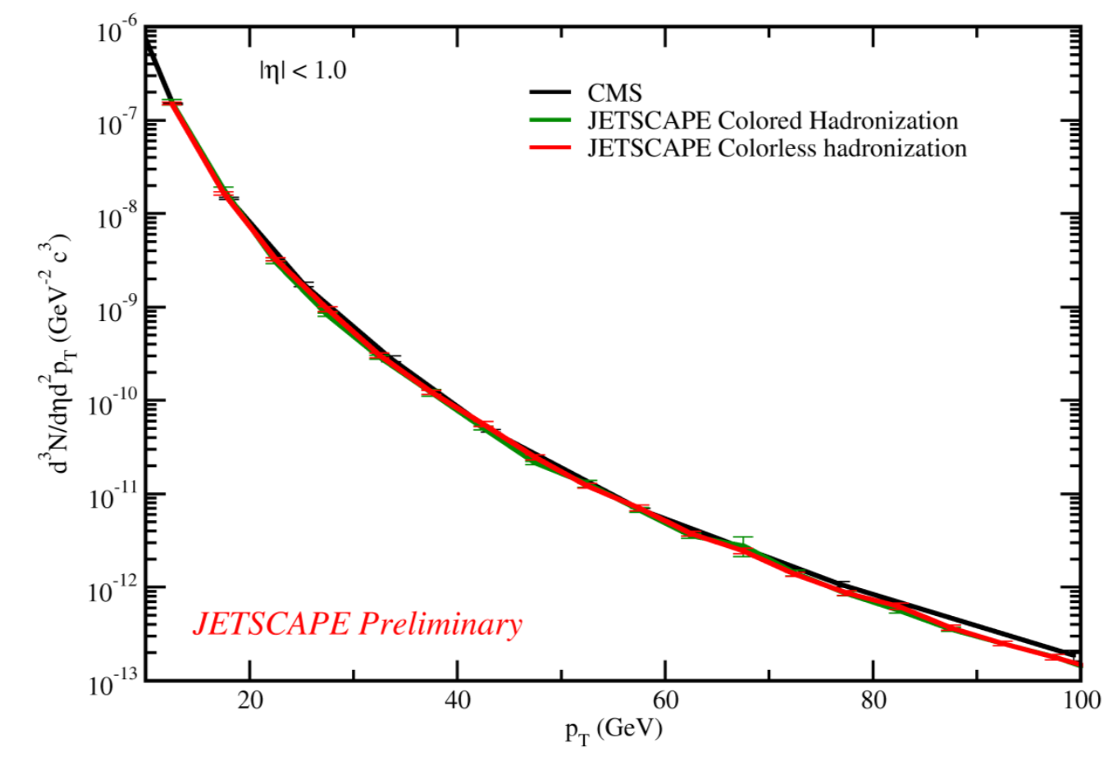
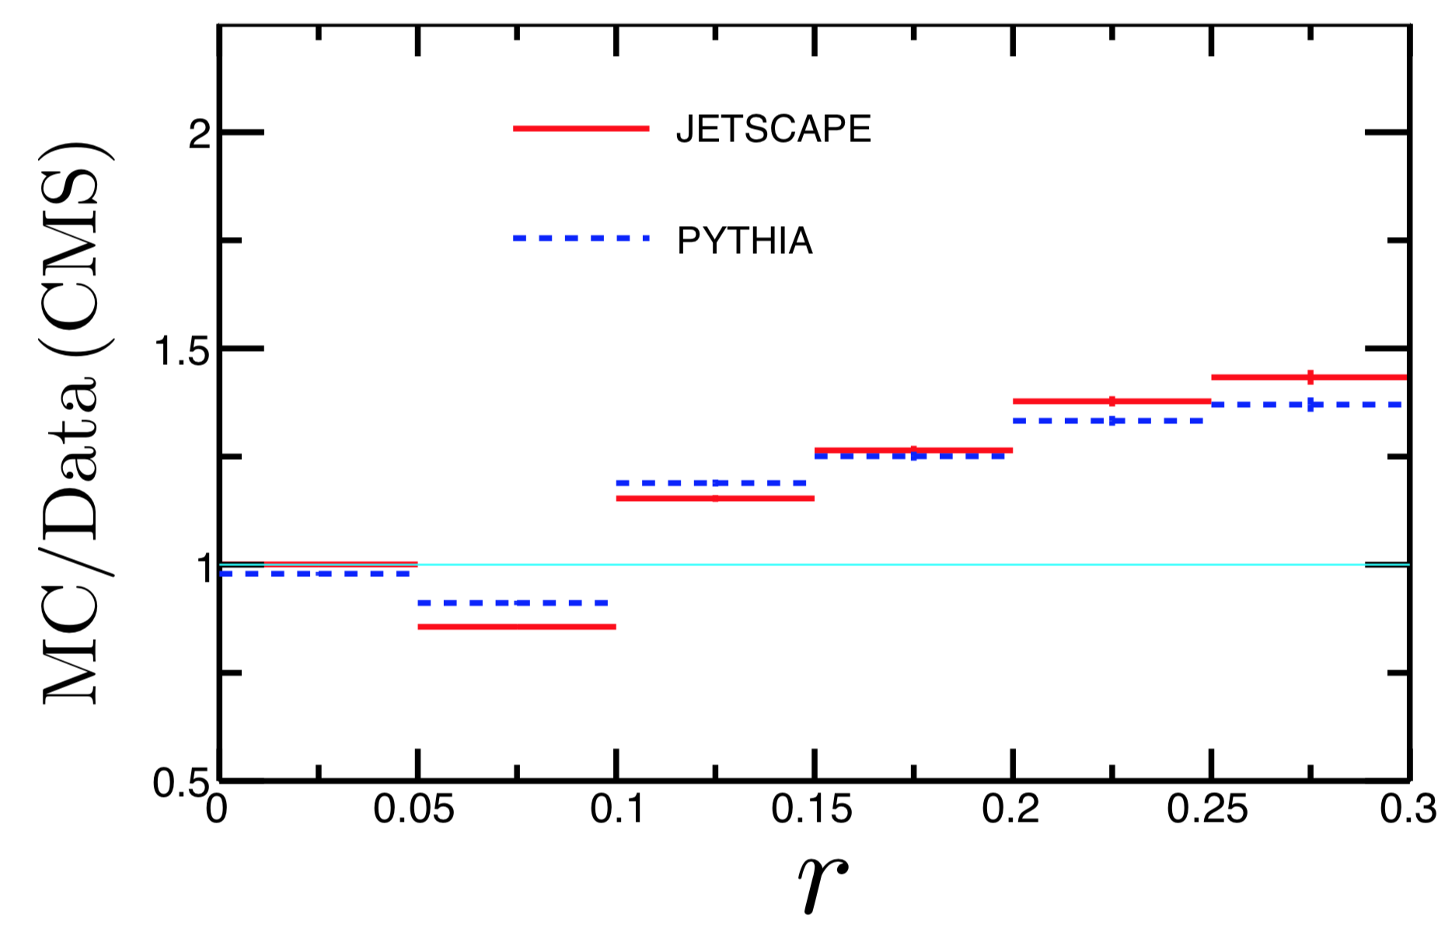
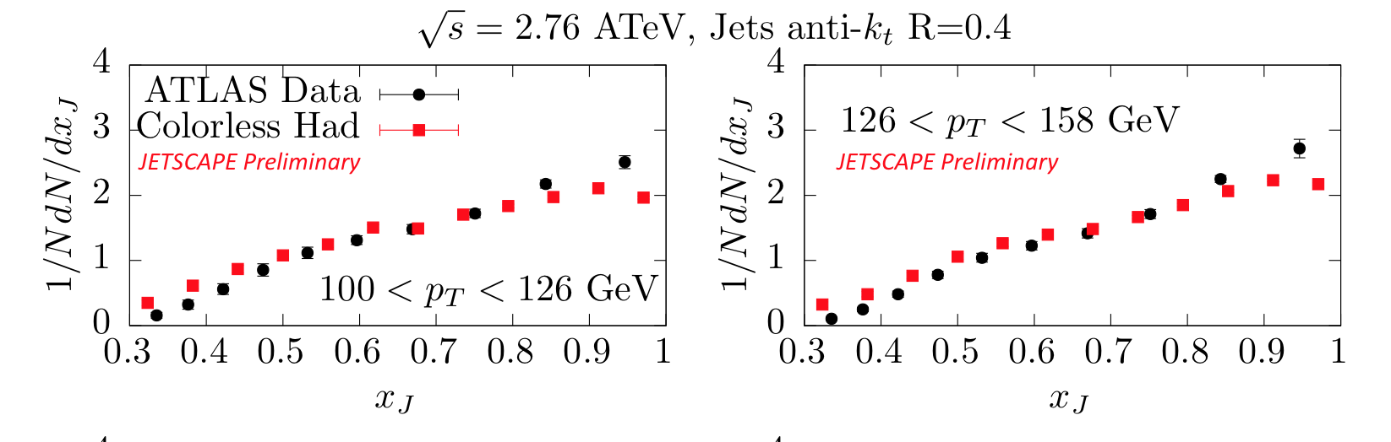
Vacuum Shower
Vacuum fragmentation with MATTER and qhat = 0
Virtuality ordered
Individual showers are generated for all “hard” partons and underlying event hadrons
Virtuality regenerated before shower
Tuned to mid-η at LHC energies, demonstrated excellent agreement
R=0.4 Jets
hadrons
JETSCAPE Preliminary
Jet shapes
Dijets

Slide 12
Hadronization Options
“Colorless”:
All showers hadronize together
Intended for situations where color information is not maintained in E-loss module
One parton down the beam pipe closes the loop
Then hand off to Pythia8
Adaptions:
Use true remnant kinematics

Slide 13
Hadronization Options
“Colored”:
Showers hadronize individually
One beam parton closes each loop
+/- η assigned interchangingly
Then hand off to Pythia8
Adaptions:
Use true remnant kinematics
Re-distribute remnant momentum among showers

Slide 14
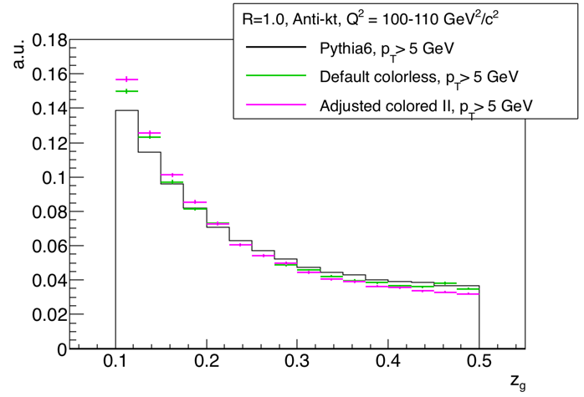
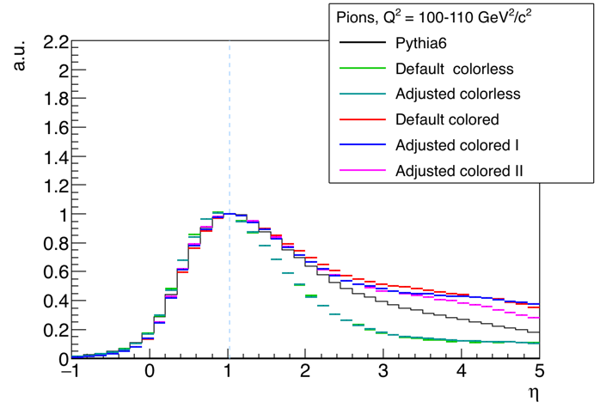
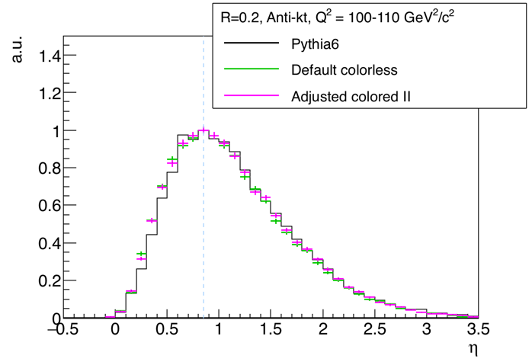
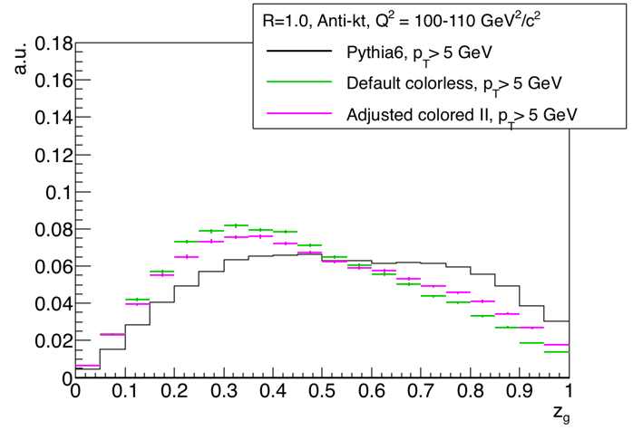
e+P Status
Pions
anti-k_{t}
R=0.2
z_{g}
Good performance for hadrons, jets, sub-structure
Further improvements (beyond fine-tuning): Maintain color structure throughout event → out of my scope
R_{g}
PGF, Q² = 100–110 GeV²
20 on 250 GeV e+P
Breit Frame

Slide 15
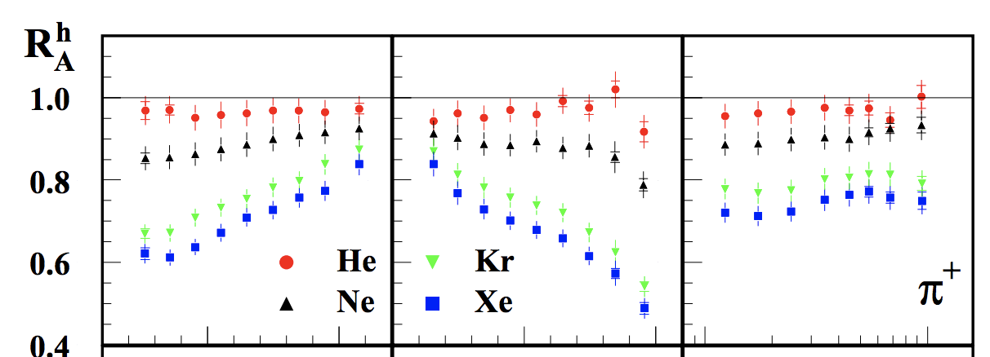
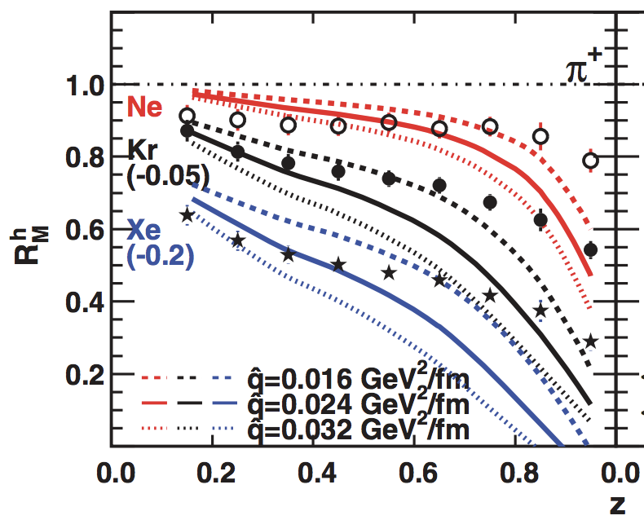
In a Medium
No e+A jet data exists – use FXT hadron suppression as proxy
HERMES data has been reasonably described using:
DGLAP eqns effectively modified by multiple scattering (Higher Twist)
Jet transport parameter qhat ~0.024 GeV²/fm
Medium length from Woods-Saxon
FXT, 27.6 GeV e on X
Same physics as MATTER in a variable Brick - repeat!
HERMES, Nucl. Phys. B780: (2007)
Deng, Wang - PRC 81, 024902 (2010)
Majumder, Wang - arXiv:0806.2653

Slide 16
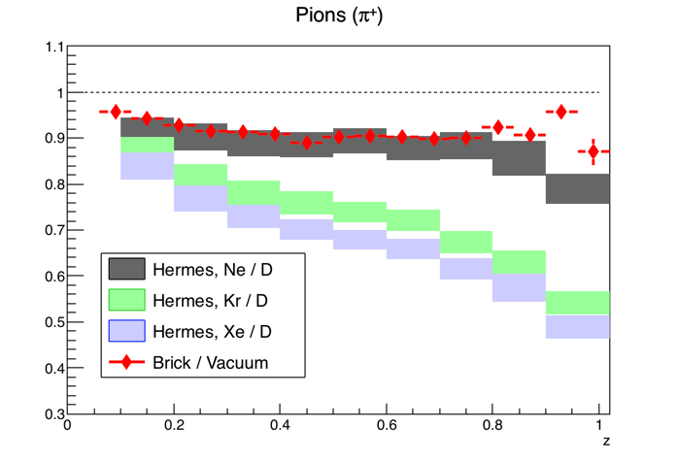
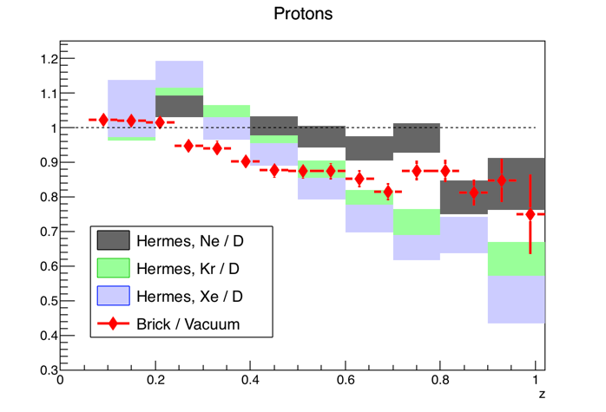
First Look
Pions (π⁺)
Protons
Brick / Vacuum, not Deuterium
Pion suppression too small, protons promising
Proof of concept! NOT even preliminary
qhat = 0.02 GeV² / fm
L = 5 fm
FXT, 27.6 GeV e on X
HERMES, Nucl. Phys. B780: (2007)

Slide 17
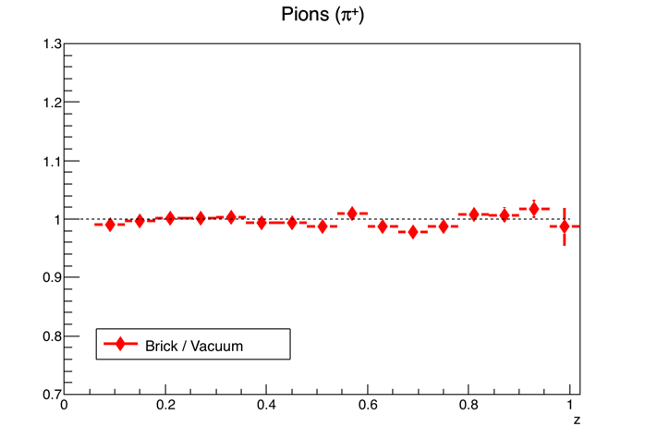
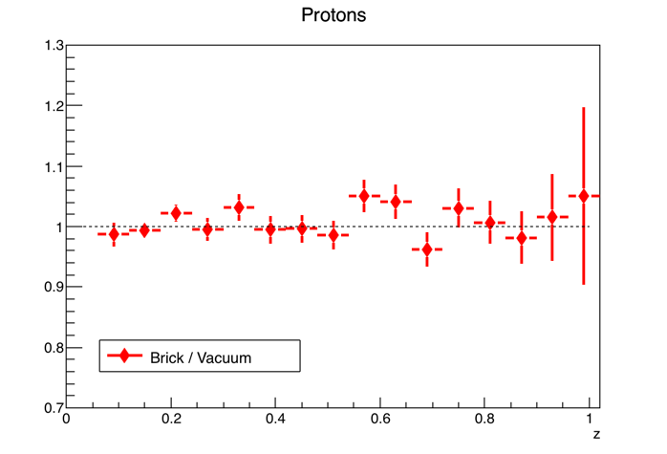
Sanity Check
Pions (π⁺)
Protons
Not shown: qhat, L dependence is too weak, double-check that Brick → Vacuum as qhat → 0
qhat = 2E-5 GeV² / fm
L = 5 fm
FXT, 27.6 GeV e on X

Slide 18
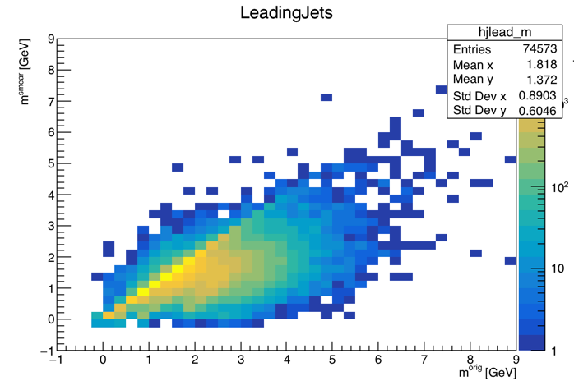
Detector Simulations
Assumed coordinator responsibilities for the BNL/EIC software stack
Maintain fast simulation EicSmear
Maintain MC Generators
Contribute to Eic Software Community
Smearer
“Detector”
Smearer
Smearer
PYTHIA
DPMJet
Smearer
PEPSI
gmc_trans
Smearer
Djangoh
Milou
Rapgap
BeAGLE

Slide 19
Status and Outlook
Develop JETSCAPE as an ideal, complementary, candidate to double the current number of e+A GPMCs
e+P (essentially) done
e+A: Reference quenching tuned to HERMES is nearing completion
Now include into official distribution, leverage collaboration, use to explore quenching @ EIC!
Use new tools such as WTA, grooming to both improve existing measurements and gain new, sensitive observables

Slide 20
Activity 2019
Papers
The JETSCAPE framework J. Putschke, KK, JETSCAPE Collaboration submitted to Comp. Phys. Comm., arXiv:1903.07706
First fully unfolded measurements of jet splitting in p+p √s=200 GeV at STAR STAR Collaboration (co-PA) to be submitted to PLB
Observation of charmed baryon-to-meson ratio enhancement at mid-rapidity in Au+Au collisions at √s_{NN} = 200 GeV STAR Collaboration (GPC) submitted to PRL (arXiv:1910.14628)
Underlying Event Measurements in p+p Collisions at √s=200 GeV STAR Collaboration (GPC) to be submitted to PLB
Talks
JETSCAPE for EIC MCEGs for future ep and eA facilities, Vienna, Austria
Using JETSCAPE to Simulate Jets at an EIC POETIC, LBNL
Using JETSCAPE to Simulate Jets at an EIC, DNP, Crystal City, VA
Exploring Jet Observables at an EIC with the JETSCAPE framework EICUG Users' Meeting, Paris, France
Eic-Smear and its parameterizations EICUG Users' Meeting, Paris, France
Eic-Smear and its parameterizations EIC Software Meeting on Detector and Physics Simulations, BNL
Eic-Smear and its parameterizations EIC Software Meeting, Trieste, Italy
Using JETSCAPE to Simulate Jets at an EIC DIS, Turin, Italy
Jets in eA Collisions MCEGs for future ep and eA facilities, Hamburg, Germany

Slide 21
Backup

Slide 22
NB: Jet Reconstruction
Sequential Clustering:
Calculate a distance d_{ij} between two particles and a beam distance d_{iB} for all particles.
Find smallest of all d_{ij}, d_{iB}
If it’s a d_{ij}, recombine particles i and j. If it’s a d_{iB}, call particle i a jet
Repeat from step 2 until no particles are left
Resulting clusters are jets.
Operational definition. No unambiguous jet definition exists!
Advantages:
Minimize sensitivity to hadronization: IR-safe and collinear-safe algorithm and instrumentation
Measure energy flow: connect to dynamics of partons
Comparison to QCD calculations beyond event generators
De-facto standard. For substructure: also provides cluster history

